Slide 1
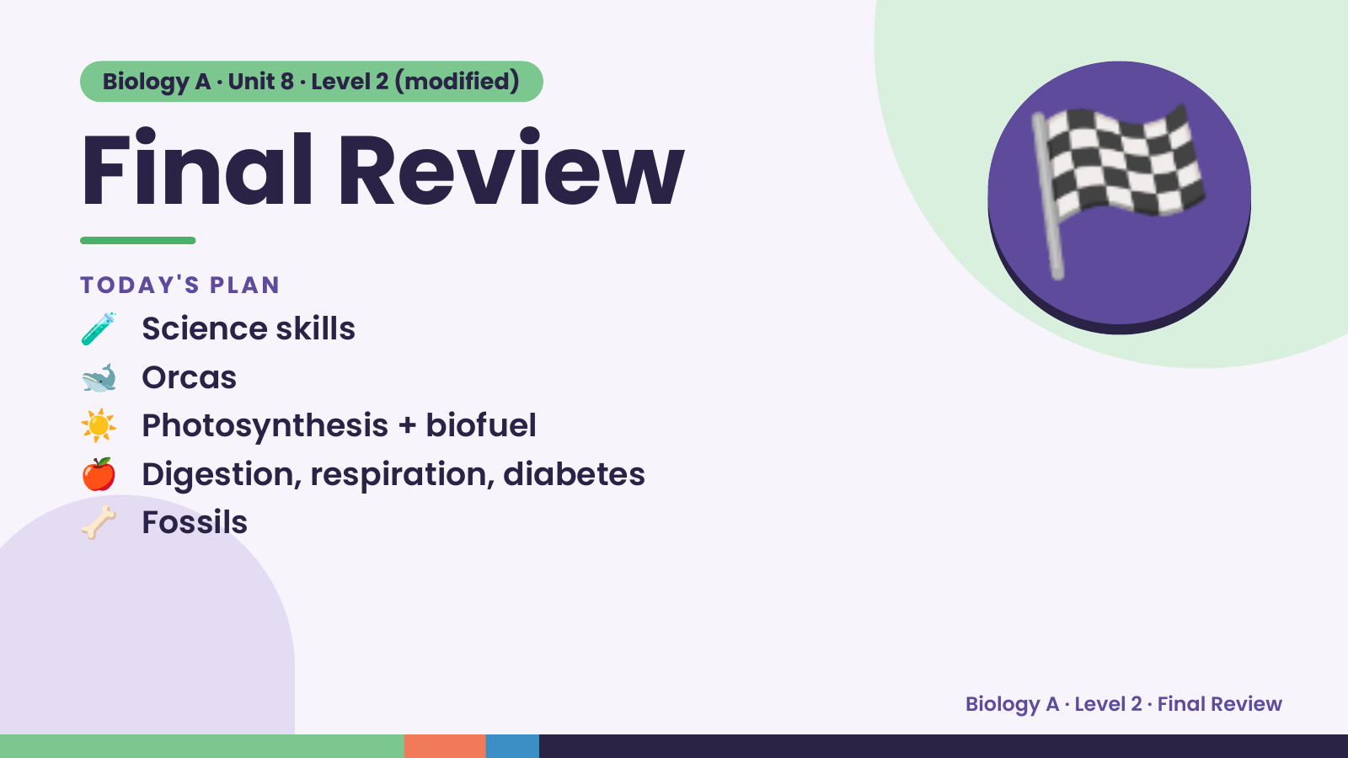
Notes:
Biology A · Unit 8 · Level 2 (modified)
Final Review
🧪 Science skills
TODAY'S PLAN
🐋 Orcas
☀️ Photosynthesis + biofuel
🏁
🍎 Digestion, respiration, diabetes
🦴 Fossils
Biology A · Level 2 · Final Review

Slide 2
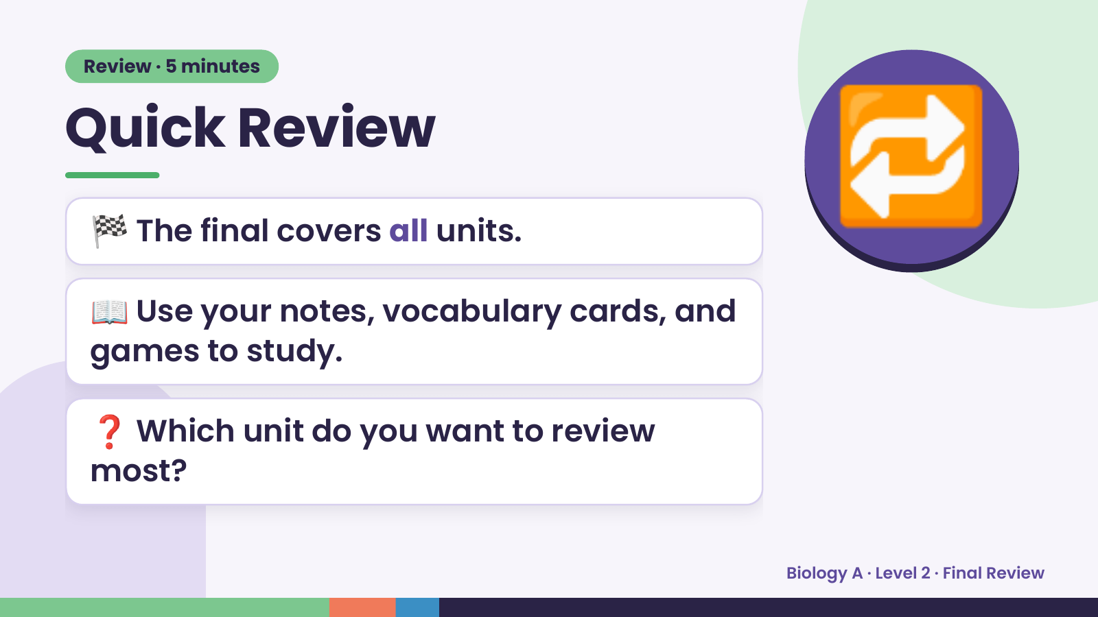
Notes:
Review · 5 minutes
Quick Review
🏁 The final covers all units.
📖 Use your notes, vocabulary cards, and
🔁
games to study.
❓ Which unit do you want to review
most?
Biology A · Level 2 · Final Review

Slide 3
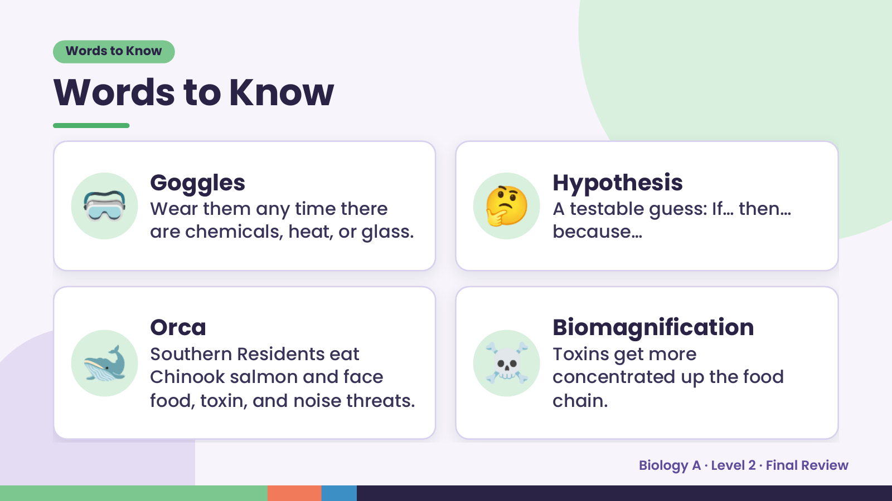
Notes:
Words to Know
Words to Know
🥽 Goggles
Wear them any time there
are chemicals, heat, or glass.
🤔 Hypothesis
A testable guess: If… then…
because…
🐋 Orca
Southern Residents eat
Chinook salmon and face
food, toxin, and noise threats.
☠️ Biomagnification
Toxins get more
concentrated up the food
chain.
Biology A · Level 2 · Final Review

Slide 4
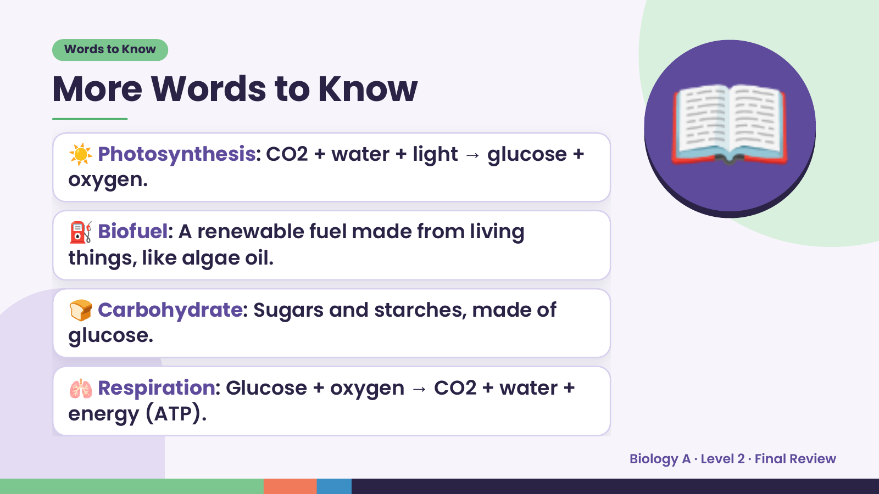
Notes:
Words to Know
More Words to Know
☀️ Photosynthesis: CO2 + water + light → glucose +
oxygen.
⛽ Biofuel: A renewable fuel made from living
things, like algae oil.
📖
🍞 Carbohydrate: Sugars and starches, made of
glucose.
🫁 Respiration: Glucose + oxygen → CO2 + water +
energy (ATP).
Biology A · Level 2 · Final Review

Slide 5
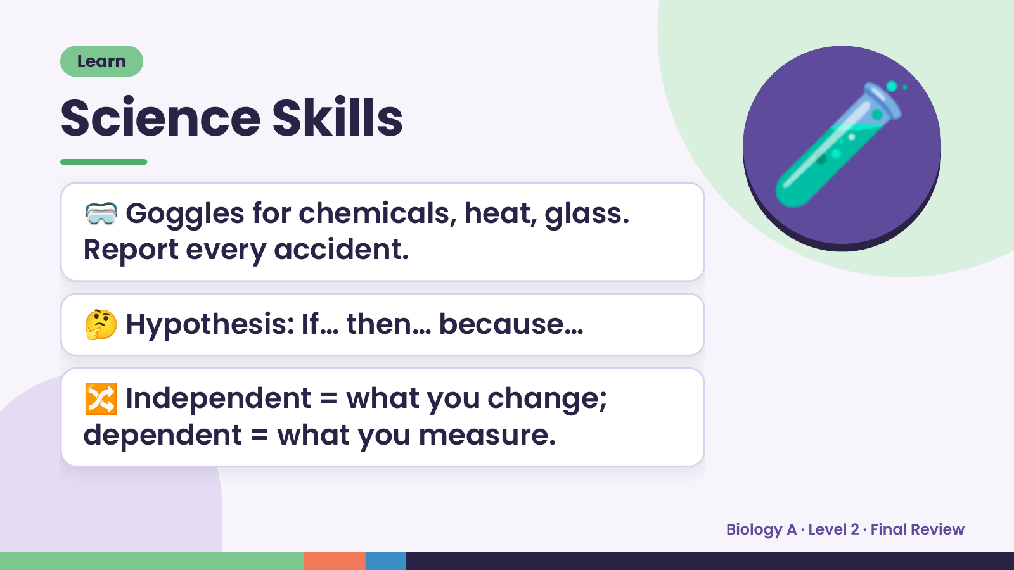
Notes:
Learn
Science Skills
🥽 Goggles for chemicals, heat, glass.
Report every accident.
🧪
🤔 Hypothesis: If… then… because…
🔀 Independent = what you change;
dependent = what you measure.
Biology A · Level 2 · Final Review

Slide 6
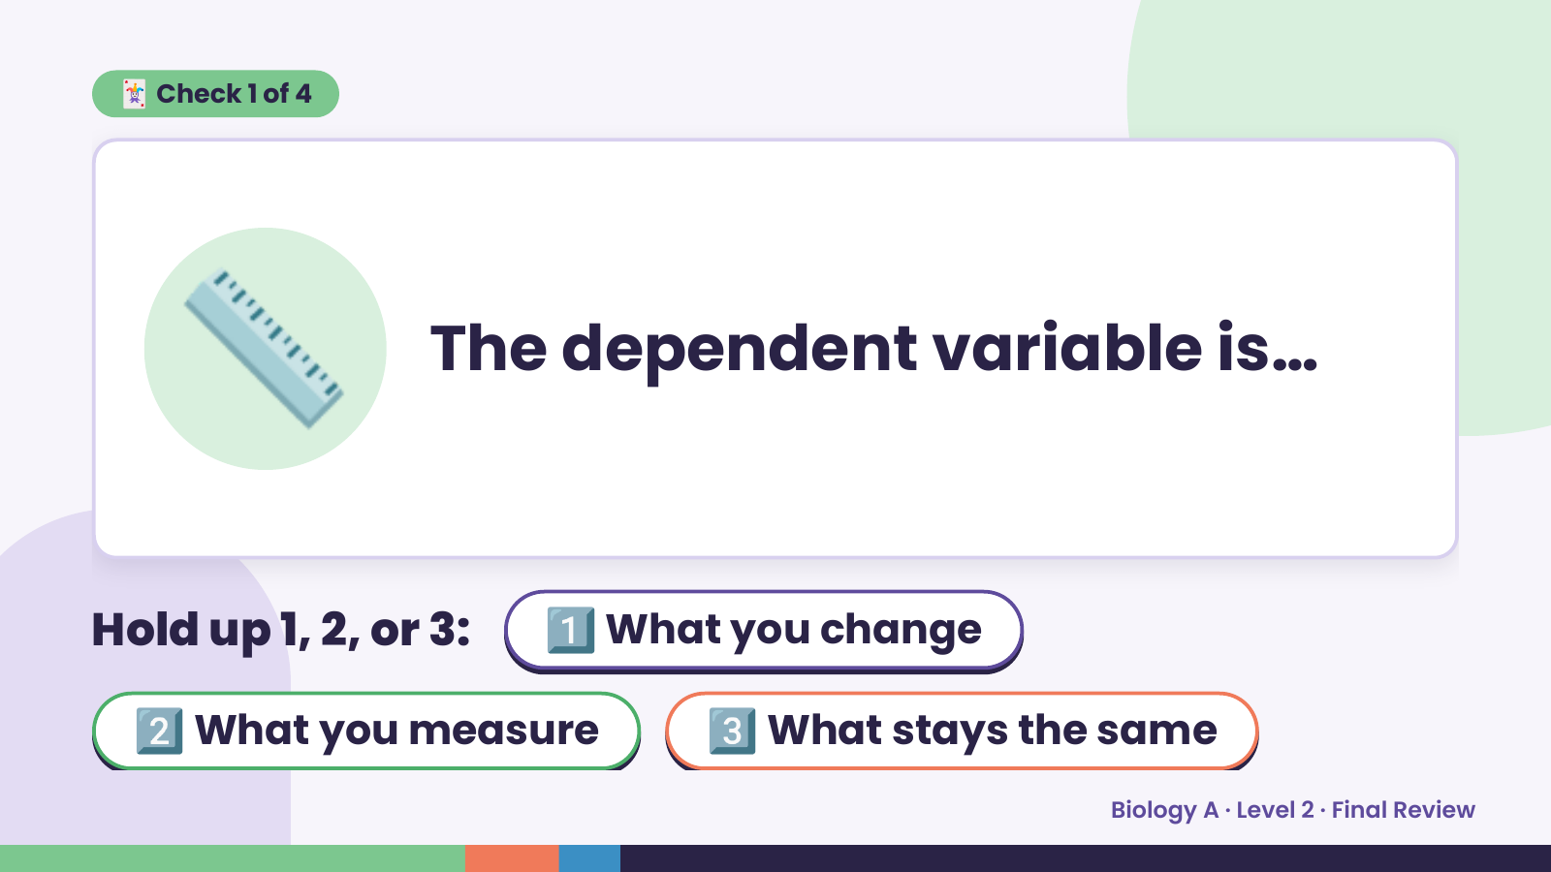
Notes:
🃏 Check 1 of 4
📏 The dependent variable is…
Hold up 1, 2, or 3: 1️⃣ What you change
2️⃣ What you measure 3️⃣ What stays the same
Biology A · Level 2 · Final Review

Slide 7
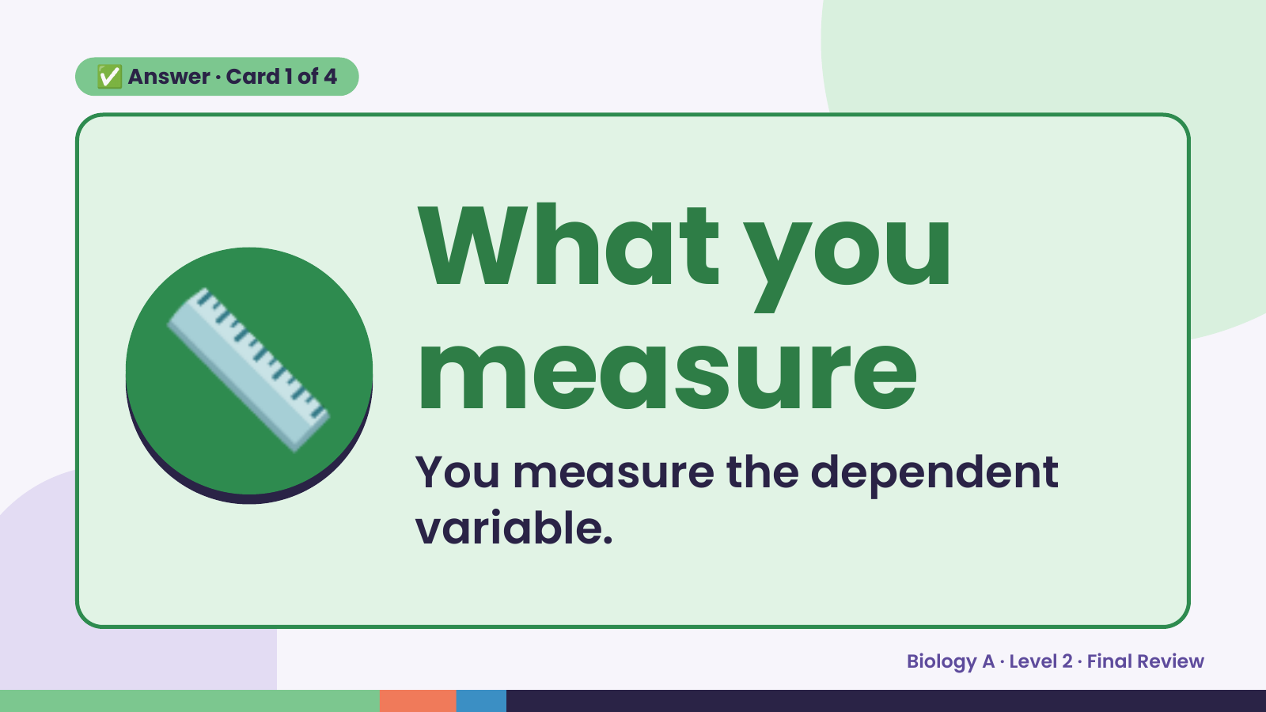
Notes:
✅ Answer · Card 1 of 4
📏 What you
measure
You measure the dependent
variable.
Biology A · Level 2 · Final Review

Slide 8
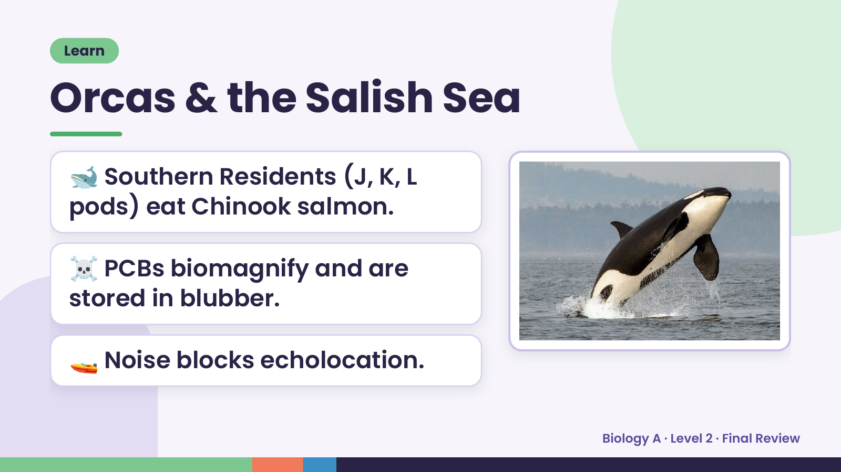
Notes:
Learn
Orcas & the Salish Sea
🐋 Southern Residents (J, K, L
pods) eat Chinook salmon.
☠️ PCBs biomagnify and are
stored in blubber.
🚤 Noise blocks echolocation.
Biology A · Level 2 · Final Review

Slide 9
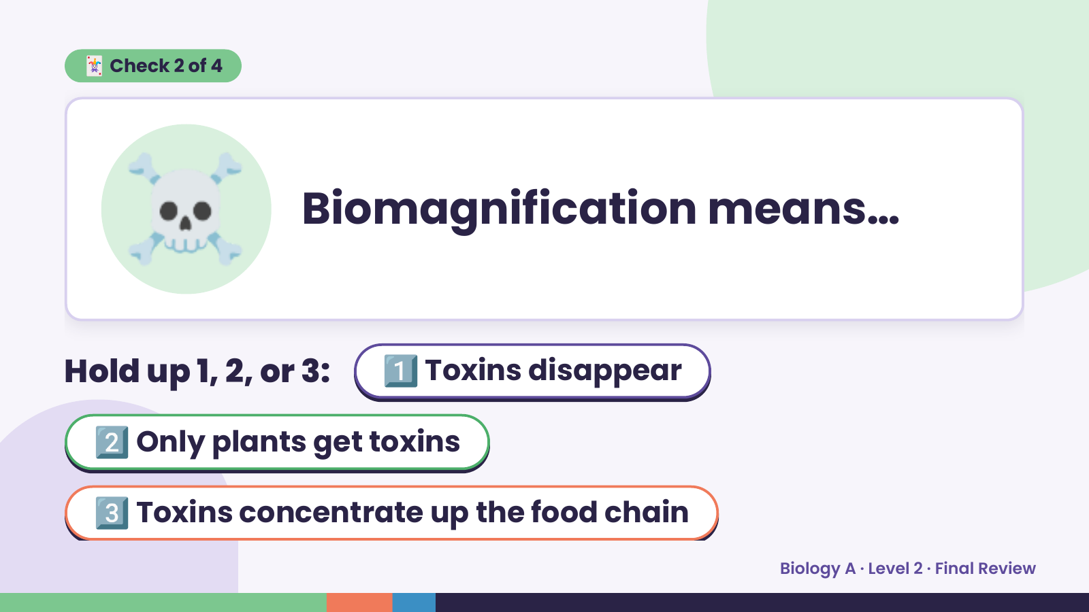
Notes:
☠️
🃏 Check 2 of 4
Biomagnification means…
Hold up 1, 2, or 3: 1️⃣ Toxins disappear
2️⃣ Only plants get toxins
3️⃣ Toxins concentrate up the food chain
Biology A · Level 2 · Final Review

Slide 10
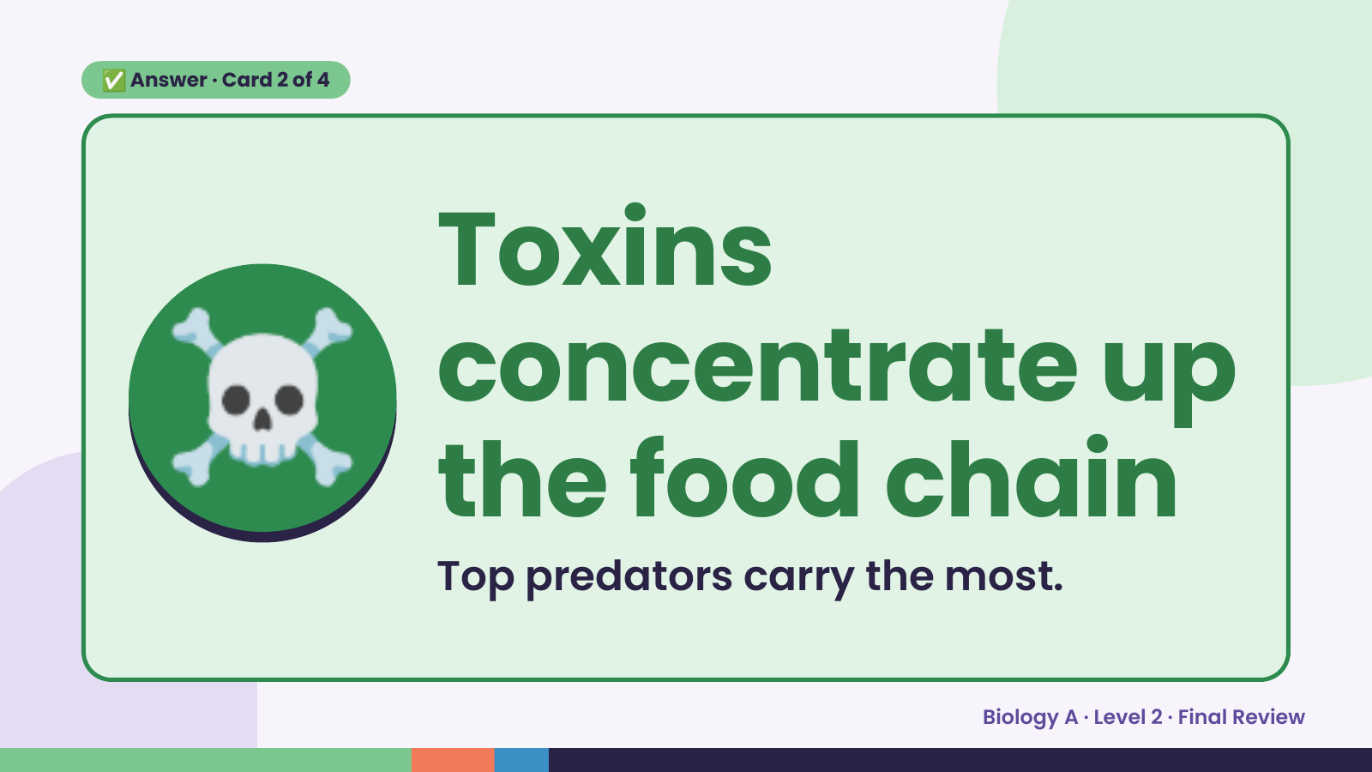
Notes:
✅ Answer · Card 2 of 4
☠️ Toxins
concentrate up
the food chain
Top predators carry the most.
Biology A · Level 2 · Final Review

Slide 11
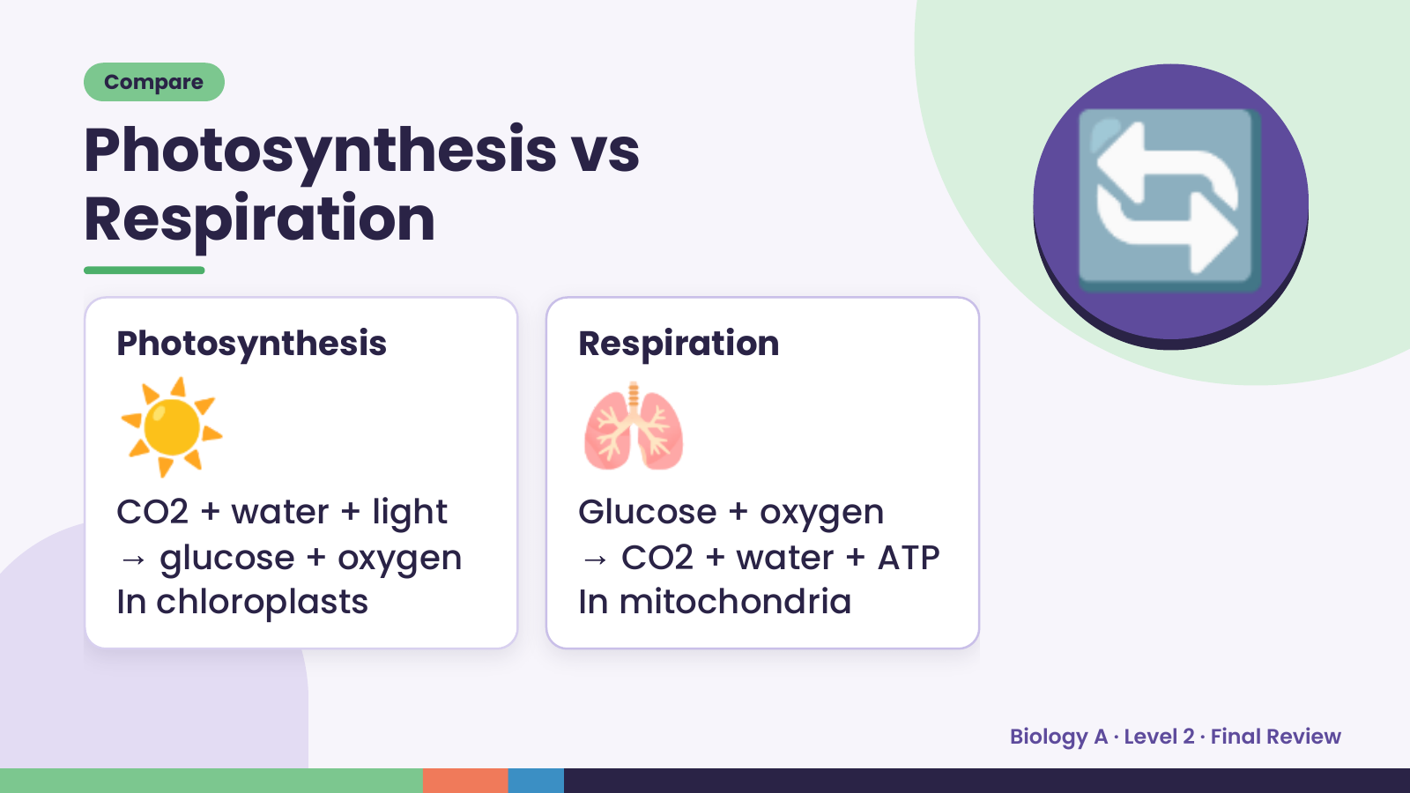
Notes:
Compare
Photosynthesis vs
Respiration
☀️
Photosynthesis
🫁
Respiration
🔄
CO2 + water + light Glucose + oxygen
→ glucose + oxygen → CO2 + water + ATP
In chloroplasts In mitochondria
Biology A · Level 2 · Final Review

Slide 12
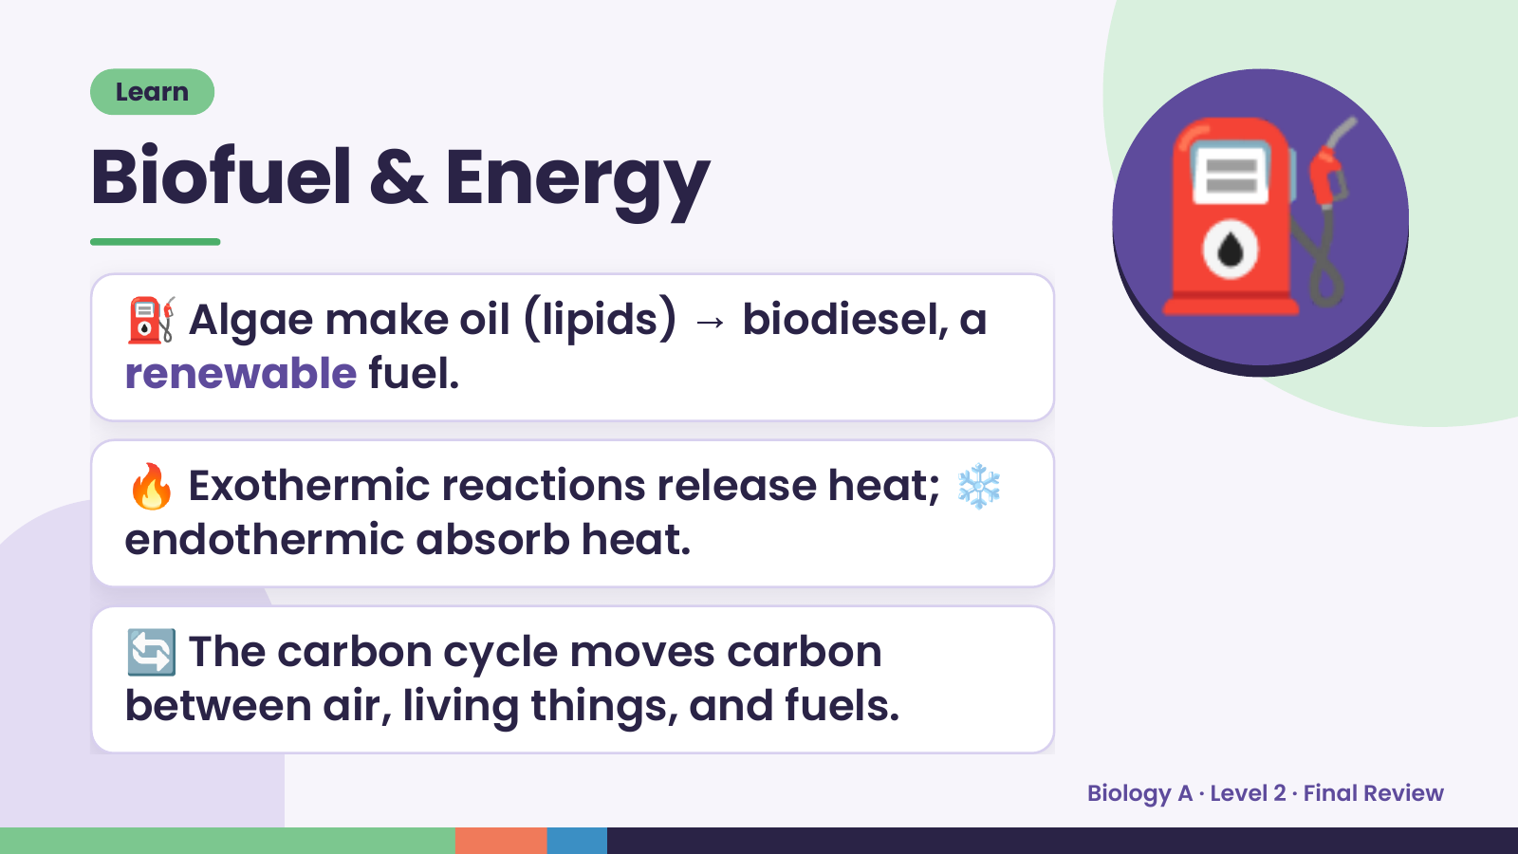
Notes:
Learn
Biofuel & Energy
⛽ Algae make oil (lipids) → biodiesel, a
renewable fuel.
⛽
🔥 Exothermic reactions release heat; ❄️
endothermic absorb heat.
🔄 The carbon cycle moves carbon
between air, living things, and fuels.
Biology A · Level 2 · Final Review

Slide 13
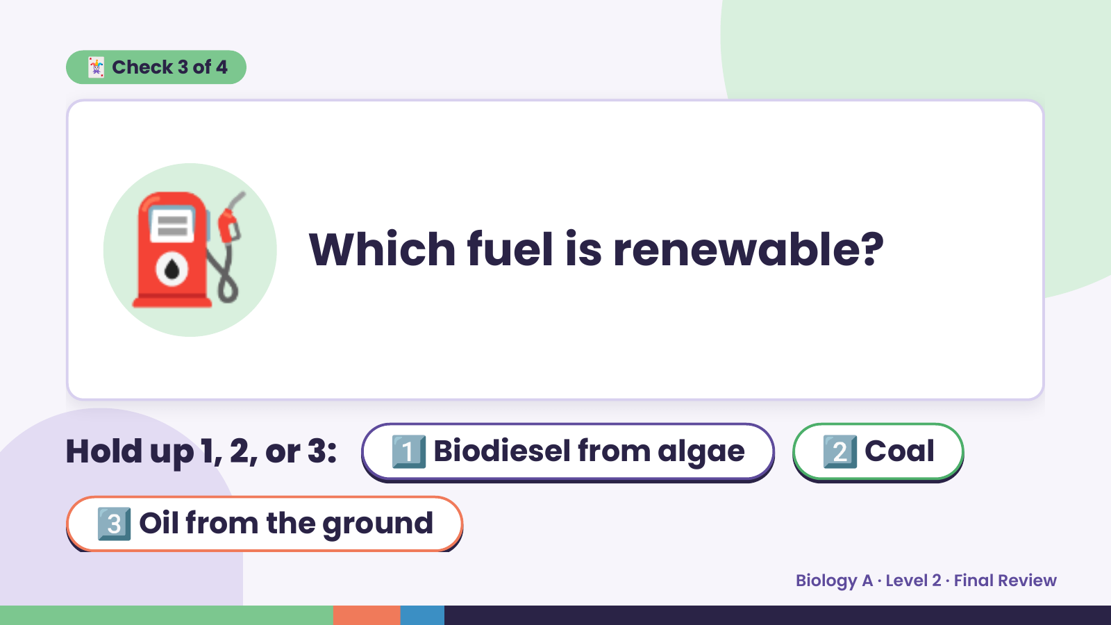
Notes:
🃏 Check 3 of 4
⛽ Which fuel is renewable?
Hold up 1, 2, or 3: 1️⃣ Biodiesel from algae 2️⃣ Coal
3️⃣ Oil from the ground
Biology A · Level 2 · Final Review

Slide 14
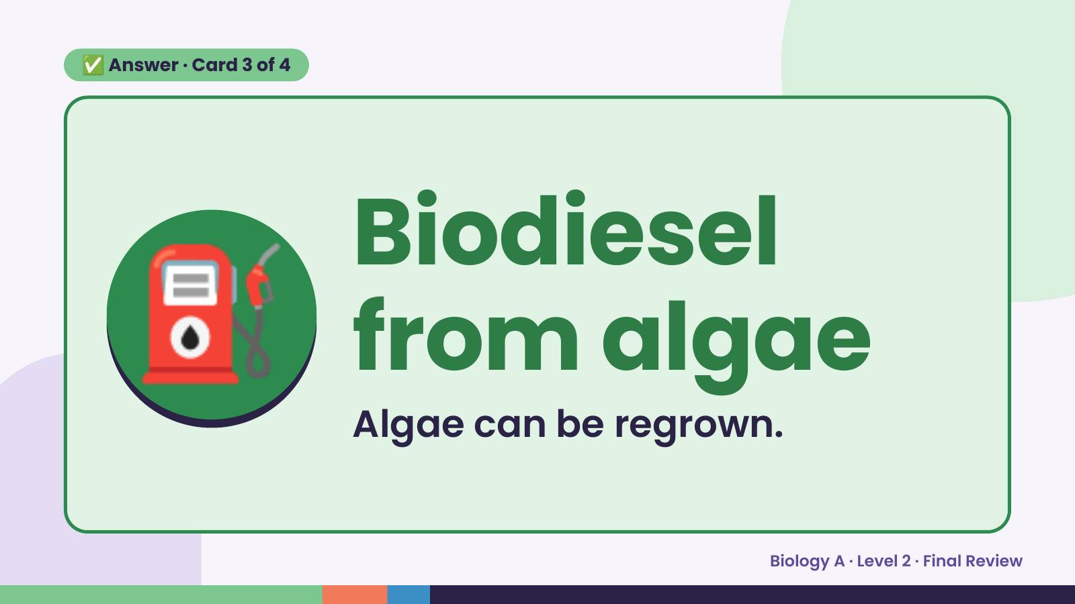
Notes:
✅ Answer · Card 3 of 4
⛽ Biodiesel
from algae
Algae can be regrown.
Biology A · Level 2 · Final Review

Slide 15
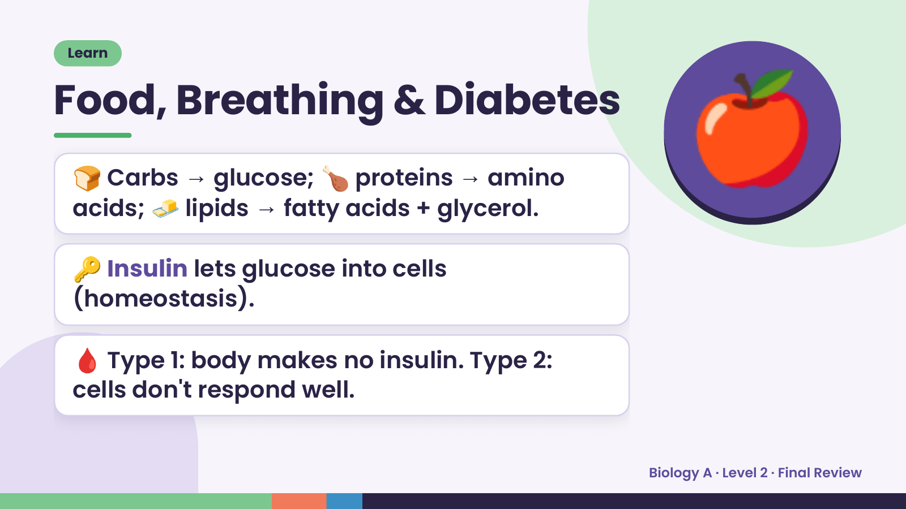
Notes:
Learn
Food, Breathing & Diabetes
🍞 Carbs → glucose; 🍗 proteins → amino
acids; 🧈 lipids → fatty acids + glycerol.
🔑 Insulin lets glucose into cells
🍎
(homeostasis).
🩸 Type 1: body makes no insulin. Type 2:
cells don't respond well.
Biology A · Level 2 · Final Review

Slide 16
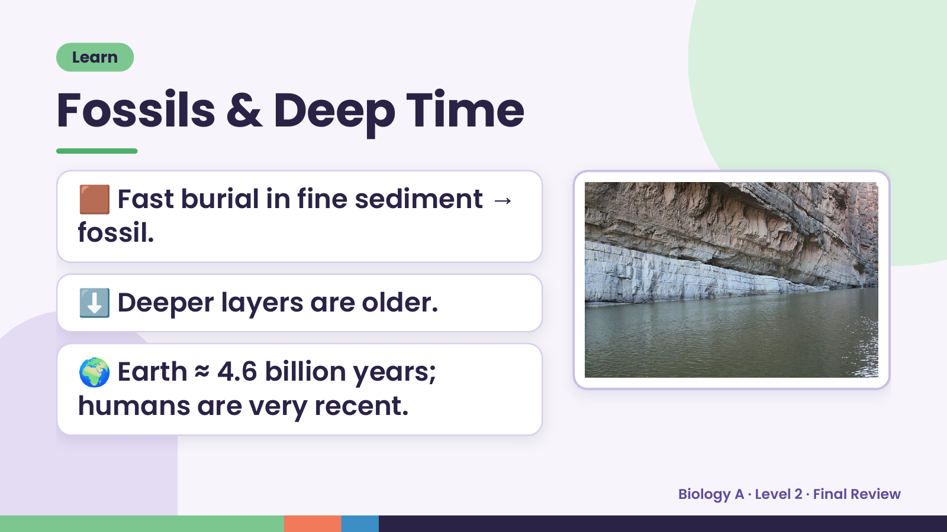
Notes:
Learn
Fossils & Deep Time
🟫 Fast burial in fine sediment →
fossil.
⬇️ Deeper layers are older.
🌍 Earth ≈ 4.6 billion years;
humans are very recent.
Biology A · Level 2 · Final Review

Slide 17
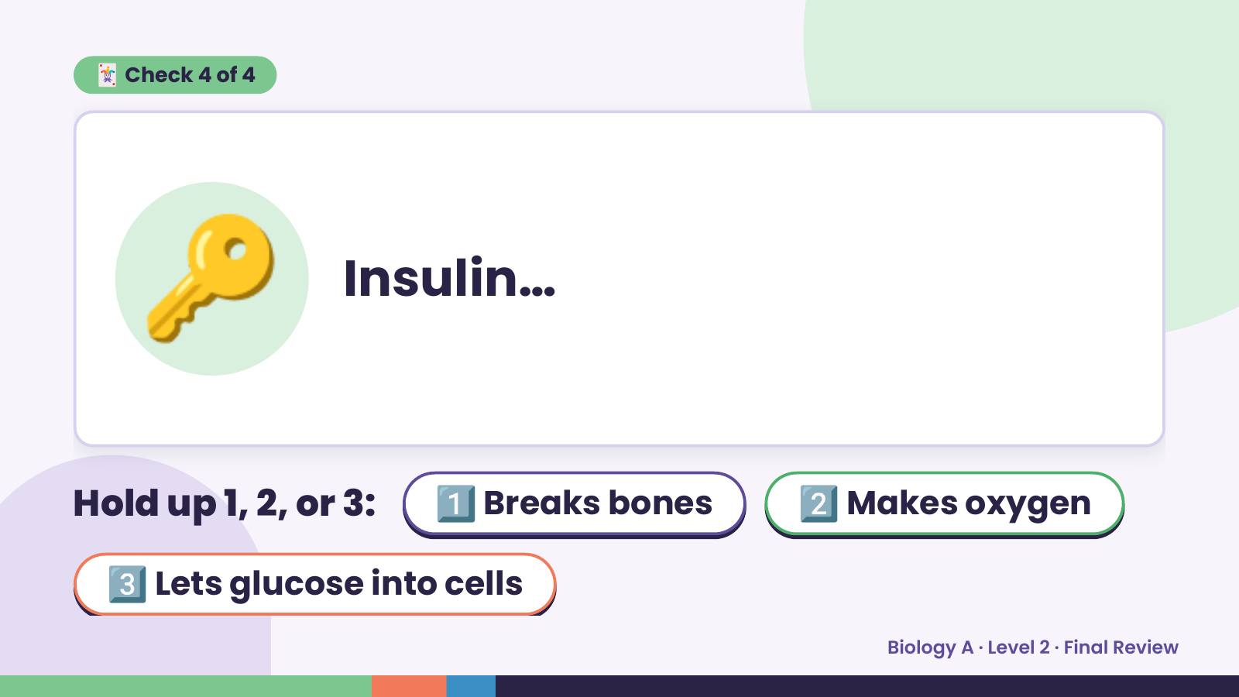
Notes:
🃏 Check 4 of 4
🔑 Insulin…
Hold up 1, 2, or 3: 1️⃣ Breaks bones 2️⃣ Makes oxygen
3️⃣ Lets glucose into cells
Biology A · Level 2 · Final Review

Slide 18
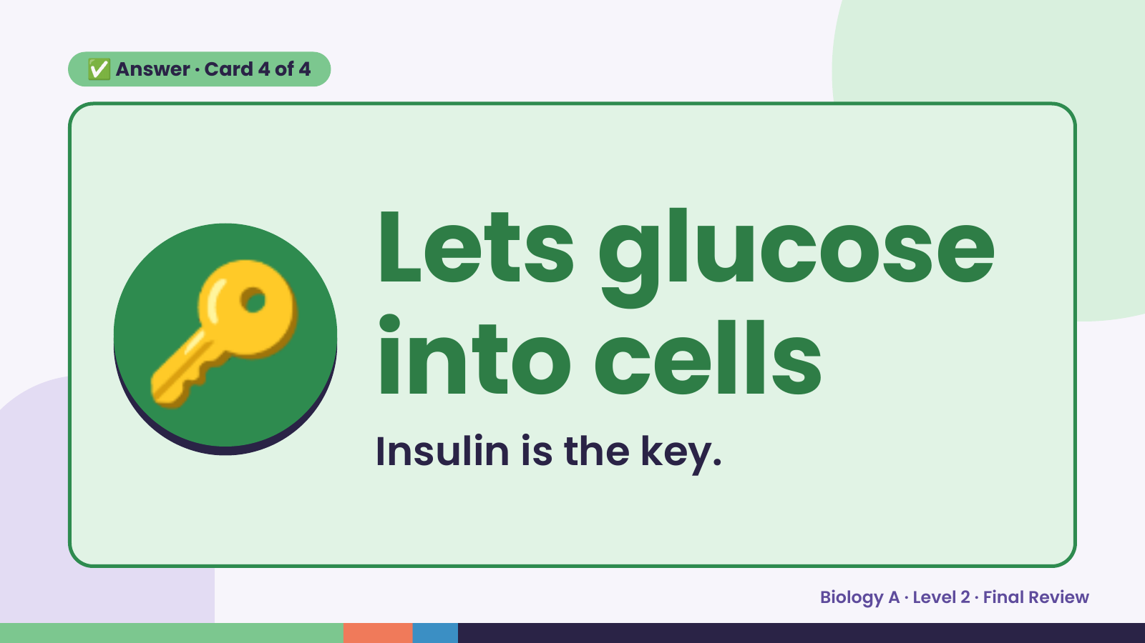
Notes:
✅ Answer · Card 4 of 4
🔑 Lets glucose
into cells
Insulin is the key.
Biology A · Level 2 · Final Review

Slide 19
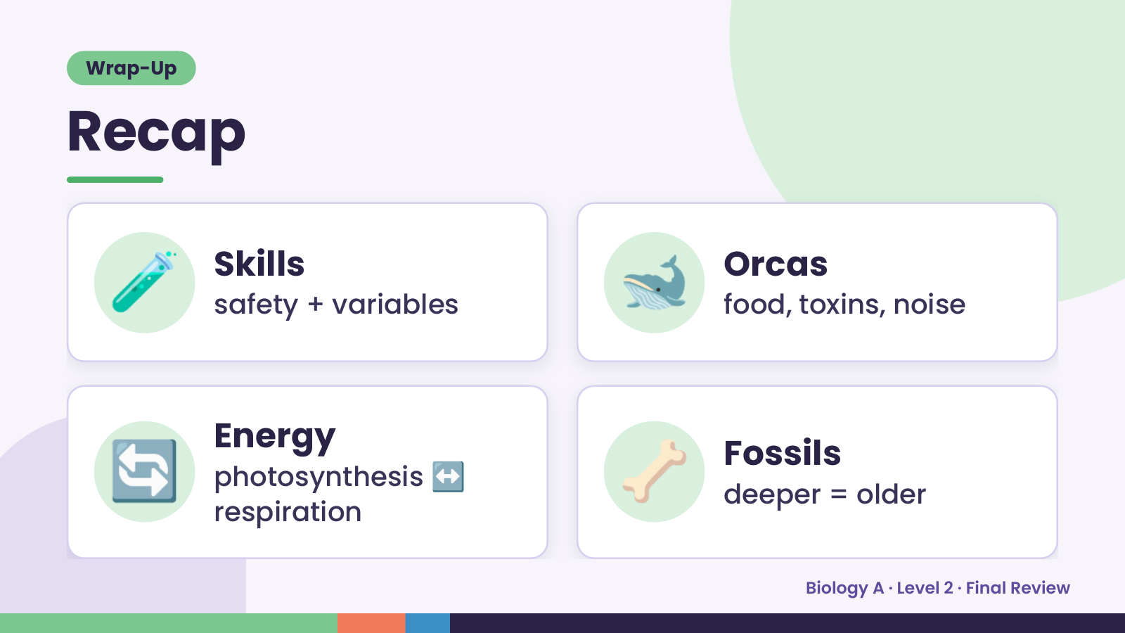
Notes:
Wrap-Up
Recap
🧪 Skills
safety + variables 🐋 Orcas
food, toxins, noise
🔄 Energy
photosynthesis
respiration
↔ 🦴 Fossils
deeper = older
Biology A · Level 2 · Final Review

Slide 20
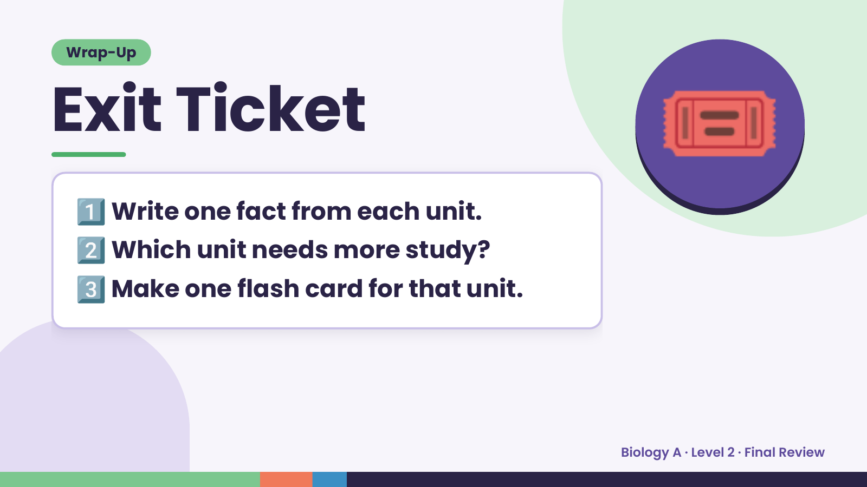
Notes:
Wrap-Up
Exit Ticket
1️⃣
2️⃣
Write one fact from each unit.
Which unit needs more study?
🎟️
3️⃣Make one flash card for that unit.
Biology A · Level 2 · Final Review

