Slide 1
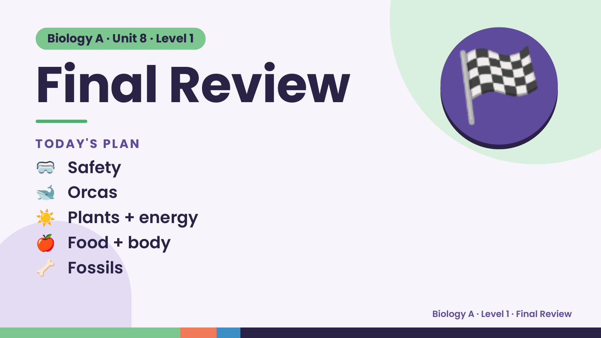
Notes:
Biology A · Unit 8 · Level 1
Final Review
TODAY'S PLAN
🥽 Safety
🏁
🐋 Orcas
☀️ Plants + energy
🍎 Food + body
🦴 Fossils
Biology A · Level 1 · Final Review

Slide 2
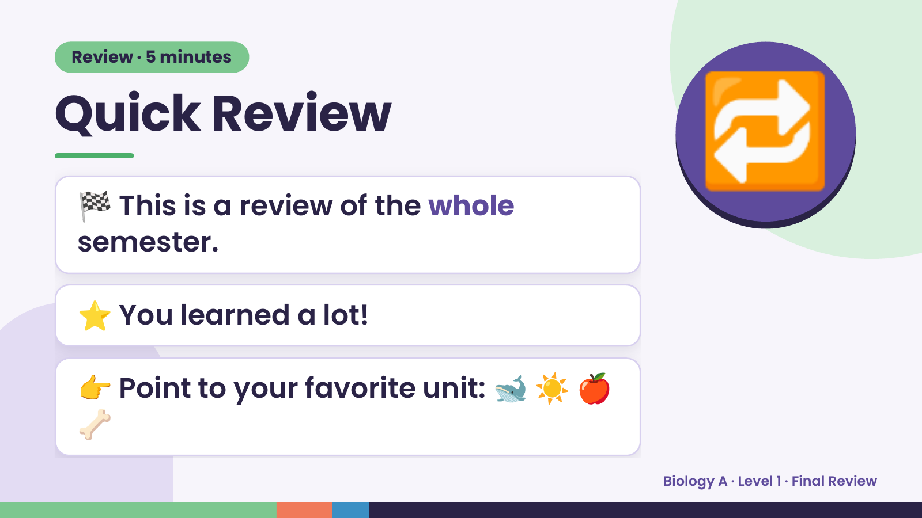
Notes:
Review · 5 minutes
Quick Review
🏁 This is a review of the whole
semester.
🔁
⭐ You learned a lot!
👉 Point to your favorite unit: 🐋 ☀️ 🍎
🦴
Biology A · Level 1 · Final Review

Slide 3
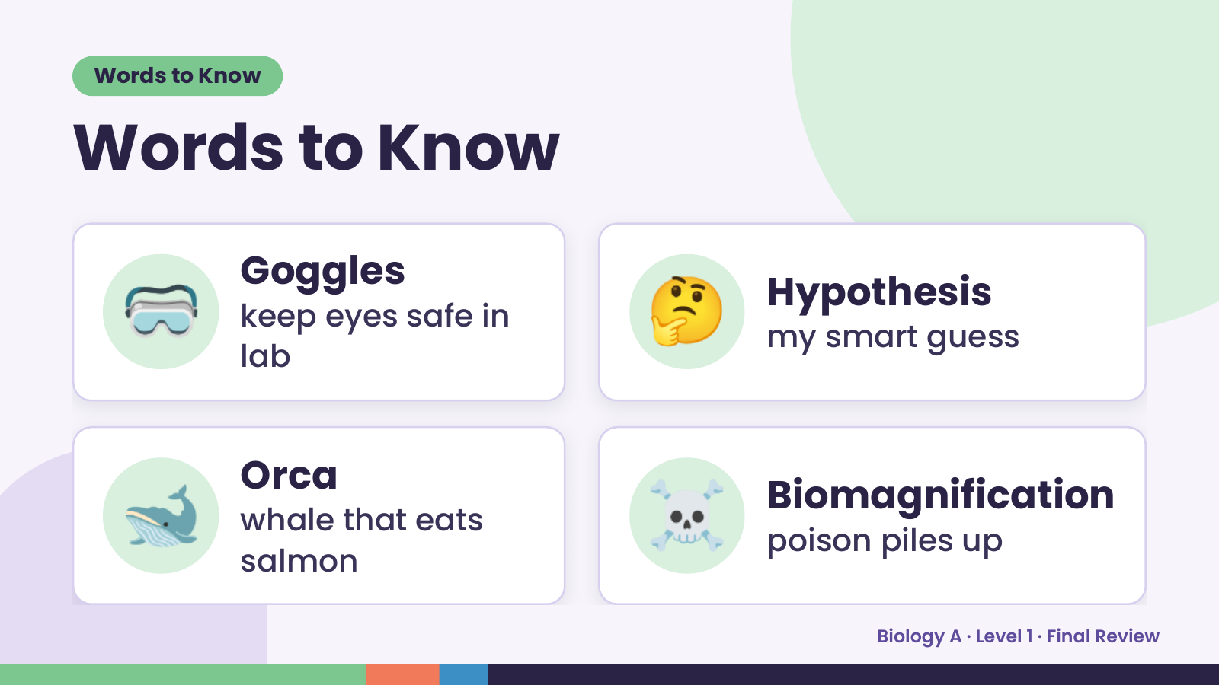
Notes:
Words to Know
Words to Know
🥽 Goggles
keep eyes safe in
lab
🤔 Hypothesis
my smart guess
🐋 Orca
whale that eats
salmon
☠️ Biomagnification
poison piles up
Biology A · Level 1 · Final Review

Slide 4
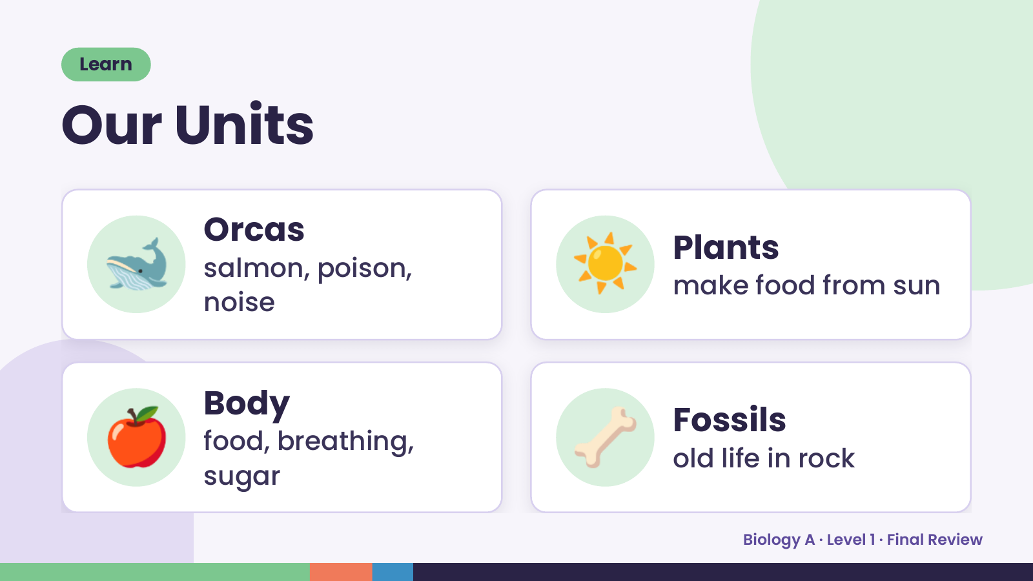
Notes:
Learn
Our Units
🐋 Orcas
salmon, poison,
noise
☀️ Plants
make food from sun
🍎 Body
food, breathing,
sugar
🦴 Fossils
old life in rock
Biology A · Level 1 · Final Review

Slide 5
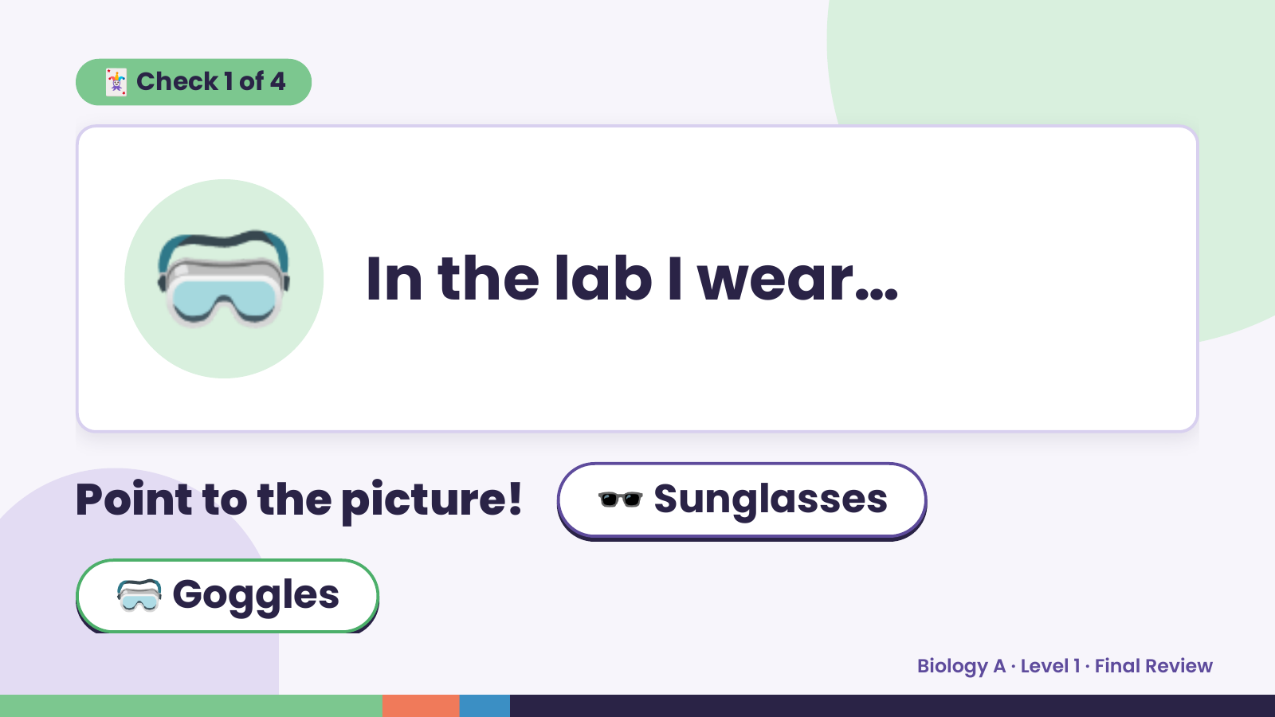
Notes:
🃏 Check 1 of 4
🥽 In the lab I wear…
Point to the picture! 🕶️ Sunglasses
🥽 Goggles
Biology A · Level 1 · Final Review

Slide 6
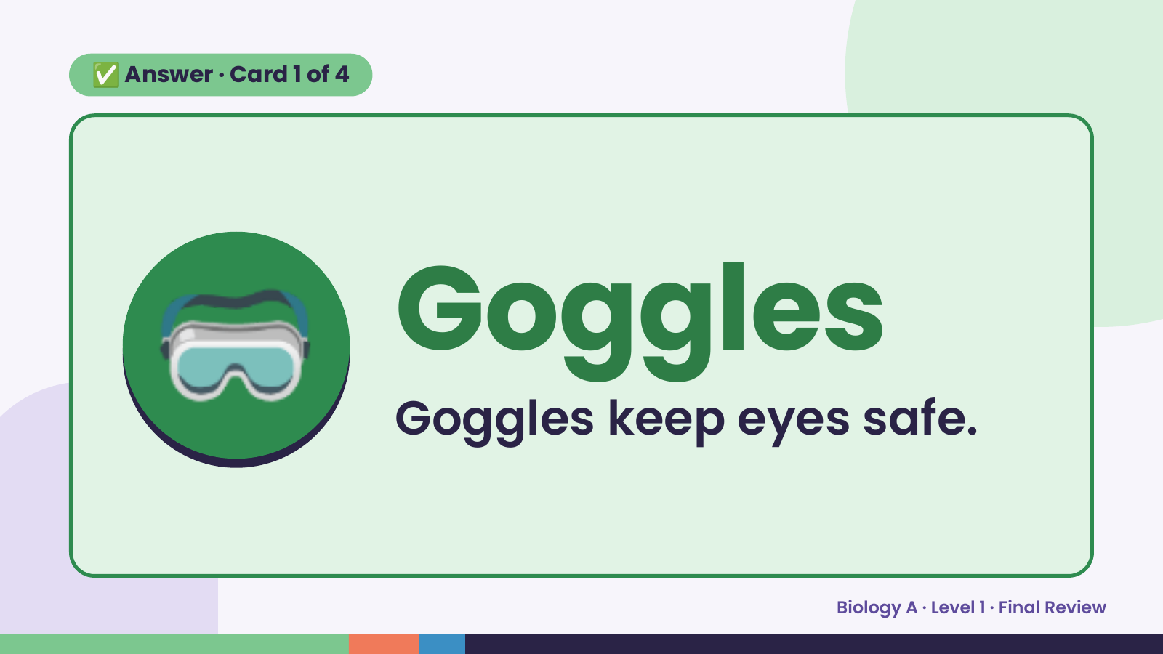
Notes:
✅ Answer · Card 1 of 4
🥽 Goggles
Goggles keep eyes safe.
Biology A · Level 1 · Final Review

Slide 7
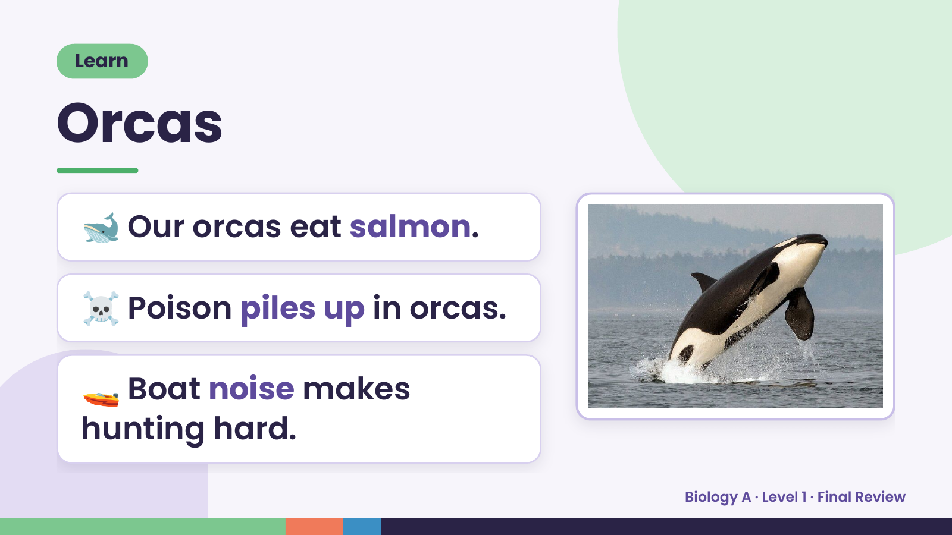
Notes:
Learn
Orcas
🐋 Our orcas eat salmon.
☠️ Poison piles up in orcas.
🚤 Boat noise makes
hunting hard.
Biology A · Level 1 · Final Review

Slide 8
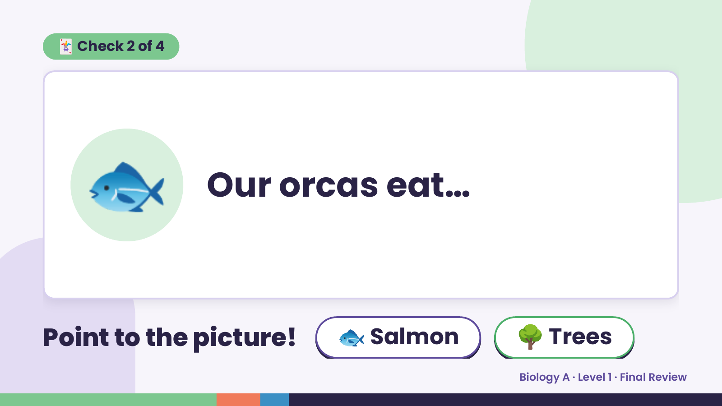
Notes:
🃏 Check 2 of 4
🐟 Our orcas eat…
Point to the picture! 🐟 Salmon 🌳 Trees
Biology A · Level 1 · Final Review

Slide 9
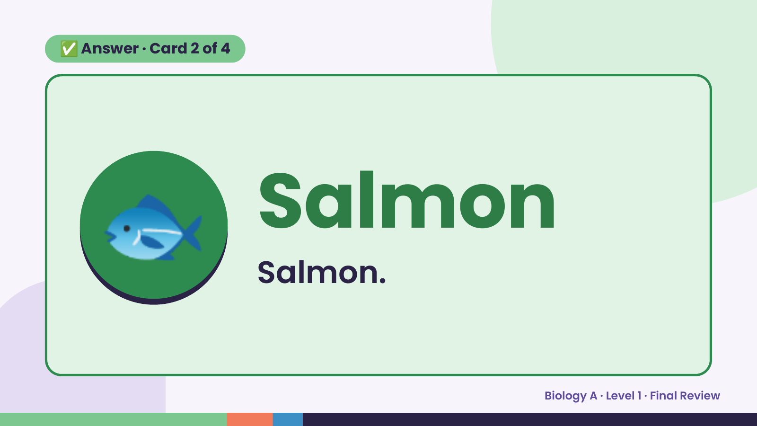
Notes:
✅ Answer · Card 2 of 4
🐟 Salmon
Salmon.
Biology A · Level 1 · Final Review

Slide 10
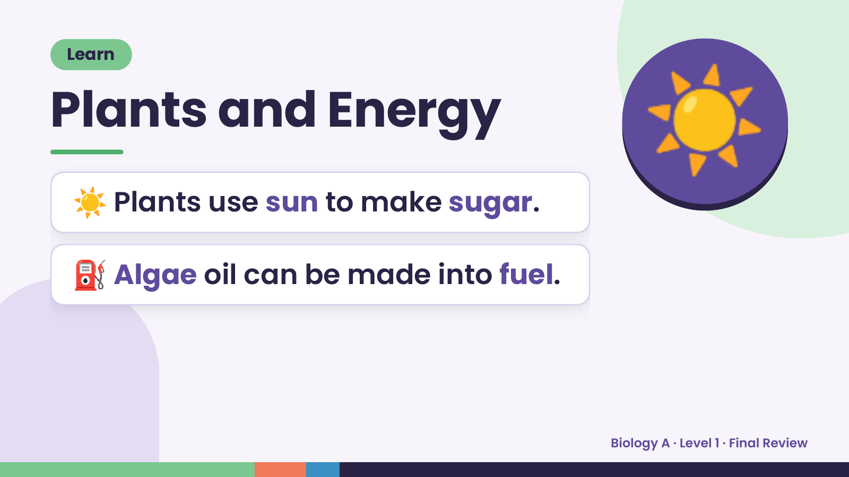
Notes:
Learn
Plants and Energy
☀️ Plants use sun to make sugar.
☀️
⛽ Algae oil can be made into fuel.
Biology A · Level 1 · Final Review

Slide 11
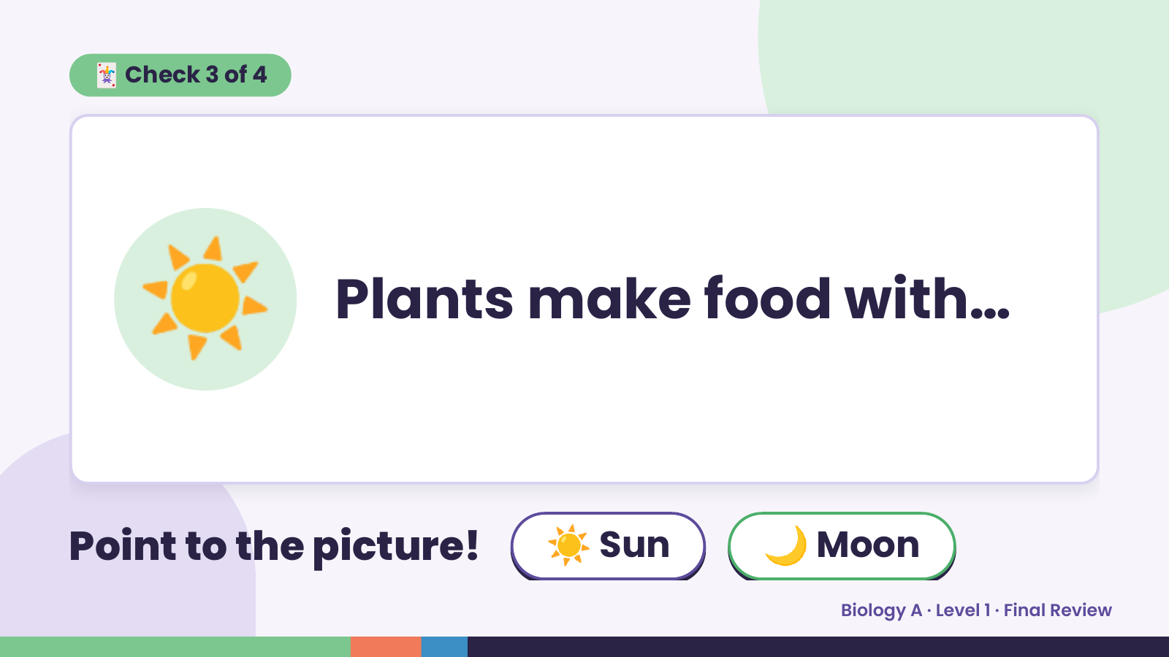
Notes:
🃏 Check 3 of 4
☀️ Plants make food with…
Point to the picture! ☀️ Sun 🌙 Moon
Biology A · Level 1 · Final Review

Slide 12
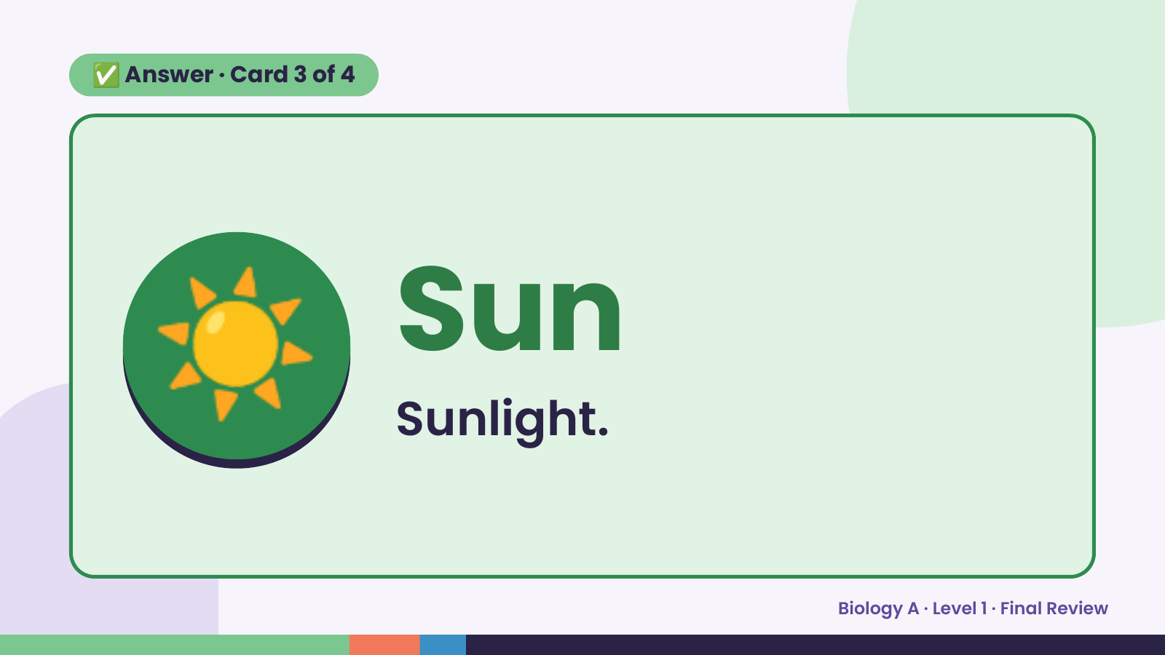
Notes:
✅ Answer · Card 3 of 4
☀️ Sun
Sunlight.
Biology A · Level 1 · Final Review

Slide 13
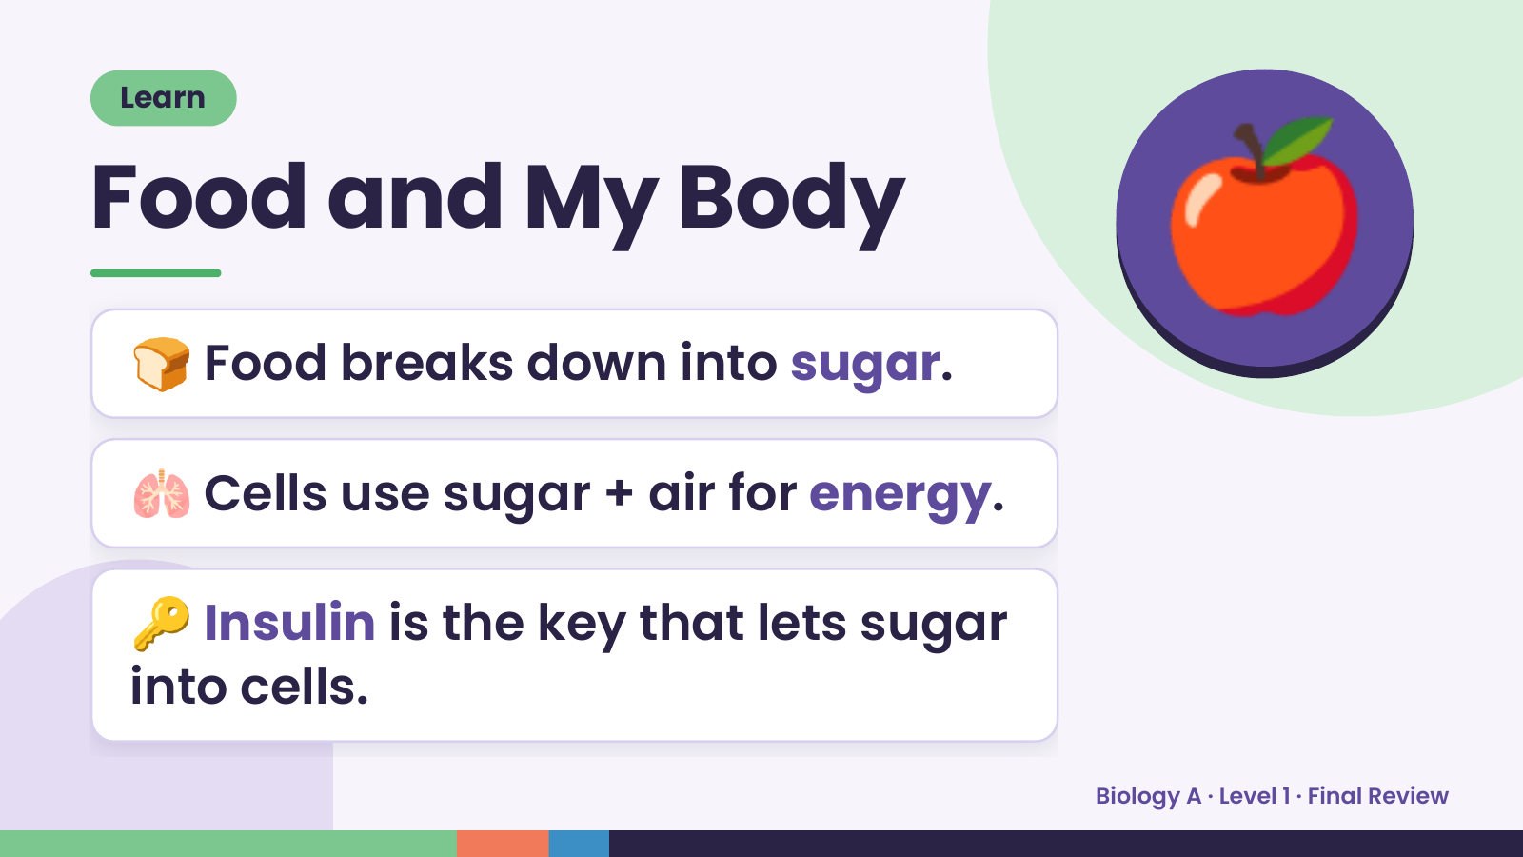
Notes:
Learn
Food and My Body
🍞 Food breaks down into sugar.
🍎
🫁 Cells use sugar + air for energy.
🔑 Insulin is the key that lets sugar
into cells.
Biology A · Level 1 · Final Review

Slide 14
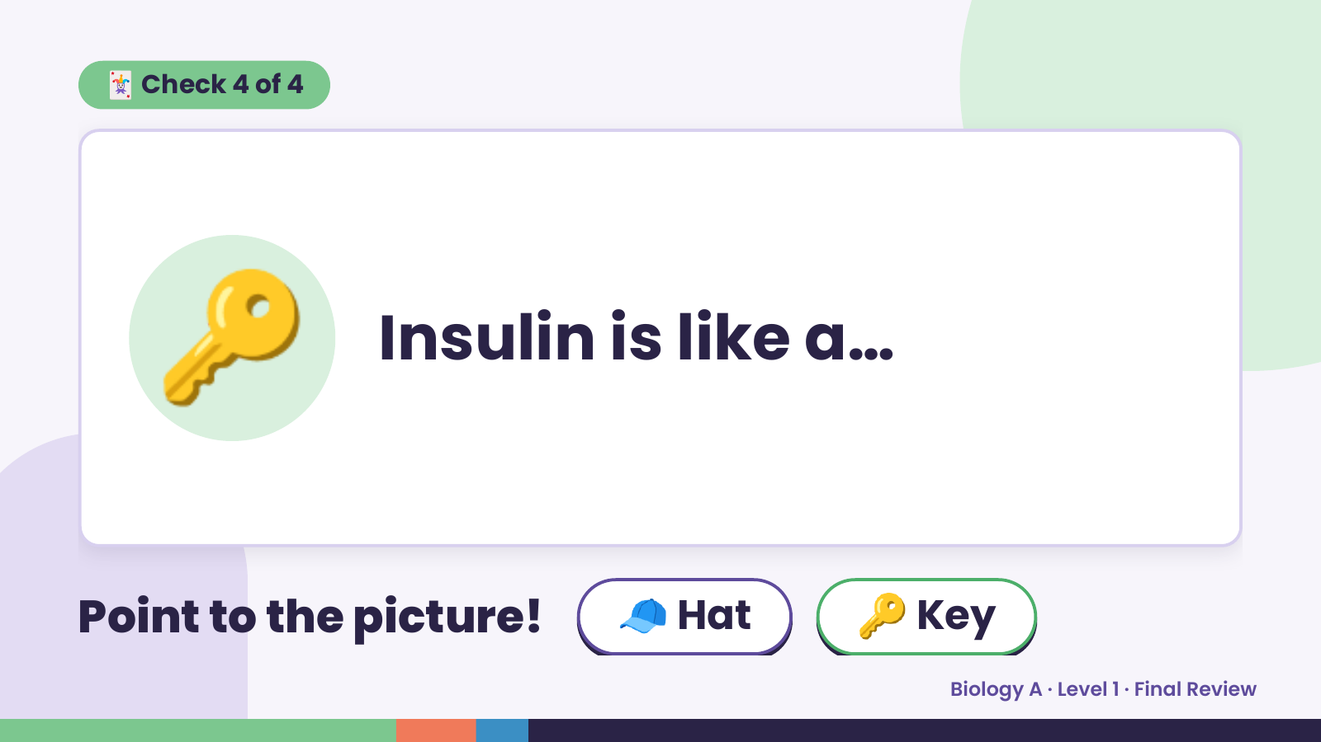
Notes:
🃏 Check 4 of 4
🔑 Insulin is like a…
Point to the picture! 🧢 Hat 🔑 Key
Biology A · Level 1 · Final Review

Slide 15
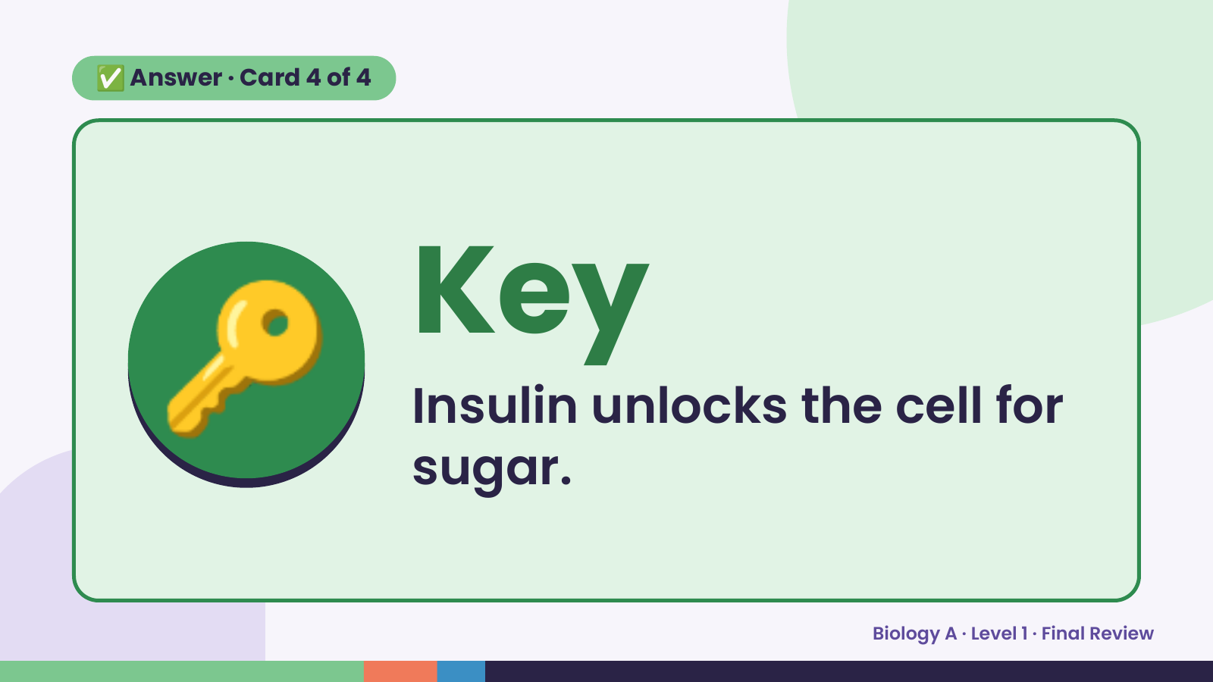
Notes:
✅ Answer · Card 4 of 4
🔑 Key
Insulin unlocks the cell for
sugar.
Biology A · Level 1 · Final Review

Slide 16
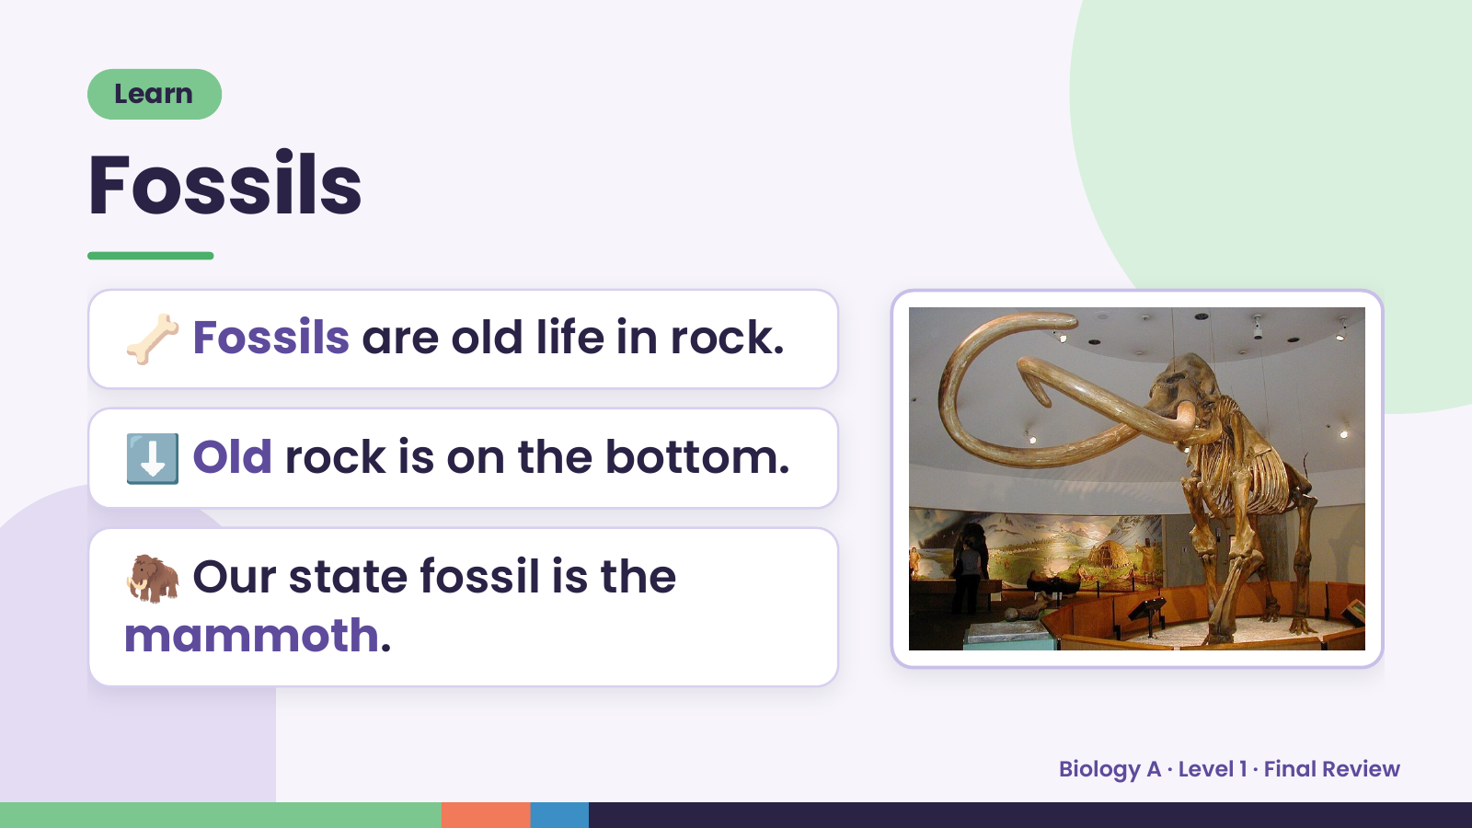
Notes:
Learn
Fossils
🦴 Fossils are old life in rock.
⬇️ Old rock is on the bottom.
🦣 Our state fossil is the
mammoth.
Biology A · Level 1 · Final Review

Slide 17
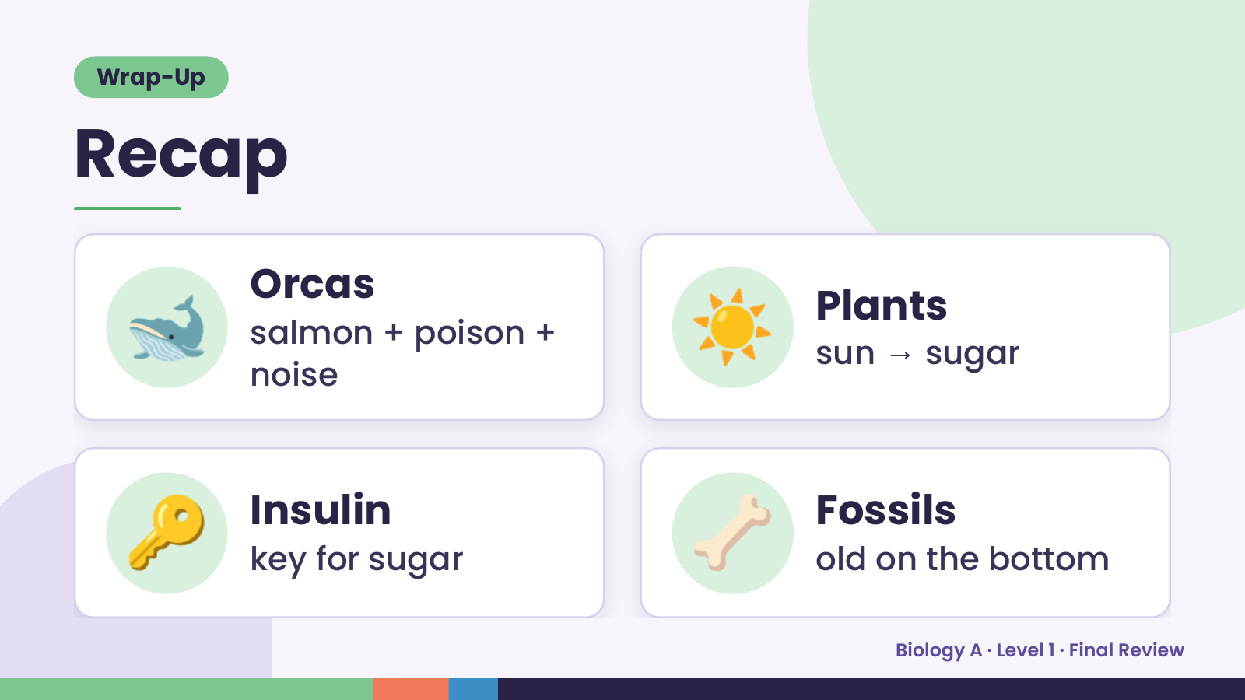
Notes:
Wrap-Up
Recap
🐋 Orcas
salmon + poison +
noise
☀️ Plants
sun → sugar
🔑 Insulin
key for sugar 🦴 Fossils
old on the bottom
Biology A · Level 1 · Final Review

Slide 18
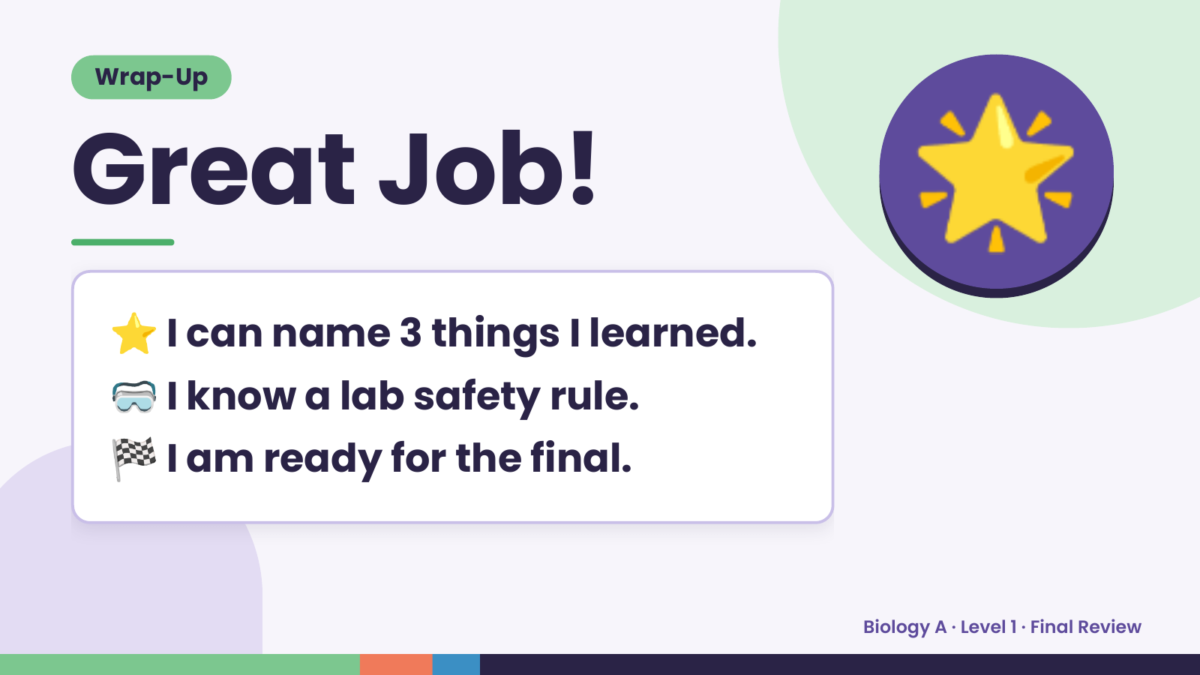
Notes:
Wrap-Up
Great Job!
⭐ I can name 3 things I learned.
🌟
🥽 I know a lab safety rule.
🏁 I am ready for the final.
Biology A · Level 1 · Final Review

