Slide 1
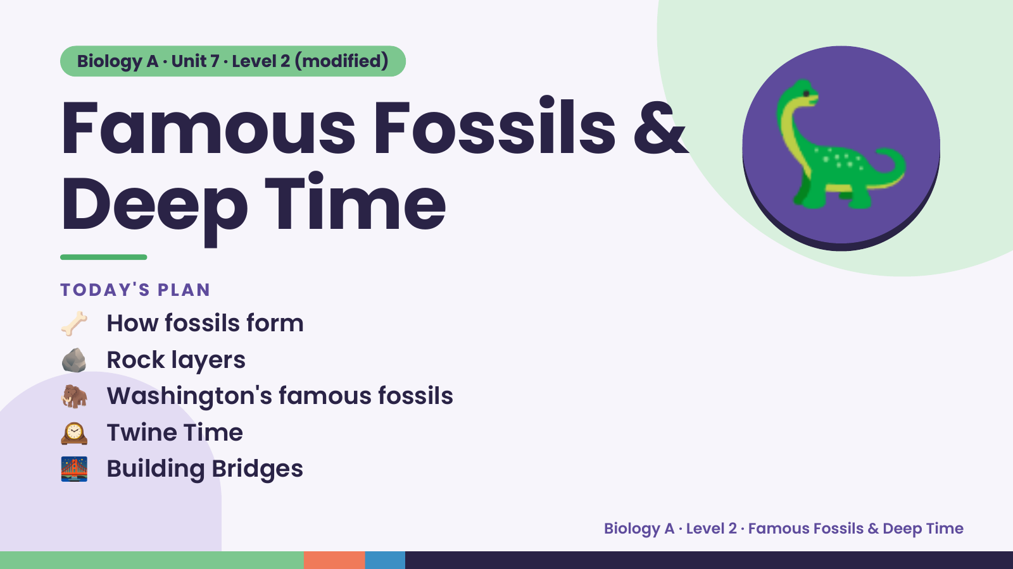
Notes:
Biology A · Unit 7 · Level 2 (modified)
Famous Fossils &
Deep Time
🦴 How fossils form
TODAY'S PLAN
🦕
🪨 Rock layers
🦣 Washington's famous fossils
🕰️ Twine Time
🌉 Building Bridges
Biology A · Level 2 · Famous Fossils & Deep Time

Slide 2
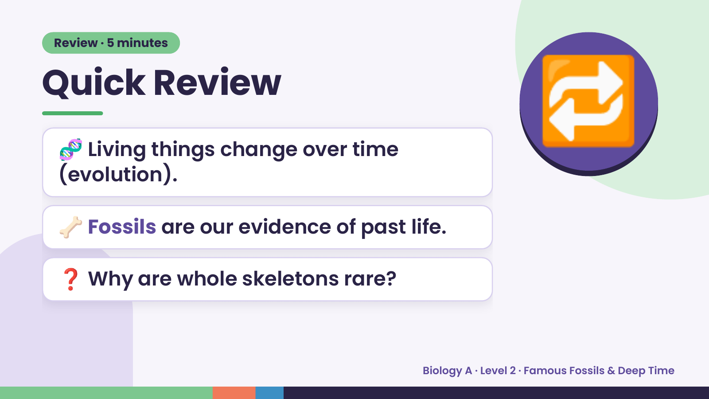
Notes:
Review · 5 minutes
Quick Review
🧬 Living things change over time
(evolution).
🔁
🦴 Fossils are our evidence of past life.
❓ Why are whole skeletons rare?
Biology A · Level 2 · Famous Fossils & Deep Time

Slide 3
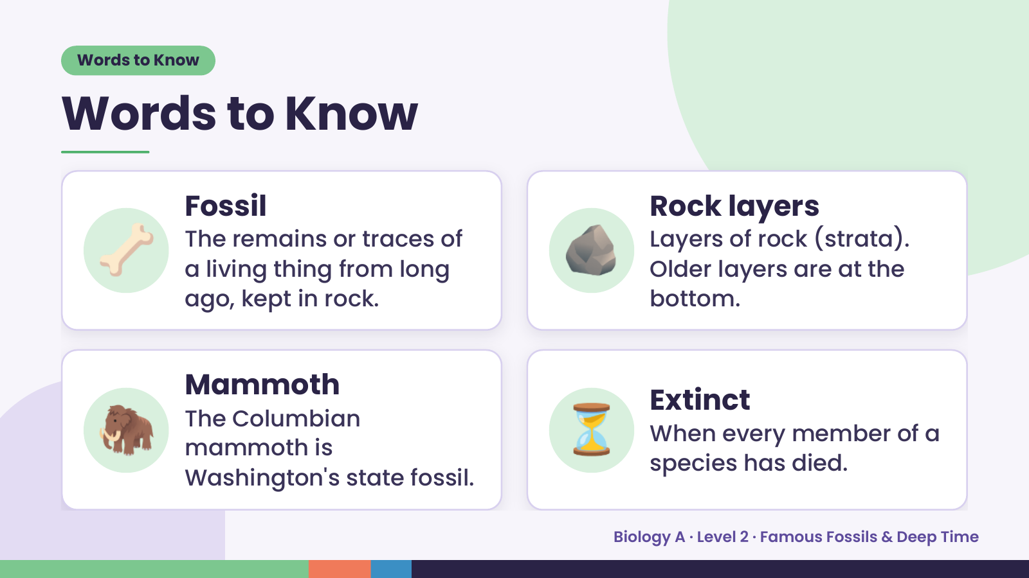
Notes:
Words to Know
Words to Know
🦴 Fossil
The remains or traces of
a living thing from long
ago, kept in rock.
🪨 Rock layers
Layers of rock (strata).
Older layers are at the
bottom.
🦣 Mammoth
The Columbian
mammoth is
Washington's state fossil.
⏳ Extinct
When every member of a
species has died.
Biology A · Level 2 · Famous Fossils & Deep Time

Slide 4
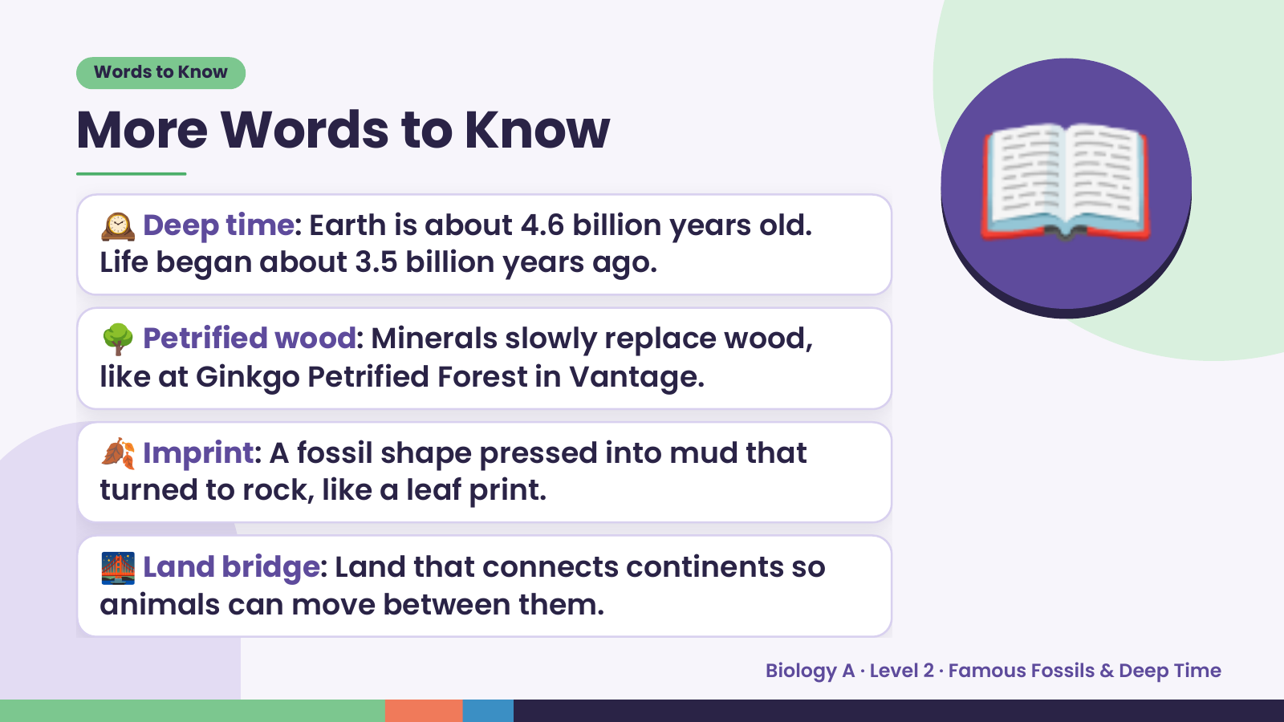
Notes:
Words to Know
More Words to Know
🕰️ Deep time: Earth is about 4.6 billion years old.
Life began about 3.5 billion years ago.
🌳 Petrified wood: Minerals slowly replace wood,
like at Ginkgo Petrified Forest in Vantage.
📖
🍂 Imprint: A fossil shape pressed into mud that
turned to rock, like a leaf print.
🌉 Land bridge: Land that connects continents so
animals can move between them.
Biology A · Level 2 · Famous Fossils & Deep Time

Slide 5
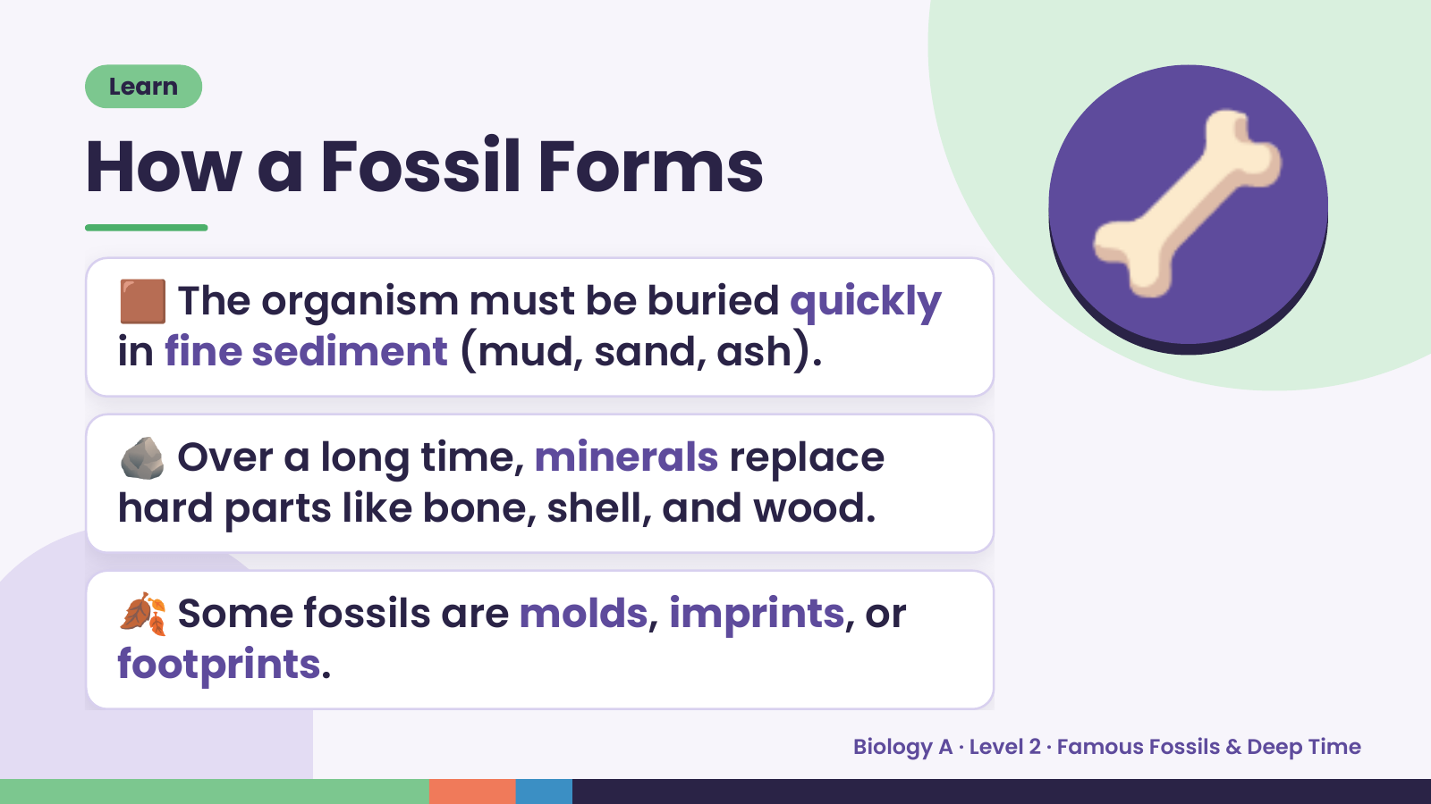
Notes:
Learn
How a Fossil Forms
🟫 The organism must be buried quickly
in fine sediment (mud, sand, ash).
🦴
🪨 Over a long time, minerals replace
hard parts like bone, shell, and wood.
🍂 Some fossils are molds, imprints, or
footprints.
Biology A · Level 2 · Famous Fossils & Deep Time

Slide 6
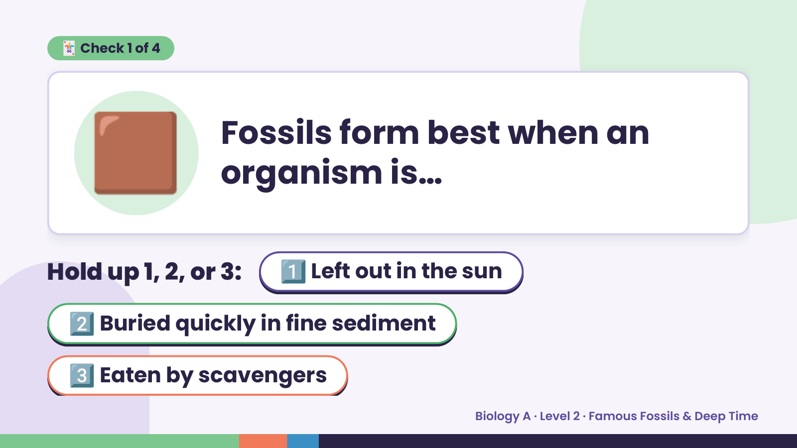
Notes:
🟫
🃏 Check 1 of 4
Fossils form best when an
organism is…
Hold up 1, 2, or 3: 1️⃣ Left out in the sun
2️⃣ Buried quickly in fine sediment
3️⃣ Eaten by scavengers
Biology A · Level 2 · Famous Fossils & Deep Time

Slide 7
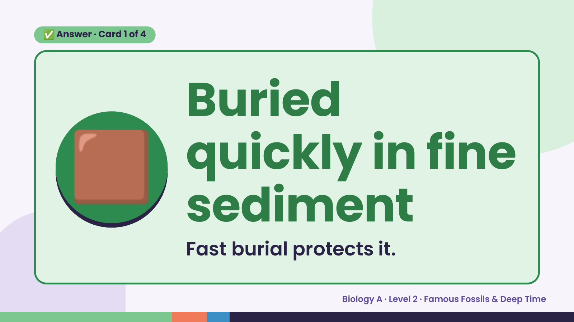
Notes:
✅ Answer · Card 1 of 4
🟫 Buried
quickly in fine
sediment
Fast burial protects it.
Biology A · Level 2 · Famous Fossils & Deep Time

Slide 8
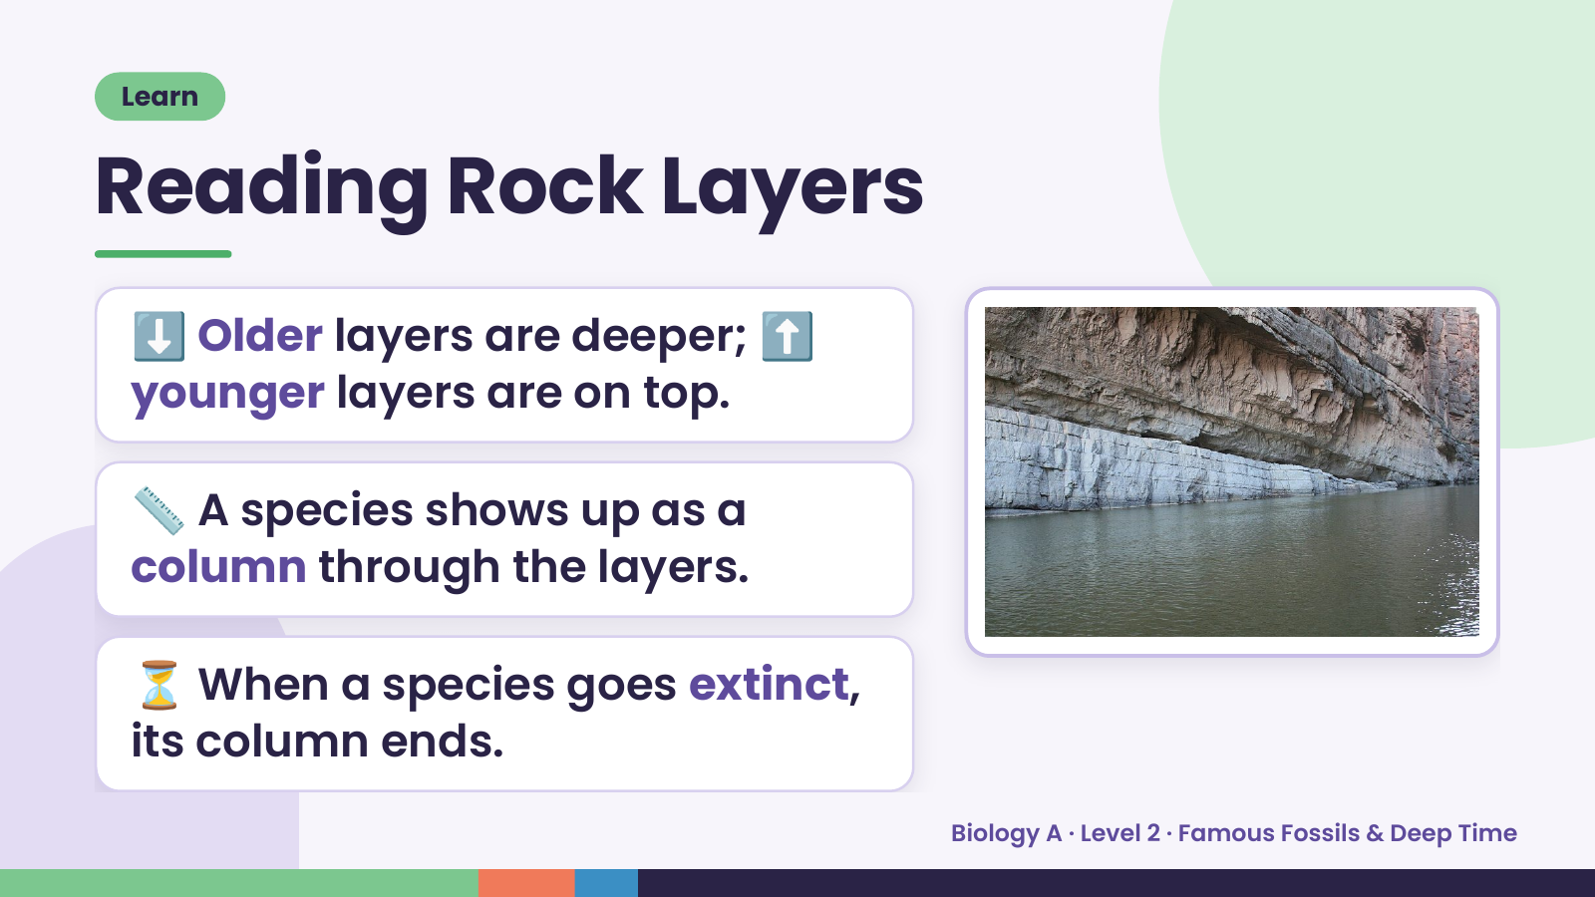
Notes:
Learn
Reading Rock Layers
⬇️ Older layers are deeper; ⬆️
younger layers are on top.
📏 A species shows up as a
column through the layers.
⏳ When a species goes extinct,
its column ends.
Biology A · Level 2 · Famous Fossils & Deep Time

Slide 9
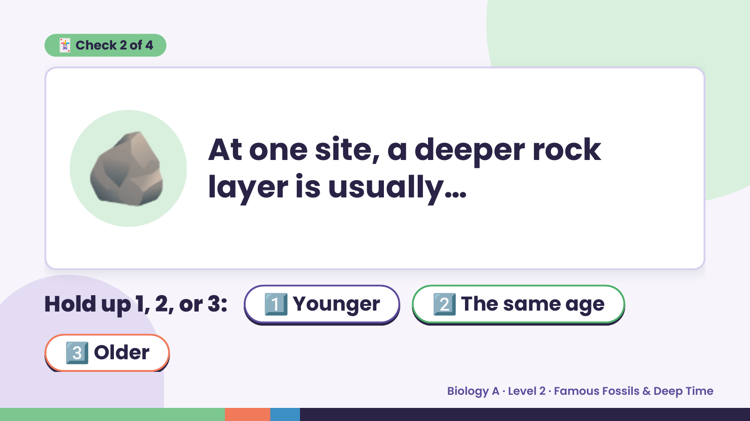
Notes:
🃏 Check 2 of 4
🪨 At one site, a deeper rock
layer is usually…
Hold up 1, 2, or 3: 1️⃣ Younger 2️⃣ The same age
3️⃣ Older
Biology A · Level 2 · Famous Fossils & Deep Time

Slide 10
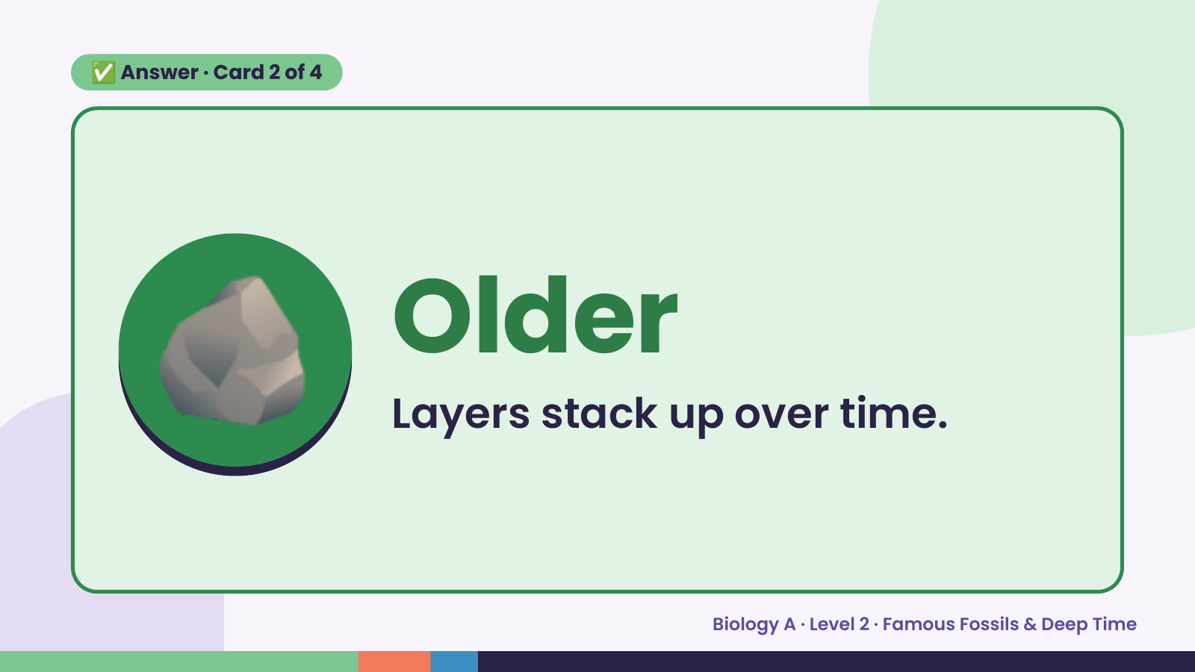
Notes:
✅ Answer · Card 2 of 4
🪨 Older
Layers stack up over time.
Biology A · Level 2 · Famous Fossils & Deep Time

Slide 11
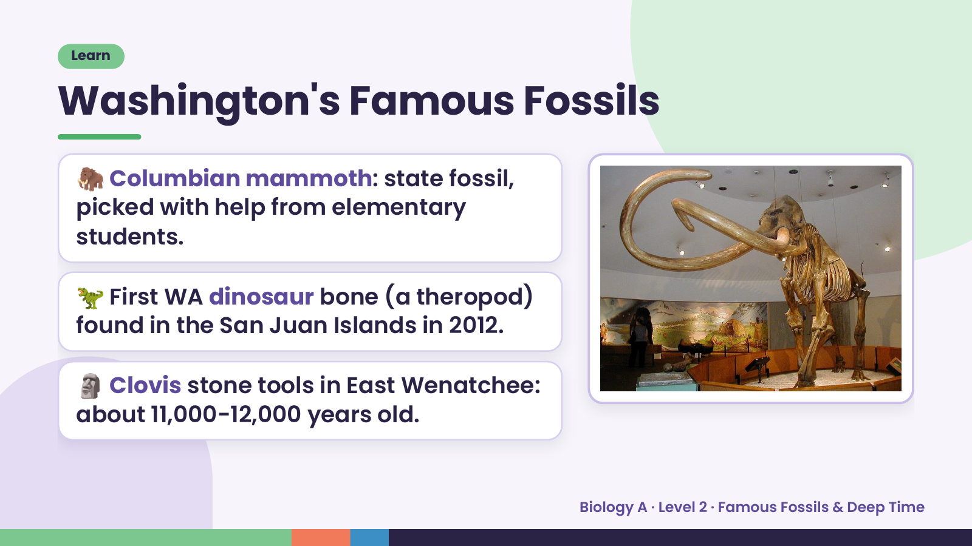
Notes:
Learn
Washington's Famous Fossils
🦣 Columbian mammoth: state fossil,
picked with help from elementary
students.
🦖 First WA dinosaur bone (a theropod)
found in the San Juan Islands in 2012.
🗿 Clovis stone tools in East Wenatchee:
about 11,000-12,000 years old.
Biology A · Level 2 · Famous Fossils & Deep Time

Slide 12
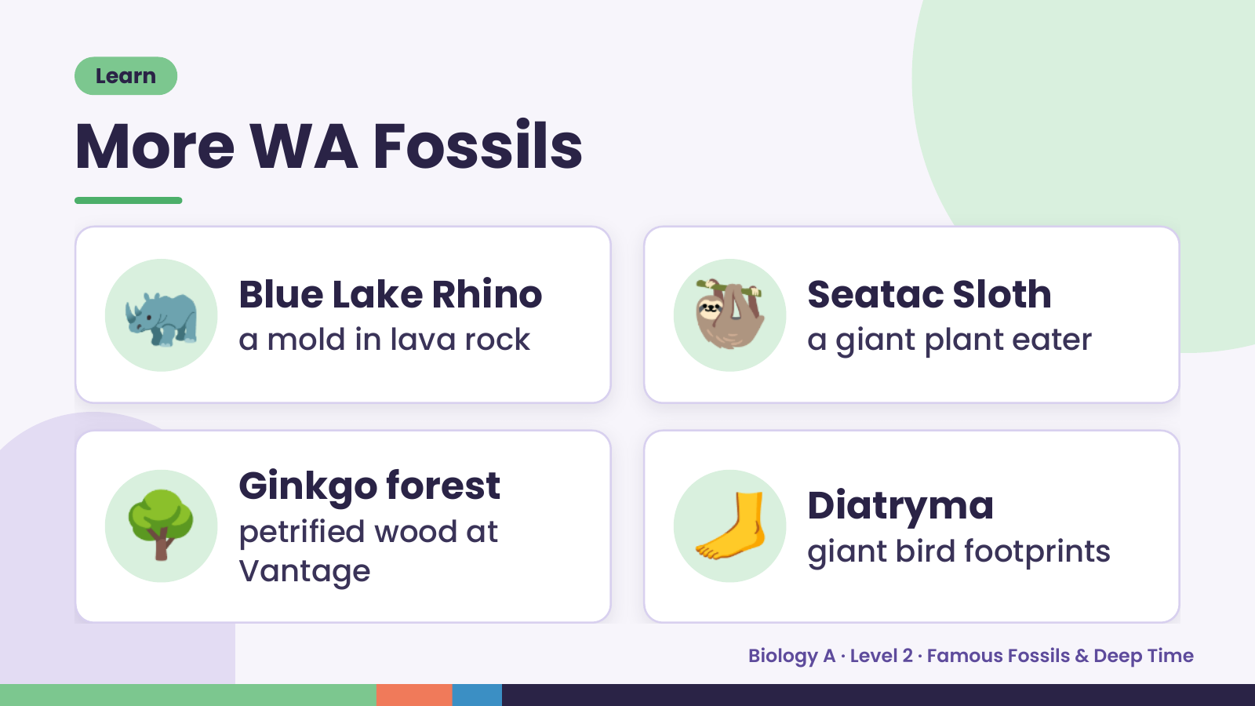
Notes:
Learn
More WA Fossils
🦏 Blue Lake Rhino
a mold in lava rock 🦥 Seatac Sloth
a giant plant eater
🌳 Ginkgo forest
petrified wood at
Vantage
🦶 Diatryma
giant bird footprints
Biology A · Level 2 · Famous Fossils & Deep Time

Slide 13
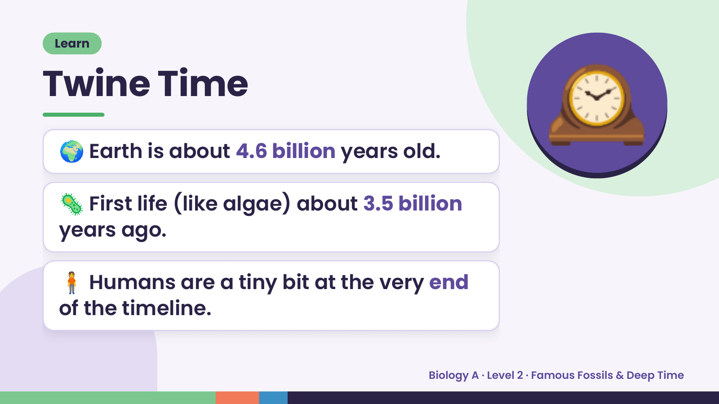
Notes:
Learn
Twine Time
🌍 Earth is about 4.6 billion years old.
🦠 First life (like algae) about 3.5 billion
🕰️
years ago.
🧍 Humans are a tiny bit at the very end
of the timeline.
Biology A · Level 2 · Famous Fossils & Deep Time

Slide 14
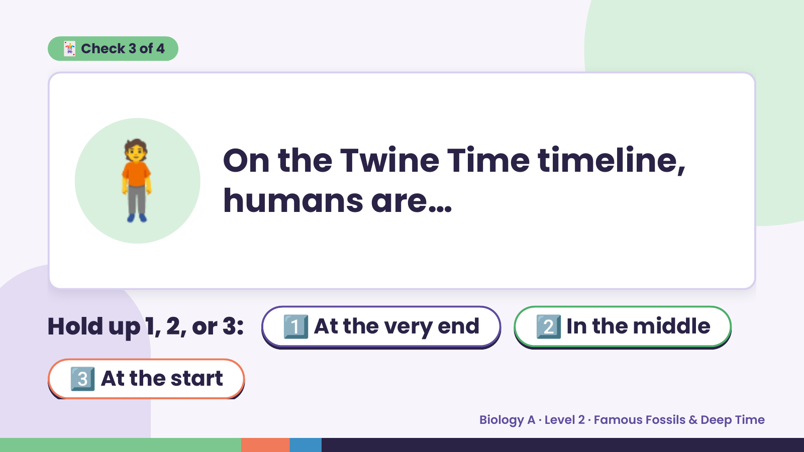
Notes:
🃏 Check 3 of 4
🧍 On the Twine Time timeline,
humans are…
Hold up 1, 2, or 3: 1️⃣ At the very end 2️⃣ In the middle
3️⃣ At the start
Biology A · Level 2 · Famous Fossils & Deep Time

Slide 15
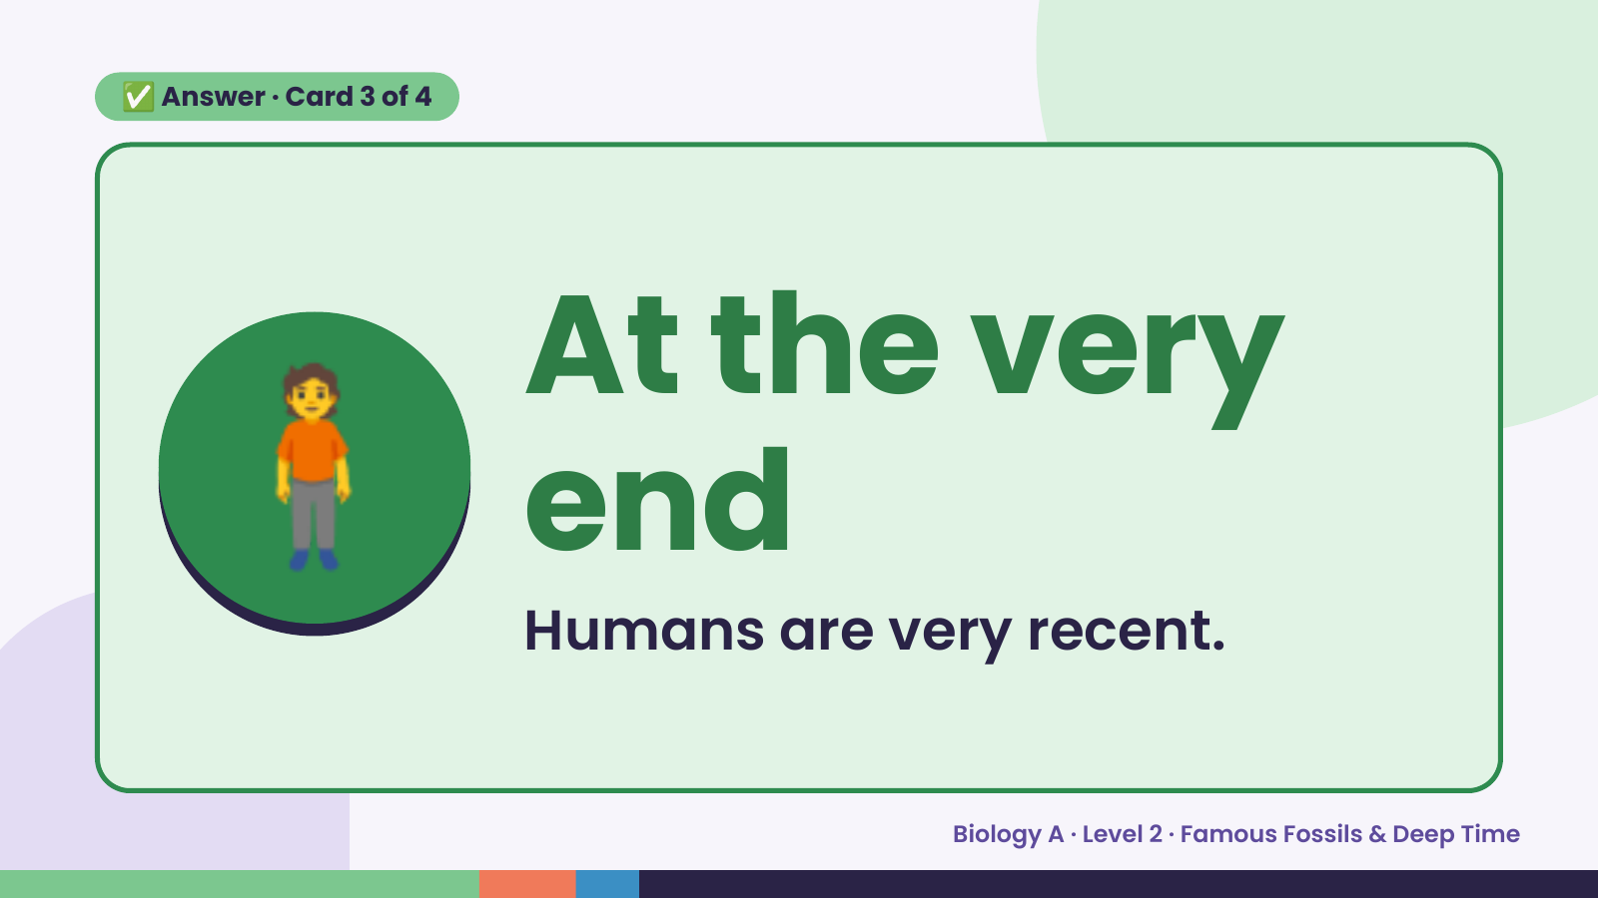
Notes:
✅ Answer · Card 3 of 4
🧍 At the very
end
Humans are very recent.
Biology A · Level 2 · Famous Fossils & Deep Time

Slide 16
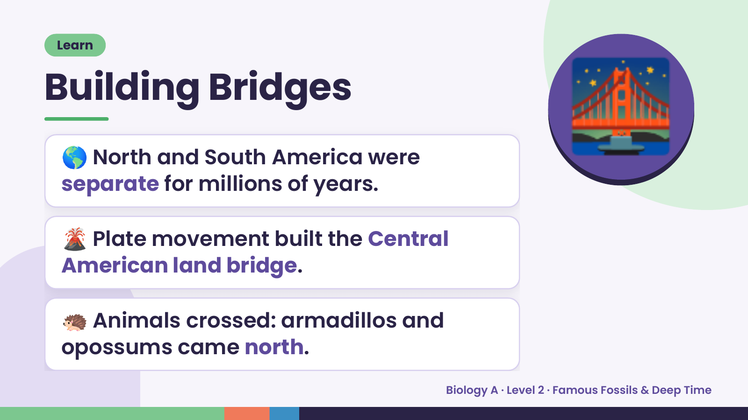
Notes:
Learn
Building Bridges
🌎 North and South America were
separate for millions of years.
🌉
🌋 Plate movement built the Central
American land bridge.
🦔 Animals crossed: armadillos and
opossums came north.
Biology A · Level 2 · Famous Fossils & Deep Time

Slide 17
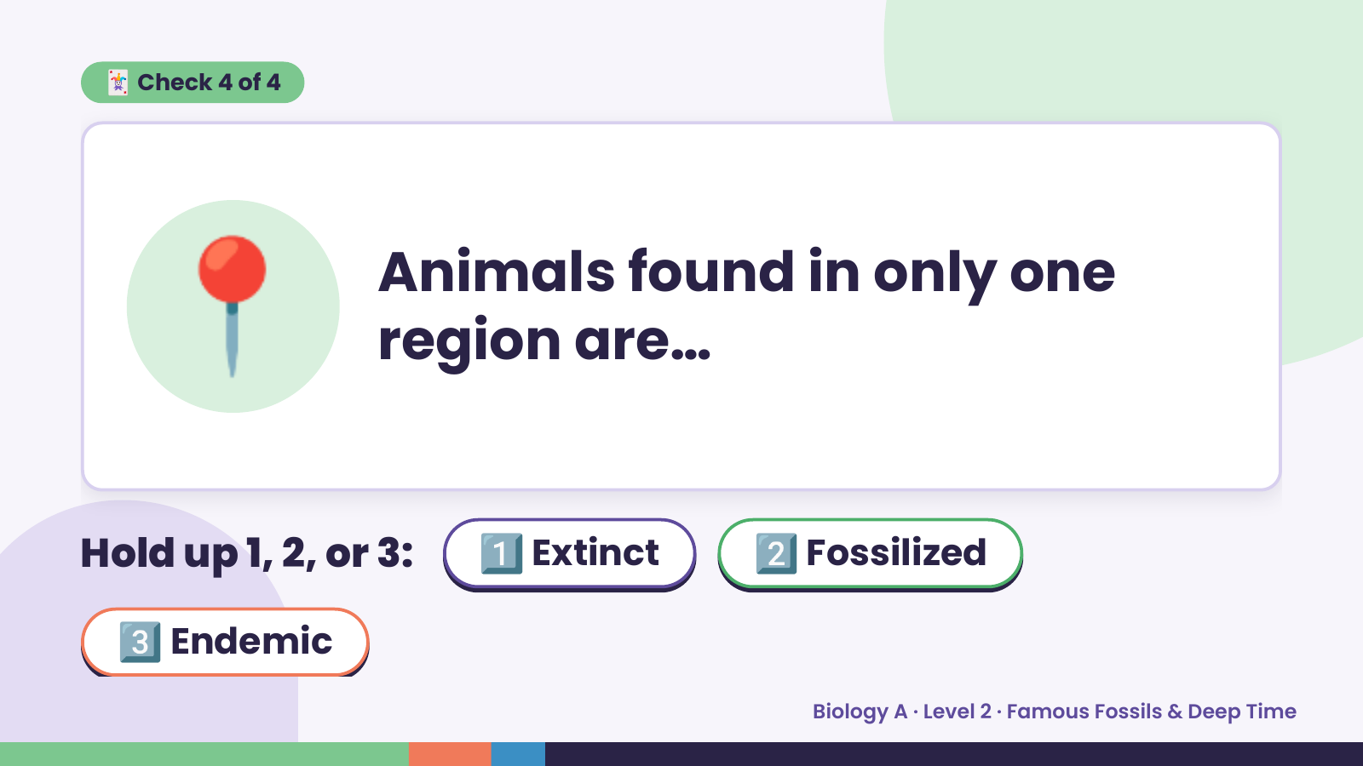
Notes:
🃏 Check 4 of 4
📍 Animals found in only one
region are…
Hold up 1, 2, or 3: 1️⃣ Extinct 2️⃣ Fossilized
3️⃣ Endemic
Biology A · Level 2 · Famous Fossils & Deep Time

Slide 18
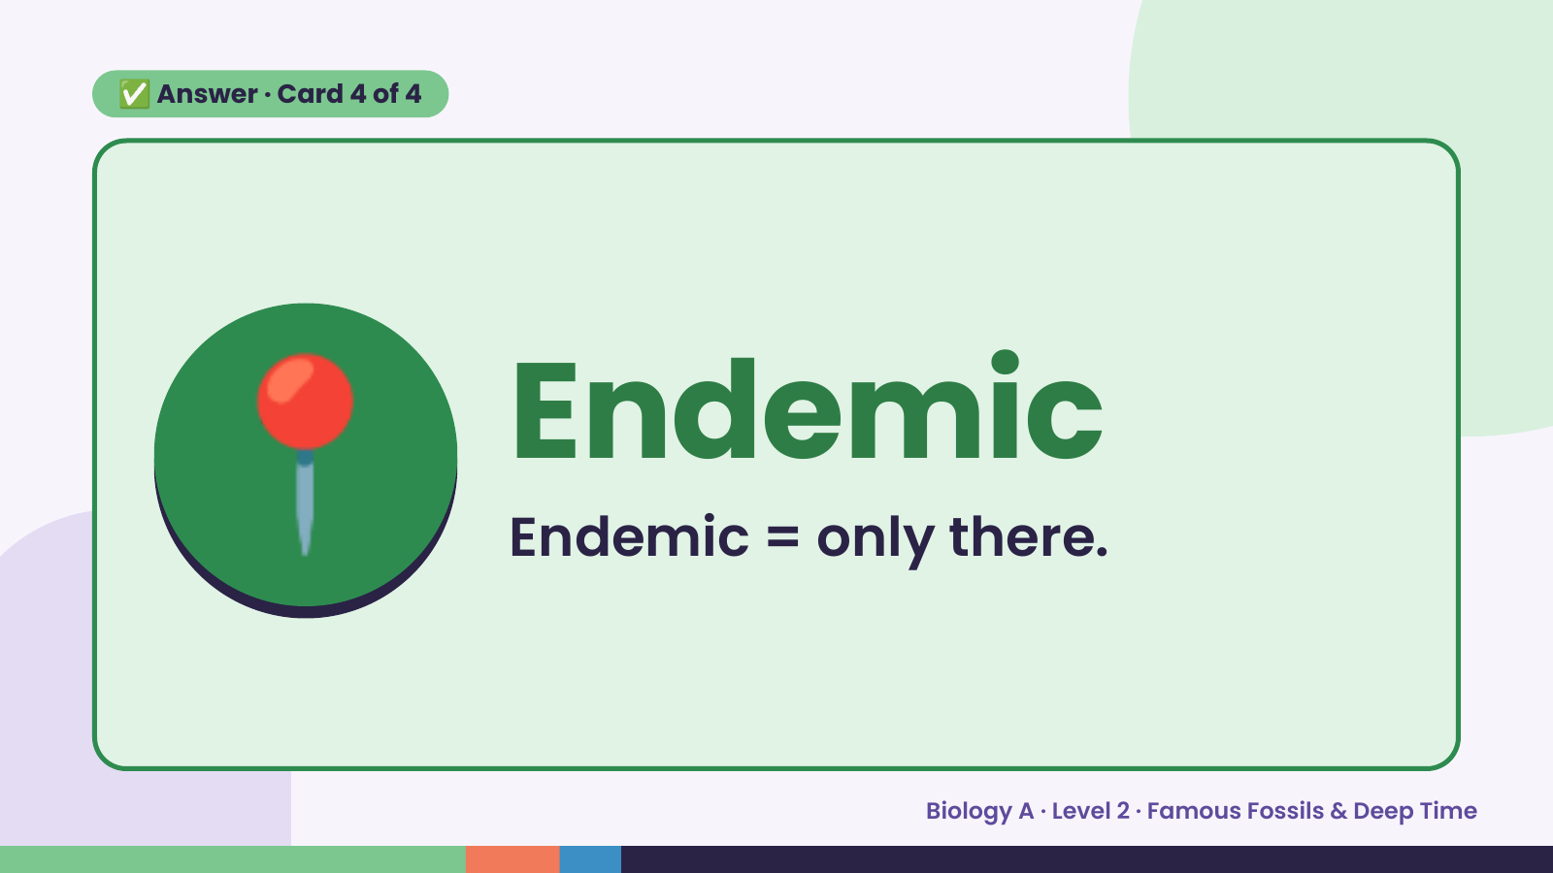
Notes:
✅ Answer · Card 4 of 4
📍 Endemic
Endemic = only there.
Biology A · Level 2 · Famous Fossils & Deep Time

Slide 19
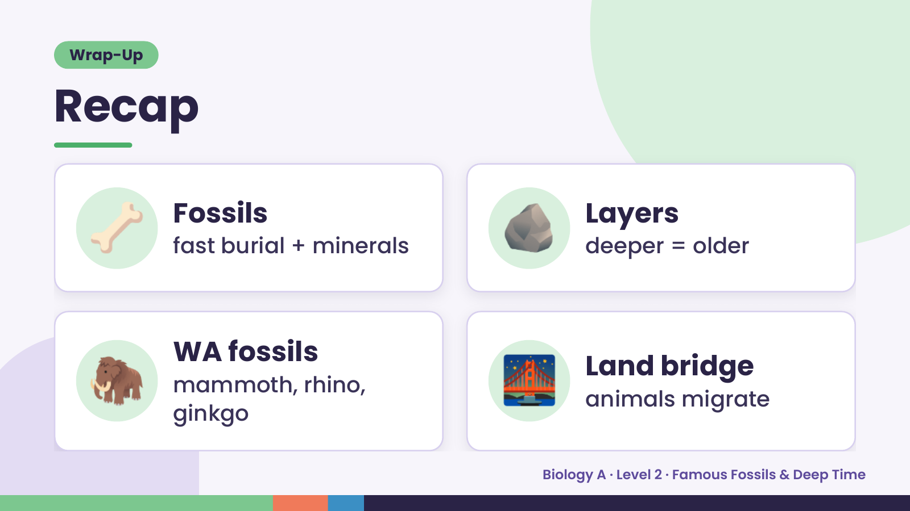
Notes:
Wrap-Up
Recap
🦴 Fossils
fast burial + minerals 🪨 Layers
deeper = older
🦣 WA fossils
mammoth, rhino,
ginkgo
🌉 Land bridge
animals migrate
Biology A · Level 2 · Famous Fossils & Deep Time

Slide 20
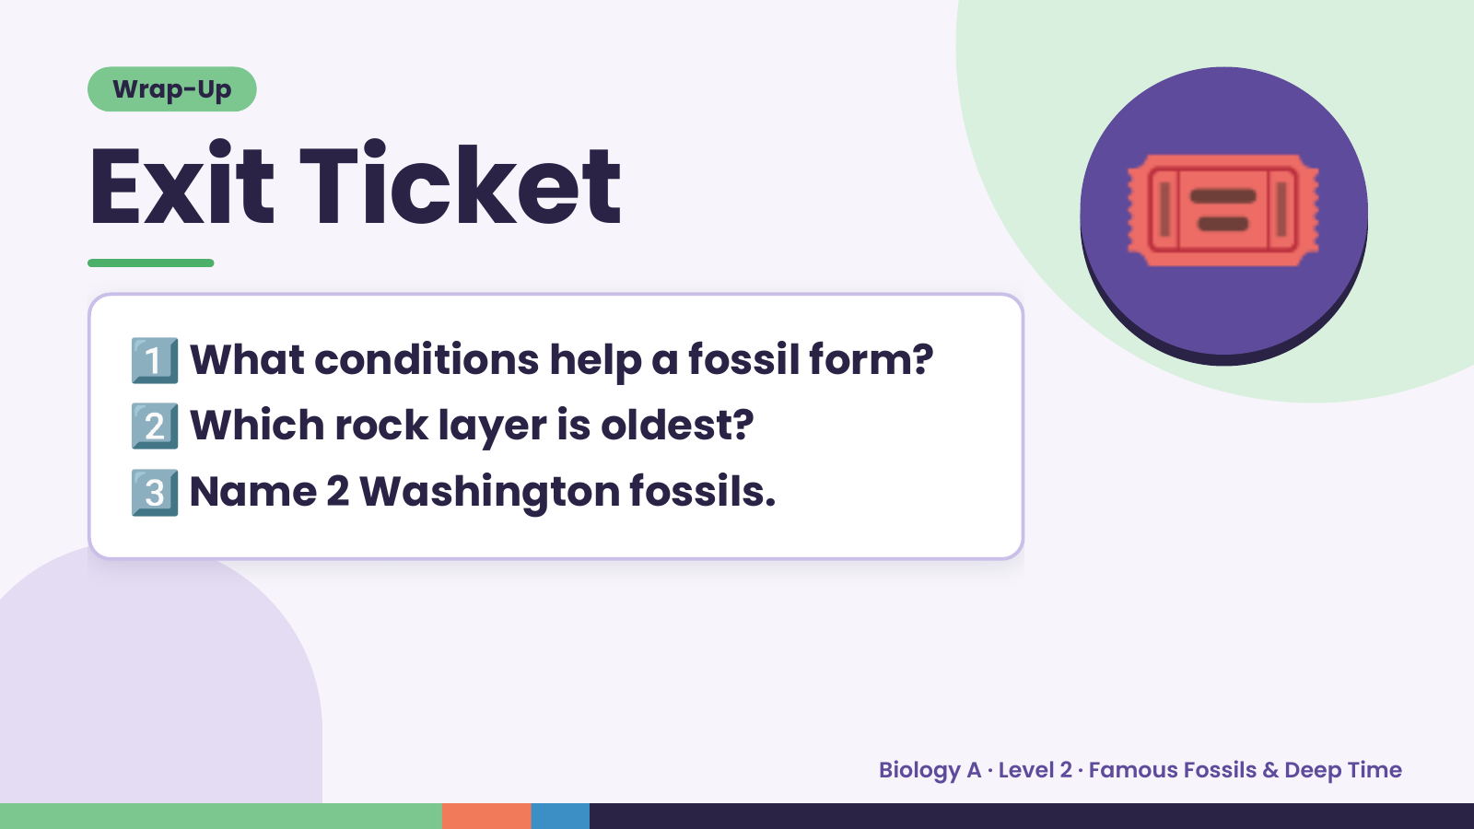
Notes:
Wrap-Up
Exit Ticket
1️⃣
2️⃣
What conditions help a fossil form?
Which rock layer is oldest?
🎟️
3️⃣Name 2 Washington fossils.
Biology A · Level 2 · Famous Fossils & Deep Time

