Slide 1
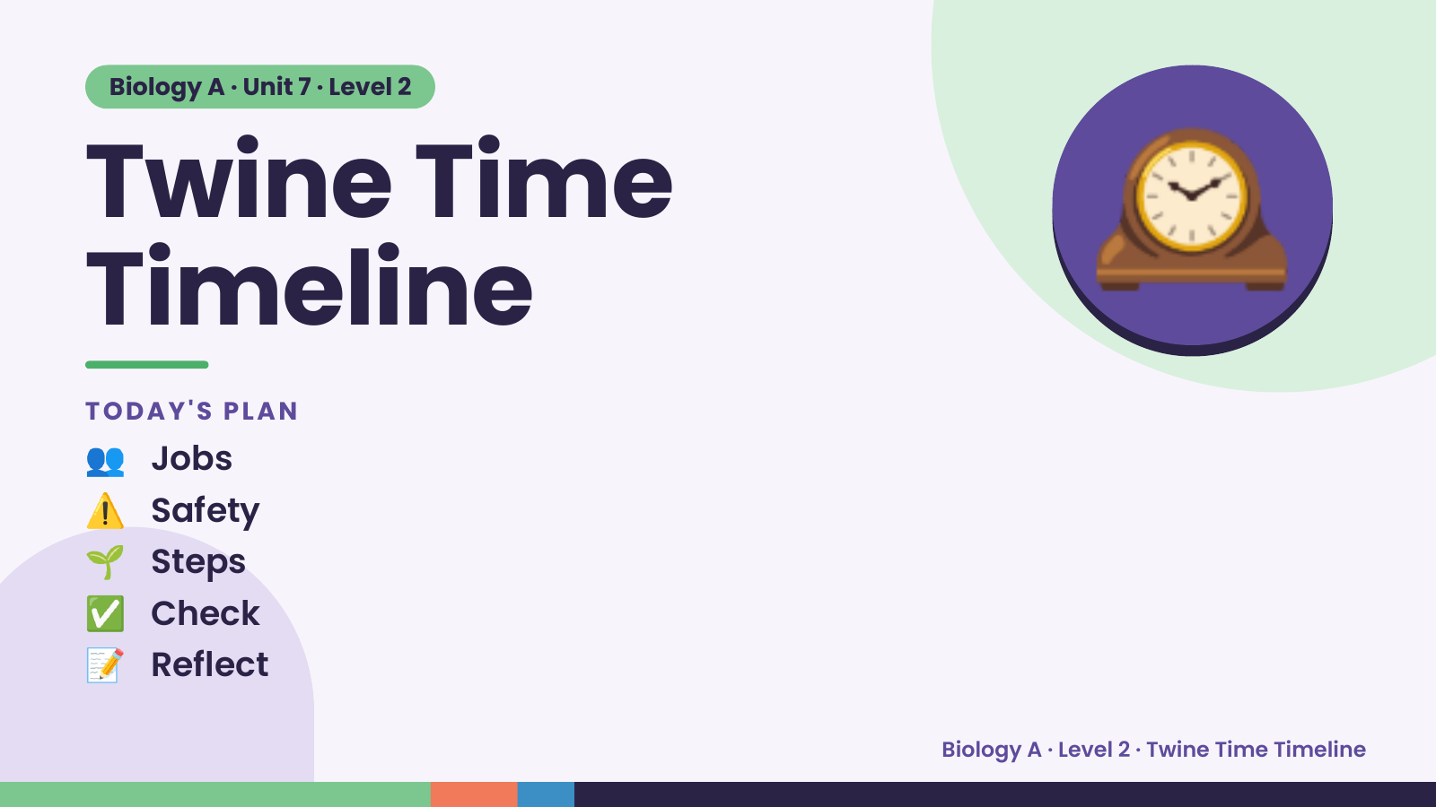
Notes:
Biology A · Unit 7 · Level 2
Twine Time
Timeline
👥 Jobs
TODAY'S PLAN
🕰️
⚠️ Safety
🌱 Steps
✅ Check
📝 Reflect
Biology A · Level 2 · Twine Time Timeline

Slide 2
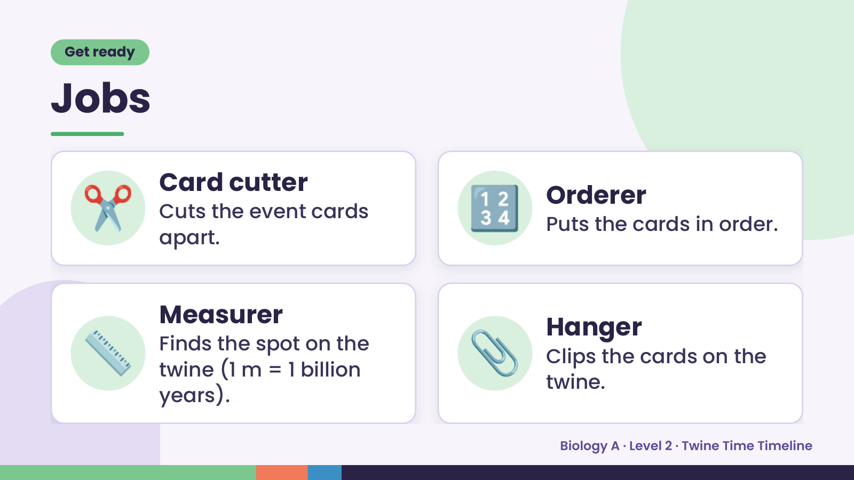
Notes:
Get ready
Jobs
✂️ Card cutter
Cuts the event cards
apart.
🔢 Orderer
Puts the cards in order.
📏 Measurer
Finds the spot on the
twine (1 m = 1 billion
years).
📎 Hanger
Clips the cards on the
twine.
Biology A · Level 2 · Twine Time Timeline

Slide 3
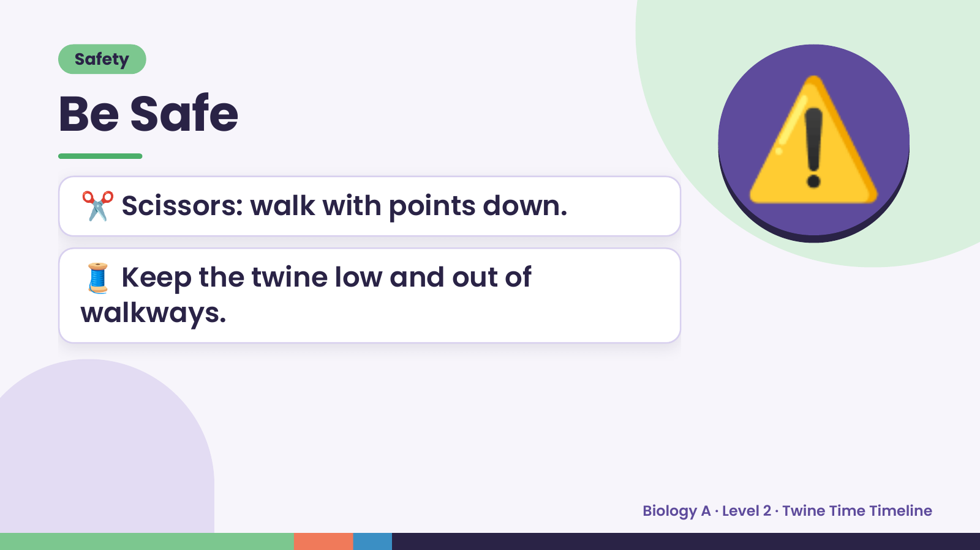
Notes:
Safety
Be Safe
✂️ Scissors: walk with points down.
🧵 Keep the twine low and out of
⚠️
walkways.
Biology A · Level 2 · Twine Time Timeline

Slide 4
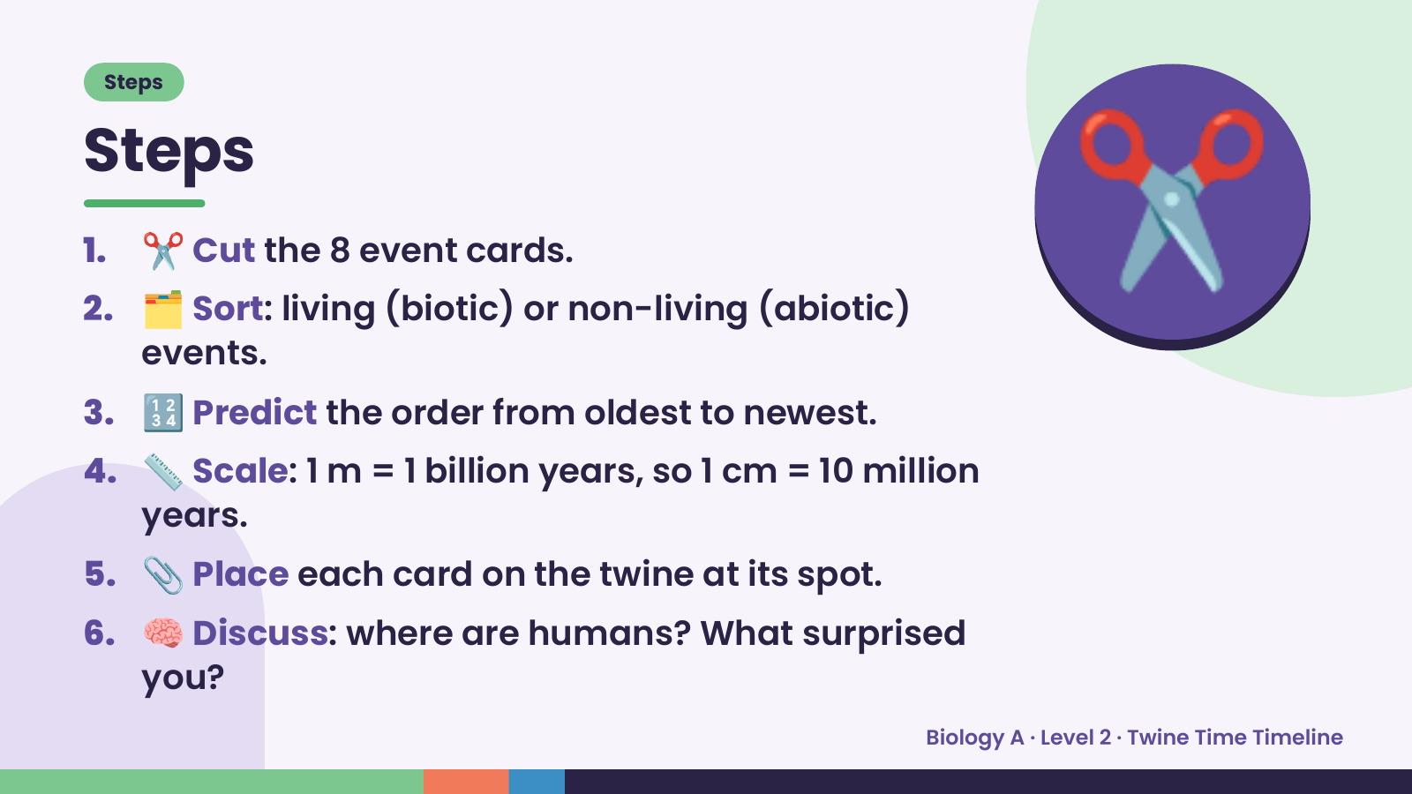
Notes:
Steps
Steps
1. ✂️ Cut the 8 event cards.
2. 🗂️ Sort: living (biotic) or non-living (abiotic)
events.
3. 🔢 Predict the order from oldest to newest.
✂️
4. 📏 Scale: 1 m = 1 billion years, so 1 cm = 10 million
years.
5. 📎 Place each card on the twine at its spot.
6. 🧠 Discuss: where are humans? What surprised
you?
Biology A · Level 2 · Twine Time Timeline

Slide 5
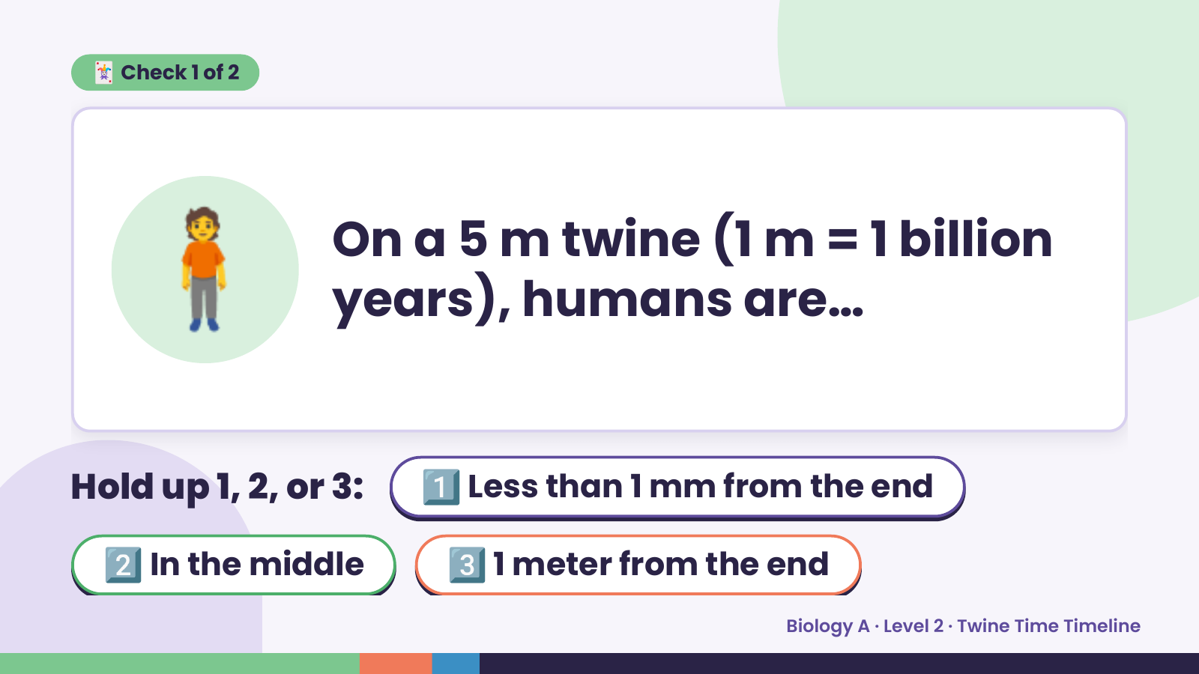
Notes:
🃏 Check 1 of 2
🧍 On a 5 m twine (1 m = 1 billion
years), humans are…
Hold up 1, 2, or 3: 1️⃣ Less than 1 mm from the end
2️⃣ In the middle 3️⃣ 1 meter from the end
Biology A · Level 2 · Twine Time Timeline

Slide 6
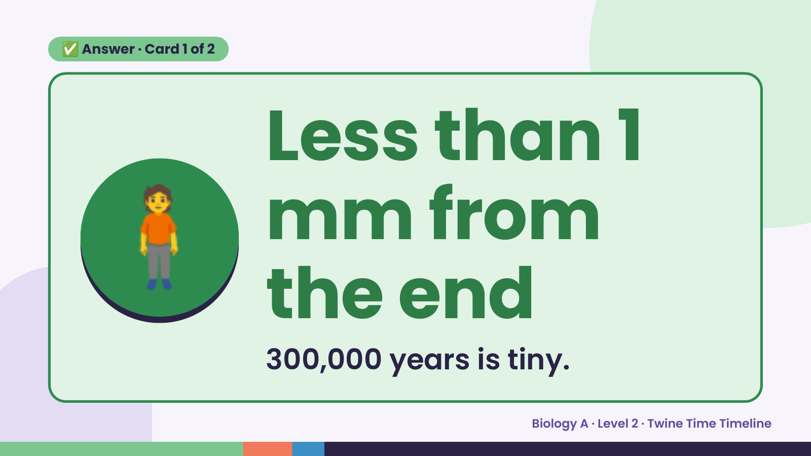
Notes:
✅ Answer · Card 1 of 2
🧍 Less than 1
mm from
the end
300,000 years is tiny.
Biology A · Level 2 · Twine Time Timeline

Slide 7
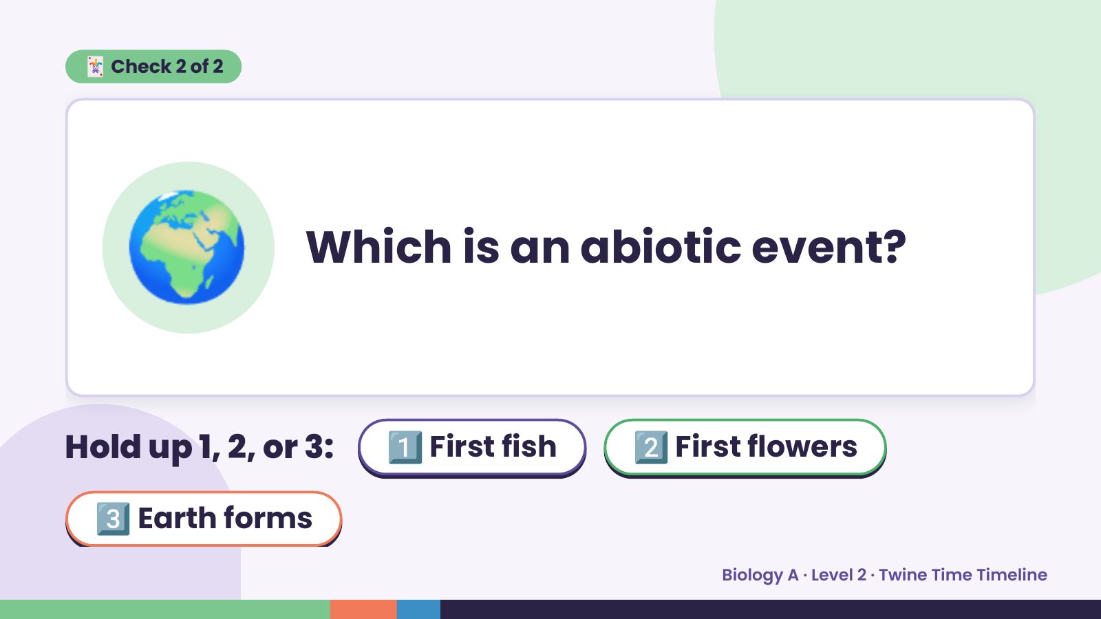
Notes:
🃏 Check 2 of 2
🌍 Which is an abiotic event?
Hold up 1, 2, or 3: 1️⃣ First fish 2️⃣ First flowers
3️⃣ Earth forms
Biology A · Level 2 · Twine Time Timeline

Slide 8
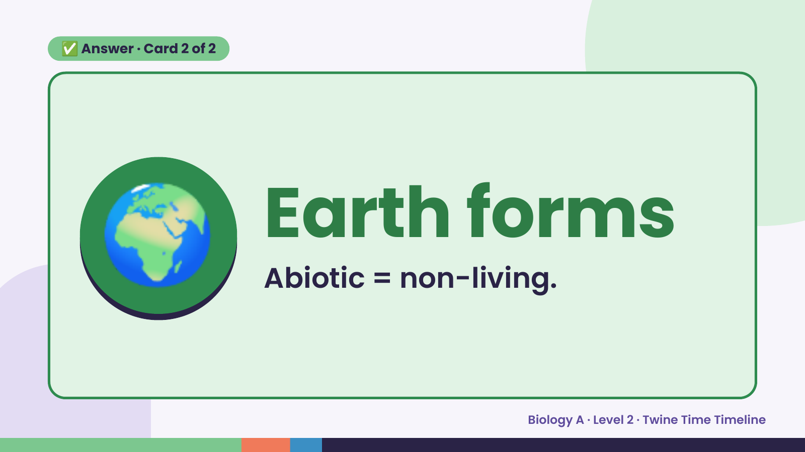
Notes:
✅ Answer · Card 2 of 2
🌍 Earth forms
Abiotic = non-living.
Biology A · Level 2 · Twine Time Timeline

Slide 9
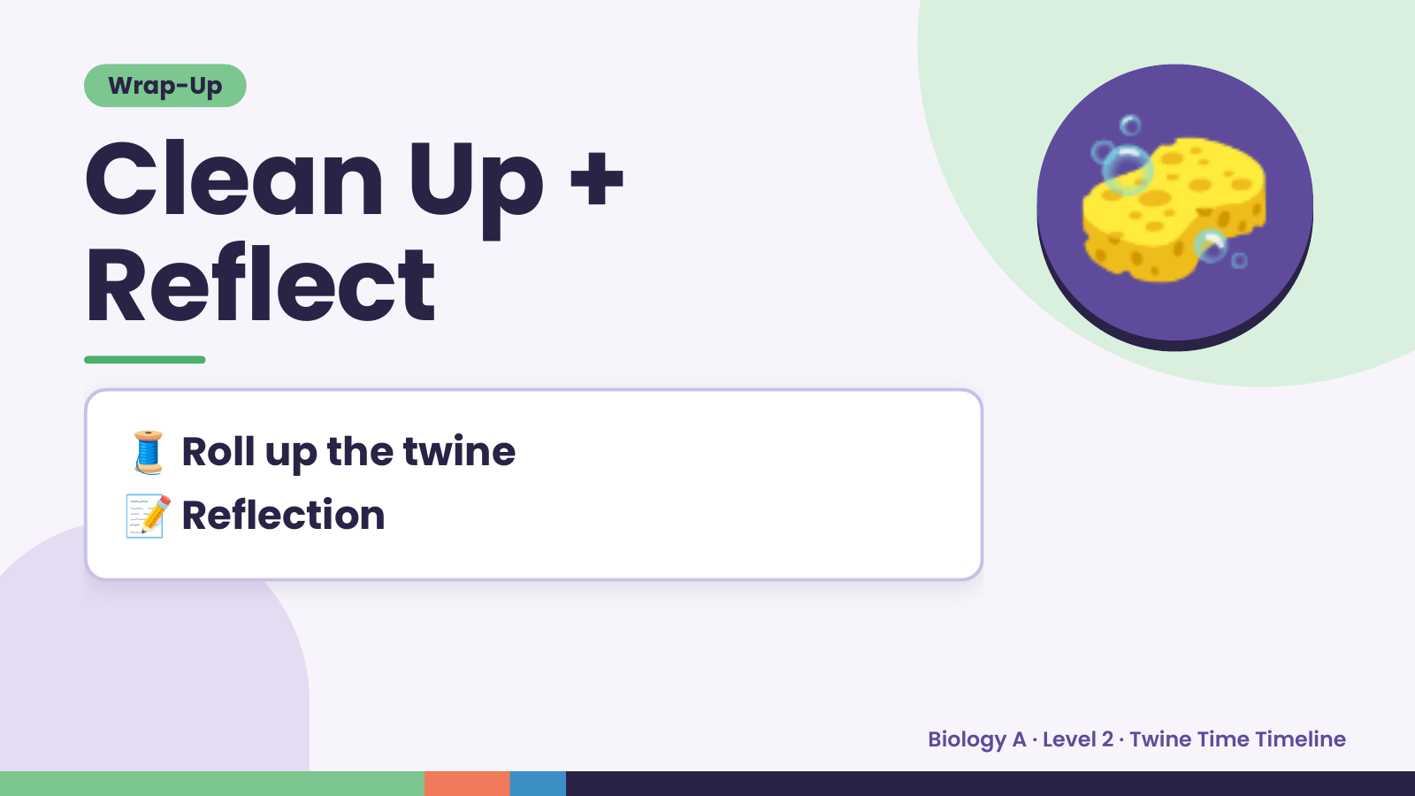
Notes:
Wrap-Up
Clean Up +
Reflect
🧽
🧵 Roll up the twine
📝 Reflection
Biology A · Level 2 · Twine Time Timeline

