Slide 1
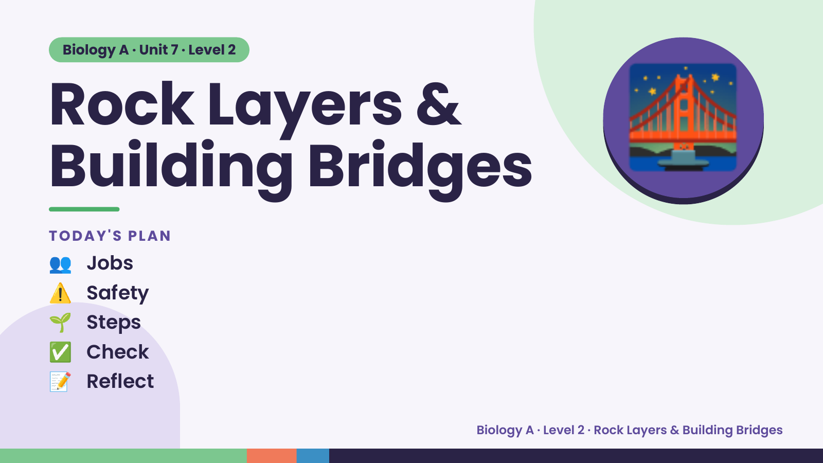
Notes:
Biology A · Unit 7 · Level 2
Rock Layers &
Building Bridges
👥 Jobs
TODAY'S PLAN
🌉
⚠️ Safety
🌱 Steps
✅ Check
📝 Reflect
Biology A · Level 2 · Rock Layers & Building Bridges

Slide 2
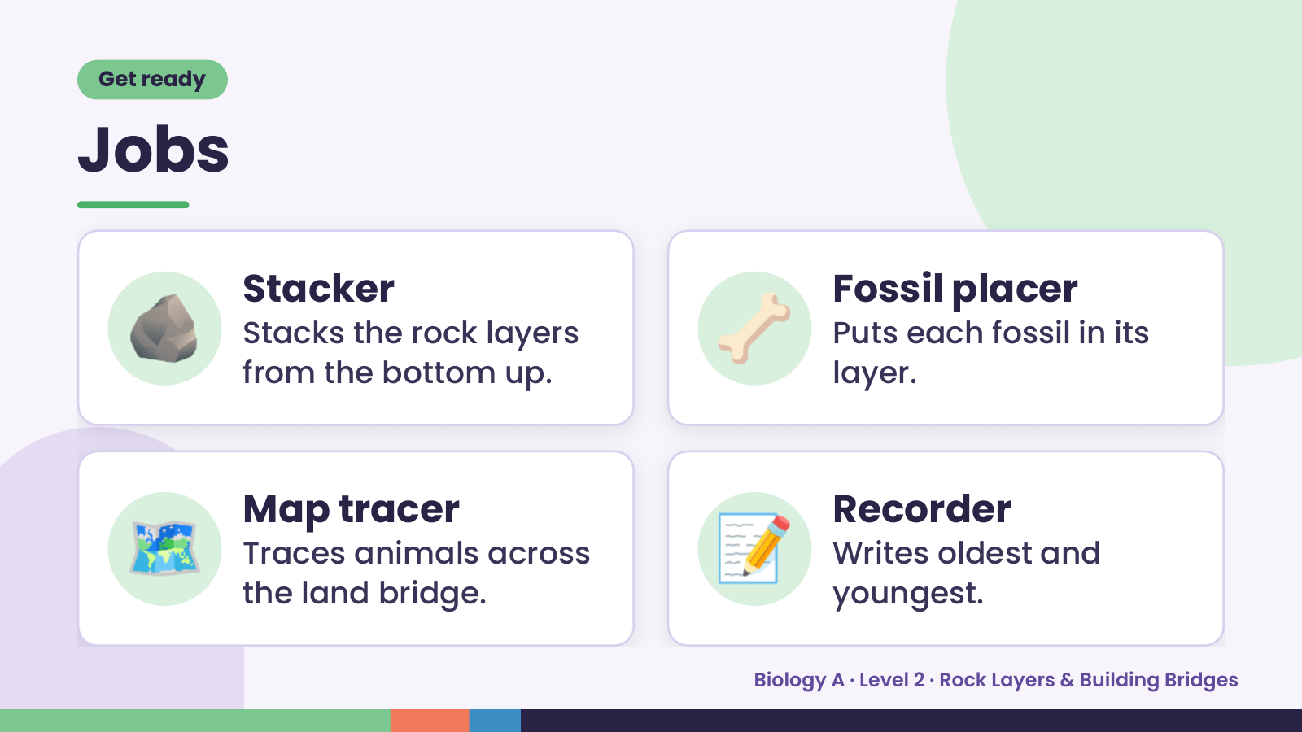
Notes:
Get ready
Jobs
🪨 Stacker
Stacks the rock layers
from the bottom up.
🦴 Fossil placer
Puts each fossil in its
layer.
🗺️ Map tracer
Traces animals across
the land bridge.
📝 Recorder
Writes oldest and
youngest.
Biology A · Level 2 · Rock Layers & Building Bridges

Slide 3
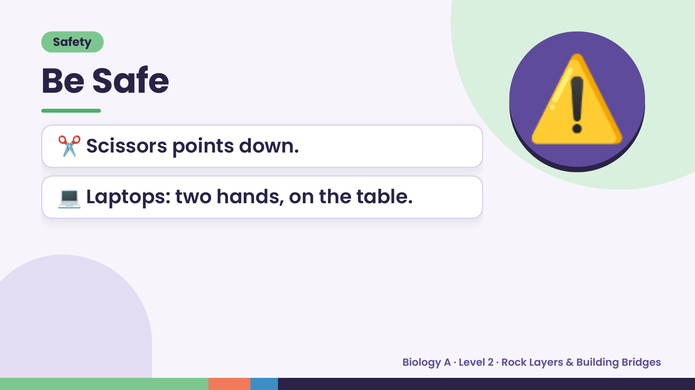
Notes:
Safety
Be Safe
✂️ Scissors points down.
💻 Laptops: two hands, on the table.
⚠️
Biology A · Level 2 · Rock Layers & Building Bridges

Slide 4
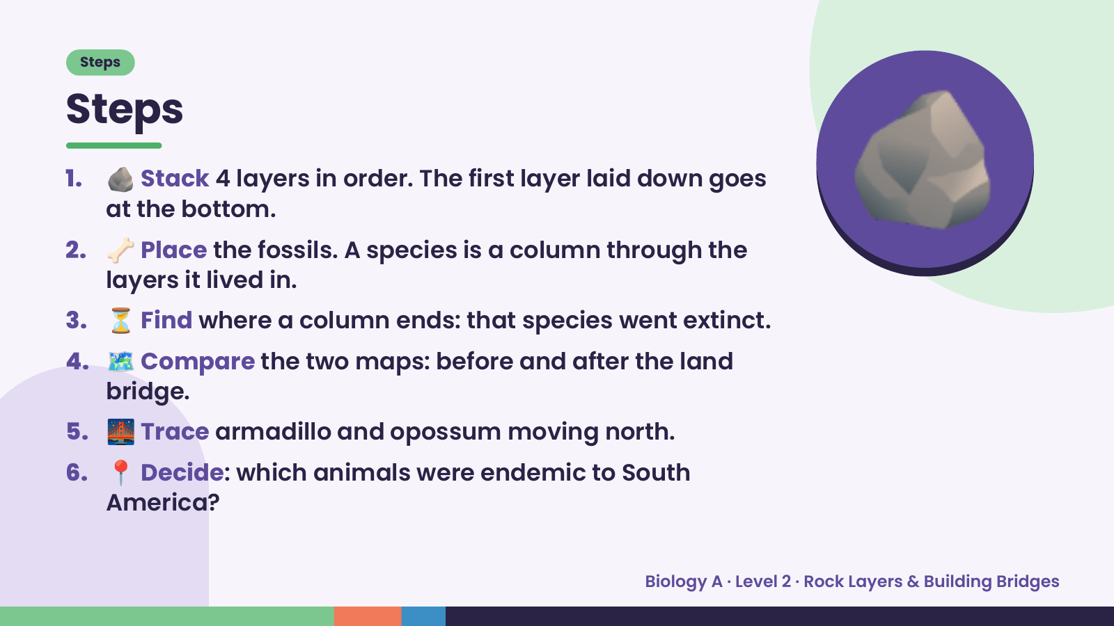
Notes:
Steps
Steps
1. 🪨 Stack 4 layers in order. The first layer laid down goes
at the bottom.
2. 🦴 Place the fossils. A species is a column through the
layers it lived in.
3. ⏳ Find where a column ends: that species went extinct.
🪨
4. 🗺️ Compare the two maps: before and after the land
bridge.
5. 🌉 Trace armadillo and opossum moving north.
6. 📍 Decide: which animals were endemic to South
America?
Biology A · Level 2 · Rock Layers & Building Bridges

Slide 5
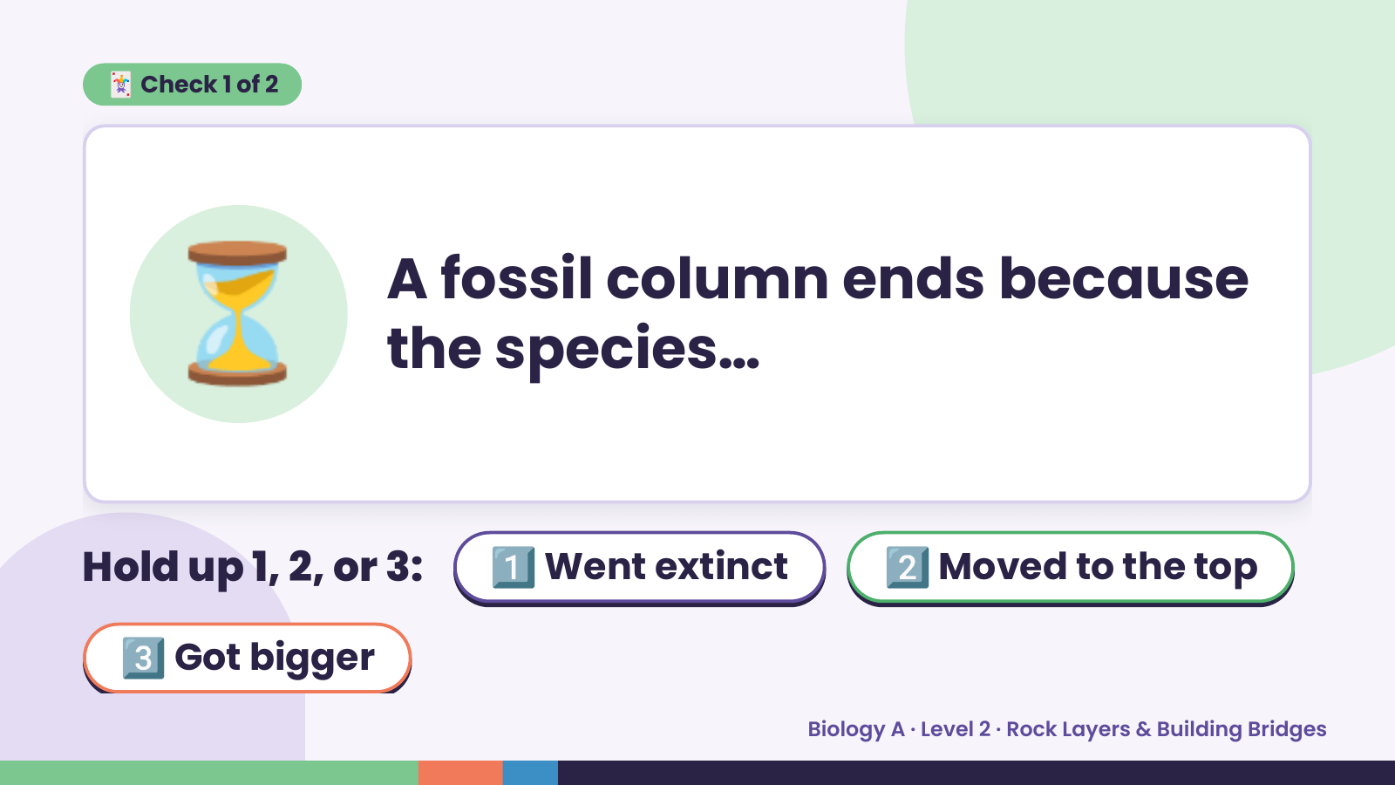
Notes:
🃏 Check 1 of 2
⏳ A fossil column ends because
the species…
Hold up 1, 2, or 3: 1️⃣ Went extinct 2️⃣ Moved to the top
3️⃣ Got bigger
Biology A · Level 2 · Rock Layers & Building Bridges

Slide 6
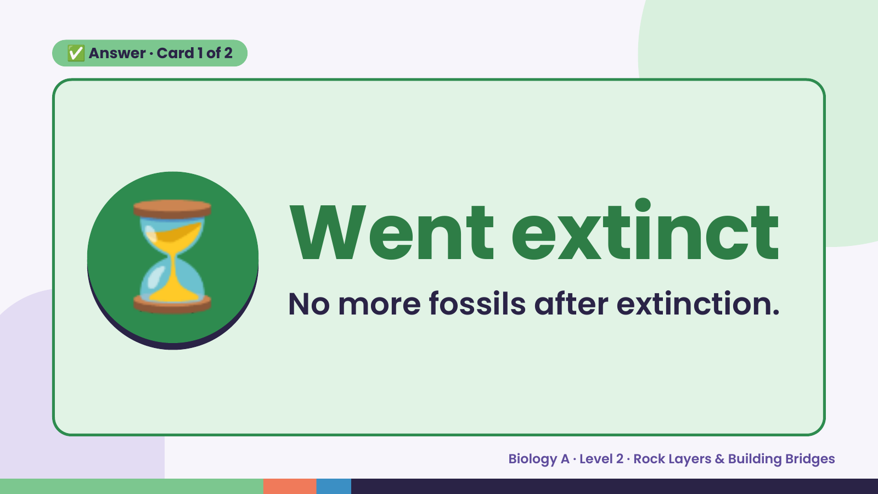
Notes:
✅ Answer · Card 1 of 2
⏳ Went extinct
No more fossils after extinction.
Biology A · Level 2 · Rock Layers & Building Bridges

Slide 7
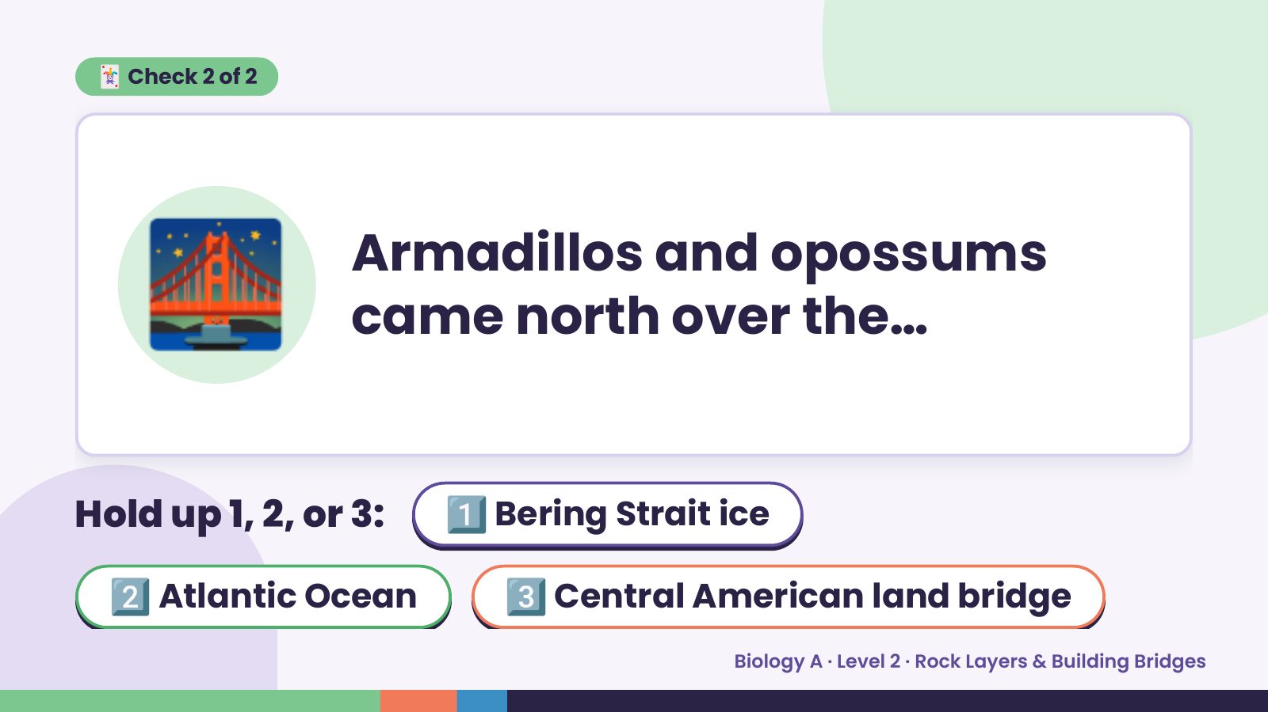
Notes:
🃏 Check 2 of 2
🌉 Armadillos and opossums
came north over the…
Hold up 1, 2, or 3: 1️⃣ Bering Strait ice
2️⃣ Atlantic Ocean 3️⃣ Central American land bridge
Biology A · Level 2 · Rock Layers & Building Bridges

Slide 8
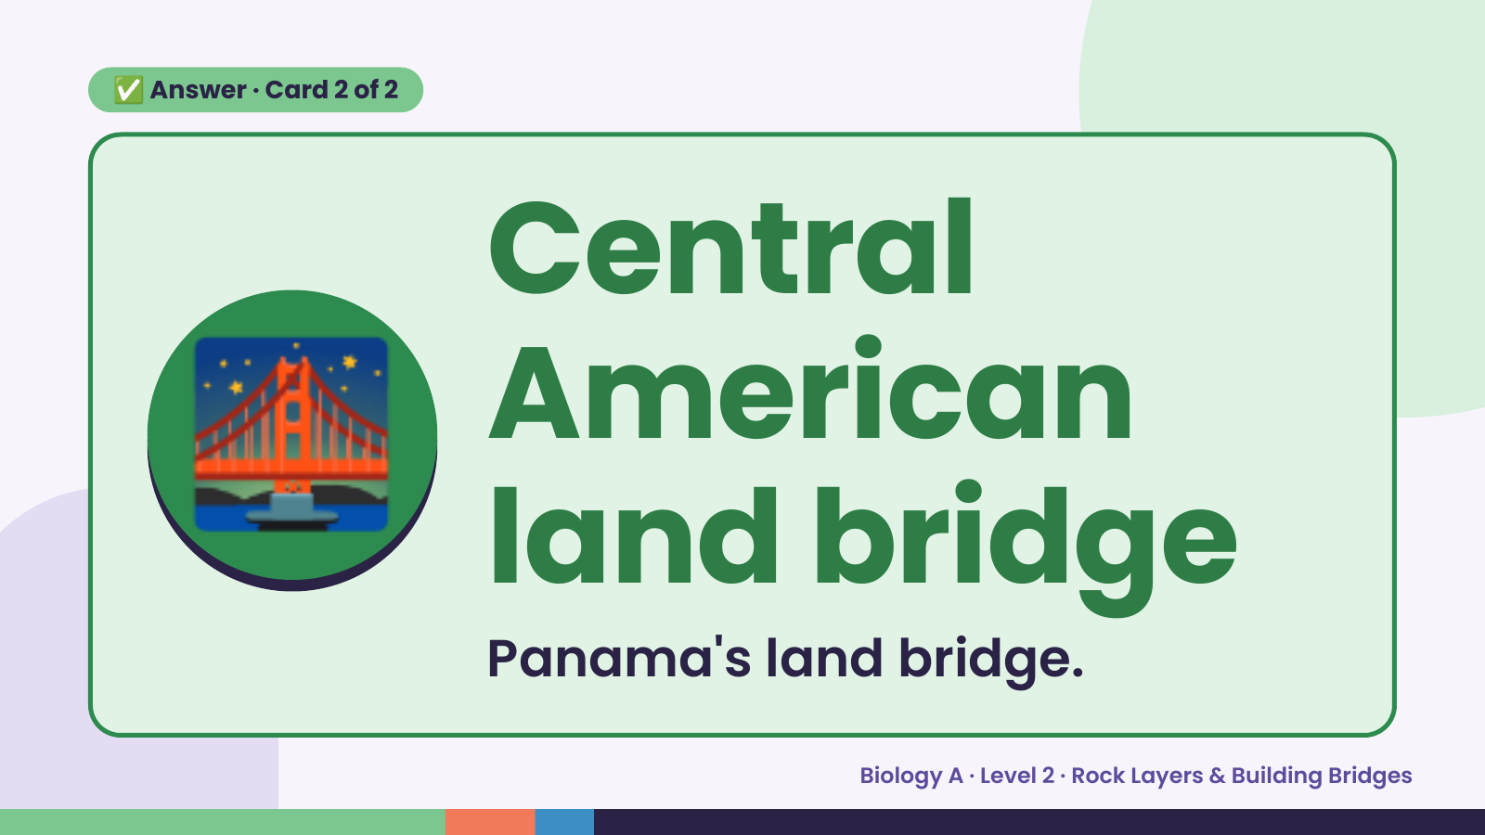
Notes:
✅ Answer · Card 2 of 2
🌉 Central
American
land bridge
Panama's land bridge.
Biology A · Level 2 · Rock Layers & Building Bridges

Slide 9
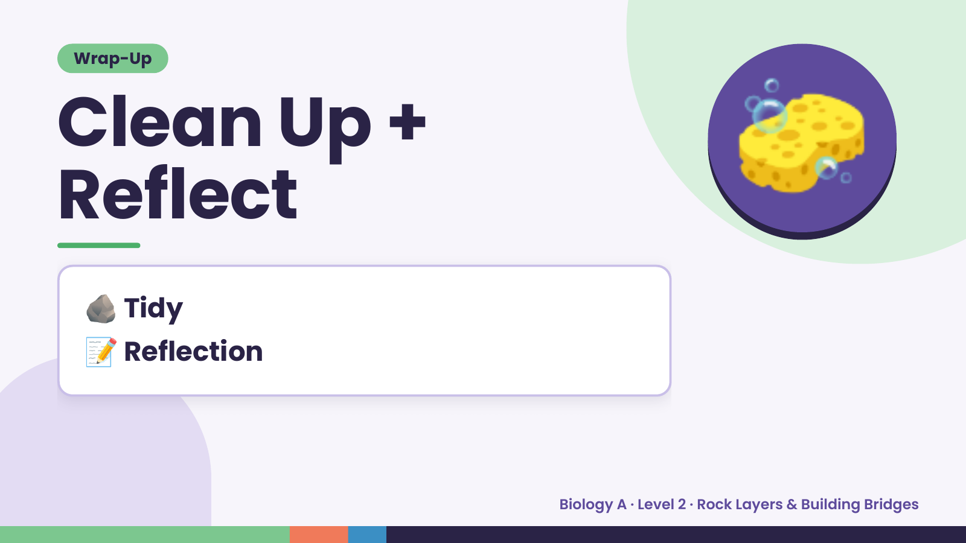
Notes:
Wrap-Up
Clean Up +
Reflect
🧽
🪨 Tidy
📝 Reflection
Biology A · Level 2 · Rock Layers & Building Bridges

