Slide 1
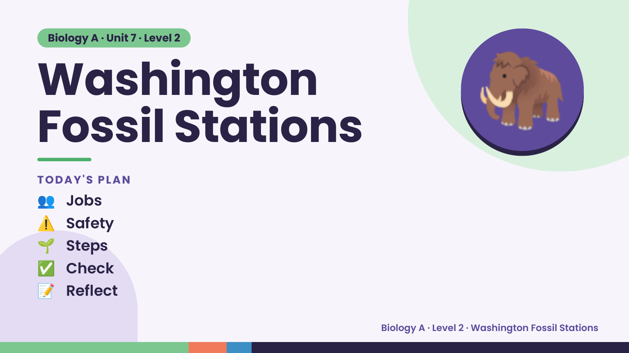
Notes:
Biology A · Unit 7 · Level 2
Washington
Fossil Stations
👥 Jobs
TODAY'S PLAN
🦣
⚠️ Safety
🌱 Steps
✅ Check
📝 Reflect
Biology A · Level 2 · Washington Fossil Stations

Slide 2
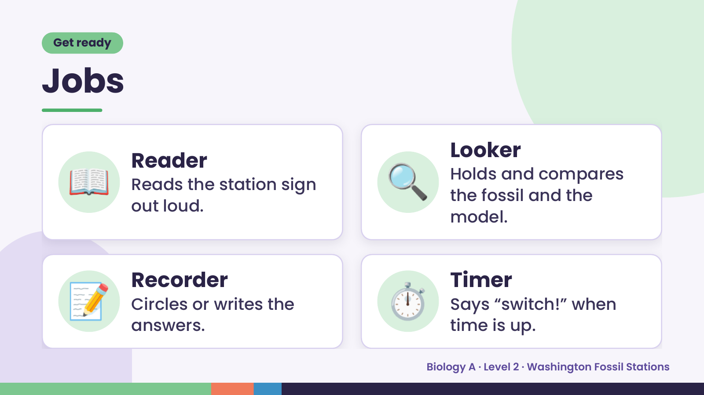
Notes:
Get ready
Jobs
📖 Reader
Reads the station sign
out loud.
🔍 Looker
Holds and compares
the fossil and the
model.
📝 Recorder
Circles or writes the
answers.
⏱️ Timer
Says “switch!” when
time is up.
Biology A · Level 2 · Washington Fossil Stations

Slide 3
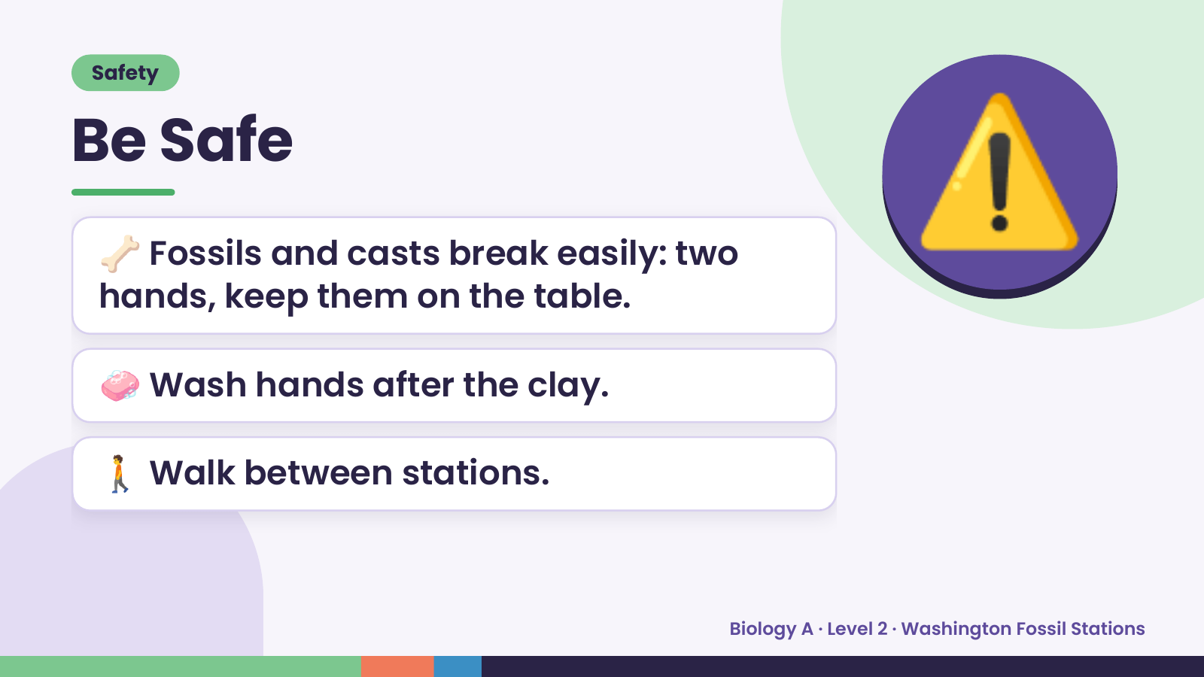
Notes:
Safety
Be Safe
🦴 Fossils and casts break easily: two
hands, keep them on the table.
⚠️
🧼 Wash hands after the clay.
🚶 Walk between stations.
Biology A · Level 2 · Washington Fossil Stations

Slide 4
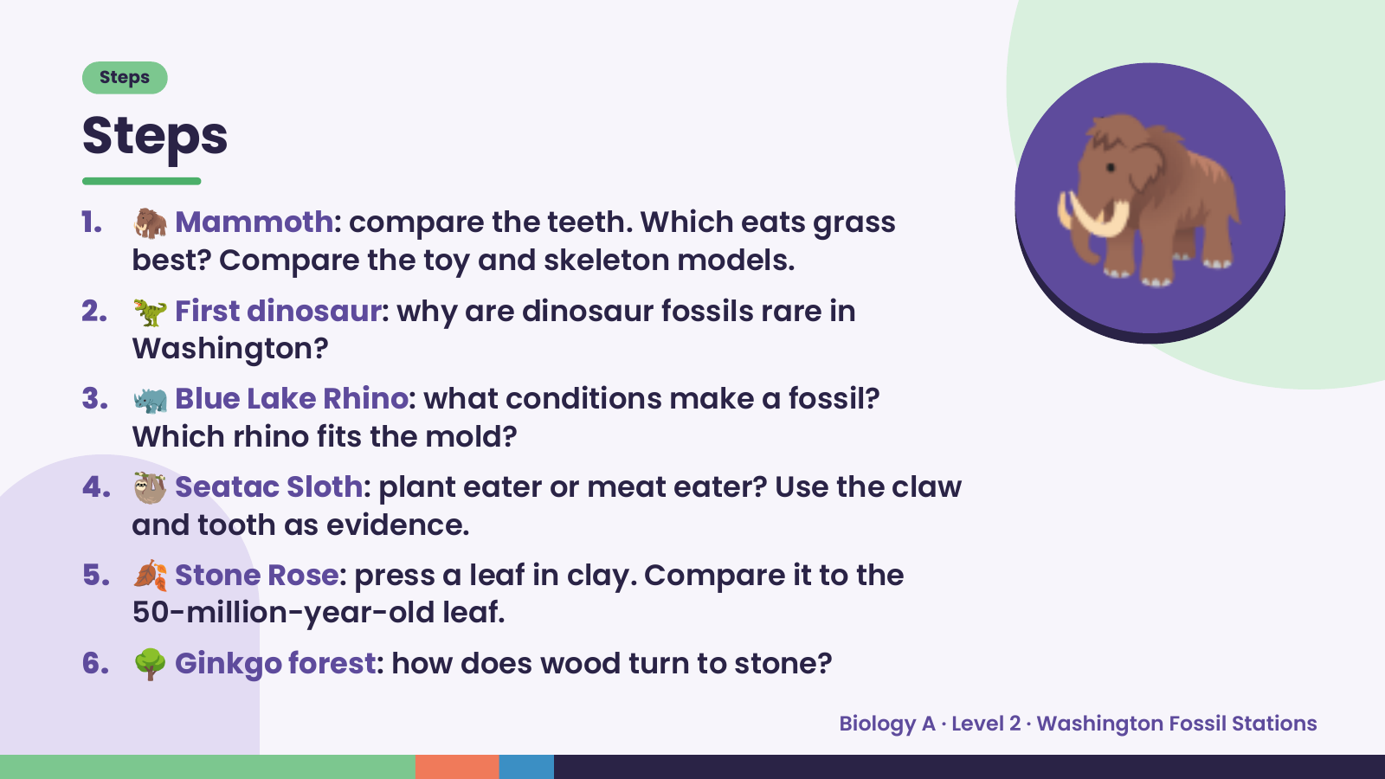
Notes:
Steps
Steps
1. 🦣 Mammoth: compare the teeth. Which eats grass
best? Compare the toy and skeleton models.
2. 🦖 First dinosaur: why are dinosaur fossils rare in
Washington?
3. 🦏 Blue Lake Rhino: what conditions make a fossil?
Which rhino fits the mold?
🦣
4. 🦥 Seatac Sloth: plant eater or meat eater? Use the claw
and tooth as evidence.
5. 🍂 Stone Rose: press a leaf in clay. Compare it to the
50-million-year-old leaf.
6. 🌳 Ginkgo forest: how does wood turn to stone?
Biology A · Level 2 · Washington Fossil Stations

Slide 5
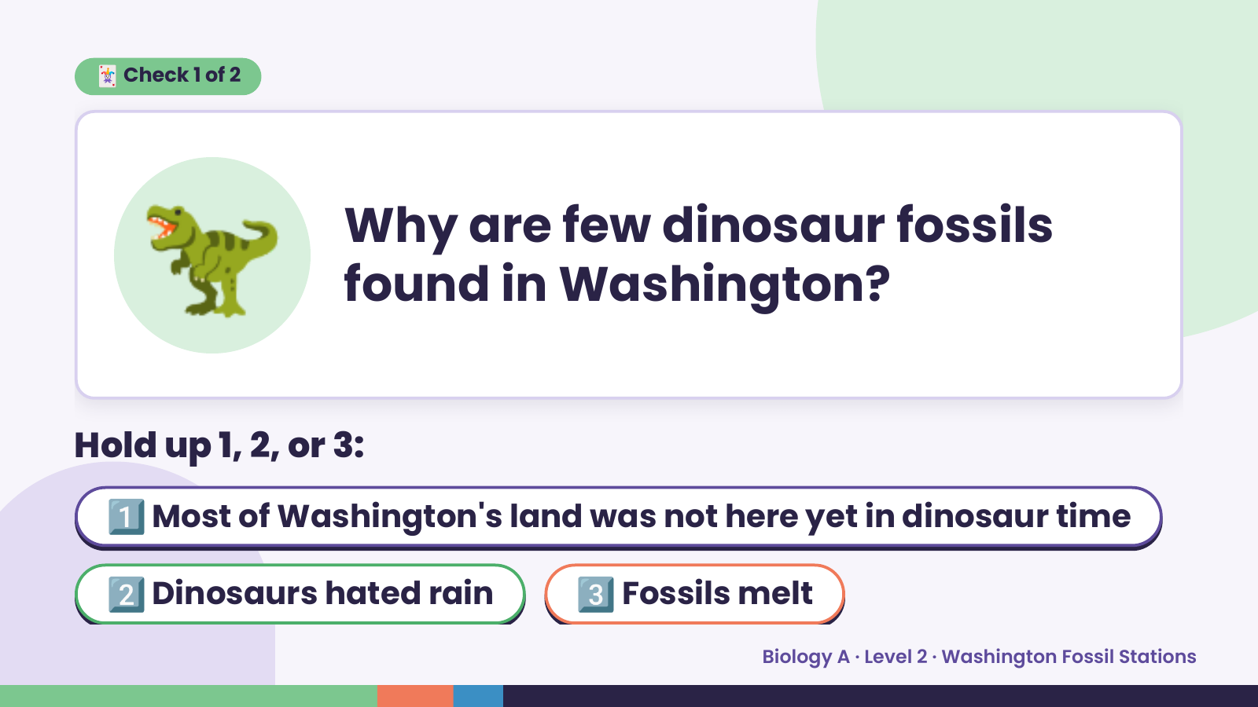
Notes:
🦖
🃏 Check 1 of 2
Why are few dinosaur fossils
found in Washington?
Hold up 1, 2, or 3:
1️⃣ Most of Washington's land was not here yet in dinosaur time
2️⃣ Dinosaurs hated rain 3️⃣ Fossils melt
Biology A · Level 2 · Washington Fossil Stations

Slide 6
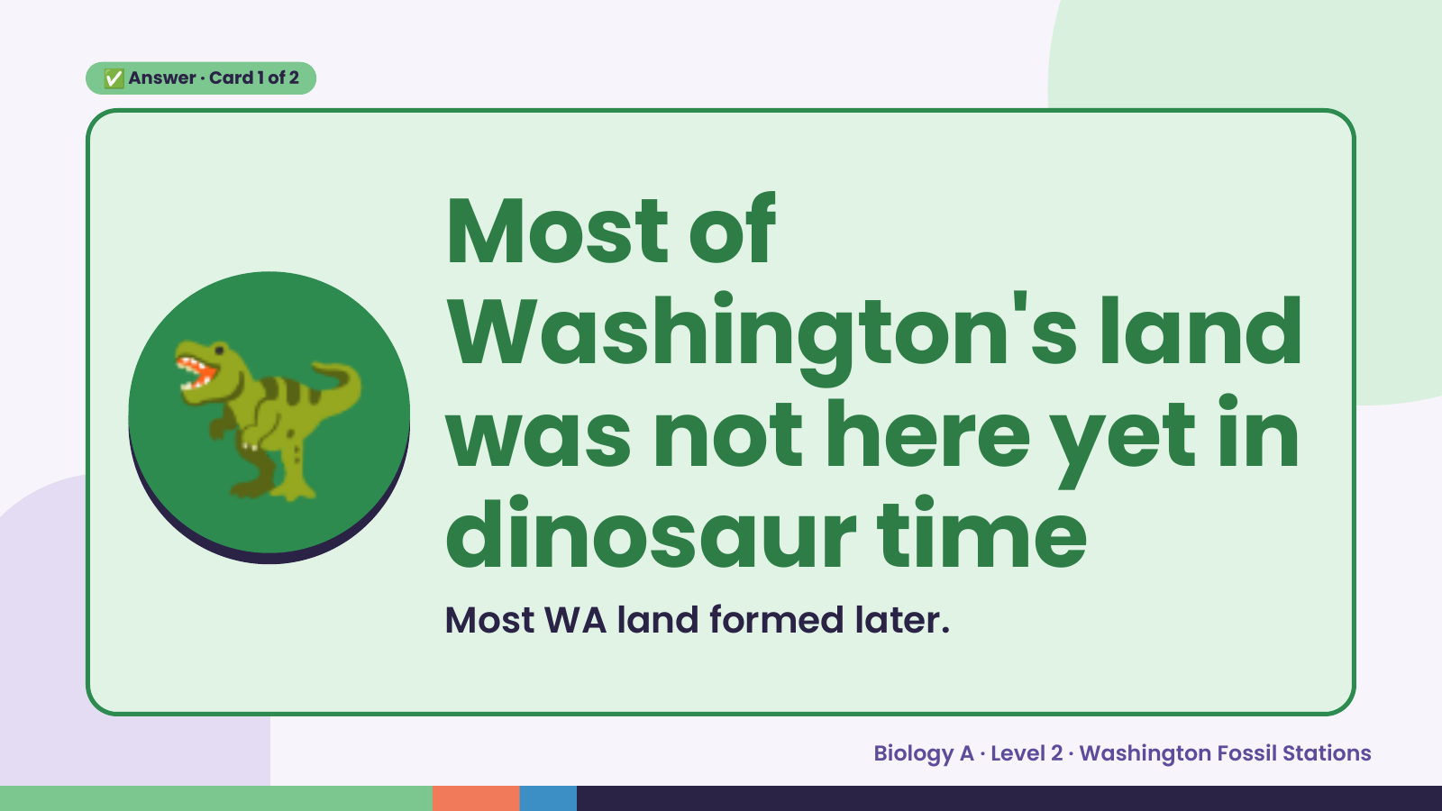
Notes:
✅ Answer · Card 1 of 2
🦖 Most of
Washington's land
was not here yet in
dinosaur time
Most WA land formed later.
Biology A · Level 2 · Washington Fossil Stations

Slide 7
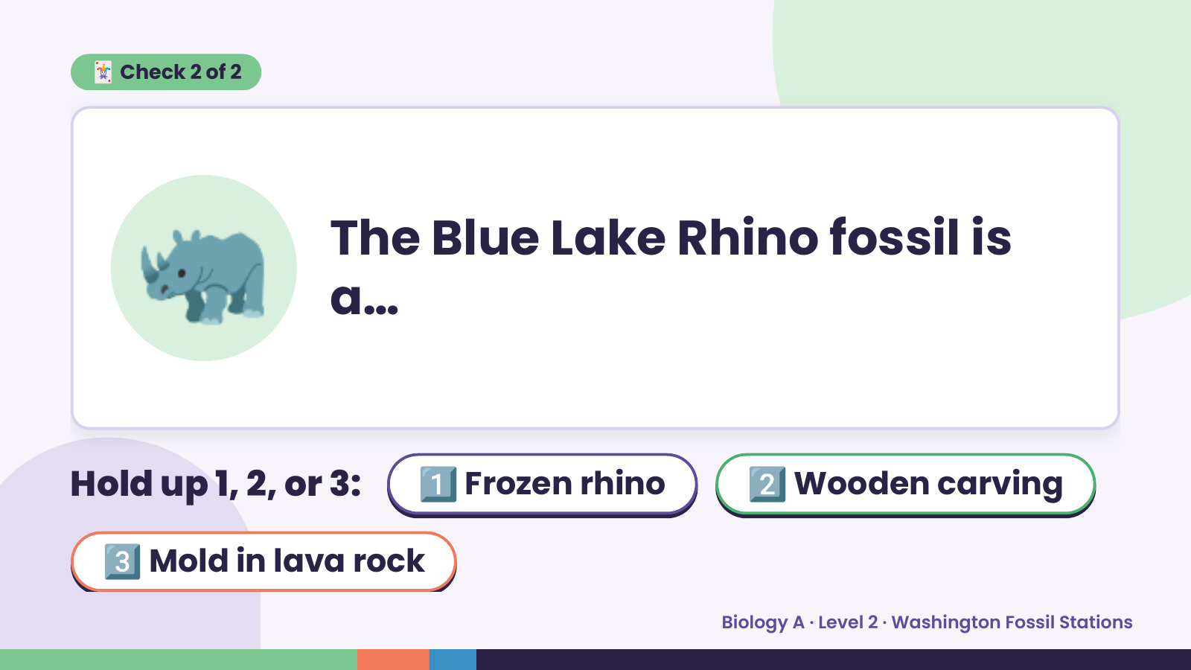
Notes:
🃏 Check 2 of 2
🦏 The Blue Lake Rhino fossil is
a…
Hold up 1, 2, or 3: 1️⃣ Frozen rhino 2️⃣ Wooden carving
3️⃣ Mold in lava rock
Biology A · Level 2 · Washington Fossil Stations

Slide 8
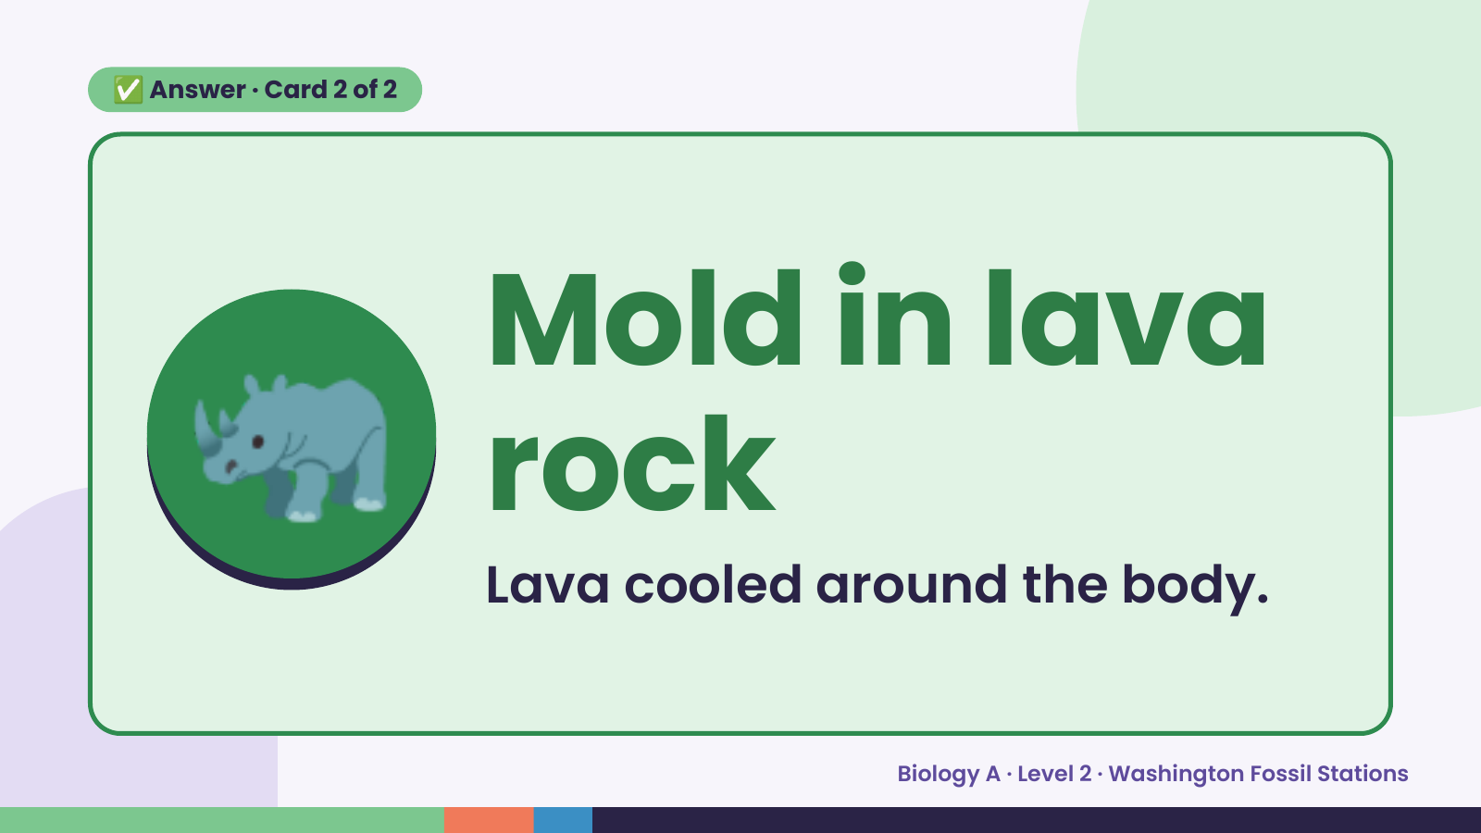
Notes:
✅ Answer · Card 2 of 2
🦏 Mold in lava
rock
Lava cooled around the body.
Biology A · Level 2 · Washington Fossil Stations

Slide 9
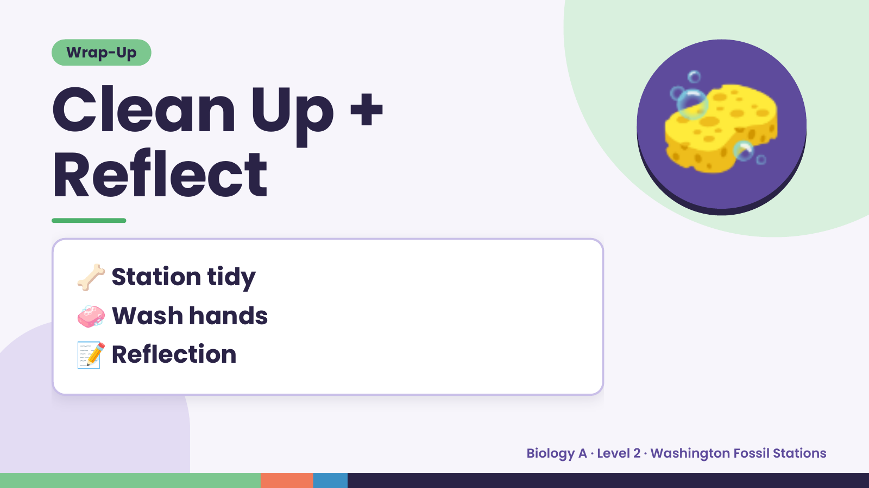
Notes:
Wrap-Up
Clean Up +
Reflect
🧽
🦴 Station tidy
🧼 Wash hands
📝 Reflection
Biology A · Level 2 · Washington Fossil Stations

