Slide 1
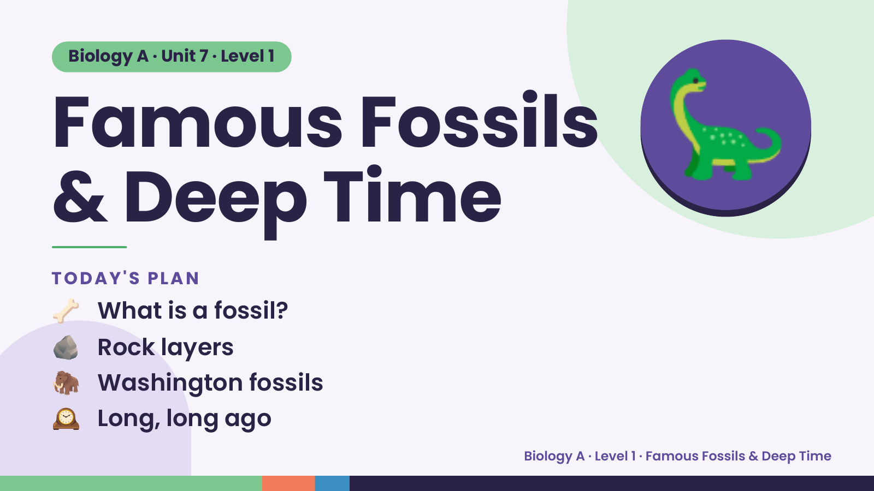
Notes:
Biology A · Unit 7 · Level 1
Famous Fossils
& Deep Time
🦕
🦴 What is a fossil?
TODAY'S PLAN
🪨 Rock layers
🦣 Washington fossils
🕰️ Long, long ago
Biology A · Level 1 · Famous Fossils & Deep Time

Slide 2
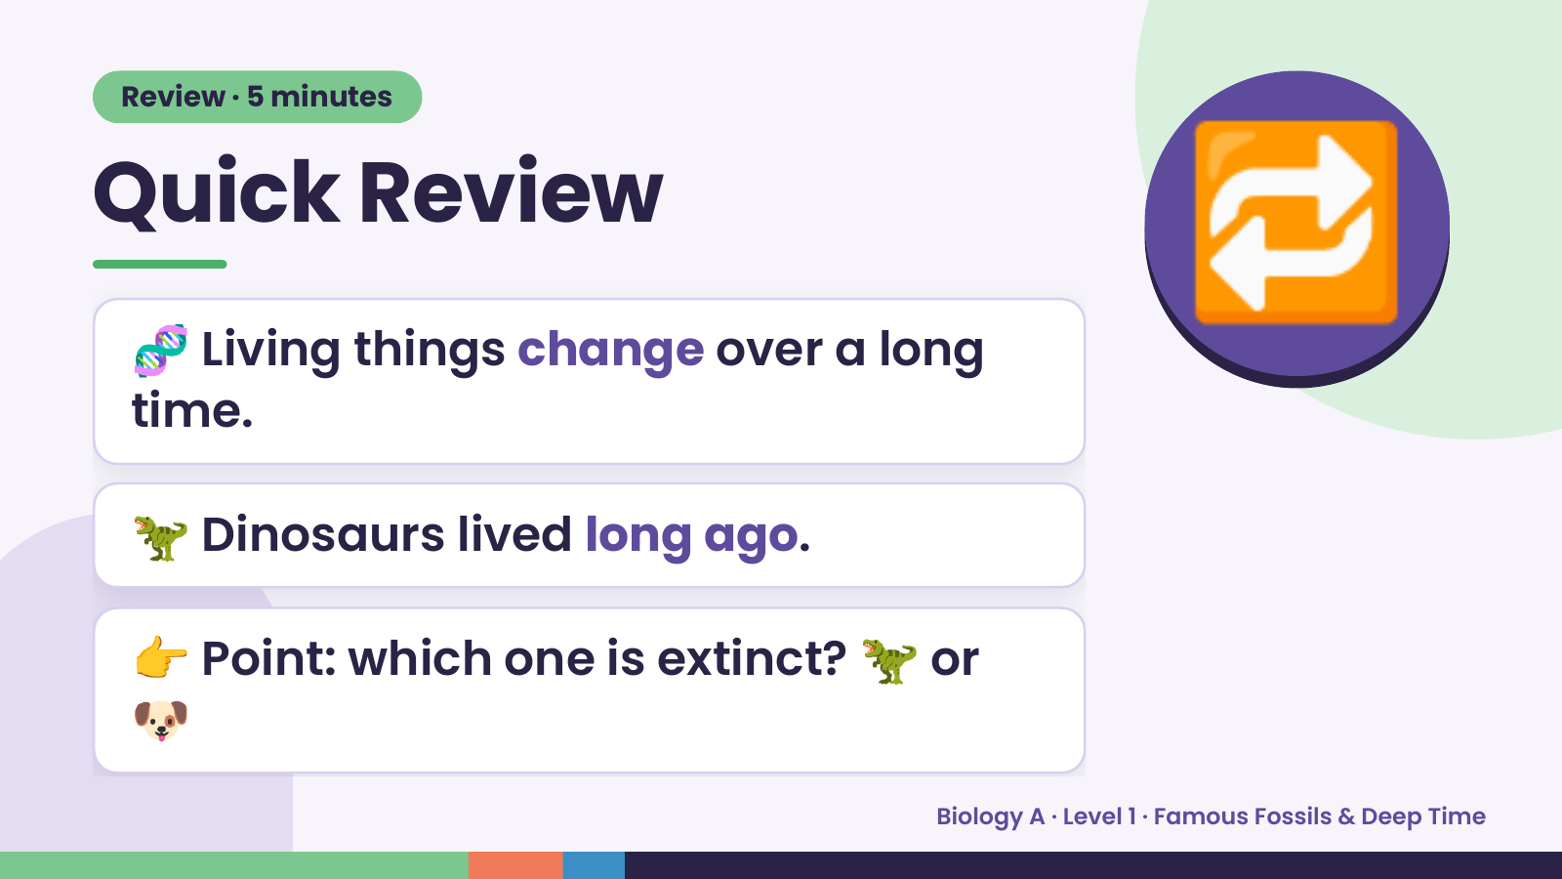
Notes:
Review · 5 minutes
Quick Review
🧬 Living things change over a long
time.
🔁
🦖 Dinosaurs lived long ago.
👉 Point: which one is extinct? 🦖 or
🐶
Biology A · Level 1 · Famous Fossils & Deep Time

Slide 3
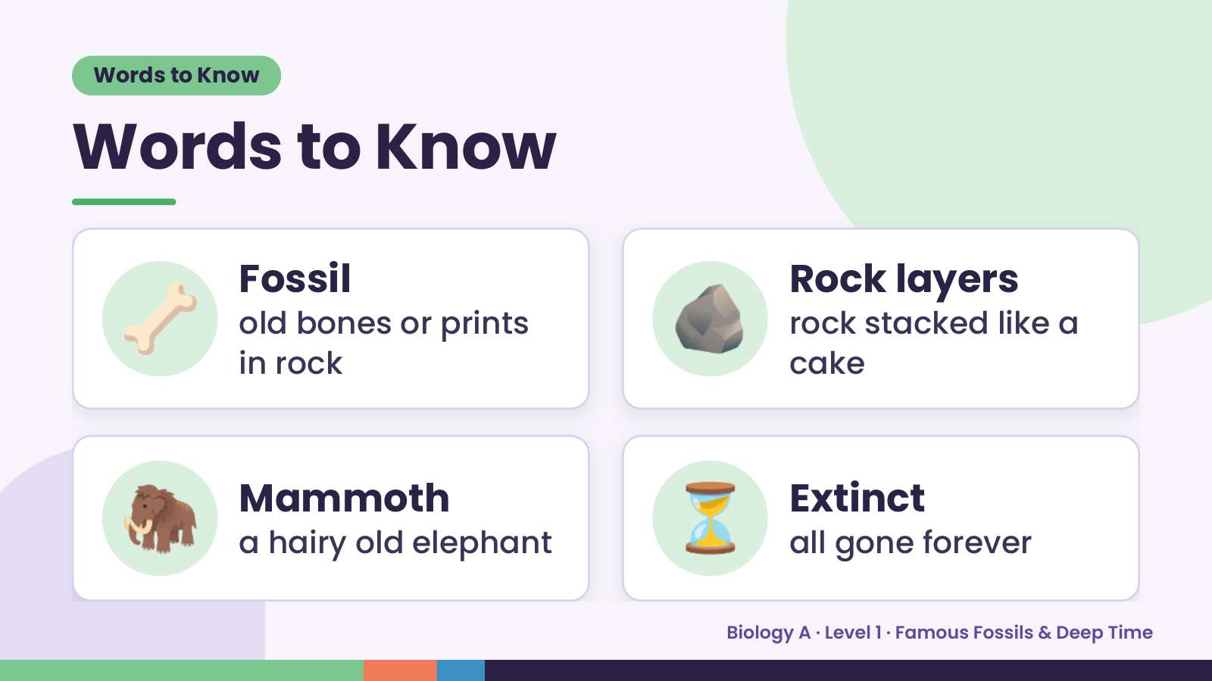
Notes:
Words to Know
Words to Know
🦴 Fossil
old bones or prints
in rock
🪨 Rock layers
rock stacked like a
cake
🦣 Mammoth
a hairy old elephant ⏳ Extinct
all gone forever
Biology A · Level 1 · Famous Fossils & Deep Time

Slide 4
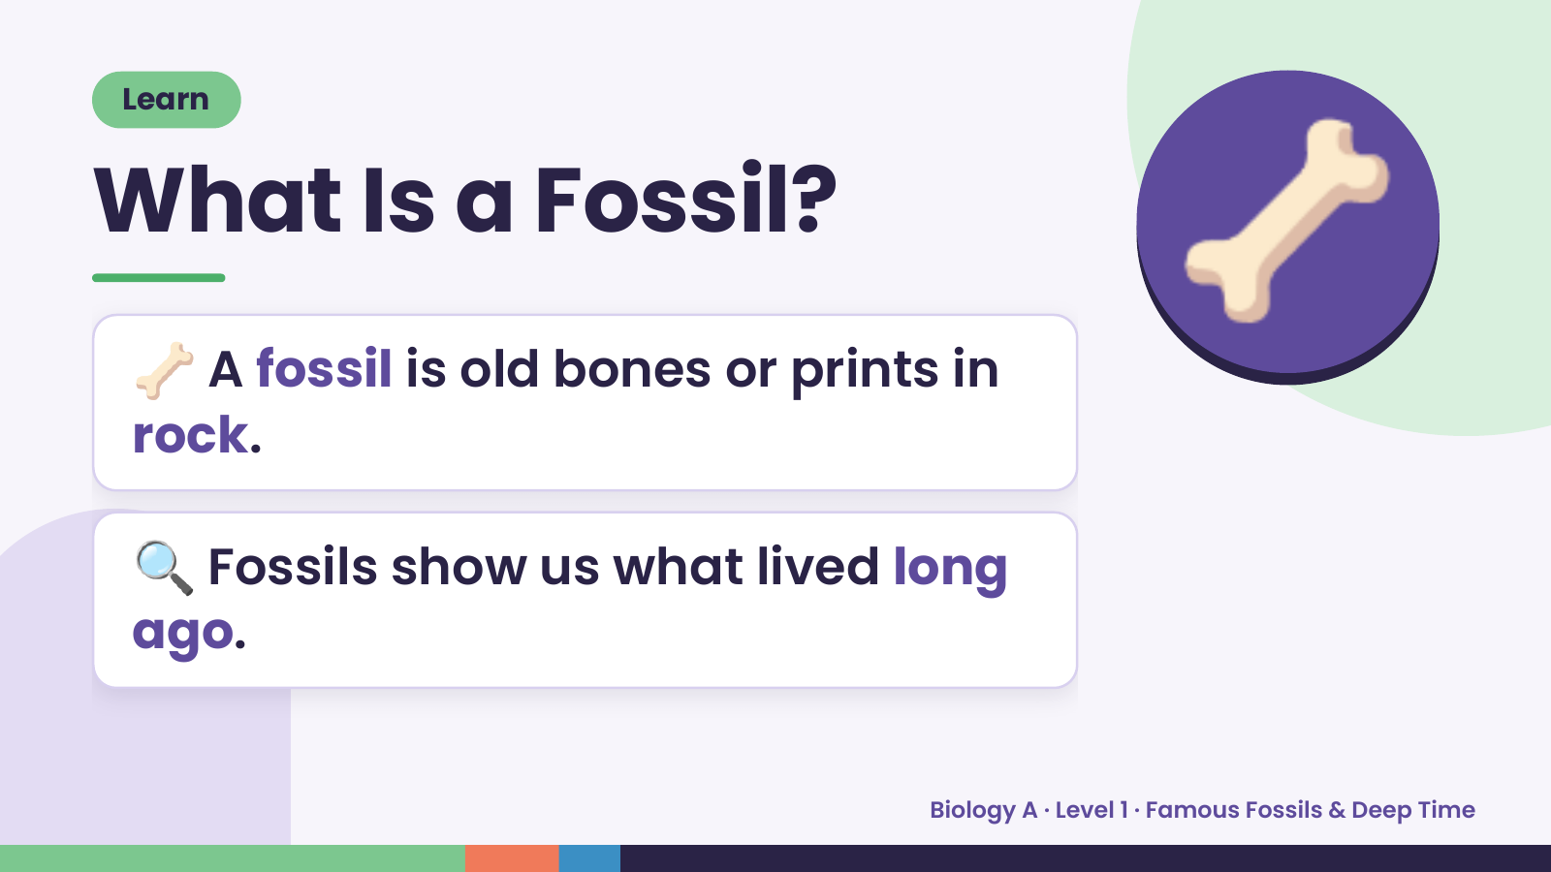
Notes:
Learn
What Is a Fossil?
🦴 A fossil is old bones or prints in
rock.
🦴
🔍 Fossils show us what lived long
ago.
Biology A · Level 1 · Famous Fossils & Deep Time

Slide 5
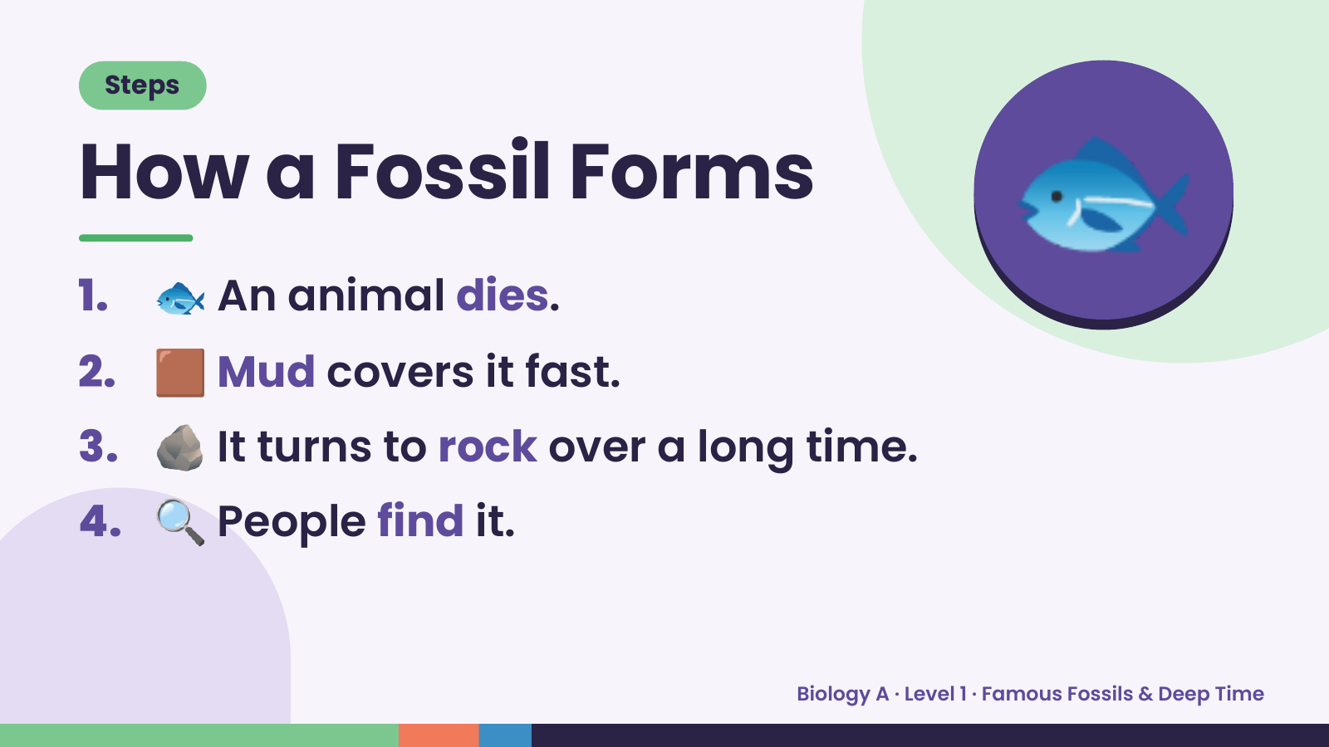
Notes:
Steps
How a Fossil Forms
1. 🐟 An animal dies.
2. 🟫 Mud covers it fast.
🐟
3. 🪨 It turns to rock over a long time.
4. 🔍 People find it.
Biology A · Level 1 · Famous Fossils & Deep Time

Slide 6
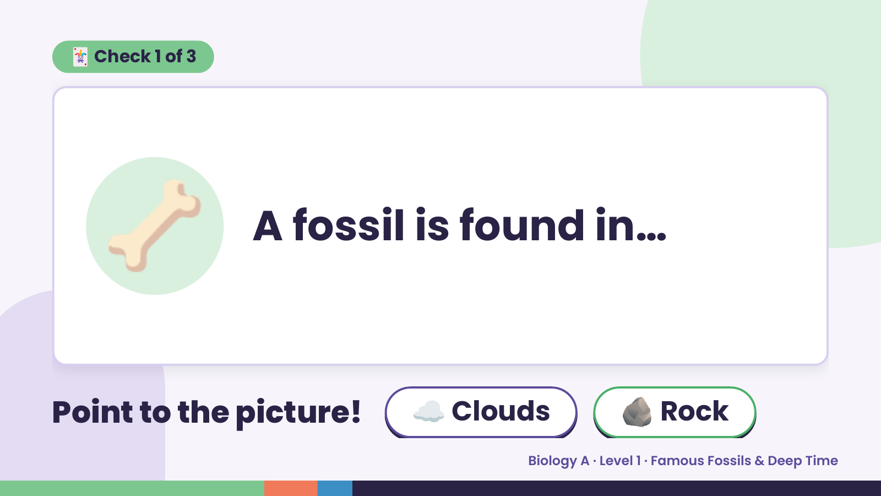
Notes:
🃏 Check 1 of 3
🦴 A fossil is found in…
Point to the picture! ☁️ Clouds 🪨 Rock
Biology A · Level 1 · Famous Fossils & Deep Time

Slide 7
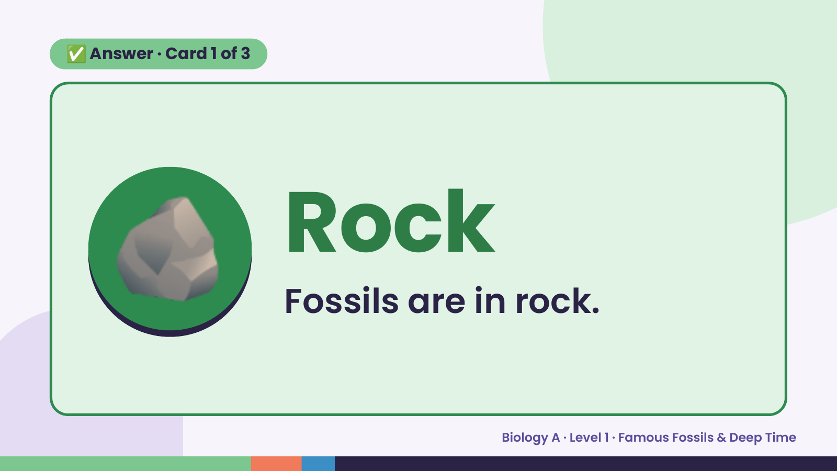
Notes:
✅ Answer · Card 1 of 3
🪨 Rock
Fossils are in rock.
Biology A · Level 1 · Famous Fossils & Deep Time

Slide 8
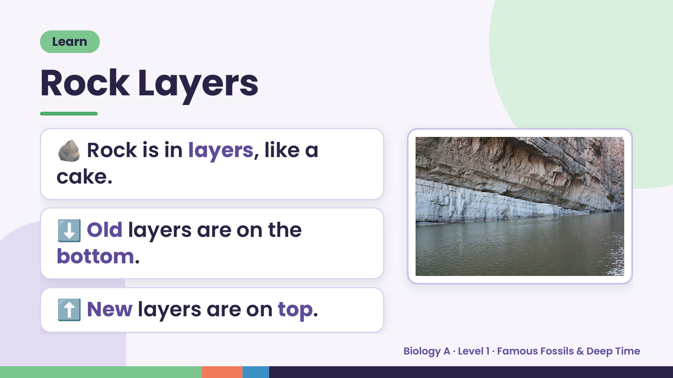
Notes:
Learn
Rock Layers
🪨 Rock is in layers, like a
cake.
⬇️ Old layers are on the
bottom.
⬆️ New layers are on top.
Biology A · Level 1 · Famous Fossils & Deep Time

Slide 9
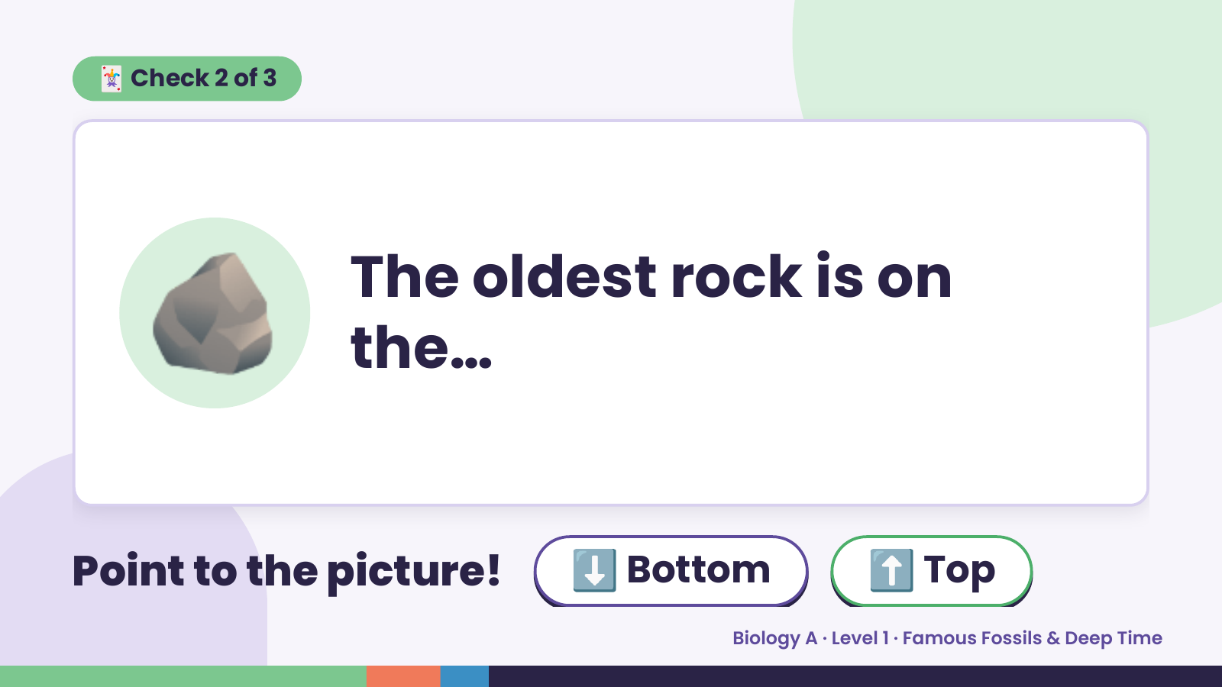
Notes:
🃏 Check 2 of 3
🪨 The oldest rock is on
the…
Point to the picture! ⬇️ Bottom ⬆️ Top
Biology A · Level 1 · Famous Fossils & Deep Time

Slide 10
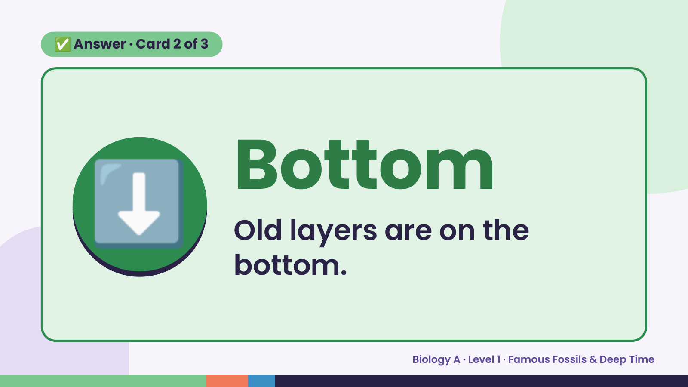
Notes:
✅ Answer · Card 2 of 3
⬇️ Bottom
Old layers are on the
bottom.
Biology A · Level 1 · Famous Fossils & Deep Time

Slide 11
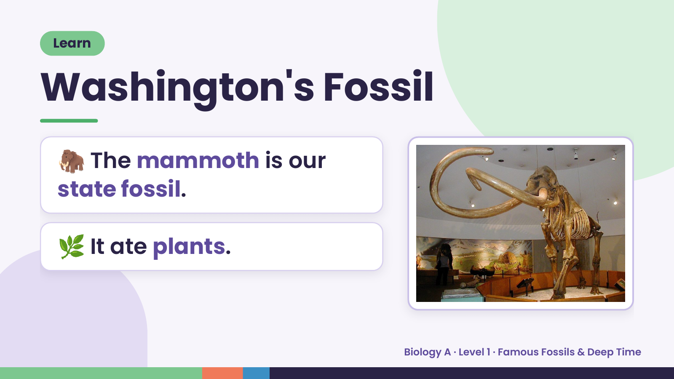
Notes:
Learn
Washington's Fossil
🦣 The mammoth is our
state fossil.
🌿 It ate plants.
Biology A · Level 1 · Famous Fossils & Deep Time

Slide 12
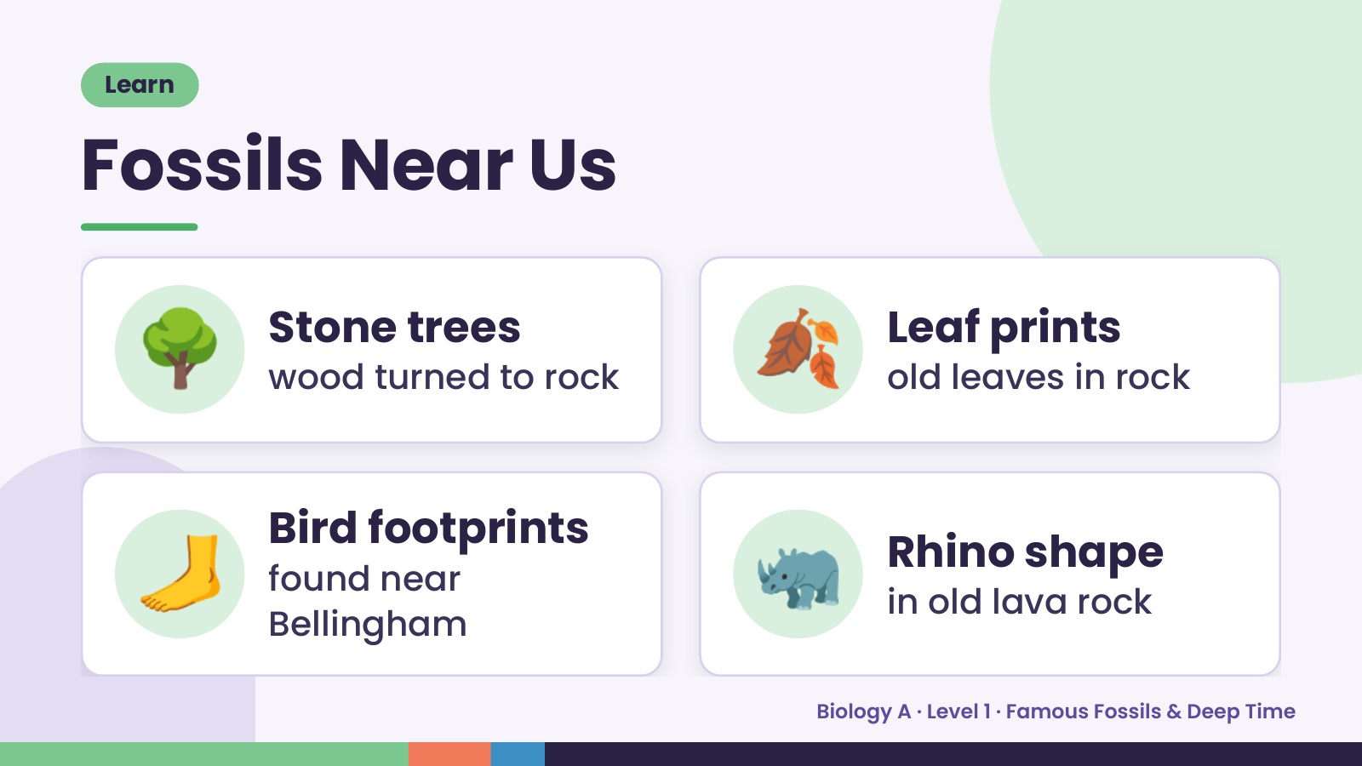
Notes:
Learn
Fossils Near Us
🌳 Stone trees
wood turned to rock 🍂 Leaf prints
old leaves in rock
🦶 Bird footprints
found near
Bellingham
🦏 Rhino shape
in old lava rock
Biology A · Level 1 · Famous Fossils & Deep Time

Slide 13
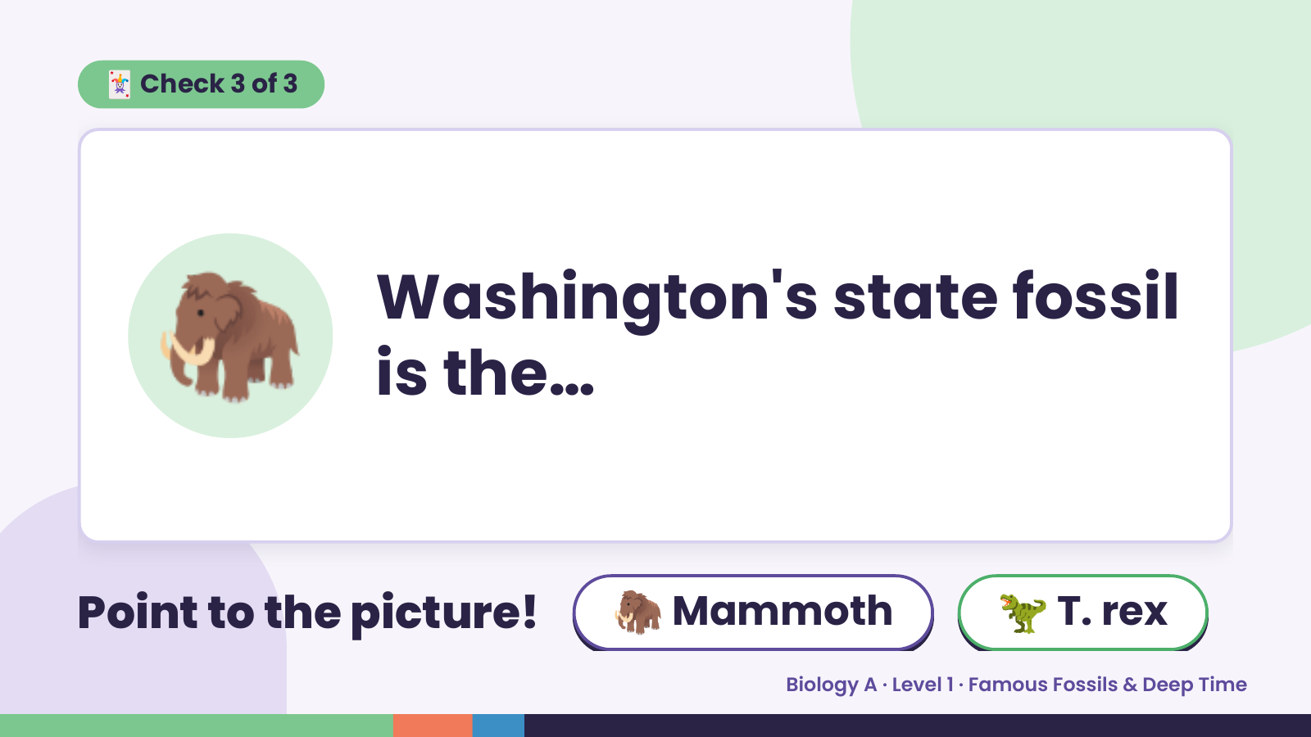
Notes:
🃏 Check 3 of 3
🦣 Washington's state fossil
is the…
Point to the picture! 🦣 Mammoth 🦖 T. rex
Biology A · Level 1 · Famous Fossils & Deep Time

Slide 14
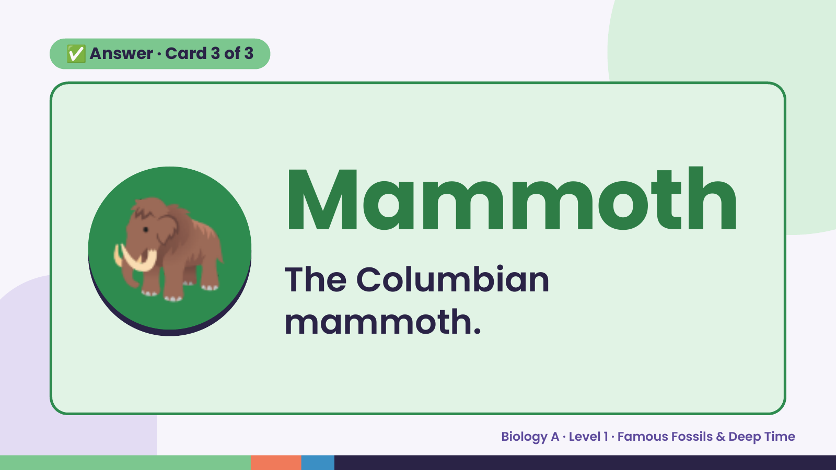
Notes:
✅ Answer · Card 3 of 3
🦣 Mammoth
The Columbian
mammoth.
Biology A · Level 1 · Famous Fossils & Deep Time

Slide 15
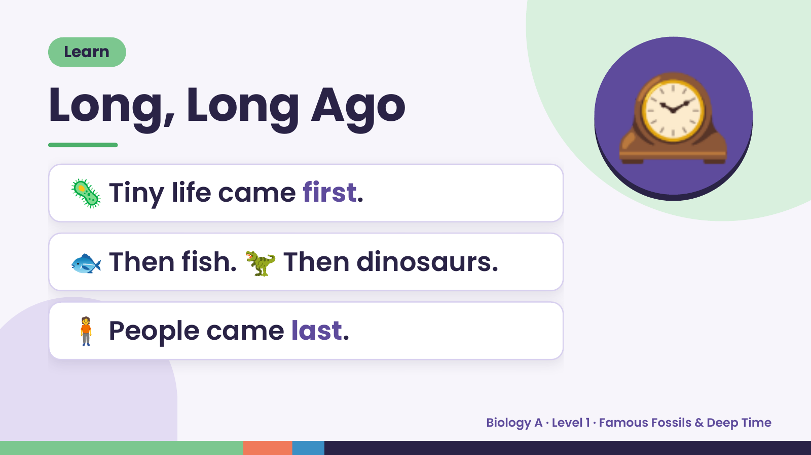
Notes:
Learn
Long, Long Ago
🦠 Tiny life came first.
🕰️
🐟 Then fish. 🦖 Then dinosaurs.
🧍 People came last.
Biology A · Level 1 · Famous Fossils & Deep Time

Slide 16
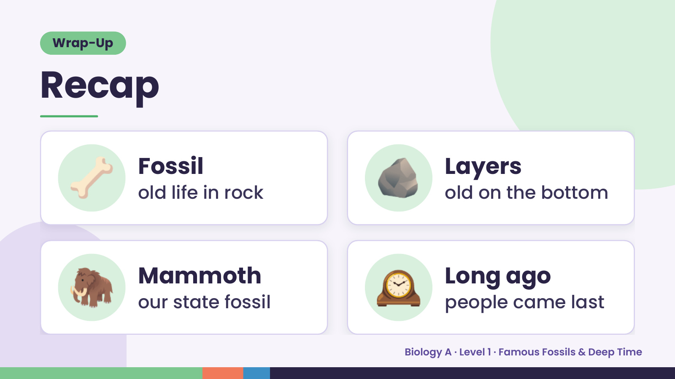
Notes:
Wrap-Up
Recap
🦴 Fossil
old life in rock 🪨 Layers
old on the bottom
🦣 Mammoth
our state fossil 🕰️ Long ago
people came last
Biology A · Level 1 · Famous Fossils & Deep Time

Slide 17
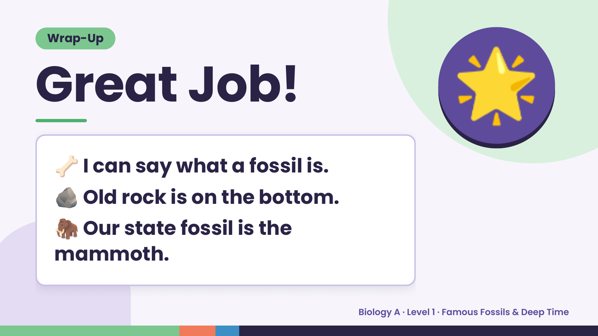
Notes:
Wrap-Up
Great Job!
🦴 I can say what a fossil is.
🌟
🪨 Old rock is on the bottom.
🦣Our state fossil is the
mammoth.
Biology A · Level 1 · Famous Fossils & Deep Time

