Slide 1
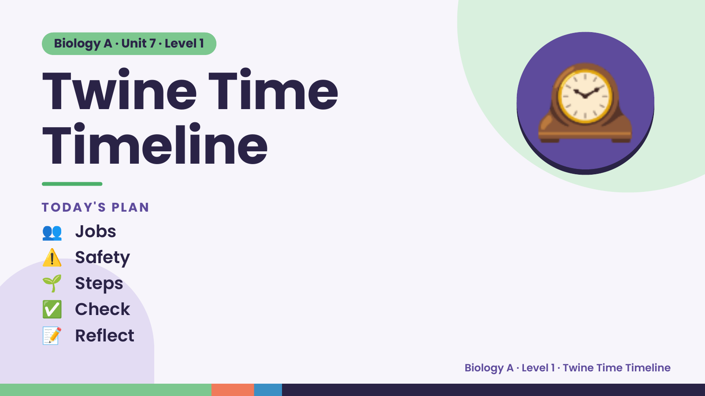
Notes:
Biology A · Unit 7 · Level 1
Twine Time
Timeline
TODAY'S PLAN
🕰️
👥 Jobs
⚠️ Safety
🌱 Steps
✅ Check
📝 Reflect
Biology A · Level 1 · Twine Time Timeline

Slide 2
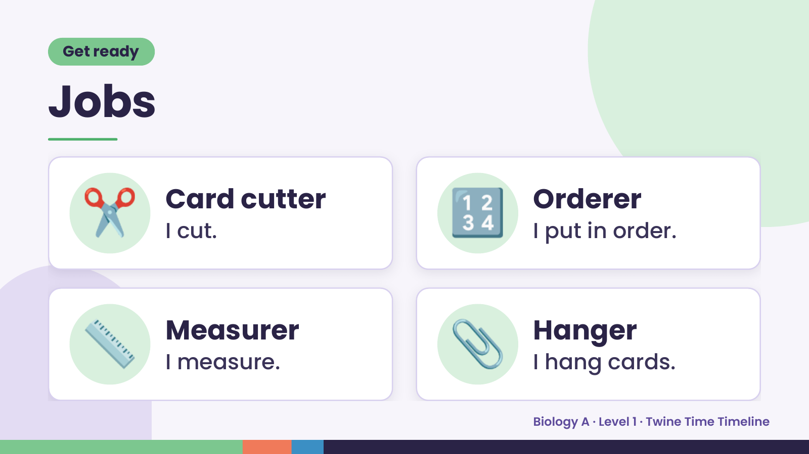
Notes:
Get ready
Jobs
✂️ Card cutter
I cut. 🔢 Orderer
I put in order.
📏 Measurer
I measure. 📎 Hanger
I hang cards.
Biology A · Level 1 · Twine Time Timeline

Slide 3
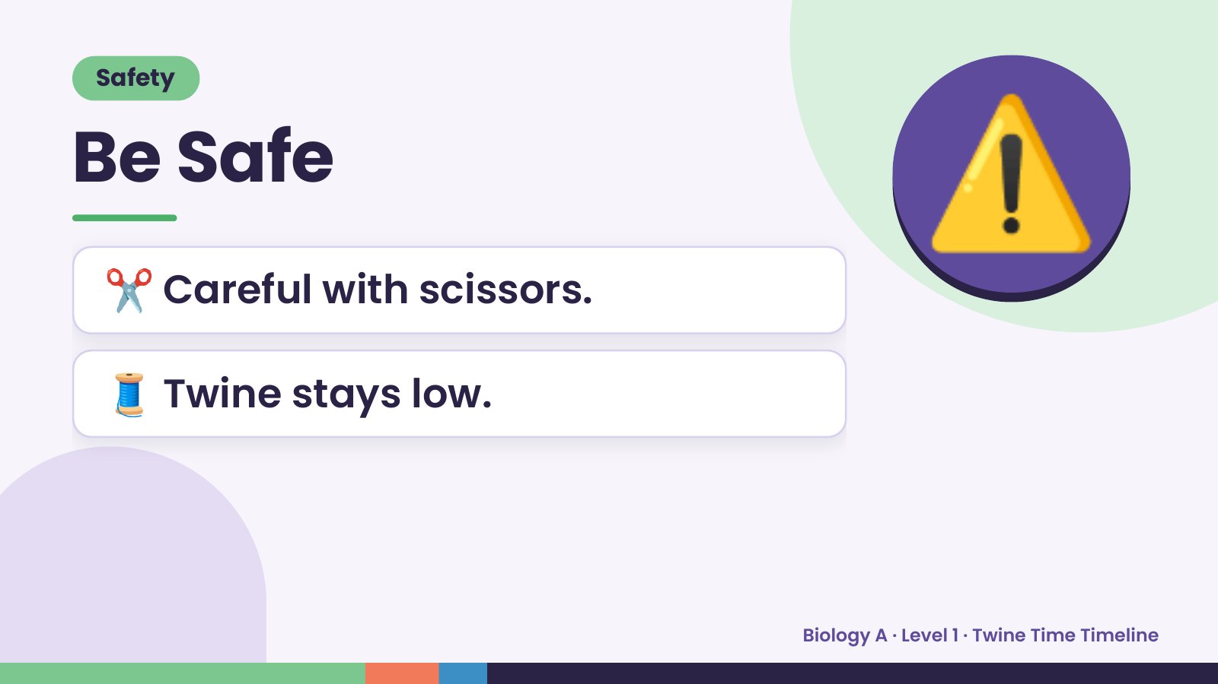
Notes:
Safety
Be Safe
✂️ Careful with scissors.
⚠️
🧵 Twine stays low.
Biology A · Level 1 · Twine Time Timeline

Slide 4
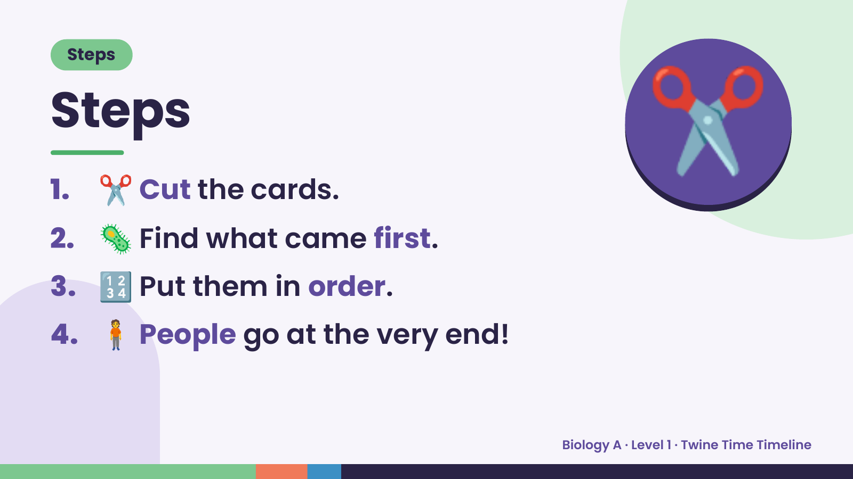
Notes:
Steps
Steps
1. ✂️ Cut the cards.
2. 🦠 Find what came first.
✂️
3. 🔢 Put them in order.
4. 🧍 People go at the very end!
Biology A · Level 1 · Twine Time Timeline

Slide 5
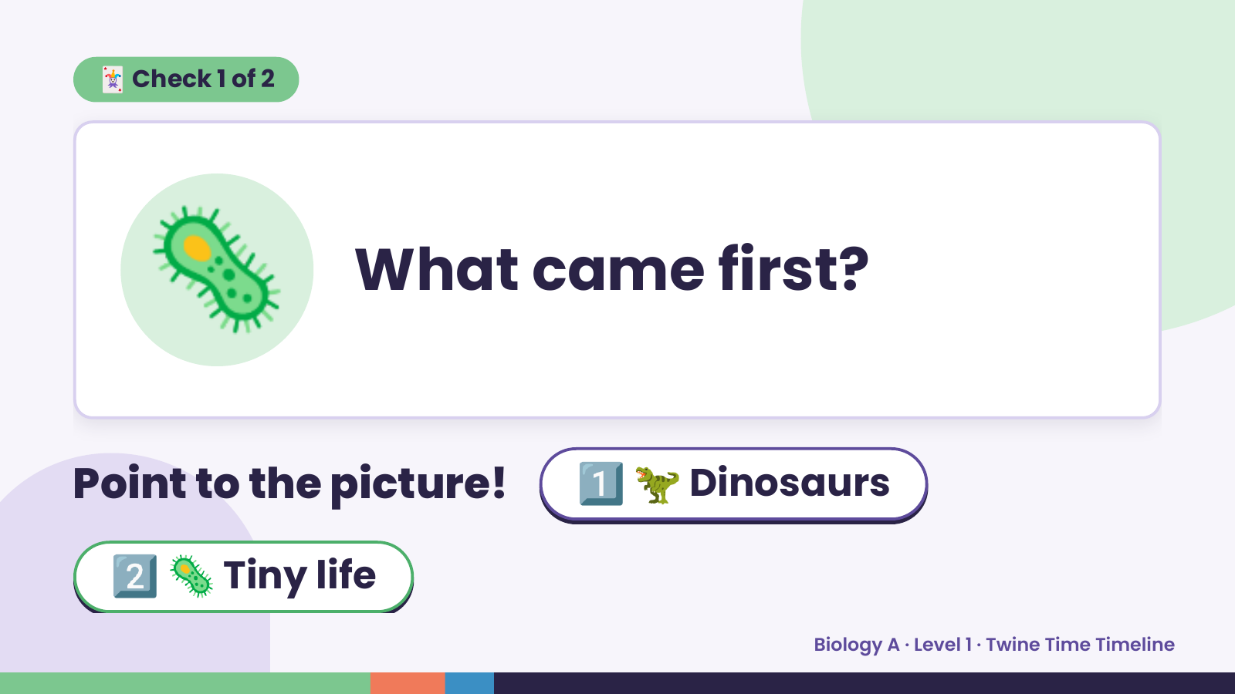
Notes:
🃏 Check 1 of 2
🦠 What came first?
Point to the picture! 1️⃣ 🦖 Dinosaurs
2️⃣ 🦠 Tiny life
Biology A · Level 1 · Twine Time Timeline

Slide 6
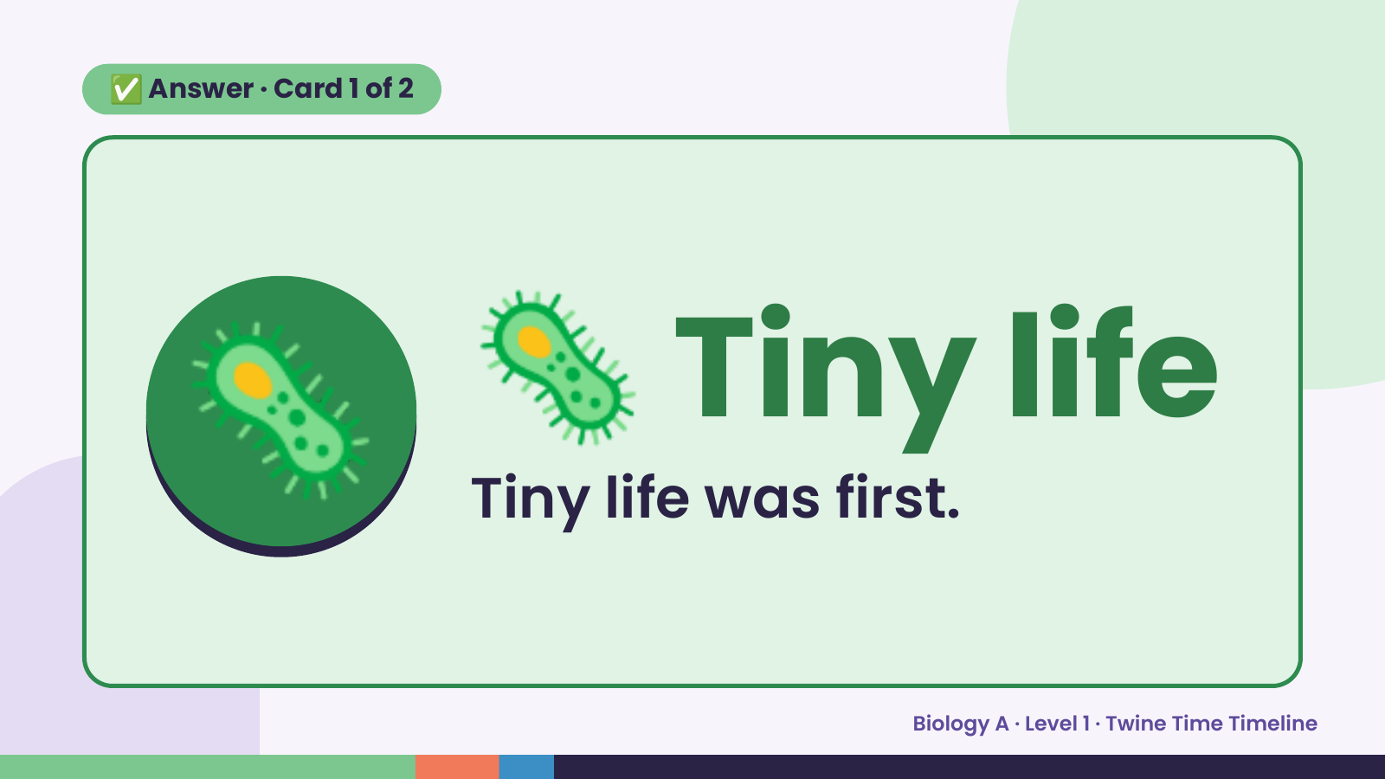
Notes:
✅ Answer · Card 1 of 2
🦠 🦠 Tiny life
Tiny life was first.
Biology A · Level 1 · Twine Time Timeline

Slide 7
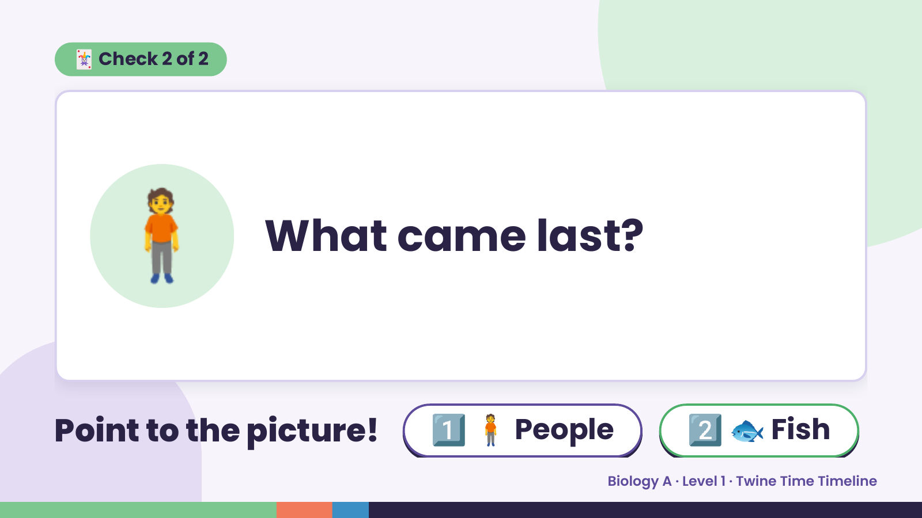
Notes:
🃏 Check 2 of 2
🧍 What came last?
Point to the picture! 1️⃣ 🧍 People 2️⃣ 🐟 Fish
Biology A · Level 1 · Twine Time Timeline

Slide 8
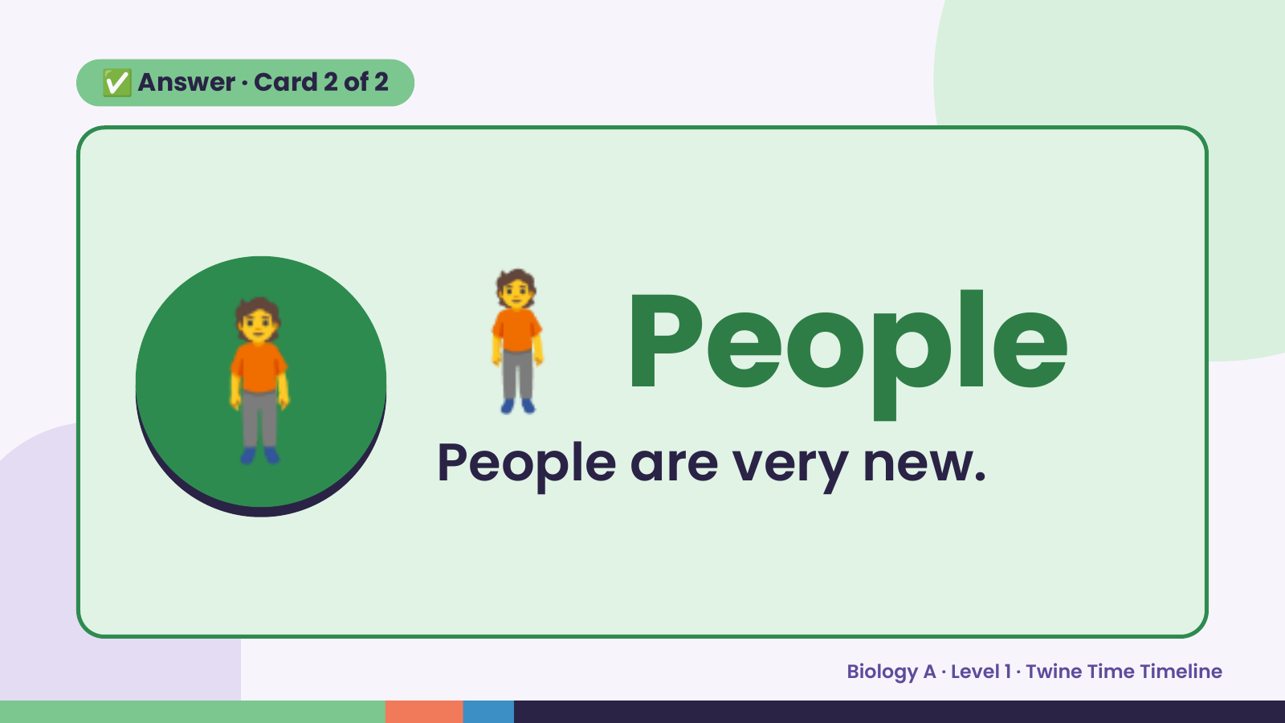
Notes:
✅ Answer · Card 2 of 2
🧍 🧍 People
People are very new.
Biology A · Level 1 · Twine Time Timeline

Slide 9
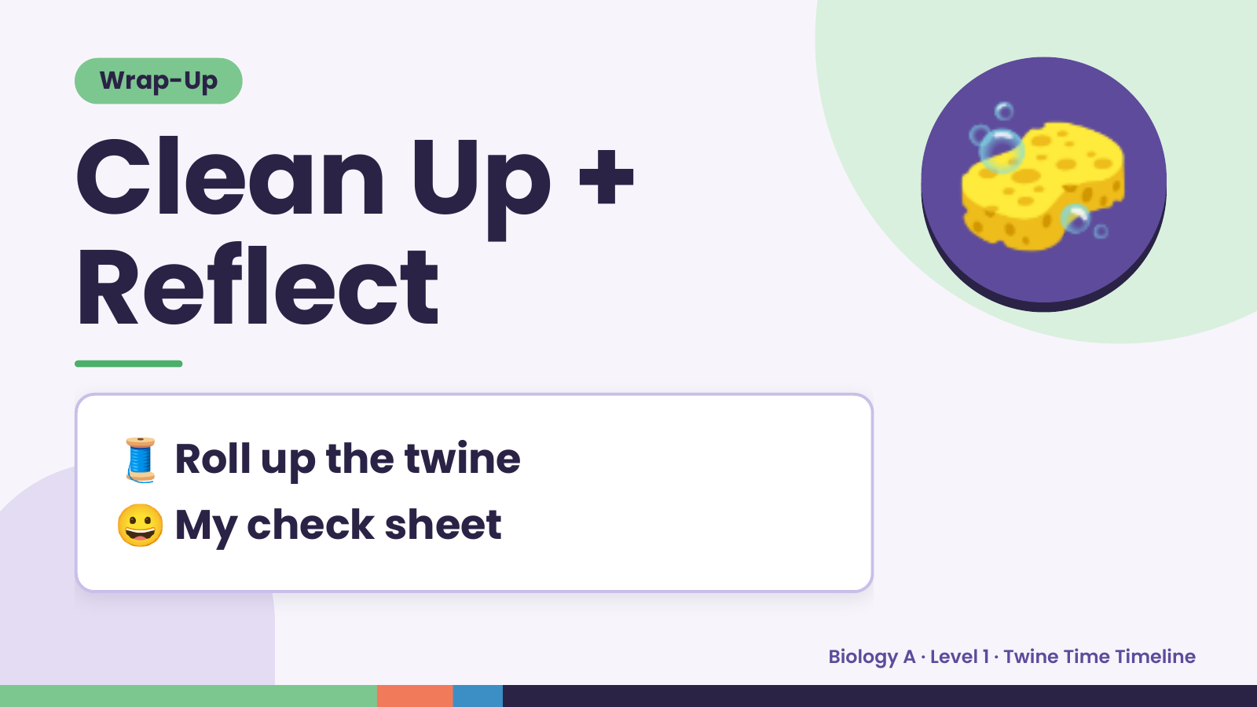
Notes:
Wrap-Up
Clean Up +
Reflect
🧽
🧵 Roll up the twine
😀 My check sheet
Biology A · Level 1 · Twine Time Timeline

