Slide 1
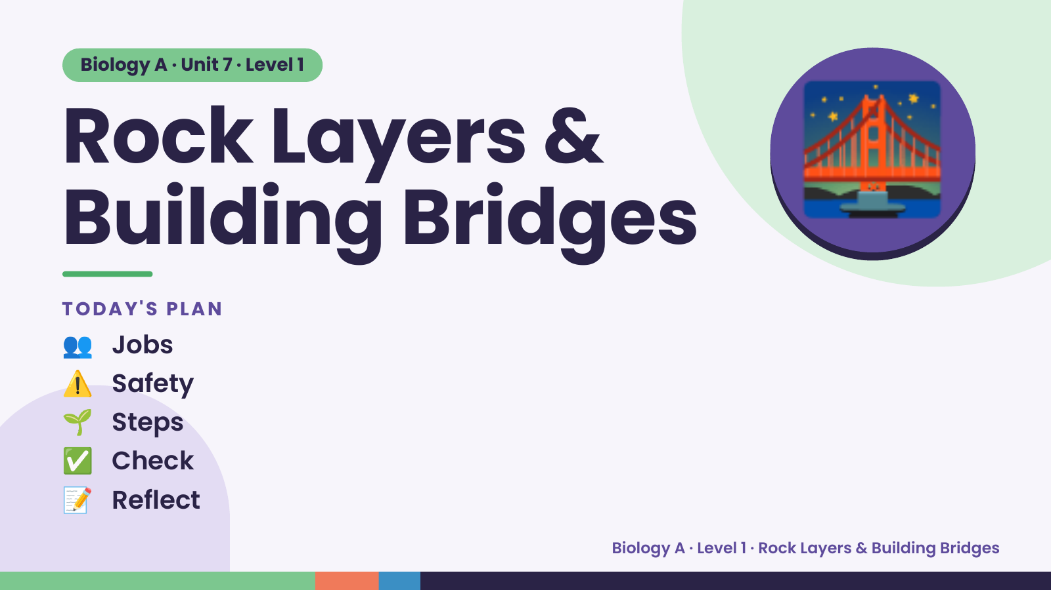
Notes:
Biology A · Unit 7 · Level 1
Rock Layers &
Building Bridges
TODAY'S PLAN
🌉
👥 Jobs
⚠️ Safety
🌱 Steps
✅ Check
📝 Reflect
Biology A · Level 1 · Rock Layers & Building Bridges

Slide 2
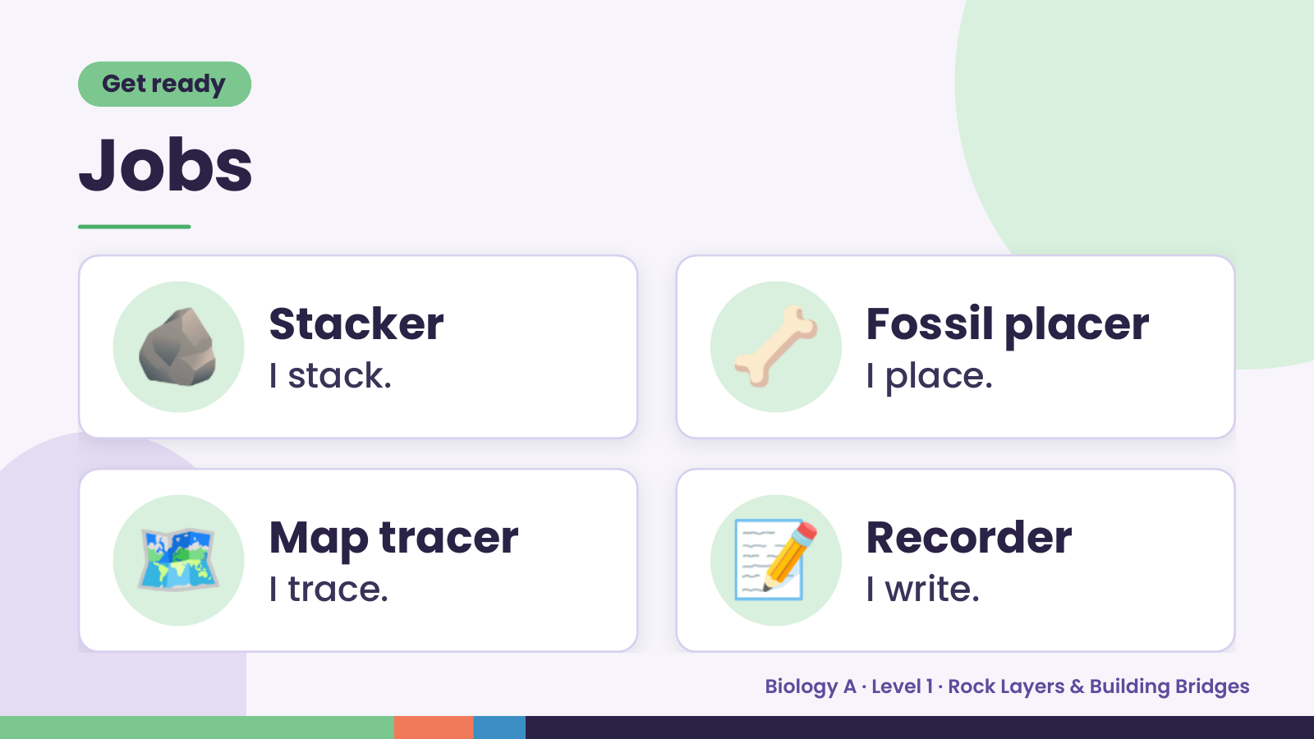
Notes:
Get ready
Jobs
🪨 Stacker
I stack. 🦴 Fossil placer
I place.
🗺️ Map tracer
I trace. 📝 Recorder
I write.
Biology A · Level 1 · Rock Layers & Building Bridges

Slide 3
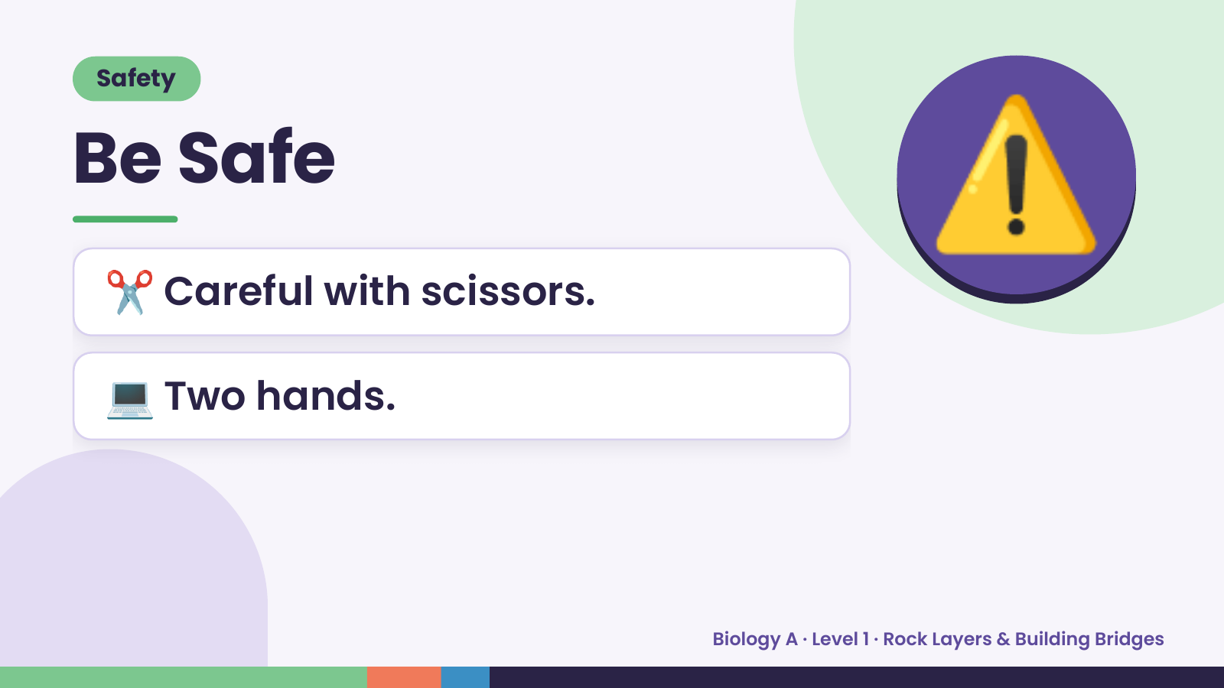
Notes:
Safety
Be Safe
✂️ Careful with scissors.
⚠️
💻 Two hands.
Biology A · Level 1 · Rock Layers & Building Bridges

Slide 4
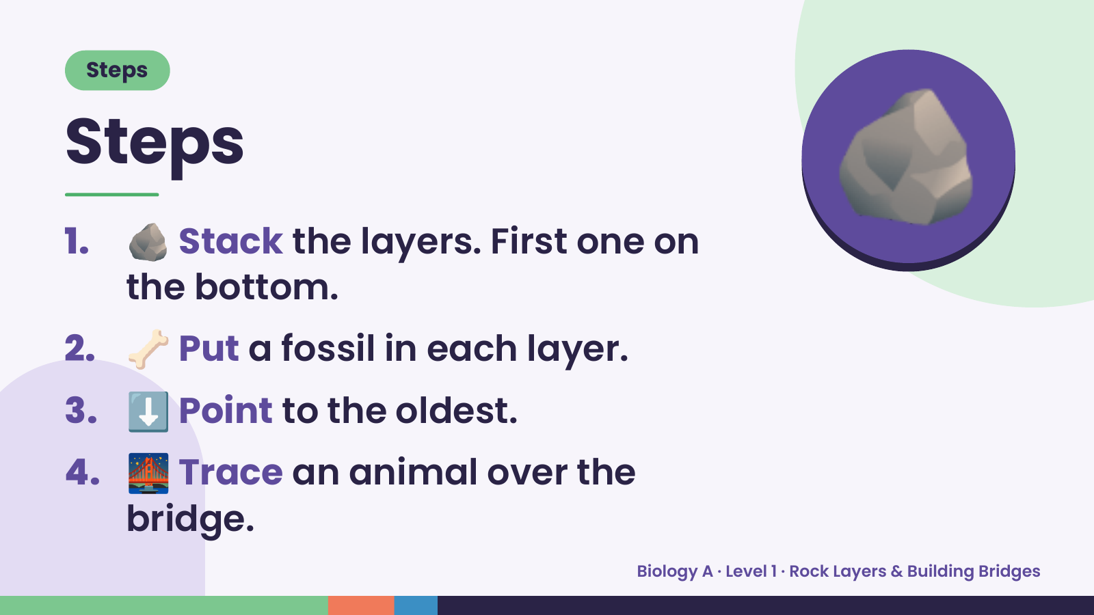
Notes:
Steps
Steps
1. 🪨 Stack the layers. First one on
the bottom.
🪨
2. 🦴 Put a fossil in each layer.
3. ⬇️ Point to the oldest.
4. 🌉 Trace an animal over the
bridge.
Biology A · Level 1 · Rock Layers & Building Bridges

Slide 5
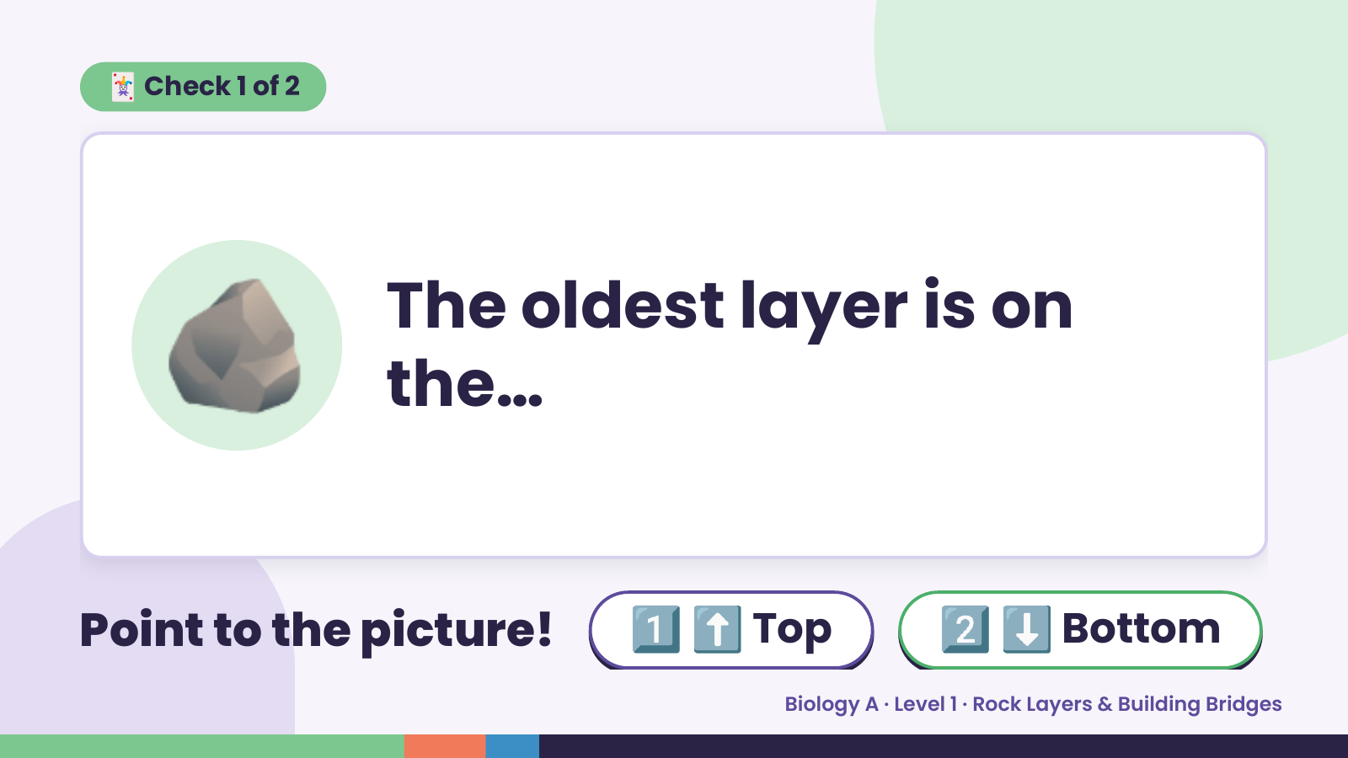
Notes:
🃏 Check 1 of 2
🪨 The oldest layer is on
the…
Point to the picture! 1️⃣ ⬆️ Top 2️⃣ ⬇️ Bottom
Biology A · Level 1 · Rock Layers & Building Bridges

Slide 6
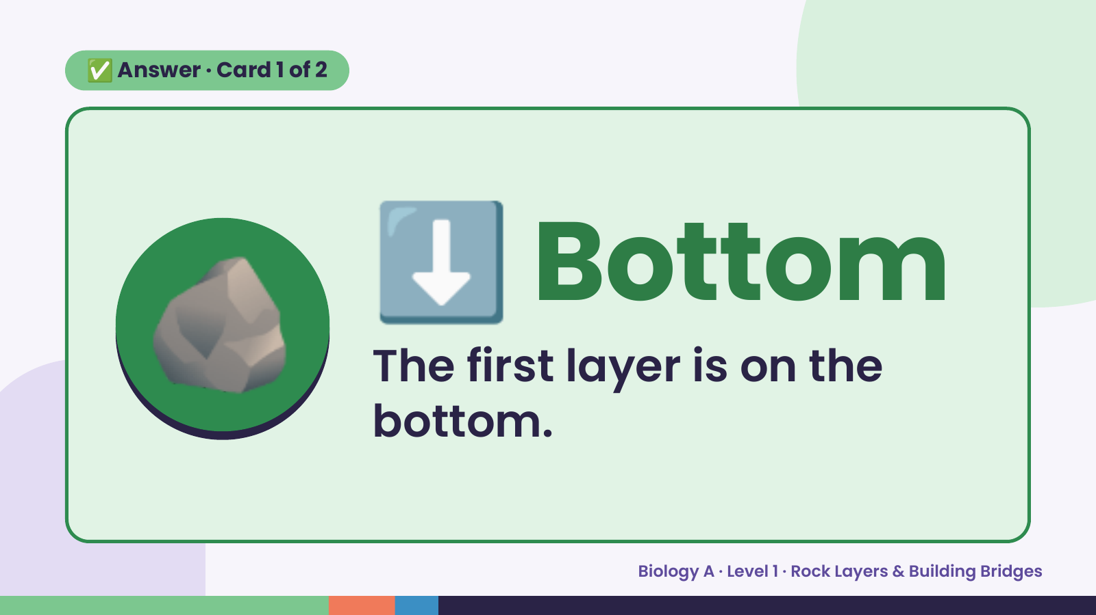
Notes:
✅ Answer · Card 1 of 2
🪨 ⬇️ Bottom
The first layer is on the
bottom.
Biology A · Level 1 · Rock Layers & Building Bridges

Slide 7
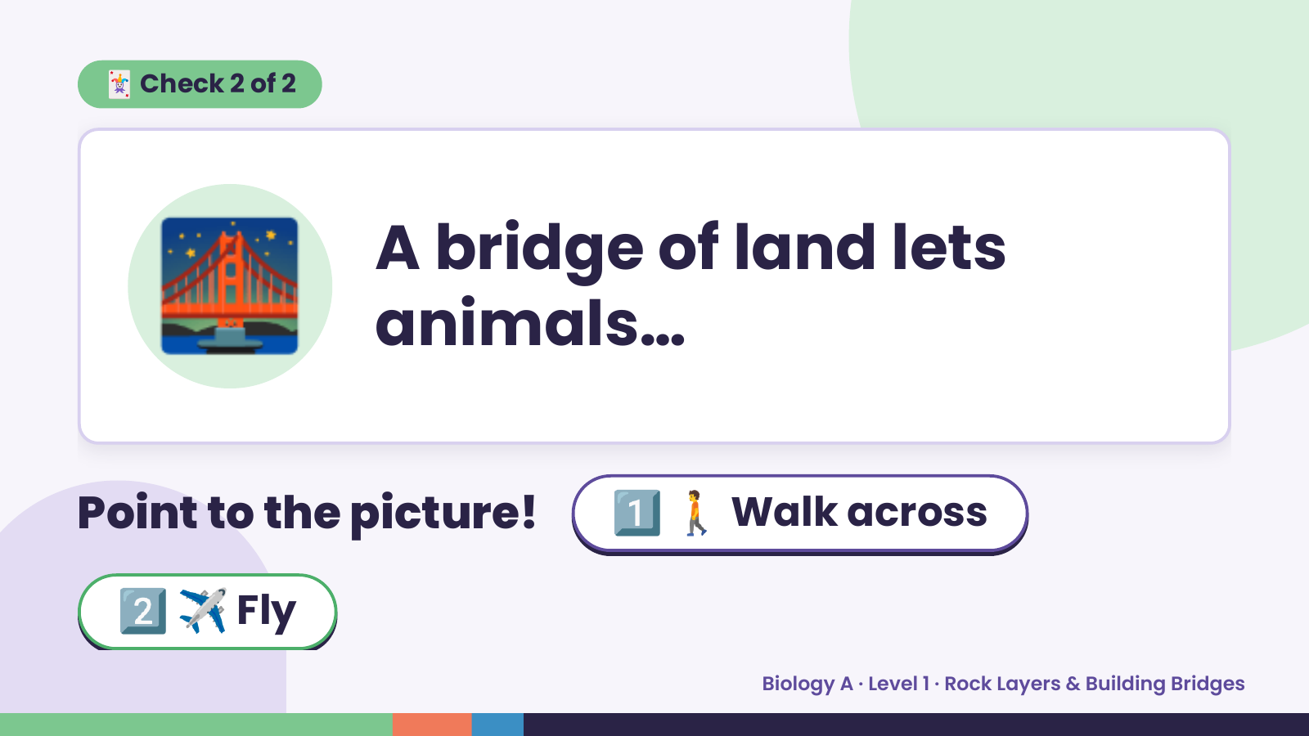
Notes:
🃏 Check 2 of 2
🌉 A bridge of land lets
animals…
Point to the picture! 1️⃣ 🚶 Walk across
2️⃣ ✈️ Fly
Biology A · Level 1 · Rock Layers & Building Bridges

Slide 8
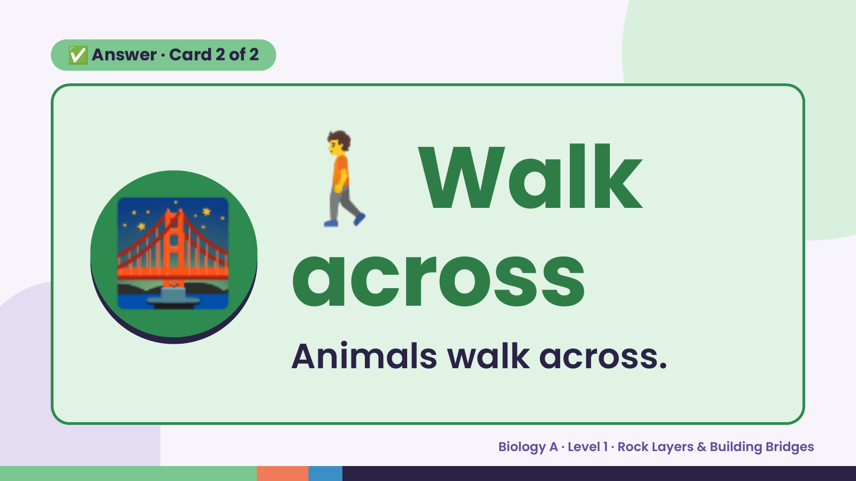
Notes:
🚶
✅ Answer · Card 2 of 2
🌉 across
Walk
Animals walk across.
Biology A · Level 1 · Rock Layers & Building Bridges

Slide 9
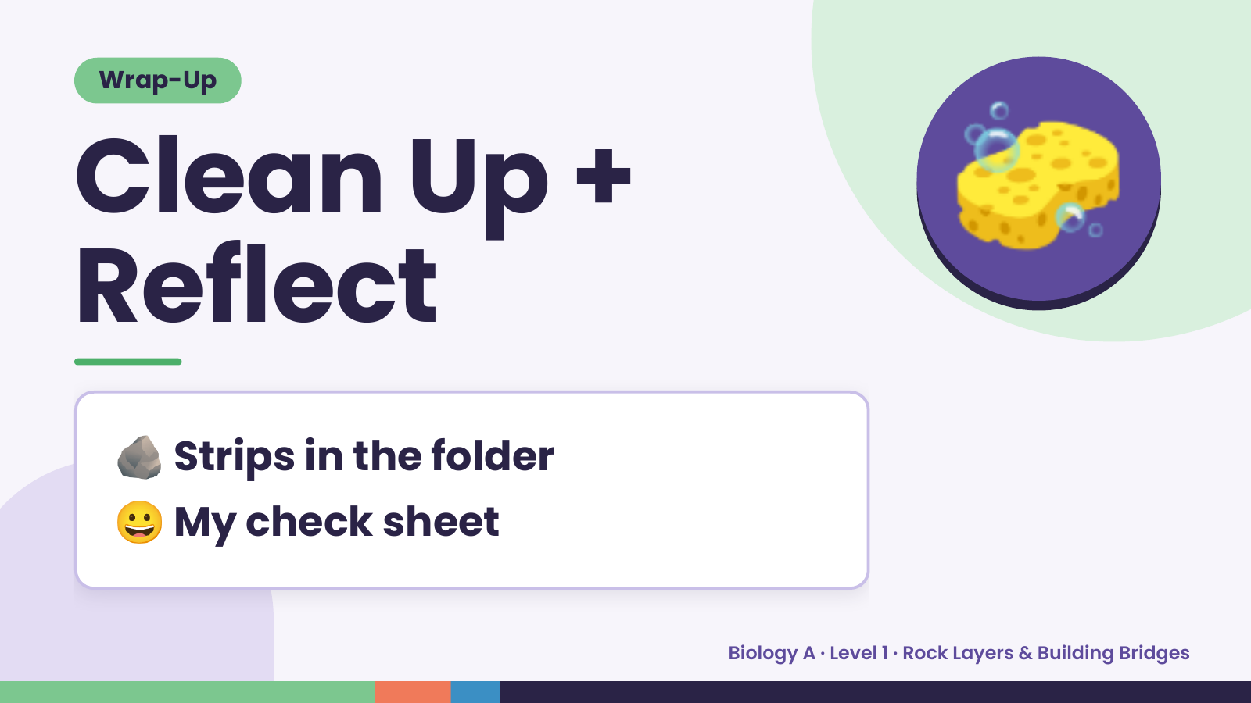
Notes:
Wrap-Up
Clean Up +
Reflect
🧽
🪨 Strips in the folder
😀 My check sheet
Biology A · Level 1 · Rock Layers & Building Bridges

