Slide 1
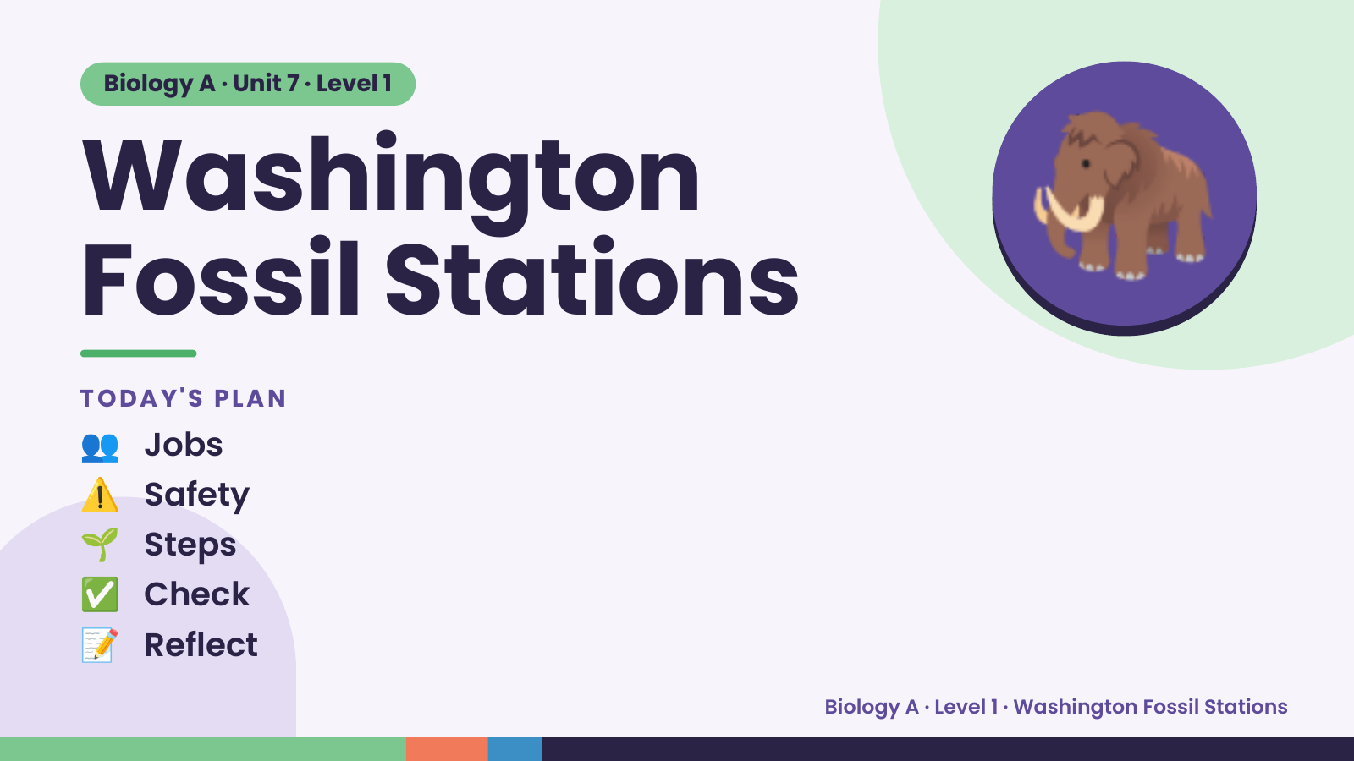
Notes:
Biology A · Unit 7 · Level 1
Washington
Fossil Stations
TODAY'S PLAN
🦣
👥 Jobs
⚠️ Safety
🌱 Steps
✅ Check
📝 Reflect
Biology A · Level 1 · Washington Fossil Stations

Slide 2
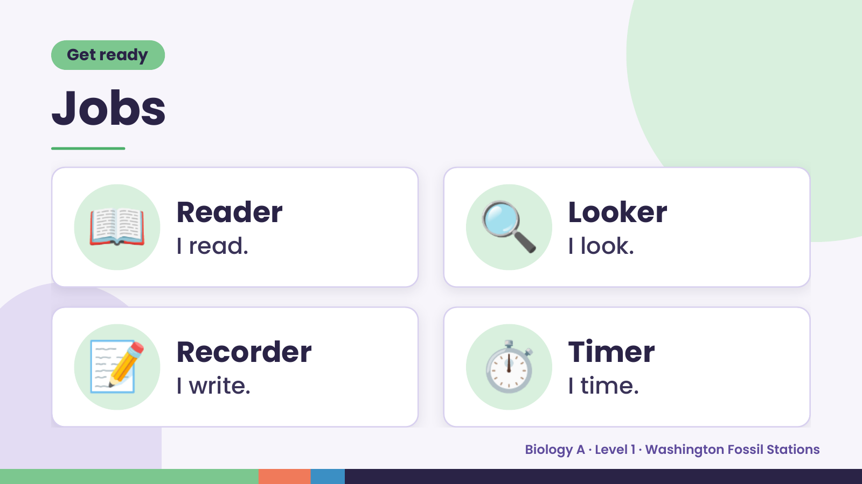
Notes:
Get ready
Jobs
📖 Reader
I read. 🔍 Looker
I look.
📝 Recorder
I write. ⏱️ Timer
I time.
Biology A · Level 1 · Washington Fossil Stations

Slide 3
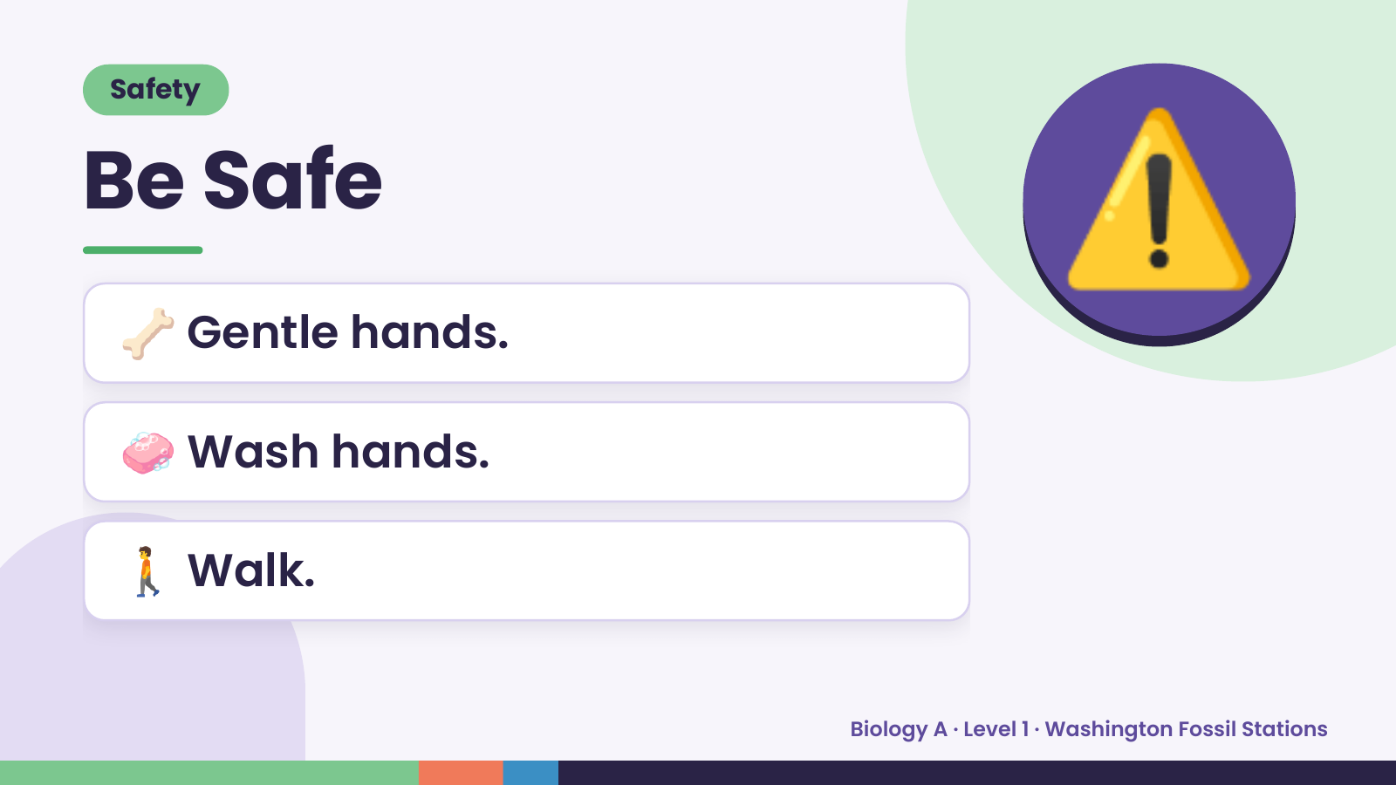
Notes:
Safety
Be Safe
🦴 Gentle hands.
⚠️
🧼 Wash hands.
🚶 Walk.
Biology A · Level 1 · Washington Fossil Stations

Slide 4
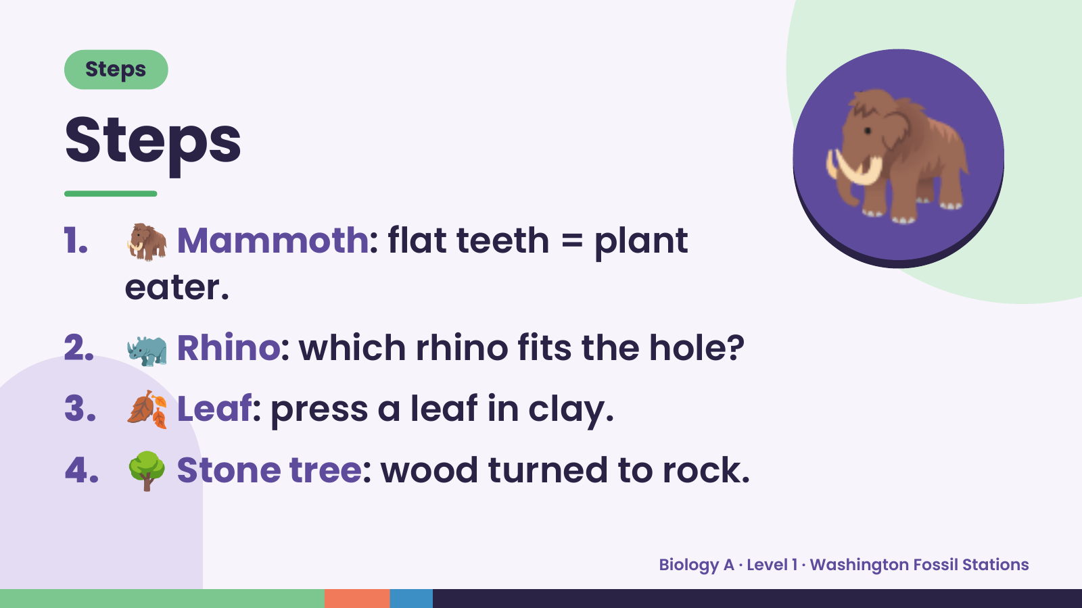
Notes:
Steps
Steps
1. 🦣 Mammoth: flat teeth = plant
eater.
🦣
2. 🦏 Rhino: which rhino fits the hole?
3. 🍂 Leaf: press a leaf in clay.
4. 🌳 Stone tree: wood turned to rock.
Biology A · Level 1 · Washington Fossil Stations

Slide 5
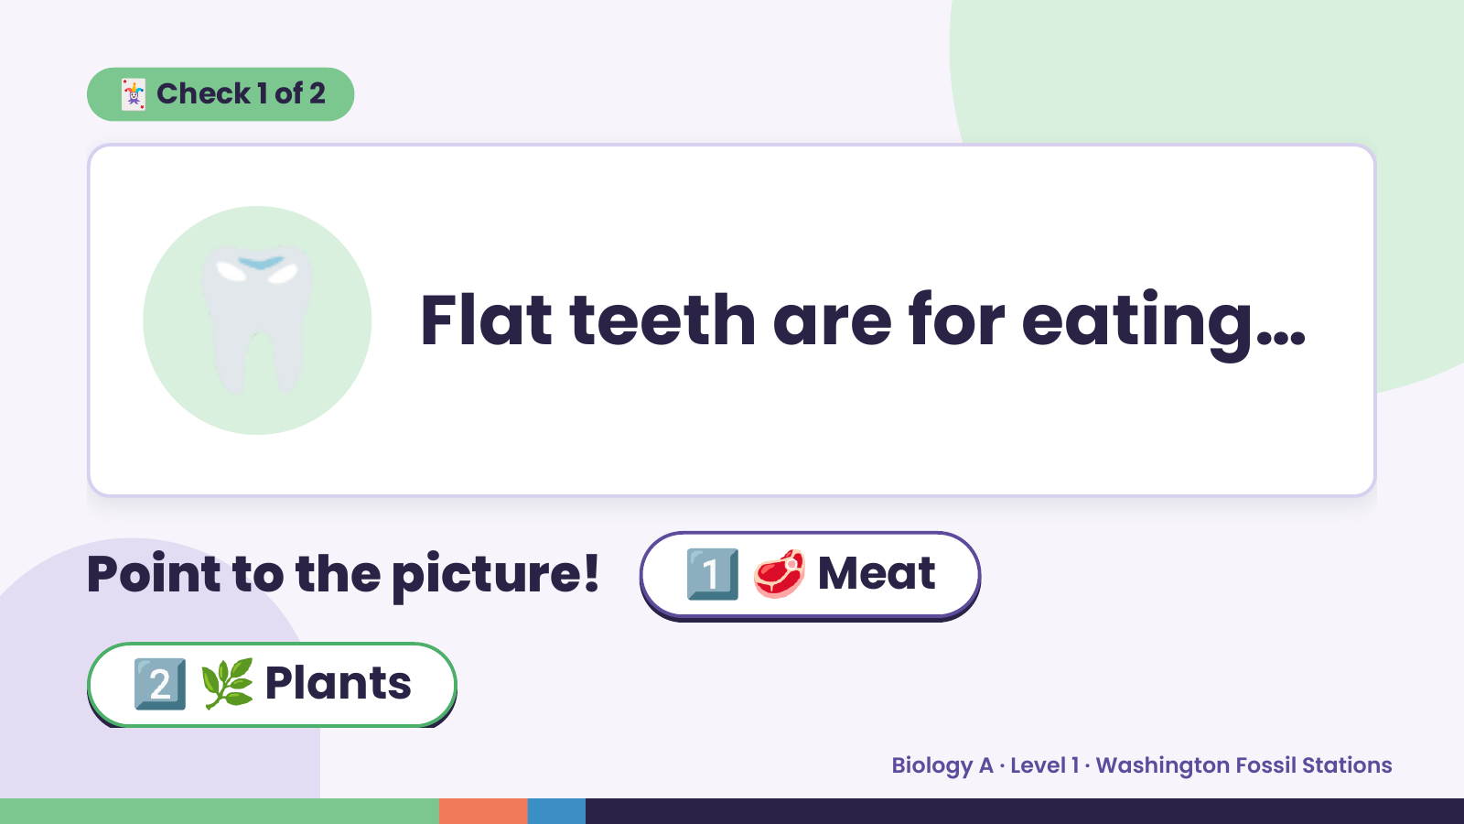
Notes:
🃏 Check 1 of 2
🦷 Flat teeth are for eating…
Point to the picture! 1️⃣ 🥩 Meat
2️⃣ 🌿 Plants
Biology A · Level 1 · Washington Fossil Stations

Slide 6
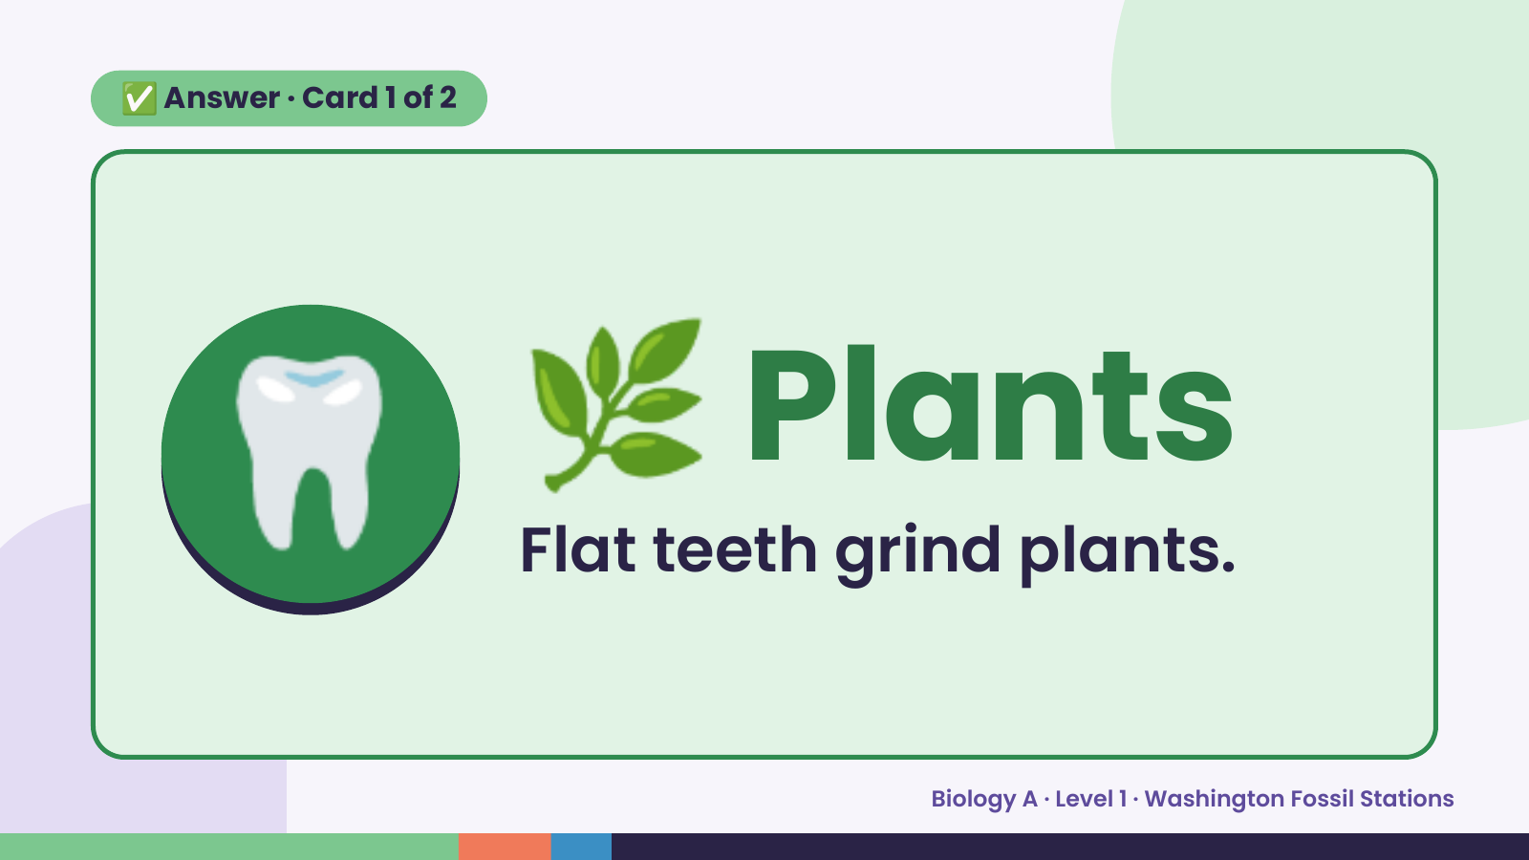
Notes:
✅ Answer · Card 1 of 2
🦷 🌿 Plants
Flat teeth grind plants.
Biology A · Level 1 · Washington Fossil Stations

Slide 7
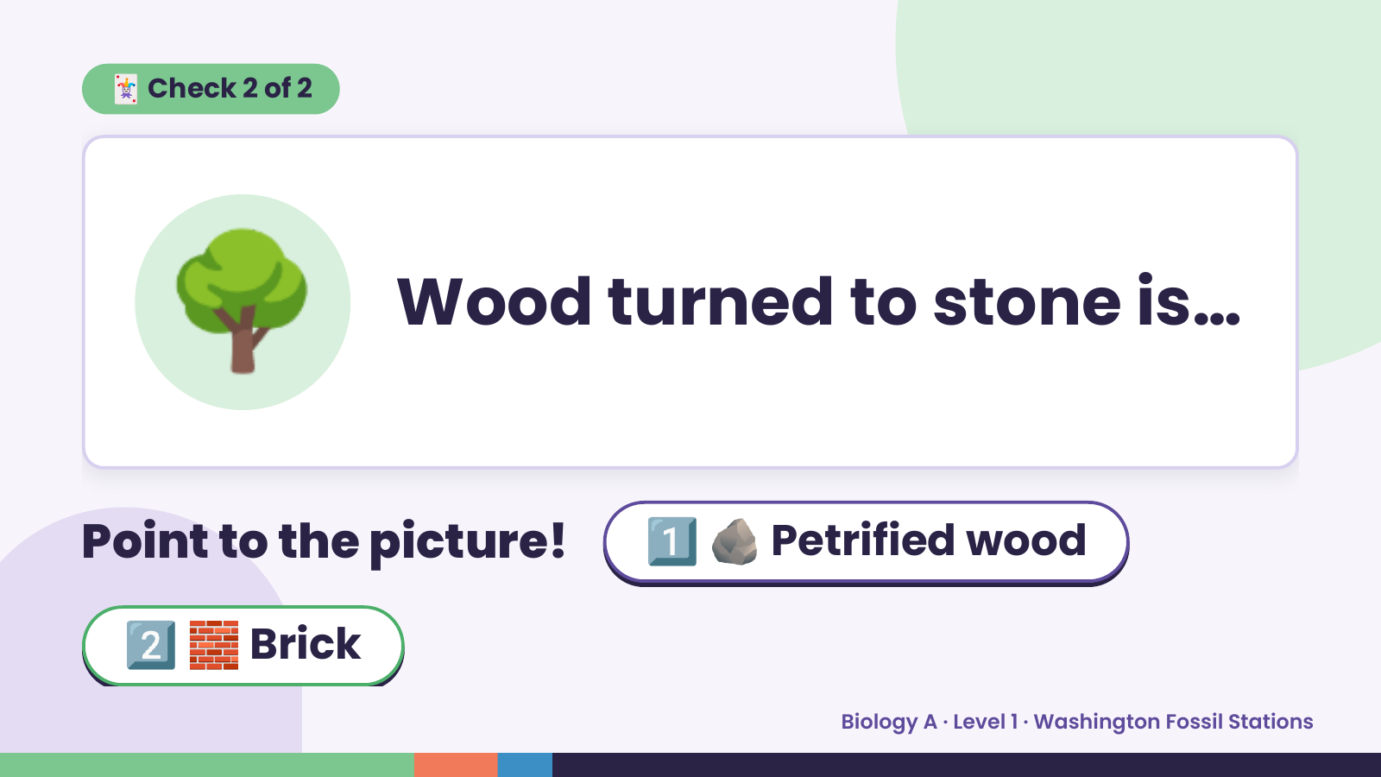
Notes:
🃏 Check 2 of 2
🌳 Wood turned to stone is…
Point to the picture! 1️⃣ 🪨 Petrified wood
2️⃣ 🧱 Brick
Biology A · Level 1 · Washington Fossil Stations

Slide 8
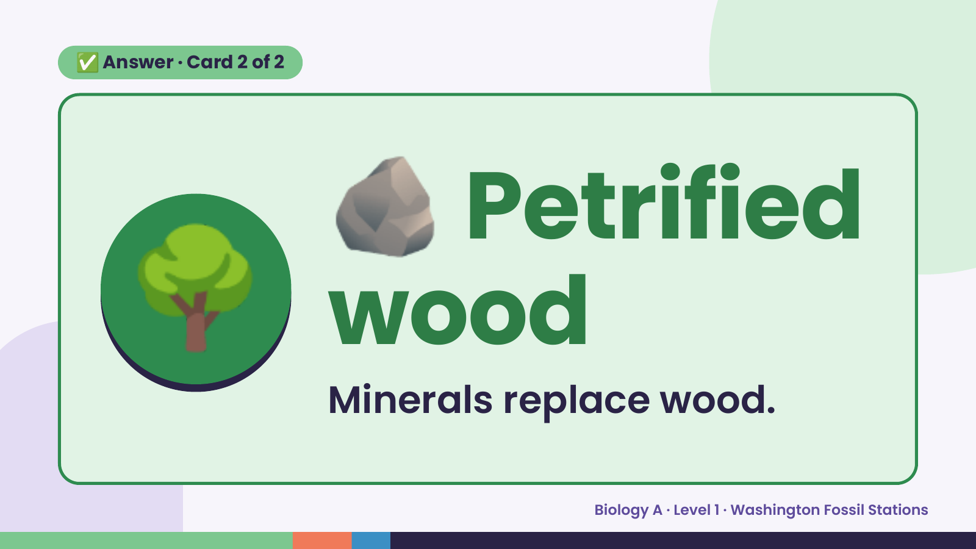
Notes:
🪨
✅ Answer · Card 2 of 2
🌳 wood
Petrified
Minerals replace wood.
Biology A · Level 1 · Washington Fossil Stations

Slide 9
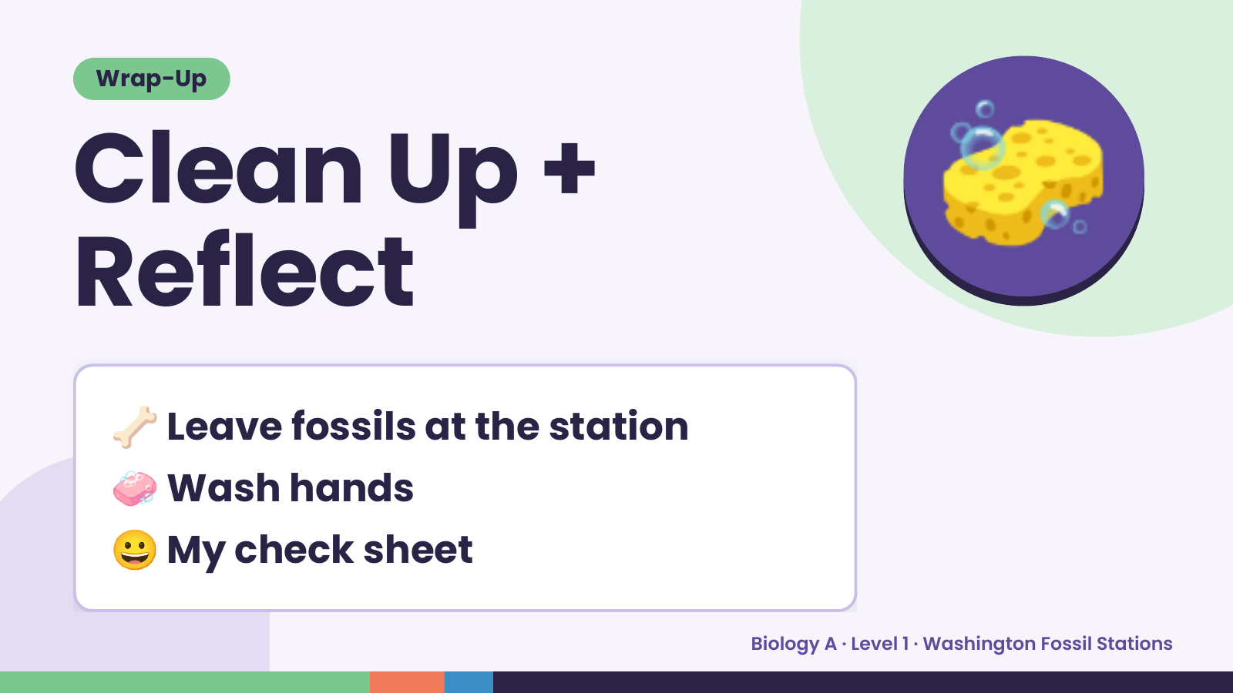
Notes:
Wrap-Up
Clean Up +
Reflect
🧽
🦴 Leave fossils at the station
🧼 Wash hands
😀 My check sheet
Biology A · Level 1 · Washington Fossil Stations

