Slide 1
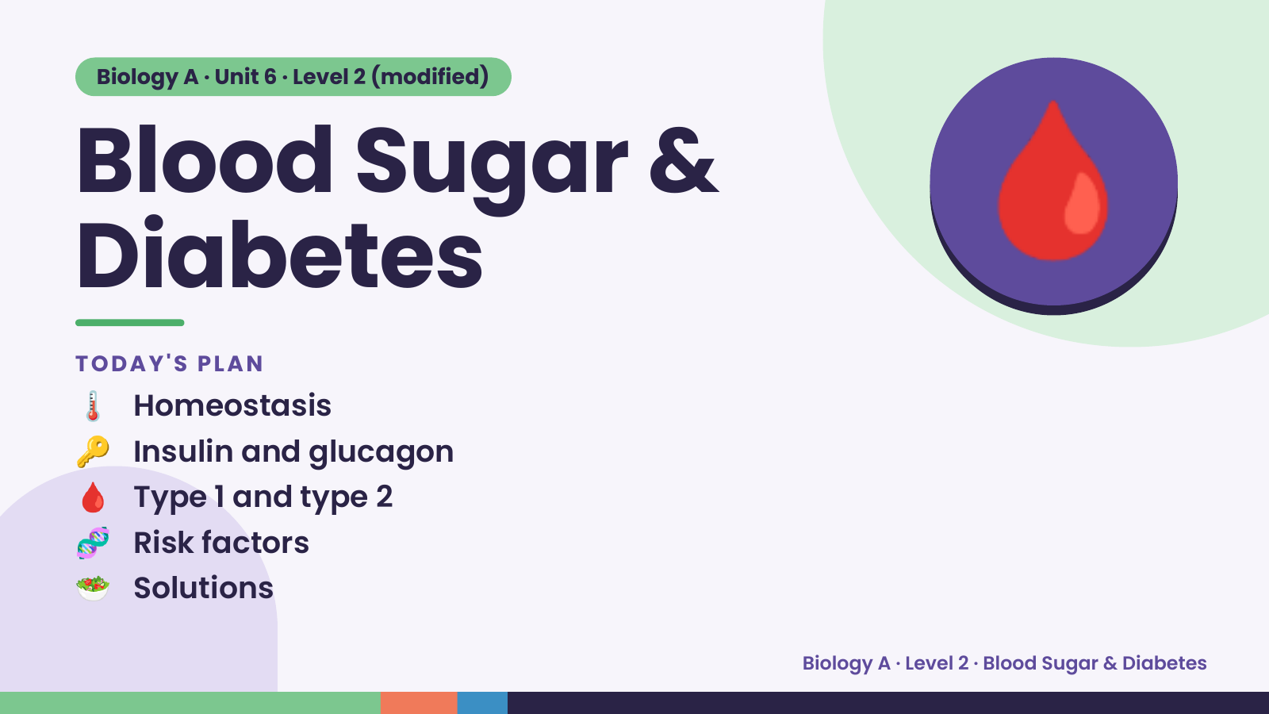
Notes:
Biology A · Unit 6 · Level 2 (modified)
Blood Sugar &
Diabetes
🌡️ Homeostasis
TODAY'S PLAN
🩸
🔑 Insulin and glucagon
🩸 Type 1 and type 2
🧬 Risk factors
🥗 Solutions
Biology A · Level 2 · Blood Sugar & Diabetes

Slide 2
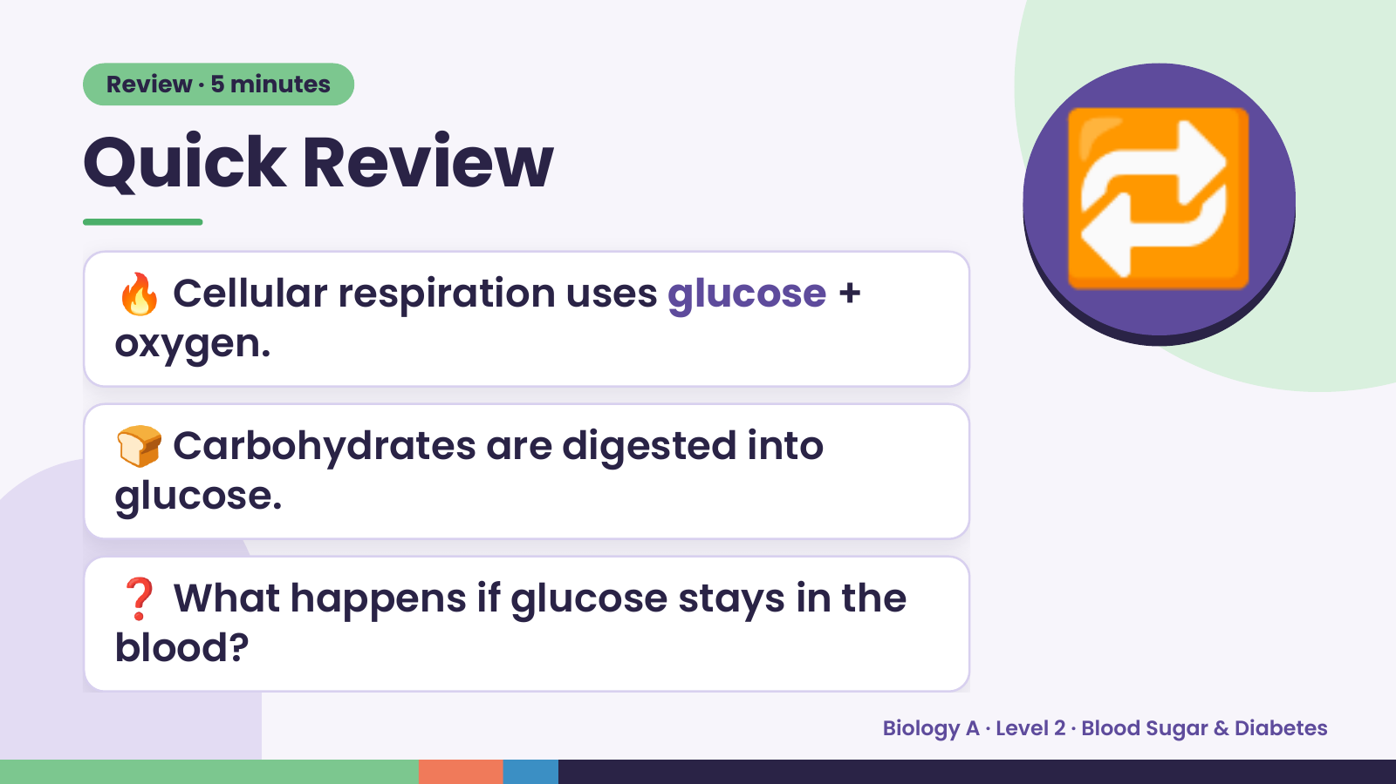
Notes:
Review · 5 minutes
Quick Review
🔥 Cellular respiration uses glucose +
oxygen.
🔁
🍞 Carbohydrates are digested into
glucose.
❓ What happens if glucose stays in the
blood?
Biology A · Level 2 · Blood Sugar & Diabetes

Slide 3
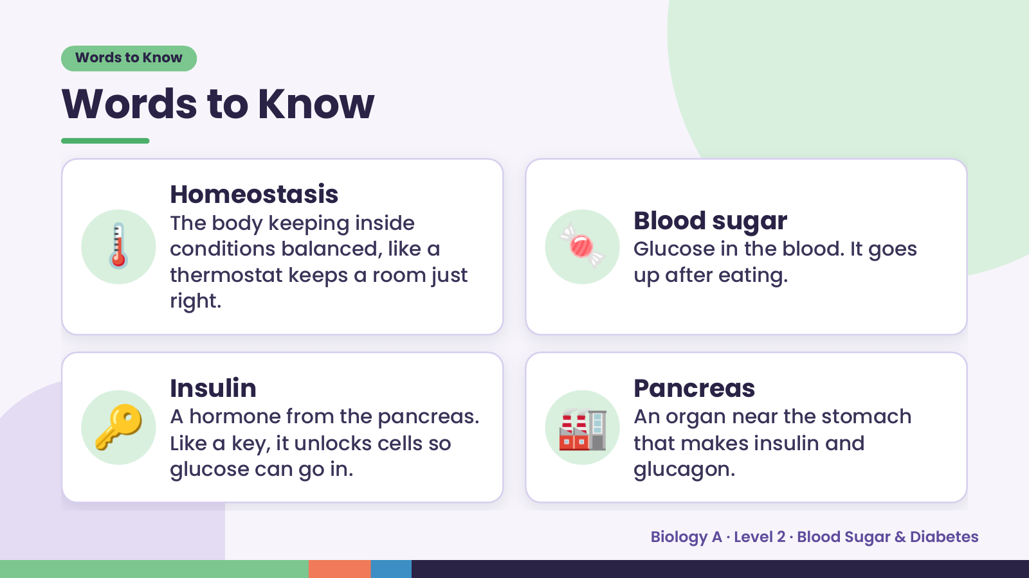
Notes:
Words to Know
Words to Know
🌡️ 🍬
Homeostasis
The body keeping inside Blood sugar
conditions balanced, like a Glucose in the blood. It goes
thermostat keeps a room just up after eating.
right.
🔑 Insulin
A hormone from the pancreas.
Like a key, it unlocks cells so
glucose can go in.
🏭 Pancreas
An organ near the stomach
that makes insulin and
glucagon.
Biology A · Level 2 · Blood Sugar & Diabetes

Slide 4
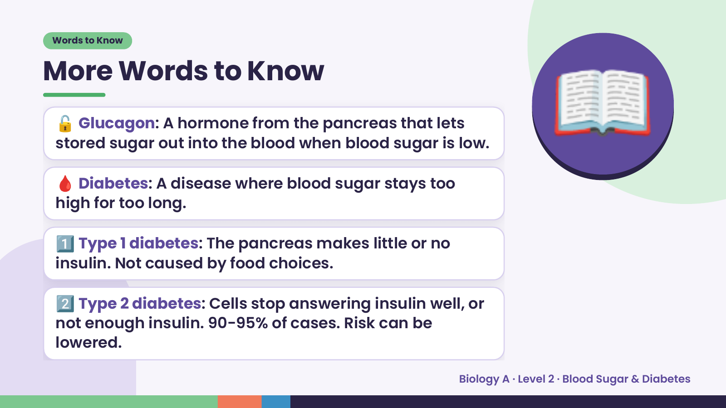
Notes:
Words to Know
More Words to Know
🔓 Glucagon: A hormone from the pancreas that lets
stored sugar out into the blood when blood sugar is low.
🩸 Diabetes: A disease where blood sugar stays too
high for too long.
📖
1️⃣ Type 1 diabetes: The pancreas makes little or no
insulin. Not caused by food choices.
2️⃣ Type 2 diabetes: Cells stop answering insulin well, or
not enough insulin. 90-95% of cases. Risk can be
lowered.
Biology A · Level 2 · Blood Sugar & Diabetes

Slide 5
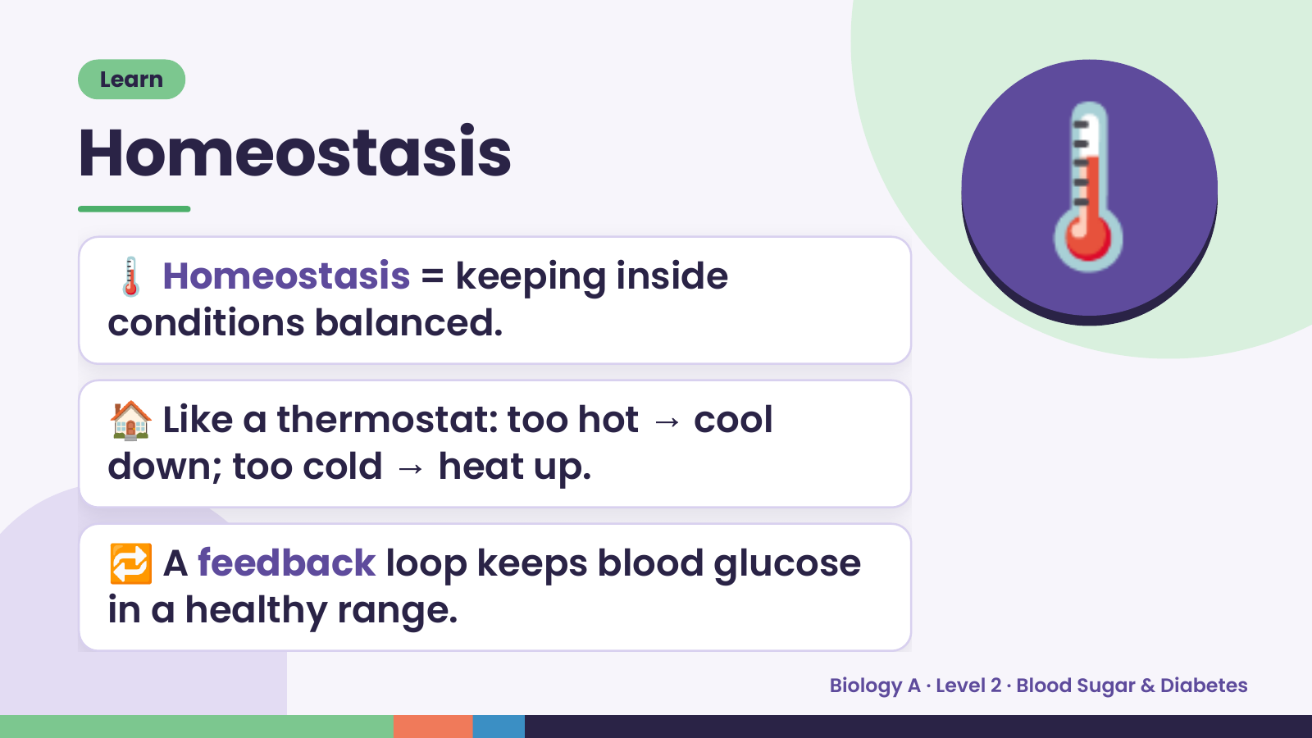
Notes:
Learn
Homeostasis
🌡️ Homeostasis = keeping inside
conditions balanced.
🌡️
🏠 Like a thermostat: too hot → cool
down; too cold → heat up.
🔁 A feedback loop keeps blood glucose
in a healthy range.
Biology A · Level 2 · Blood Sugar & Diabetes

Slide 6
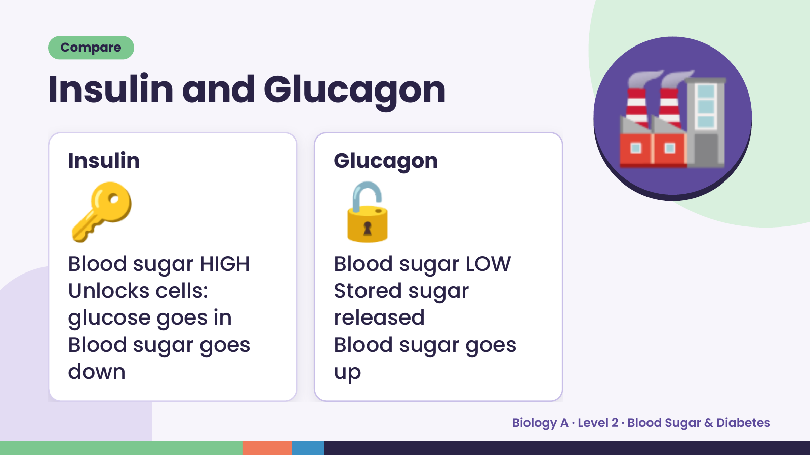
Notes:
Compare
Insulin and Glucagon
🔑
Insulin
🔓
Glucagon
🏭
Blood sugar HIGH Blood sugar LOW
Unlocks cells: Stored sugar
glucose goes in released
Blood sugar goes Blood sugar goes
down up
Biology A · Level 2 · Blood Sugar & Diabetes

Slide 7
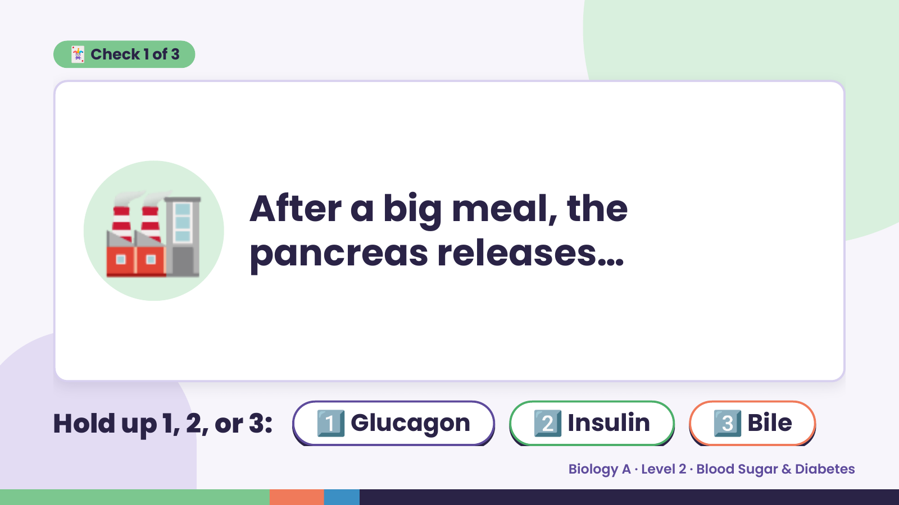
Notes:
🃏 Check 1 of 3
🏭 After a big meal, the
pancreas releases…
Hold up 1, 2, or 3: 1️⃣ Glucagon 2️⃣ Insulin 3️⃣ Bile
Biology A · Level 2 · Blood Sugar & Diabetes

Slide 8
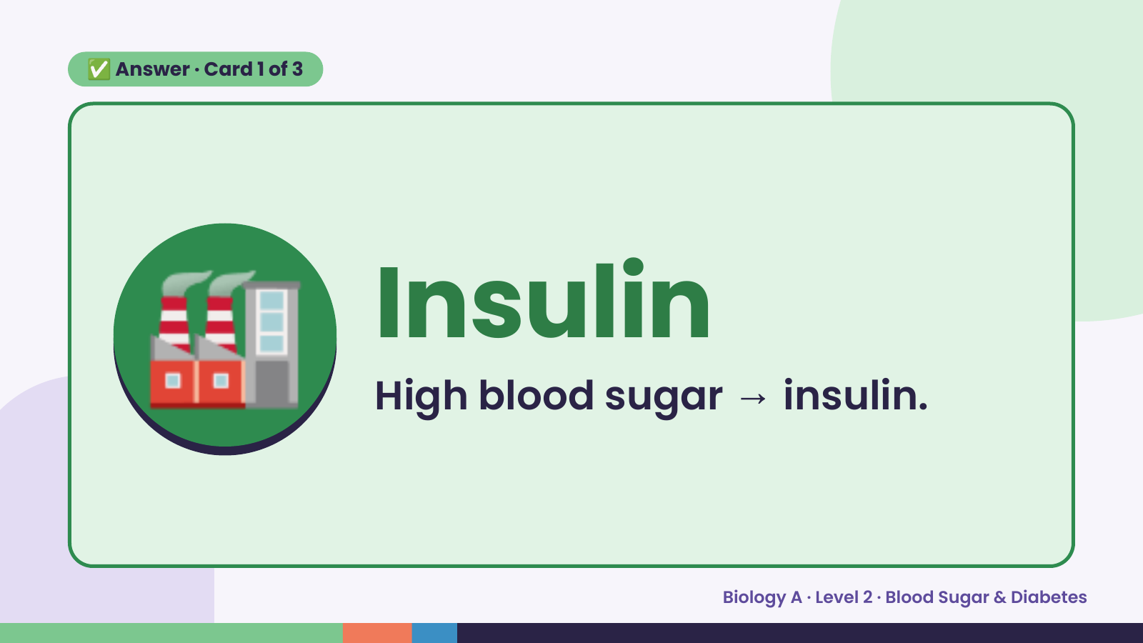
Notes:
✅ Answer · Card 1 of 3
🏭 Insulin
High blood sugar → insulin.
Biology A · Level 2 · Blood Sugar & Diabetes

Slide 9
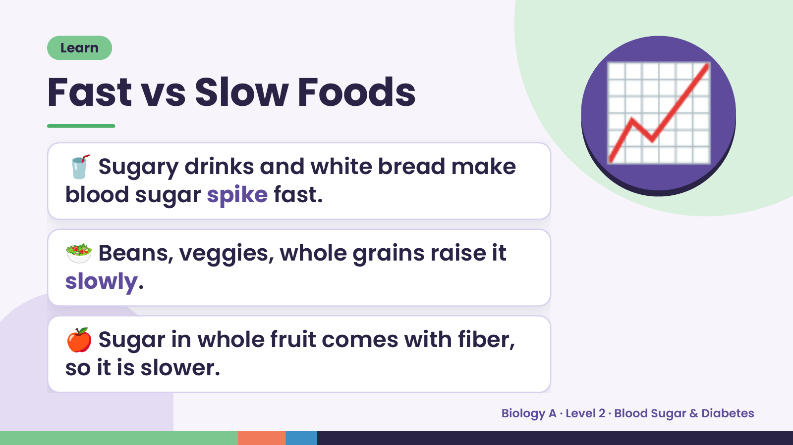
Notes:
Learn
Fast vs Slow Foods
🥤 Sugary drinks and white bread make
blood sugar spike fast.
📈
🥗 Beans, veggies, whole grains raise it
slowly.
🍎 Sugar in whole fruit comes with fiber,
so it is slower.
Biology A · Level 2 · Blood Sugar & Diabetes

Slide 10
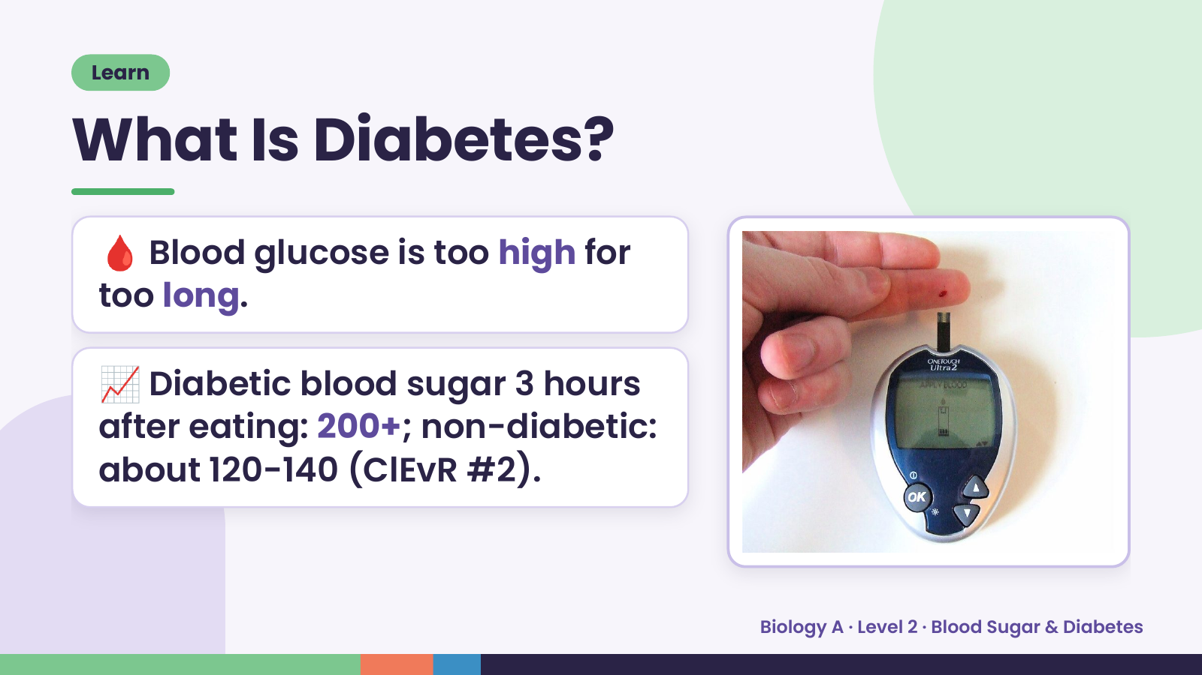
Notes:
Learn
What Is Diabetes?
🩸 Blood glucose is too high for
too long.
📈 Diabetic blood sugar 3 hours
after eating: 200+; non-diabetic:
about 120-140 (ClEvR #2).
Biology A · Level 2 · Blood Sugar & Diabetes

Slide 11
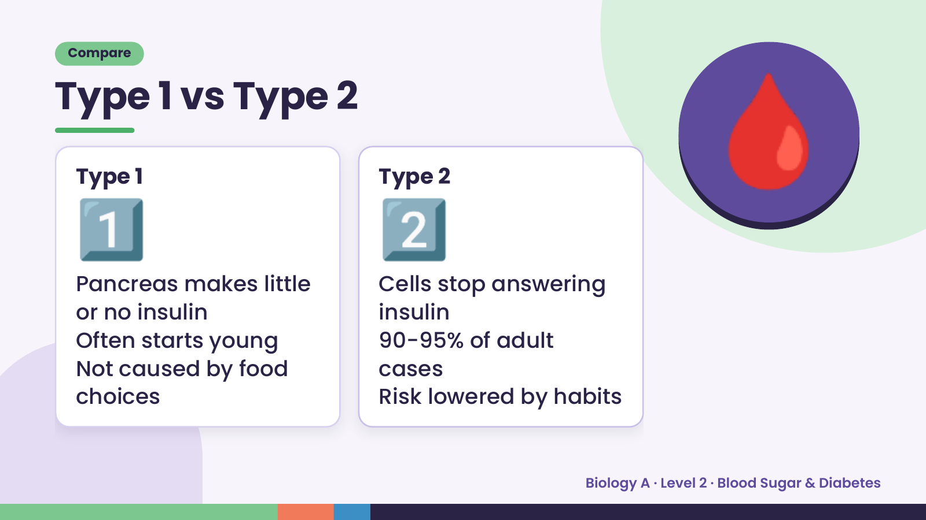
Notes:
Compare
Type 1 vs Type 2
1️⃣
Type 1
Pancreas makes little
2️⃣
Type 2
Cells stop answering
🩸
or no insulin insulin
Often starts young 90-95% of adult
Not caused by food cases
choices Risk lowered by habits
Biology A · Level 2 · Blood Sugar & Diabetes

Slide 12
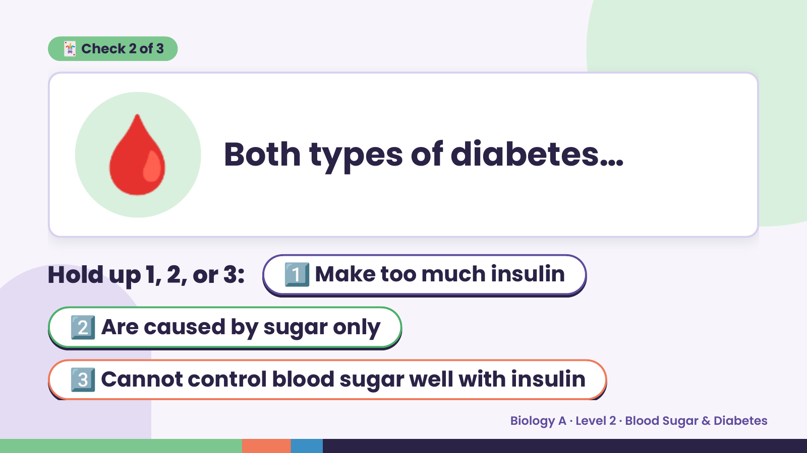
Notes:
🩸
🃏 Check 2 of 3
Both types of diabetes…
Hold up 1, 2, or 3: 1️⃣ Make too much insulin
2️⃣ Are caused by sugar only
3️⃣ Cannot control blood sugar well with insulin
Biology A · Level 2 · Blood Sugar & Diabetes

Slide 13
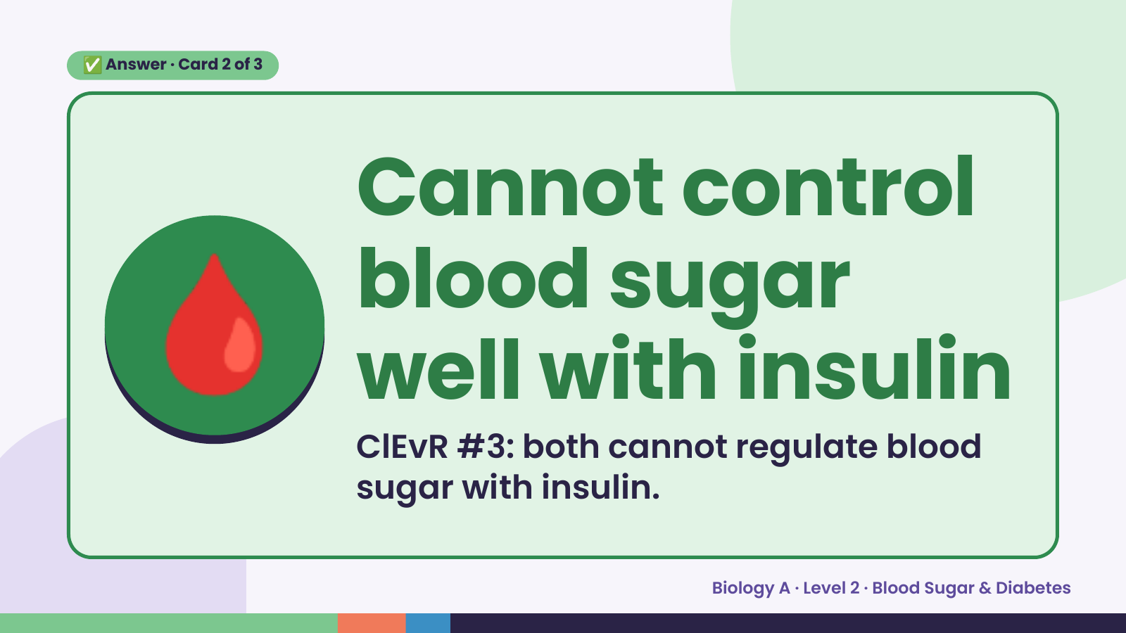
Notes:
✅ Answer · Card 2 of 3
🩸 Cannot control
blood sugar
well with insulin
ClEvR #3: both cannot regulate blood
sugar with insulin.
Biology A · Level 2 · Blood Sugar & Diabetes

Slide 14
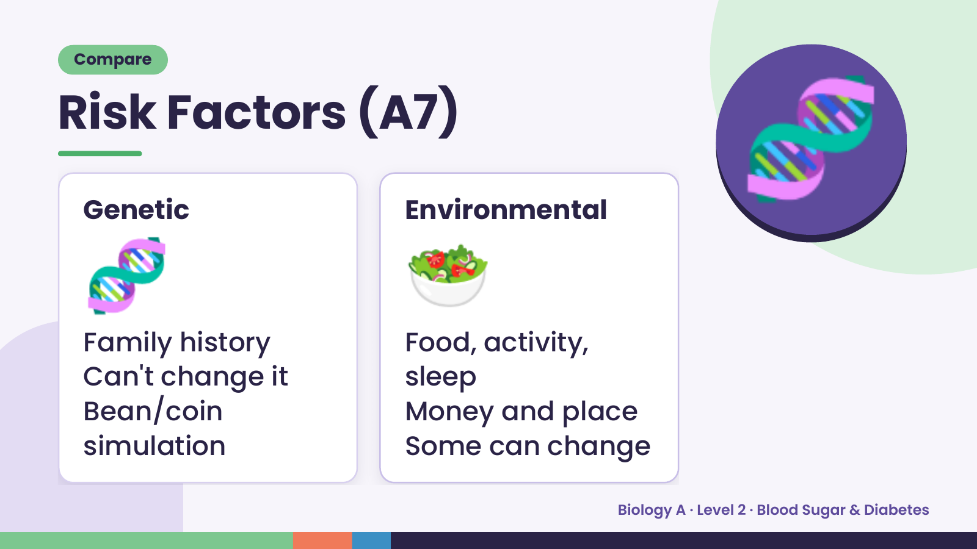
Notes:
Compare
Risk Factors (A7)
🧬
Genetic
🥗
Environmental
🧬
Family history Food, activity,
Can't change it sleep
Bean/coin Money and place
simulation Some can change
Biology A · Level 2 · Blood Sugar & Diabetes

Slide 15
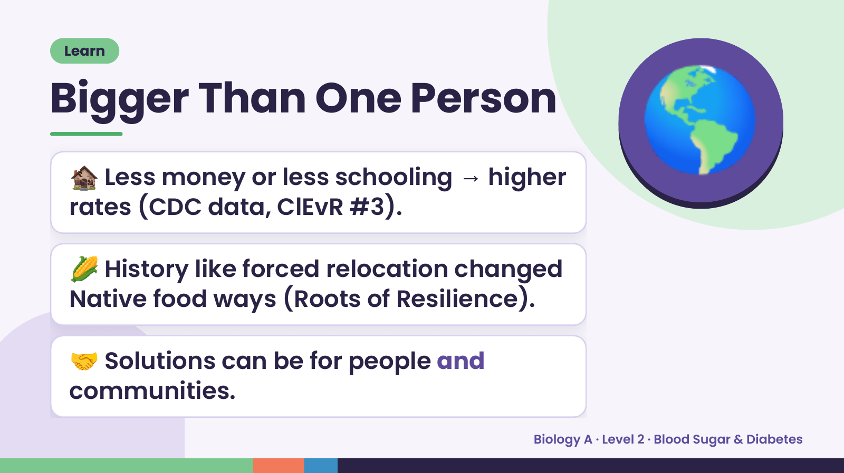
Notes:
Learn
Bigger Than One Person
🏚️ Less money or less schooling → higher
rates (CDC data, ClEvR #3).
🌎
🌽 History like forced relocation changed
Native food ways (Roots of Resilience).
🤝 Solutions can be for people and
communities.
Biology A · Level 2 · Blood Sugar & Diabetes

Slide 16
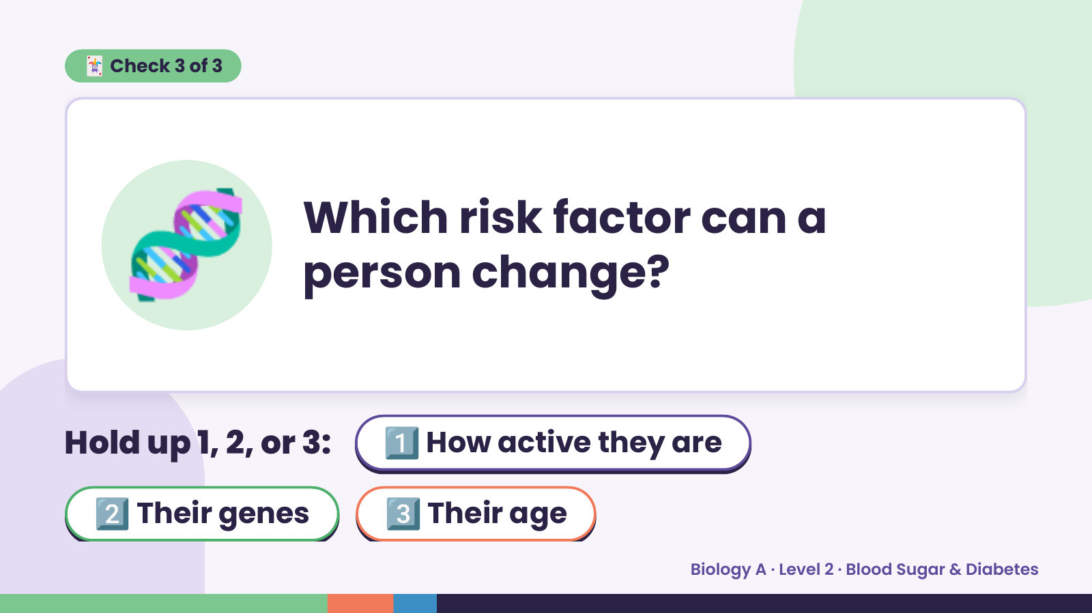
Notes:
🃏 Check 3 of 3
🧬 Which risk factor can a
person change?
Hold up 1, 2, or 3: 1️⃣ How active they are
2️⃣ Their genes 3️⃣ Their age
Biology A · Level 2 · Blood Sugar & Diabetes

Slide 17
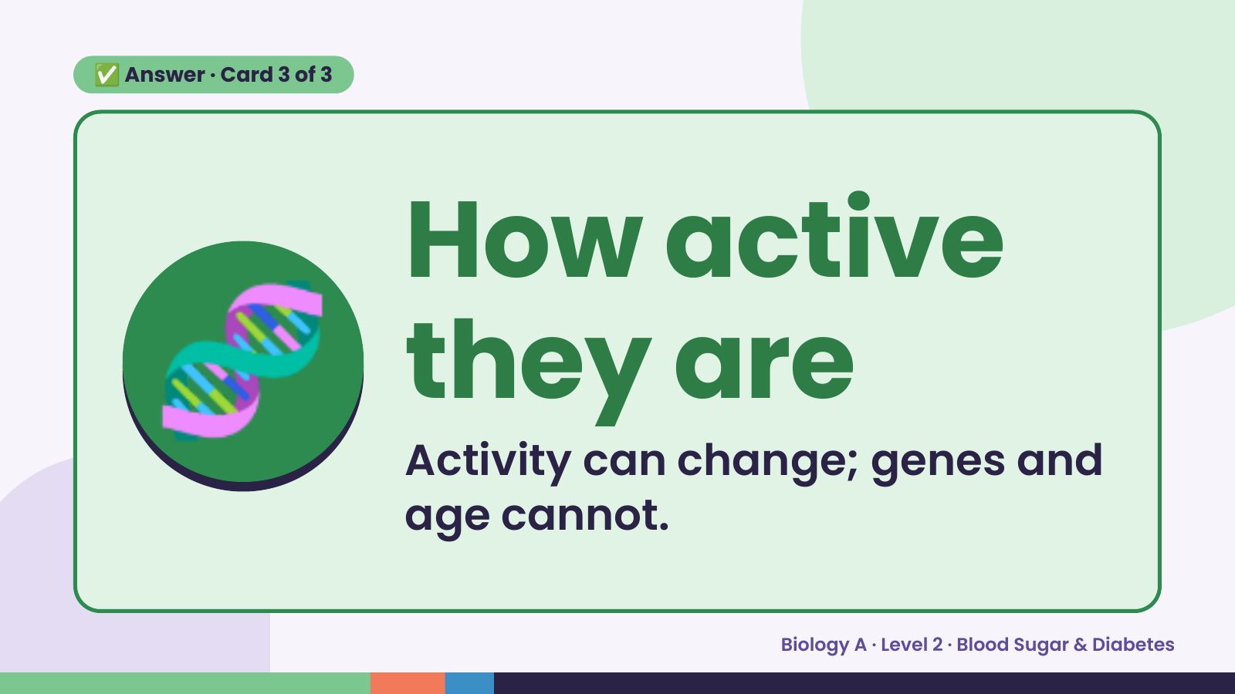
Notes:
✅ Answer · Card 3 of 3
🧬 How active
they are
Activity can change; genes and
age cannot.
Biology A · Level 2 · Blood Sugar & Diabetes

Slide 18
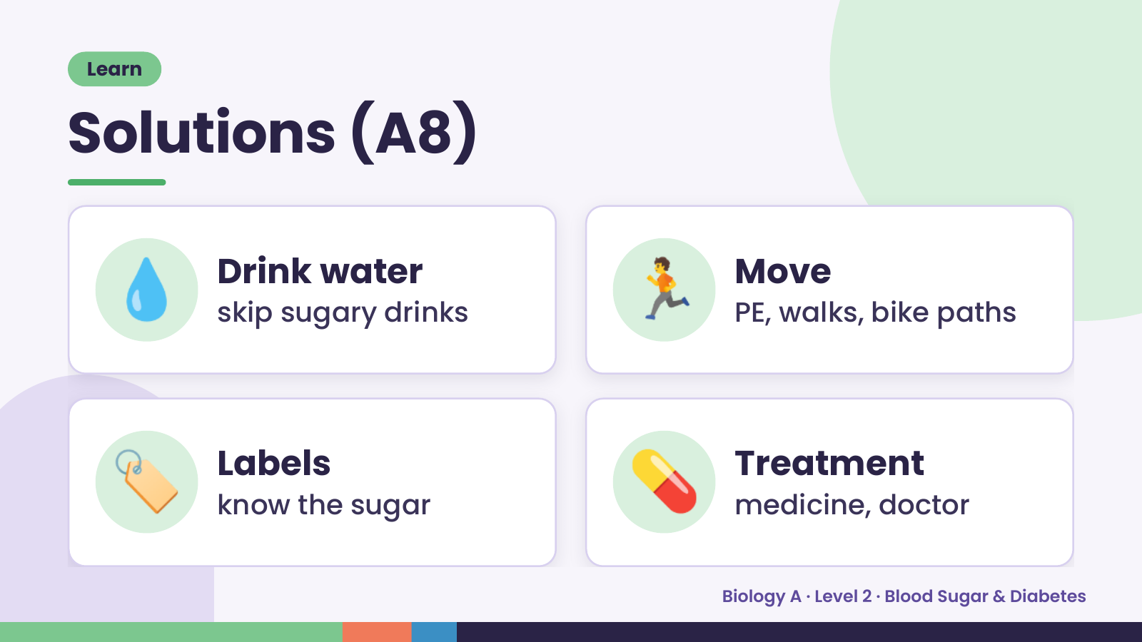
Notes:
Learn
Solutions (A8)
💧 Drink water
skip sugary drinks 🏃 Move
PE, walks, bike paths
🏷️ Labels
know the sugar 💊 Treatment
medicine, doctor
Biology A · Level 2 · Blood Sugar & Diabetes

Slide 19
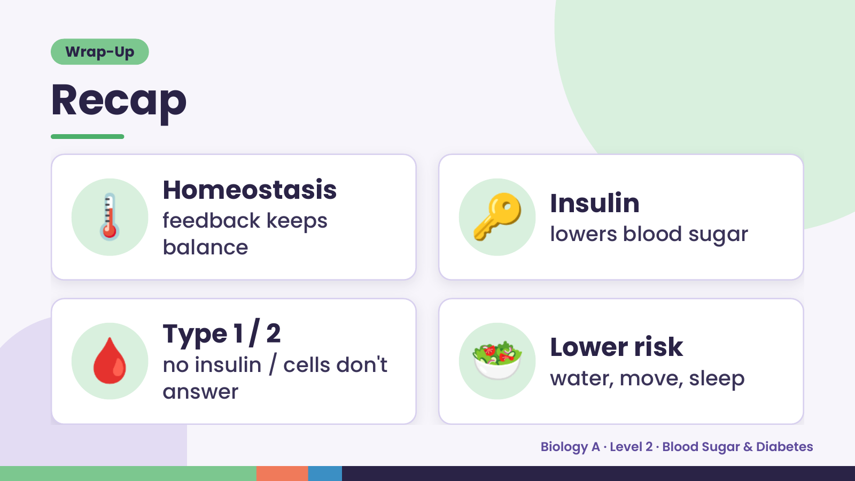
Notes:
Wrap-Up
Recap
🌡️ Homeostasis
feedback keeps
balance
🔑 Insulin
lowers blood sugar
🩸 Type 1 / 2
no insulin / cells don't
answer
🥗 Lower risk
water, move, sleep
Biology A · Level 2 · Blood Sugar & Diabetes

Slide 20
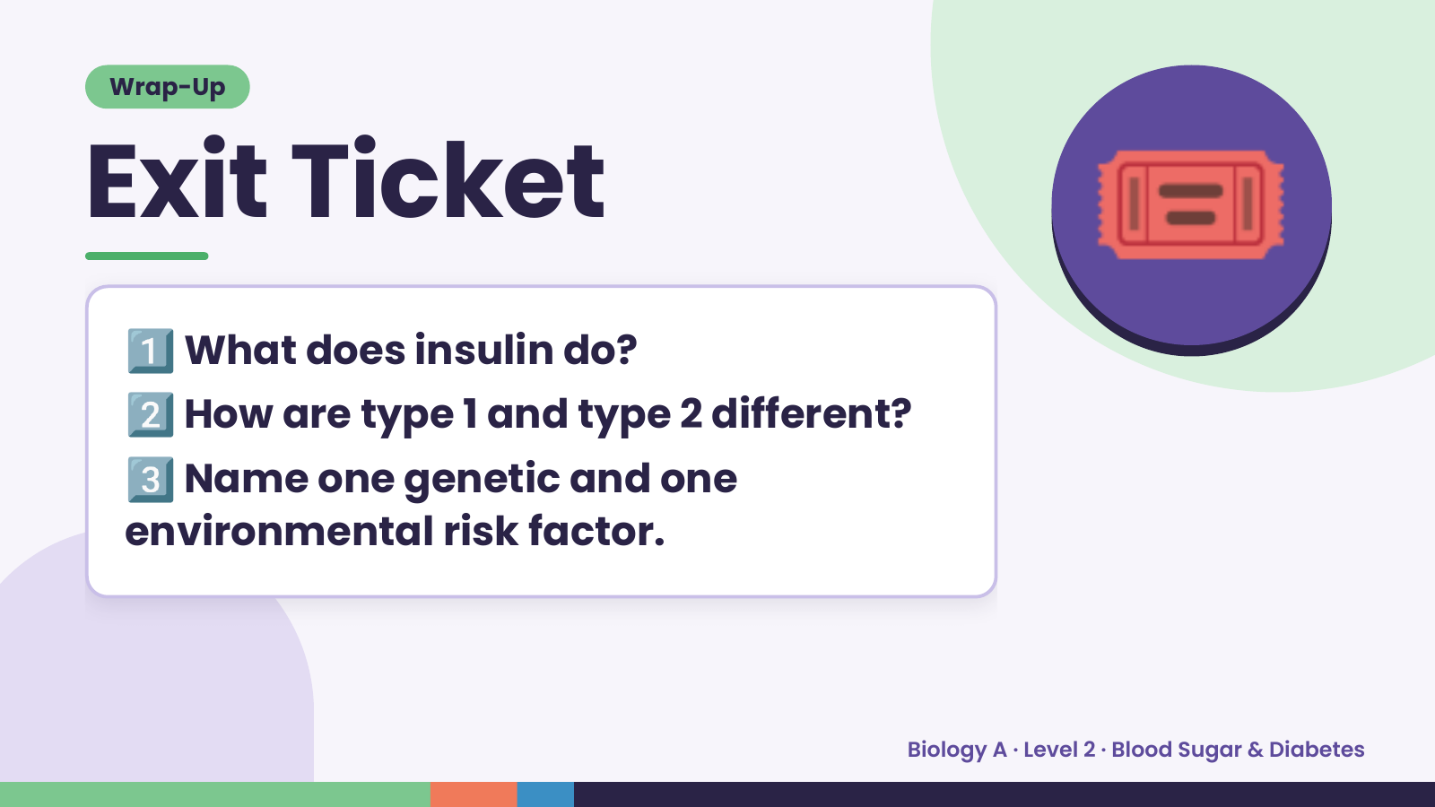
Notes:
Wrap-Up
Exit Ticket
1️⃣
2️⃣
What does insulin do?
How are type 1 and type 2 different?
🎟️
3️⃣
Name one genetic and one
environmental risk factor.
Biology A · Level 2 · Blood Sugar & Diabetes

