Slide 1
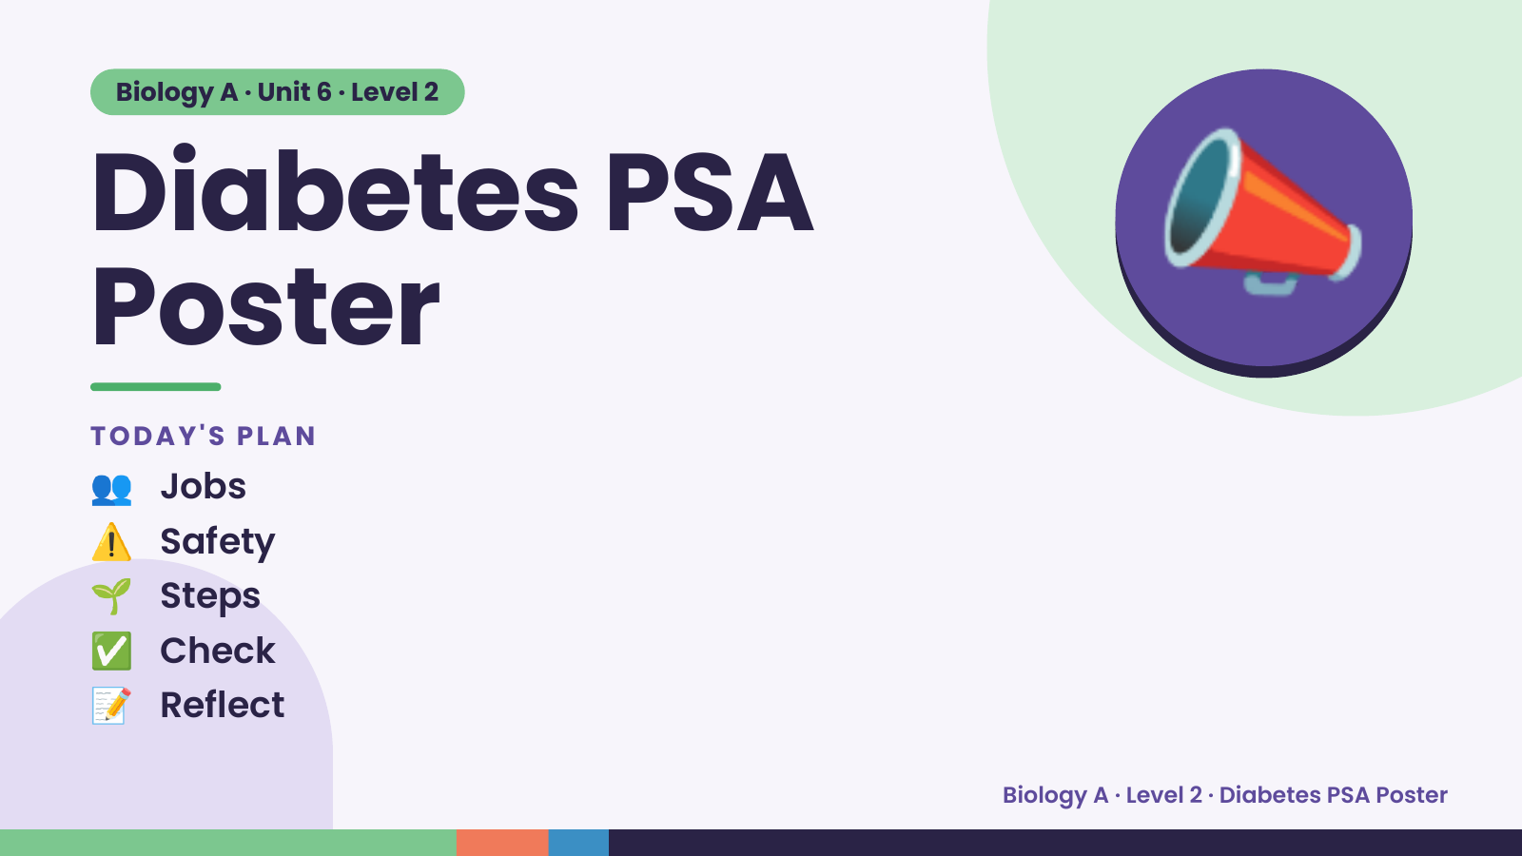
Notes:
Biology A · Unit 6 · Level 2
Diabetes PSA
Poster
👥 Jobs
TODAY'S PLAN
📣
⚠️ Safety
🌱 Steps
✅ Check
📝 Reflect
Biology A · Level 2 · Diabetes PSA Poster

Slide 2
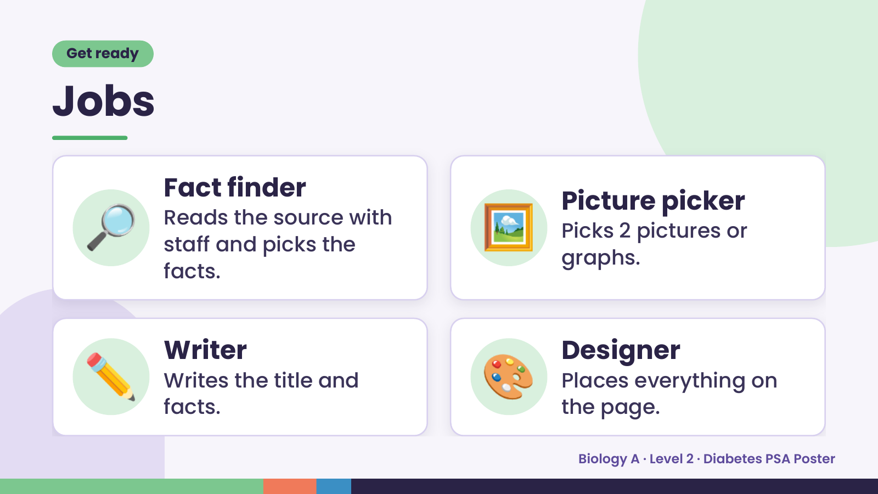
Notes:
Get ready
Jobs
🔎 Fact finder
Reads the source with
staff and picks the
facts.
🖼️ Picture picker
Picks 2 pictures or
graphs.
✏️ Writer
Writes the title and
facts.
🎨 Designer
Places everything on
the page.
Biology A · Level 2 · Diabetes PSA Poster

Slide 3
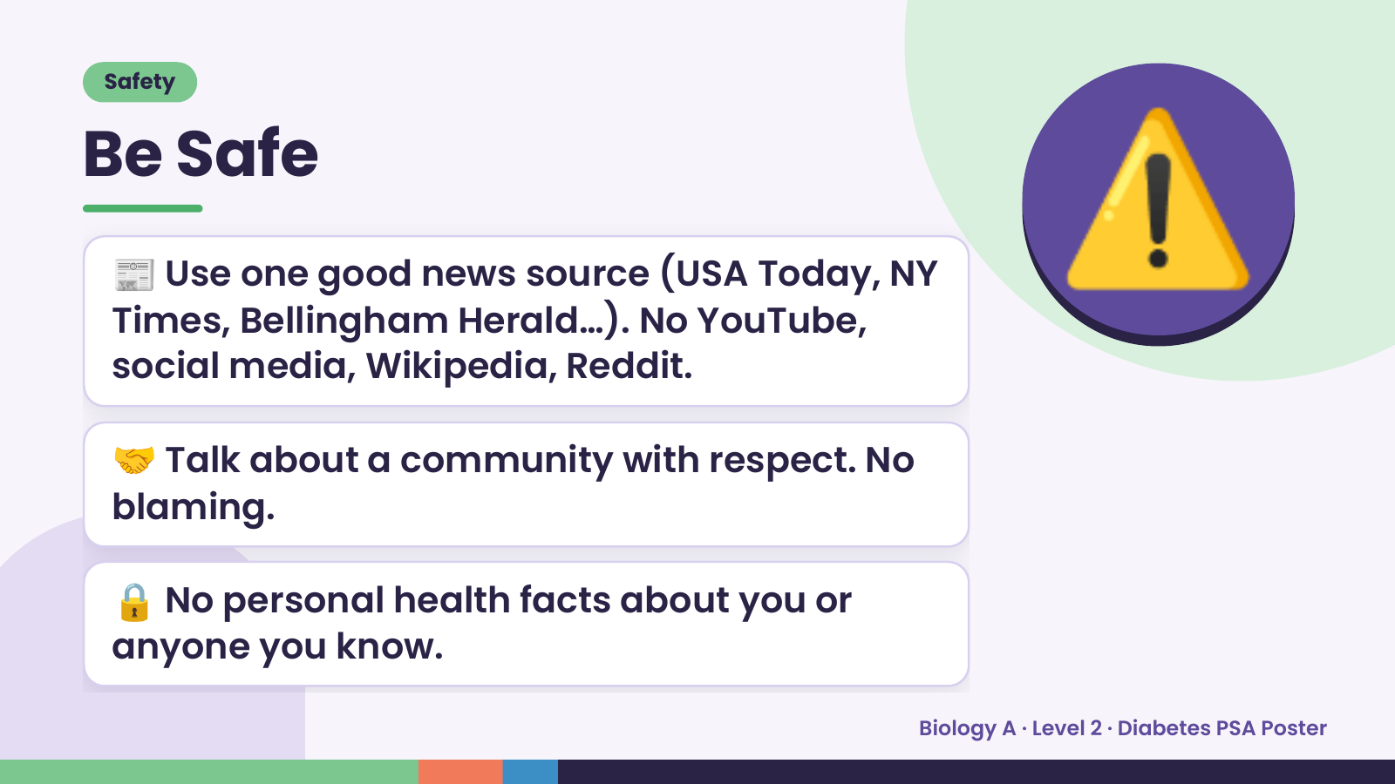
Notes:
Safety
Be Safe
📰 Use one good news source (USA Today, NY
Times, Bellingham Herald…). No YouTube,
social media, Wikipedia, Reddit.
⚠️
🤝 Talk about a community with respect. No
blaming.
🔒 No personal health facts about you or
anyone you know.
Biology A · Level 2 · Diabetes PSA Poster

Slide 4
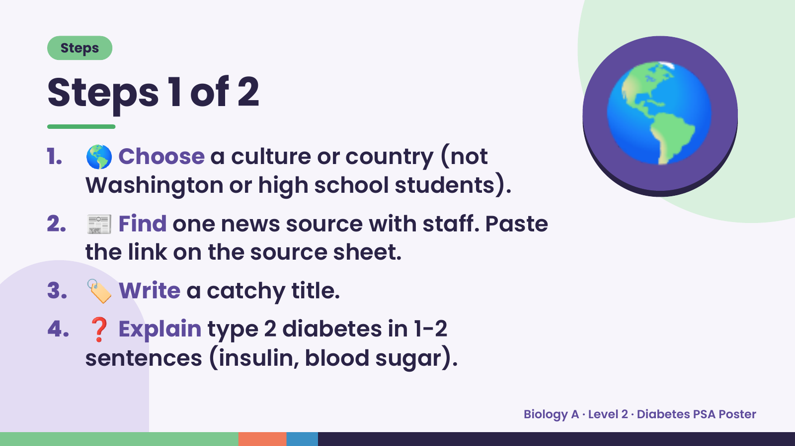
Notes:
Steps
Steps 1 of 2
1. 🌎 Choose a culture or country (not
Washington or high school students).
2. 📰 Find one news source with staff. Paste
the link on the source sheet.
🌎
3. 🏷️ Write a catchy title.
4. ❓ Explain type 2 diabetes in 1-2
sentences (insulin, blood sugar).
Biology A · Level 2 · Diabetes PSA Poster

Slide 5
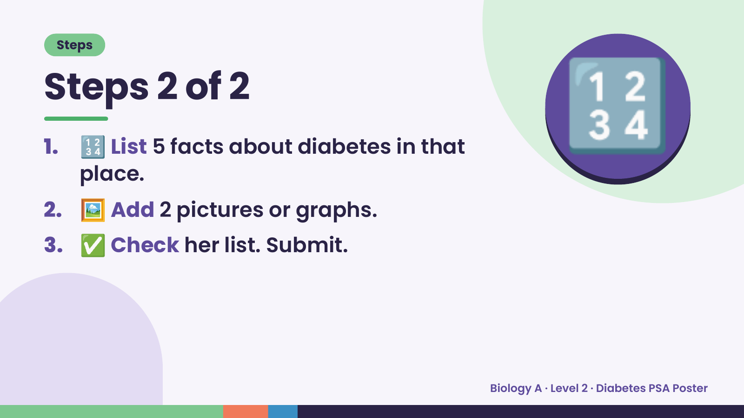
Notes:
Steps
Steps 2 of 2
1. 🔢 List 5 facts about diabetes in that
place.
2. 🖼️ Add 2 pictures or graphs.
🔢
3. ✅ Check her list. Submit.
Biology A · Level 2 · Diabetes PSA Poster

Slide 6
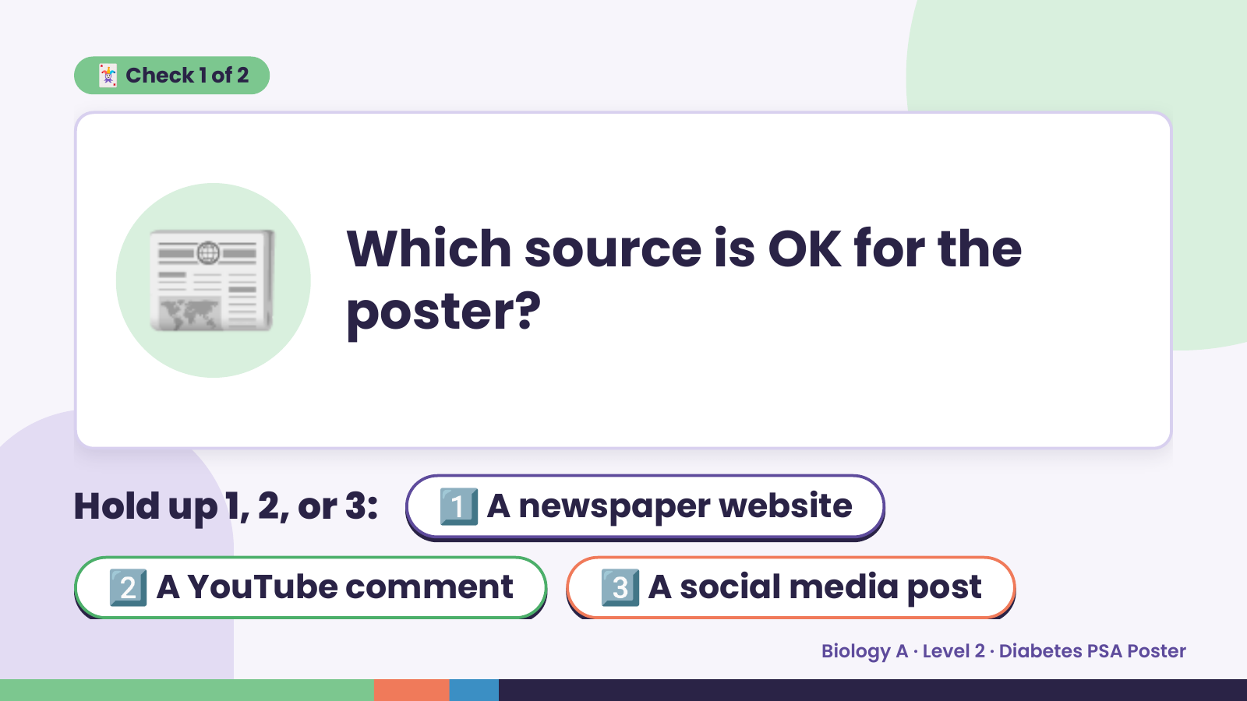
Notes:
🃏 Check 1 of 2
📰 Which source is OK for the
poster?
Hold up 1, 2, or 3:1️⃣ A newspaper website
2️⃣ A YouTube comment 3️⃣ A social media post
Biology A · Level 2 · Diabetes PSA Poster

Slide 7

Notes:
✅ Answer · Card 1 of 2
📰 A
newspaper
website
Use a reputable news source.
Biology A · Level 2 · Diabetes PSA Poster

Slide 8
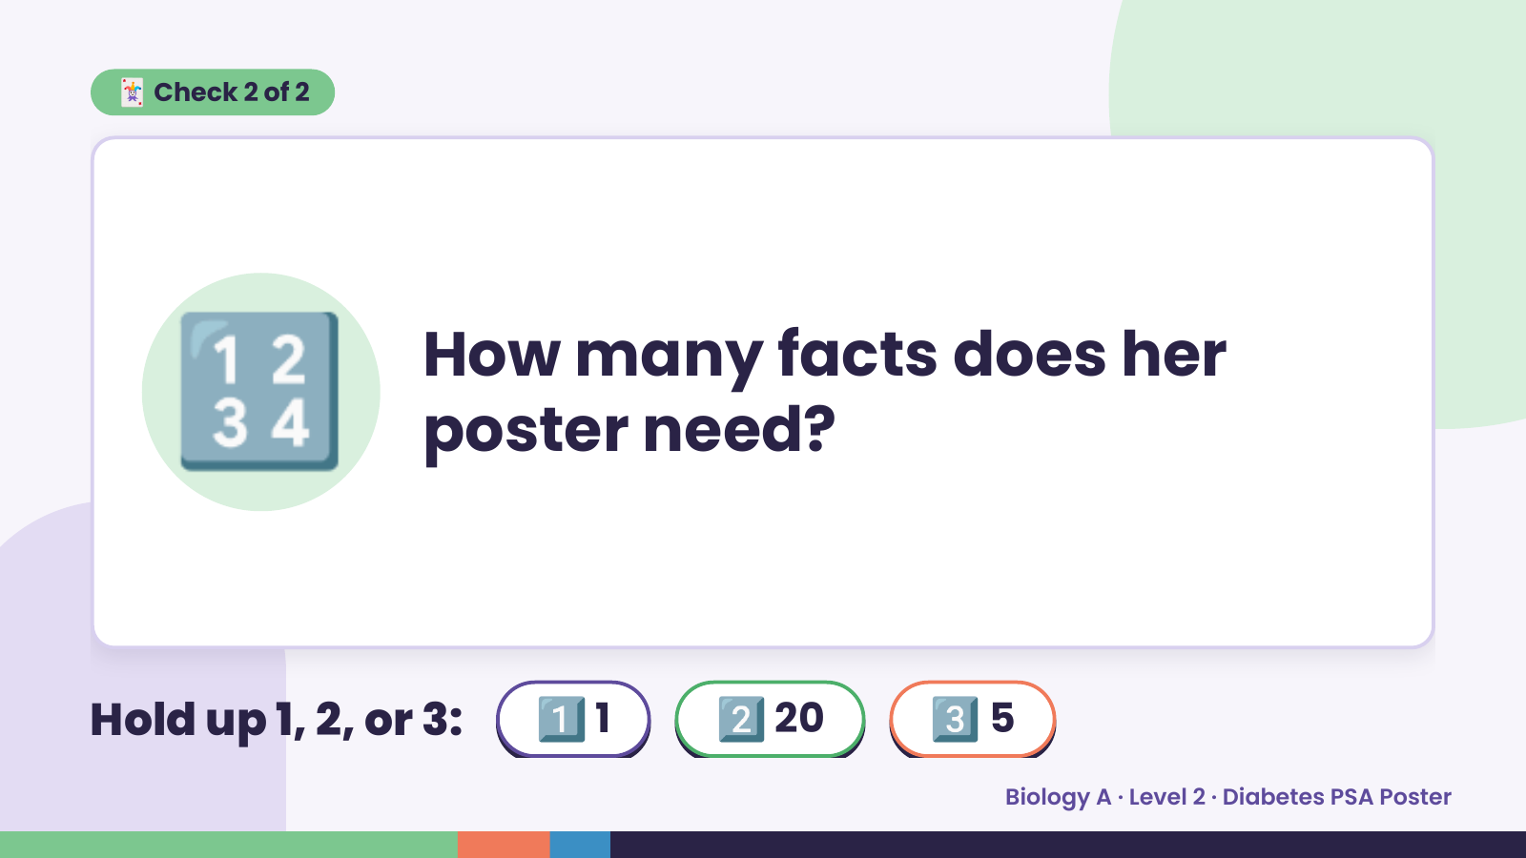
Notes:
🃏 Check 2 of 2
🔢 How many facts does her
poster need?
Hold up 1, 2, or 3: 1️⃣ 1 2️⃣ 20 3️⃣ 5
Biology A · Level 2 · Diabetes PSA Poster

Slide 9
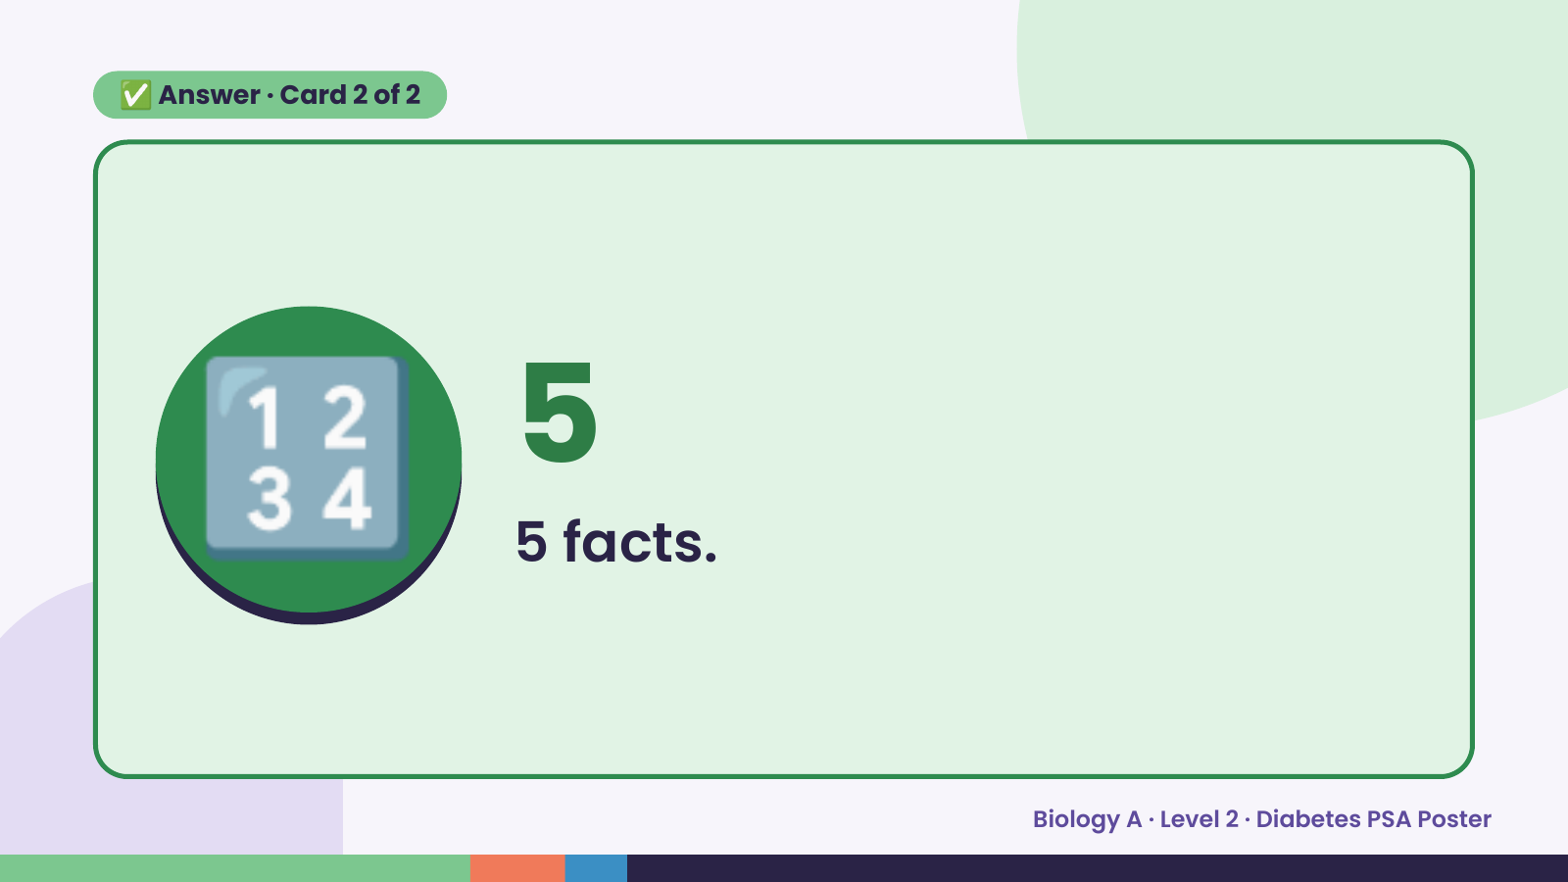
Notes:
✅ Answer · Card 2 of 2
🔢 5
5 facts.
Biology A · Level 2 · Diabetes PSA Poster

Slide 10

Notes:
Wrap-Up
Clean Up +
Reflect
🧽
💾 Save and submit
📝 Source sheet done
Biology A · Level 2 · Diabetes PSA Poster

