Slide 1
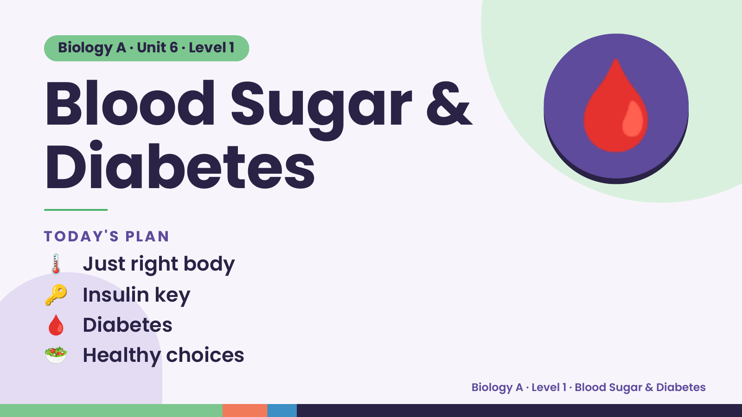
Notes:
Biology A · Unit 6 · Level 1
Blood Sugar &
Diabetes
🩸
🌡️ Just right body
TODAY'S PLAN
🔑 Insulin key
🩸 Diabetes
🥗 Healthy choices
Biology A · Level 1 · Blood Sugar & Diabetes

Slide 2
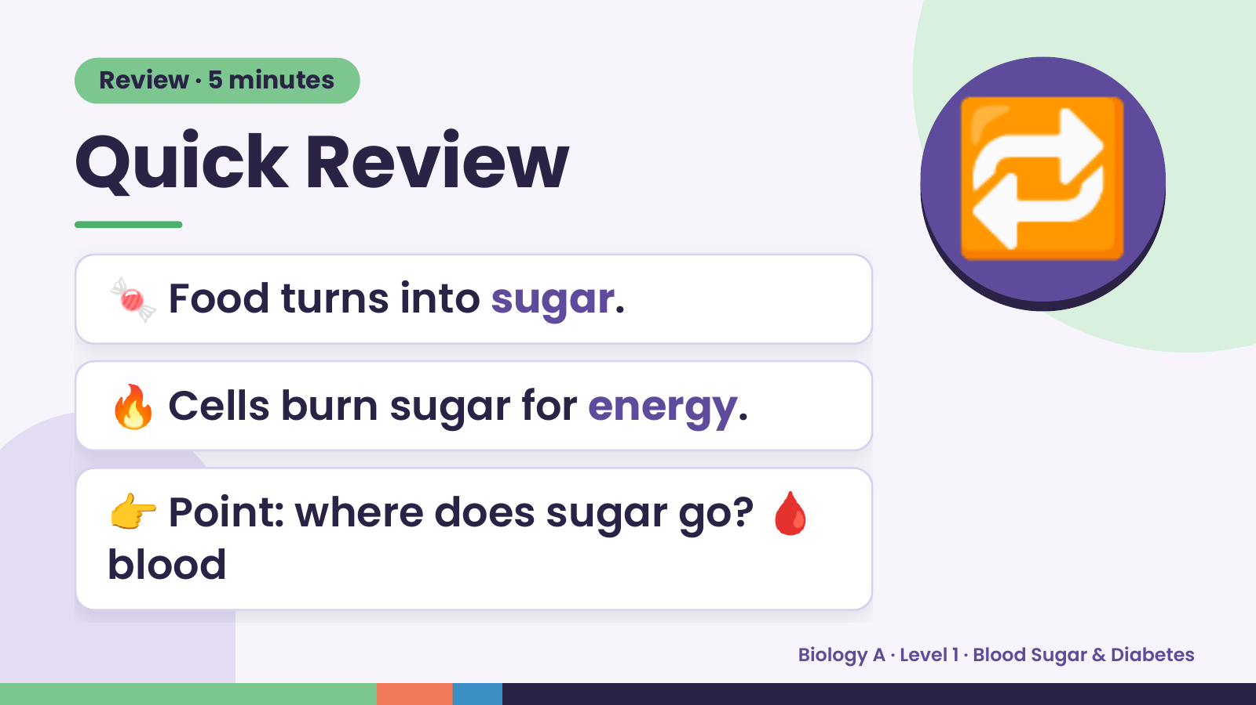
Notes:
Review · 5 minutes
Quick Review
🍬 Food turns into sugar.
🔁
🔥 Cells burn sugar for energy.
👉 Point: where does sugar go? 🩸
blood
Biology A · Level 1 · Blood Sugar & Diabetes

Slide 3
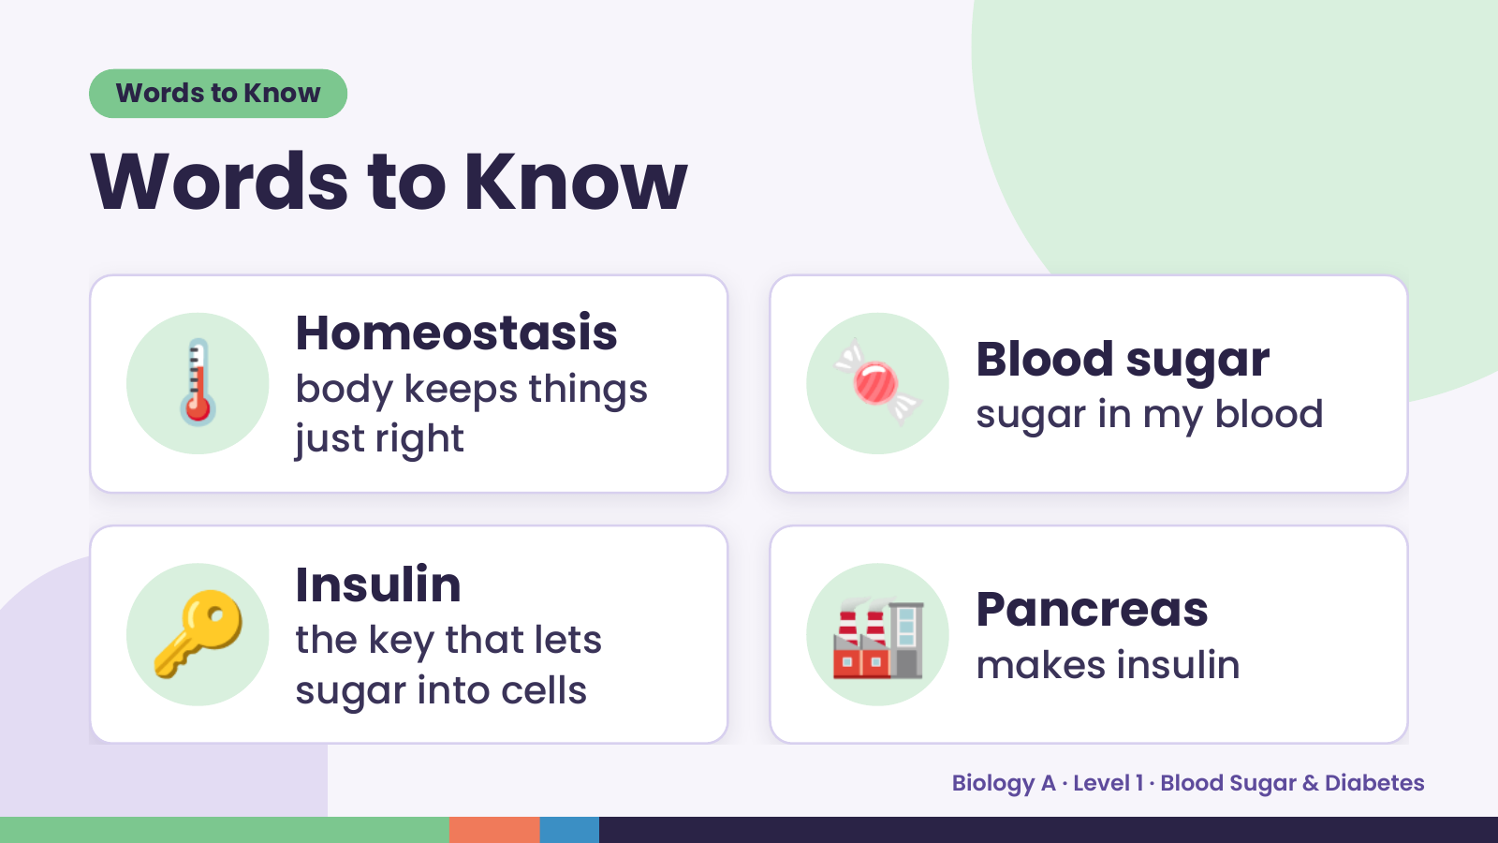
Notes:
Words to Know
Words to Know
🌡️ Homeostasis
body keeps things
just right
🍬 Blood sugar
sugar in my blood
🔑 Insulin
the key that lets
sugar into cells
🏭 Pancreas
makes insulin
Biology A · Level 1 · Blood Sugar & Diabetes

Slide 4
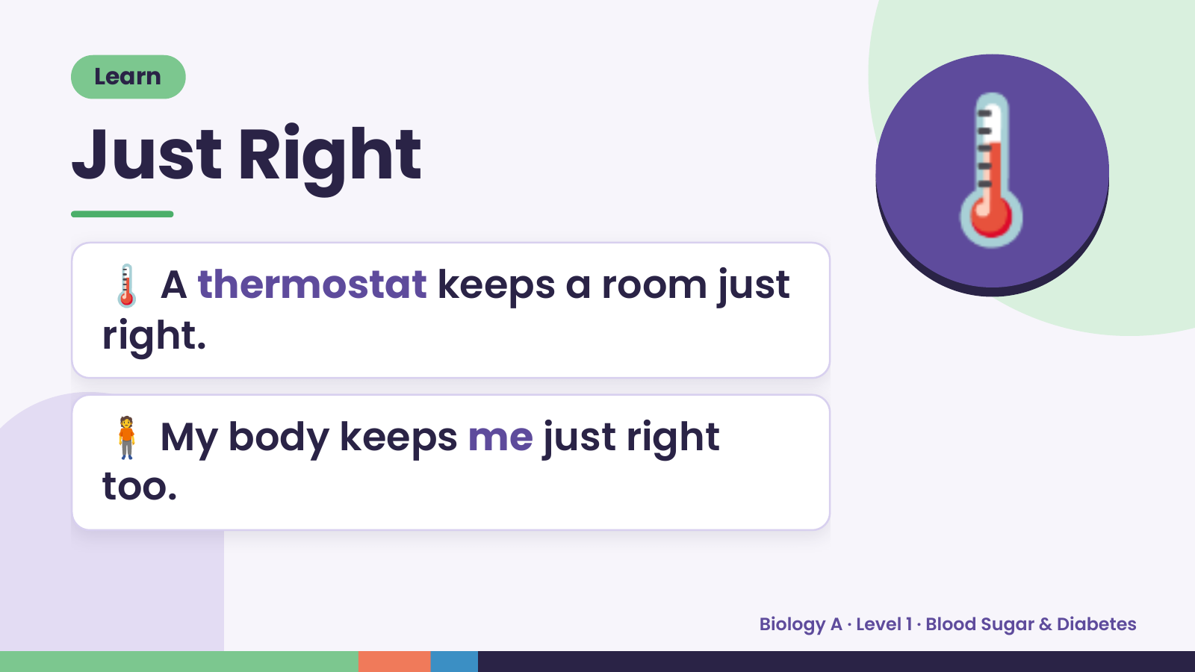
Notes:
Learn
Just Right
🌡️ A thermostat keeps a room just
right.
🌡️
🧍 My body keeps me just right
too.
Biology A · Level 1 · Blood Sugar & Diabetes

Slide 5
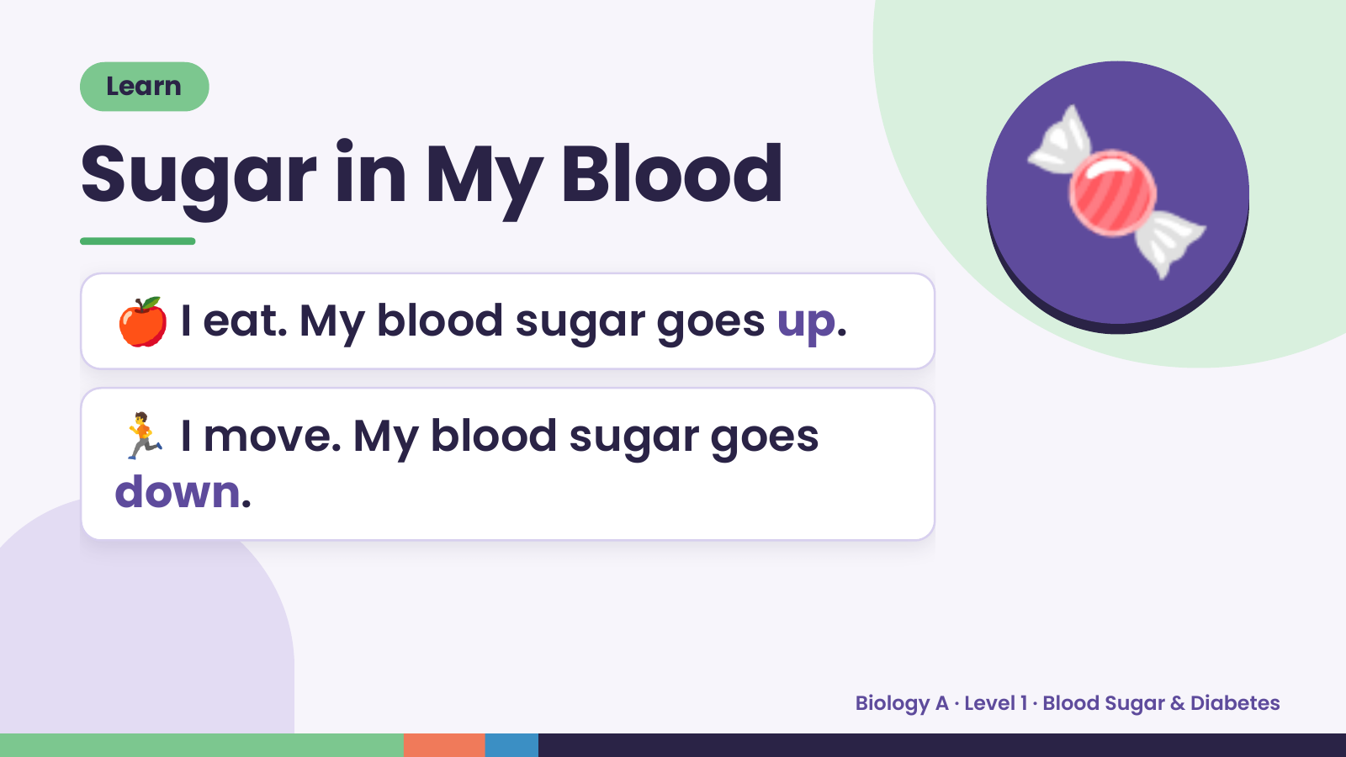
Notes:
Learn
Sugar in My Blood
🍎 I eat. My blood sugar goes up.
🍬
🏃 I move. My blood sugar goes
down.
Biology A · Level 1 · Blood Sugar & Diabetes

Slide 6
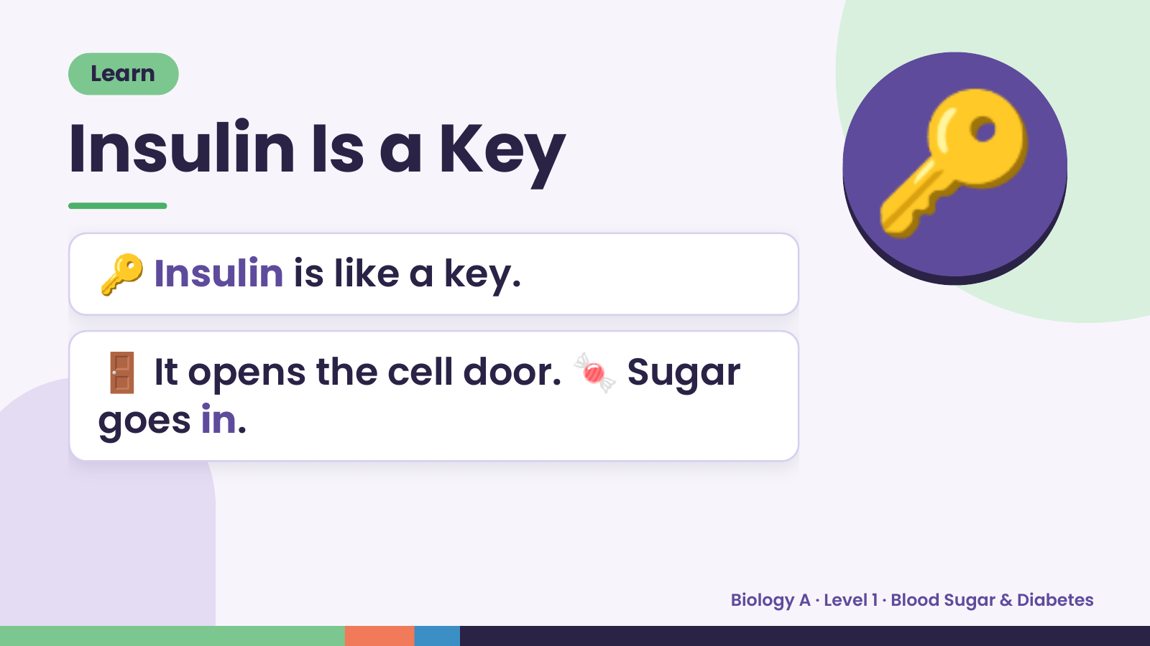
Notes:
Learn
Insulin Is a Key
🔑 Insulin is like a key.
🔑
🚪 It opens the cell door. 🍬 Sugar
goes in.
Biology A · Level 1 · Blood Sugar & Diabetes

Slide 7
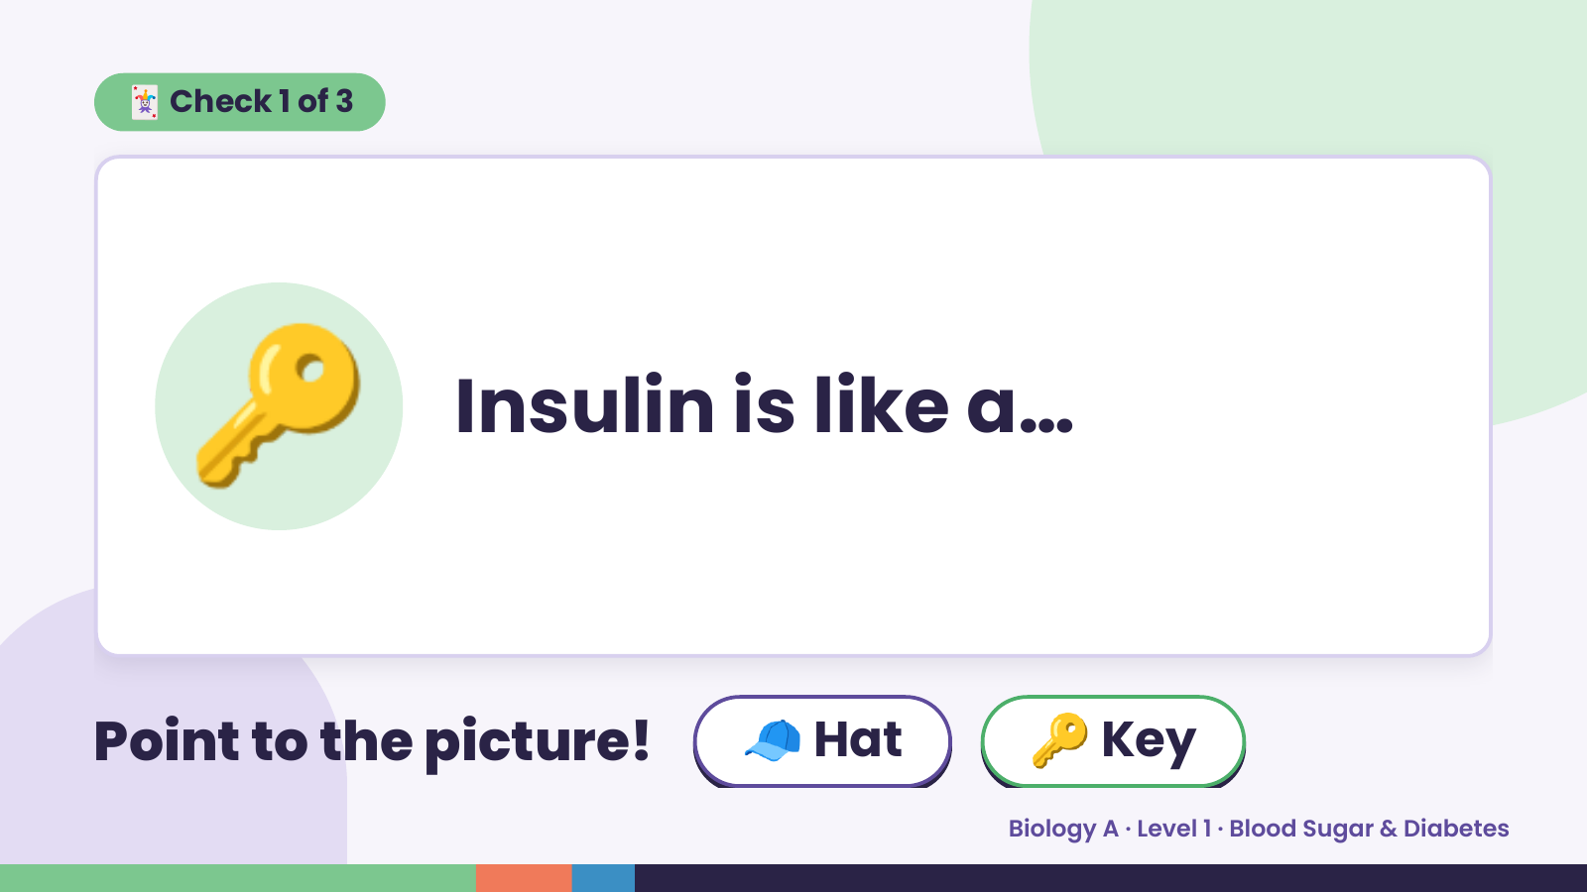
Notes:
🃏 Check 1 of 3
🔑 Insulin is like a…
Point to the picture! 🧢 Hat 🔑 Key
Biology A · Level 1 · Blood Sugar & Diabetes

Slide 8
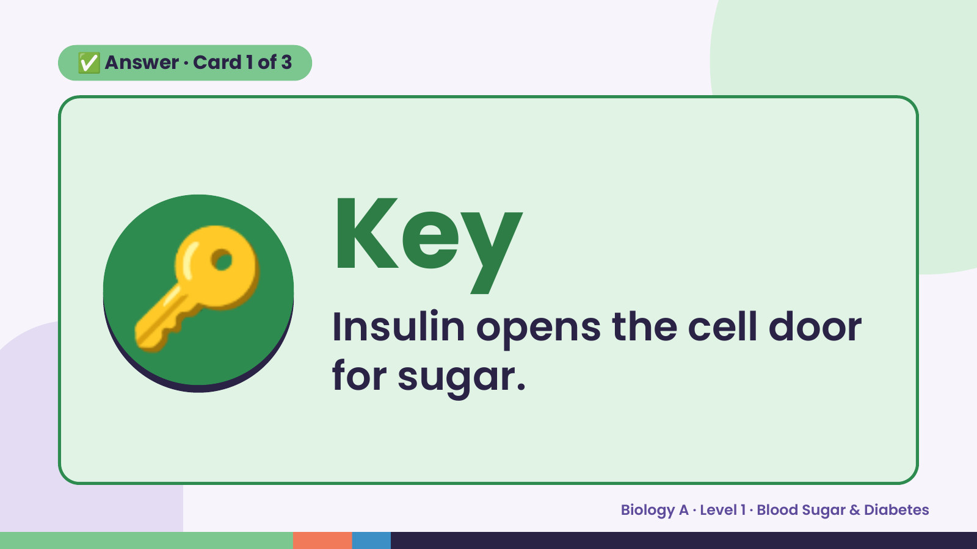
Notes:
✅ Answer · Card 1 of 3
🔑 Key
Insulin opens the cell door
for sugar.
Biology A · Level 1 · Blood Sugar & Diabetes

Slide 9
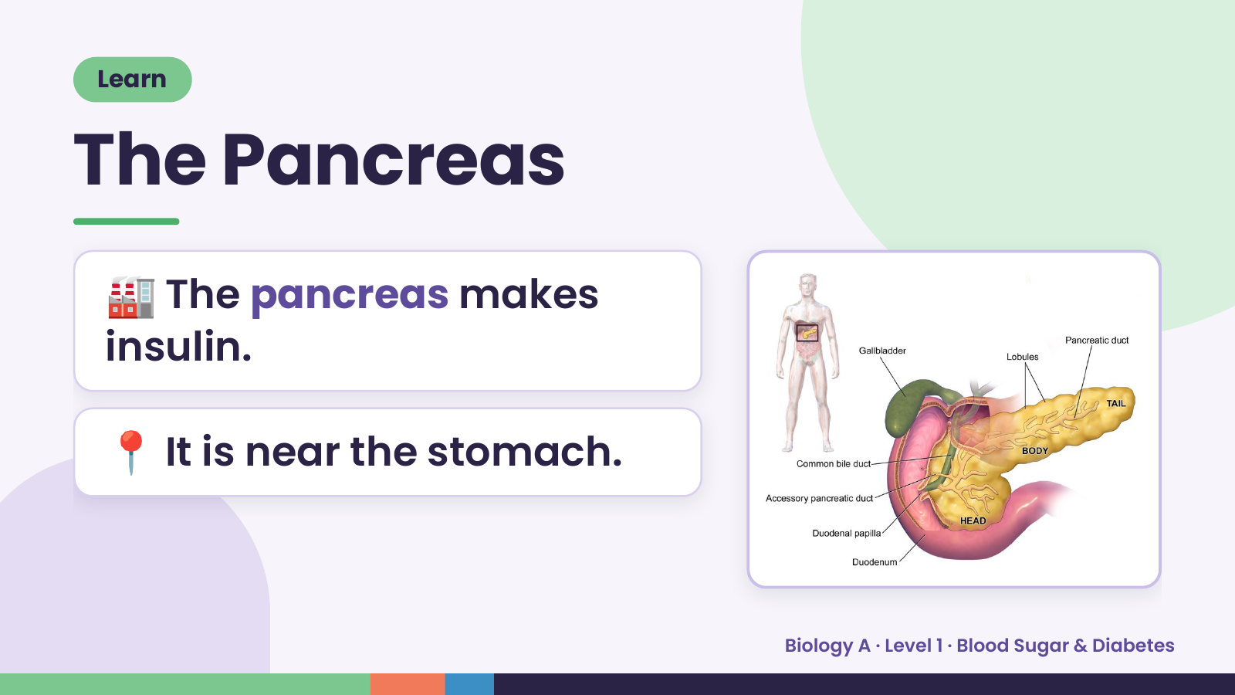
Notes:
Learn
The Pancreas
🏭 The pancreas makes
insulin.
📍 It is near the stomach.
Biology A · Level 1 · Blood Sugar & Diabetes

Slide 10
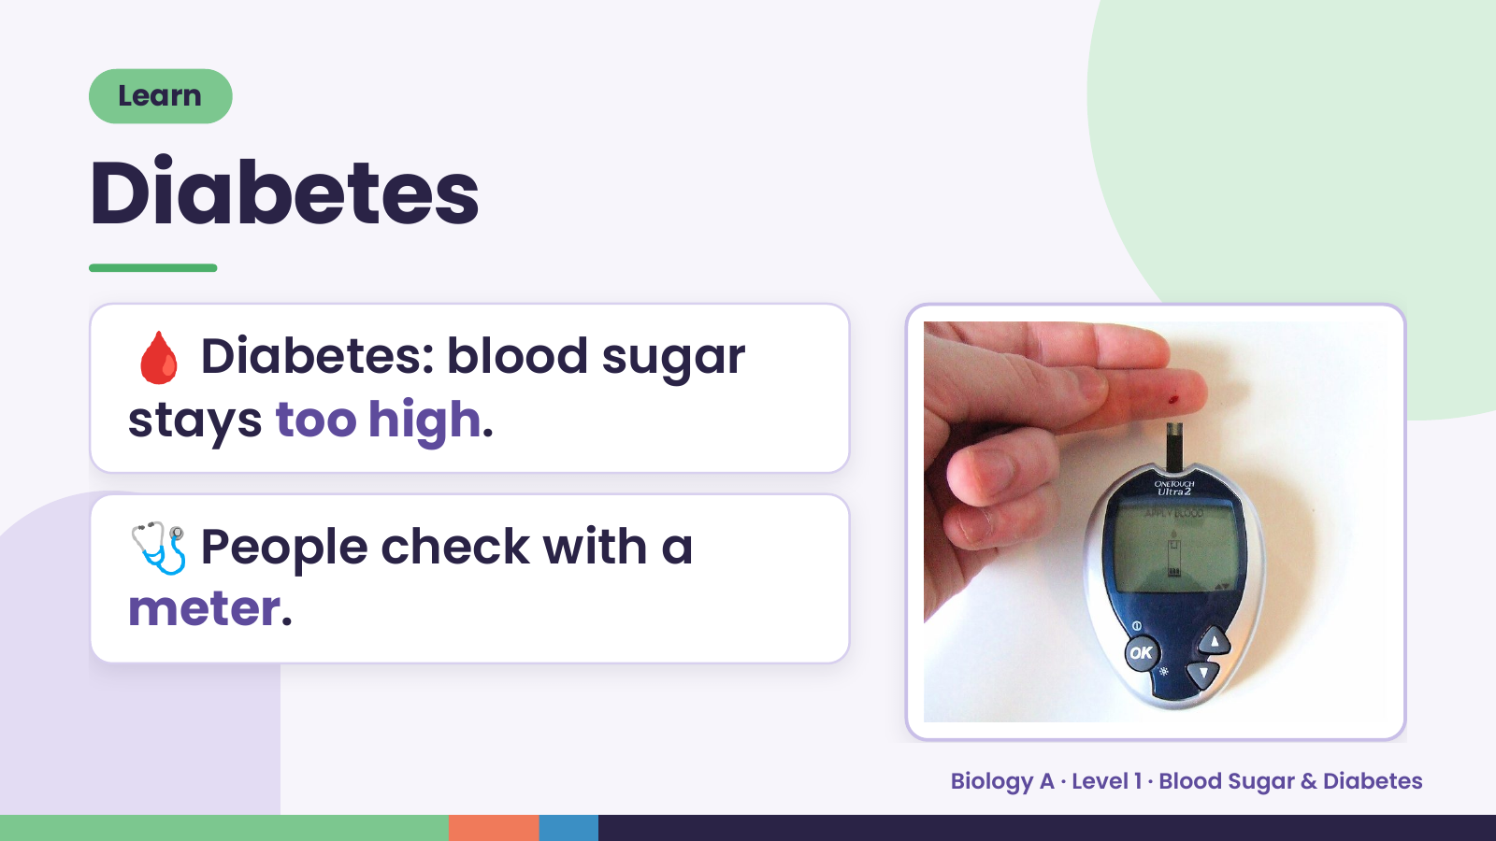
Notes:
Learn
Diabetes
🩸 Diabetes: blood sugar
stays too high.
🩺 People check with a
meter.
Biology A · Level 1 · Blood Sugar & Diabetes

Slide 11
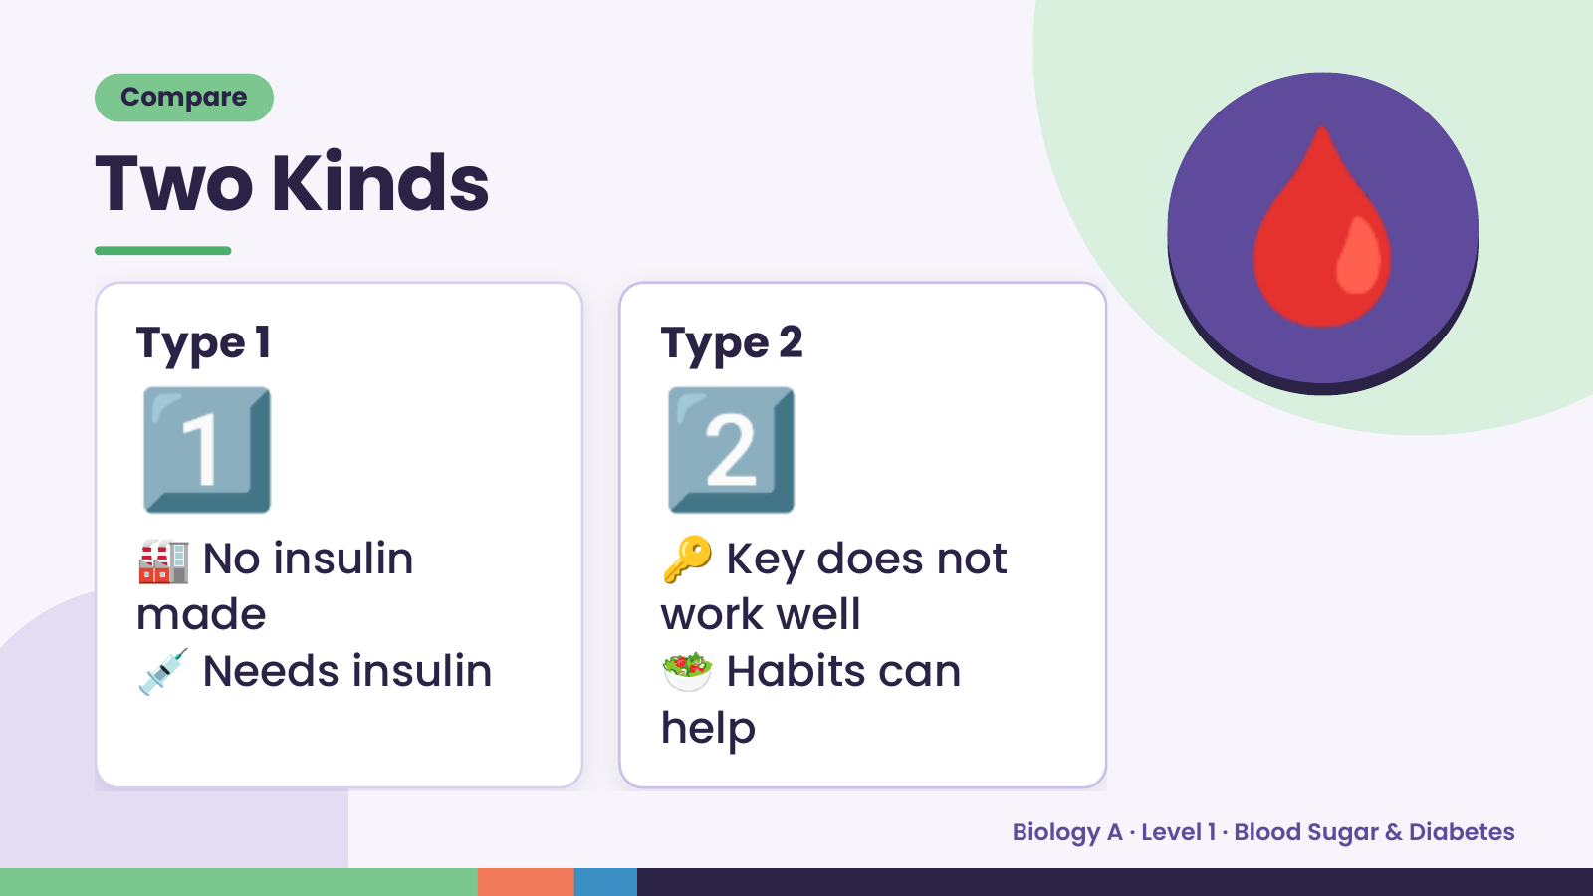
Notes:
Compare
Two Kinds
1️⃣
Type 1
2️⃣
Type 2
🩸
🏭 No insulin 🔑 Key does not
💉 Needs insulin 🥗 Habits can
made work well
help
Biology A · Level 1 · Blood Sugar & Diabetes

Slide 12
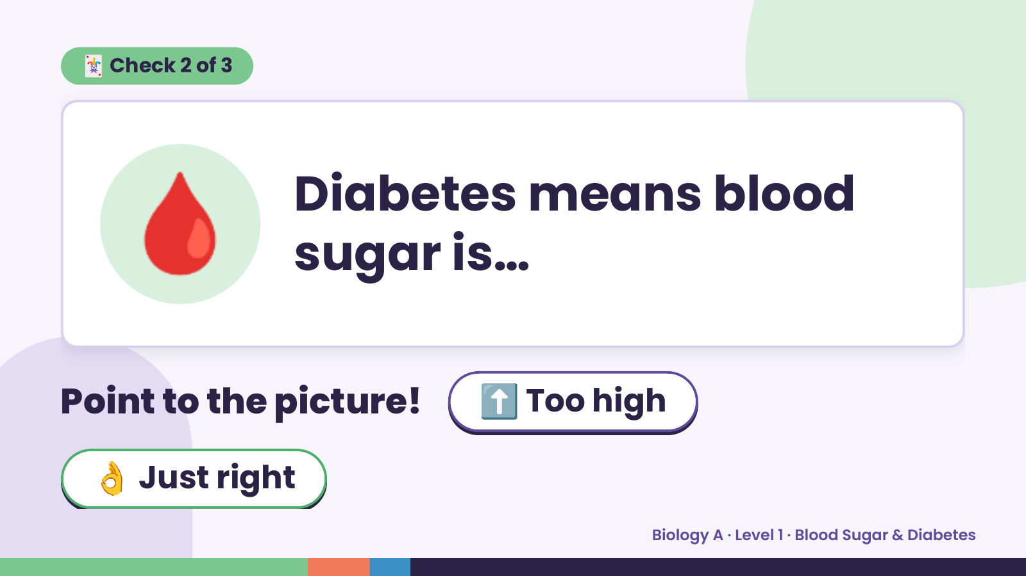
Notes:
🃏 Check 2 of 3
🩸 Diabetes means blood
sugar is…
Point to the picture! ⬆️ Too high
👌 Just right
Biology A · Level 1 · Blood Sugar & Diabetes

Slide 13
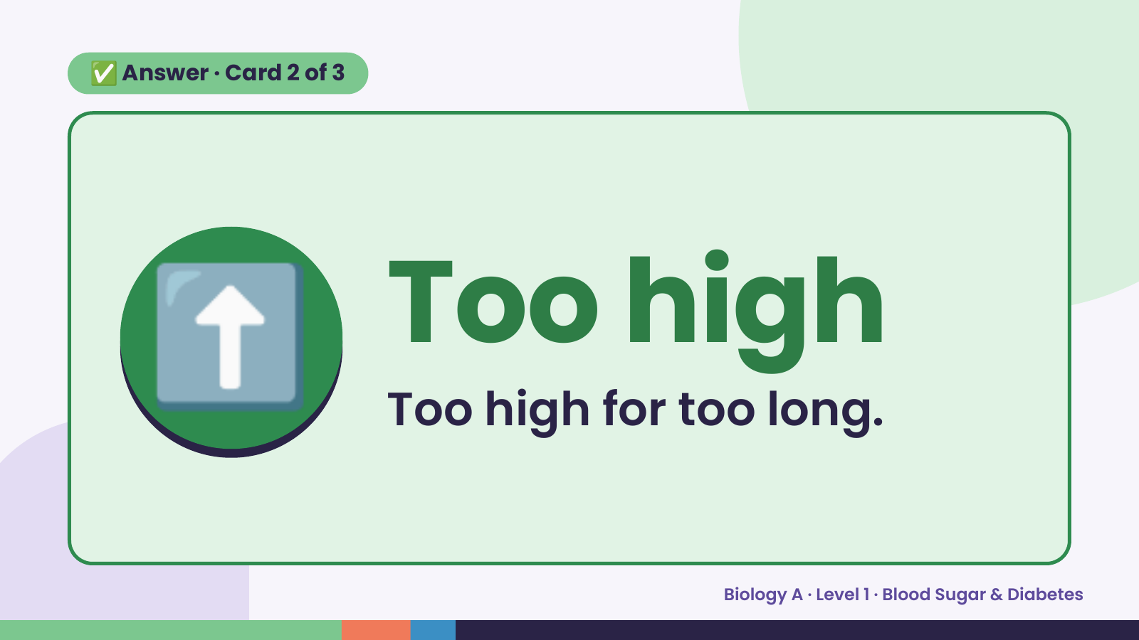
Notes:
✅ Answer · Card 2 of 3
⬆️ Too high
Too high for too long.
Biology A · Level 1 · Blood Sugar & Diabetes

Slide 14
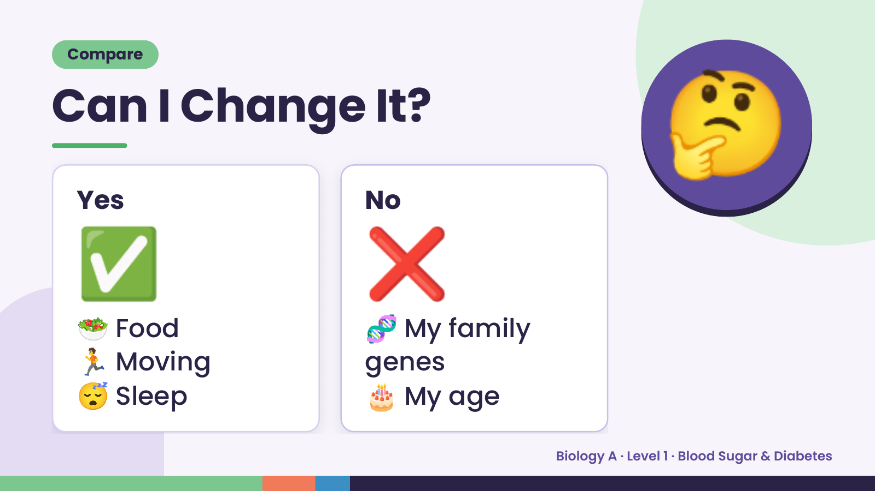
Notes:
Compare
Can I Change It?
🤔
✅
Yes
🥗 Food
🏃 Moving
❌
No
🧬 My family
😴 Sleep
genes
🎂 My age
Biology A · Level 1 · Blood Sugar & Diabetes

Slide 15
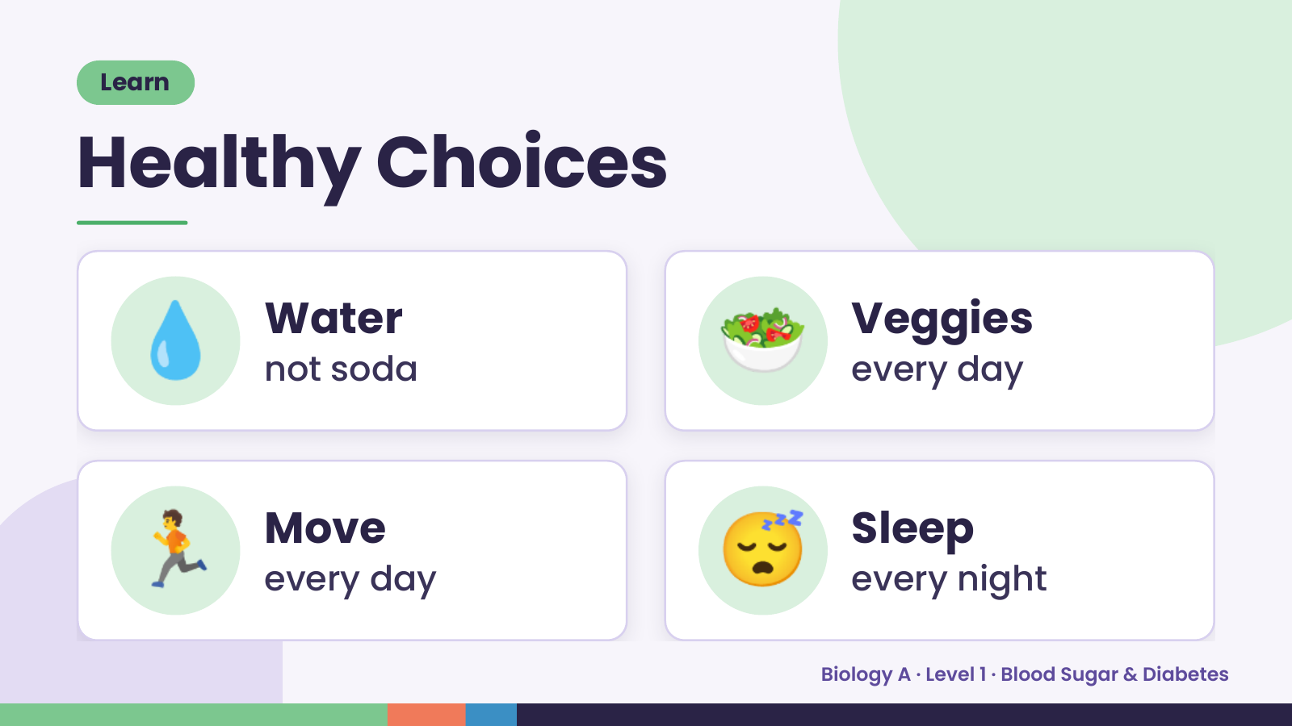
Notes:
Learn
Healthy Choices
💧 Water
not soda 🥗 Veggies
every day
🏃 Move
every day 😴 Sleep
every night
Biology A · Level 1 · Blood Sugar & Diabetes

Slide 16
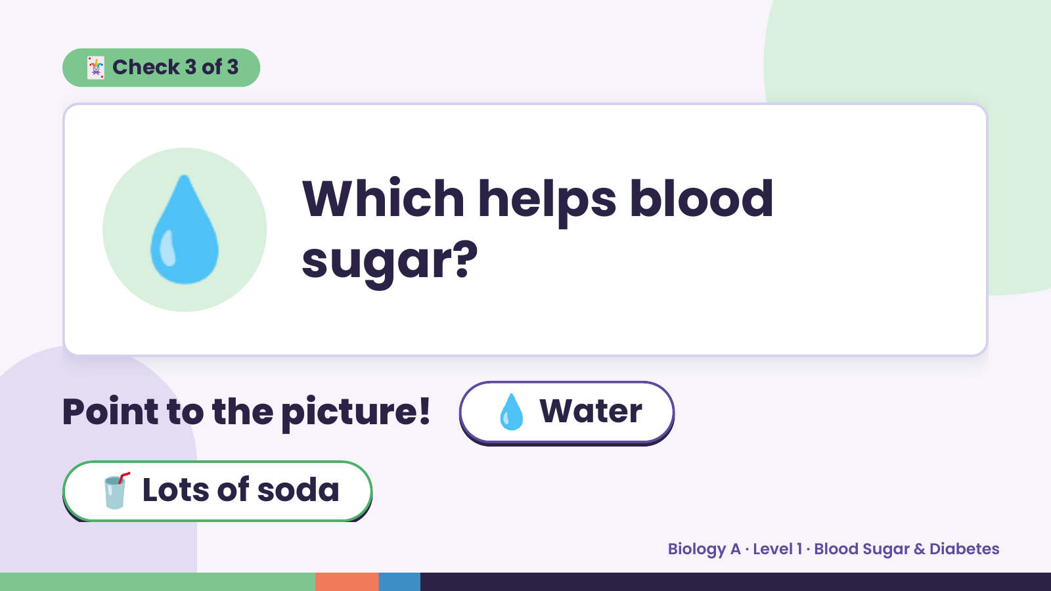
Notes:
🃏 Check 3 of 3
💧 Which helps blood
sugar?
Point to the picture! 💧 Water
🥤 Lots of soda
Biology A · Level 1 · Blood Sugar & Diabetes

Slide 17
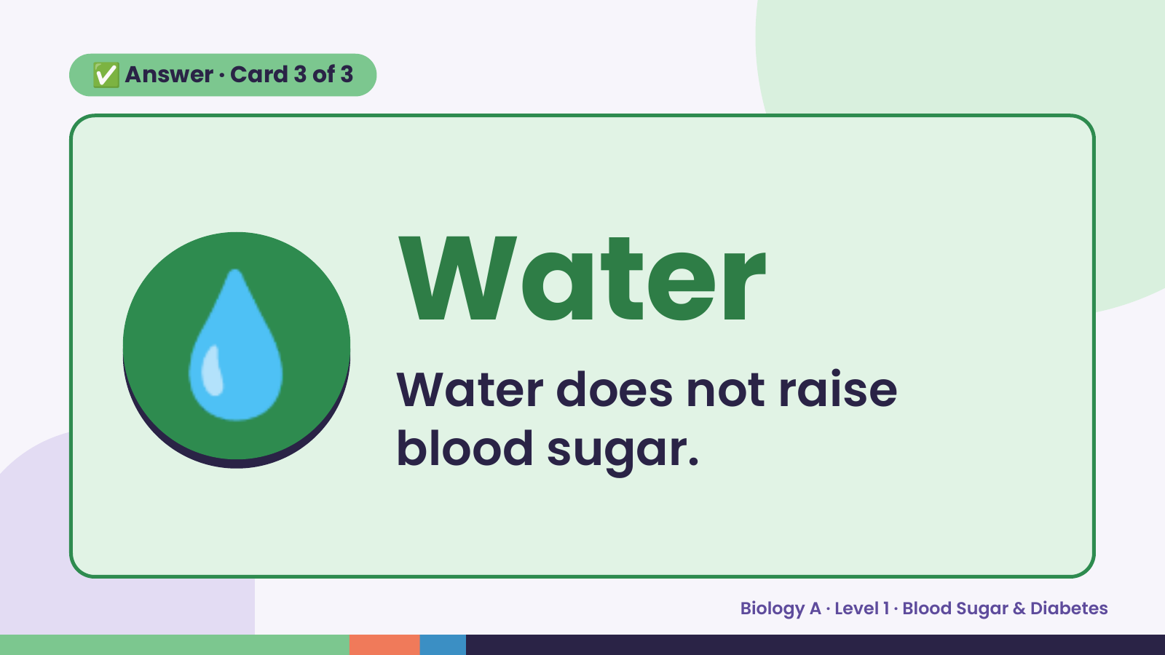
Notes:
✅ Answer · Card 3 of 3
💧 Water
Water does not raise
blood sugar.
Biology A · Level 1 · Blood Sugar & Diabetes

Slide 18
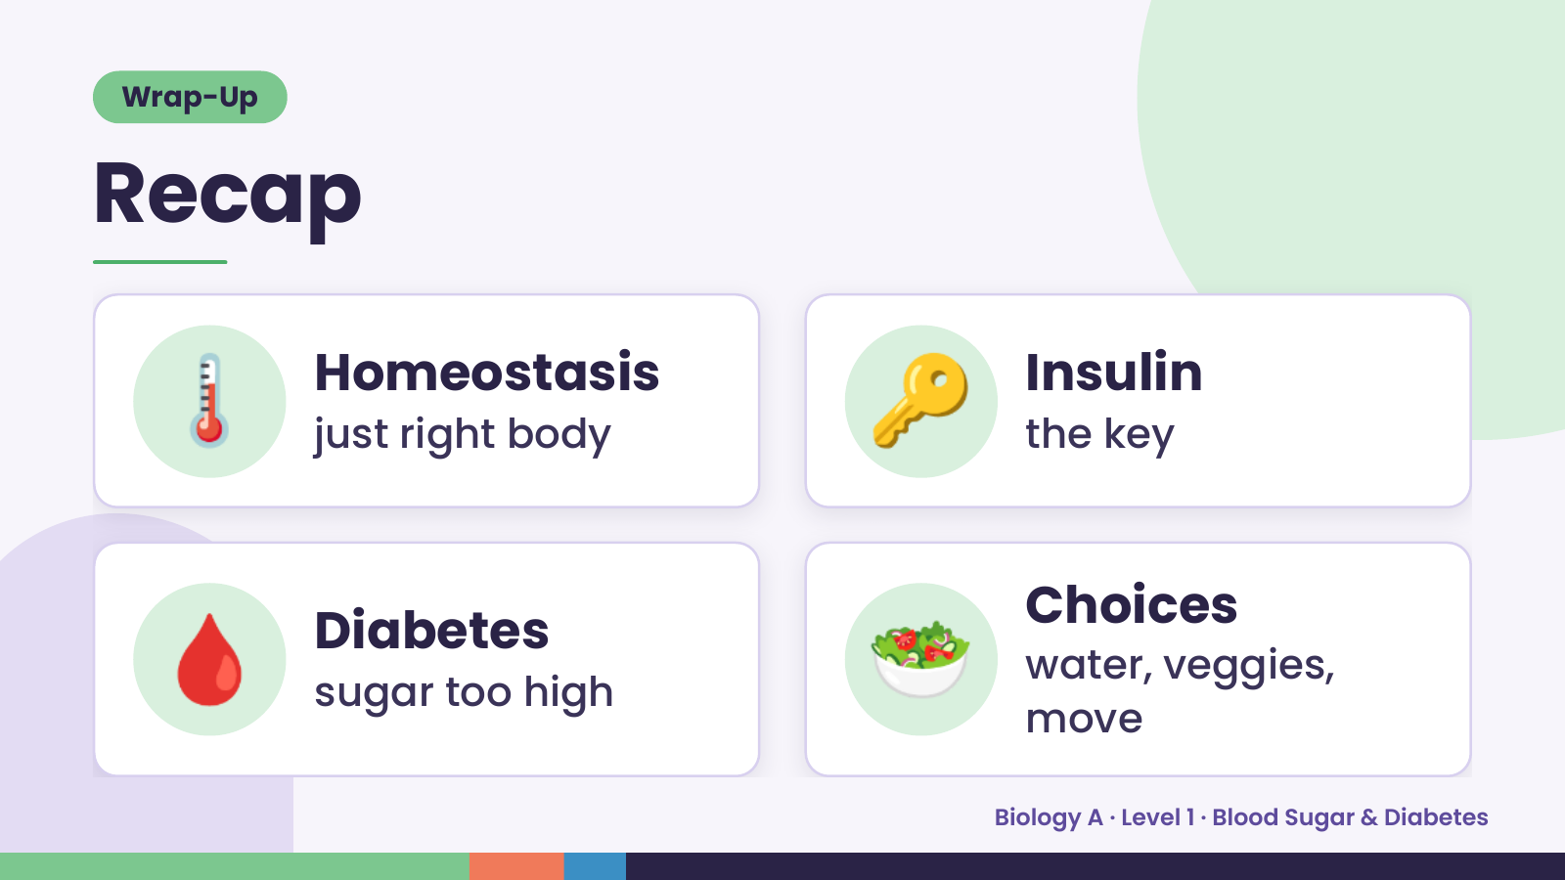
Notes:
Wrap-Up
Recap
🌡️ Homeostasis
just right body 🔑 Insulin
the key
🩸 Diabetes
sugar too high 🥗 Choices
water, veggies,
move
Biology A · Level 1 · Blood Sugar & Diabetes

Slide 19
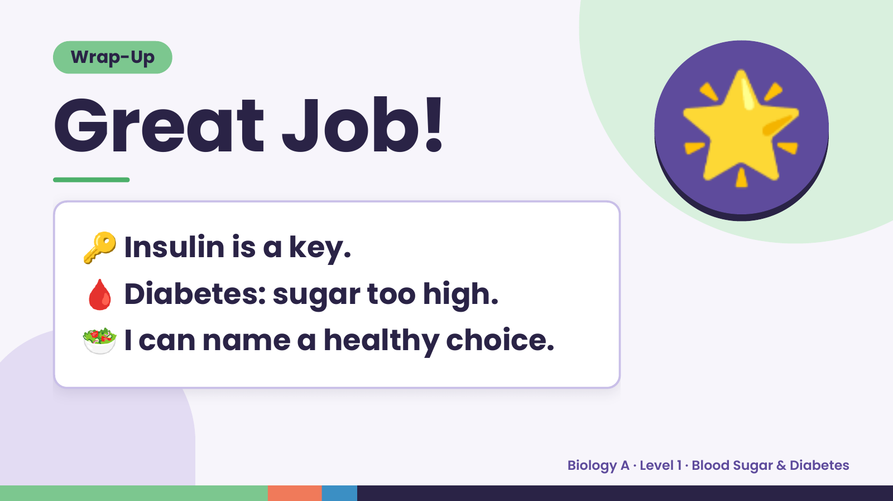
Notes:
Wrap-Up
Great Job!
🔑 Insulin is a key.
🌟
🩸 Diabetes: sugar too high.
🥗 I can name a healthy choice.
Biology A · Level 1 · Blood Sugar & Diabetes

