Slide 1
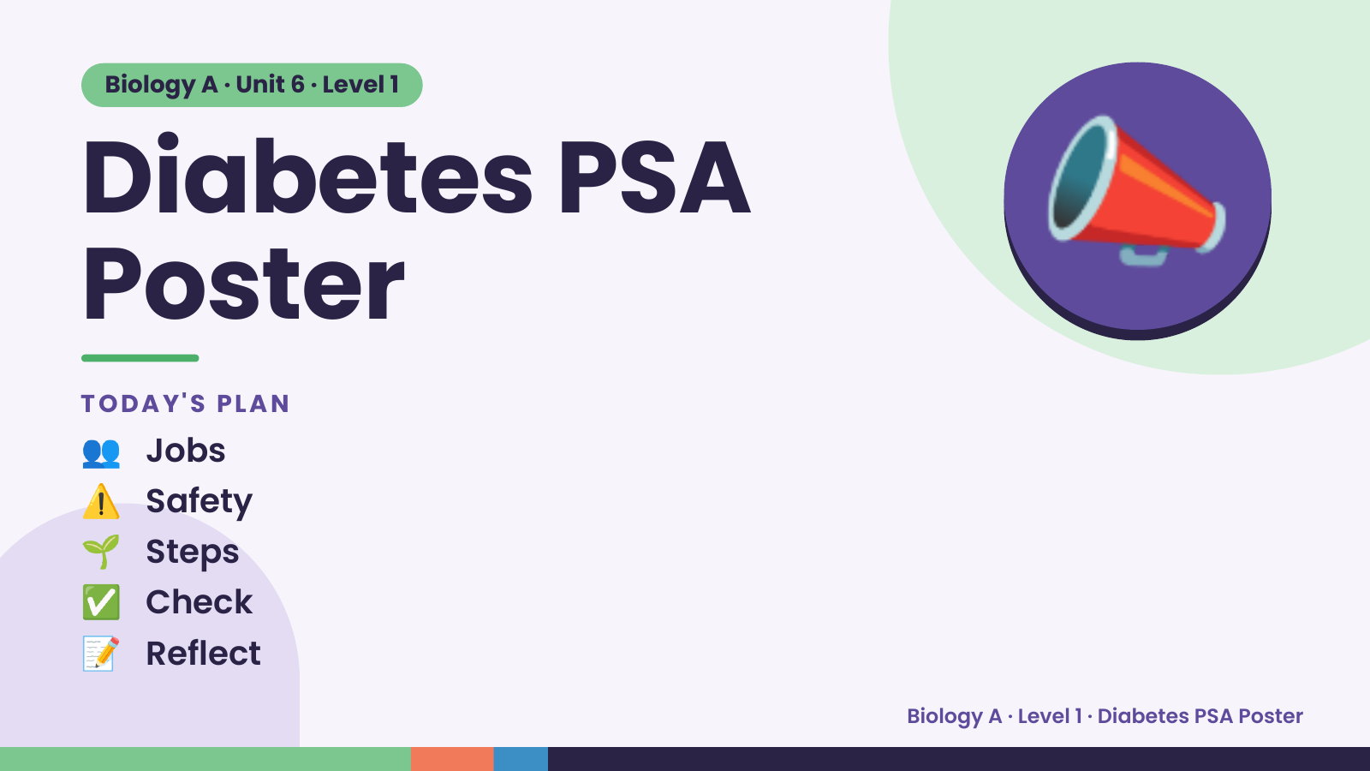
Notes:
Biology A · Unit 6 · Level 1
Diabetes PSA
Poster
TODAY'S PLAN
📣
👥 Jobs
⚠️ Safety
🌱 Steps
✅ Check
📝 Reflect
Biology A · Level 1 · Diabetes PSA Poster

Slide 2
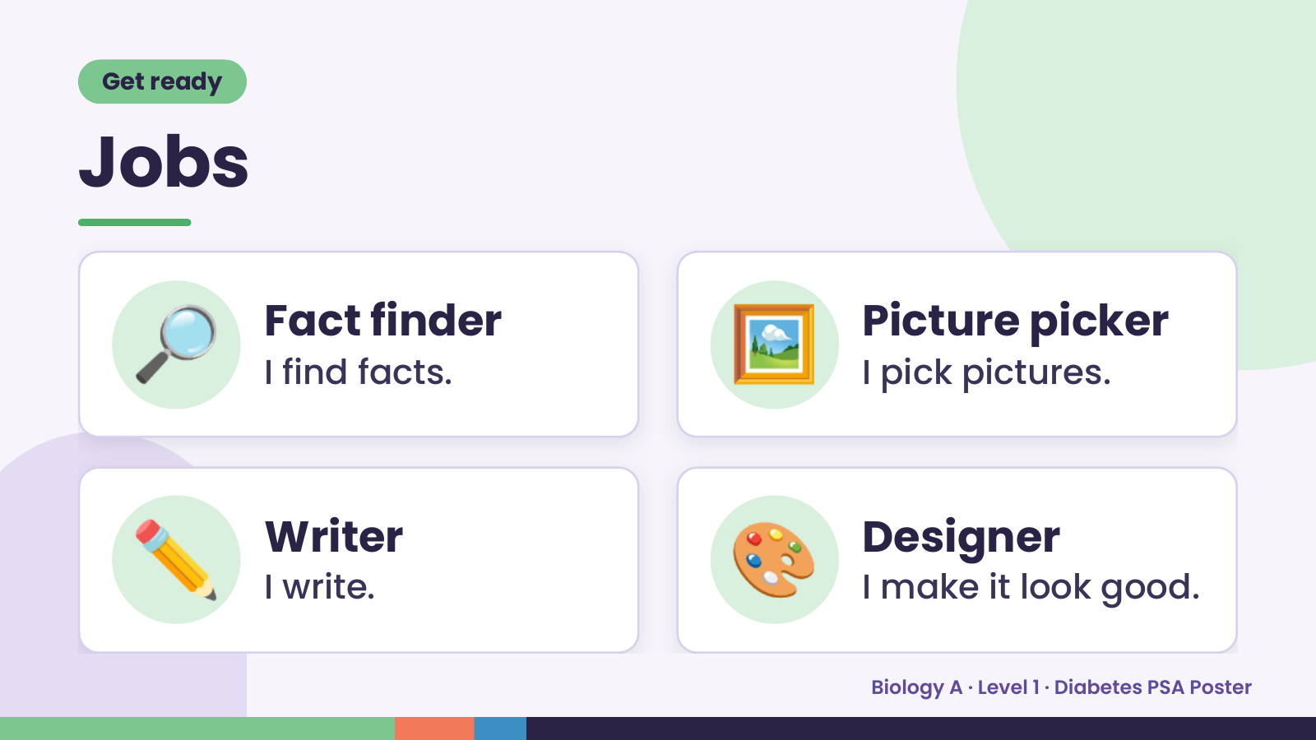
Notes:
Get ready
Jobs
🔎 Fact finder
I find facts. 🖼️ Picture picker
I pick pictures.
✏️ Writer
I write. 🎨 Designer
I make it look good.
Biology A · Level 1 · Diabetes PSA Poster

Slide 3
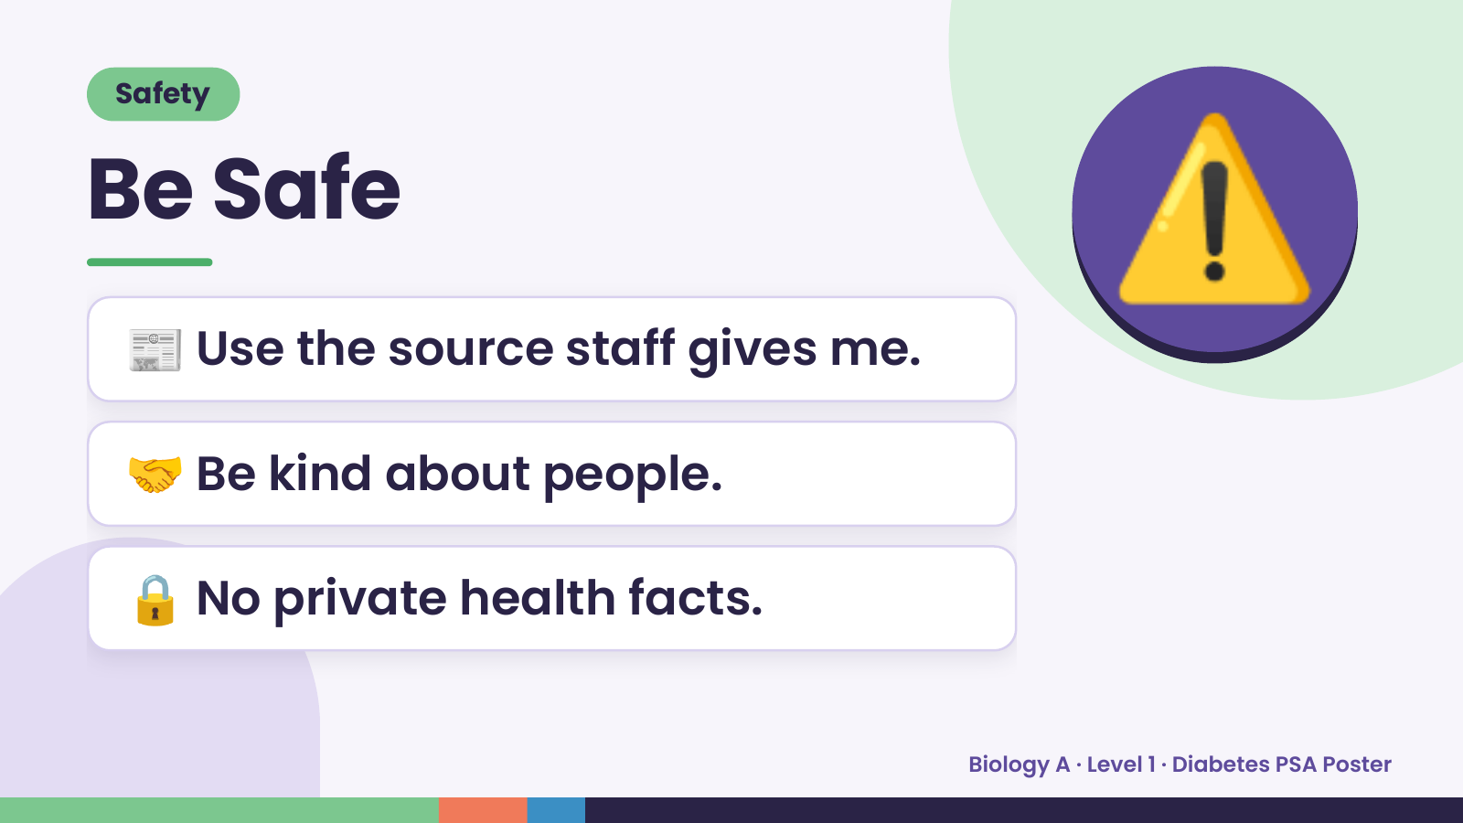
Notes:
Safety
Be Safe
📰 Use the source staff gives me.
⚠️
🤝 Be kind about people.
🔒 No private health facts.
Biology A · Level 1 · Diabetes PSA Poster

Slide 4
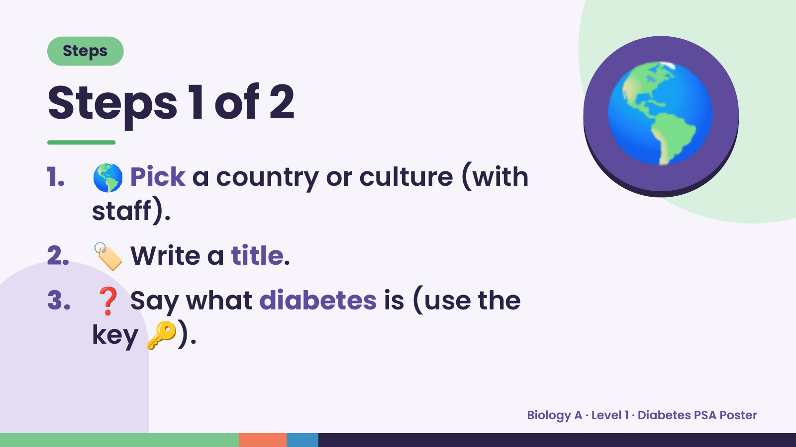
Notes:
Steps
Steps 1 of 2
1. 🌎 Pick a country or culture (with
staff).
🌎
2. 🏷️ Write a title.
3. ❓ Say what diabetes is (use the
key 🔑).
Biology A · Level 1 · Diabetes PSA Poster

Slide 5
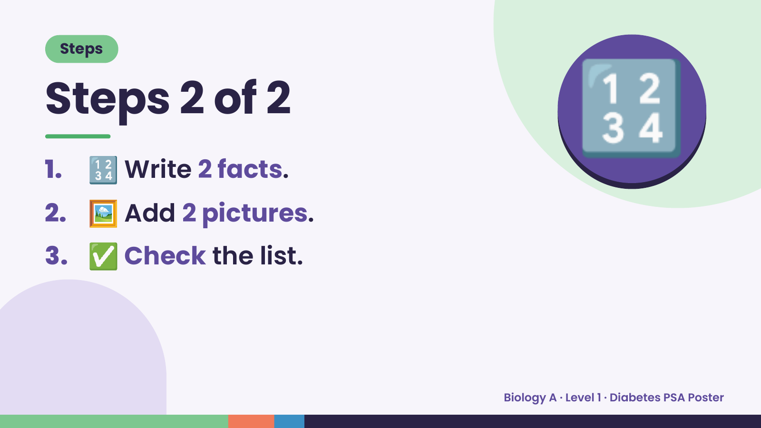
Notes:
Steps
Steps 2 of 2
1. 🔢 Write 2 facts.
2. 🖼️ Add 2 pictures.
🔢
3. ✅ Check the list.
Biology A · Level 1 · Diabetes PSA Poster

Slide 6
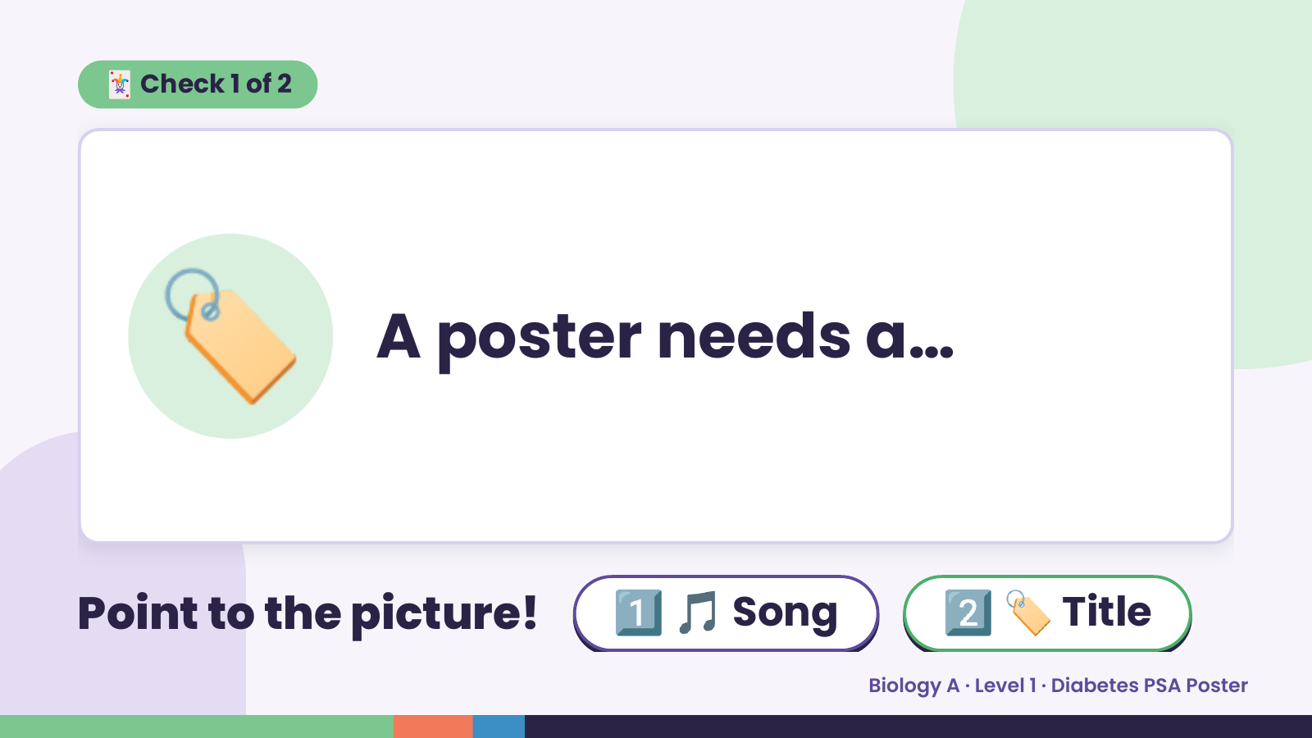
Notes:
🃏 Check 1 of 2
🏷️ A poster needs a…
Point to the picture! 1️⃣ 🎵 Song 2️⃣ 🏷️ Title
Biology A · Level 1 · Diabetes PSA Poster

Slide 7
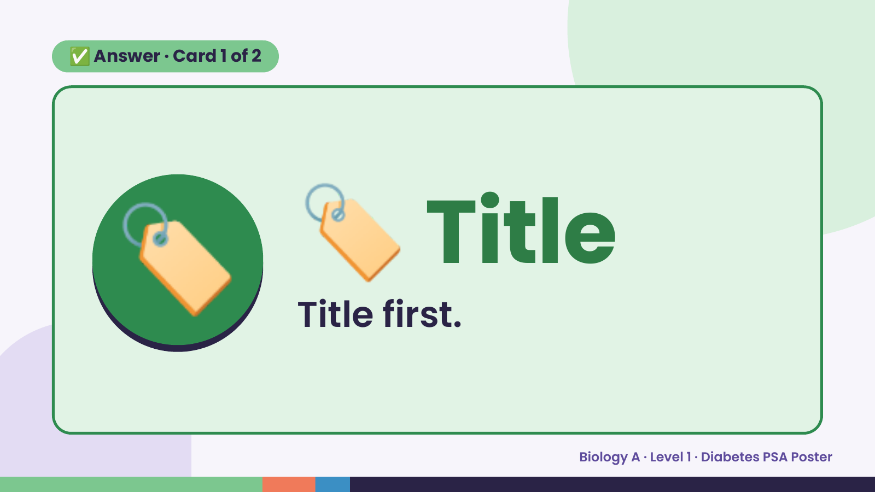
Notes:
✅ Answer · Card 1 of 2
🏷️ 🏷️ Title
Title first.
Biology A · Level 1 · Diabetes PSA Poster

Slide 8
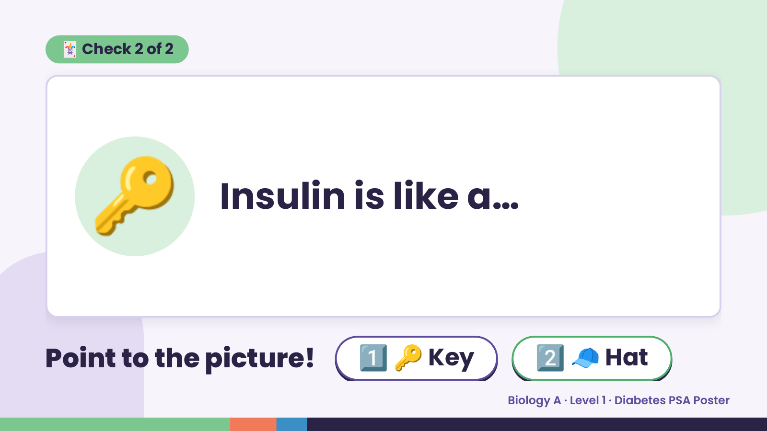
Notes:
🃏 Check 2 of 2
🔑 Insulin is like a…
Point to the picture! 1️⃣ 🔑 Key 2️⃣ 🧢 Hat
Biology A · Level 1 · Diabetes PSA Poster

Slide 9
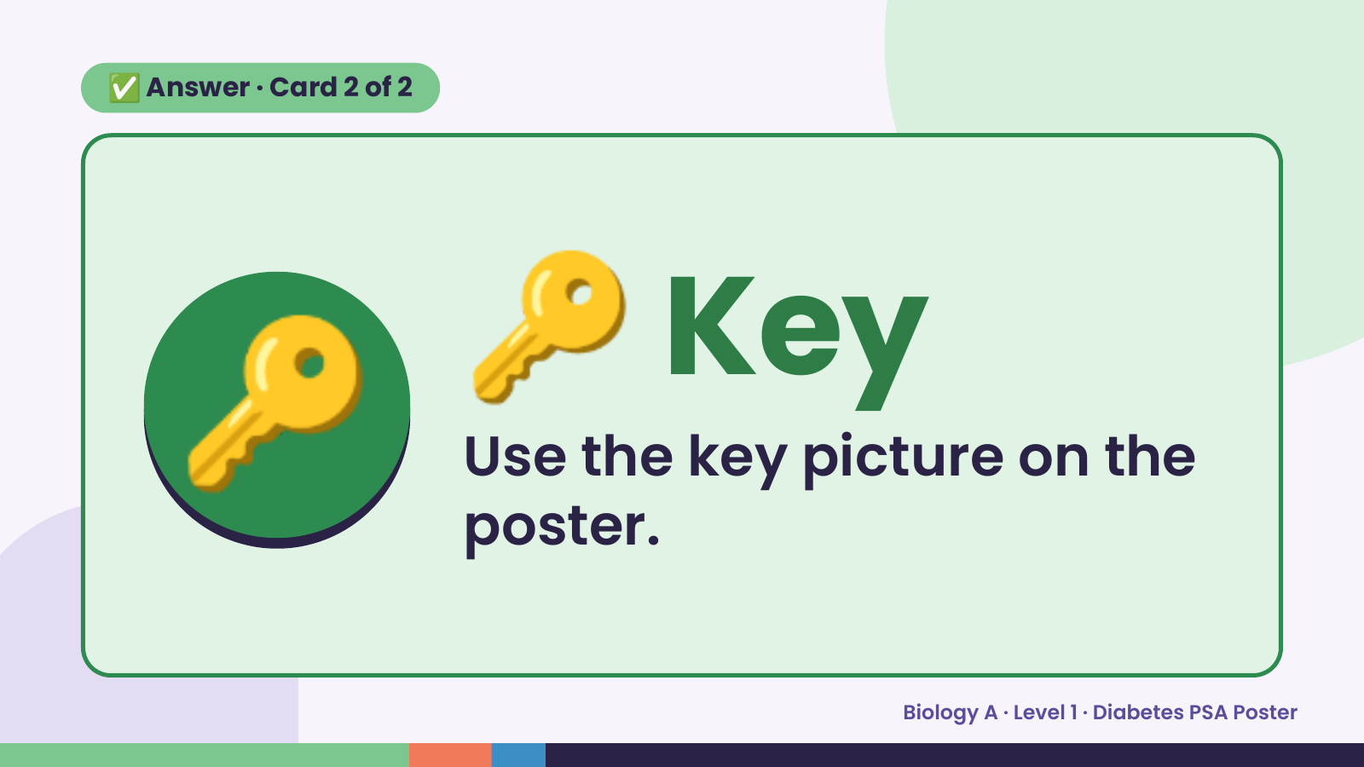
Notes:
✅ Answer · Card 2 of 2
🔑 🔑 Key
Use the key picture on the
poster.
Biology A · Level 1 · Diabetes PSA Poster

Slide 10
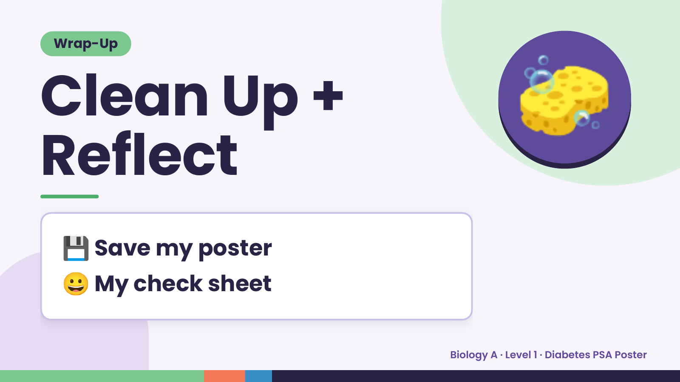
Notes:
Wrap-Up
Clean Up +
Reflect
🧽
💾 Save my poster
😀 My check sheet
Biology A · Level 1 · Diabetes PSA Poster

