Slide 1
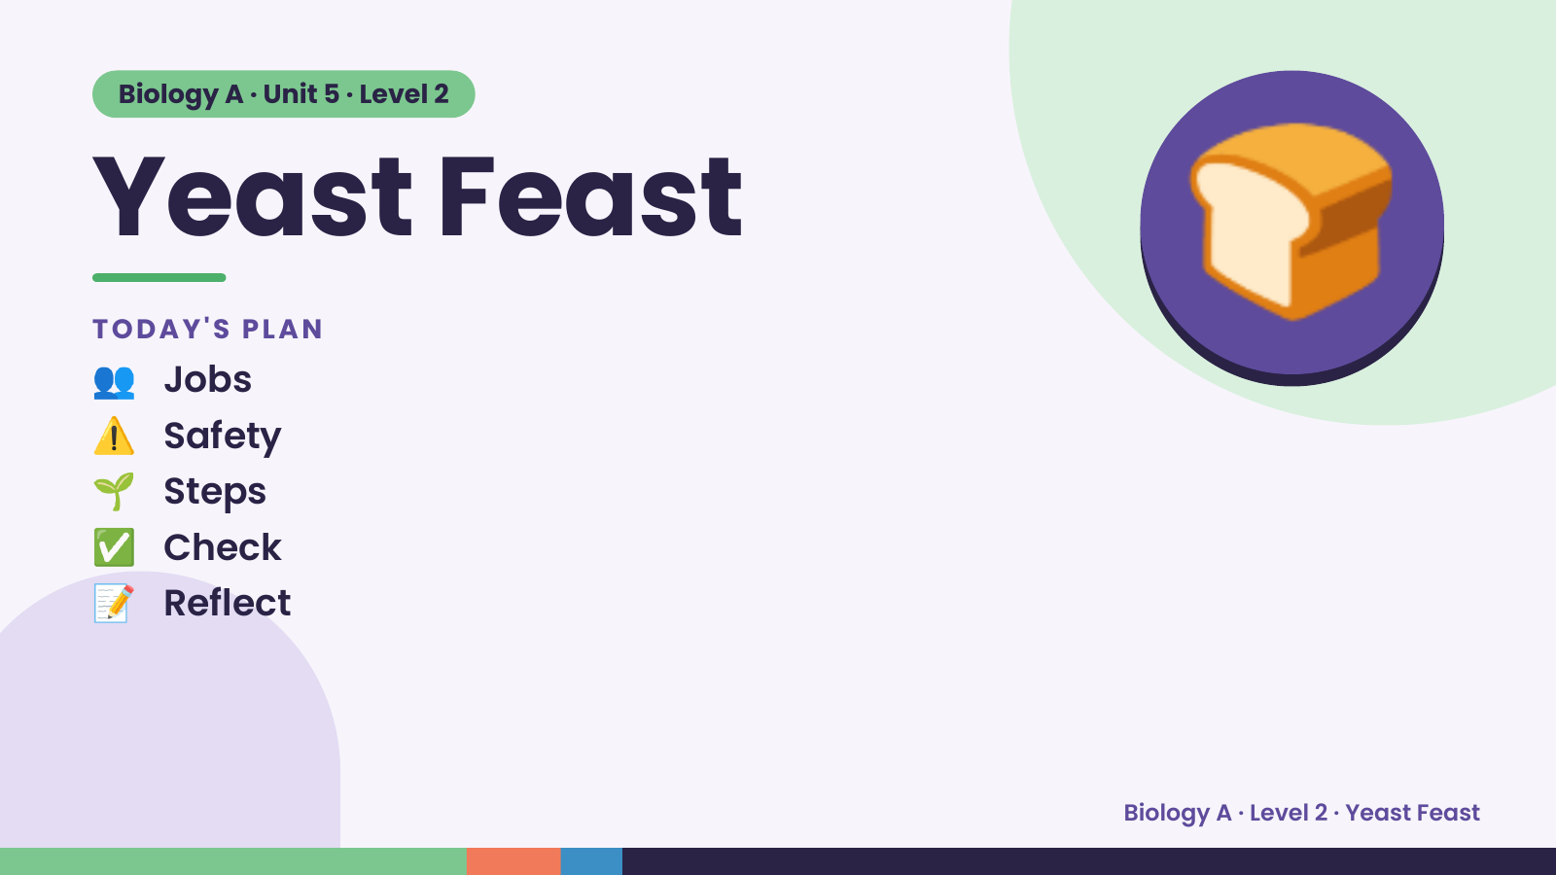
Notes:
Biology A · Unit 5 · Level 2
Yeast Feast
👥 Jobs
TODAY'S PLAN
⚠️ Safety
🌱 Steps
🍞
✅ Check
📝 Reflect
Biology A · Level 2 · Yeast Feast

Slide 2
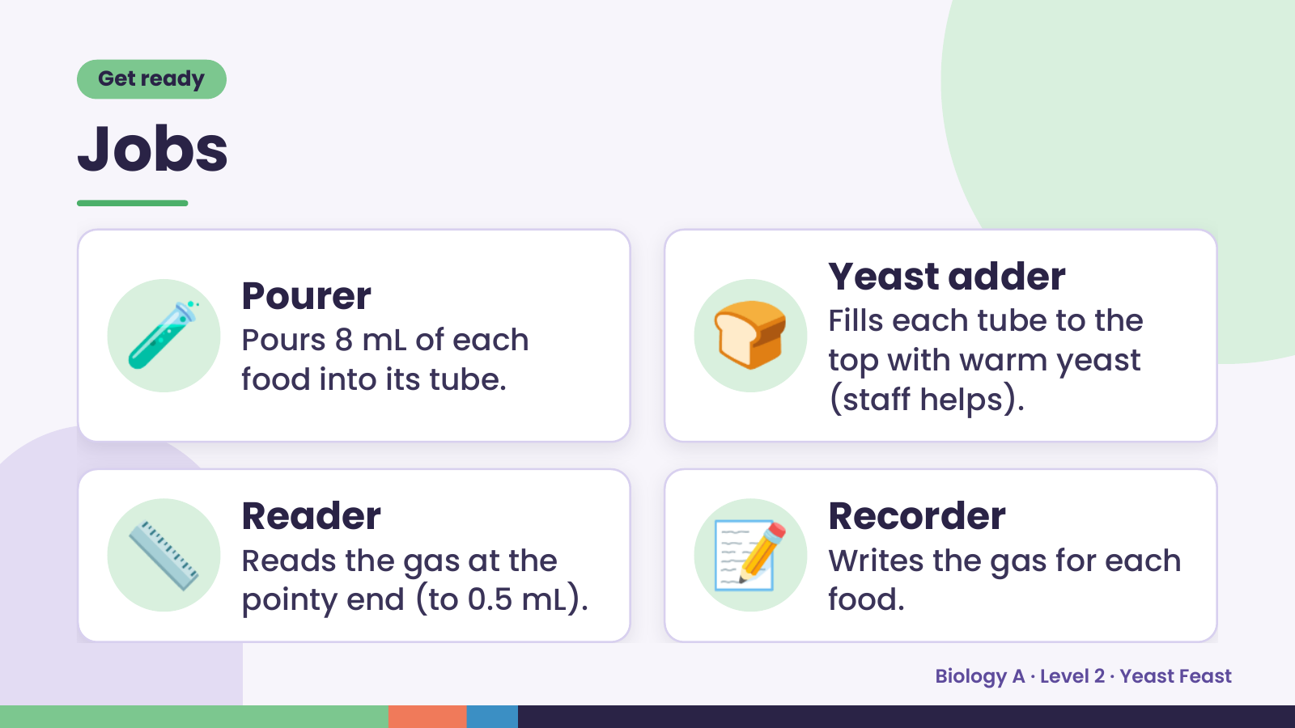
Notes:
Get ready
Jobs
🧪 Pourer
Pours 8 mL of each
food into its tube.
🍞 Yeast adder
Fills each tube to the
top with warm yeast
(staff helps).
📏 Reader
Reads the gas at the
pointy end (to 0.5 mL).
📝 Recorder
Writes the gas for each
food.
Biology A · Level 2 · Yeast Feast

Slide 3
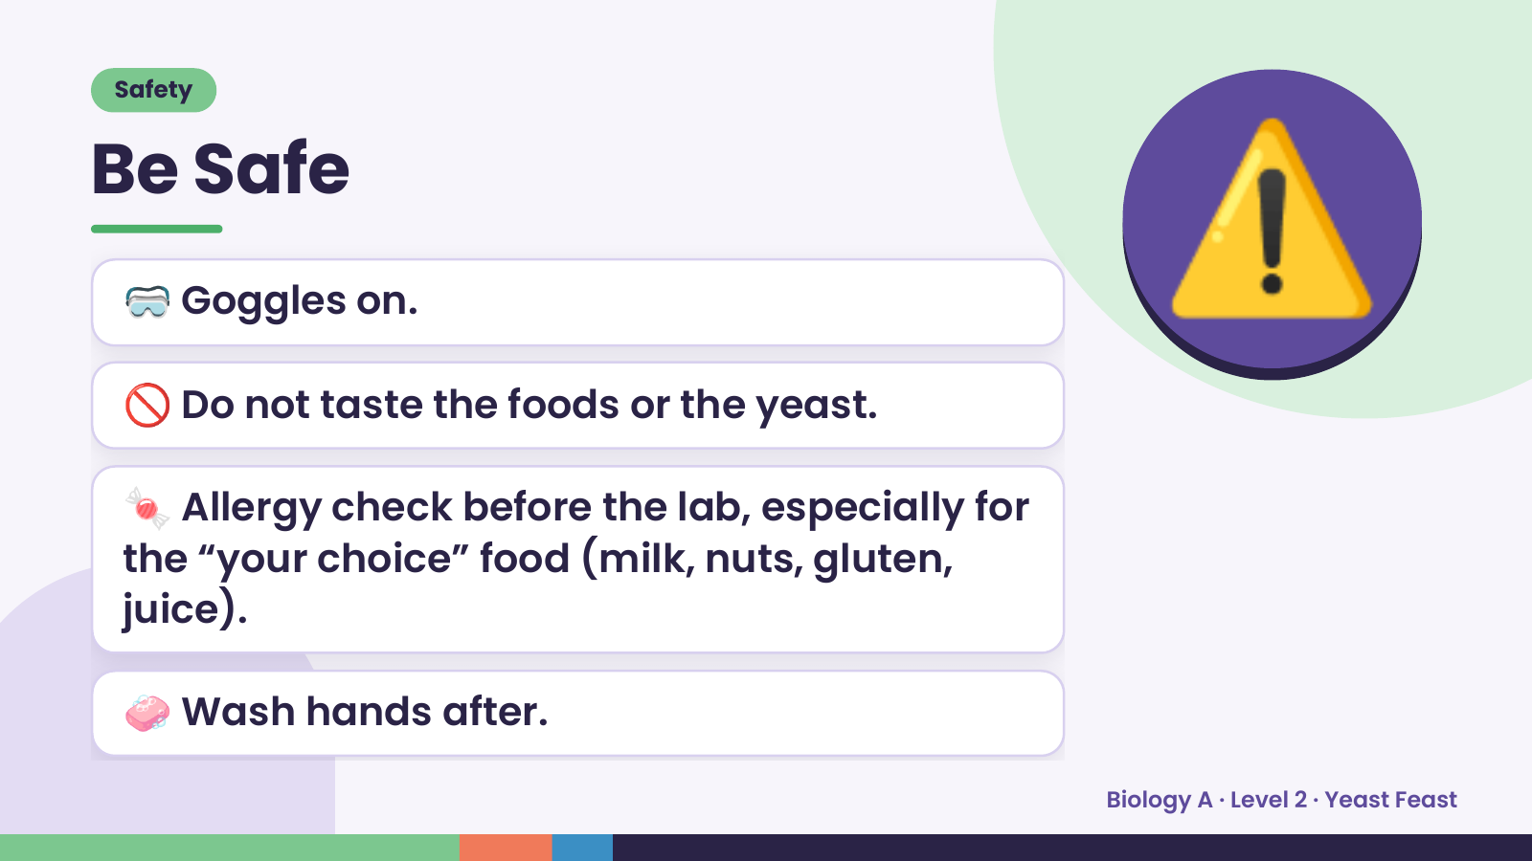
Notes:
Safety
Be Safe
🥽 Goggles on.
🚫 Do not taste the foods or the yeast.
⚠️
🍬 Allergy check before the lab, especially for
the “your choice” food (milk, nuts, gluten,
juice).
🧼 Wash hands after.
Biology A · Level 2 · Yeast Feast

Slide 4
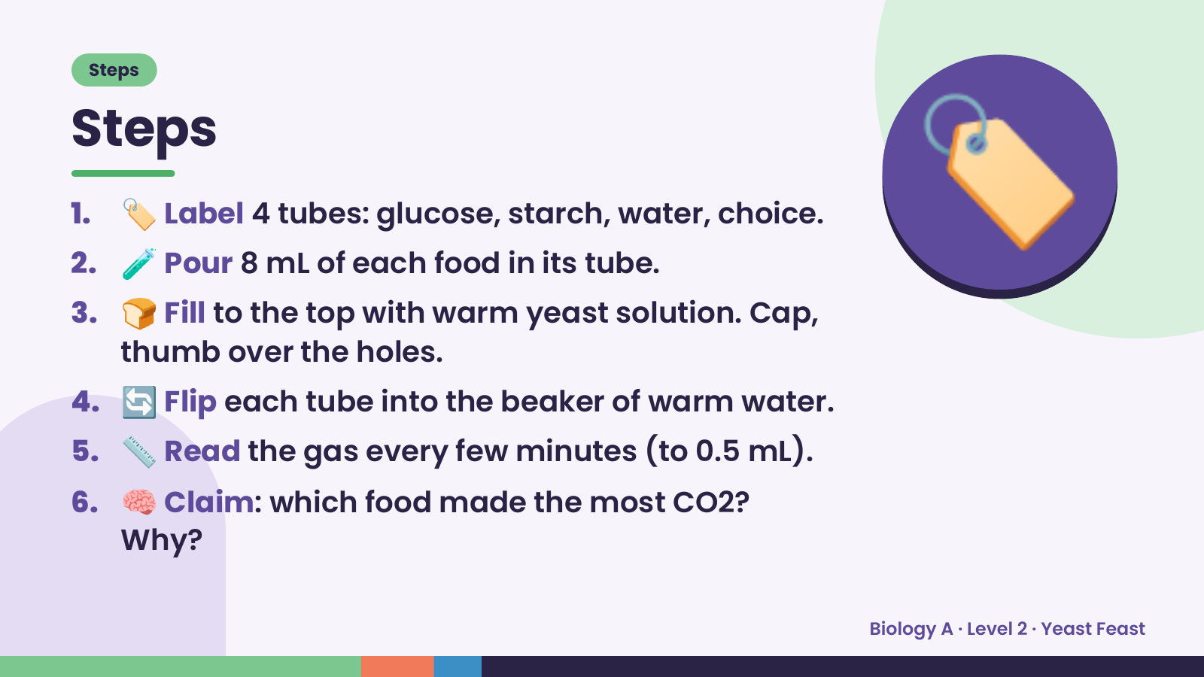
Notes:
Steps
Steps
1. 🏷️ Label 4 tubes: glucose, starch, water, choice.
2. 🧪 Pour 8 mL of each food in its tube.
3. 🍞 Fill to the top with warm yeast solution. Cap,
thumb over the holes.
🏷️
4. 🔄 Flip each tube into the beaker of warm water.
5. 📏 Read the gas every few minutes (to 0.5 mL).
6. 🧠 Claim: which food made the most CO2?
Why?
Biology A · Level 2 · Yeast Feast

Slide 5
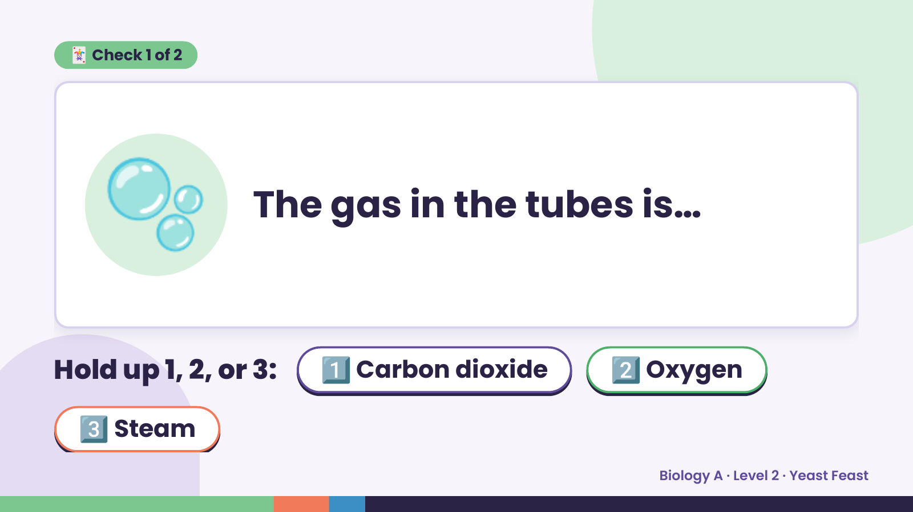
Notes:
🃏 Check 1 of 2
🫧 The gas in the tubes is…
Hold up 1, 2, or 3: 1️⃣ Carbon dioxide 2️⃣ Oxygen
3️⃣ Steam
Biology A · Level 2 · Yeast Feast

Slide 6
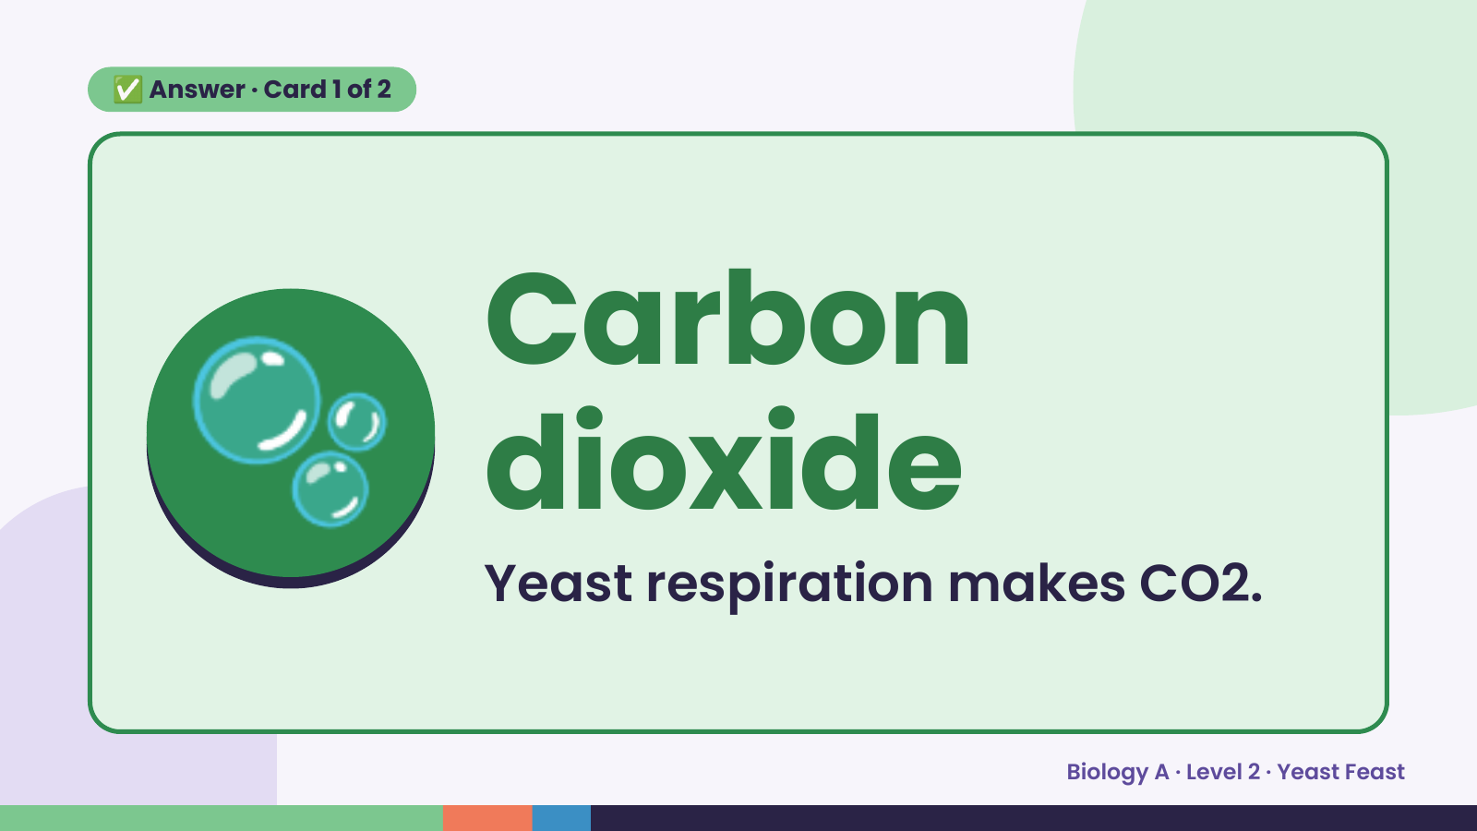
Notes:
✅ Answer · Card 1 of 2
🫧 Carbon
dioxide
Yeast respiration makes CO2.
Biology A · Level 2 · Yeast Feast

Slide 7
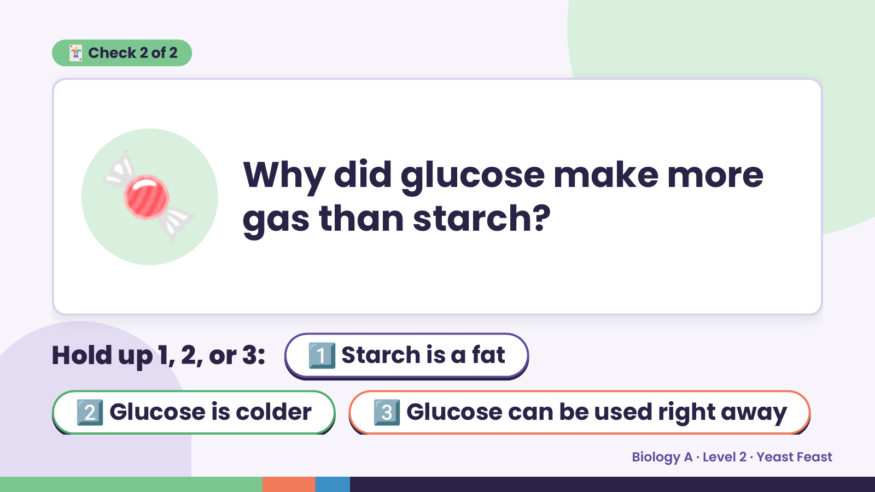
Notes:
🃏 Check 2 of 2
🍬 Why did glucose make more
gas than starch?
Hold up 1, 2, or 3: 1️⃣ Starch is a fat
2️⃣ Glucose is colder 3️⃣ Glucose can be used right away
Biology A · Level 2 · Yeast Feast

Slide 8
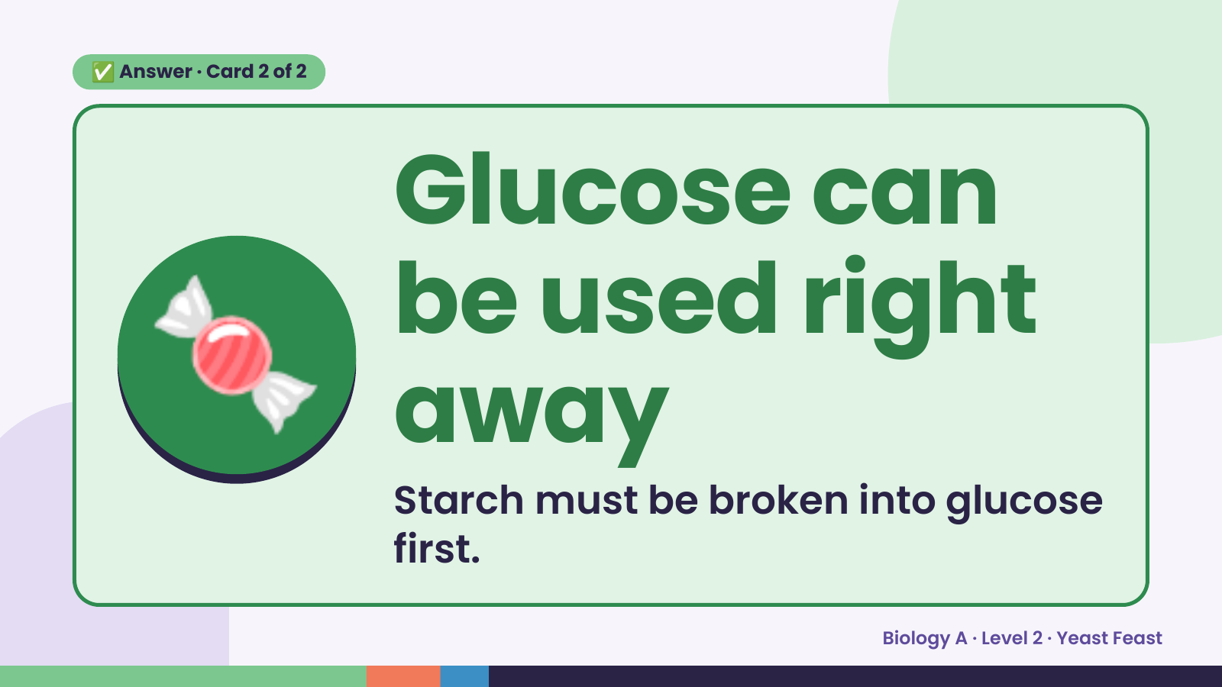
Notes:
✅ Answer · Card 2 of 2
🍬
Glucose can
be used right
away
Starch must be broken into glucose
first.
Biology A · Level 2 · Yeast Feast

Slide 9
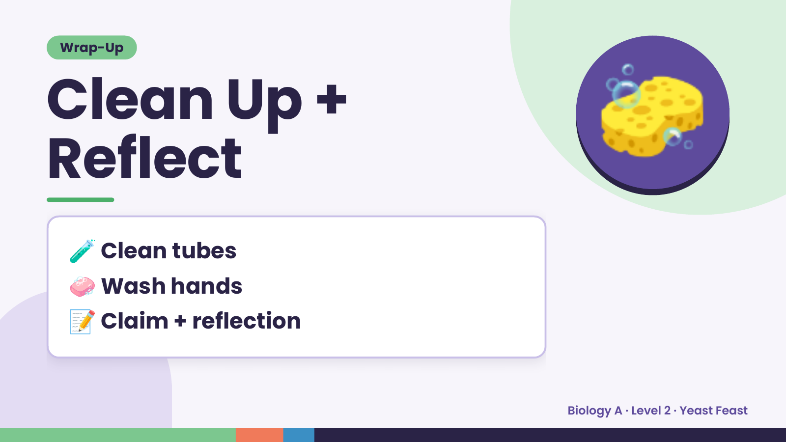
Notes:
Wrap-Up
Clean Up +
Reflect
🧽
🧪 Clean tubes
🧼 Wash hands
📝 Claim + reflection
Biology A · Level 2 · Yeast Feast

