Slide 1
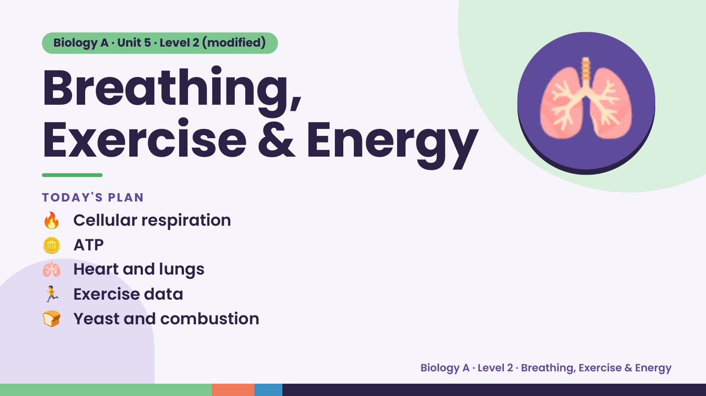
Notes:
Biology A · Unit 5 · Level 2 (modified)
Breathing,
Exercise & Energy
🔥 Cellular respiration
TODAY'S PLAN
🫁
🪙 ATP
🫁 Heart and lungs
🏃 Exercise data
🍞 Yeast and combustion
Biology A · Level 2 · Breathing, Exercise & Energy

Slide 2
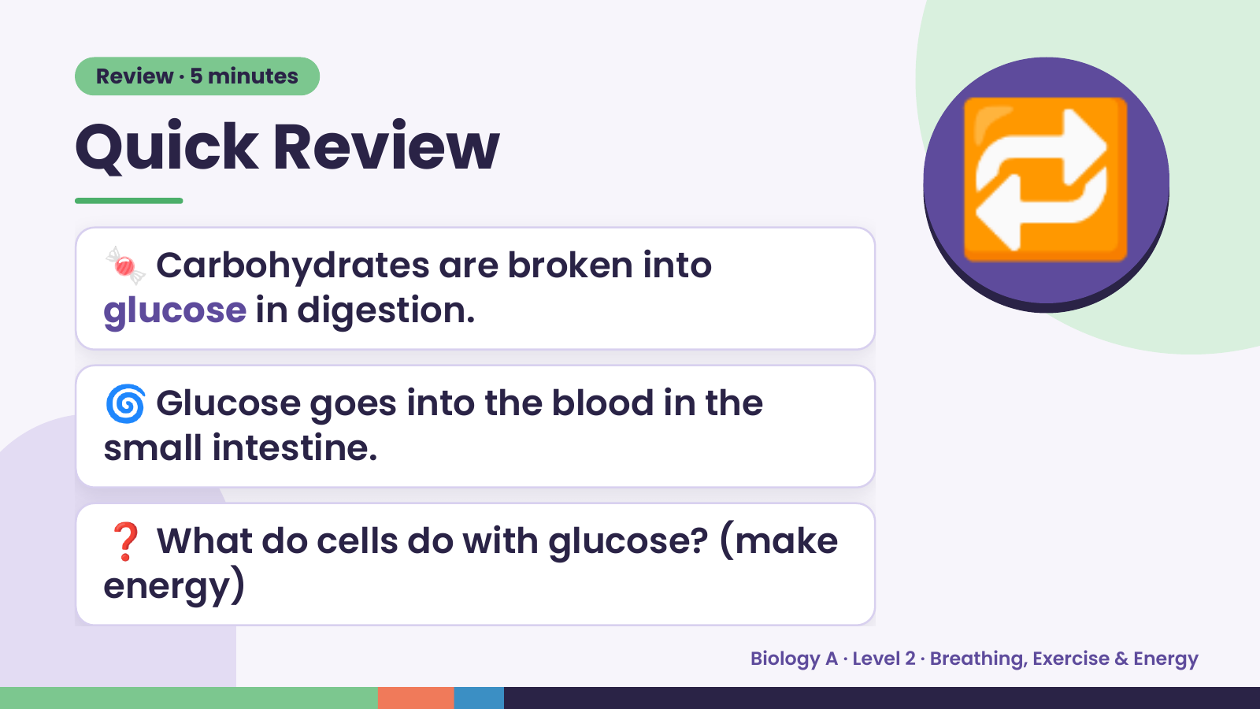
Notes:
Review · 5 minutes
Quick Review
🍬 Carbohydrates are broken into
glucose in digestion.
🔁
🌀 Glucose goes into the blood in the
small intestine.
❓ What do cells do with glucose? (make
energy)
Biology A · Level 2 · Breathing, Exercise & Energy

Slide 3
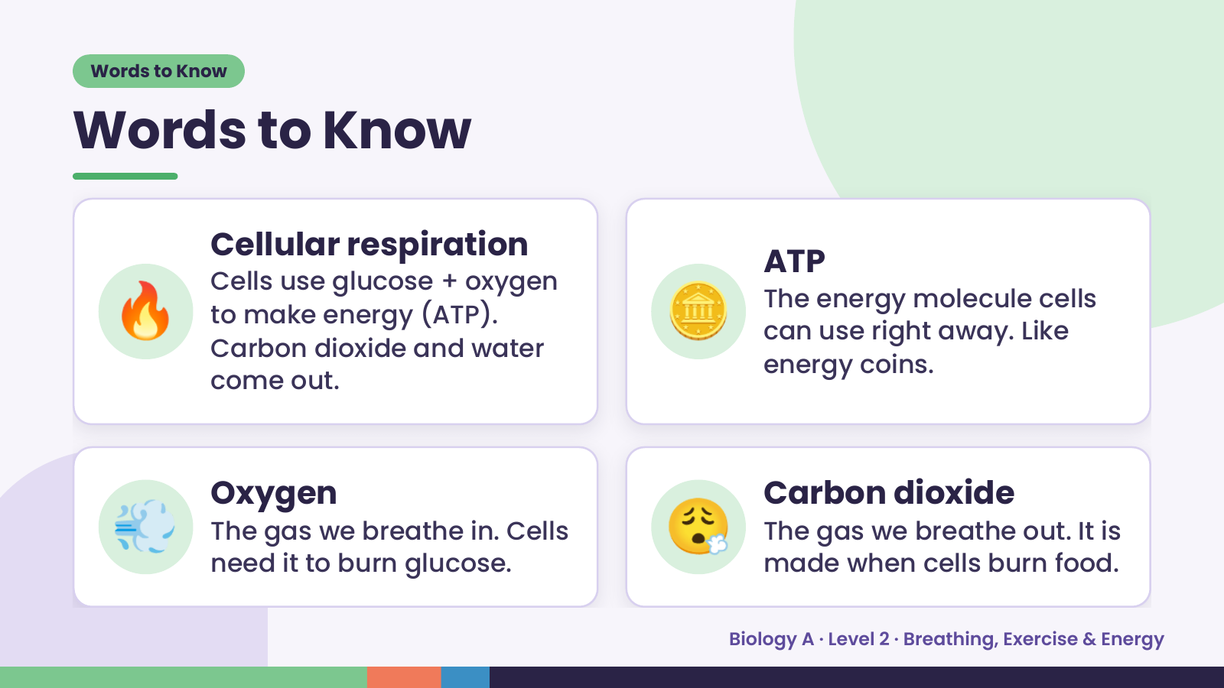
Notes:
Words to Know
Words to Know
🔥 🪙
Cellular respiration
ATP
Cells use glucose + oxygen
The energy molecule cells
to make energy (ATP).
can use right away. Like
Carbon dioxide and water
energy coins.
come out.
💨 Oxygen
The gas we breathe in. Cells
need it to burn glucose.
😮‍💨 Carbon dioxide
The gas we breathe out. It is
made when cells burn food.
Biology A · Level 2 · Breathing, Exercise & Energy

Slide 4
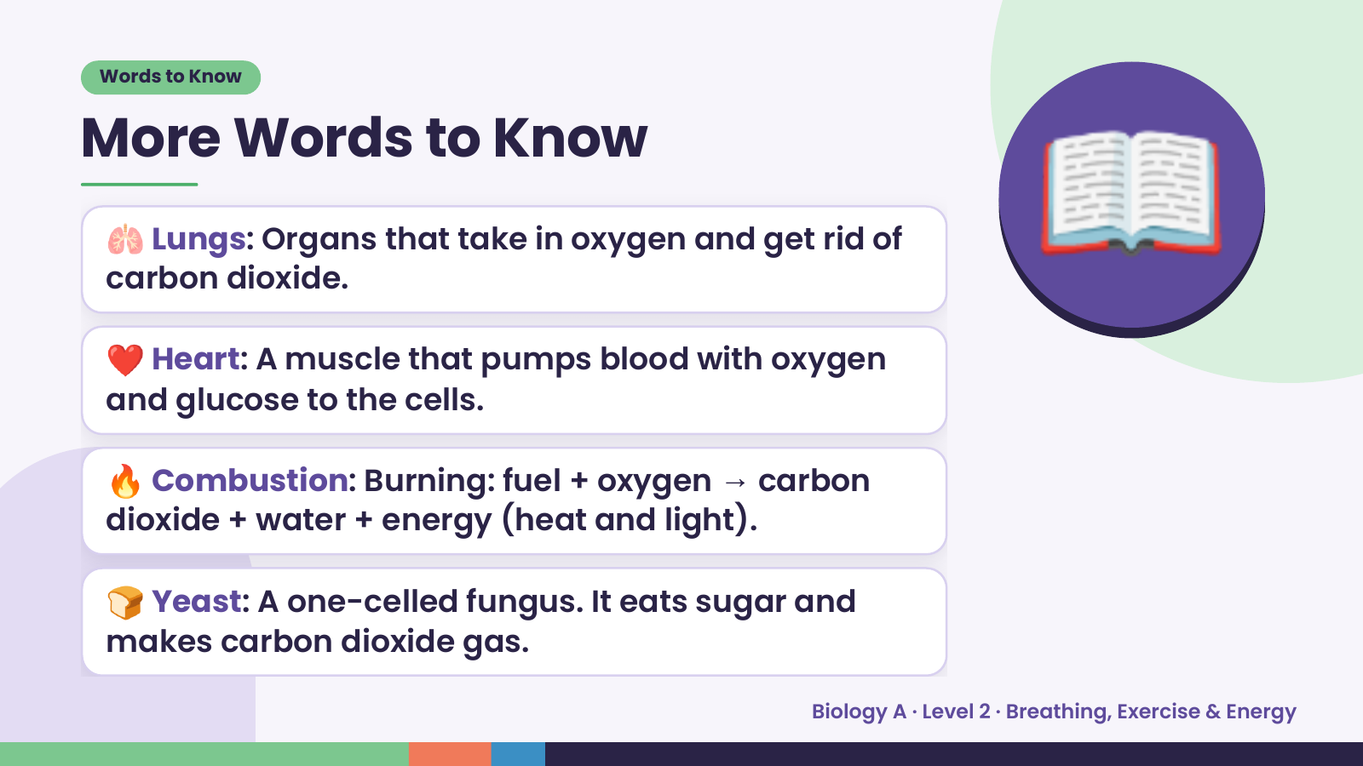
Notes:
Words to Know
More Words to Know
🫁 Lungs: Organs that take in oxygen and get rid of
carbon dioxide.
❤️ Heart: A muscle that pumps blood with oxygen
and glucose to the cells.
📖
🔥 Combustion: Burning: fuel + oxygen → carbon
dioxide + water + energy (heat and light).
🍞 Yeast: A one-celled fungus. It eats sugar and
makes carbon dioxide gas.
Biology A · Level 2 · Breathing, Exercise & Energy

Slide 5
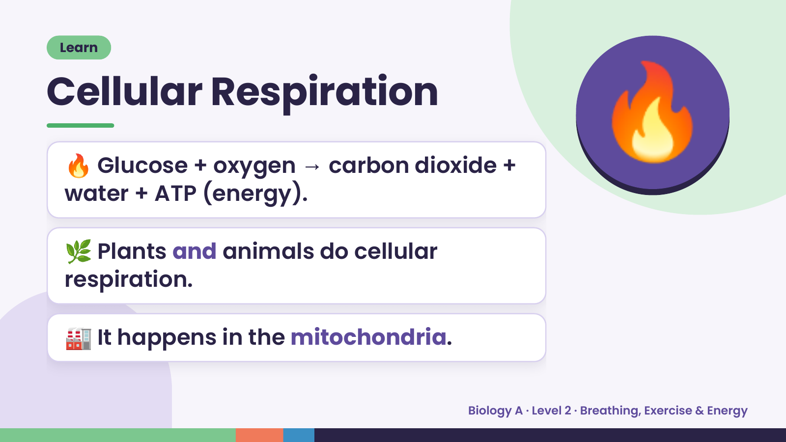
Notes:
Learn
Cellular Respiration
🔥 Glucose + oxygen → carbon dioxide +
water + ATP (energy).
🔥
🌿 Plants and animals do cellular
respiration.
🏭 It happens in the mitochondria.
Biology A · Level 2 · Breathing, Exercise & Energy

Slide 6
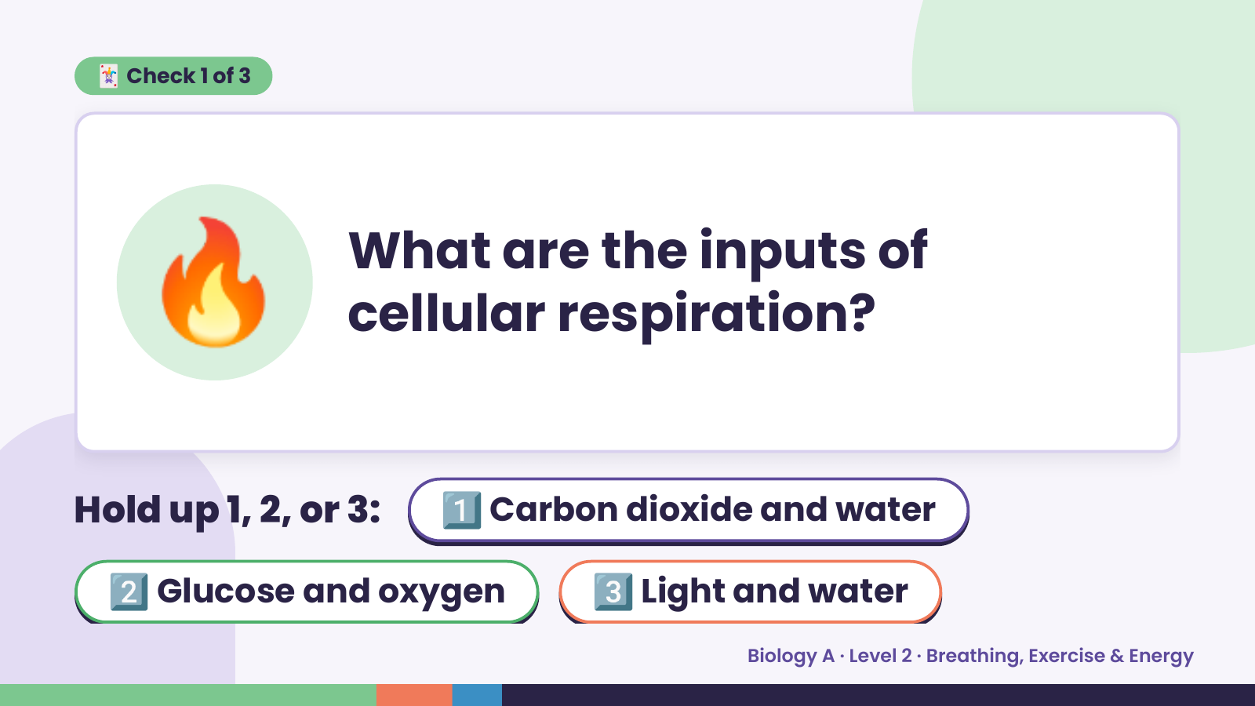
Notes:
🃏 Check 1 of 3
🔥 What are the inputs of
cellular respiration?
Hold up 1, 2, or 3: 1️⃣ Carbon dioxide and water
2️⃣ Glucose and oxygen 3️⃣ Light and water
Biology A · Level 2 · Breathing, Exercise & Energy

Slide 7
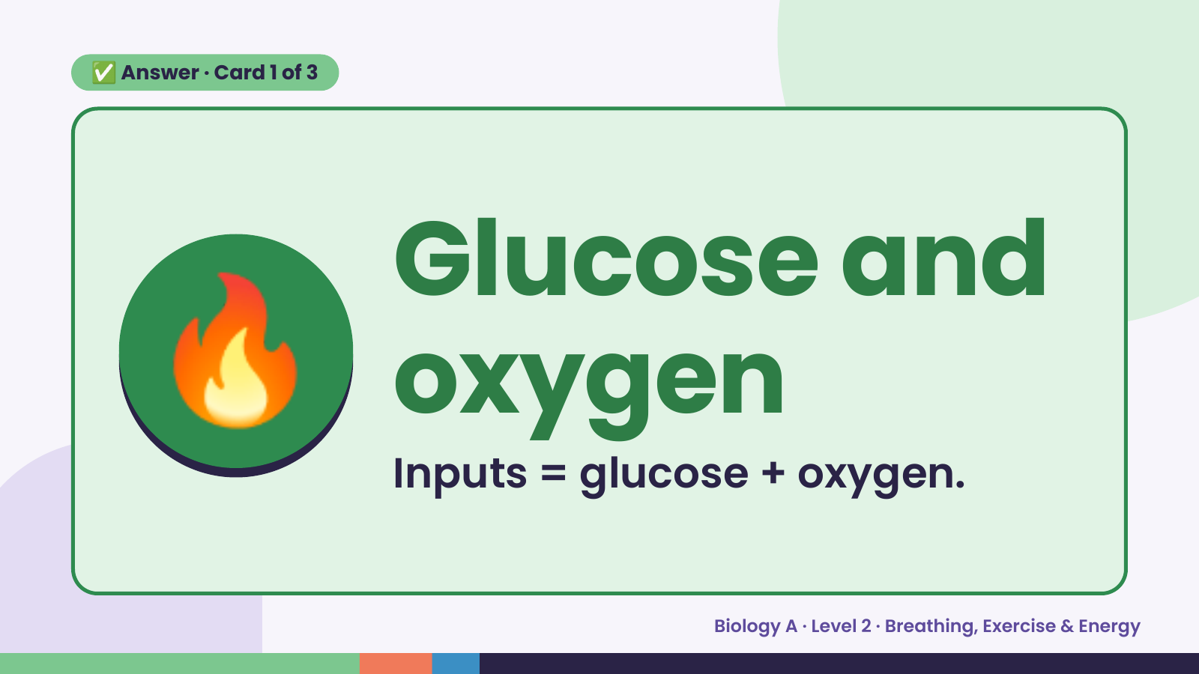
Notes:
✅ Answer · Card 1 of 3
🔥 Glucose and
oxygen
Inputs = glucose + oxygen.
Biology A · Level 2 · Breathing, Exercise & Energy

Slide 8
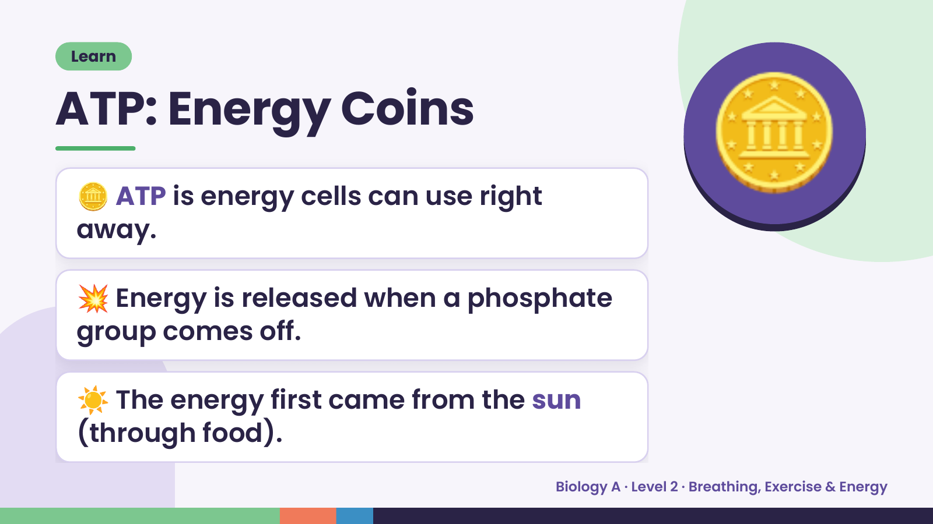
Notes:
Learn
ATP: Energy Coins
🪙 ATP is energy cells can use right
away.
🪙
💥 Energy is released when a phosphate
group comes off.
☀️ The energy first came from the sun
(through food).
Biology A · Level 2 · Breathing, Exercise & Energy

Slide 9
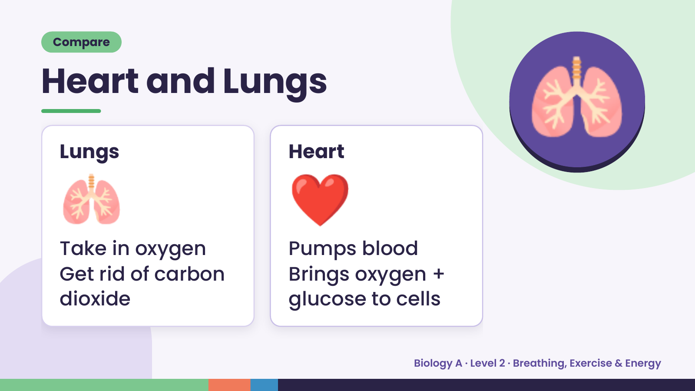
Notes:
Compare
Heart and Lungs
🫁
Lungs
❤️
Heart
🫁
Take in oxygen Pumps blood
Get rid of carbon Brings oxygen +
dioxide glucose to cells
Biology A · Level 2 · Breathing, Exercise & Energy

Slide 10
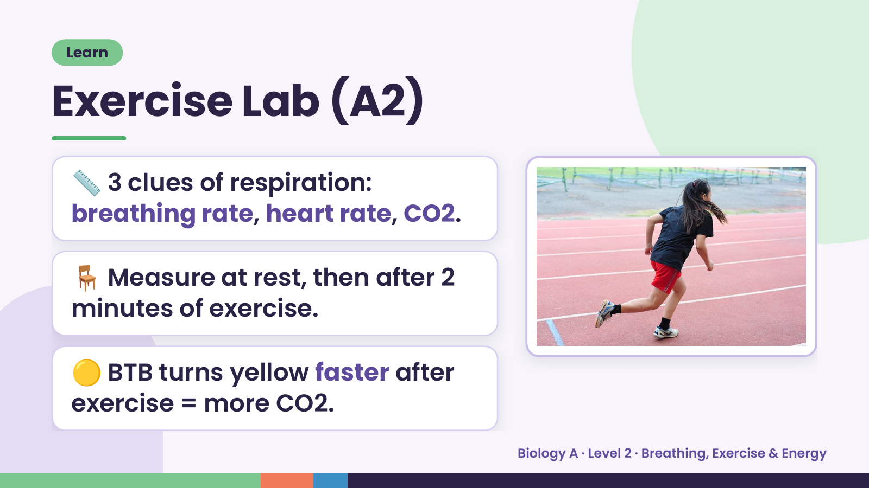
Notes:
Learn
Exercise Lab (A2)
📏 3 clues of respiration:
breathing rate, heart rate, CO2.
🪑 Measure at rest, then after 2
minutes of exercise.
🟡 BTB turns yellow faster after
exercise = more CO2.
Biology A · Level 2 · Breathing, Exercise & Energy

Slide 11
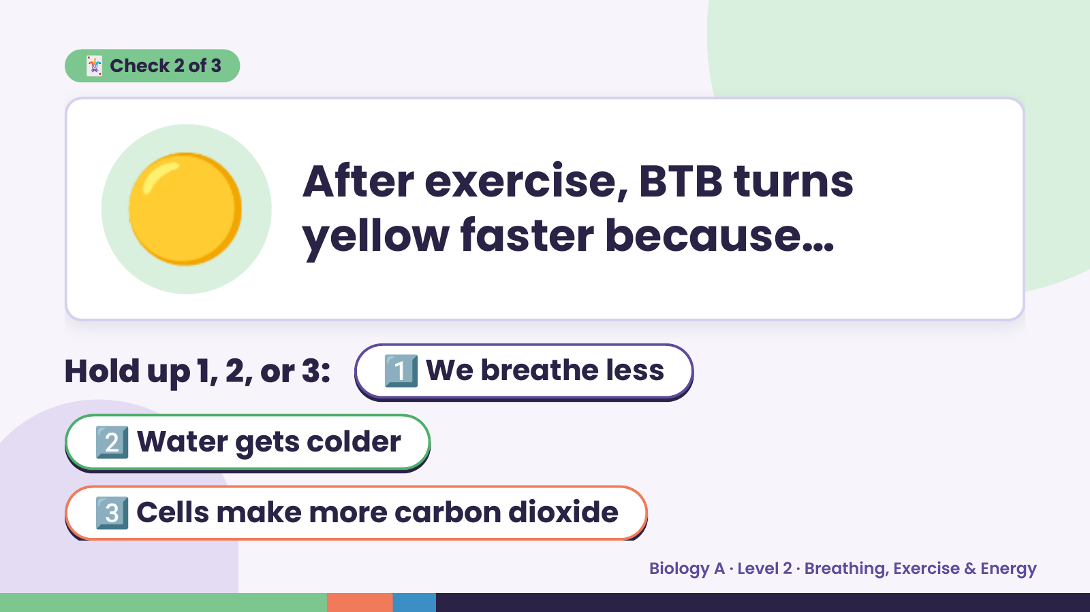
Notes:
🟡
🃏 Check 2 of 3
After exercise, BTB turns
yellow faster because…
Hold up 1, 2, or 3: 1️⃣ We breathe less
2️⃣ Water gets colder
3️⃣ Cells make more carbon dioxide
Biology A · Level 2 · Breathing, Exercise & Energy

Slide 12
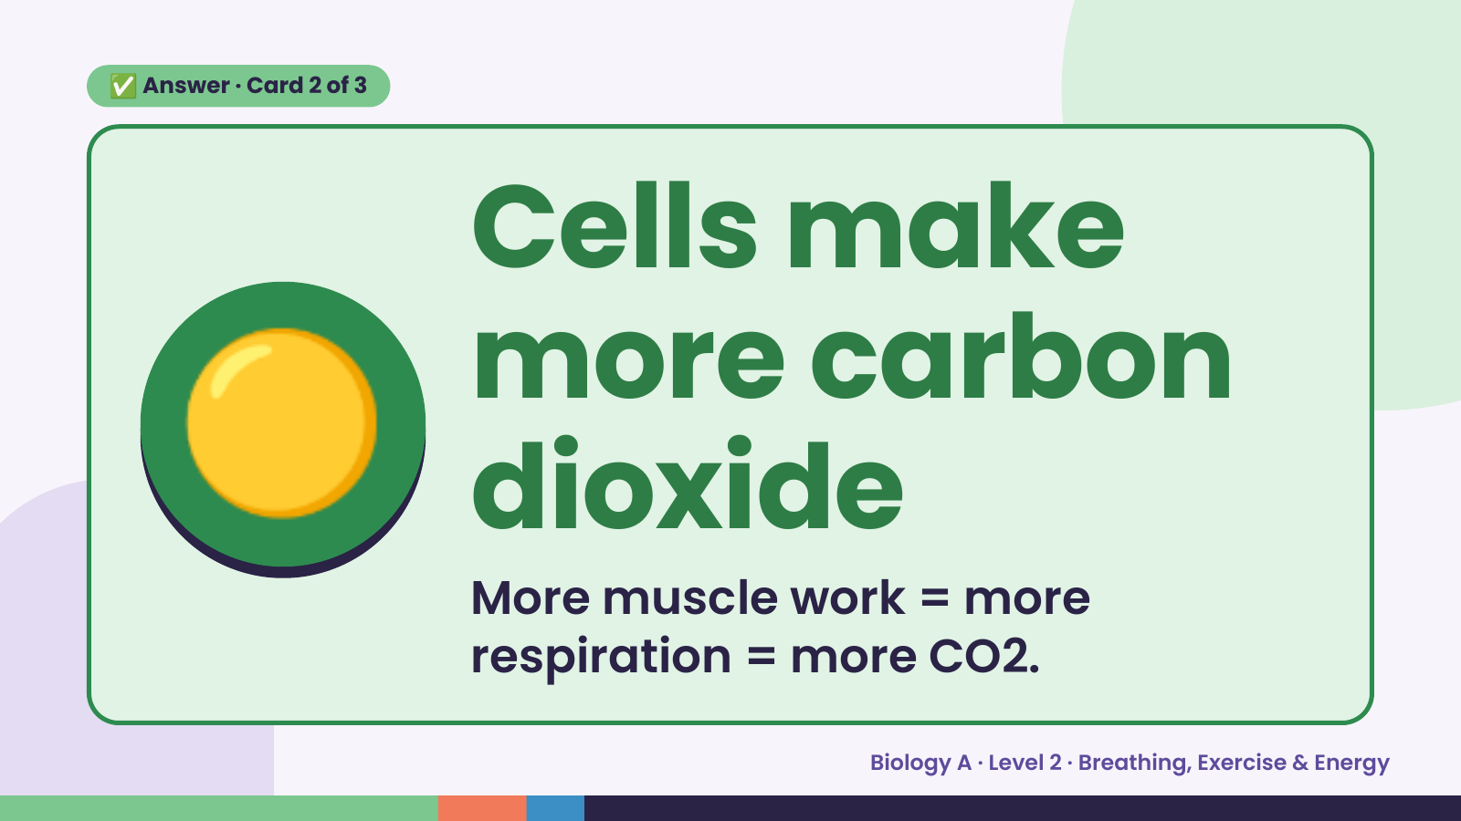
Notes:
✅ Answer · Card 2 of 3
🟡
Cells make
more carbon
dioxide
More muscle work = more
respiration = more CO2.
Biology A · Level 2 · Breathing, Exercise & Energy

Slide 13
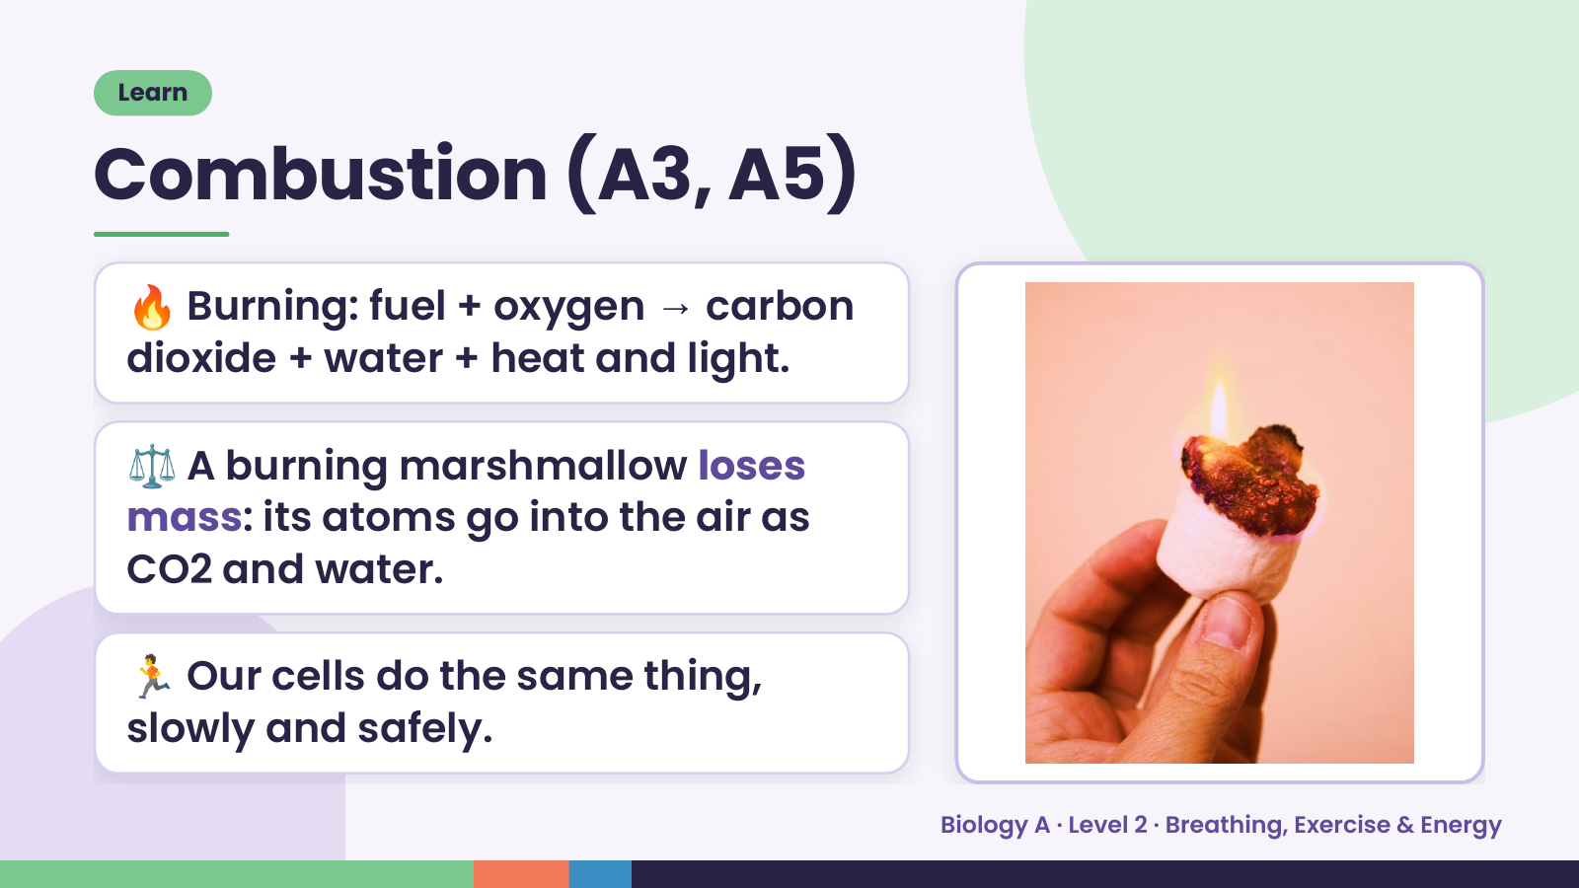
Notes:
Learn
Combustion (A3, A5)
🔥 Burning: fuel + oxygen → carbon
dioxide + water + heat and light.
⚖️ A burning marshmallow loses
mass: its atoms go into the air as
CO2 and water.
🏃 Our cells do the same thing,
slowly and safely.
Biology A · Level 2 · Breathing, Exercise & Energy

Slide 14
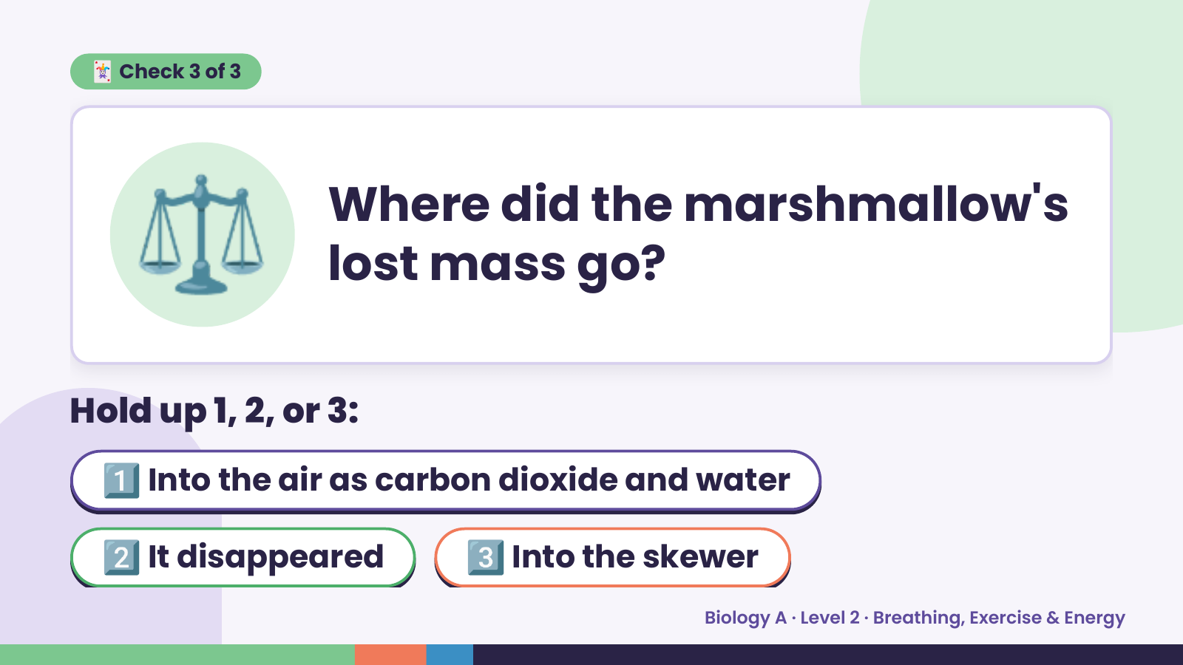
Notes:
⚖️
🃏 Check 3 of 3
Where did the marshmallow's
lost mass go?
Hold up 1, 2, or 3:
1️⃣ Into the air as carbon dioxide and water
2️⃣ It disappeared 3️⃣ Into the skewer
Biology A · Level 2 · Breathing, Exercise & Energy

Slide 15
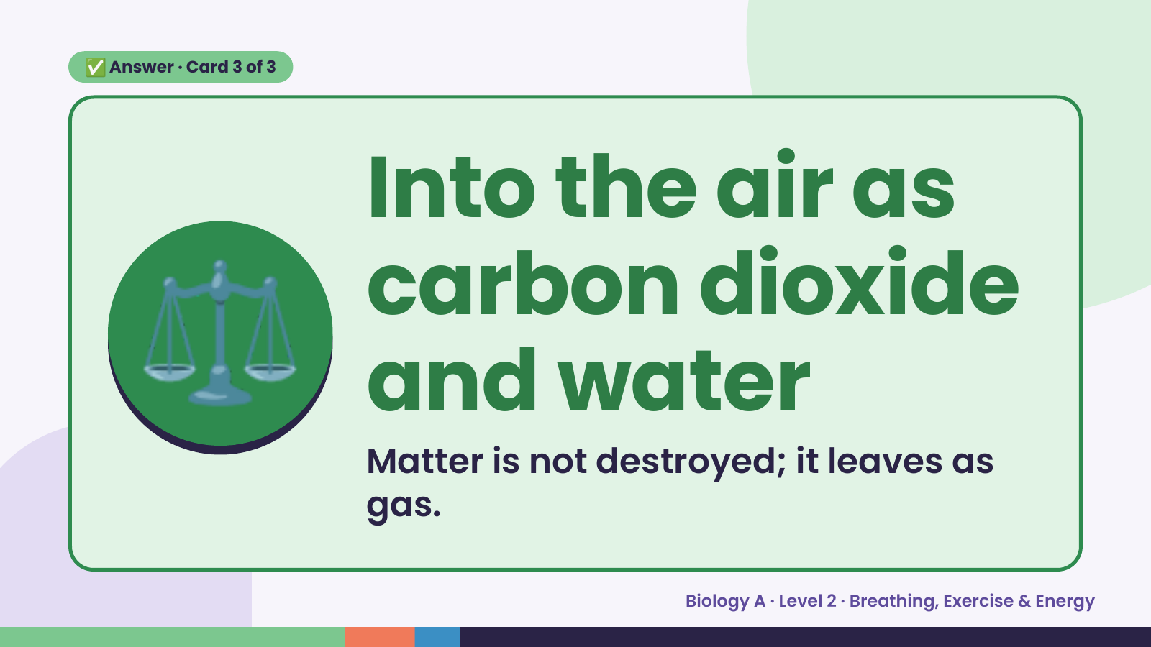
Notes:
✅ Answer · Card 3 of 3
⚖️ Into the air as
carbon dioxide
and water
Matter is not destroyed; it leaves as
gas.
Biology A · Level 2 · Breathing, Exercise & Energy

Slide 16
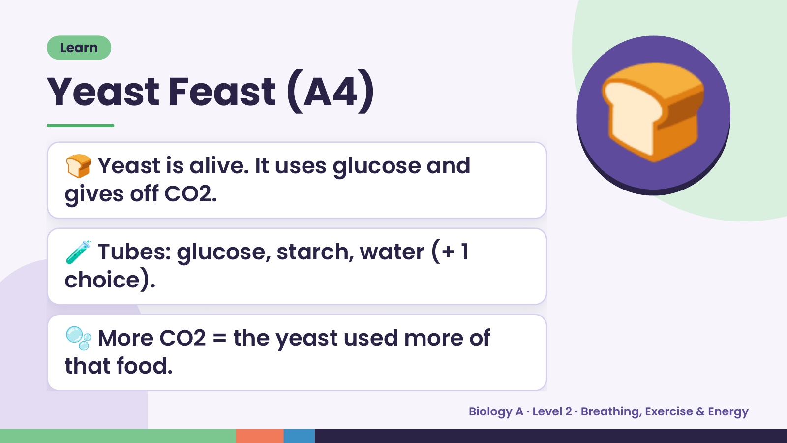
Notes:
Learn
Yeast Feast (A4)
🍞 Yeast is alive. It uses glucose and
gives off CO2.
🍞
🧪 Tubes: glucose, starch, water (+ 1
choice).
🫧 More CO2 = the yeast used more of
that food.
Biology A · Level 2 · Breathing, Exercise & Energy

Slide 17
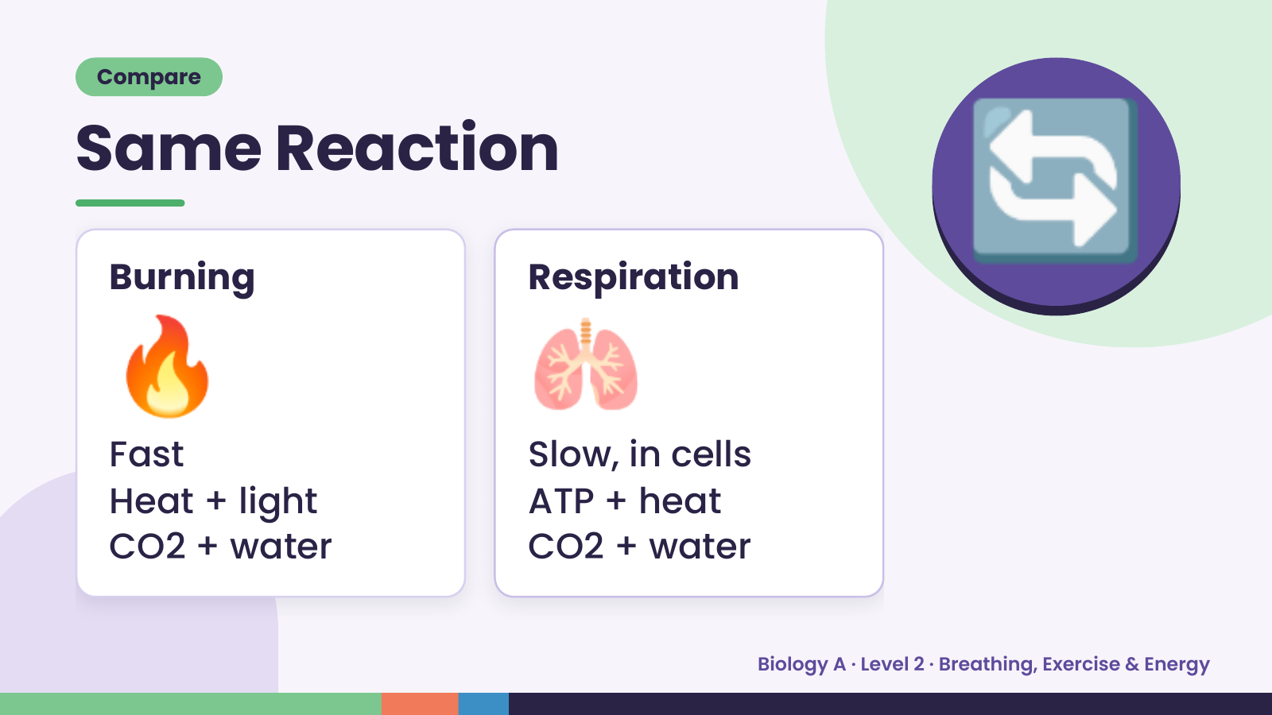
Notes:
Compare
Same Reaction
🔥
Burning
🫁
Respiration
🔄
Fast Slow, in cells
Heat + light ATP + heat
CO2 + water CO2 + water
Biology A · Level 2 · Breathing, Exercise & Energy

Slide 18
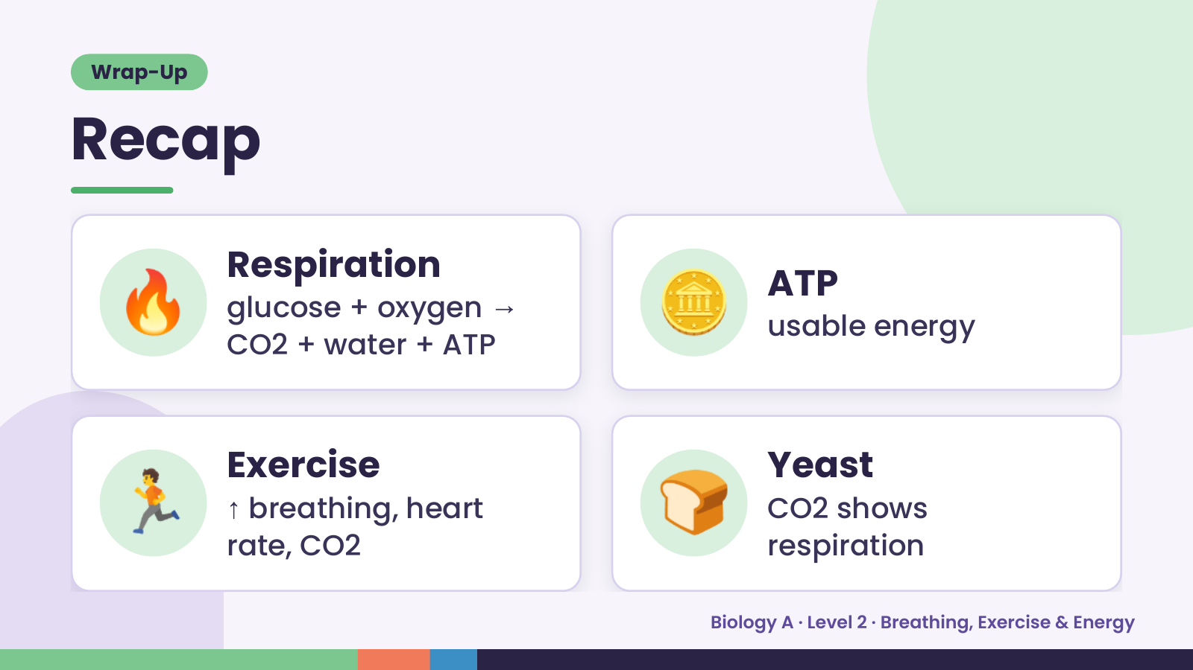
Notes:
Wrap-Up
Recap
🔥 Respiration
glucose + oxygen →
CO2 + water + ATP
🪙 ATP
usable energy
🏃 Exercise
↑ breathing, heart
rate, CO2
🍞 Yeast
CO2 shows
respiration
Biology A · Level 2 · Breathing, Exercise & Energy

Slide 19
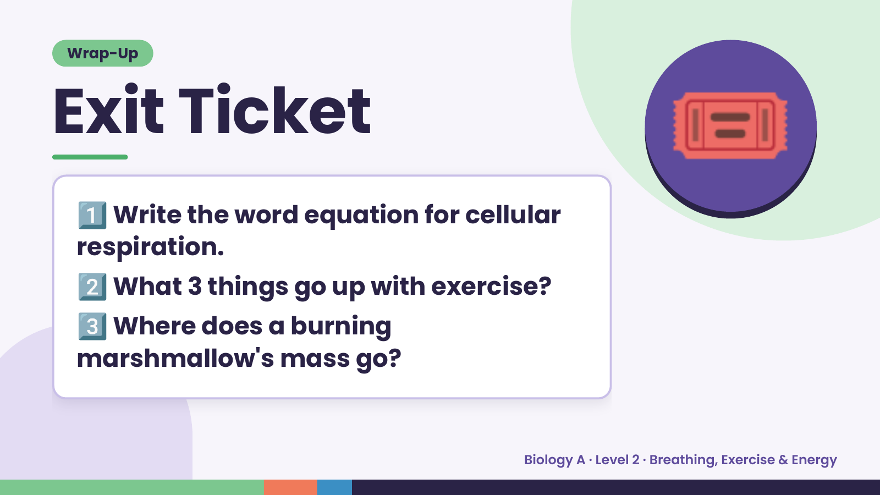
Notes:
Wrap-Up
Exit Ticket
1️⃣
Write the word equation for cellular
respiration.
🎟️
2️⃣What 3 things go up with exercise?
3️⃣
Where does a burning
marshmallow's mass go?
Biology A · Level 2 · Breathing, Exercise & Energy

