Slide 1
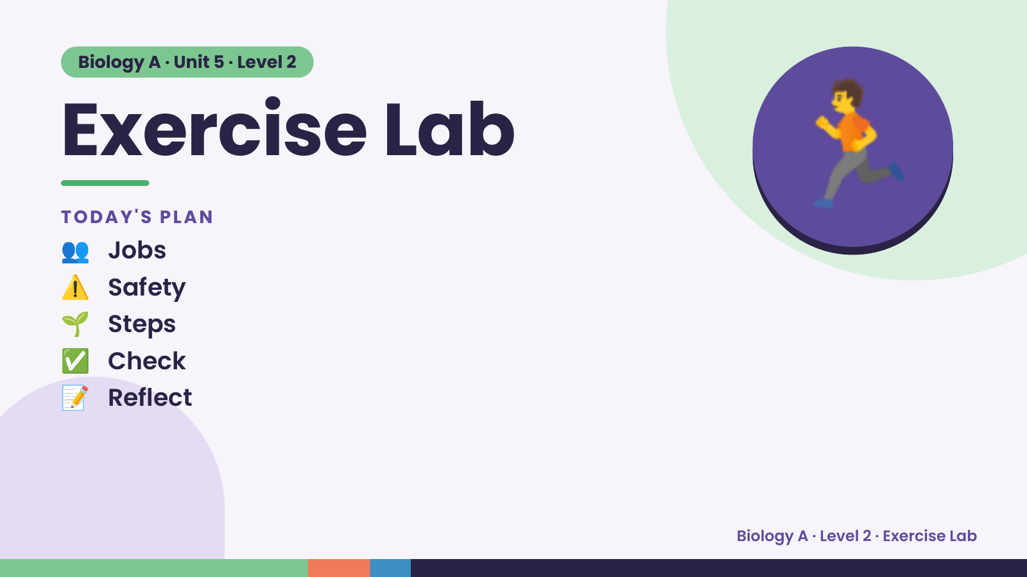
Notes:
Biology A · Unit 5 · Level 2
Exercise Lab
👥 Jobs
TODAY'S PLAN
⚠️ Safety
🌱 Steps
🏃
✅ Check
📝 Reflect
Biology A · Level 2 · Exercise Lab

Slide 2
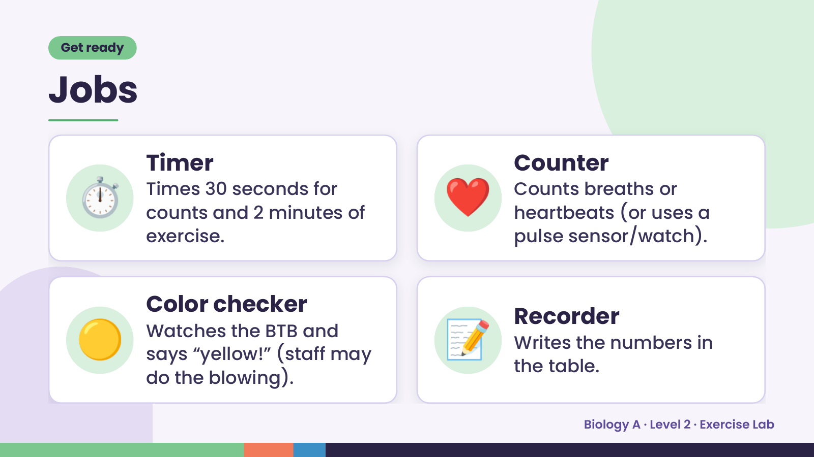
Notes:
Get ready
Jobs
⏱️ Timer
Times 30 seconds for
counts and 2 minutes of
exercise.
❤️ Counter
Counts breaths or
heartbeats (or uses a
pulse sensor/watch).
🟡 Color checker
Watches the BTB and
says “yellow!” (staff may
do the blowing).
📝 Recorder
Writes the numbers in
the table.
Biology A · Level 2 · Exercise Lab

Slide 3
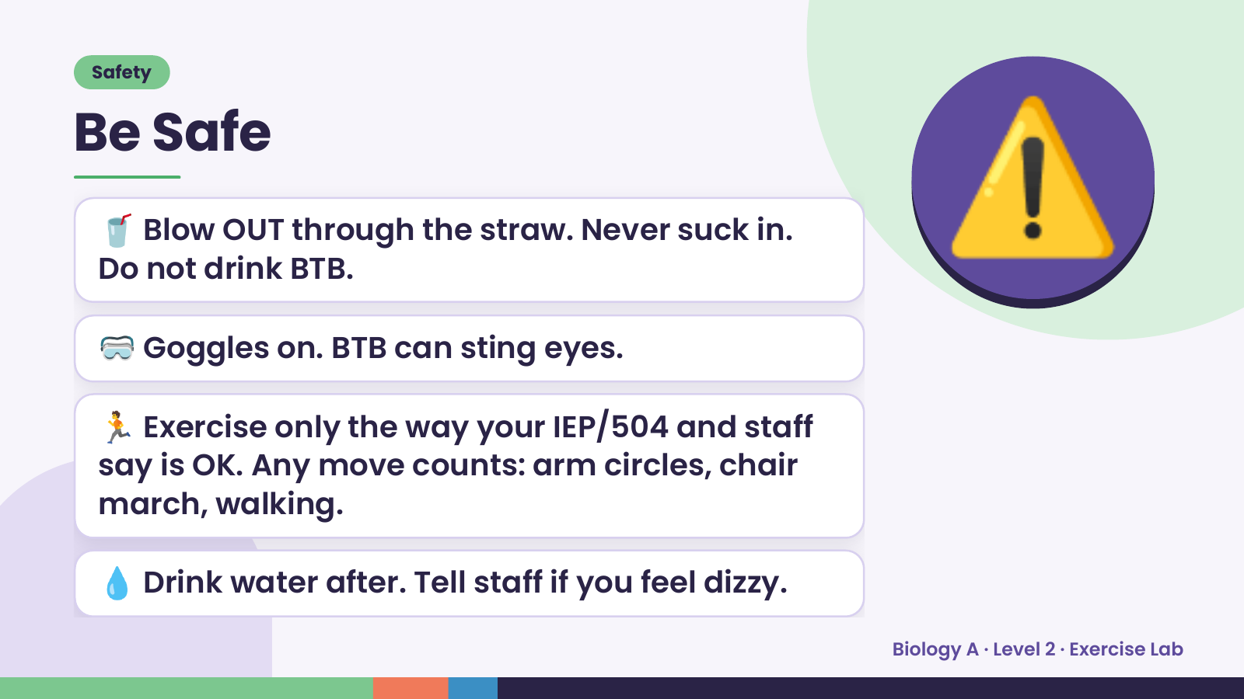
Notes:
Safety
Be Safe
🥤 Blow OUT through the straw. Never suck in.
Do not drink BTB.
🥽 Goggles on. BTB can sting eyes.
⚠️
🏃 Exercise only the way your IEP/504 and staff
say is OK. Any move counts: arm circles, chair
march, walking.
💧 Drink water after. Tell staff if you feel dizzy.
Biology A · Level 2 · Exercise Lab

Slide 4
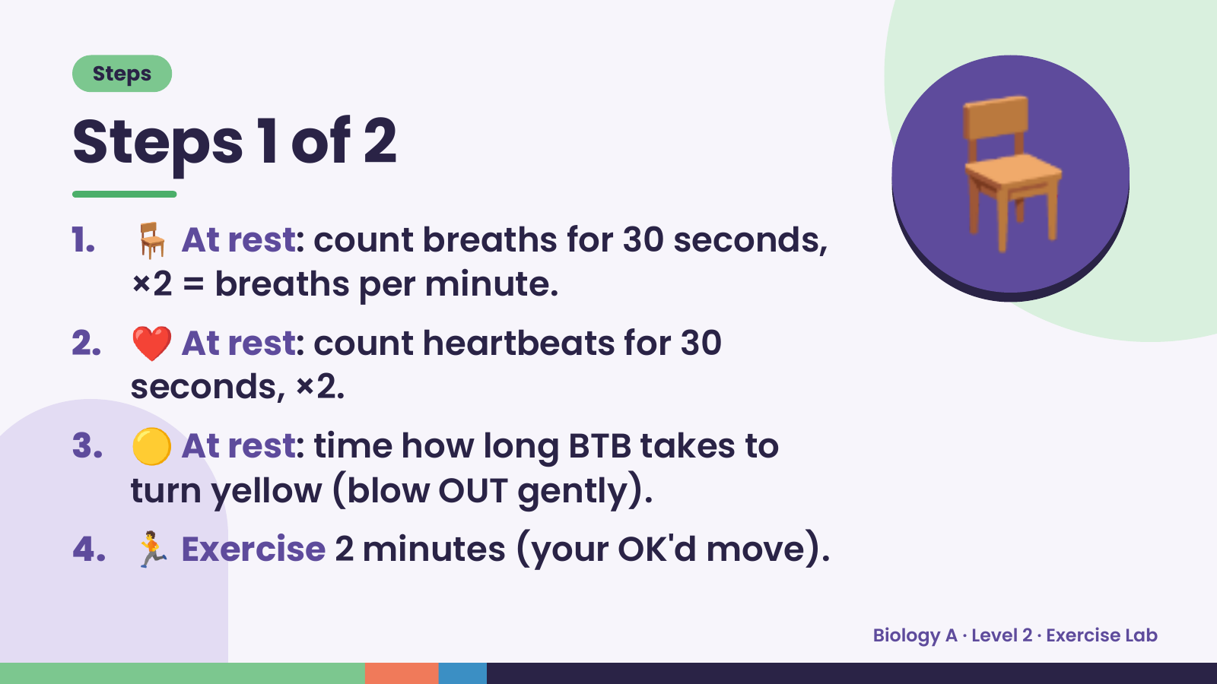
Notes:
Steps
Steps 1 of 2
1. 🪑 At rest: count breaths for 30 seconds,
×2 = breaths per minute.
2. ❤️ At rest: count heartbeats for 30
seconds, ×2.
🪑
3. 🟡 At rest: time how long BTB takes to
turn yellow (blow OUT gently).
4. 🏃 Exercise 2 minutes (your OK'd move).
Biology A · Level 2 · Exercise Lab

Slide 5
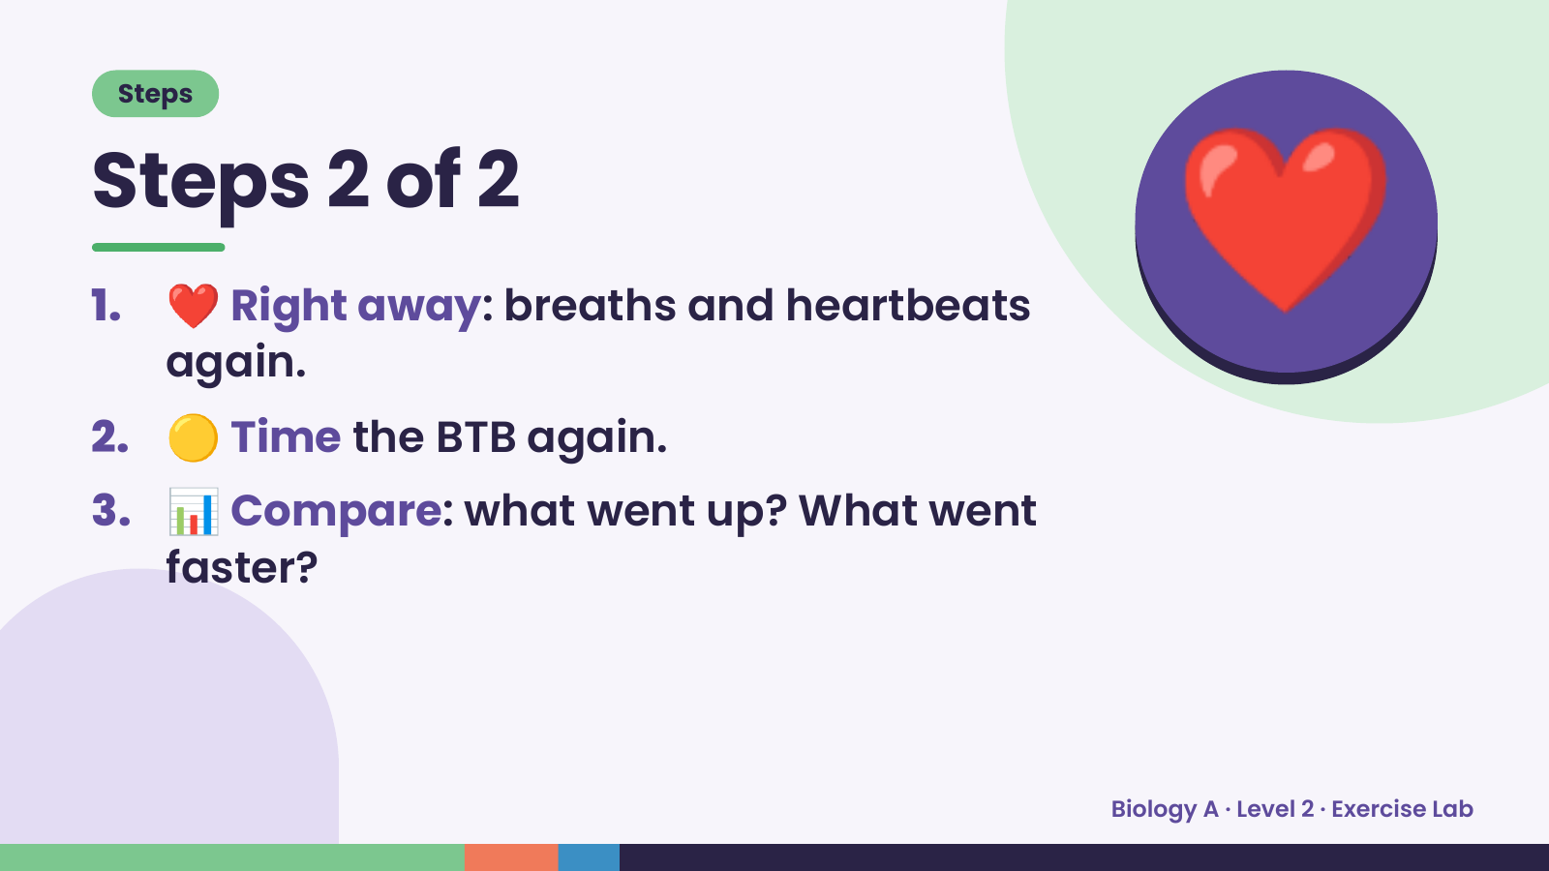
Notes:
Steps
Steps 2 of 2
1. ❤️ Right away: breaths and heartbeats
again.
2. 🟡 Time the BTB again.
❤️
3. 📊 Compare: what went up? What went
faster?
Biology A · Level 2 · Exercise Lab

Slide 6
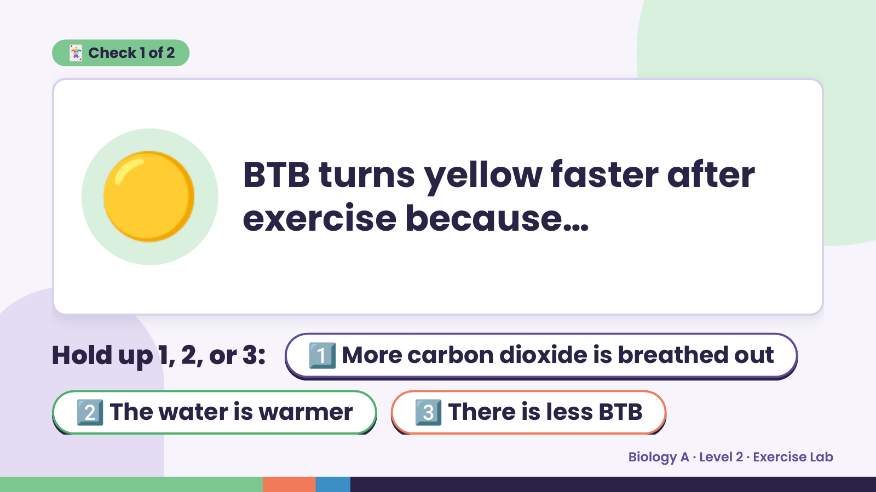
Notes:
🃏 Check 1 of 2
🟡 BTB turns yellow faster after
exercise because…
Hold up 1, 2, or 3: 1️⃣ More carbon dioxide is breathed out
2️⃣ The water is warmer 3️⃣ There is less BTB
Biology A · Level 2 · Exercise Lab

Slide 7
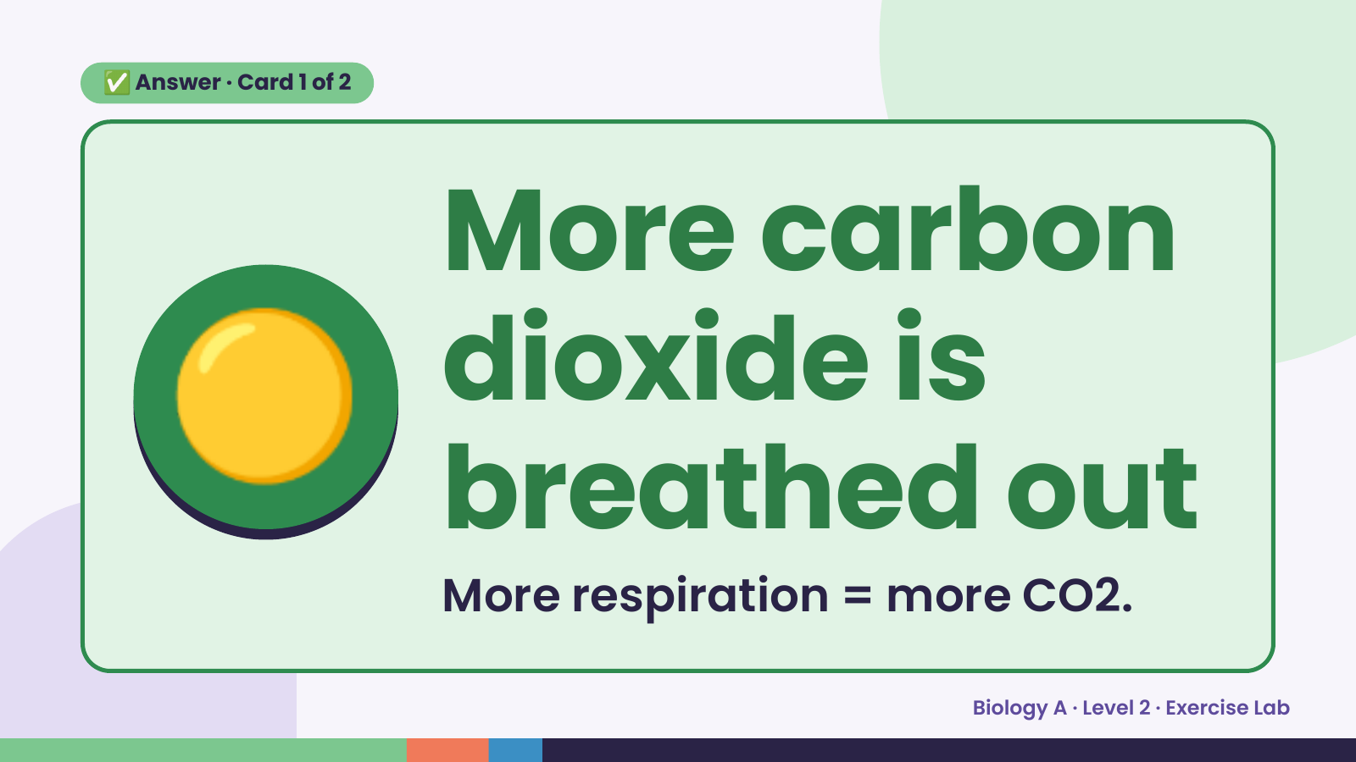
Notes:
✅ Answer · Card 1 of 2
🟡 More carbon
dioxide is
breathed out
More respiration = more CO2.
Biology A · Level 2 · Exercise Lab

Slide 8
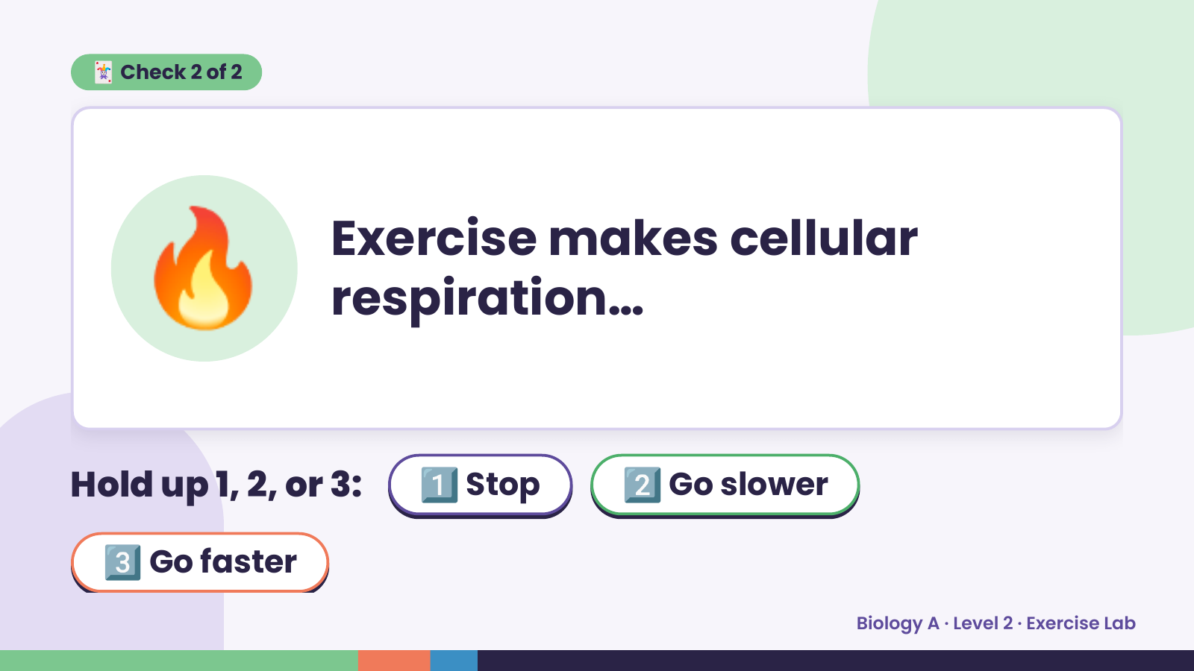
Notes:
🃏 Check 2 of 2
🔥 Exercise makes cellular
respiration…
Hold up 1, 2, or 3: 1️⃣ Stop 2️⃣ Go slower
3️⃣ Go faster
Biology A · Level 2 · Exercise Lab

Slide 9
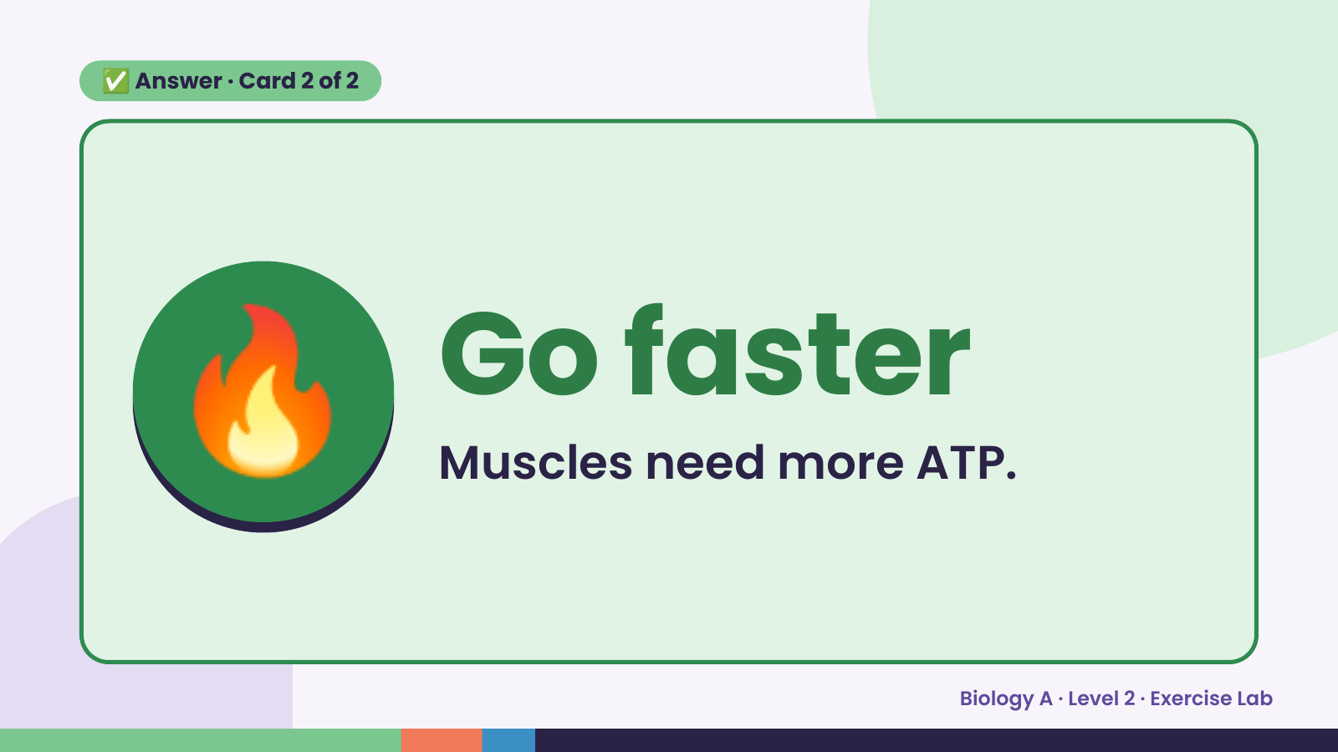
Notes:
✅ Answer · Card 2 of 2
🔥 Go faster
Muscles need more ATP.
Biology A · Level 2 · Exercise Lab

Slide 10
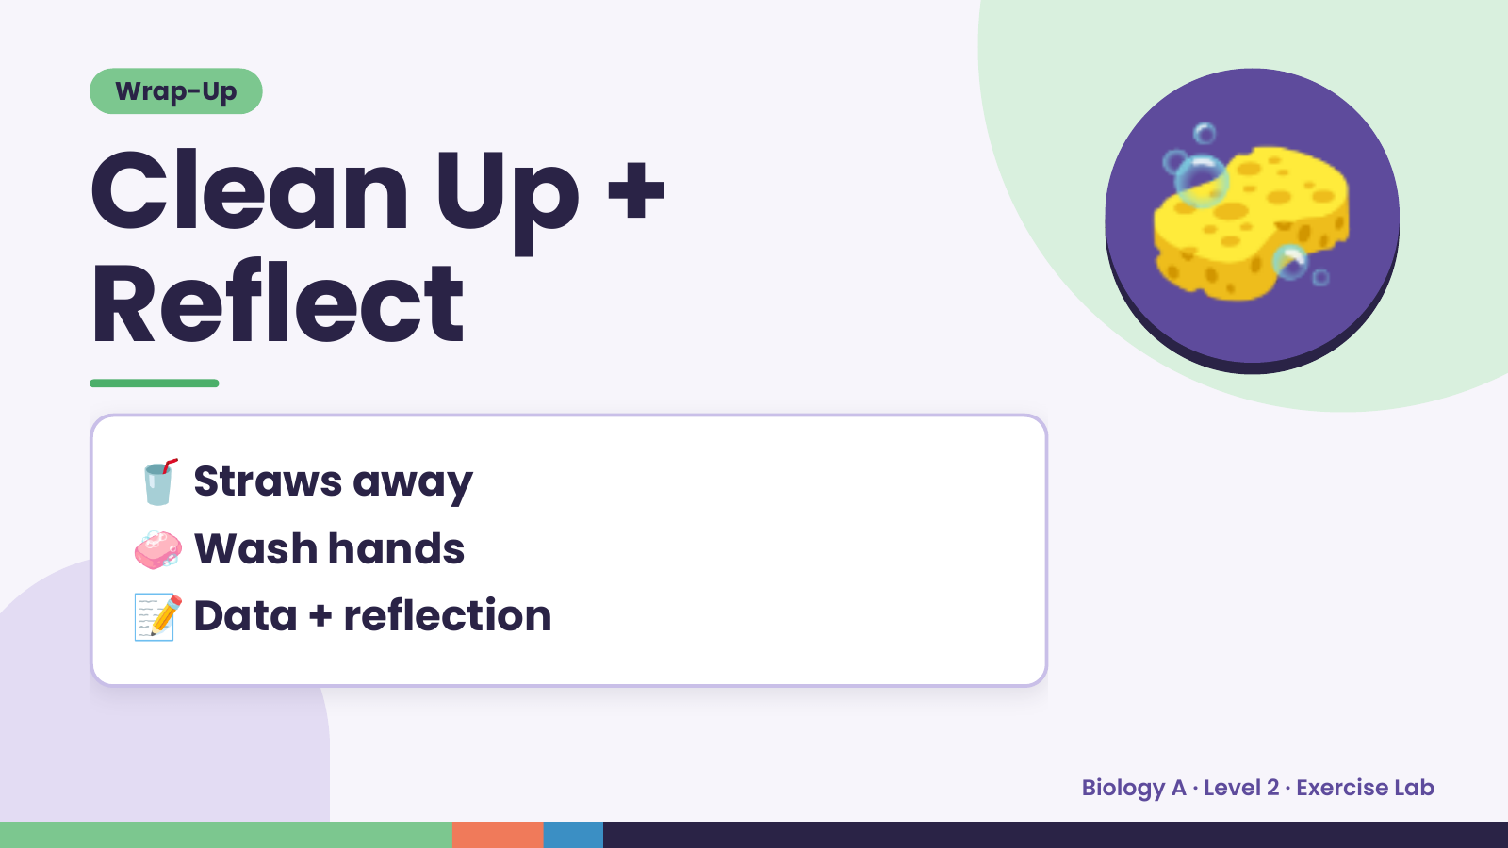
Notes:
Wrap-Up
Clean Up +
Reflect
🧽
🥤 Straws away
🧼 Wash hands
📝 Data + reflection
Biology A · Level 2 · Exercise Lab

