Slide 1
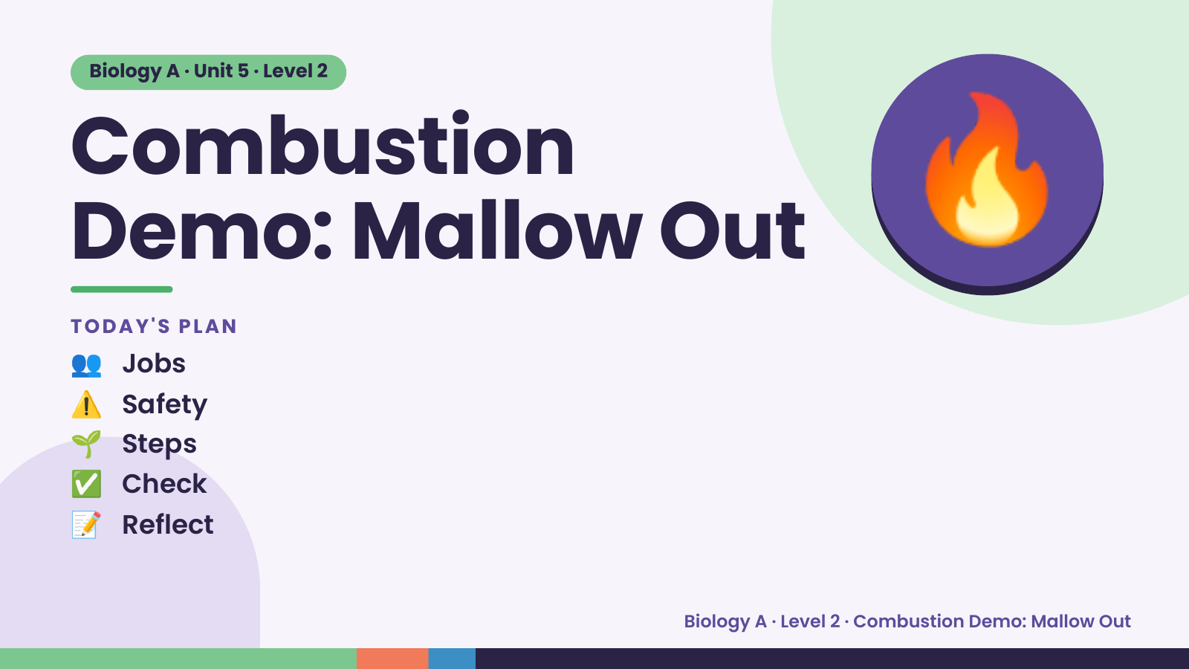
Notes:
Biology A · Unit 5 · Level 2
Combustion
Demo: Mallow Out
👥 Jobs
TODAY'S PLAN
🔥
⚠️ Safety
🌱 Steps
✅ Check
📝 Reflect
Biology A · Level 2 · Combustion Demo: Mallow Out

Slide 2
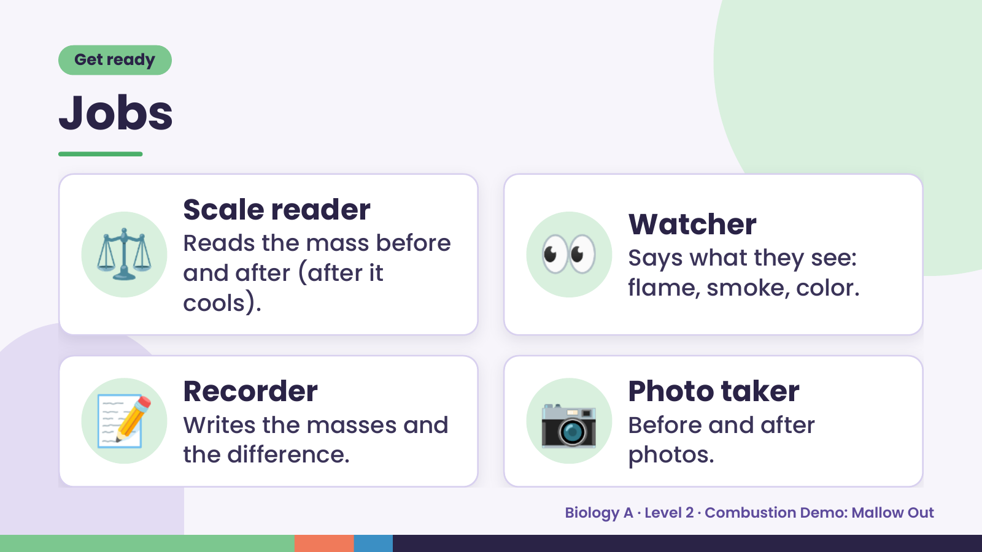
Notes:
Get ready
Jobs
⚖️ Scale reader
Reads the mass before
and after (after it
cools).
👀 Watcher
Says what they see:
flame, smoke, color.
📝 Recorder
Writes the masses and
the difference.
📷 Photo taker
Before and after
photos.
Biology A · Level 2 · Combustion Demo: Mallow Out

Slide 3
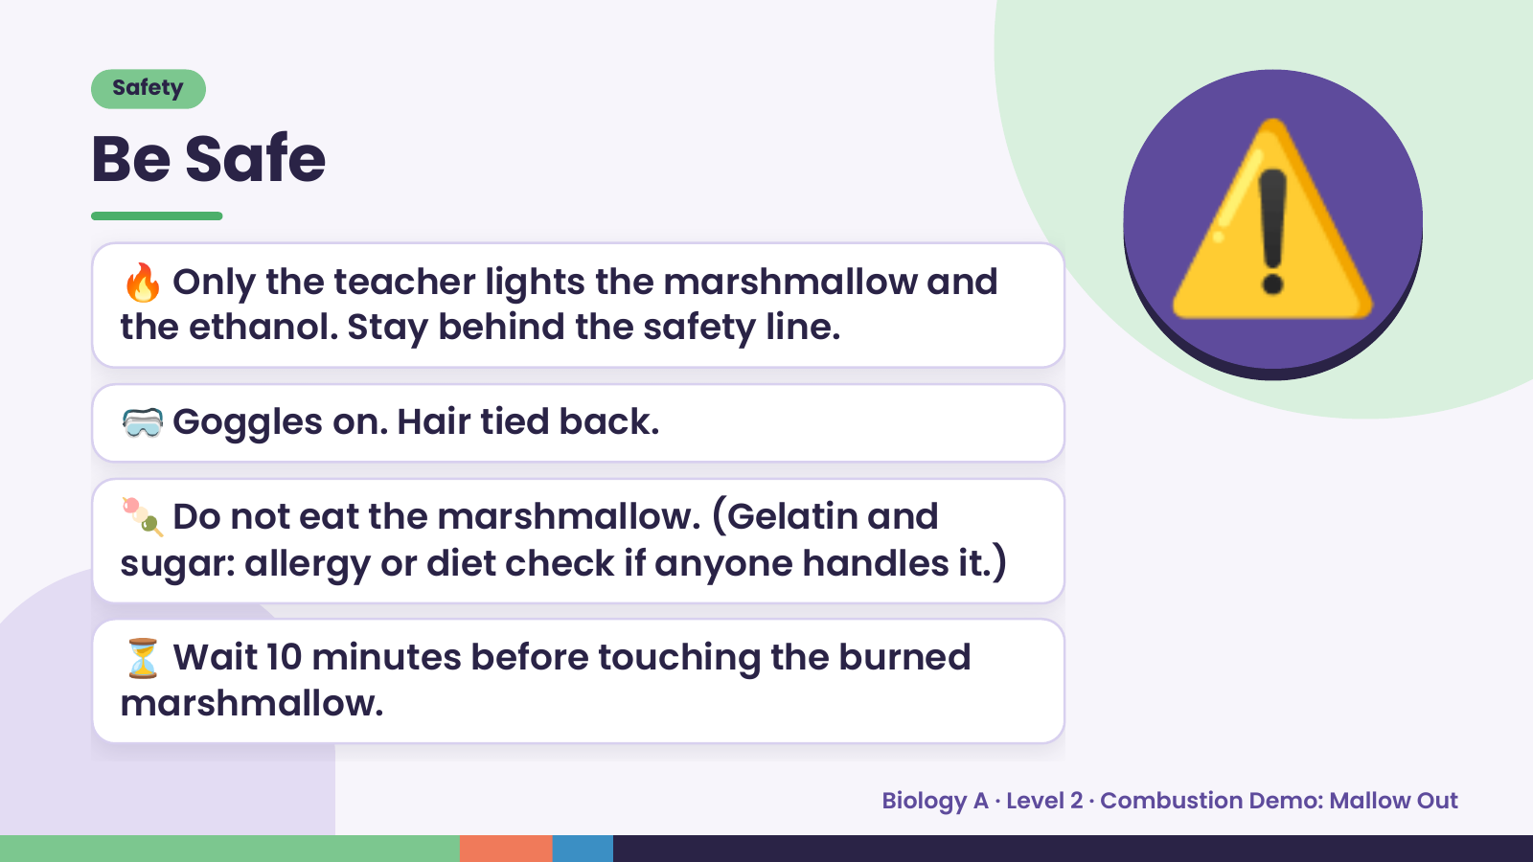
Notes:
Safety
Be Safe
🔥 Only the teacher lights the marshmallow and
the ethanol. Stay behind the safety line.
🥽 Goggles on. Hair tied back.
⚠️
🍡 Do not eat the marshmallow. (Gelatin and
sugar: allergy or diet check if anyone handles it.)
⏳ Wait 10 minutes before touching the burned
marshmallow.
Biology A · Level 2 · Combustion Demo: Mallow Out

Slide 4
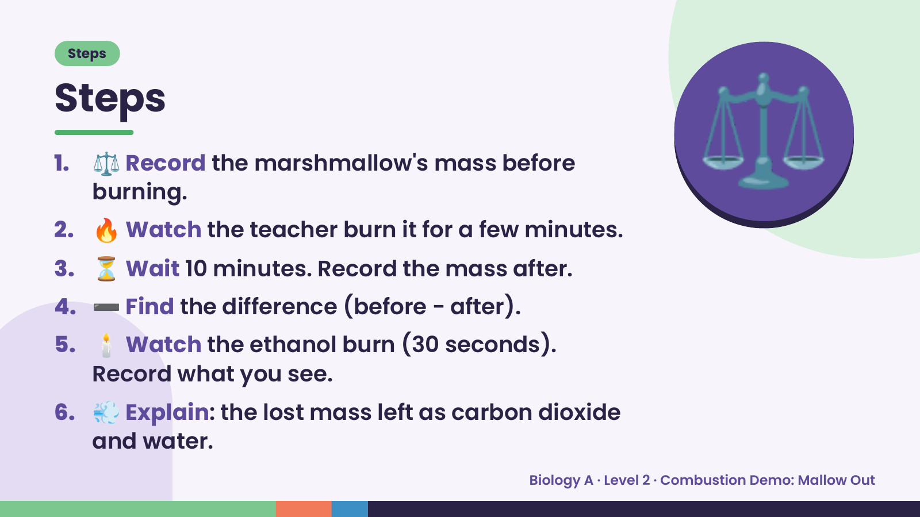
Notes:
Steps
Steps
1. ⚖️ Record the marshmallow's mass before
burning.
2. 🔥 Watch the teacher burn it for a few minutes.
3. ⏳ Wait 10 minutes. Record the mass after.
⚖️
4. ➖ Find the difference (before − after).
5. 🕯️ Watch the ethanol burn (30 seconds).
Record what you see.
6. 💨 Explain: the lost mass left as carbon dioxide
and water.
Biology A · Level 2 · Combustion Demo: Mallow Out

Slide 5
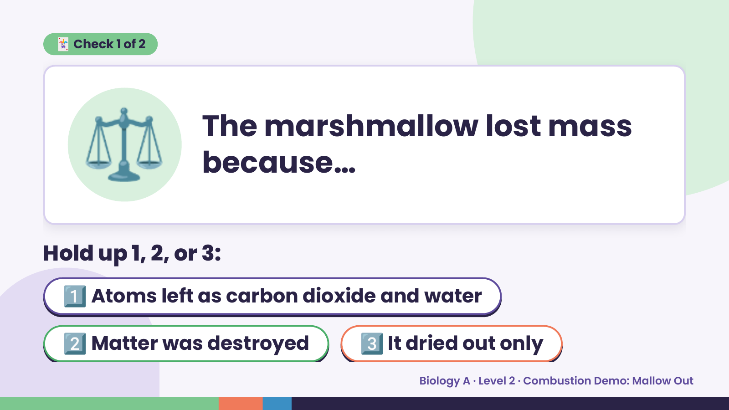
Notes:
⚖️
🃏 Check 1 of 2
The marshmallow lost mass
because…
Hold up 1, 2, or 3:
1️⃣ Atoms left as carbon dioxide and water
2️⃣ Matter was destroyed 3️⃣ It dried out only
Biology A · Level 2 · Combustion Demo: Mallow Out

Slide 6
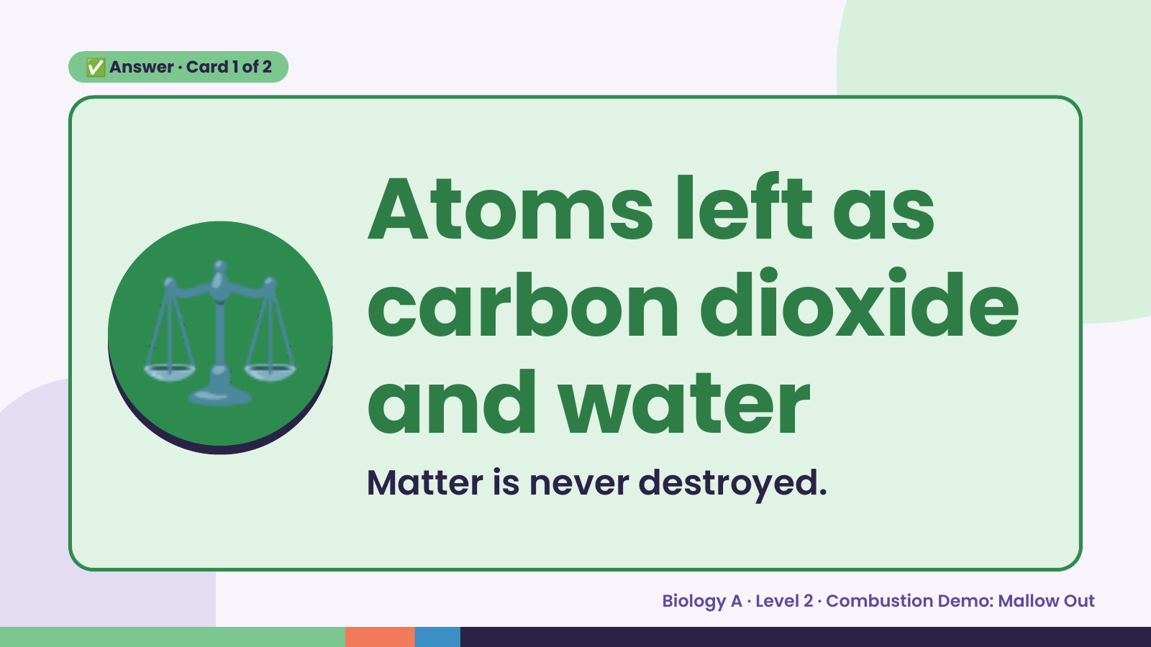
Notes:
✅ Answer · Card 1 of 2
⚖️ Atoms left as
carbon dioxide
and water
Matter is never destroyed.
Biology A · Level 2 · Combustion Demo: Mallow Out

Slide 7
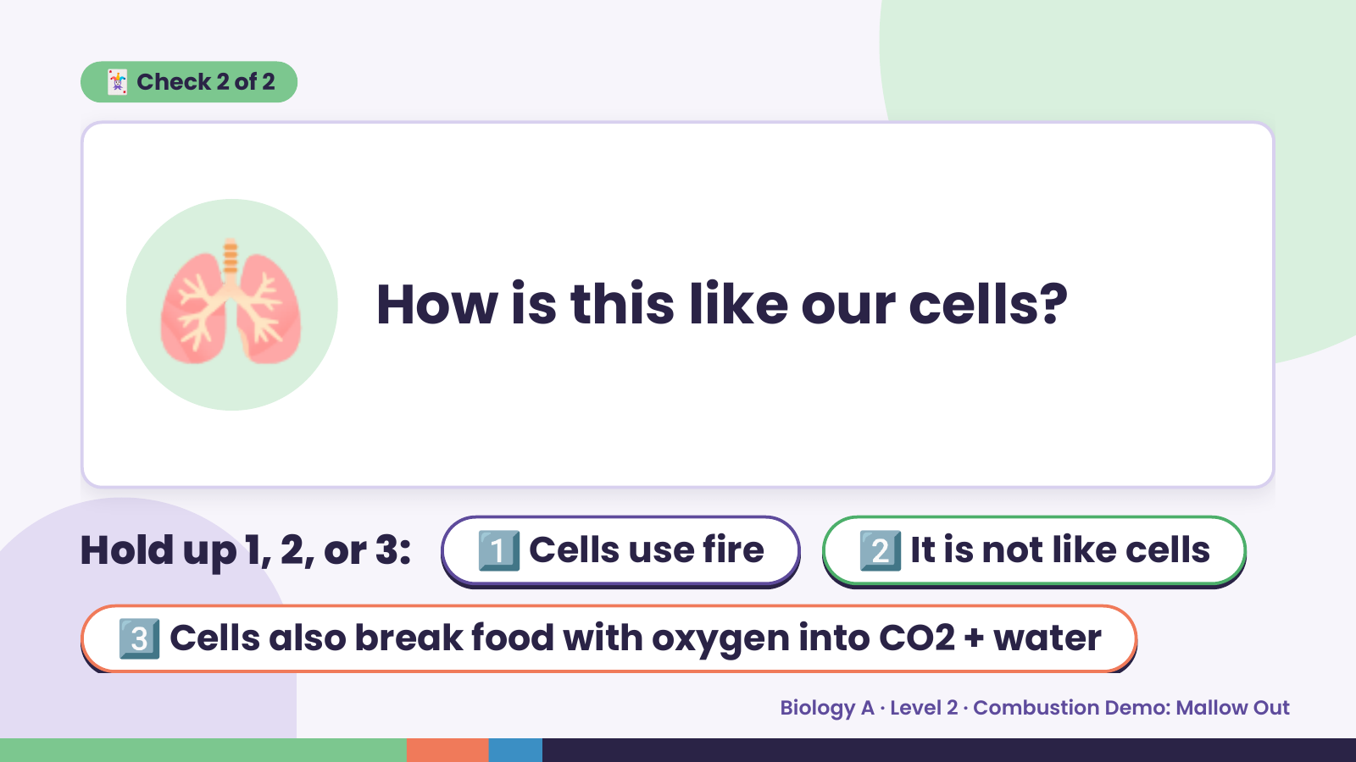
Notes:
🃏 Check 2 of 2
🫁 How is this like our cells?
Hold up 1, 2, or 3: 1️⃣ Cells use fire 2️⃣ It is not like cells
3️⃣ Cells also break food with oxygen into CO2 + water
Biology A · Level 2 · Combustion Demo: Mallow Out

Slide 8
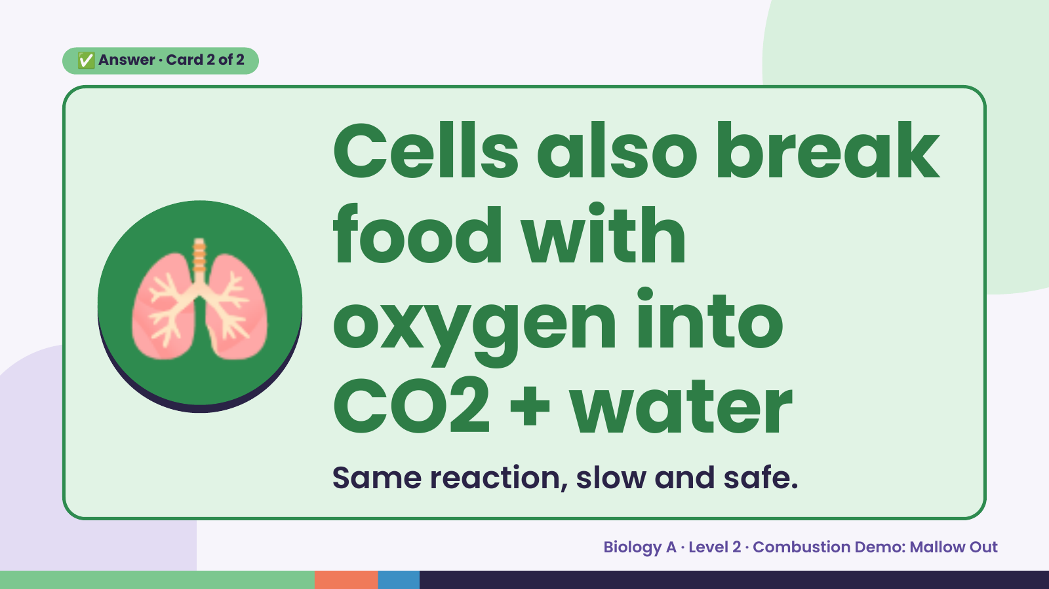
Notes:
✅ Answer · Card 2 of 2
🫁
Cells also break
food with
oxygen into
CO2 + water
Same reaction, slow and safe.
Biology A · Level 2 · Combustion Demo: Mallow Out

Slide 9
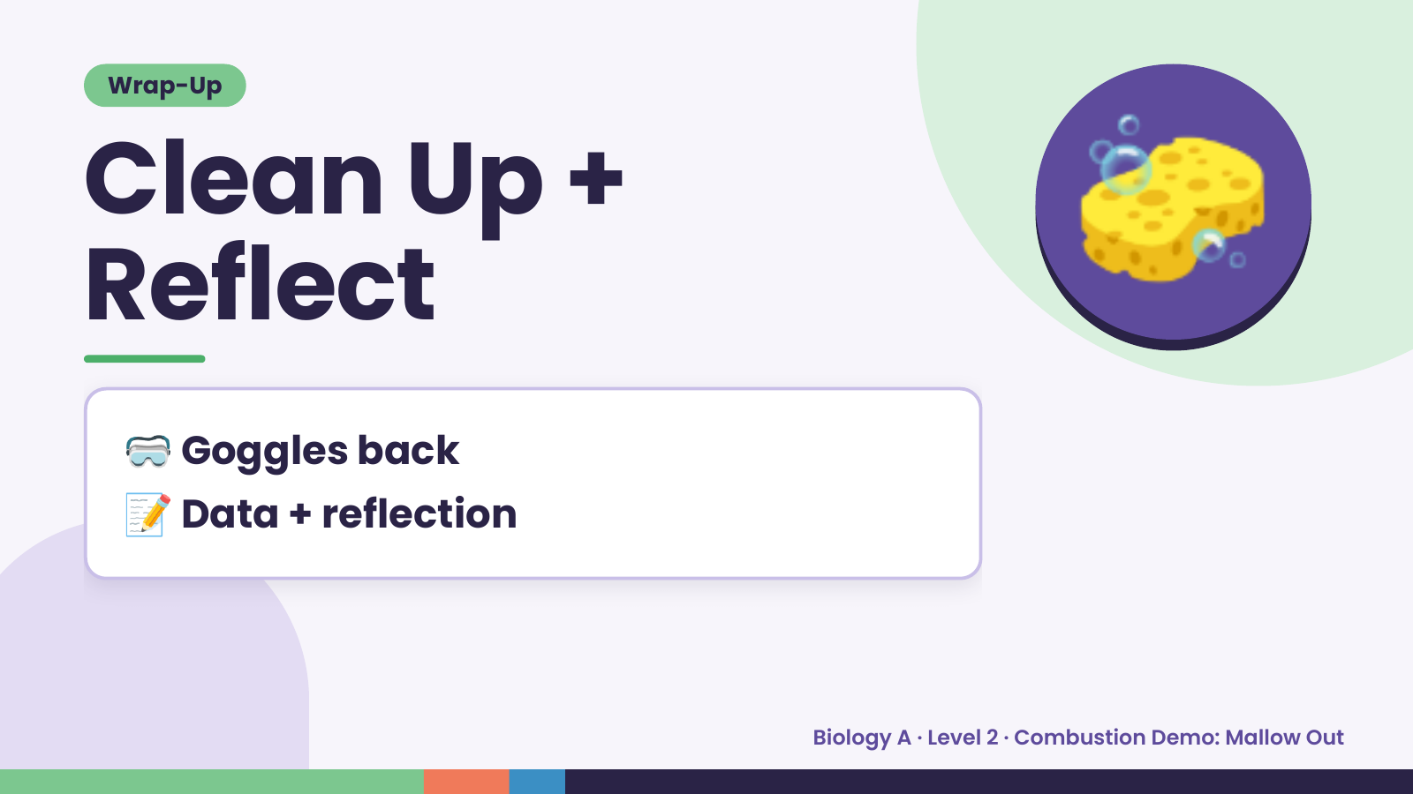
Notes:
Wrap-Up
Clean Up +
Reflect
🧽
🥽 Goggles back
📝 Data + reflection
Biology A · Level 2 · Combustion Demo: Mallow Out

