Slide 1
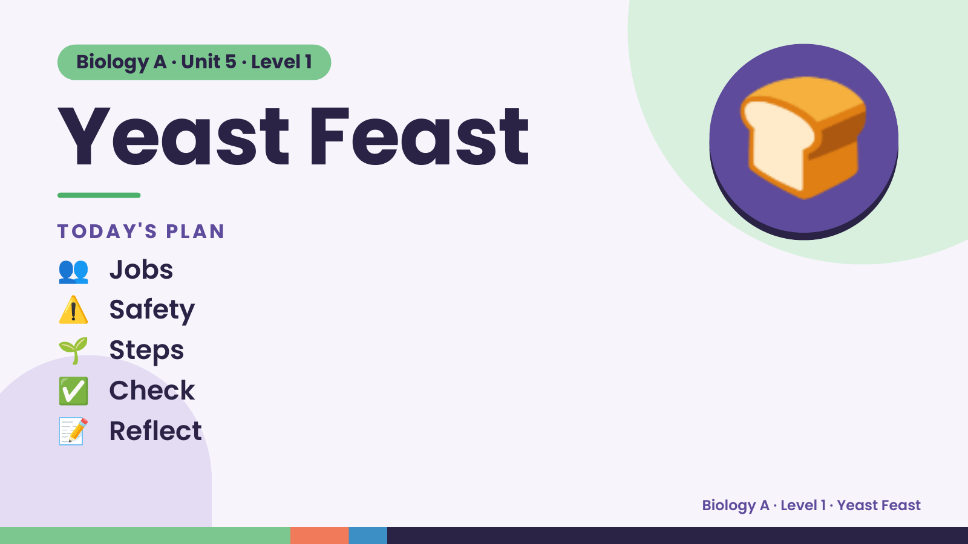
Notes:
Biology A · Unit 5 · Level 1
Yeast Feast
TODAY'S PLAN
👥 Jobs
🍞
⚠️ Safety
🌱 Steps
✅ Check
📝 Reflect
Biology A · Level 1 · Yeast Feast

Slide 2
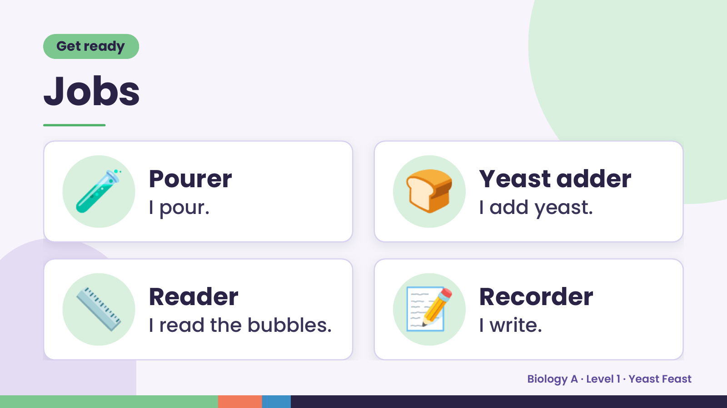
Notes:
Get ready
Jobs
🧪 Pourer
I pour. 🍞 Yeast adder
I add yeast.
📏 Reader
I read the bubbles. 📝 Recorder
I write.
Biology A · Level 1 · Yeast Feast

Slide 3
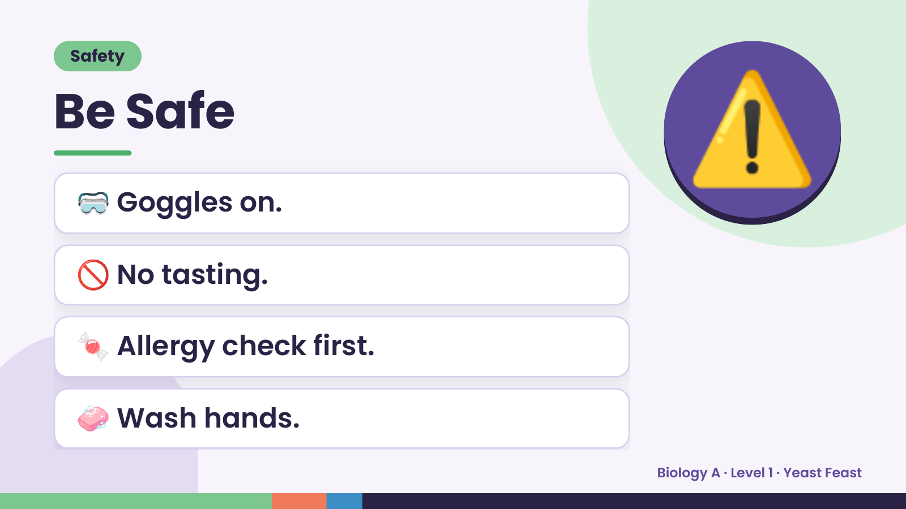
Notes:
Safety
Be Safe
🥽 Goggles on.
🚫 No tasting.
⚠️
🍬 Allergy check first.
🧼 Wash hands.
Biology A · Level 1 · Yeast Feast

Slide 4
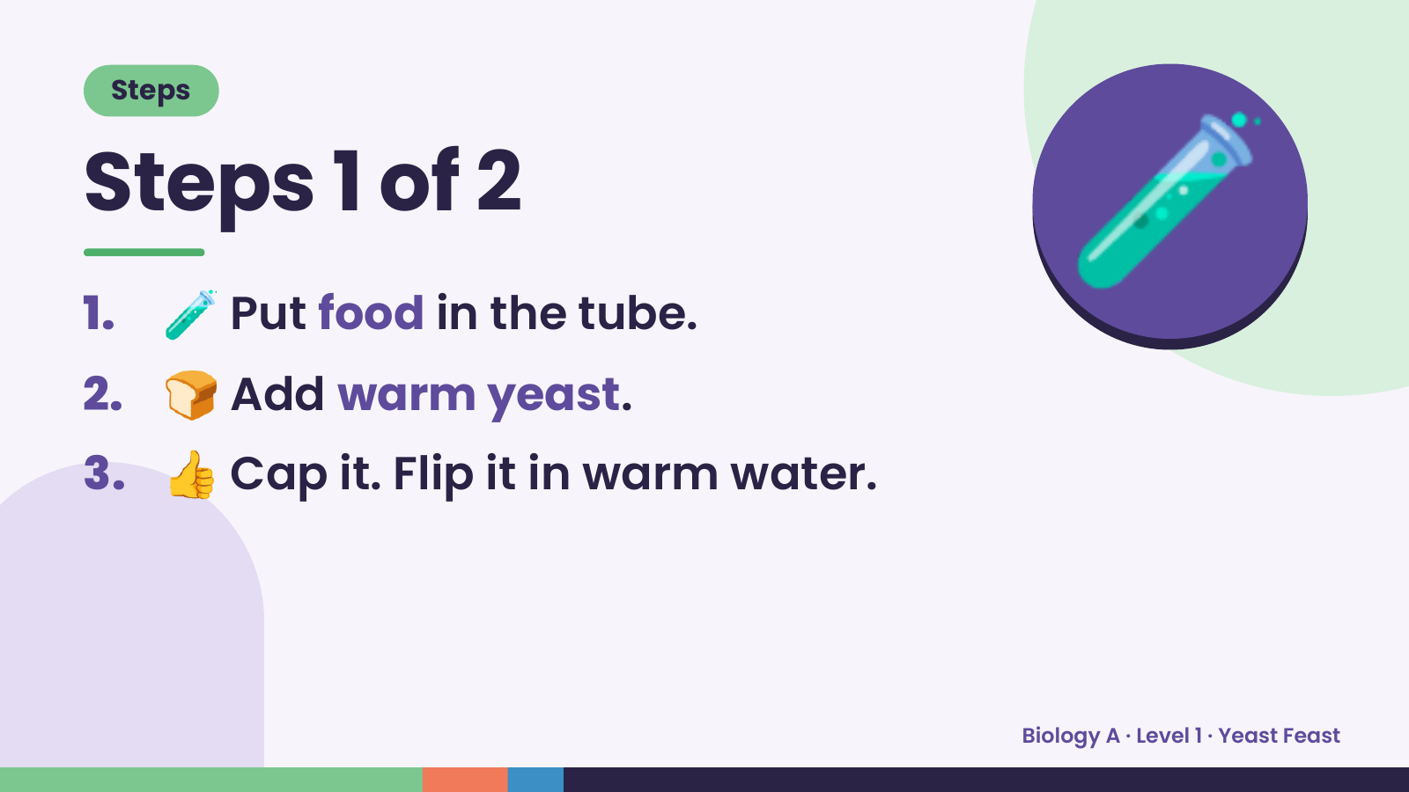
Notes:
Steps
Steps 1 of 2
1. 🧪 Put food in the tube.
2. 🍞 Add warm yeast.
🧪
3. 👍 Cap it. Flip it in warm water.
Biology A · Level 1 · Yeast Feast

Slide 5
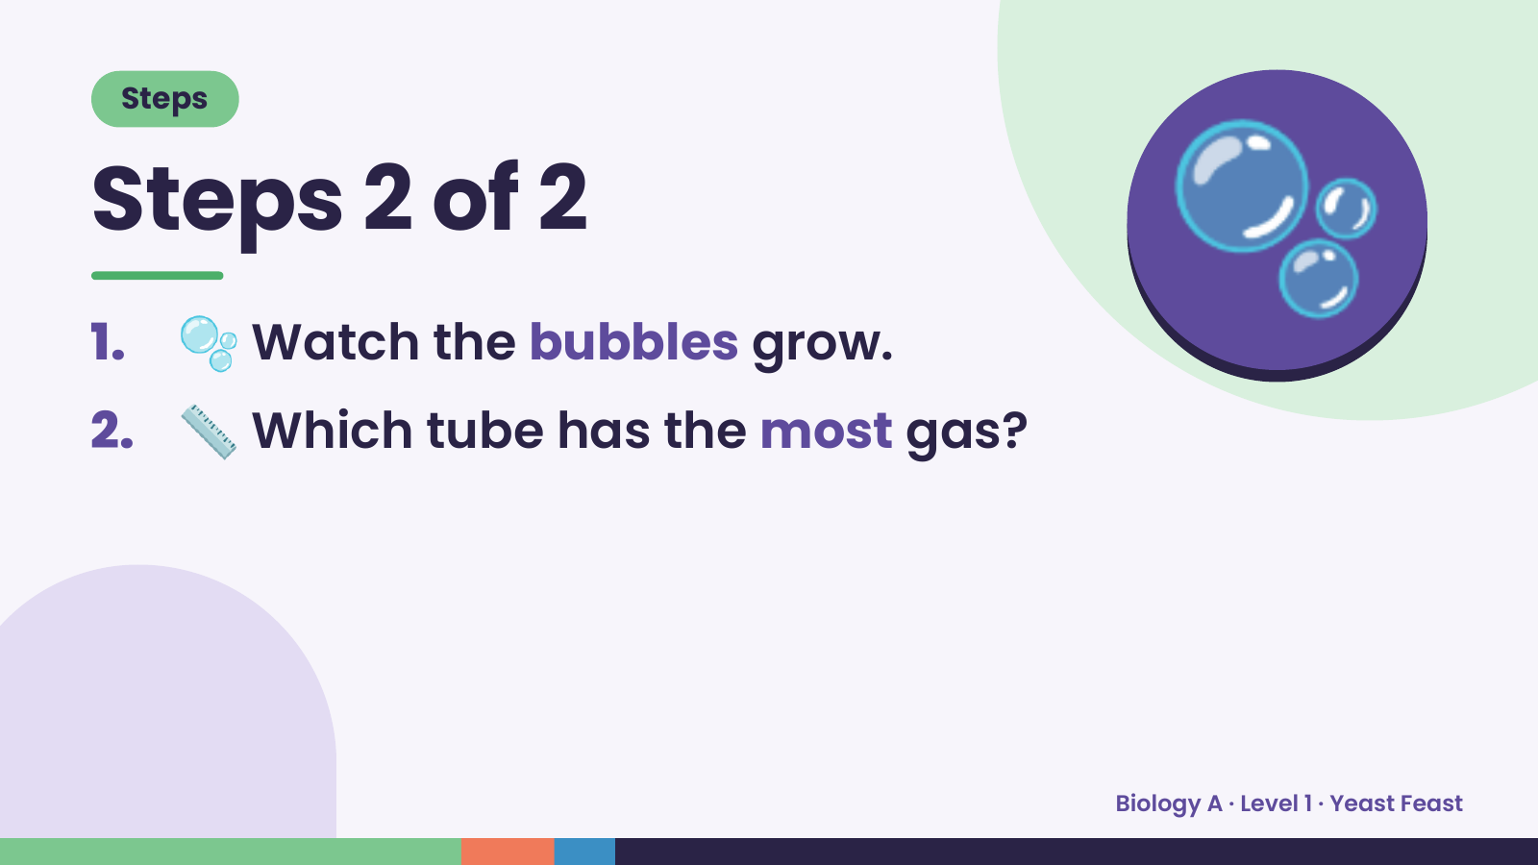
Notes:
Steps
Steps 2 of 2
1. 🫧 Watch the bubbles grow.
2. 📏 Which tube has the most gas?
🫧
Biology A · Level 1 · Yeast Feast

Slide 6
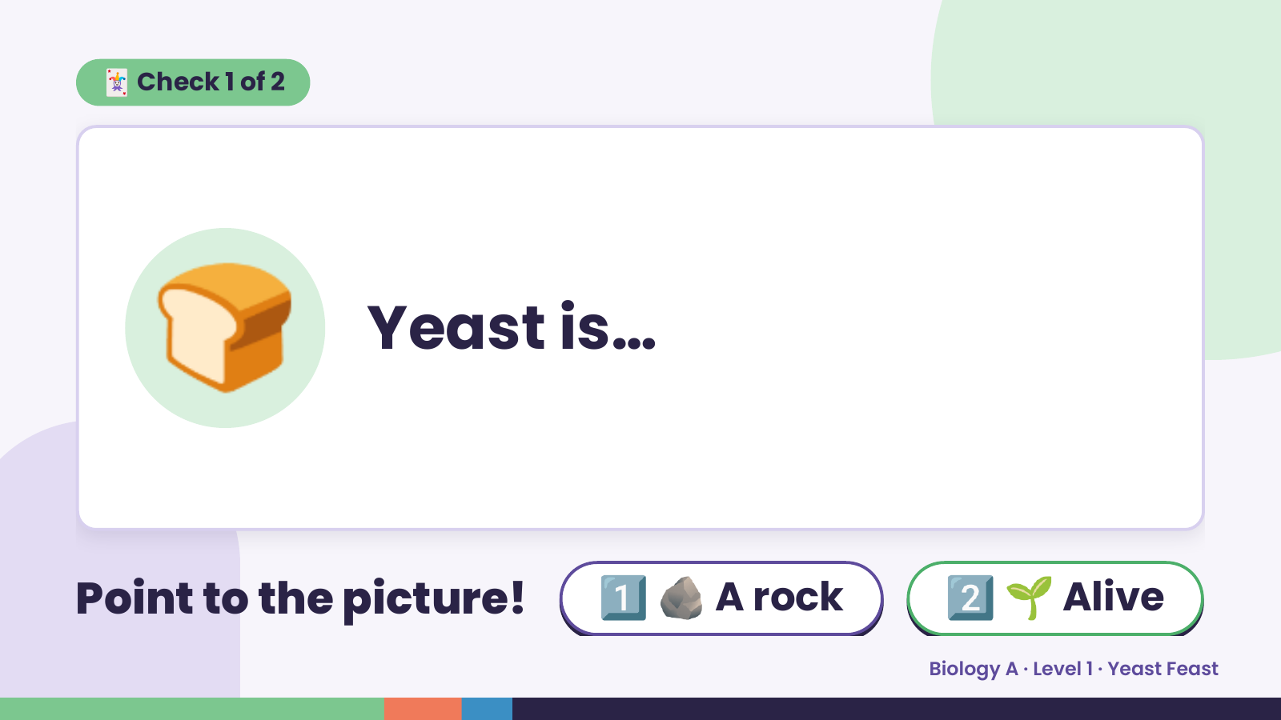
Notes:
🃏 Check 1 of 2
🍞 Yeast is…
Point to the picture! 1️⃣ 🪨 A rock 2️⃣ 🌱 Alive
Biology A · Level 1 · Yeast Feast

Slide 7
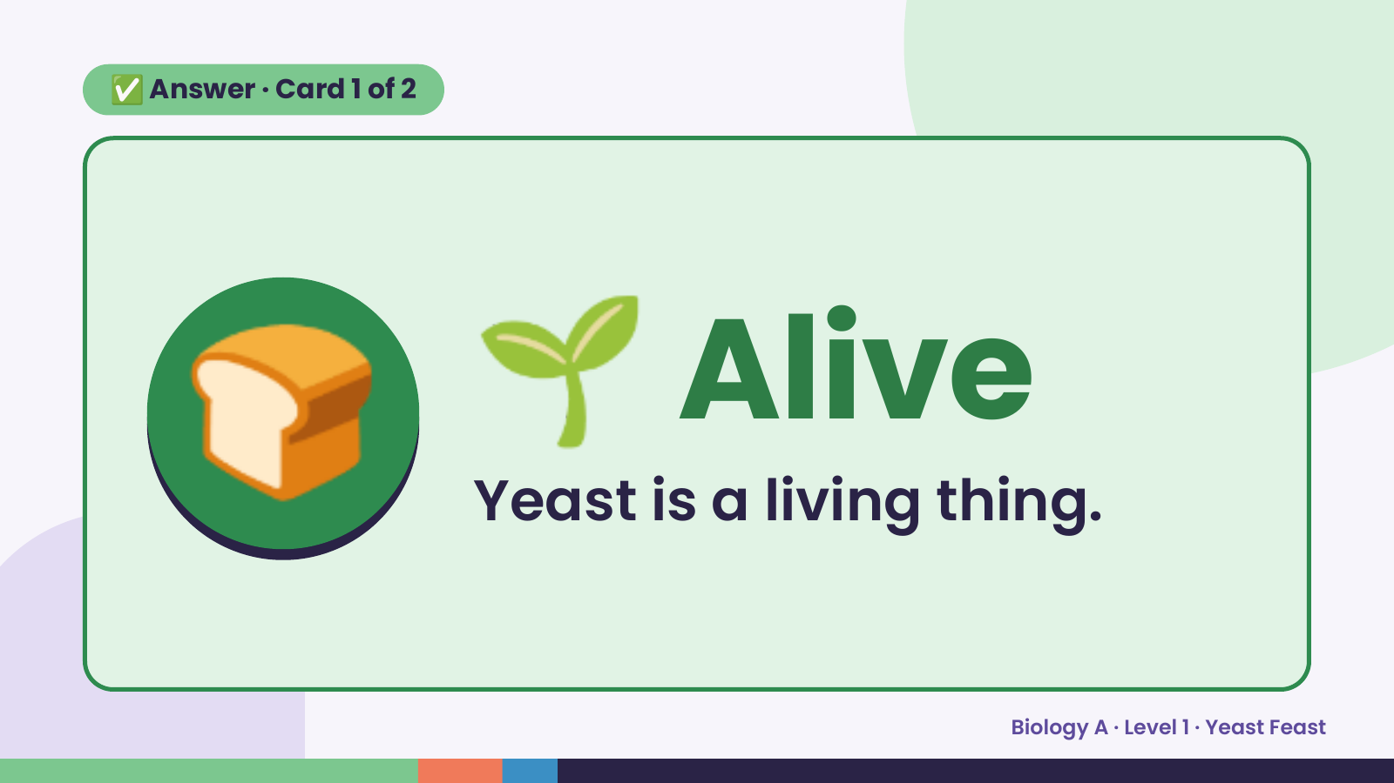
Notes:
✅ Answer · Card 1 of 2
🍞 🌱 Alive
Yeast is a living thing.
Biology A · Level 1 · Yeast Feast

Slide 8
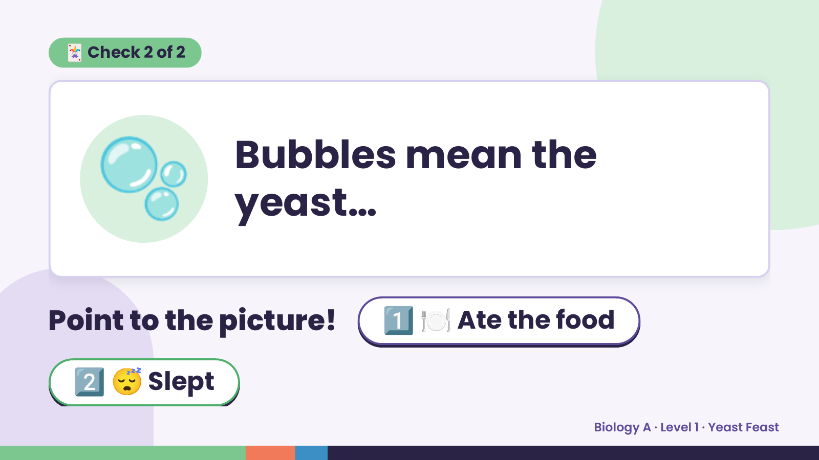
Notes:
🃏 Check 2 of 2
🫧 Bubbles mean the
yeast…
Point to the picture! 1️⃣ 🍽️ Ate the food
2️⃣ 😴 Slept
Biology A · Level 1 · Yeast Feast

Slide 9
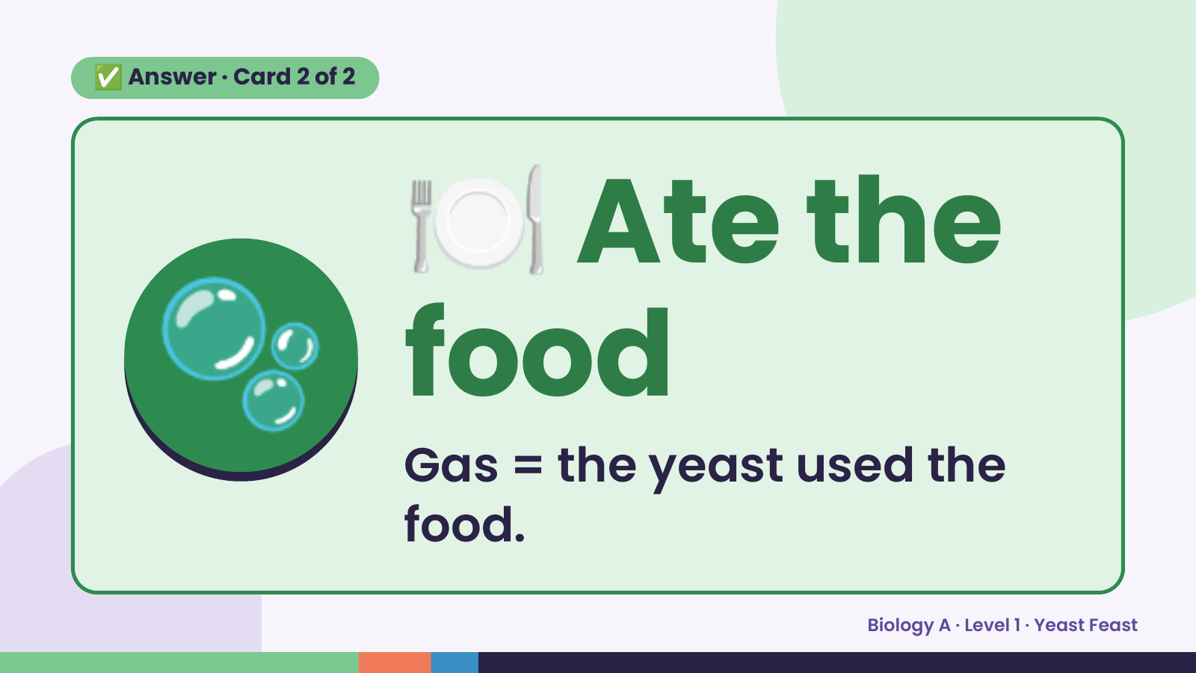
Notes:
🍽️
✅ Answer · Card 2 of 2
🫧 food
Ate the
Gas = the yeast used the
food.
Biology A · Level 1 · Yeast Feast

Slide 10
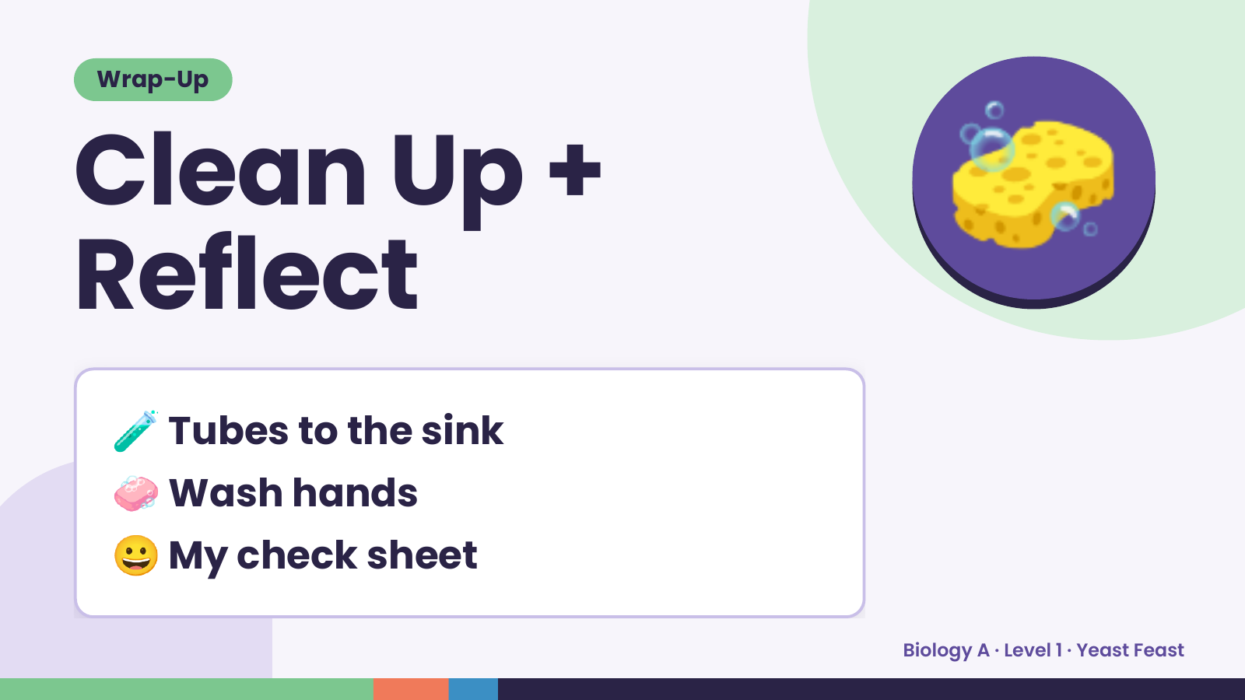
Notes:
Wrap-Up
Clean Up +
Reflect
🧽
🧪 Tubes to the sink
🧼 Wash hands
😀 My check sheet
Biology A · Level 1 · Yeast Feast

