Slide 1
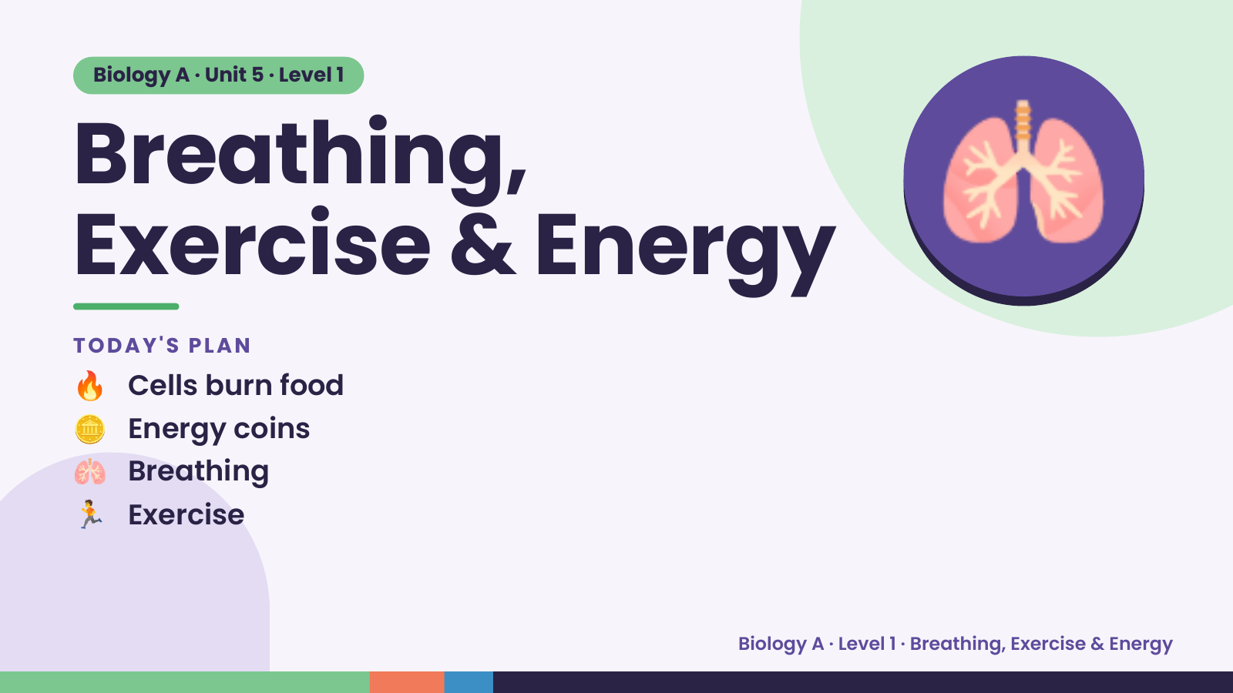
Notes:
Biology A · Unit 5 · Level 1
Breathing,
Exercise & Energy
🔥 Cells burn food
TODAY'S PLAN
🫁
🪙 Energy coins
🫁 Breathing
🏃 Exercise
Biology A · Level 1 · Breathing, Exercise & Energy

Slide 2
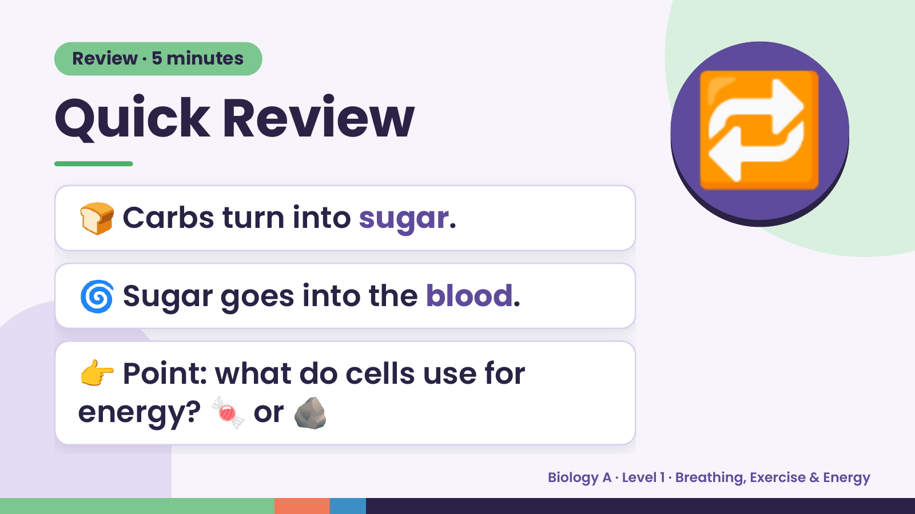
Notes:
Review · 5 minutes
Quick Review
🍞 Carbs turn into sugar.
🔁
🌀 Sugar goes into the blood.
👉 Point: what do cells use for
energy? 🍬 or 🪨
Biology A · Level 1 · Breathing, Exercise & Energy

Slide 3
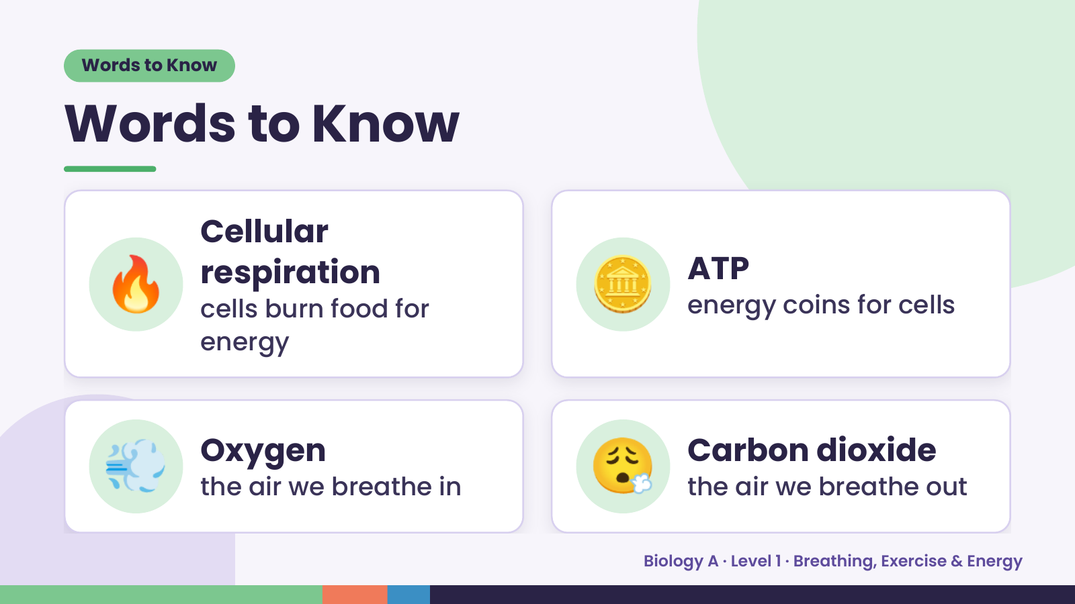
Notes:
Words to Know
Words to Know
🔥 Cellular
respiration
cells burn food for
energy
🪙 ATP
energy coins for cells
💨 Oxygen
the air we breathe in 😮‍💨 Carbon dioxide
the air we breathe out
Biology A · Level 1 · Breathing, Exercise & Energy

Slide 4
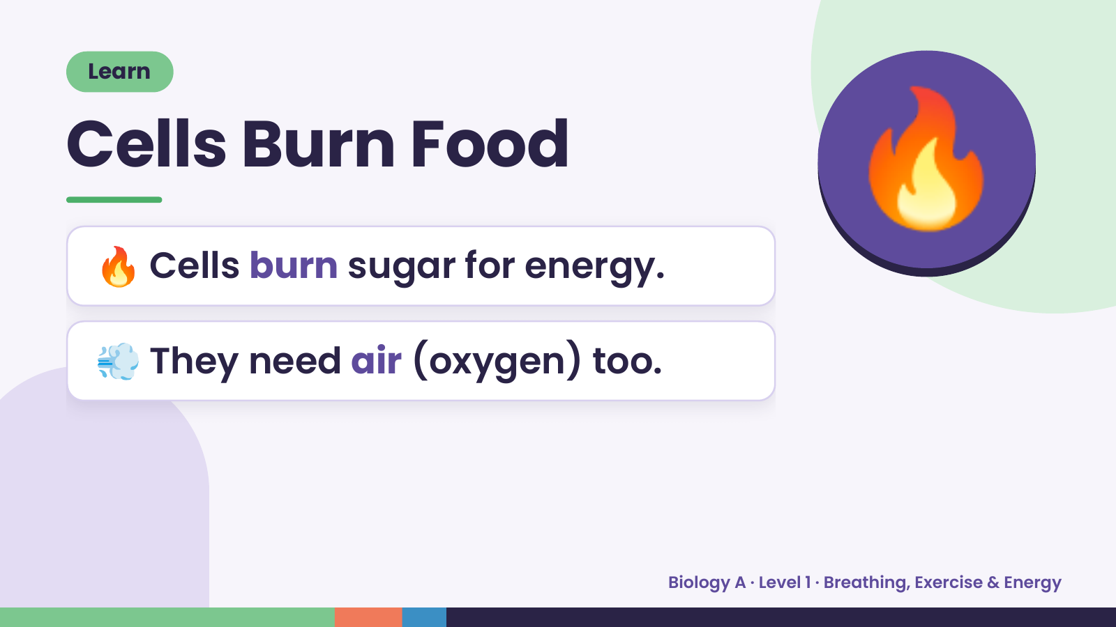
Notes:
Learn
Cells Burn Food
🔥 Cells burn sugar for energy.
🔥
💨 They need air (oxygen) too.
Biology A · Level 1 · Breathing, Exercise & Energy

Slide 5
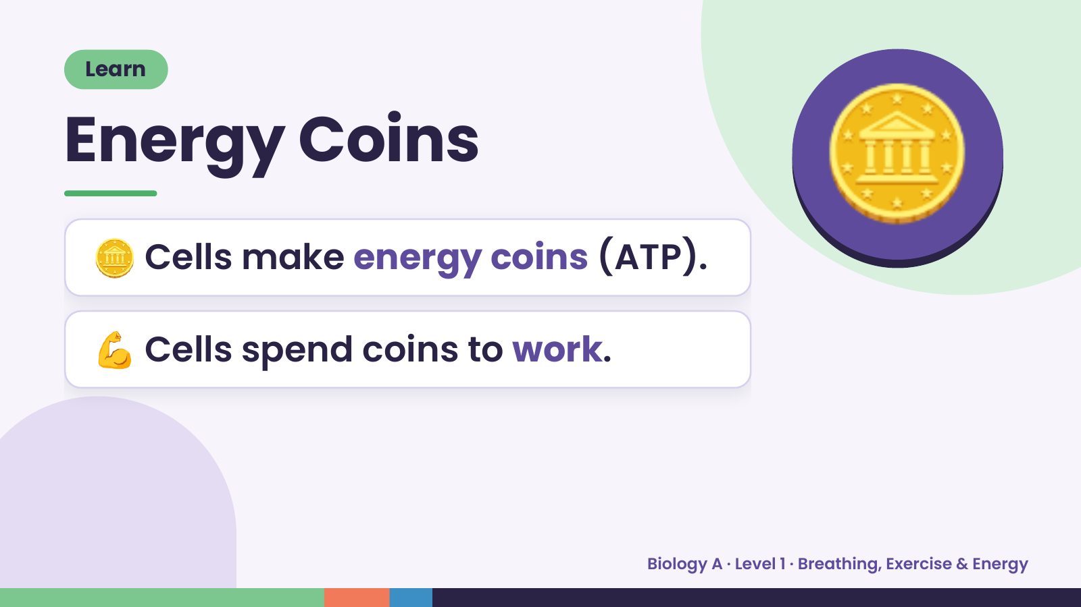
Notes:
Learn
Energy Coins
🪙 Cells make energy coins (ATP).
🪙
💪 Cells spend coins to work.
Biology A · Level 1 · Breathing, Exercise & Energy

Slide 6
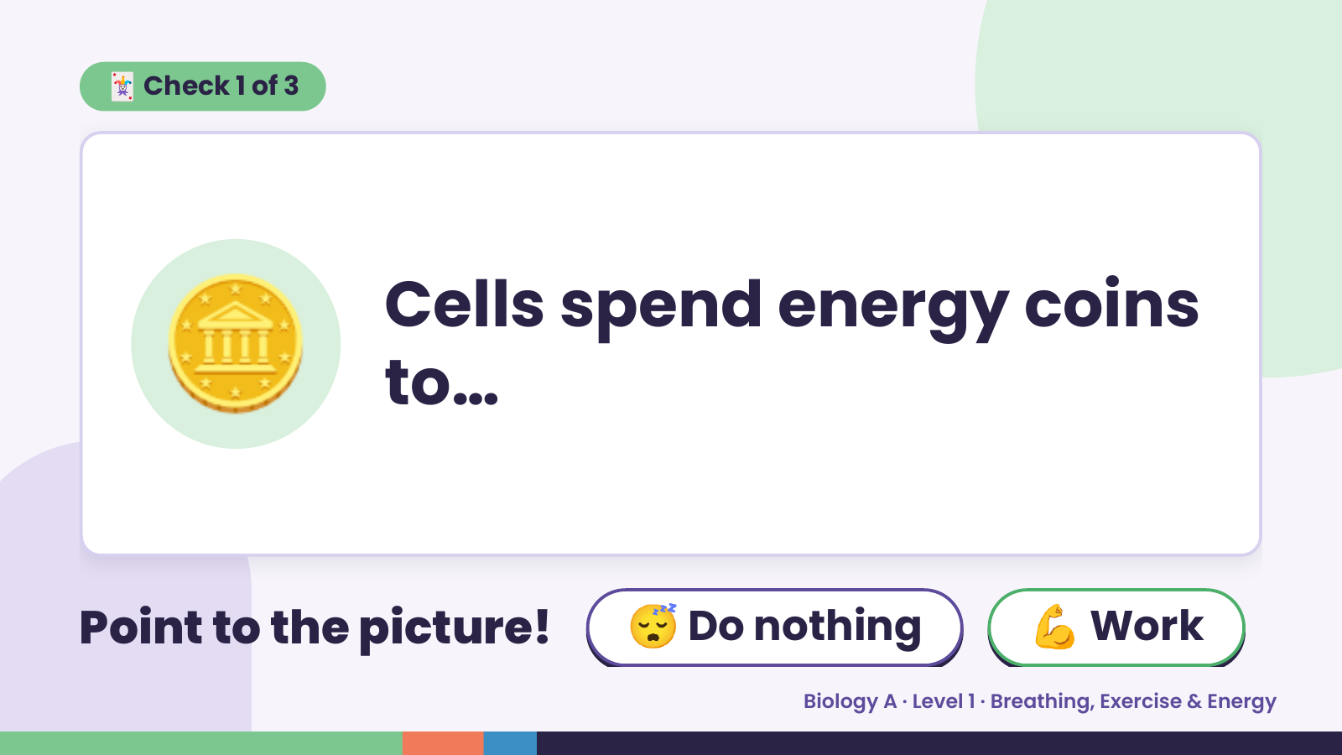
Notes:
🃏 Check 1 of 3
🪙 Cells spend energy coins
to…
Point to the picture! 😴 Do nothing 💪 Work
Biology A · Level 1 · Breathing, Exercise & Energy

Slide 7
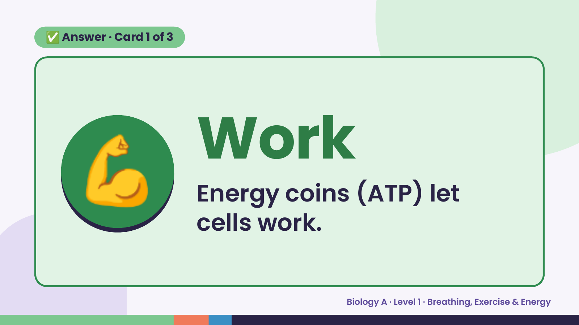
Notes:
✅ Answer · Card 1 of 3
💪 Work
Energy coins (ATP) let
cells work.
Biology A · Level 1 · Breathing, Exercise & Energy

Slide 8
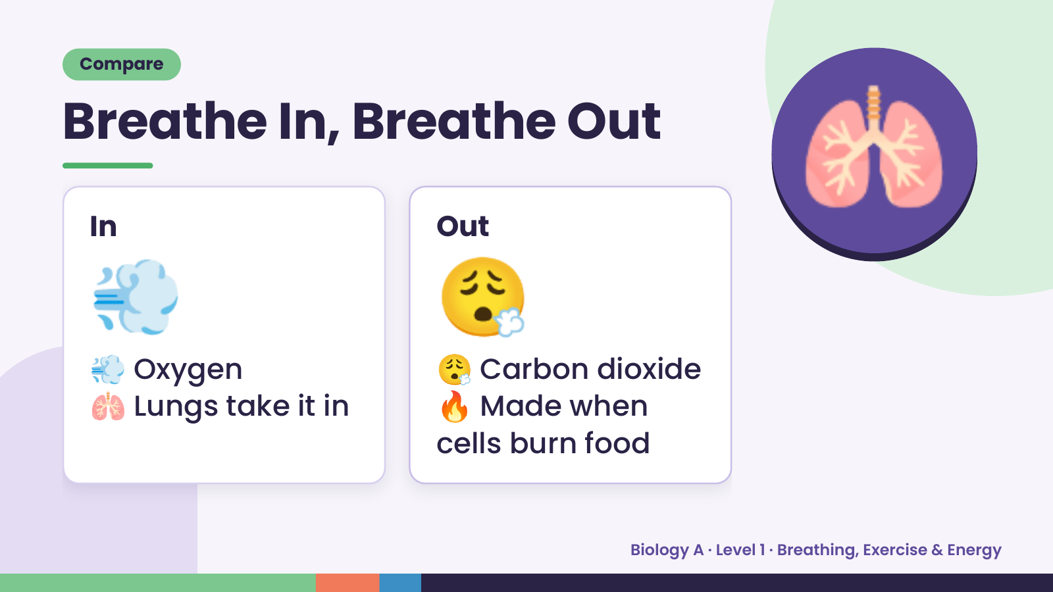
Notes:
Compare
Breathe In, Breathe Out
💨
In
😮‍💨
Out
🫁
💨 Oxygen 😮‍💨 Carbon dioxide
🫁 Lungs take it in 🔥 Made when
cells burn food
Biology A · Level 1 · Breathing, Exercise & Energy

Slide 9
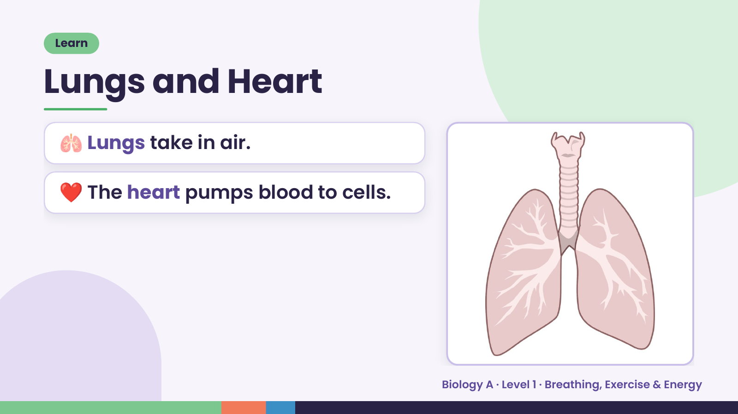
Notes:
Learn
Lungs and Heart
🫁 Lungs take in air.
❤️ The heart pumps blood to cells.
Biology A · Level 1 · Breathing, Exercise & Energy

Slide 10
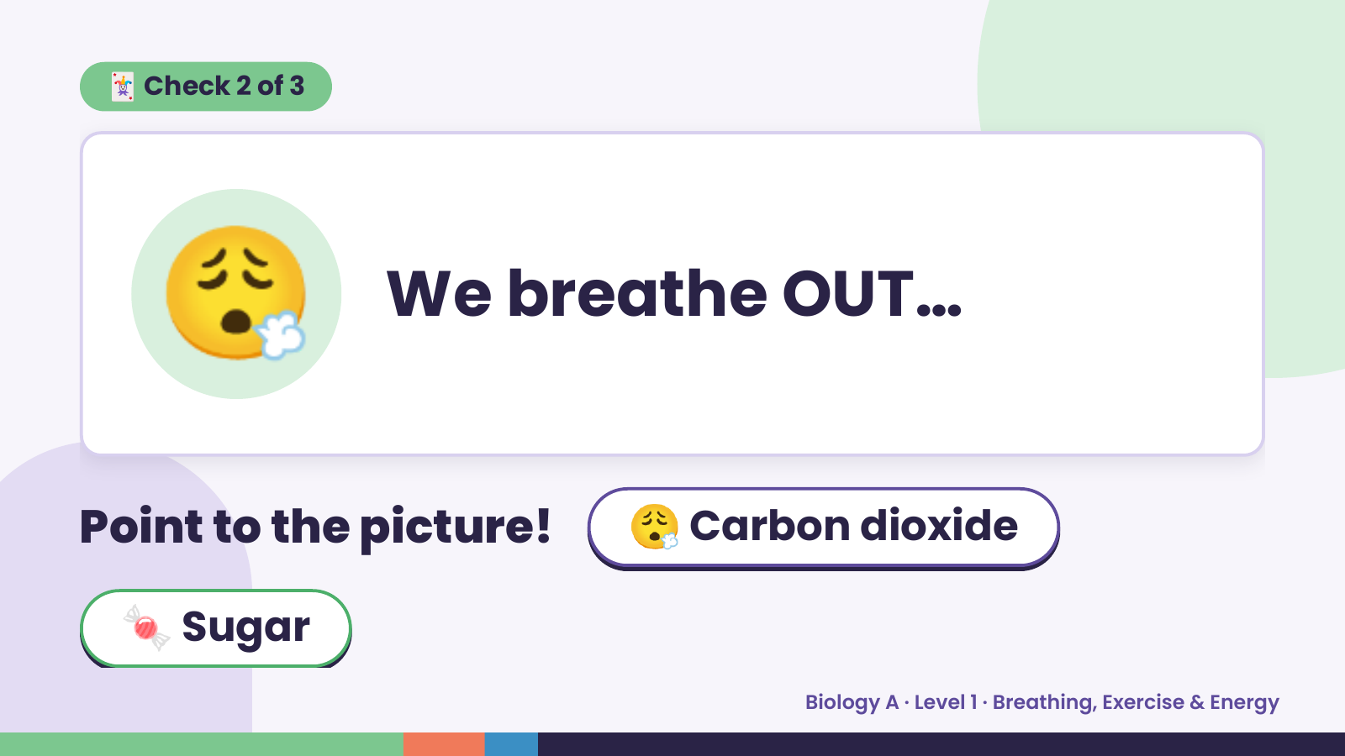
Notes:
🃏 Check 2 of 3
😮‍💨 We breathe OUT…
Point to the picture! 😮‍💨 Carbon dioxide
🍬 Sugar
Biology A · Level 1 · Breathing, Exercise & Energy

Slide 11
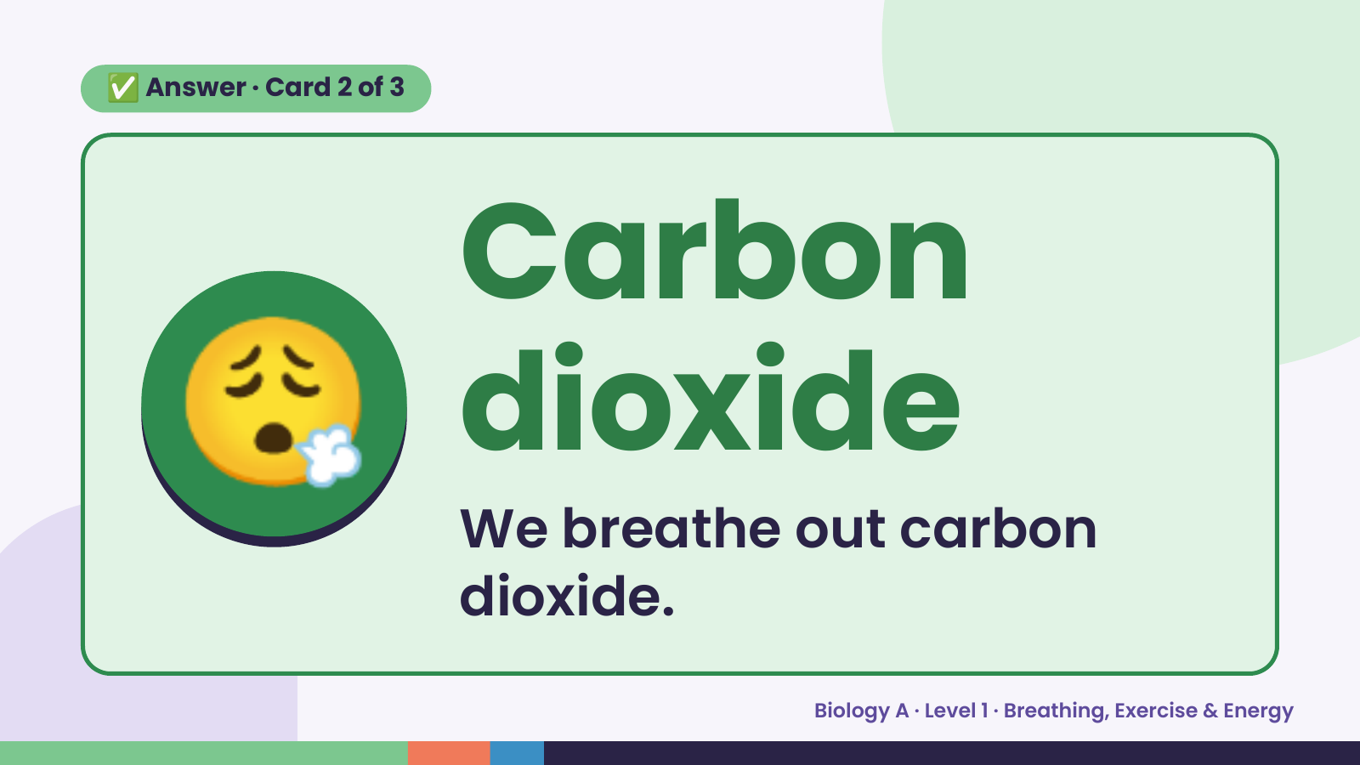
Notes:
✅ Answer · Card 2 of 3
😮‍💨 Carbon
dioxide
We breathe out carbon
dioxide.
Biology A · Level 1 · Breathing, Exercise & Energy

Slide 12
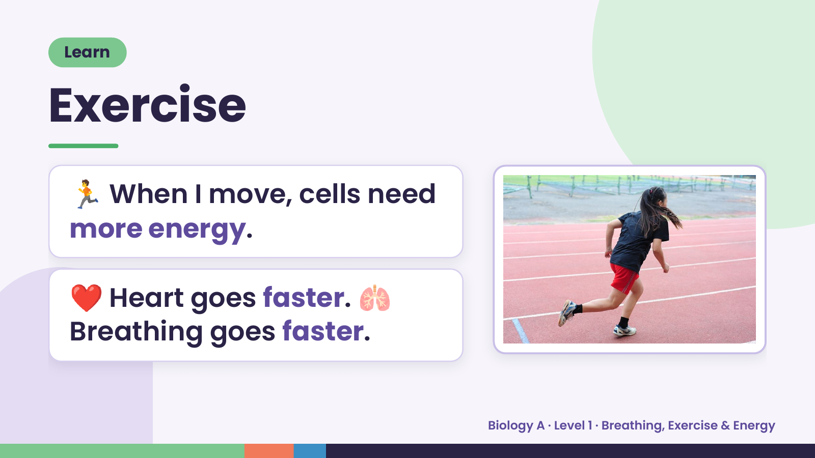
Notes:
Learn
Exercise
🏃 When I move, cells need
more energy.
❤️ Heart goes faster. 🫁
Breathing goes faster.
Biology A · Level 1 · Breathing, Exercise & Energy

Slide 13
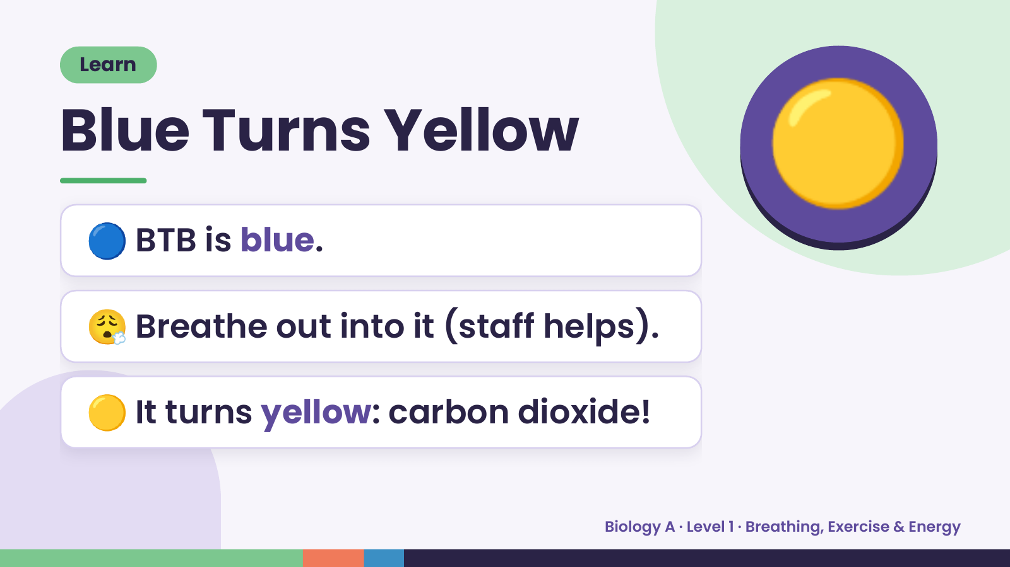
Notes:
Learn
Blue Turns Yellow
🔵 BTB is blue.
🟡
😮‍💨 Breathe out into it (staff helps).
🟡 It turns yellow: carbon dioxide!
Biology A · Level 1 · Breathing, Exercise & Energy

Slide 14
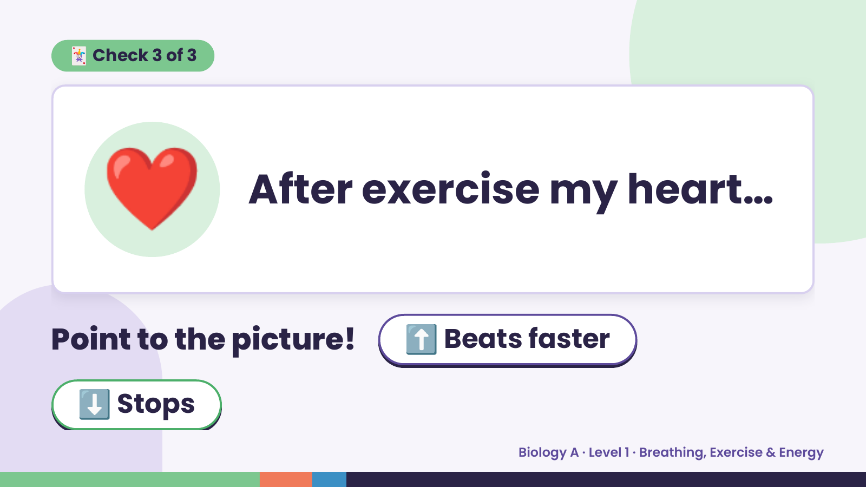
Notes:
🃏 Check 3 of 3
❤️ After exercise my heart…
Point to the picture! ⬆️ Beats faster
⬇️ Stops
Biology A · Level 1 · Breathing, Exercise & Energy

Slide 15
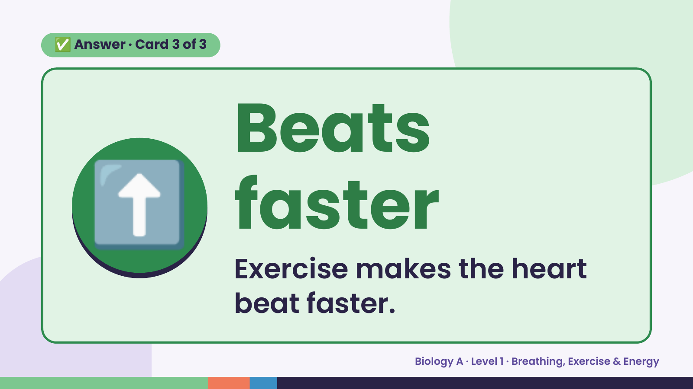
Notes:
✅ Answer · Card 3 of 3
⬆️ Beats
faster
Exercise makes the heart
beat faster.
Biology A · Level 1 · Breathing, Exercise & Energy

Slide 16
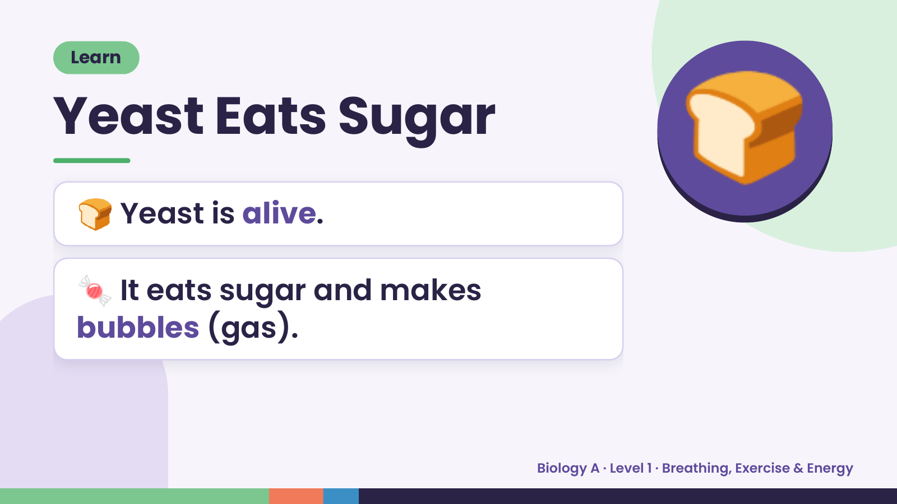
Notes:
Learn
Yeast Eats Sugar
🍞 Yeast is alive.
🍞
🍬 It eats sugar and makes
bubbles (gas).
Biology A · Level 1 · Breathing, Exercise & Energy

Slide 17
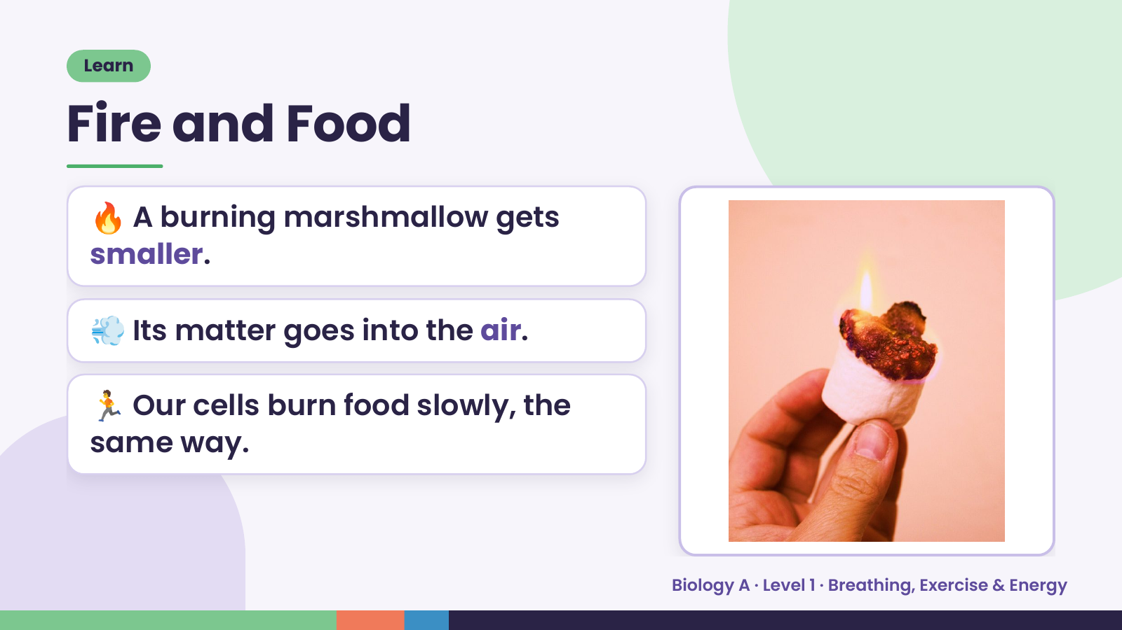
Notes:
Learn
Fire and Food
🔥 A burning marshmallow gets
smaller.
💨 Its matter goes into the air.
🏃 Our cells burn food slowly, the
same way.
Biology A · Level 1 · Breathing, Exercise & Energy

Slide 18
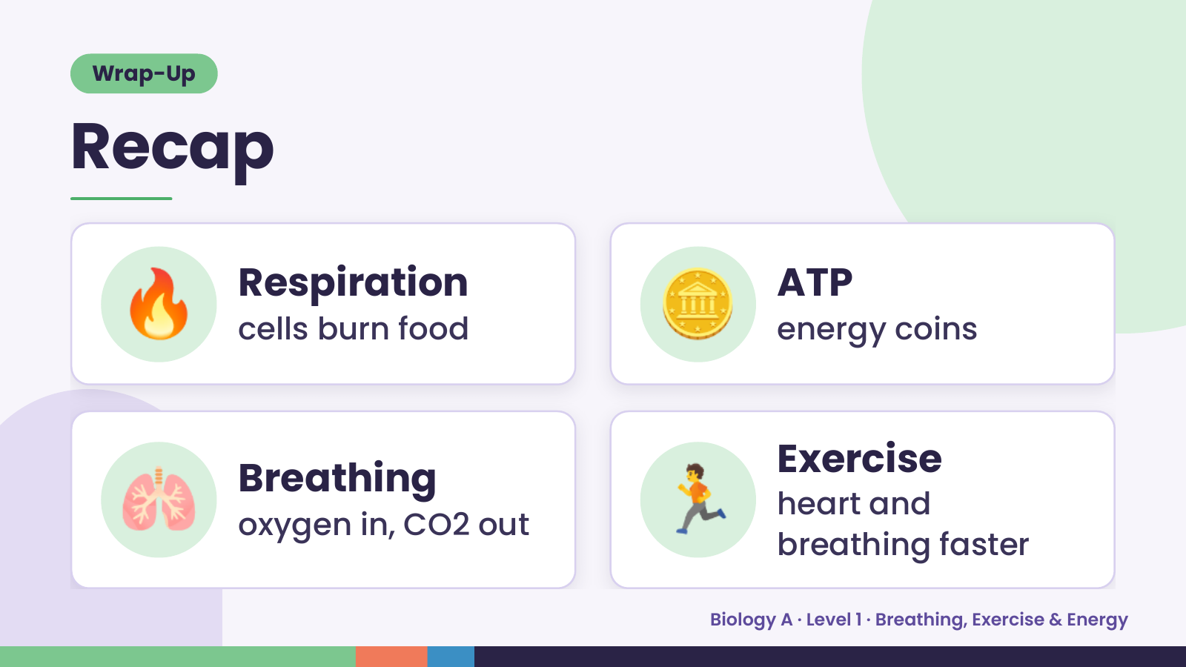
Notes:
Wrap-Up
Recap
🔥 Respiration
cells burn food 🪙 ATP
energy coins
🫁 Breathing
oxygen in, CO2 out 🏃 Exercise
heart and
breathing faster
Biology A · Level 1 · Breathing, Exercise & Energy

Slide 19
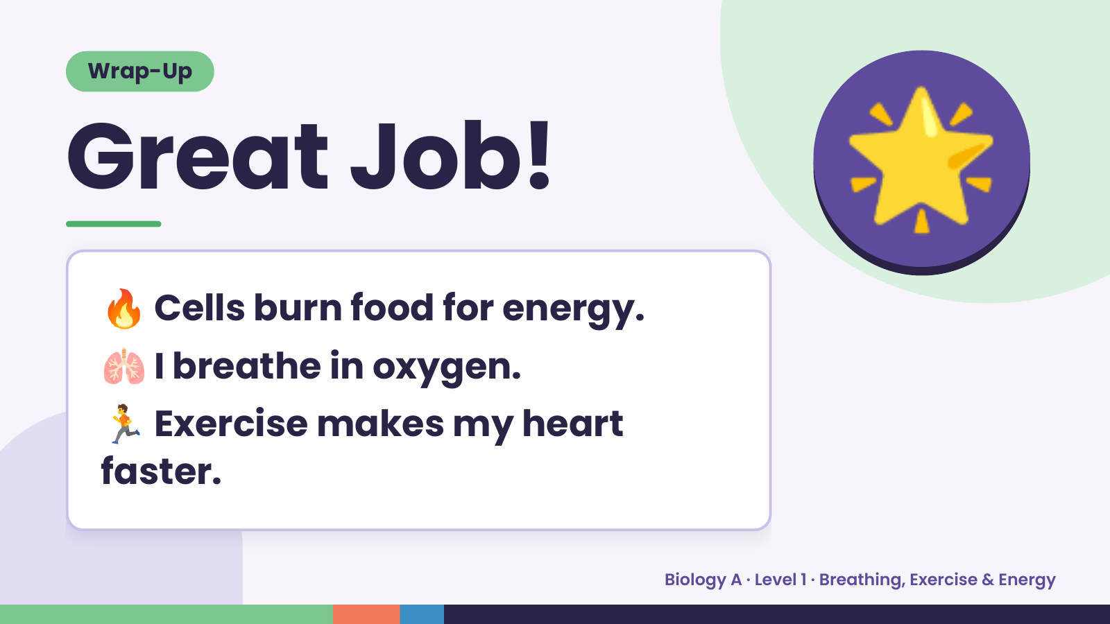
Notes:
Wrap-Up
Great Job!
🔥 Cells burn food for energy.
🌟
🫁 I breathe in oxygen.
🏃 Exercise makes my heart
faster.
Biology A · Level 1 · Breathing, Exercise & Energy

