Slide 1
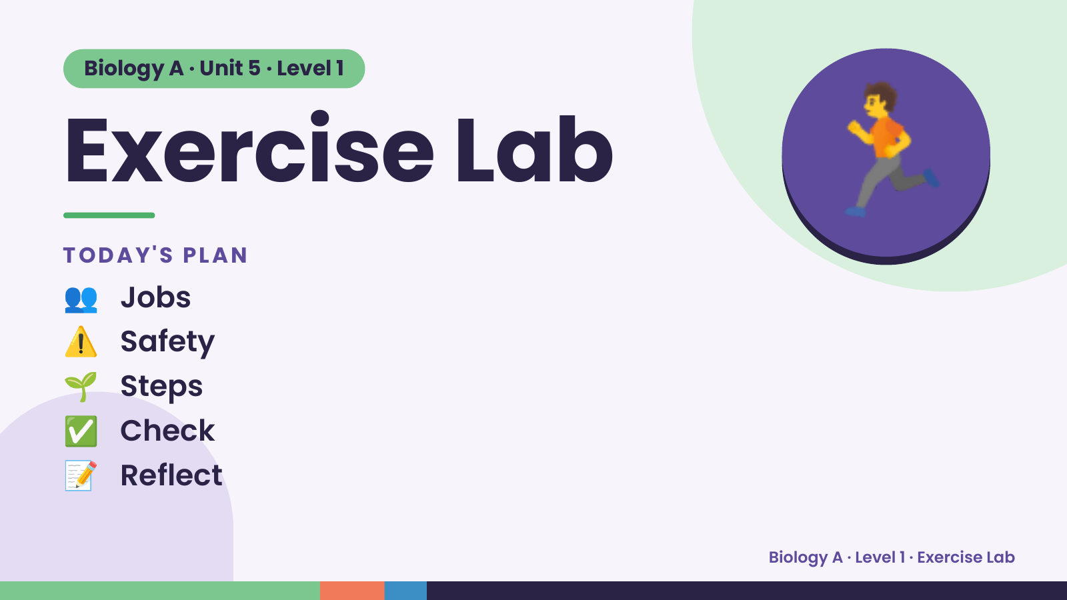
Notes:
Biology A · Unit 5 · Level 1
Exercise Lab
TODAY'S PLAN
👥 Jobs
🏃
⚠️ Safety
🌱 Steps
✅ Check
📝 Reflect
Biology A · Level 1 · Exercise Lab

Slide 2
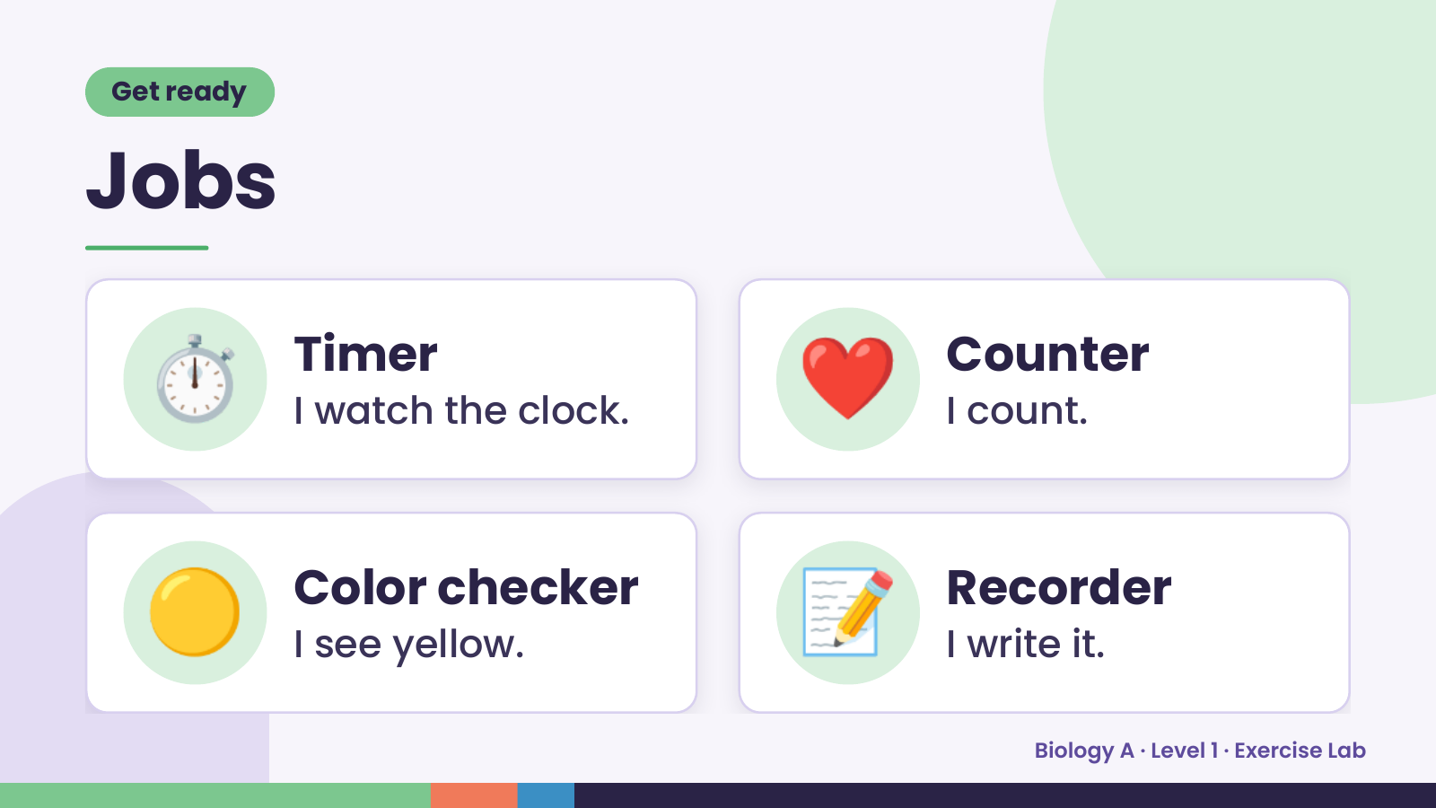
Notes:
Get ready
Jobs
⏱️ Timer
I watch the clock. ❤️ Counter
I count.
🟡 Color checker
I see yellow. 📝 Recorder
I write it.
Biology A · Level 1 · Exercise Lab

Slide 3
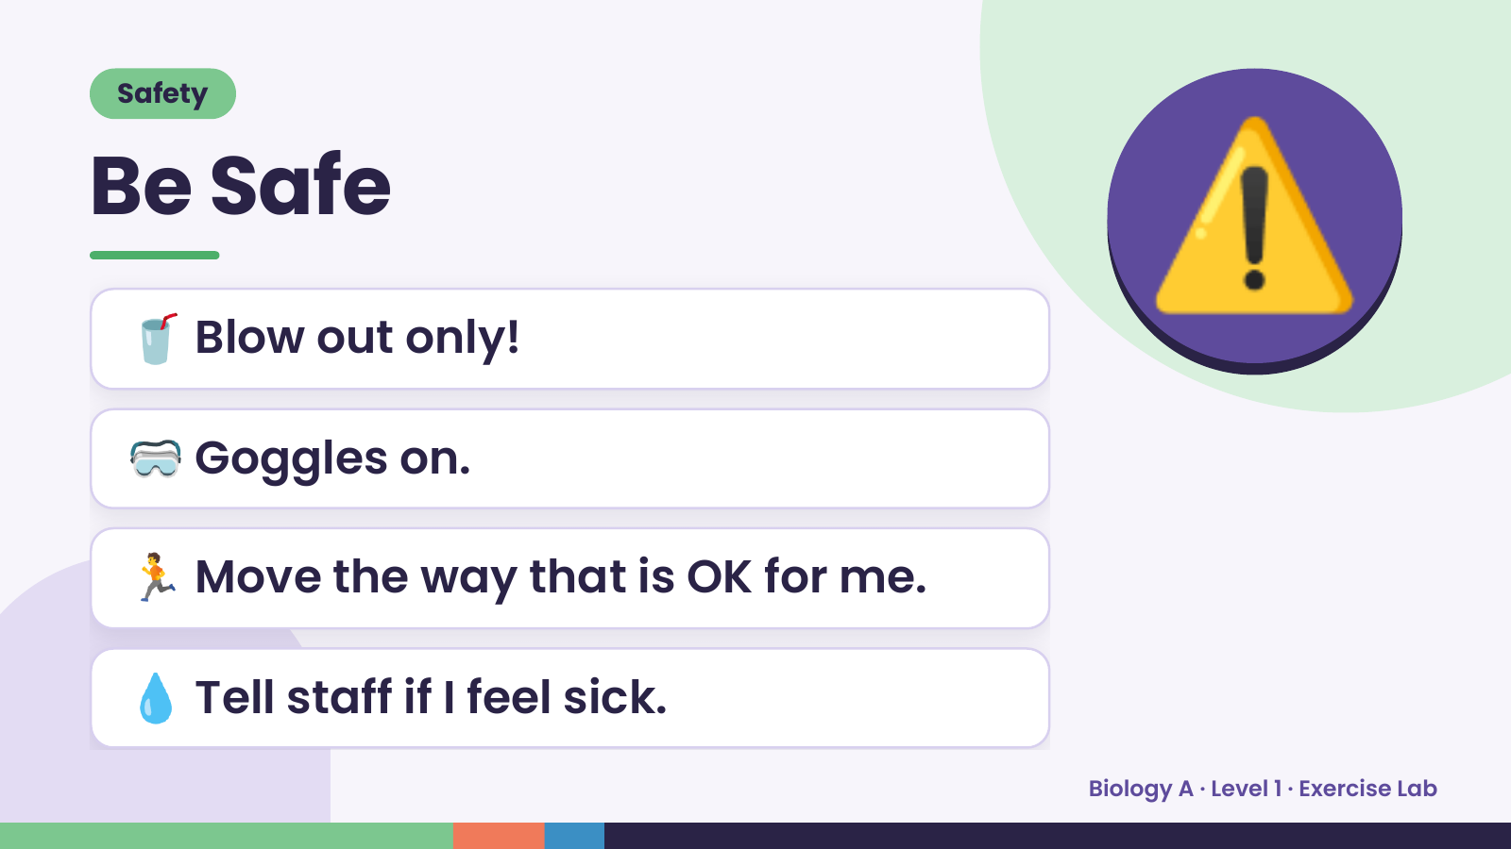
Notes:
Safety
Be Safe
🥤 Blow out only!
🥽 Goggles on.
⚠️
🏃 Move the way that is OK for me.
💧 Tell staff if I feel sick.
Biology A · Level 1 · Exercise Lab

Slide 4
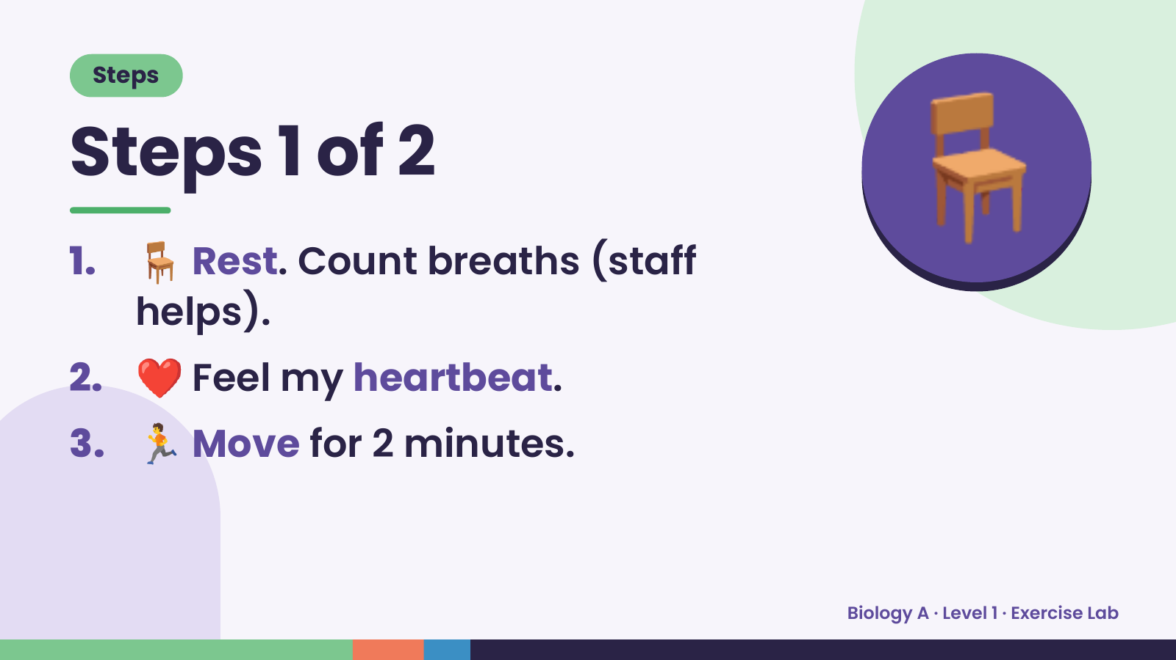
Notes:
Steps
Steps 1 of 2
1. 🪑 Rest. Count breaths (staff
helps).
🪑
2. ❤️ Feel my heartbeat.
3. 🏃 Move for 2 minutes.
Biology A · Level 1 · Exercise Lab

Slide 5
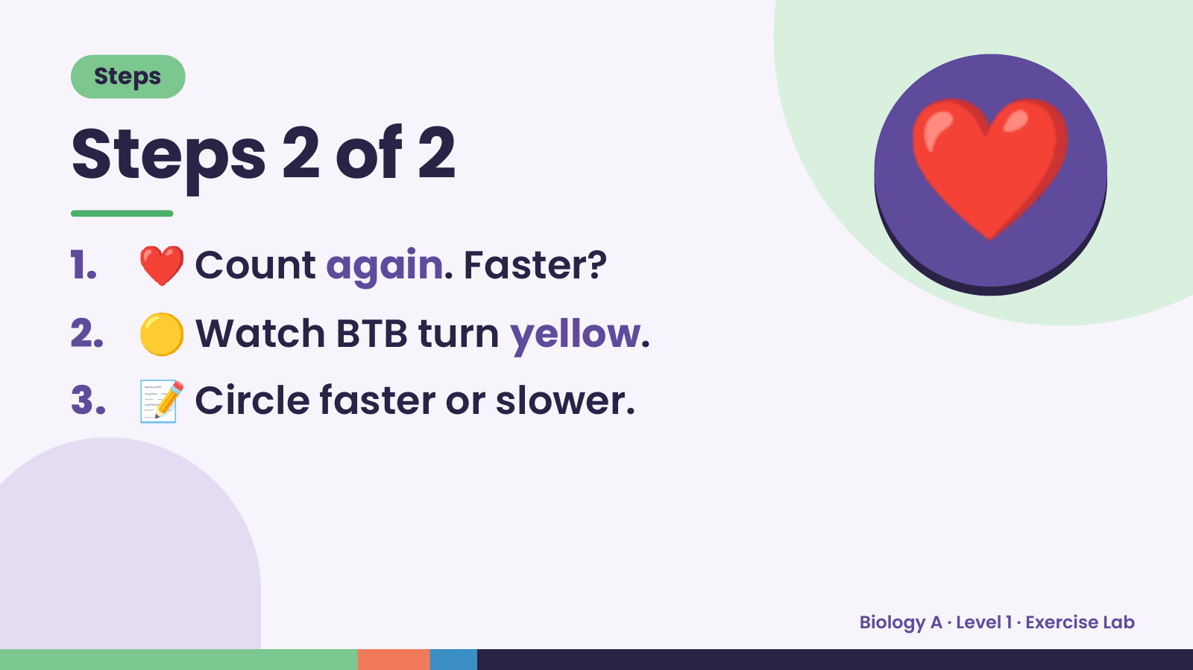
Notes:
Steps
Steps 2 of 2
1. ❤️ Count again. Faster?
2. 🟡 Watch BTB turn yellow.
❤️
3. 📝 Circle faster or slower.
Biology A · Level 1 · Exercise Lab

Slide 6
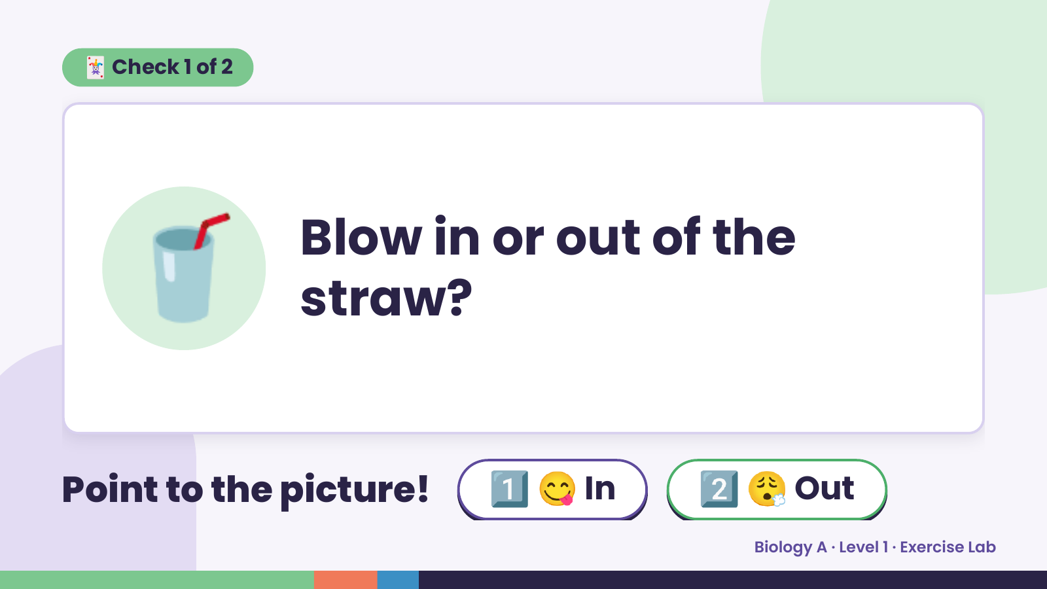
Notes:
🃏 Check 1 of 2
🥤 Blow in or out of the
straw?
Point to the picture! 1️⃣ 😋 In 2️⃣ 😮‍💨 Out
Biology A · Level 1 · Exercise Lab

Slide 7
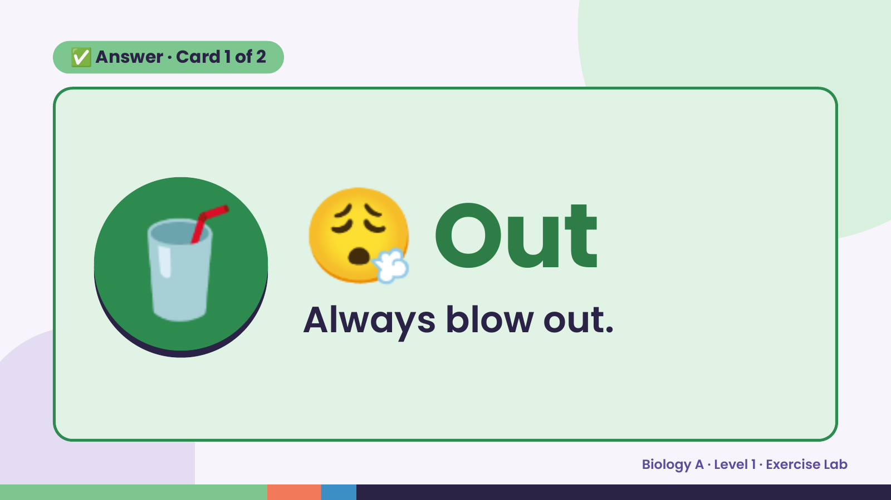
Notes:
✅ Answer · Card 1 of 2
🥤 😮‍💨 Out
Always blow out.
Biology A · Level 1 · Exercise Lab

Slide 8
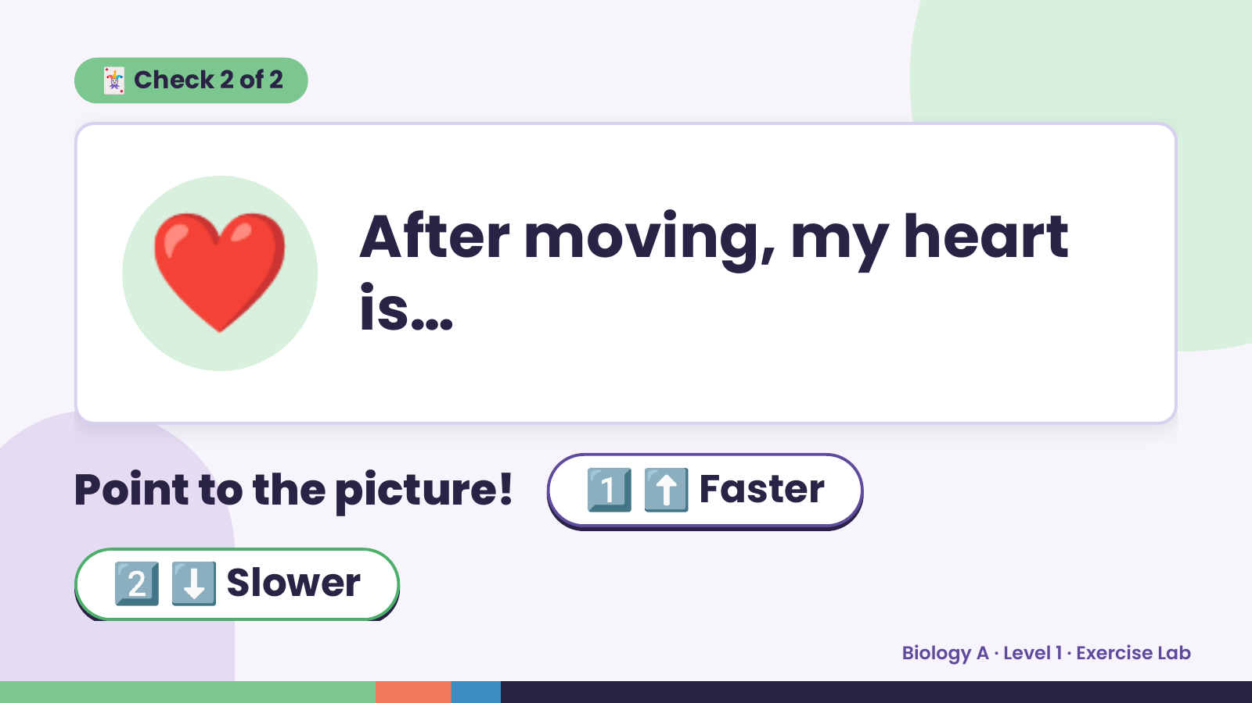
Notes:
🃏 Check 2 of 2
❤️ After moving, my heart
is…
Point to the picture! 1️⃣ ⬆️ Faster
2️⃣ ⬇️ Slower
Biology A · Level 1 · Exercise Lab

Slide 9
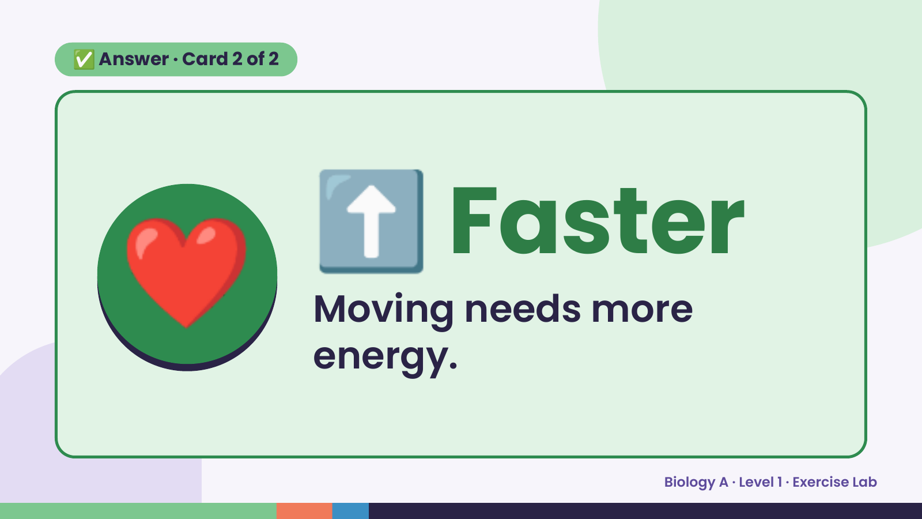
Notes:
✅ Answer · Card 2 of 2
❤️ ⬆️ Faster
Moving needs more
energy.
Biology A · Level 1 · Exercise Lab

Slide 10
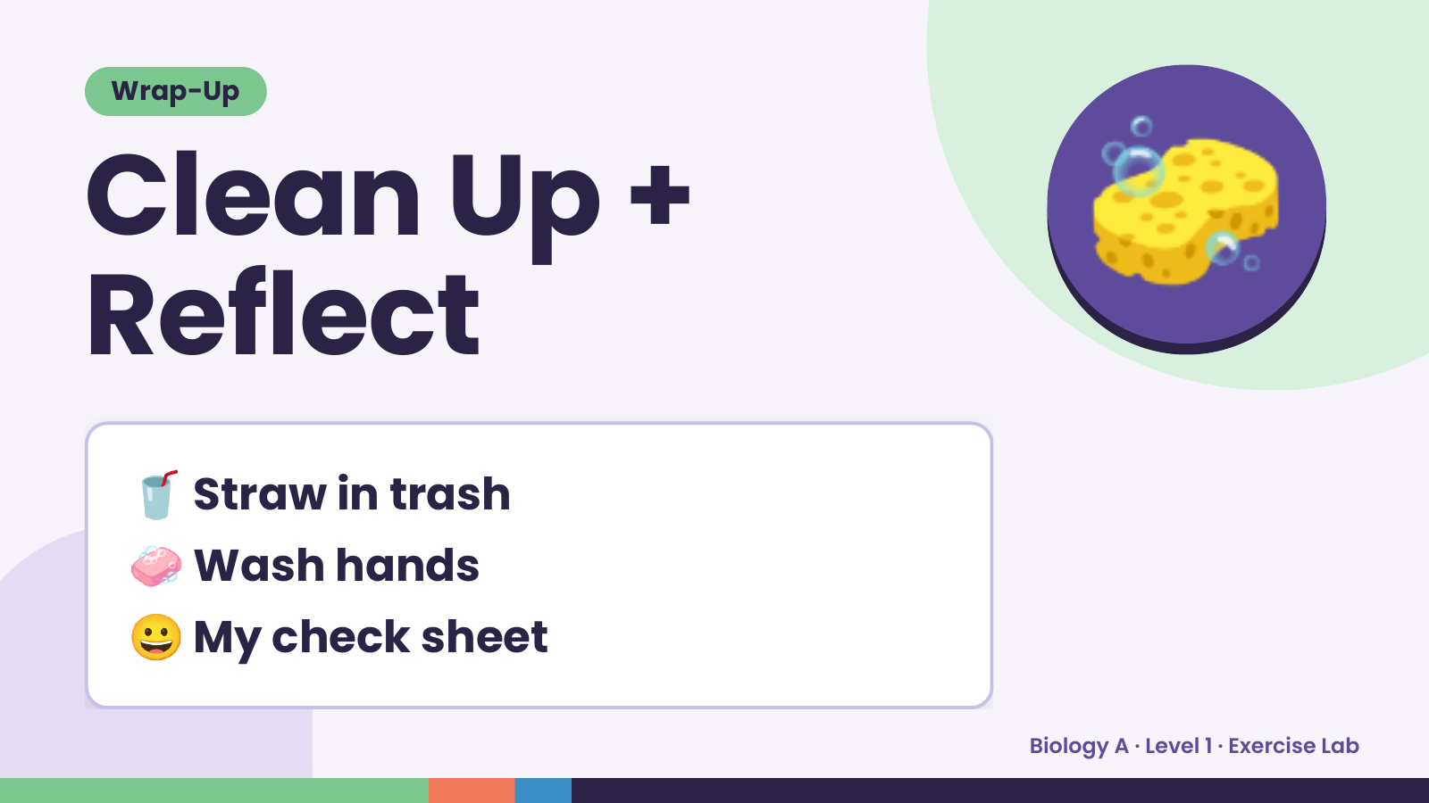
Notes:
Wrap-Up
Clean Up +
Reflect
🧽
🥤 Straw in trash
🧼 Wash hands
😀 My check sheet
Biology A · Level 1 · Exercise Lab

