Slide 1
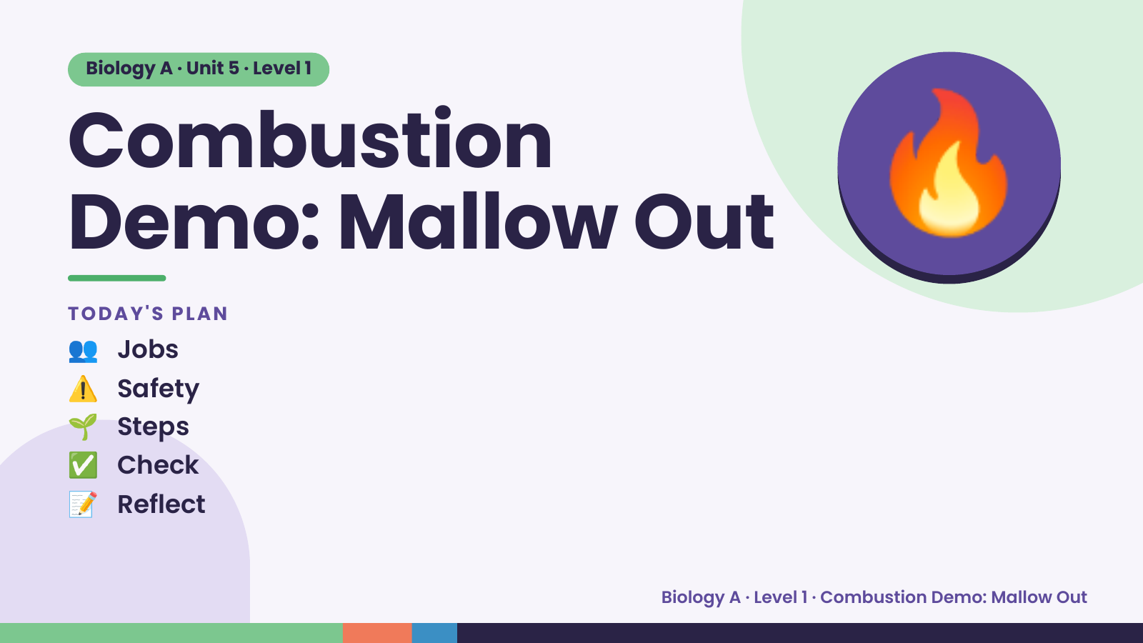
Notes:
Biology A · Unit 5 · Level 1
Combustion
Demo: Mallow Out
👥 Jobs
TODAY'S PLAN
🔥
⚠️ Safety
🌱 Steps
✅ Check
📝 Reflect
Biology A · Level 1 · Combustion Demo: Mallow Out

Slide 2
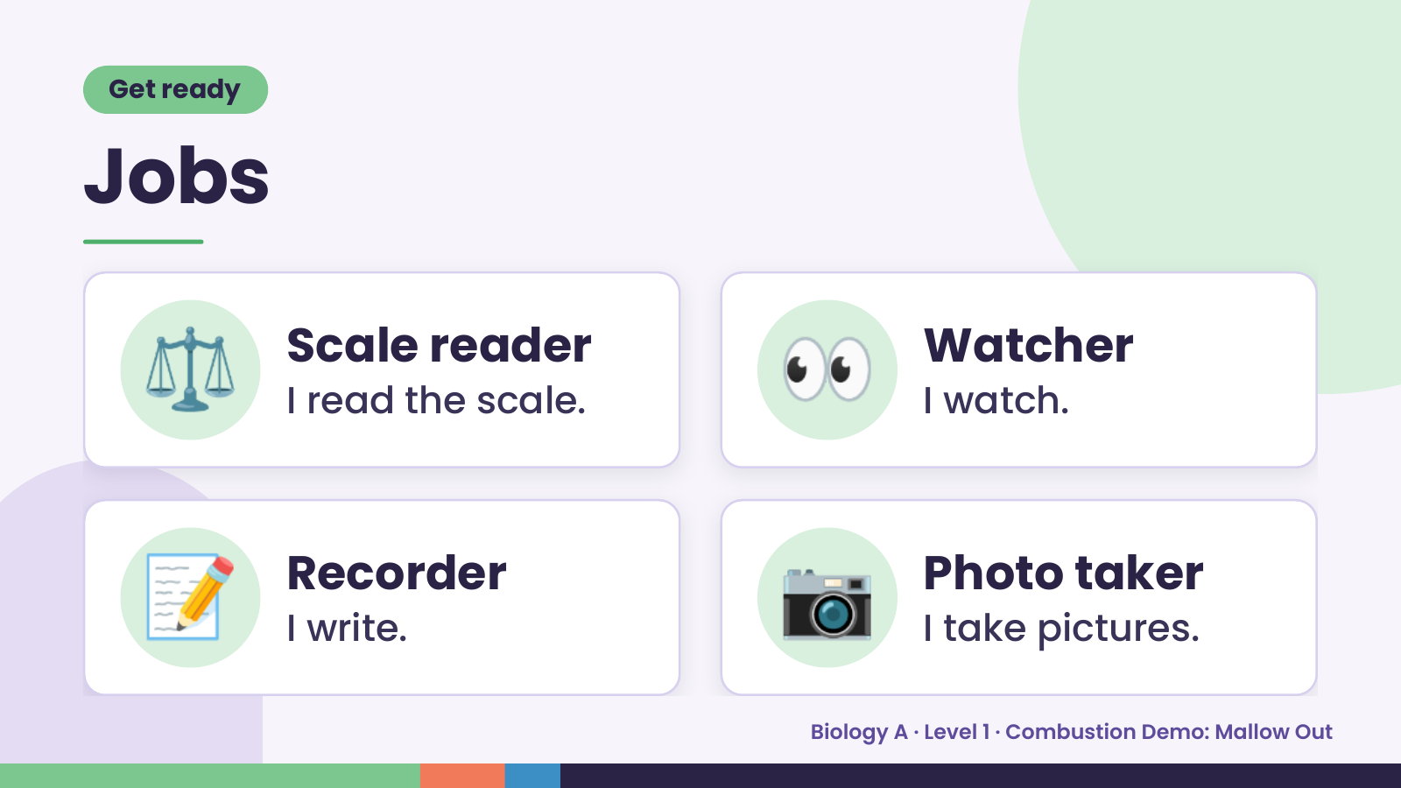
Notes:
Get ready
Jobs
⚖️ Scale reader
I read the scale. 👀 Watcher
I watch.
📝 Recorder
I write. 📷 Photo taker
I take pictures.
Biology A · Level 1 · Combustion Demo: Mallow Out

Slide 3
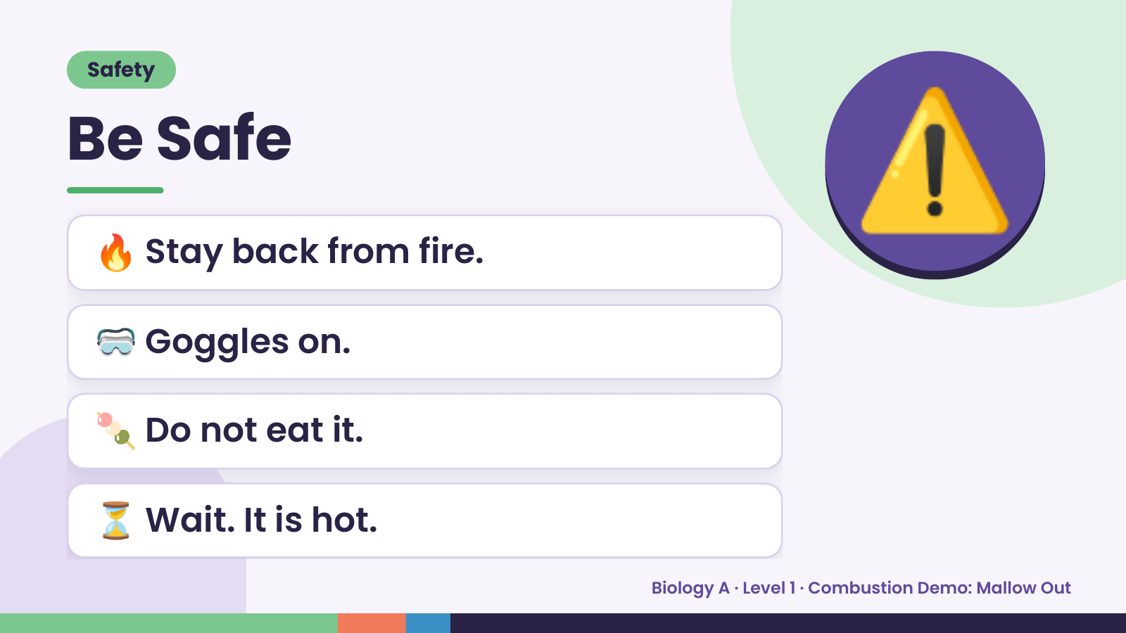
Notes:
Safety
Be Safe
🔥 Stay back from fire.
🥽 Goggles on.
⚠️
🍡 Do not eat it.
⏳ Wait. It is hot.
Biology A · Level 1 · Combustion Demo: Mallow Out

Slide 4
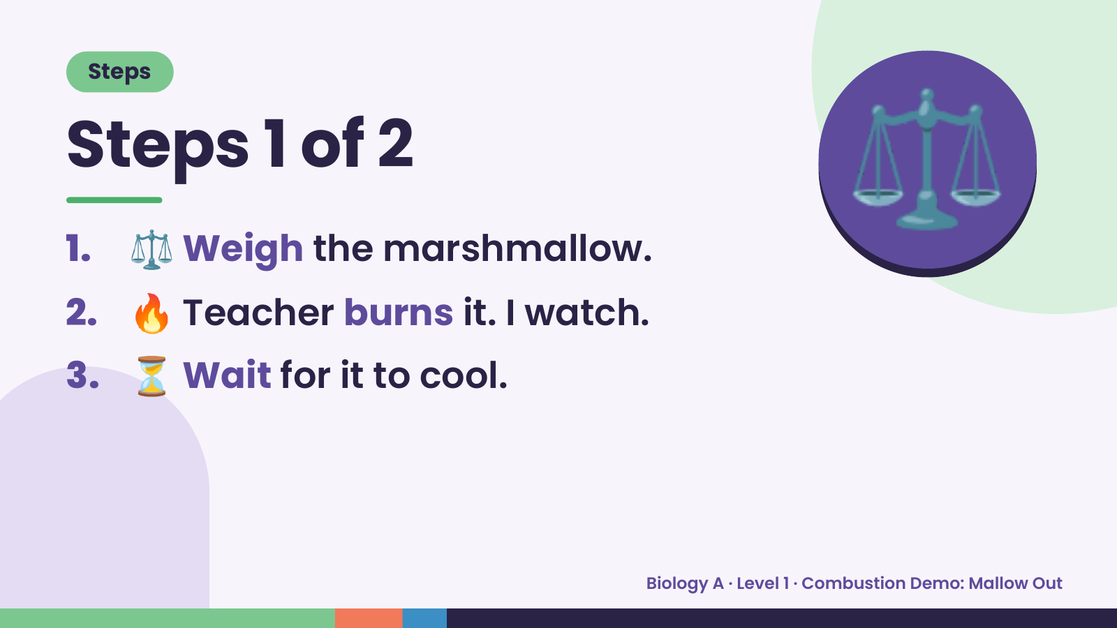
Notes:
Steps
Steps 1 of 2
1. ⚖️ Weigh the marshmallow.
2. 🔥 Teacher burns it. I watch.
⚖️
3. ⏳ Wait for it to cool.
Biology A · Level 1 · Combustion Demo: Mallow Out

Slide 5
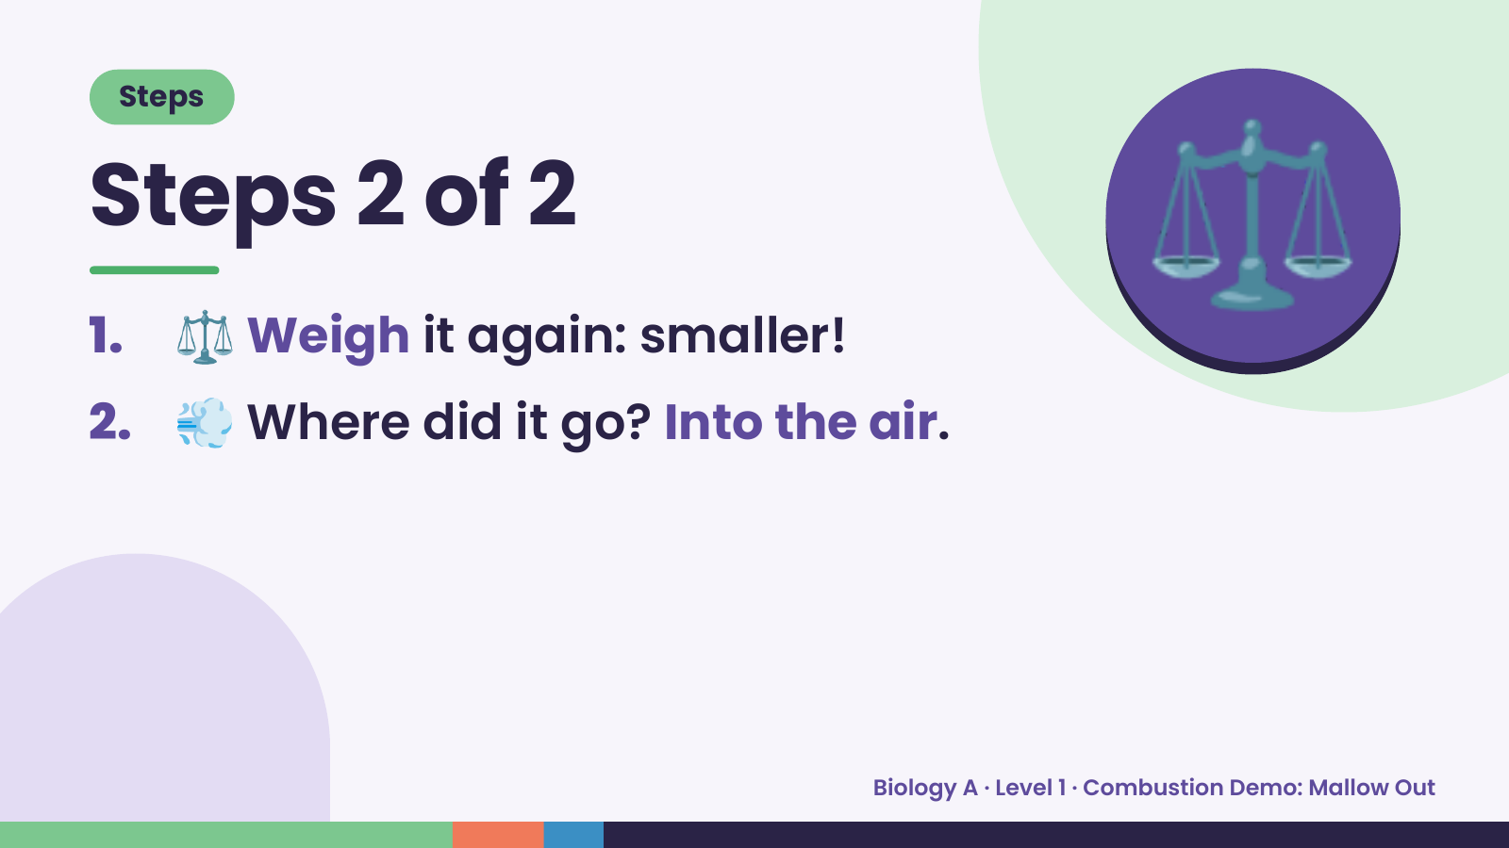
Notes:
Steps
Steps 2 of 2
1. ⚖️ Weigh it again: smaller!
2. 💨 Where did it go? Into the air.
⚖️
Biology A · Level 1 · Combustion Demo: Mallow Out

Slide 6
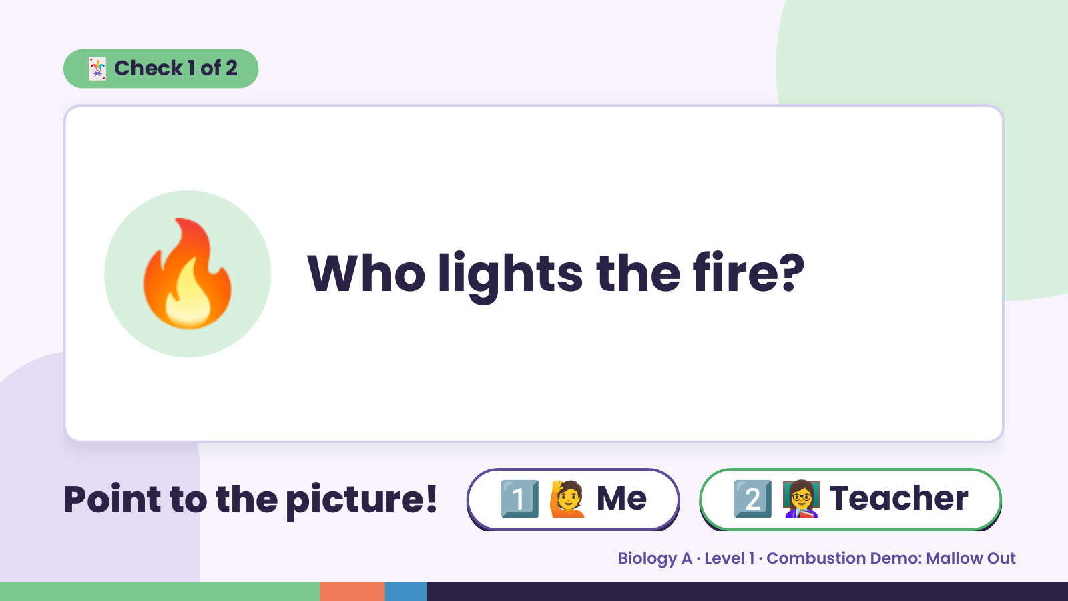
Notes:
🃏 Check 1 of 2
🔥 Who lights the fire?
Point to the picture! 1️⃣ 🙋 Me 2️⃣ 👩‍🏫 Teacher
Biology A · Level 1 · Combustion Demo: Mallow Out

Slide 7
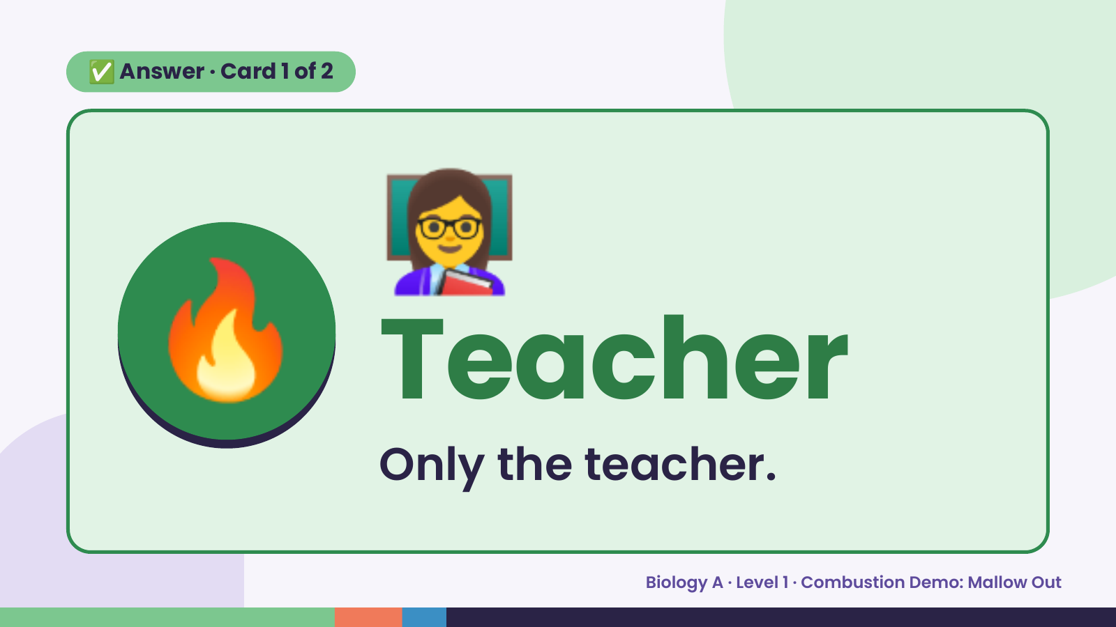
Notes:
👩‍🏫
✅ Answer · Card 1 of 2
🔥 Teacher Only the teacher.
Biology A · Level 1 · Combustion Demo: Mallow Out

Slide 8
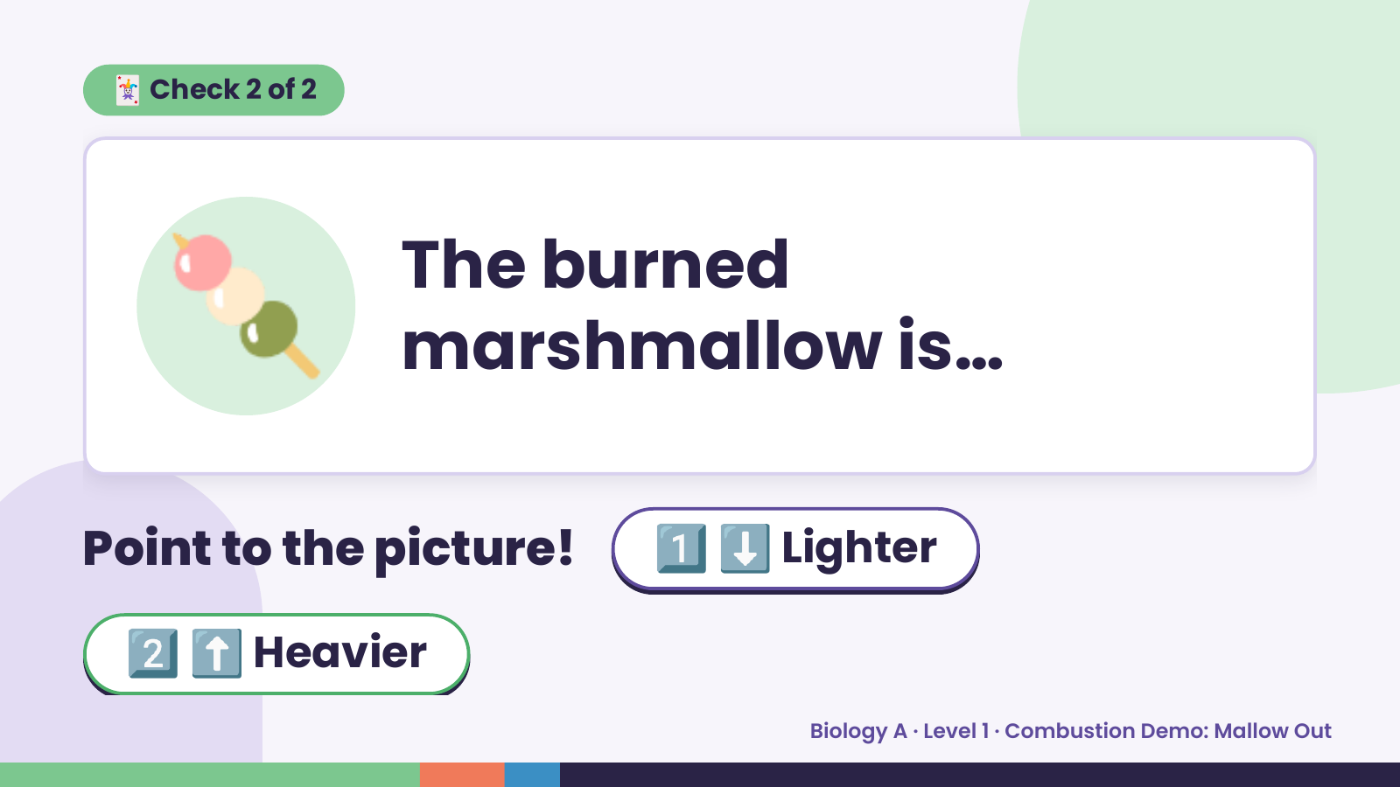
Notes:
🃏 Check 2 of 2
🍡 The burned
marshmallow is…
Point to the picture! 1️⃣ ⬇️ Lighter
2️⃣ ⬆️ Heavier
Biology A · Level 1 · Combustion Demo: Mallow Out

Slide 9
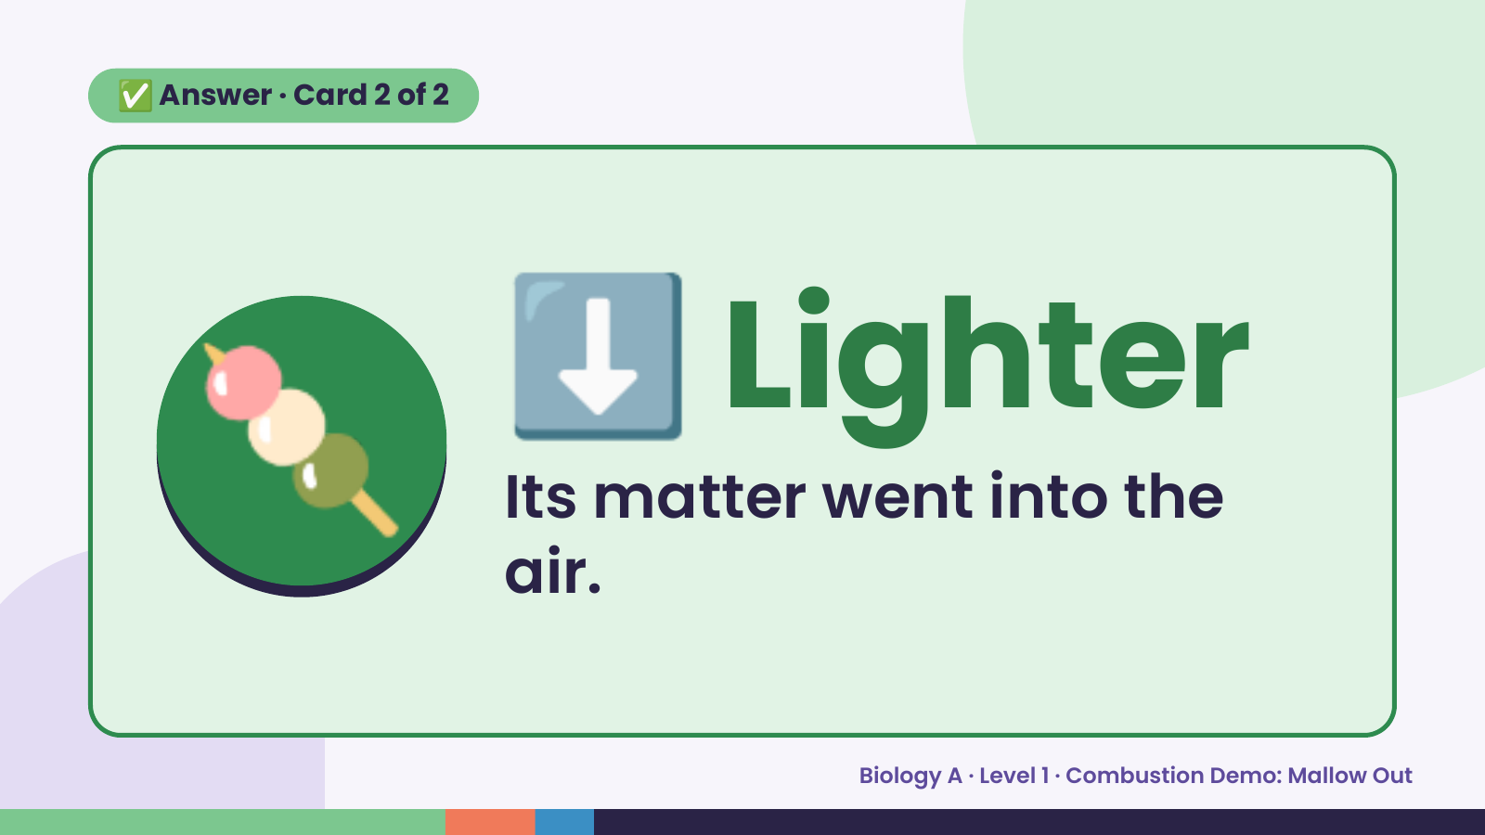
Notes:
✅ Answer · Card 2 of 2
🍡 ⬇️ Lighter
Its matter went into the
air.
Biology A · Level 1 · Combustion Demo: Mallow Out

Slide 10
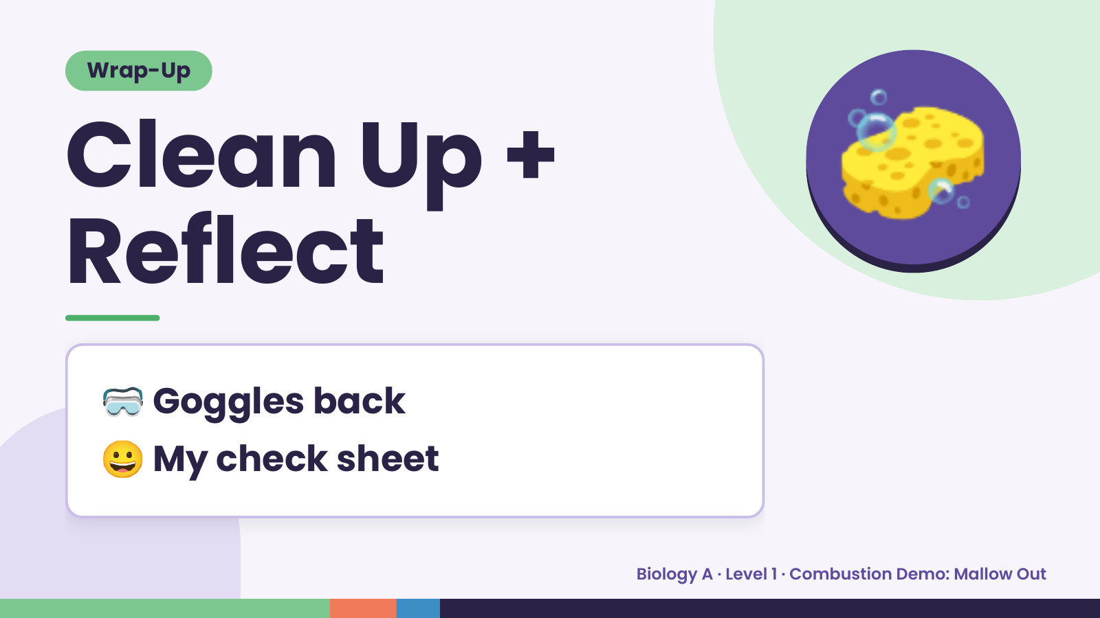
Notes:
Wrap-Up
Clean Up +
Reflect
🧽
🥽 Goggles back
😀 My check sheet
Biology A · Level 1 · Combustion Demo: Mallow Out

