Slide 1
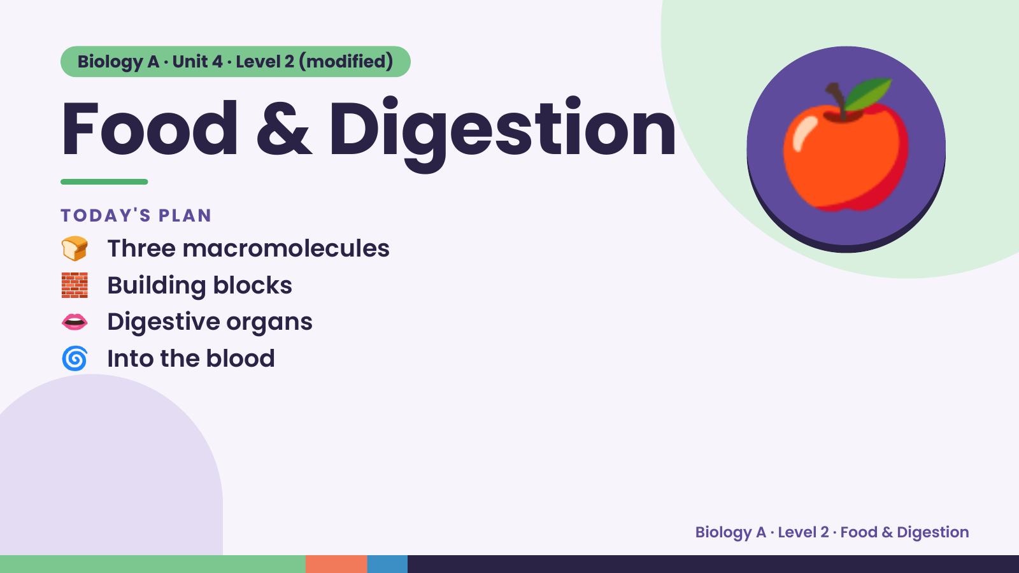
Notes:
Biology A · Unit 4 · Level 2 (modified)
Food & Digestion
🍞 Three macromolecules
TODAY'S PLAN
🧱 Building blocks
👄 Digestive organs
🍎
🌀 Into the blood
Biology A · Level 2 · Food & Digestion

Slide 2
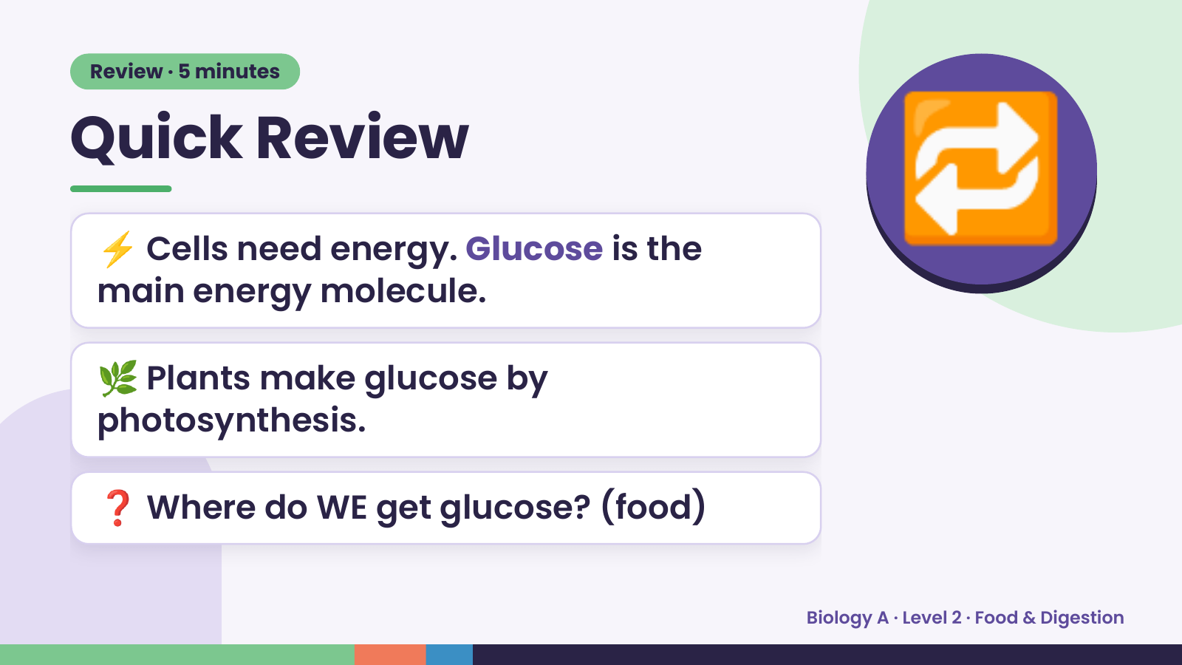
Notes:
Review · 5 minutes
Quick Review
⚡ Cells need energy. Glucose is the
main energy molecule.
🔁
🌿 Plants make glucose by
photosynthesis.
❓ Where do WE get glucose? (food)
Biology A · Level 2 · Food & Digestion

Slide 3
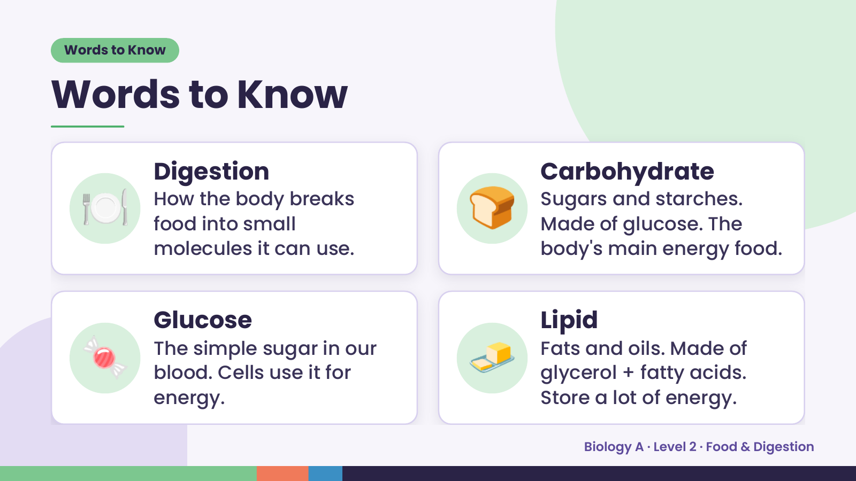
Notes:
Words to Know
Words to Know
🍽️ Digestion
How the body breaks
food into small
molecules it can use.
🍞 Carbohydrate
Sugars and starches.
Made of glucose. The
body's main energy food.
🍬 Glucose
The simple sugar in our
blood. Cells use it for
energy.
🧈 Lipid
Fats and oils. Made of
glycerol + fatty acids.
Store a lot of energy.
Biology A · Level 2 · Food & Digestion

Slide 4
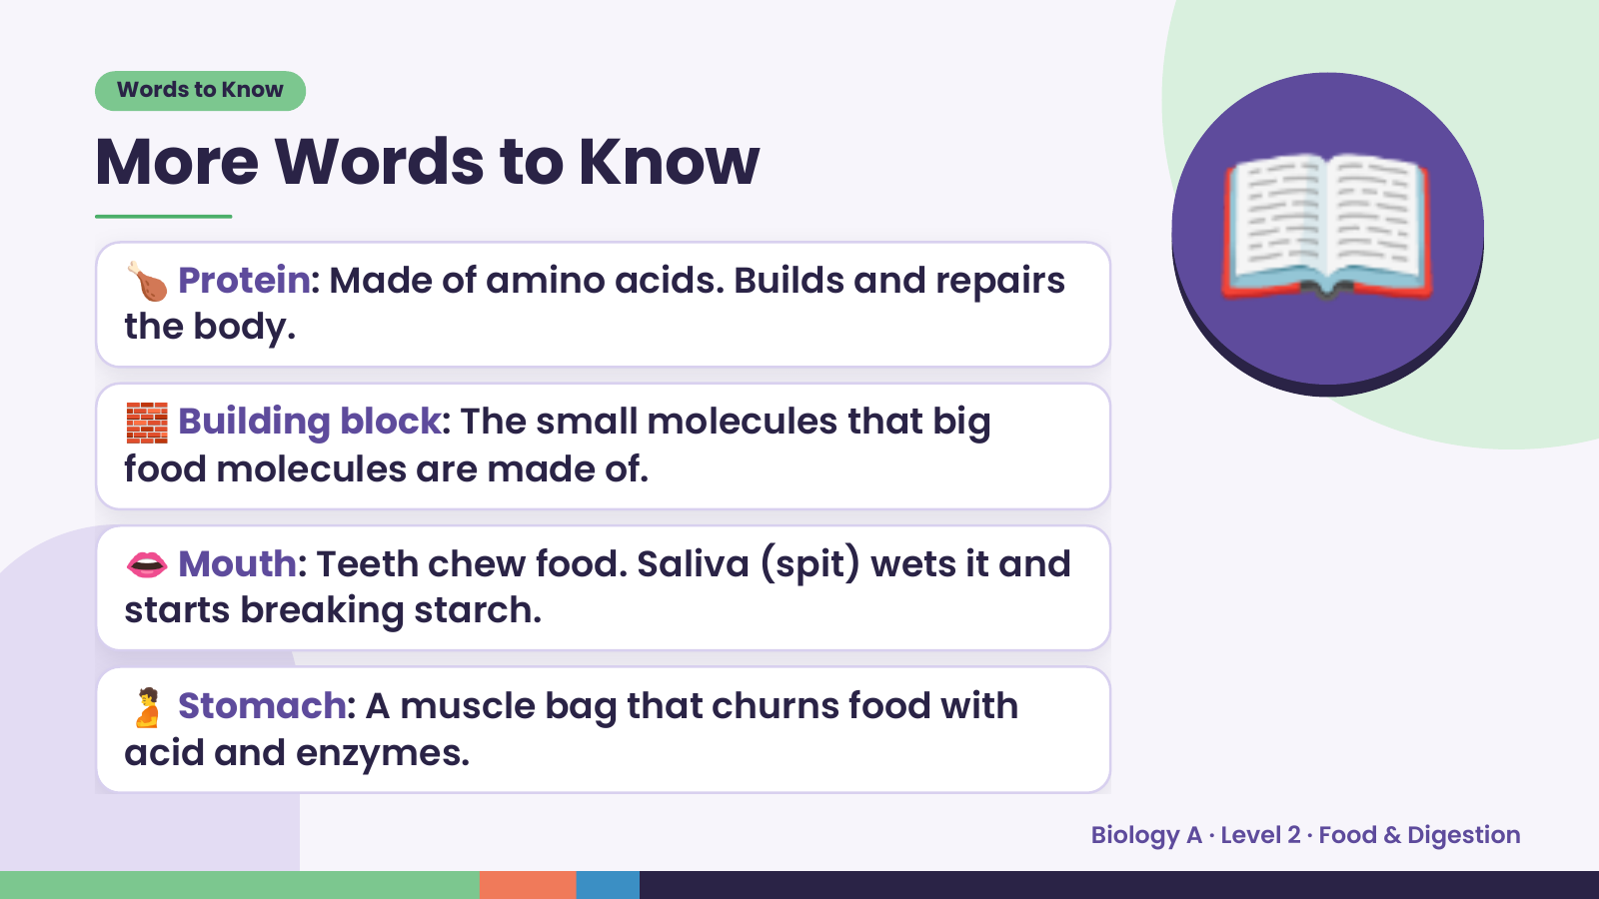
Notes:
Words to Know
More Words to Know
🍗 Protein: Made of amino acids. Builds and repairs
the body.
🧱 Building block: The small molecules that big
food molecules are made of.
📖
👄 Mouth: Teeth chew food. Saliva (spit) wets it and
starts breaking starch.
🫄 Stomach: A muscle bag that churns food with
acid and enzymes.
Biology A · Level 2 · Food & Digestion

Slide 5
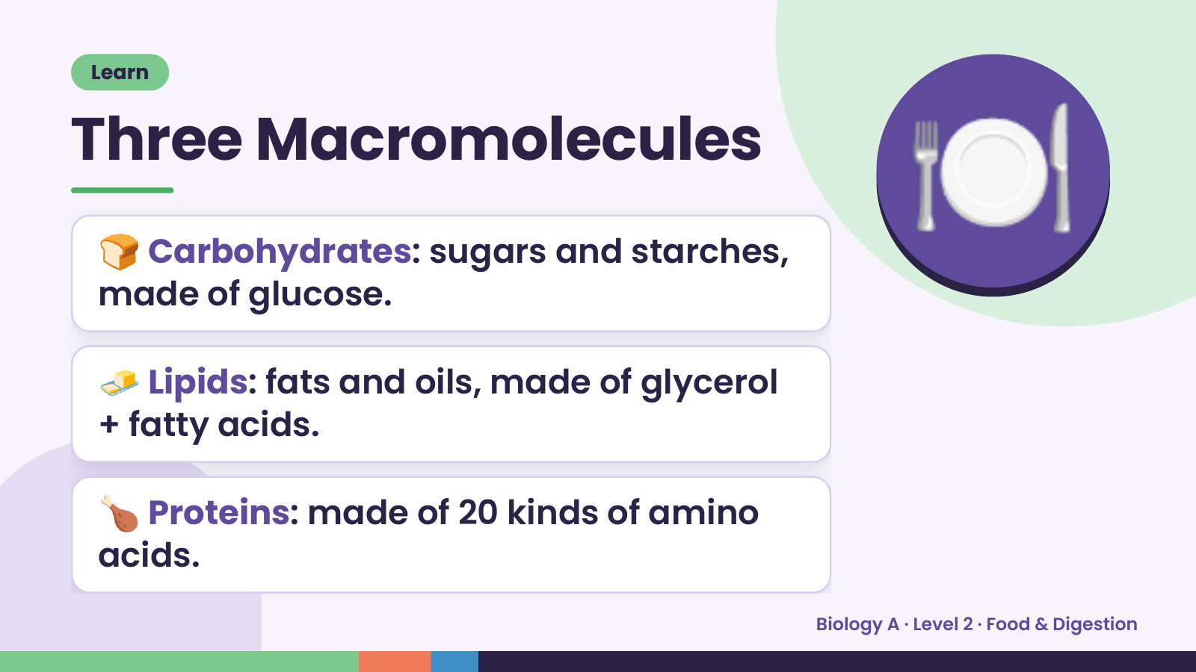
Notes:
Learn
Three Macromolecules
🍞 Carbohydrates: sugars and starches,
made of glucose.
🍽️
🧈 Lipids: fats and oils, made of glycerol
+ fatty acids.
🍗 Proteins: made of 20 kinds of amino
acids.
Biology A · Level 2 · Food & Digestion

Slide 6
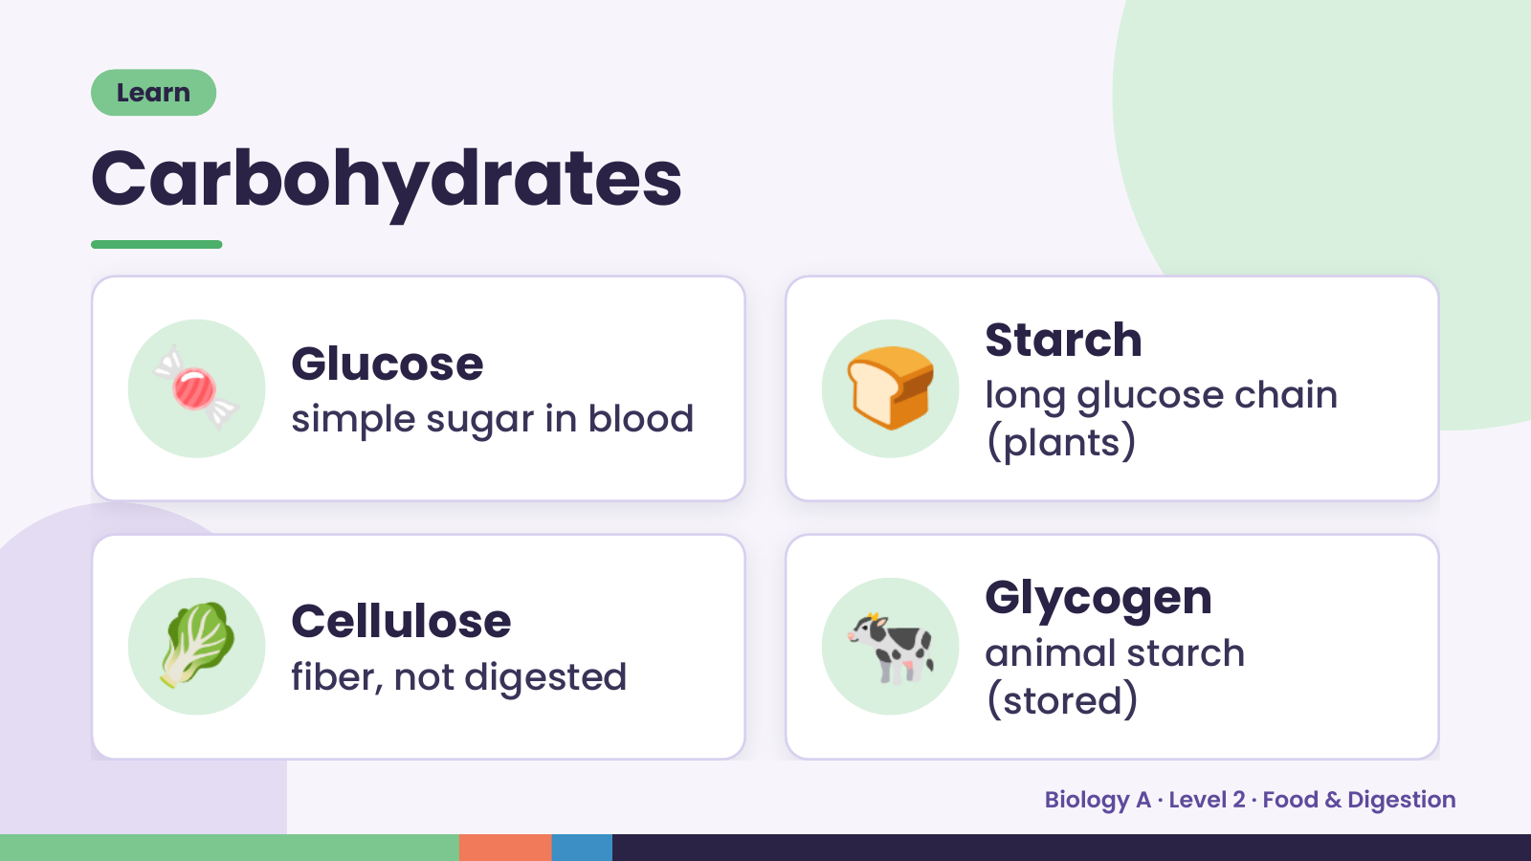
Notes:
Learn
Carbohydrates
🍬 Glucose
simple sugar in blood 🍞 Starch
long glucose chain
(plants)
🥬 Cellulose
fiber, not digested 🐄 Glycogen
animal starch
(stored)
Biology A · Level 2 · Food & Digestion

Slide 7
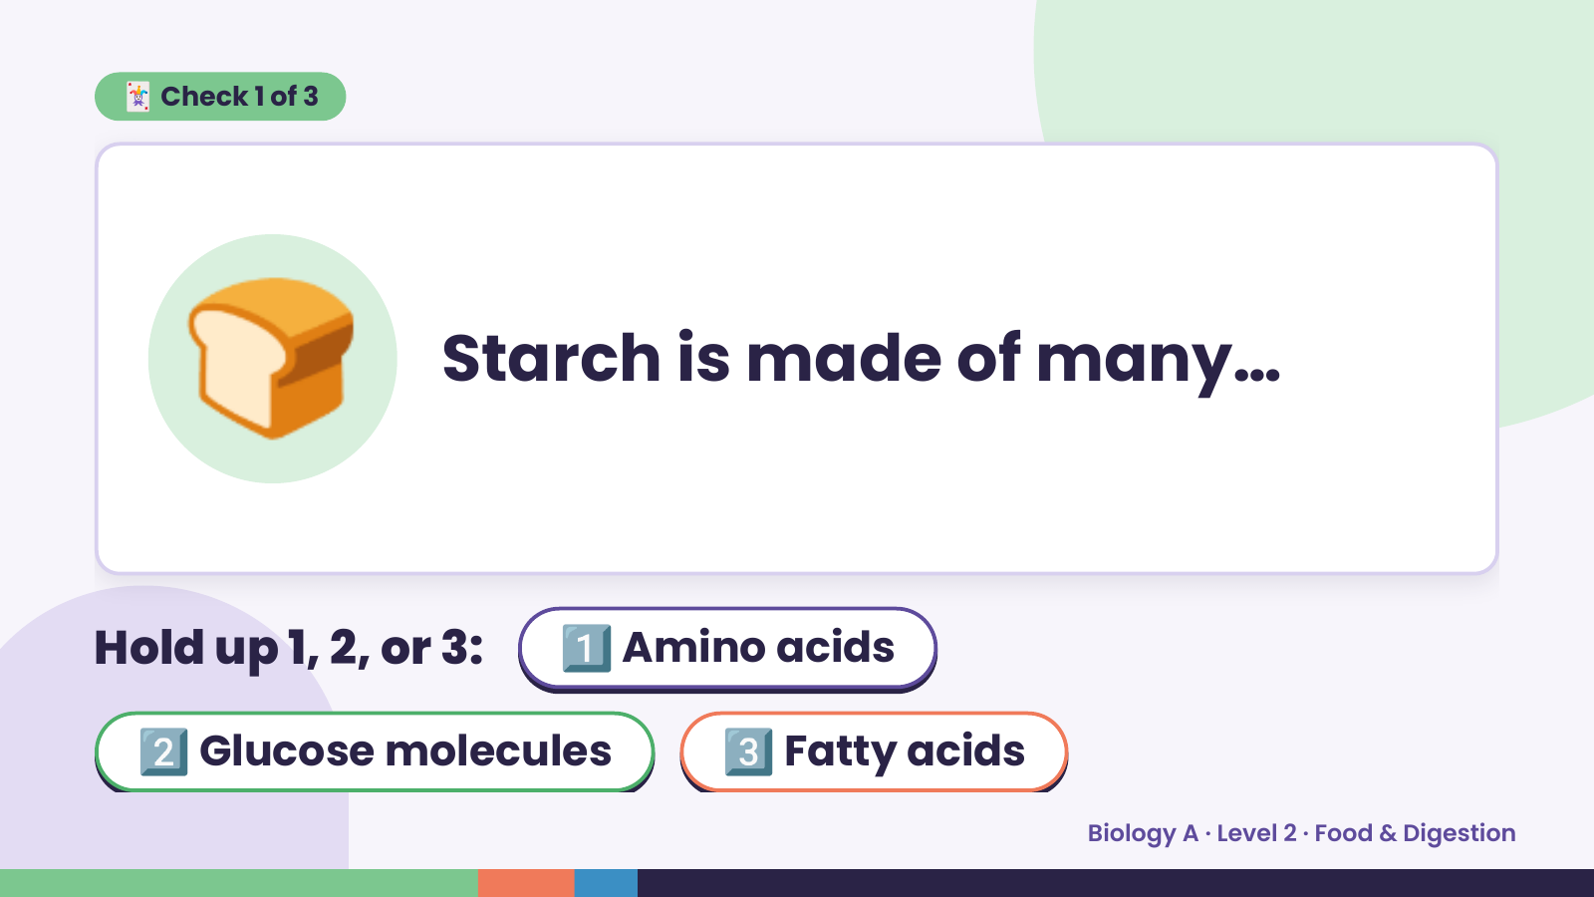
Notes:
🃏 Check 1 of 3
🍞 Starch is made of many…
Hold up 1, 2, or 3: 1️⃣ Amino acids
2️⃣ Glucose molecules 3️⃣ Fatty acids
Biology A · Level 2 · Food & Digestion

Slide 8
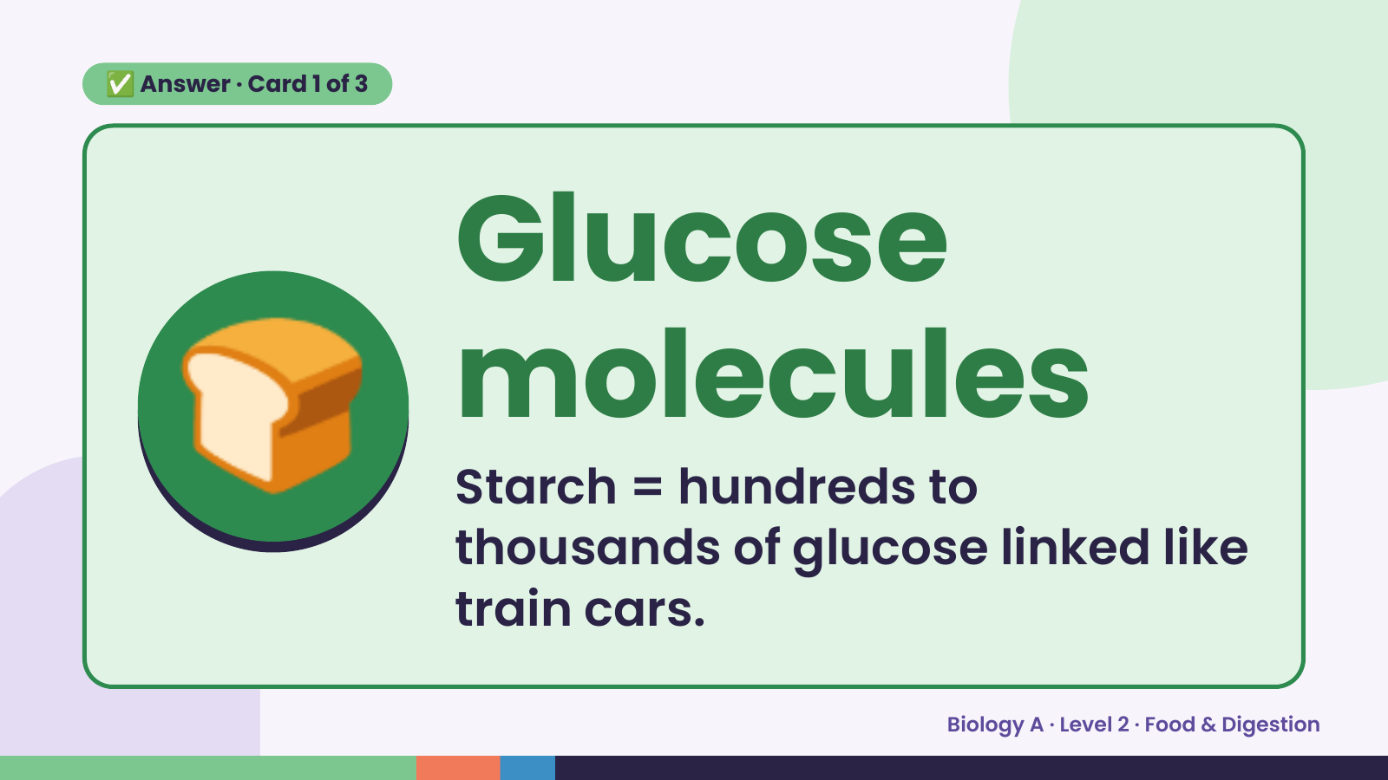
Notes:
✅ Answer · Card 1 of 3
🍞 Glucose
molecules
Starch = hundreds to
thousands of glucose linked like
train cars.
Biology A · Level 2 · Food & Digestion

Slide 9
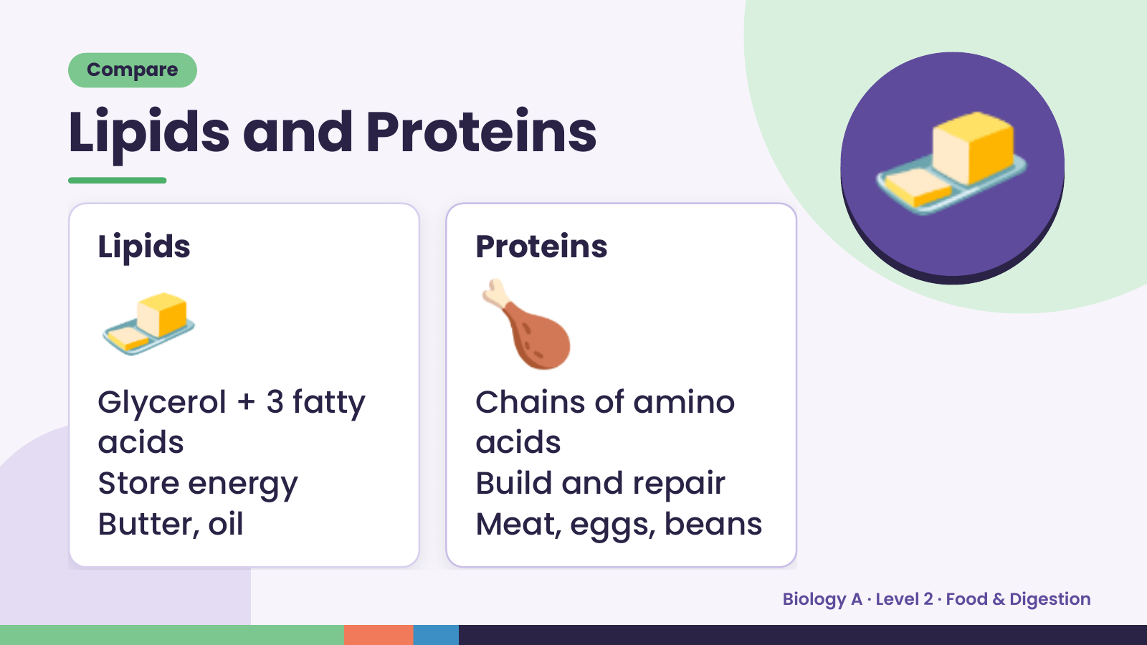
Notes:
Compare
Lipids and Proteins
🧈
Lipids
🍗
Proteins
🧈
Glycerol + 3 fatty Chains of amino
acids acids
Store energy Build and repair
Butter, oil Meat, eggs, beans
Biology A · Level 2 · Food & Digestion

Slide 10
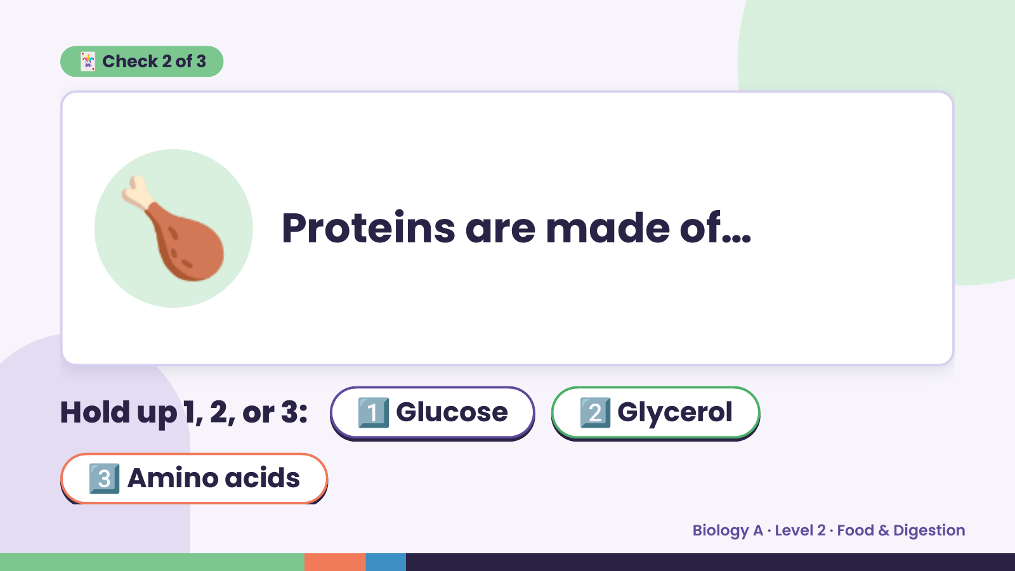
Notes:
🃏 Check 2 of 3
🍗 Proteins are made of…
Hold up 1, 2, or 3: 1️⃣ Glucose 2️⃣ Glycerol
3️⃣ Amino acids
Biology A · Level 2 · Food & Digestion

Slide 11
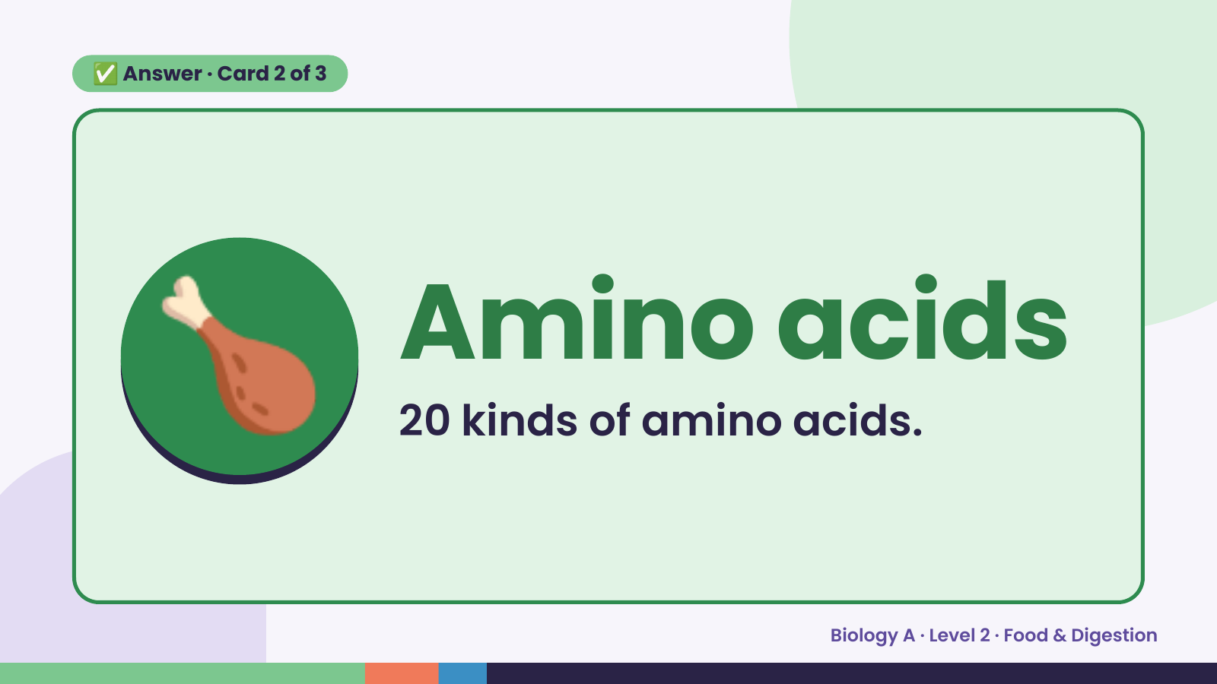
Notes:
✅ Answer · Card 2 of 3
🍗 Amino acids
20 kinds of amino acids.
Biology A · Level 2 · Food & Digestion

Slide 12
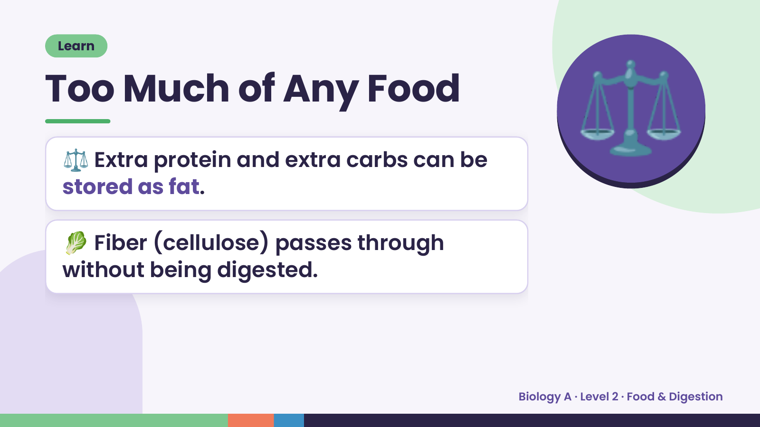
Notes:
Learn
Too Much of Any Food
⚖️ Extra protein and extra carbs can be
stored as fat.
⚖️
🥬 Fiber (cellulose) passes through
without being digested.
Biology A · Level 2 · Food & Digestion

Slide 13
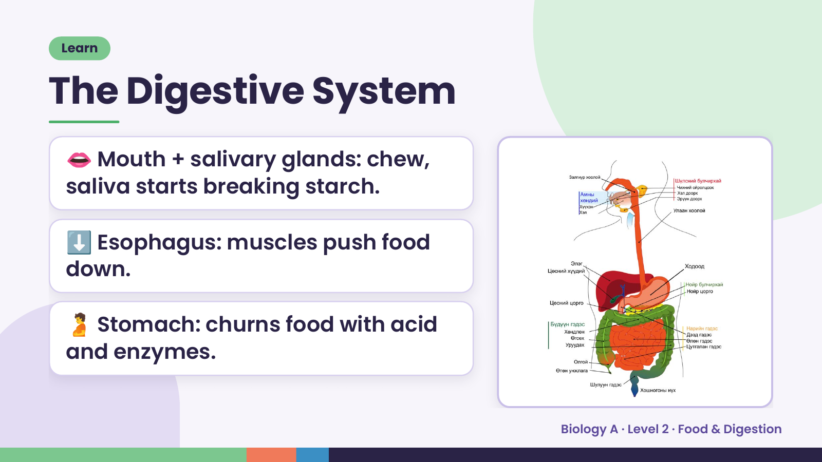
Notes:
Learn
The Digestive System
👄 Mouth + salivary glands: chew,
saliva starts breaking starch.
⬇️ Esophagus: muscles push food
down.
🫄 Stomach: churns food with acid
and enzymes.
Biology A · Level 2 · Food & Digestion

Slide 14
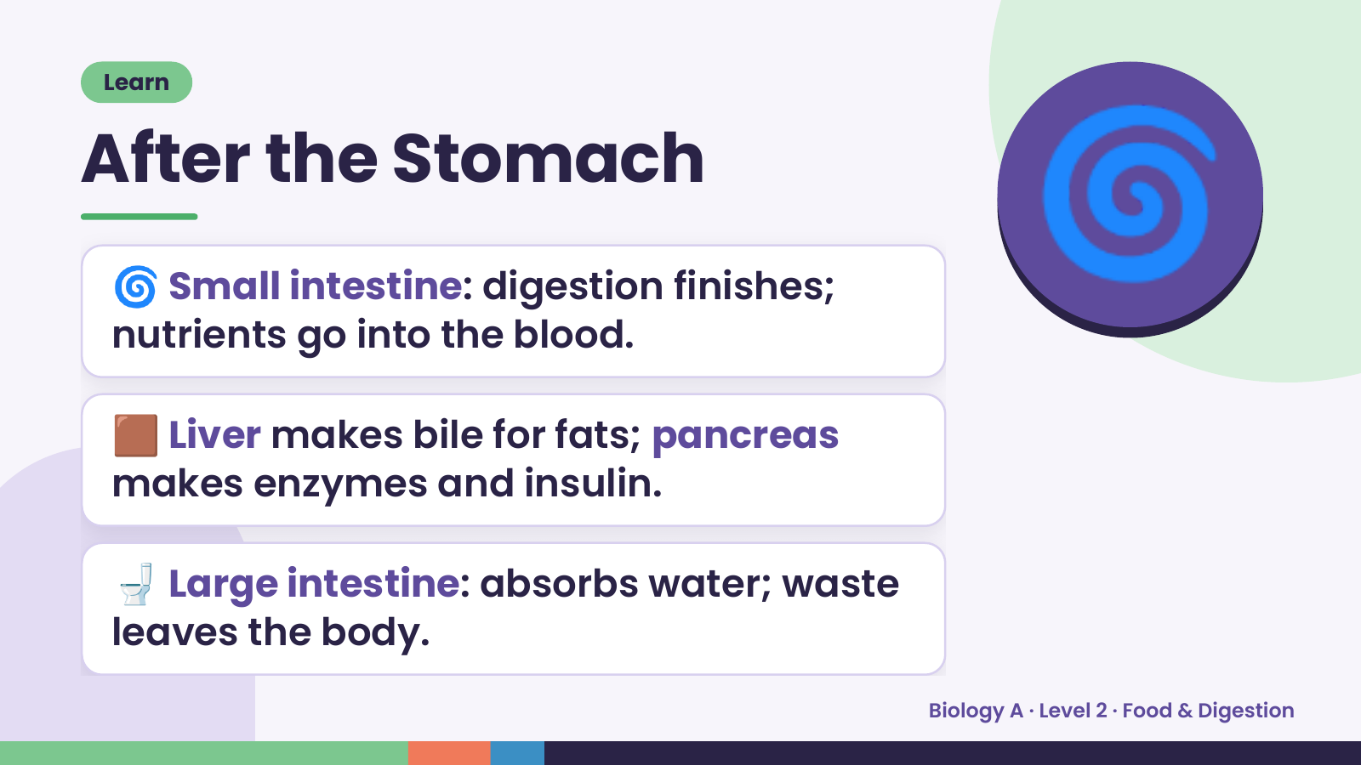
Notes:
Learn
After the Stomach
🌀 Small intestine: digestion finishes;
nutrients go into the blood.
🌀
🟫 Liver makes bile for fats; pancreas
makes enzymes and insulin.
🚽 Large intestine: absorbs water; waste
leaves the body.
Biology A · Level 2 · Food & Digestion

Slide 15
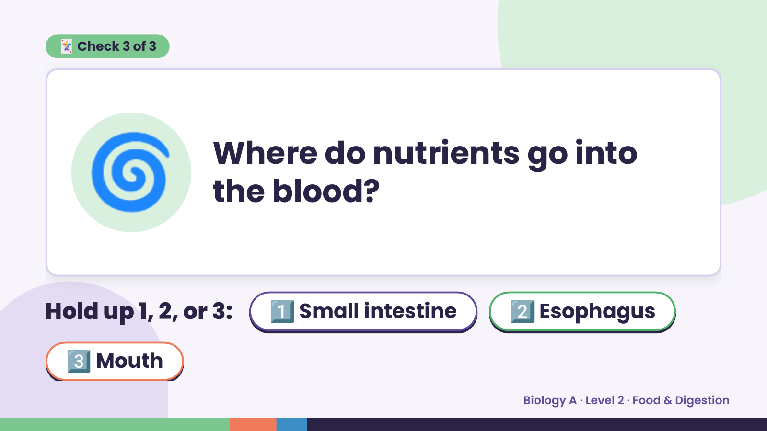
Notes:
🃏 Check 3 of 3
🌀 Where do nutrients go into
the blood?
Hold up 1, 2, or 3: 1️⃣ Small intestine 2️⃣ Esophagus
3️⃣ Mouth
Biology A · Level 2 · Food & Digestion

Slide 16
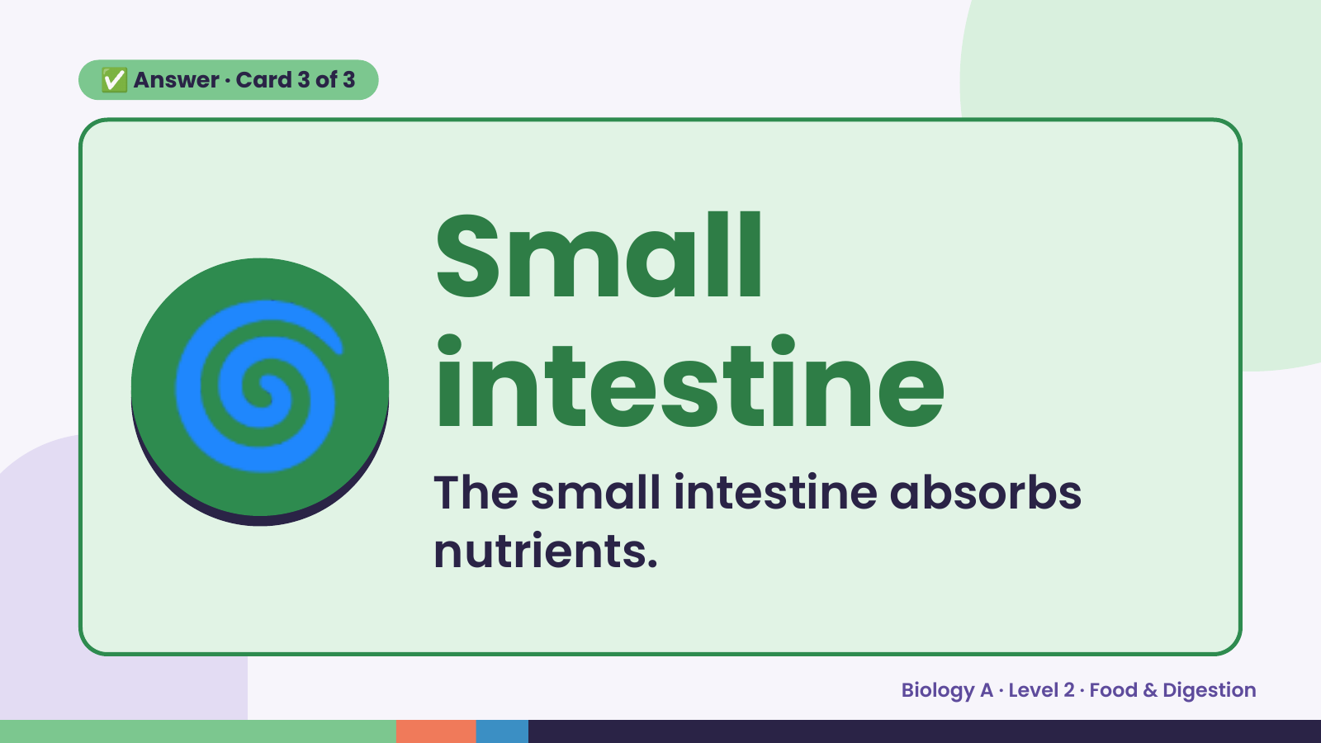
Notes:
✅ Answer · Card 3 of 3
🌀 Small
intestine
The small intestine absorbs
nutrients.
Biology A · Level 2 · Food & Digestion

Slide 17
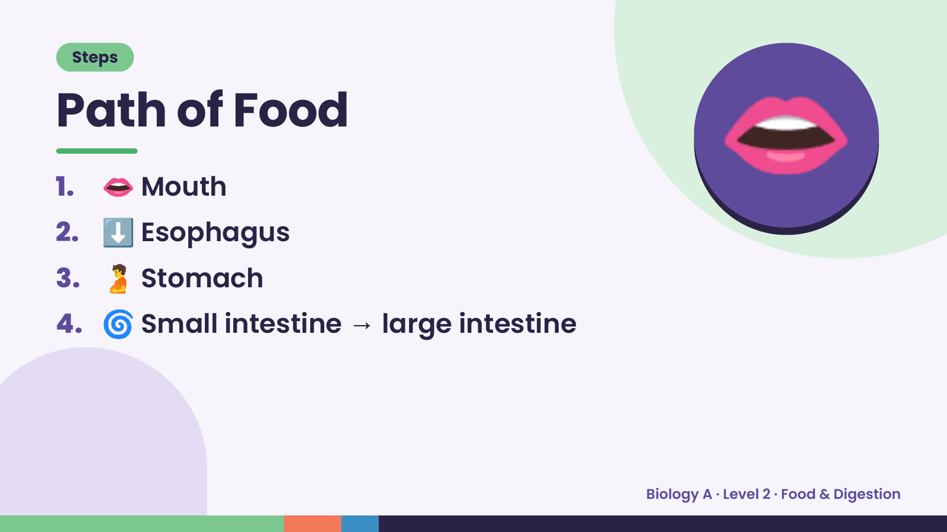
Notes:
Steps
Path of Food
1. 👄 Mouth
2. ⬇️ Esophagus
3. 🫄 Stomach
👄
4. 🌀 Small intestine → large intestine
Biology A · Level 2 · Food & Digestion

Slide 18
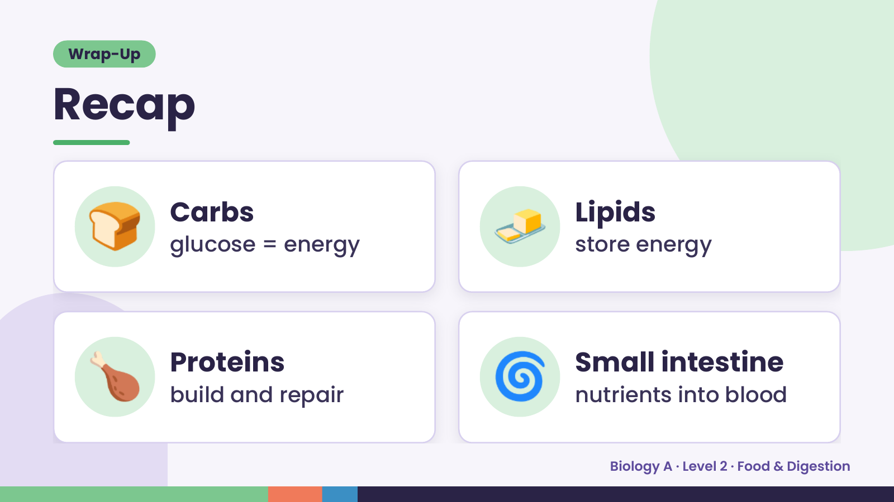
Notes:
Wrap-Up
Recap
🍞 Carbs
glucose = energy 🧈 Lipids
store energy
🍗 Proteins
build and repair 🌀 Small intestine
nutrients into blood
Biology A · Level 2 · Food & Digestion

Slide 19
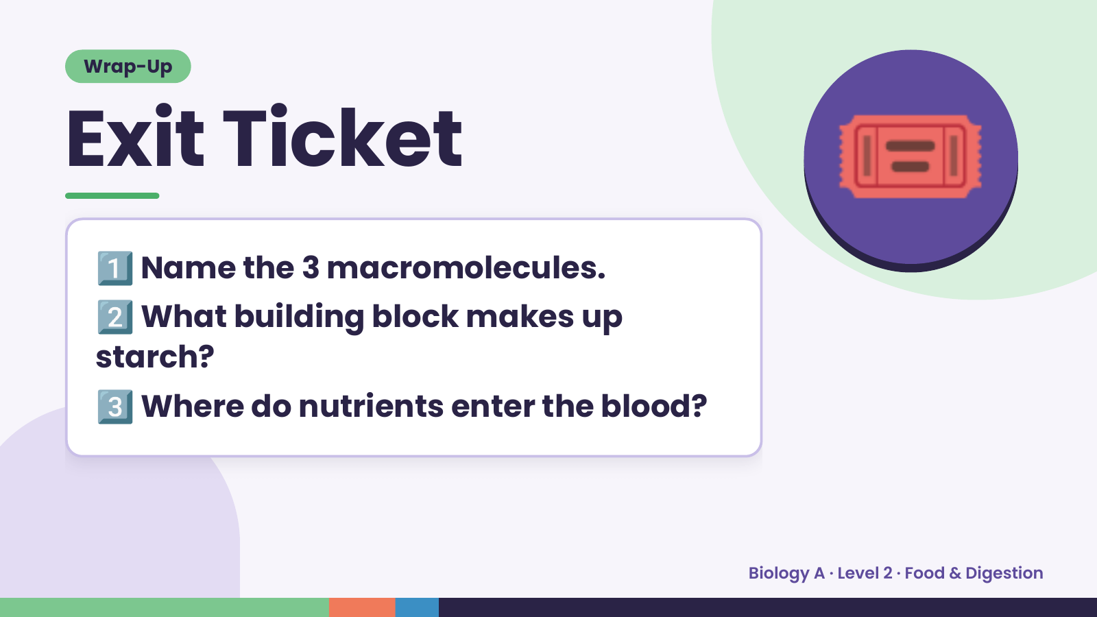
Notes:
Wrap-Up
Exit Ticket
1️⃣
2️⃣
Name the 3 macromolecules.
What building block makes up
🎟️
starch?
3️⃣Where do nutrients enter the blood?
Biology A · Level 2 · Food & Digestion

