Slide 1
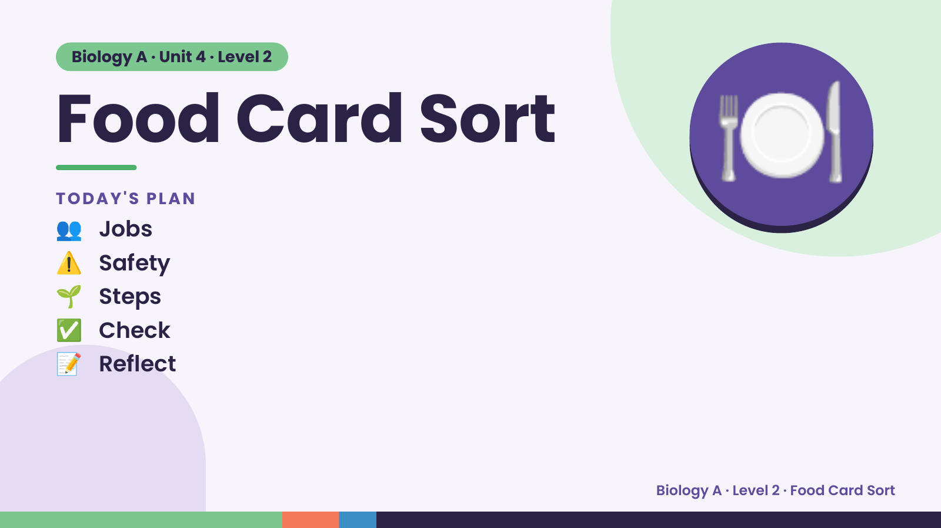
Notes:
Biology A · Unit 4 · Level 2
Food Card Sort
👥 Jobs
TODAY'S PLAN
⚠️ Safety
🌱 Steps
🍽️
✅ Check
📝 Reflect
Biology A · Level 2 · Food Card Sort

Slide 2
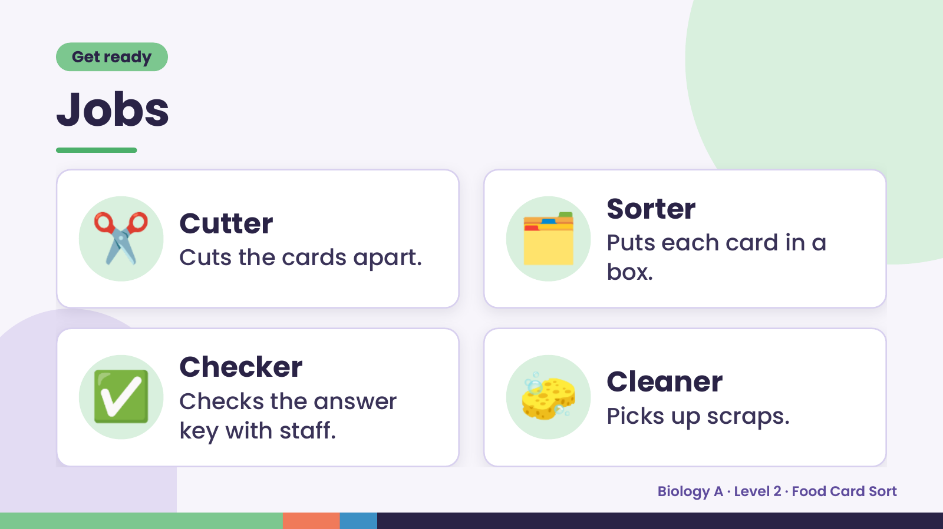
Notes:
Get ready
Jobs
✂️ Cutter
Cuts the cards apart. 🗂️ Sorter
Puts each card in a
box.
✅ Checker
Checks the answer
key with staff.
🧽 Cleaner
Picks up scraps.
Biology A · Level 2 · Food Card Sort

Slide 3
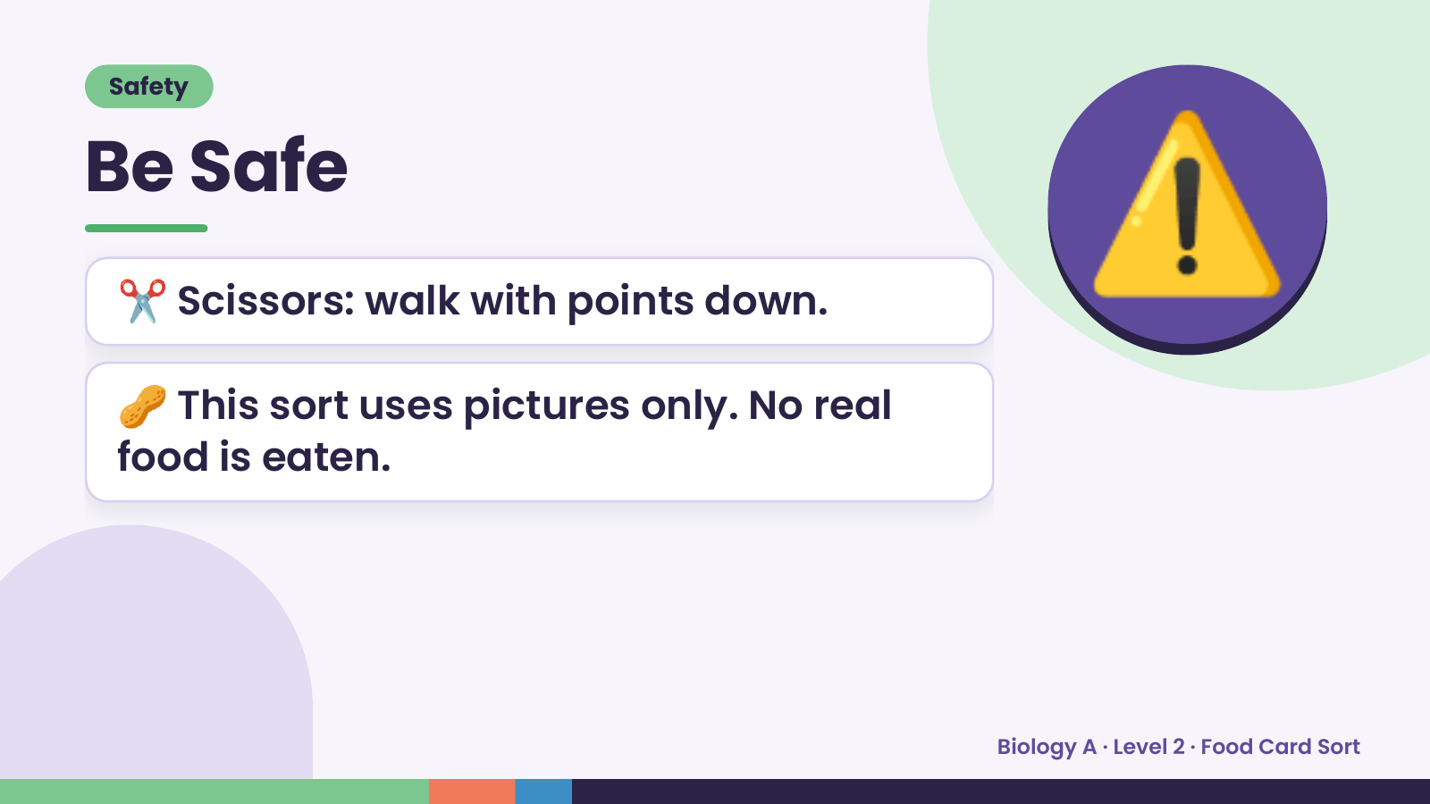
Notes:
Safety
Be Safe
✂️ Scissors: walk with points down.
🥜 This sort uses pictures only. No real
⚠️
food is eaten.
Biology A · Level 2 · Food Card Sort

Slide 4
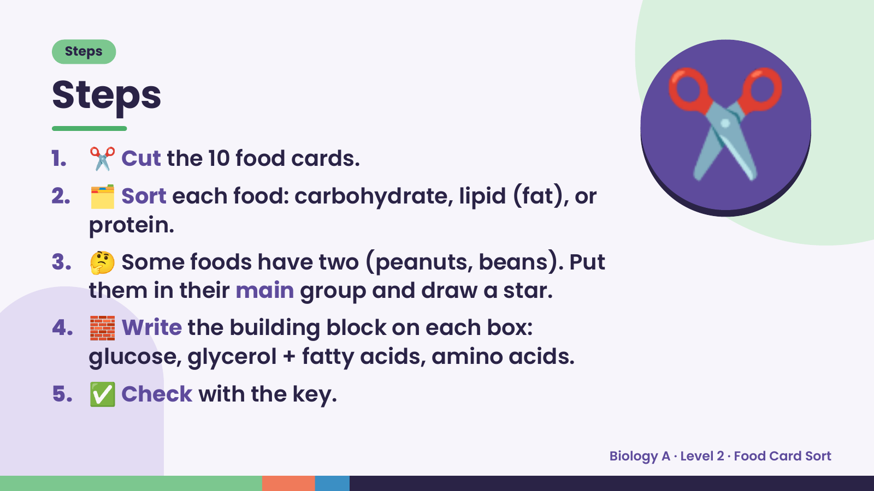
Notes:
Steps
Steps
1. ✂️ Cut the 10 food cards.
2. 🗂️ Sort each food: carbohydrate, lipid (fat), or
protein.
3. 🤔 Some foods have two (peanuts, beans). Put
✂️
them in their main group and draw a star.
4. 🧱 Write the building block on each box:
glucose, glycerol + fatty acids, amino acids.
5. ✅ Check with the key.
Biology A · Level 2 · Food Card Sort

Slide 5
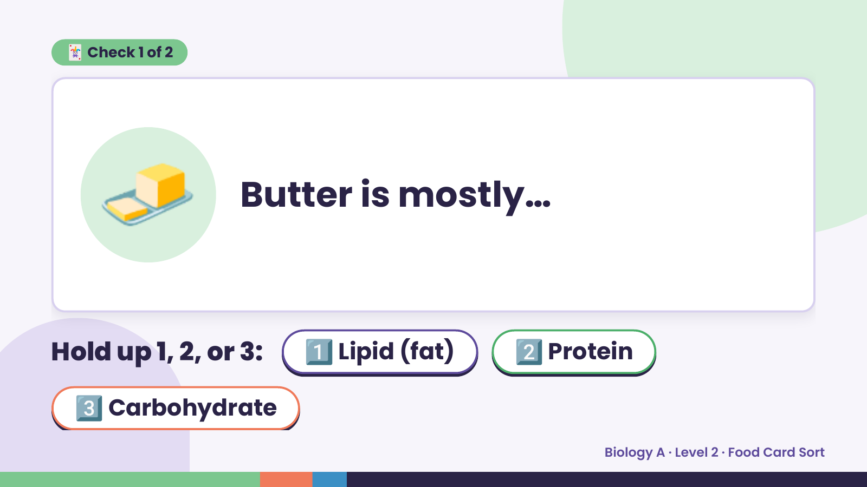
Notes:
🃏 Check 1 of 2
🧈 Butter is mostly…
Hold up 1, 2, or 3: 1️⃣ Lipid (fat) 2️⃣ Protein
3️⃣ Carbohydrate
Biology A · Level 2 · Food Card Sort

Slide 6
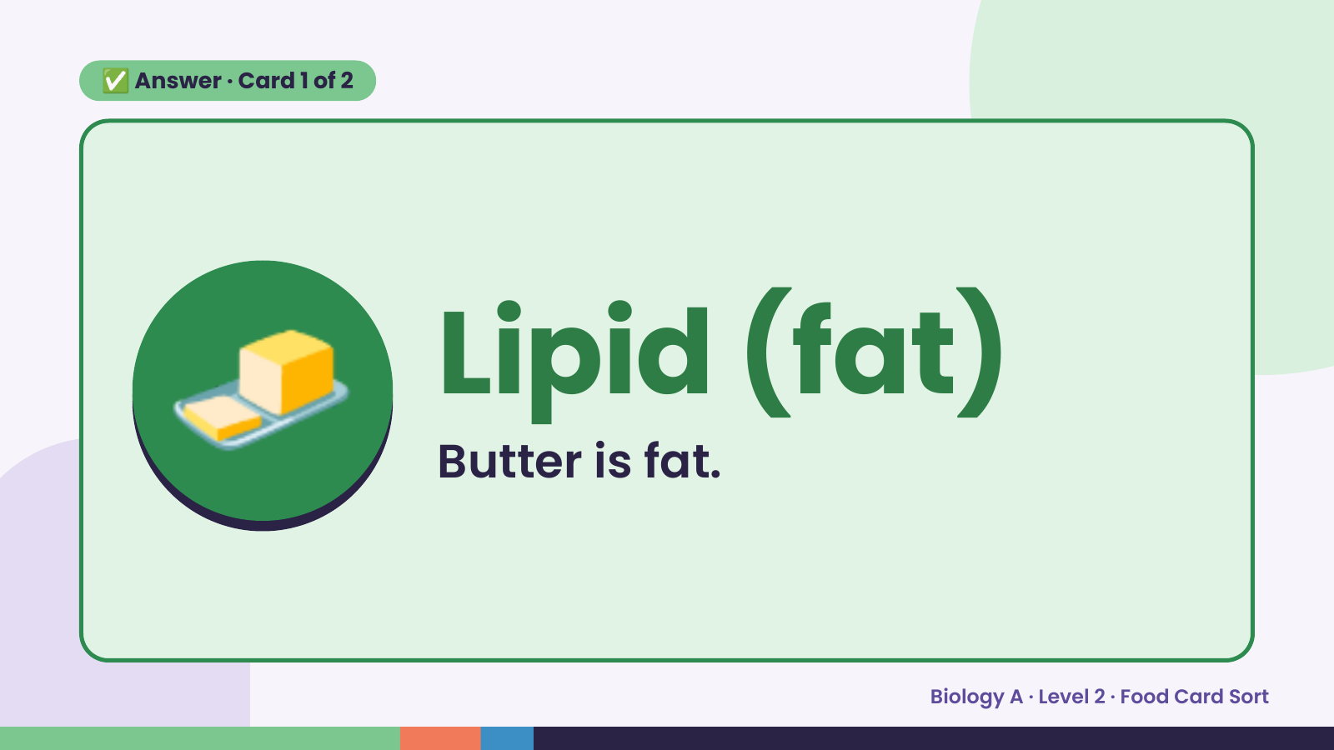
Notes:
✅ Answer · Card 1 of 2
🧈 Lipid (fat)
Butter is fat.
Biology A · Level 2 · Food Card Sort

Slide 7
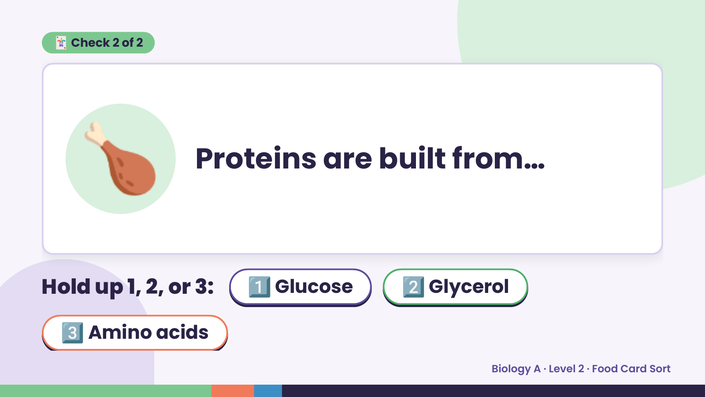
Notes:
🃏 Check 2 of 2
🍗 Proteins are built from…
Hold up 1, 2, or 3: 1️⃣ Glucose 2️⃣ Glycerol
3️⃣ Amino acids
Biology A · Level 2 · Food Card Sort

Slide 8
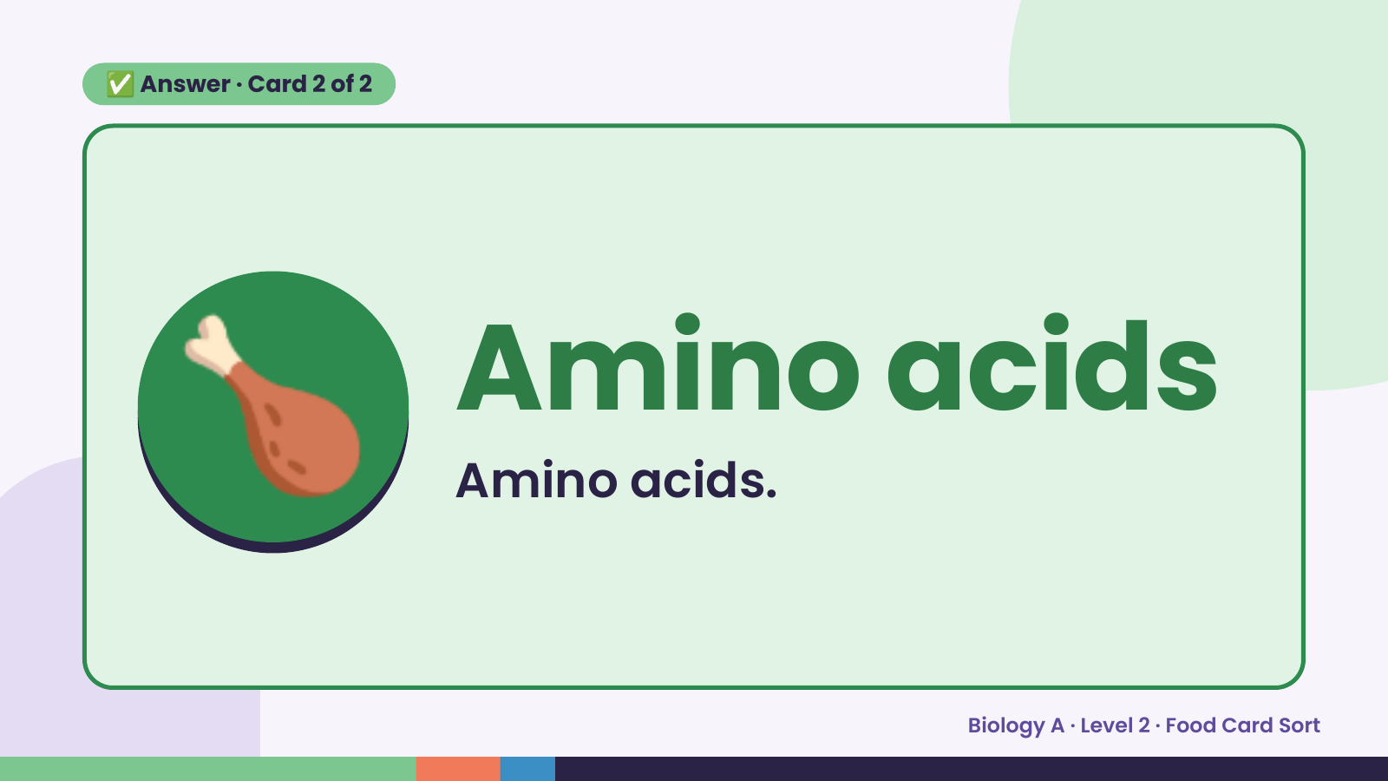
Notes:
✅ Answer · Card 2 of 2
🍗 Amino acids
Amino acids.
Biology A · Level 2 · Food Card Sort

Slide 9
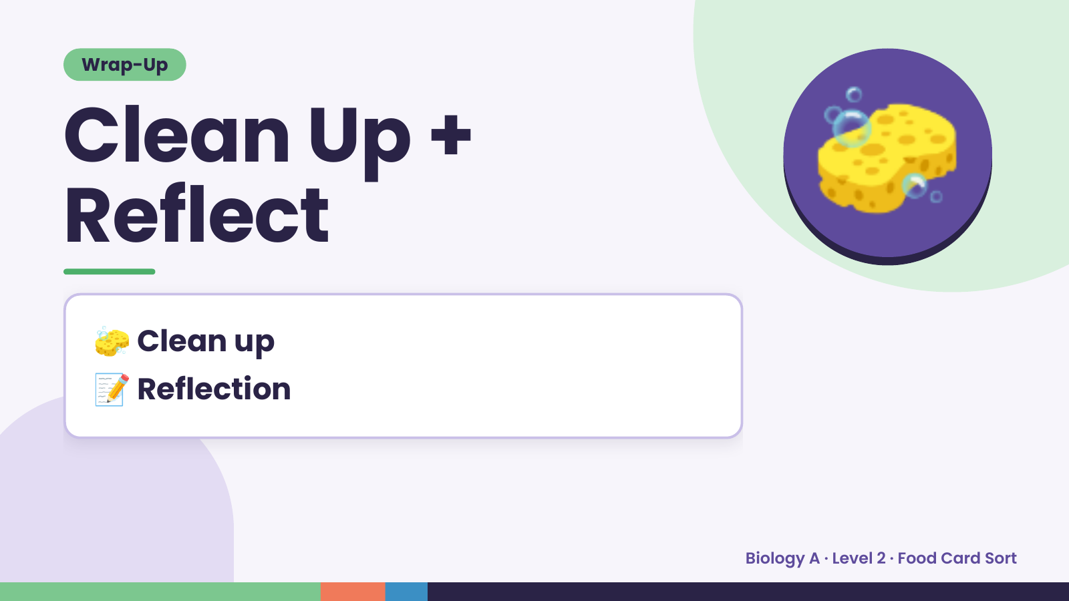
Notes:
Wrap-Up
Clean Up +
Reflect
🧽
🧽 Clean up
📝 Reflection
Biology A · Level 2 · Food Card Sort

