Slide 1
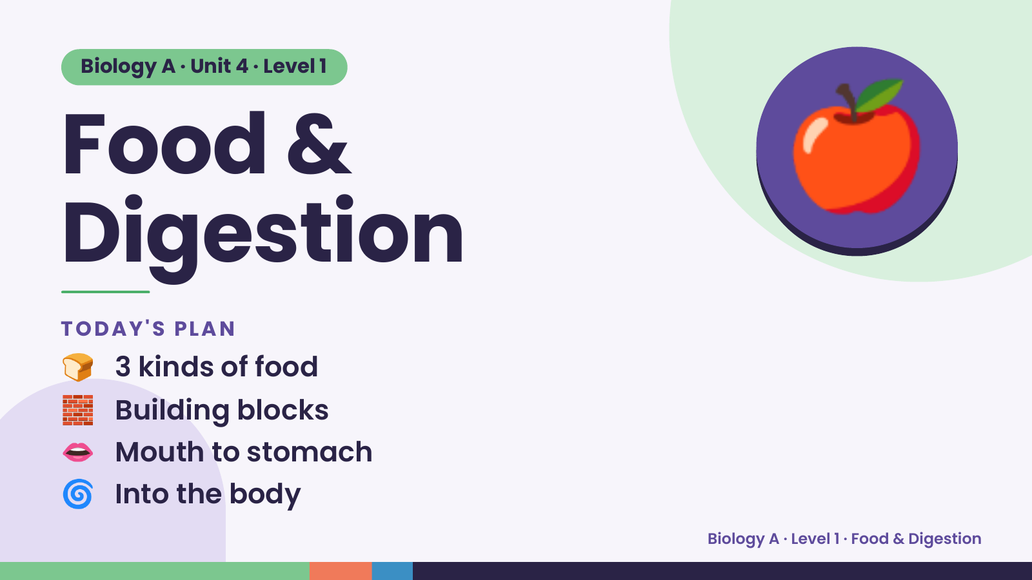
Notes:
Biology A · Unit 4 · Level 1
Food &
Digestion
🍎
🍞 3 kinds of food
TODAY'S PLAN
🧱 Building blocks
👄 Mouth to stomach
🌀 Into the body
Biology A · Level 1 · Food & Digestion

Slide 2
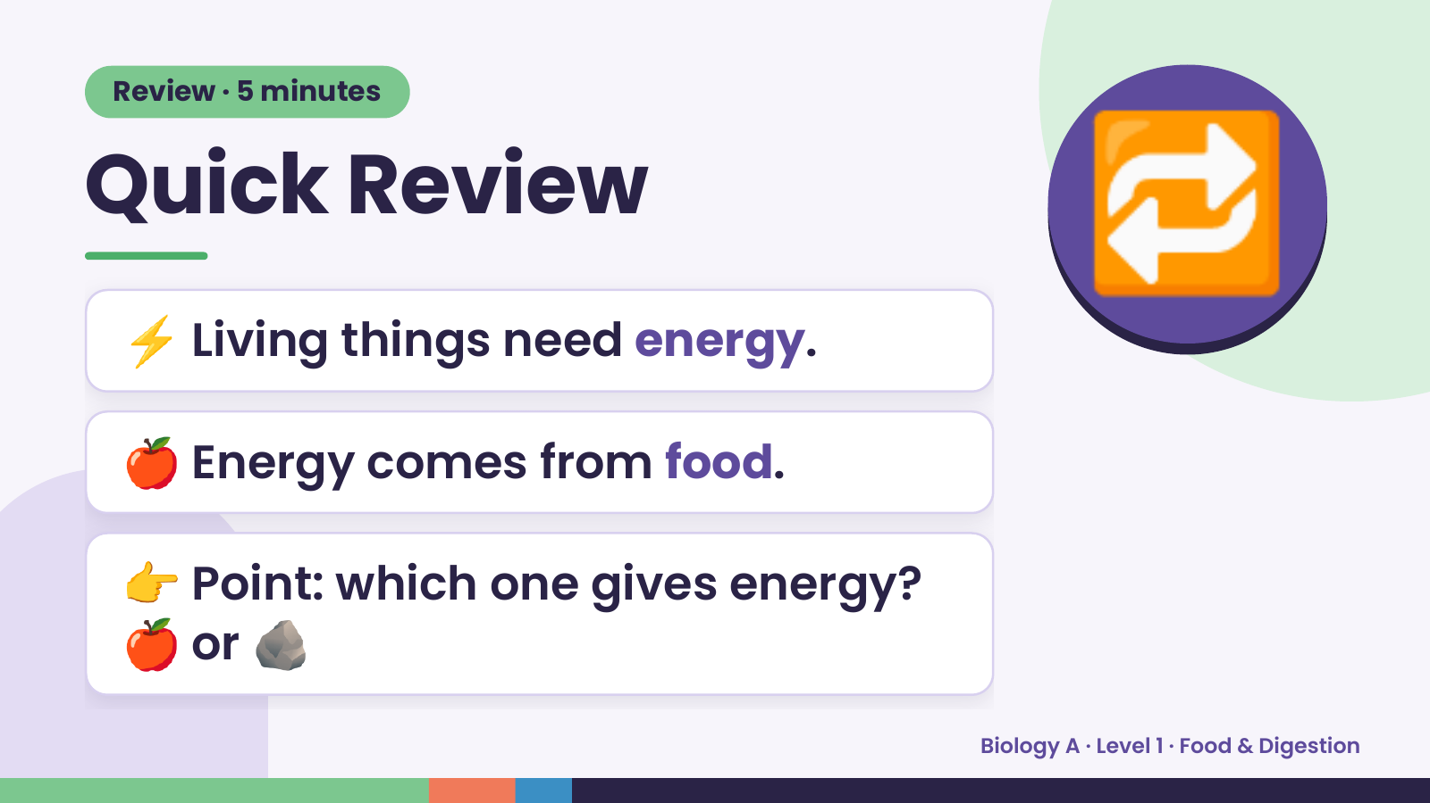
Notes:
Review · 5 minutes
Quick Review
⚡ Living things need energy.
🔁
🍎 Energy comes from food.
👉 Point: which one gives energy?
🍎 or 🪨
Biology A · Level 1 · Food & Digestion

Slide 3
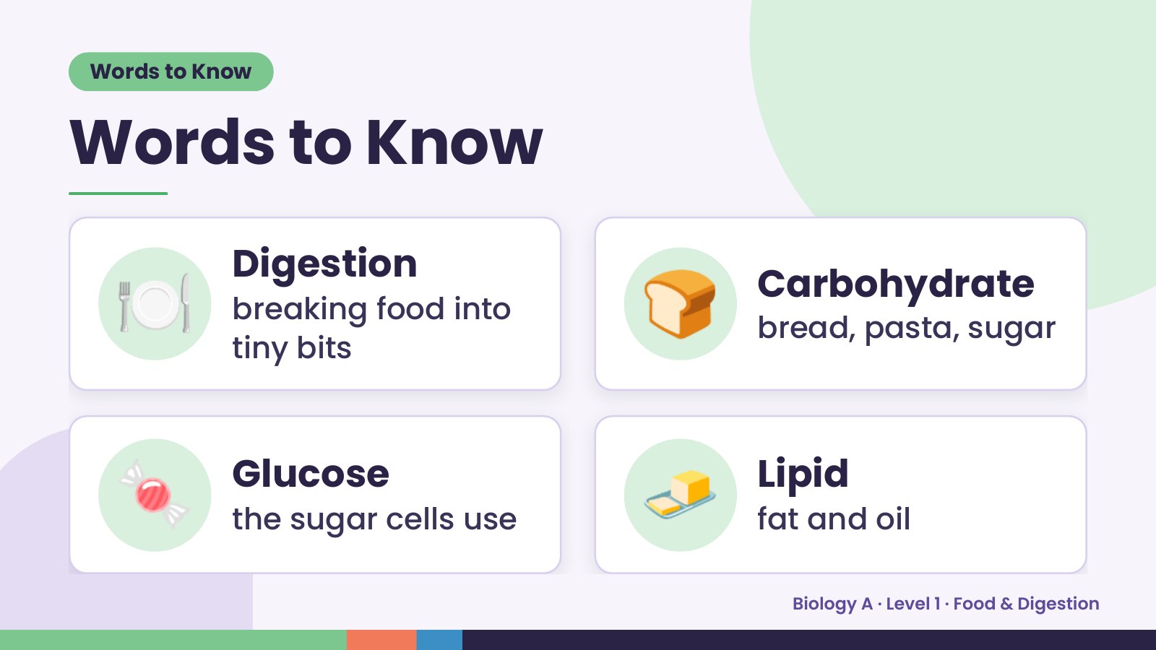
Notes:
Words to Know
Words to Know
🍽️ Digestion
breaking food into
tiny bits
🍞 Carbohydrate
bread, pasta, sugar
🍬 Glucose
the sugar cells use 🧈 Lipid
fat and oil
Biology A · Level 1 · Food & Digestion

Slide 4
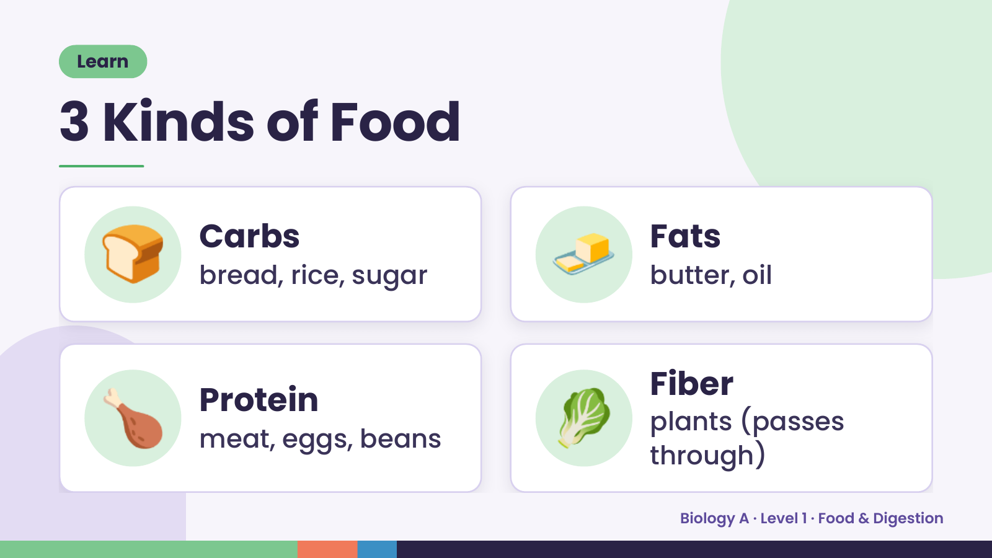
Notes:
Learn
3 Kinds of Food
🍞 Carbs
bread, rice, sugar 🧈 Fats
butter, oil
🍗 Protein
meat, eggs, beans 🥬 Fiber
plants (passes
through)
Biology A · Level 1 · Food & Digestion

Slide 5
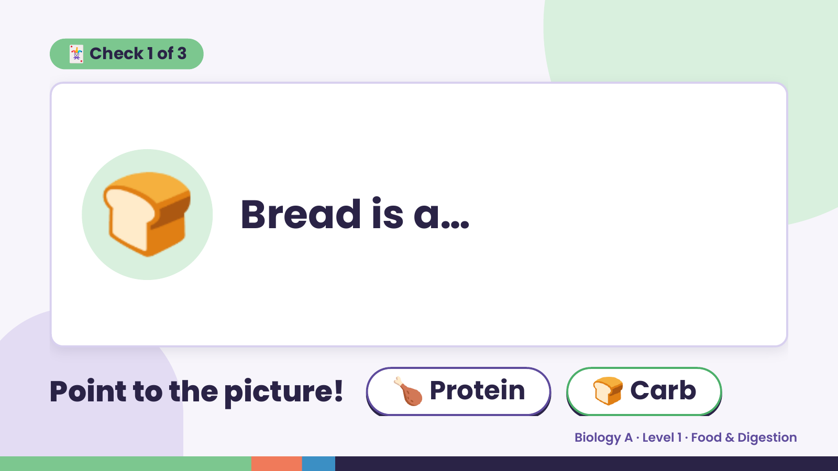
Notes:
🃏 Check 1 of 3
🍞 Bread is a…
Point to the picture! 🍗 Protein 🍞 Carb
Biology A · Level 1 · Food & Digestion

Slide 6
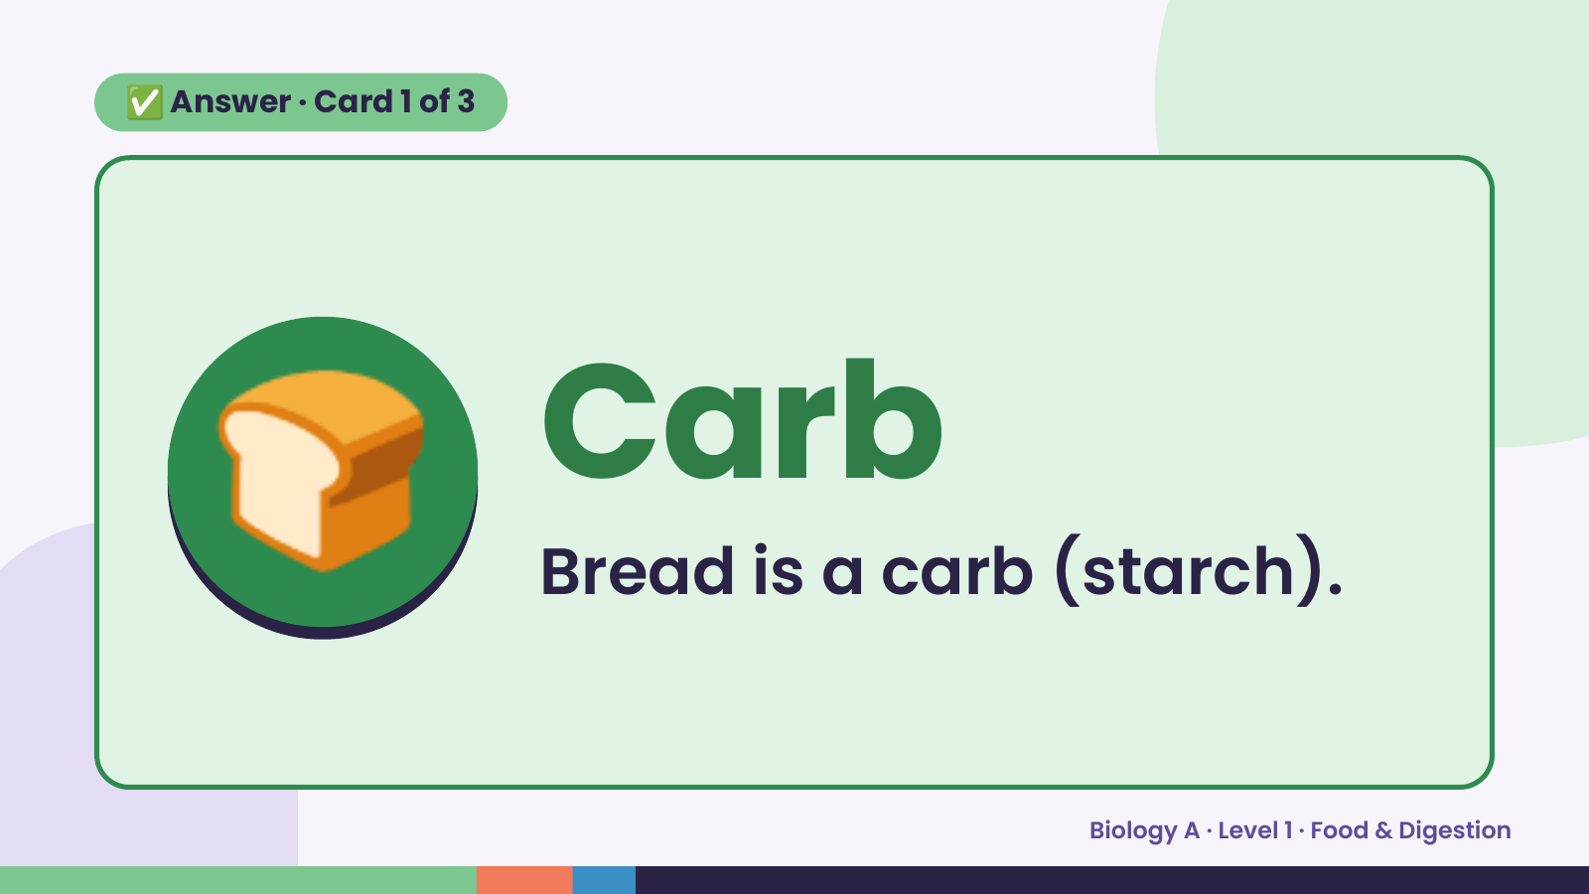
Notes:
✅ Answer · Card 1 of 3
🍞 Carb
Bread is a carb (starch).
Biology A · Level 1 · Food & Digestion

Slide 7
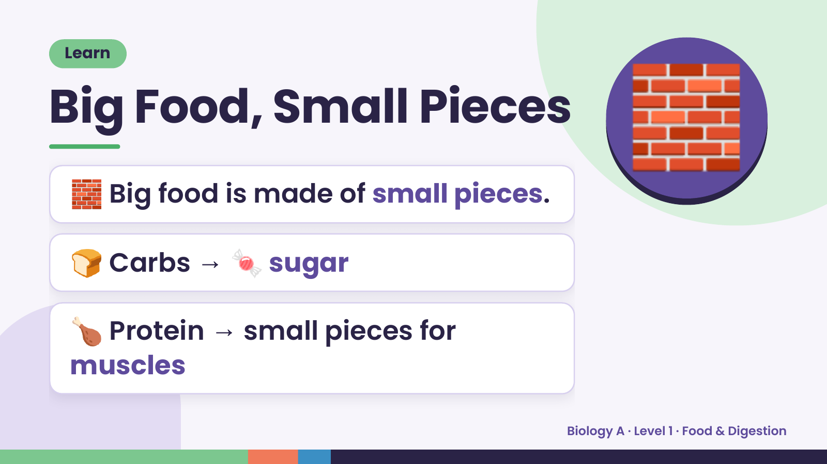
Notes:
Learn
Big Food, Small Pieces
🧱 Big food is made of small pieces.
🧱
🍞 Carbs → 🍬 sugar
🍗 Protein → small pieces for
muscles
Biology A · Level 1 · Food & Digestion

Slide 8
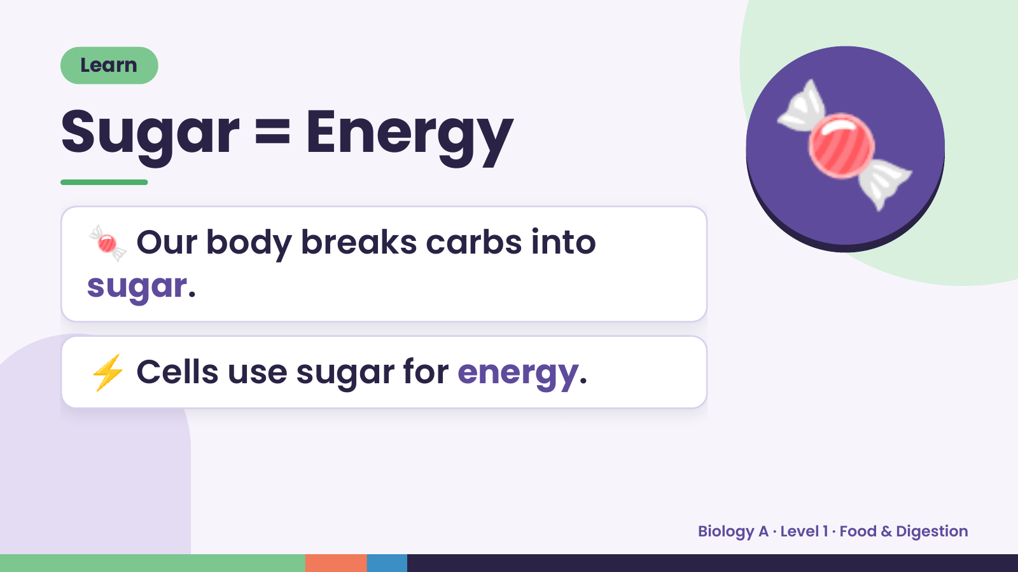
Notes:
Learn
Sugar = Energy
🍬 Our body breaks carbs into
sugar.
🍬
⚡ Cells use sugar for energy.
Biology A · Level 1 · Food & Digestion

Slide 9
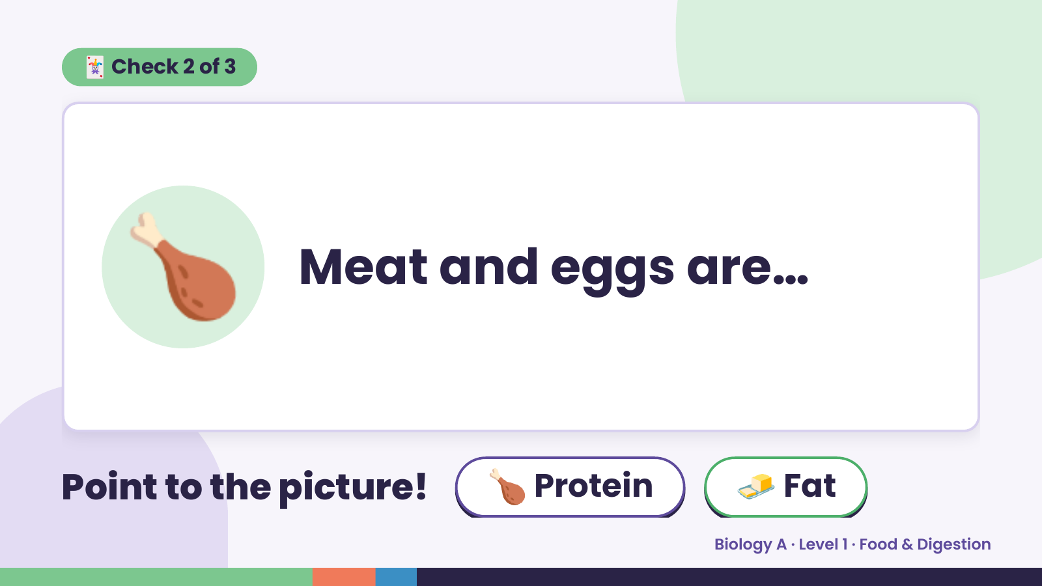
Notes:
🃏 Check 2 of 3
🍗 Meat and eggs are…
Point to the picture! 🍗 Protein 🧈 Fat
Biology A · Level 1 · Food & Digestion

Slide 10
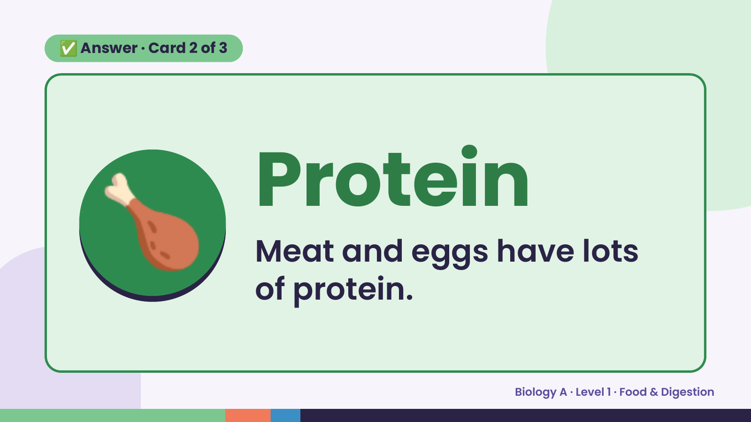
Notes:
✅ Answer · Card 2 of 3
🍗 Protein
Meat and eggs have lots
of protein.
Biology A · Level 1 · Food & Digestion

Slide 11
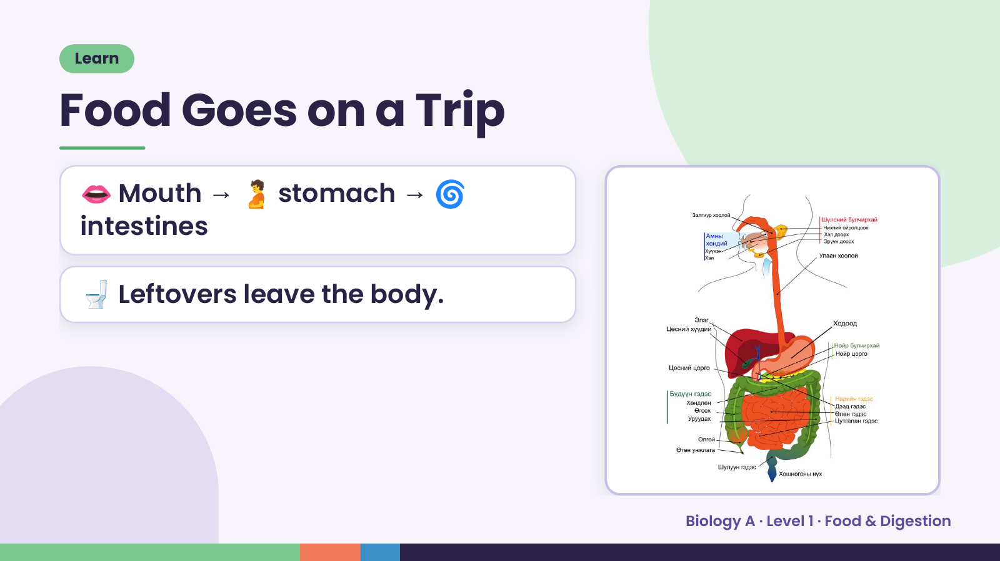
Notes:
Learn
Food Goes on a Trip
👄 Mouth → 🫄 stomach → 🌀
intestines
🚽 Leftovers leave the body.
Biology A · Level 1 · Food & Digestion

Slide 12
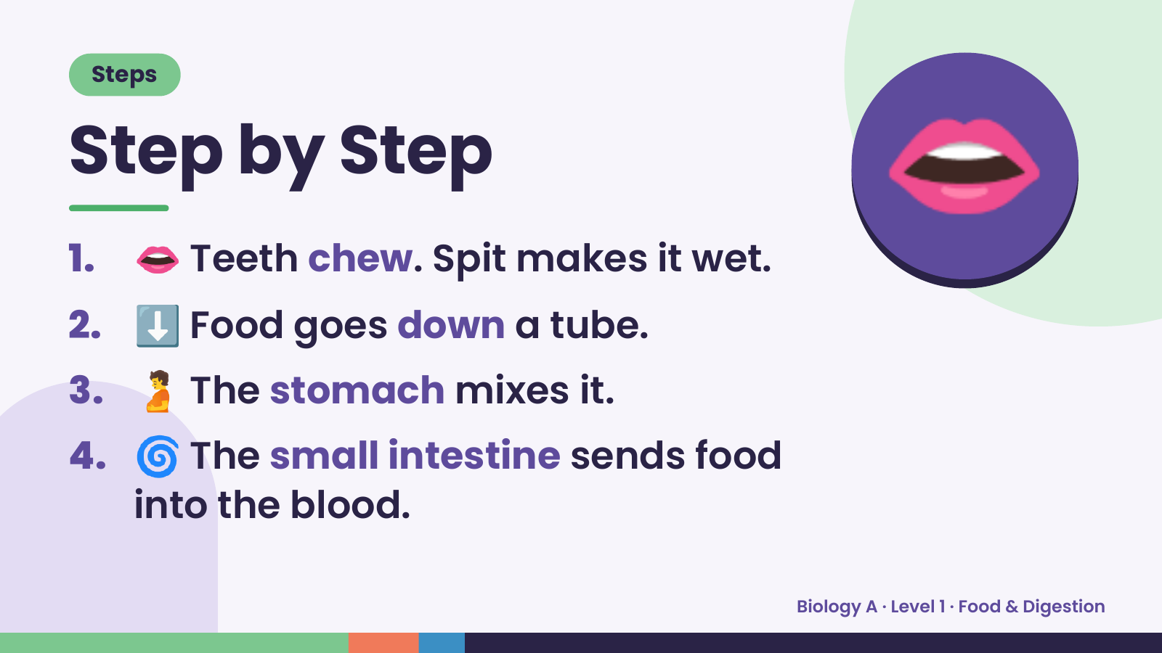
Notes:
Steps
Step by Step
1. 👄 Teeth chew. Spit makes it wet.
2. ⬇️ Food goes down a tube.
👄
3. 🫄 The stomach mixes it.
4. 🌀 The small intestine sends food
into the blood.
Biology A · Level 1 · Food & Digestion

Slide 13
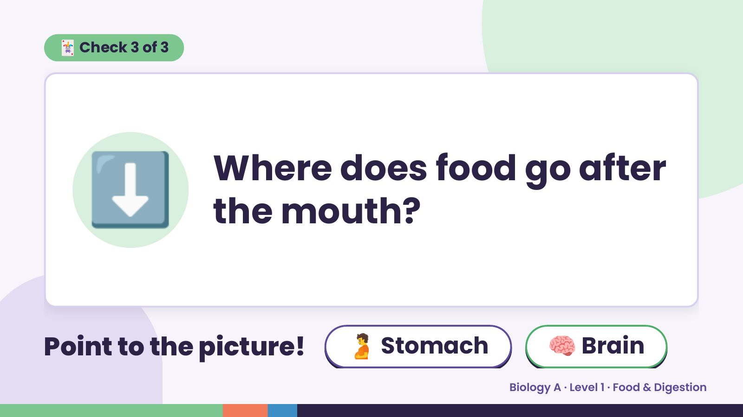
Notes:
🃏 Check 3 of 3
⬇️ Where does food go after
the mouth?
Point to the picture! 🫄 Stomach 🧠 Brain
Biology A · Level 1 · Food & Digestion

Slide 14
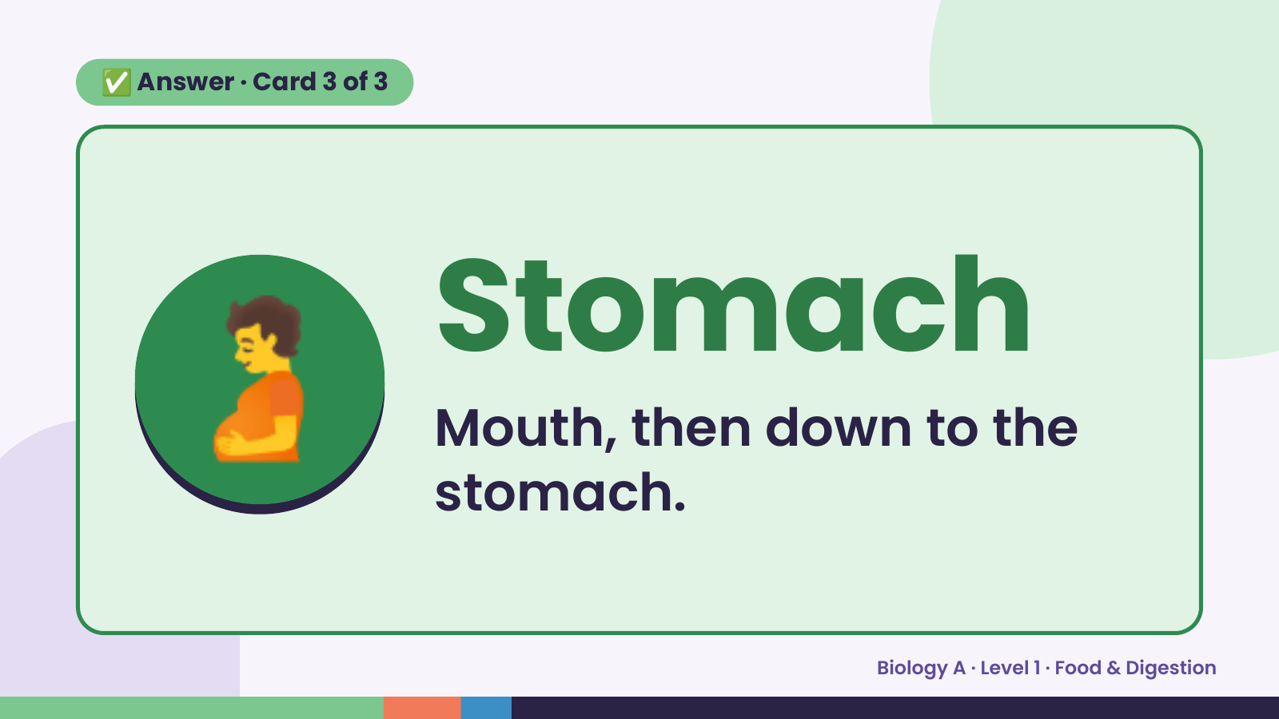
Notes:
✅ Answer · Card 3 of 3
🫄 Stomach
Mouth, then down to the
stomach.
Biology A · Level 1 · Food & Digestion

Slide 15
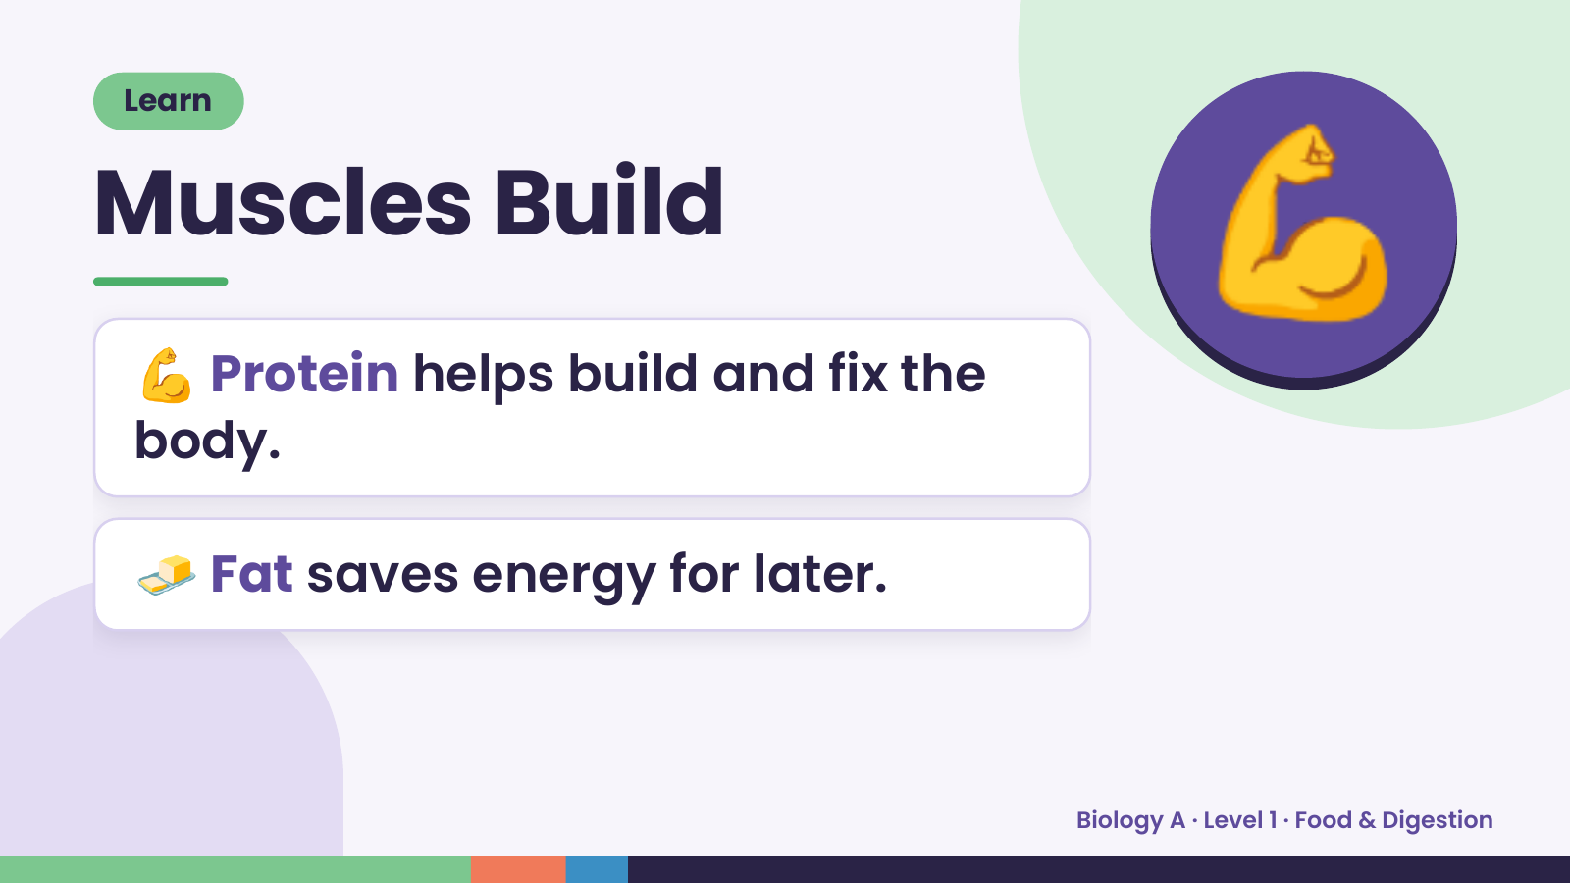
Notes:
Learn
Muscles Build
💪 Protein helps build and fix the
body.
💪
🧈 Fat saves energy for later.
Biology A · Level 1 · Food & Digestion

Slide 16
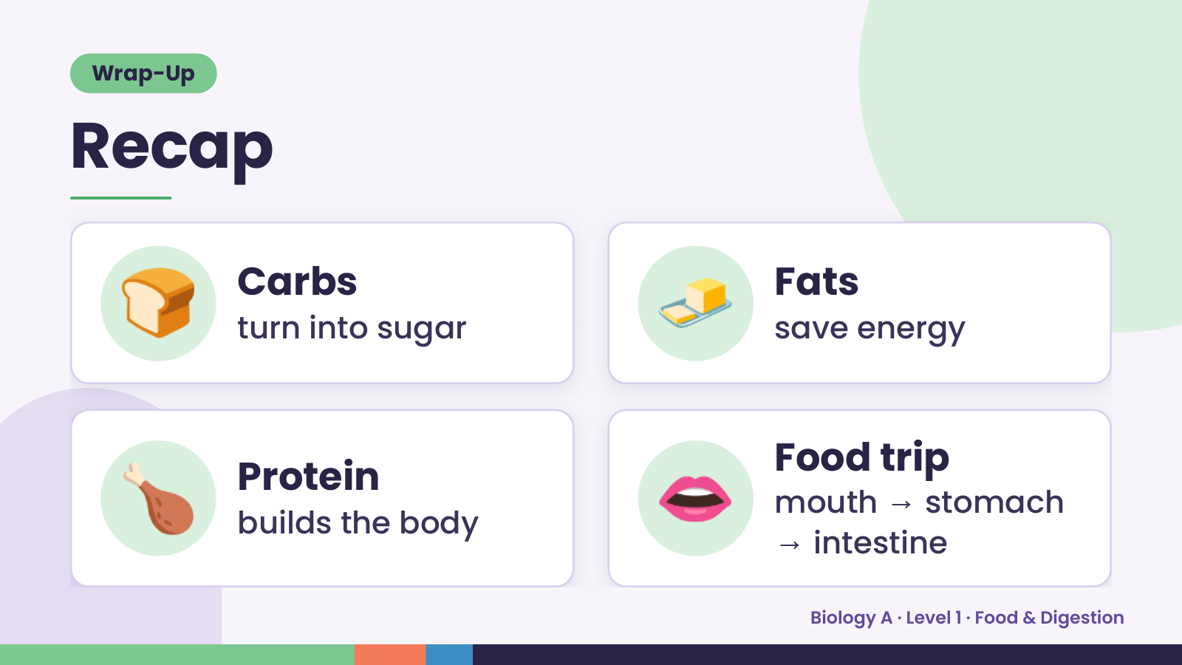
Notes:
Wrap-Up
Recap
🍞 Carbs
turn into sugar 🧈 Fats
save energy
🍗 Protein
builds the body 👄 Food trip
mouth → stomach
→ intestine
Biology A · Level 1 · Food & Digestion

Slide 17
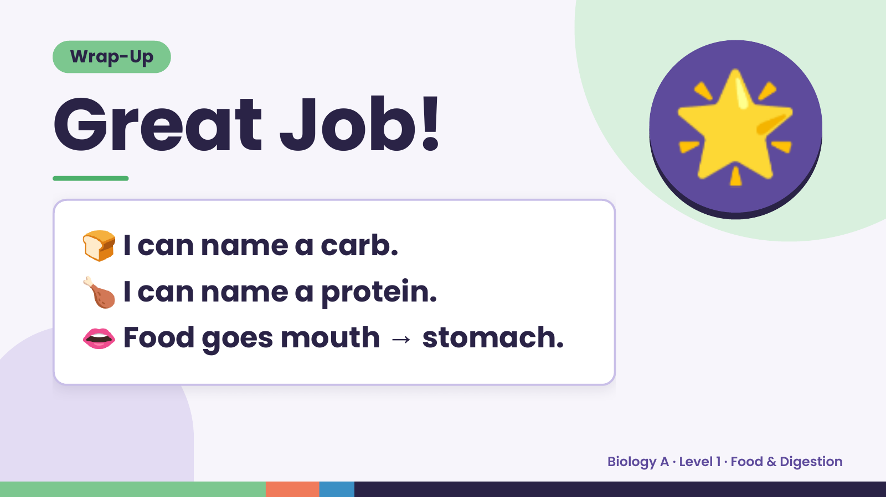
Notes:
Wrap-Up
Great Job!
🍞 I can name a carb.
🌟
🍗 I can name a protein.
👄 →
Food goes mouth stomach.
Biology A · Level 1 · Food & Digestion

