Slide 1
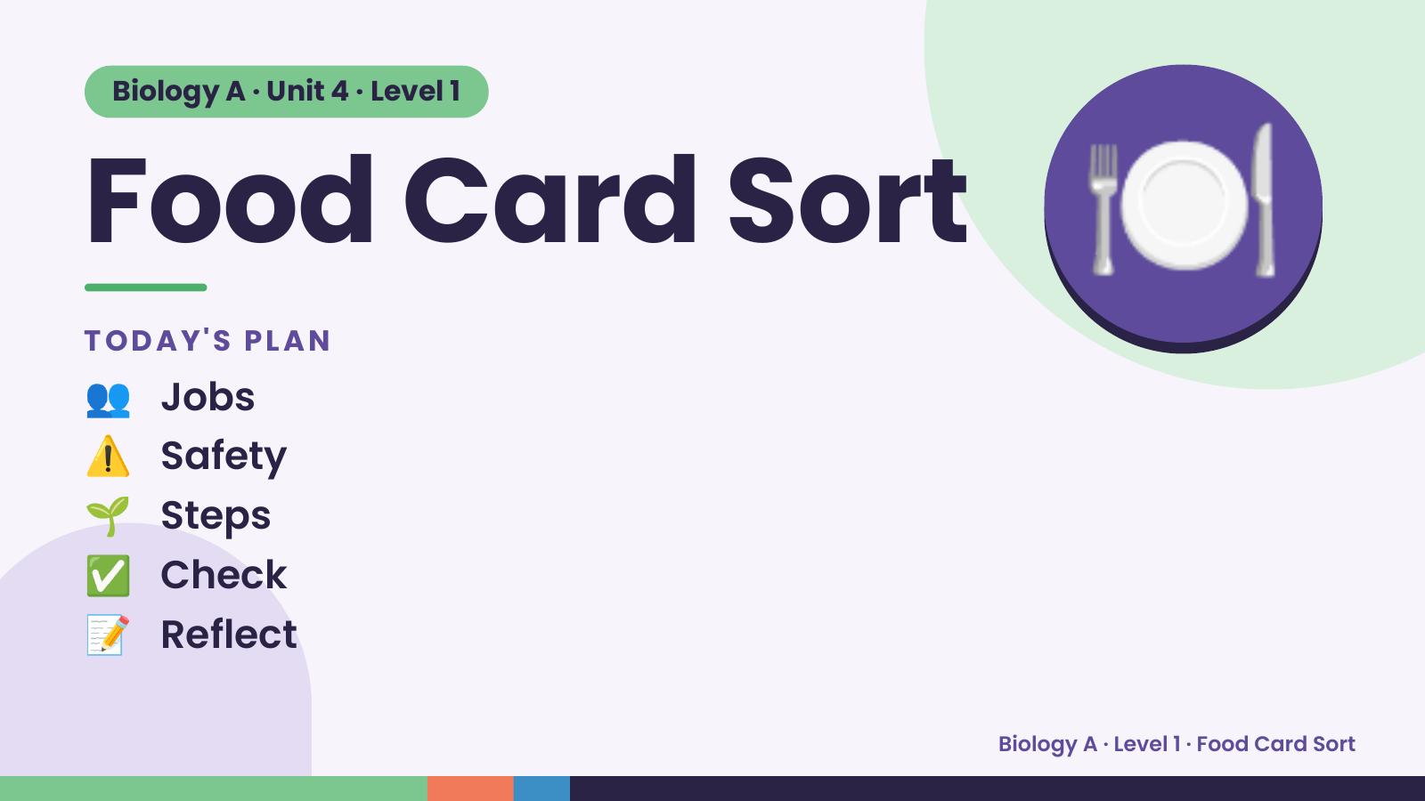
Notes:
Biology A · Unit 4 · Level 1
Food Card Sort
TODAY'S PLAN
👥 Jobs
🍽️
⚠️ Safety
🌱 Steps
✅ Check
📝 Reflect
Biology A · Level 1 · Food Card Sort

Slide 2
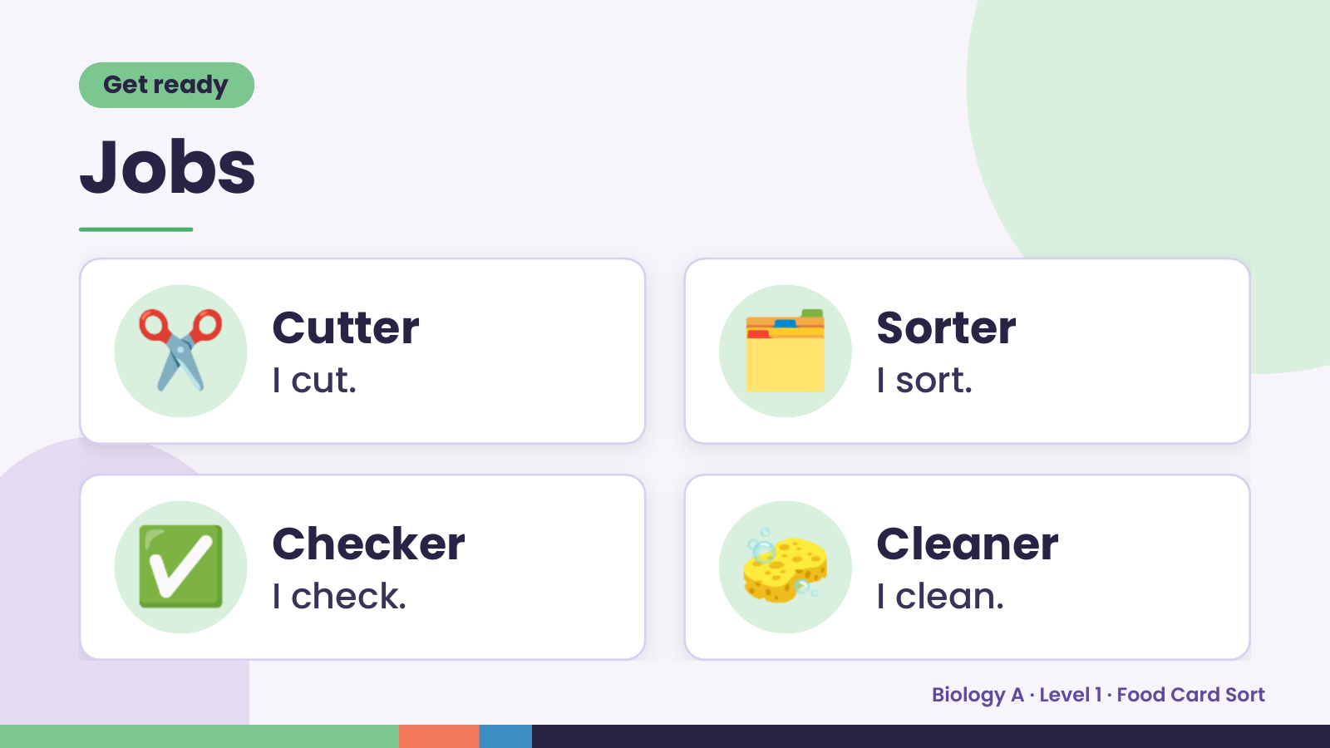
Notes:
Get ready
Jobs
✂️ Cutter
I cut. 🗂️ Sorter
I sort.
✅ Checker
I check. 🧽 Cleaner
I clean.
Biology A · Level 1 · Food Card Sort

Slide 3
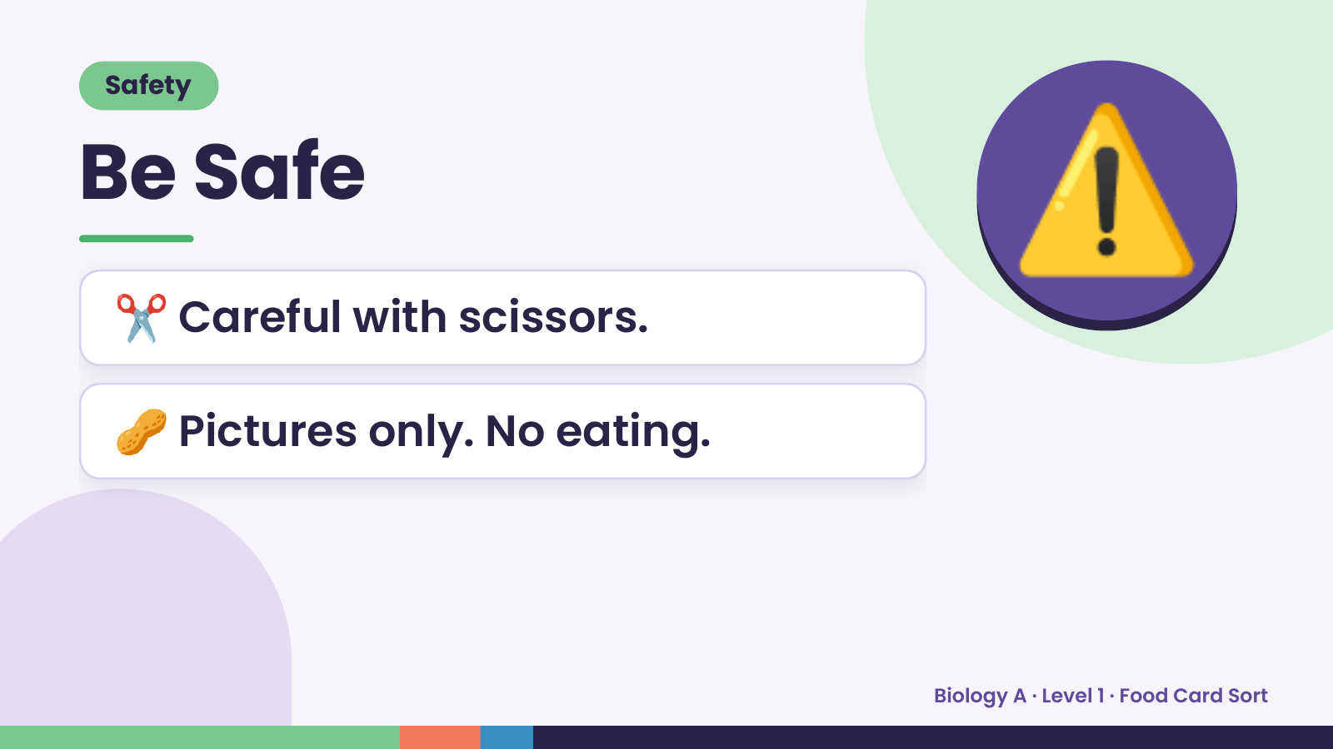
Notes:
Safety
Be Safe
✂️ Careful with scissors.
⚠️
🥜 Pictures only. No eating.
Biology A · Level 1 · Food Card Sort

Slide 4
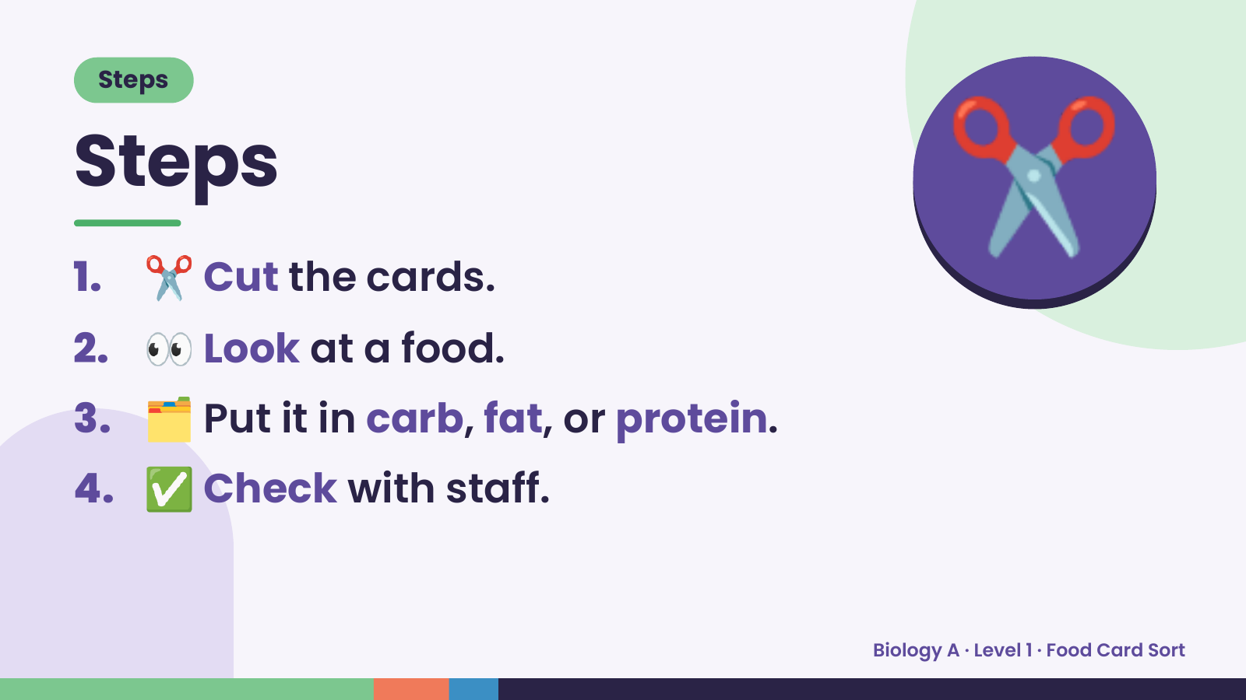
Notes:
Steps
Steps
1. ✂️ Cut the cards.
2. 👀 Look at a food.
✂️
3. 🗂️ Put it in carb, fat, or protein.
4. ✅ Check with staff.
Biology A · Level 1 · Food Card Sort

Slide 5
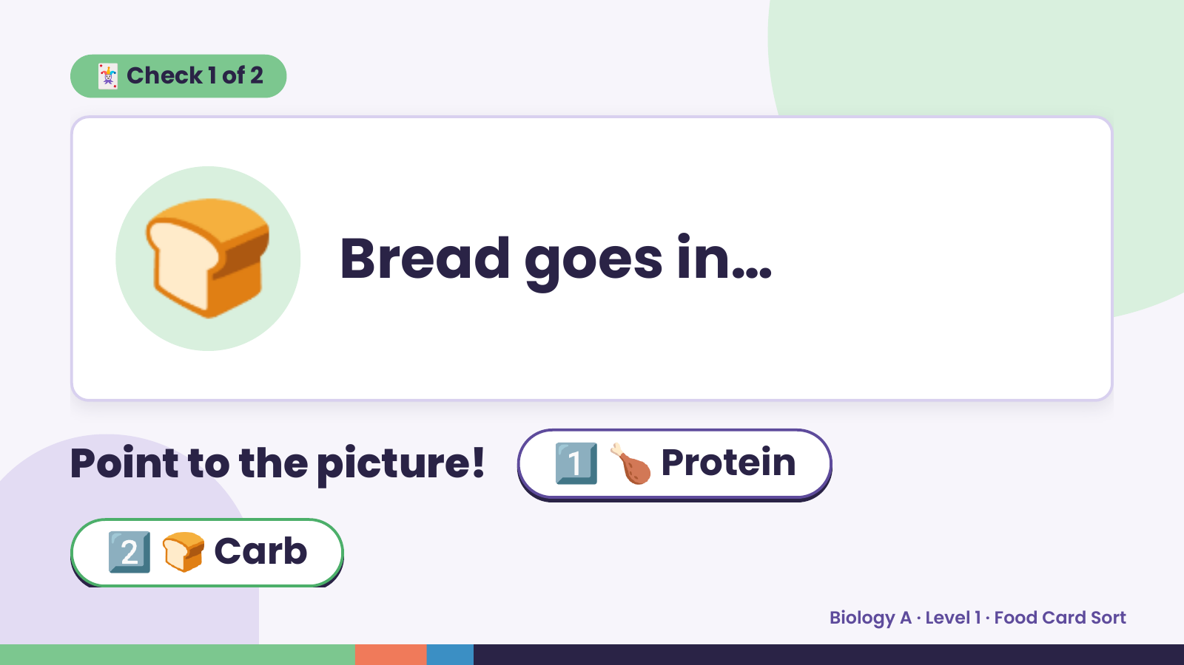
Notes:
🃏 Check 1 of 2
🍞 Bread goes in…
Point to the picture! 1️⃣ 🍗 Protein
2️⃣ 🍞 Carb
Biology A · Level 1 · Food Card Sort

Slide 6
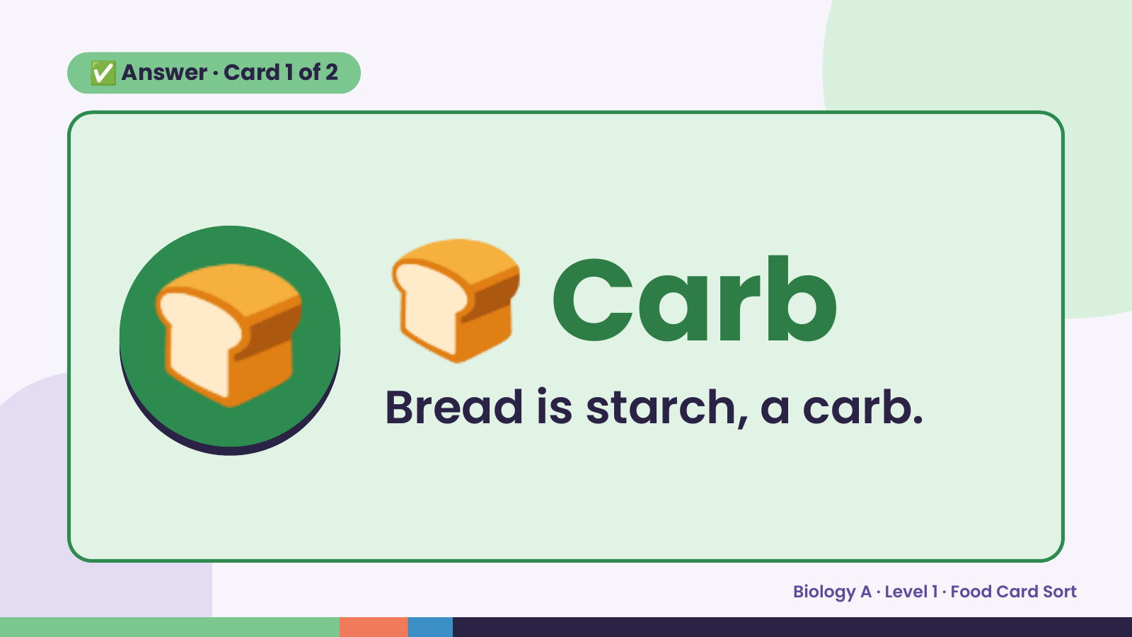
Notes:
✅ Answer · Card 1 of 2
🍞 🍞 Carb
Bread is starch, a carb.
Biology A · Level 1 · Food Card Sort

Slide 7
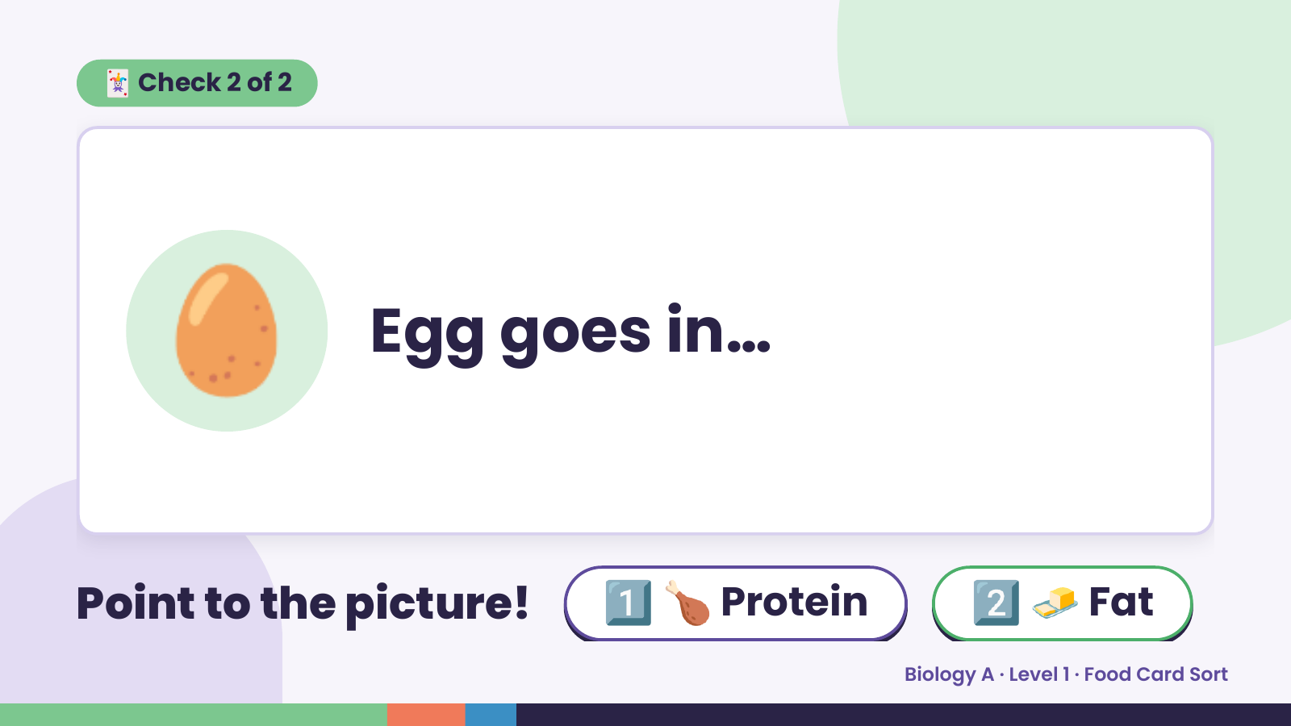
Notes:
🃏 Check 2 of 2
🥚 Egg goes in…
Point to the picture! 1️⃣ 🍗 Protein 2️⃣ 🧈 Fat
Biology A · Level 1 · Food Card Sort

Slide 8
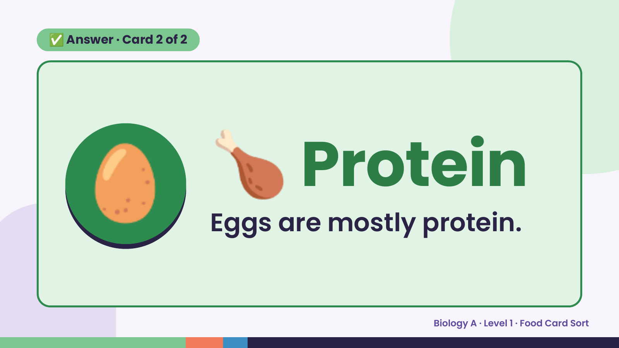
Notes:
✅ Answer · Card 2 of 2
🥚 🍗 Protein
Eggs are mostly protein.
Biology A · Level 1 · Food Card Sort

Slide 9
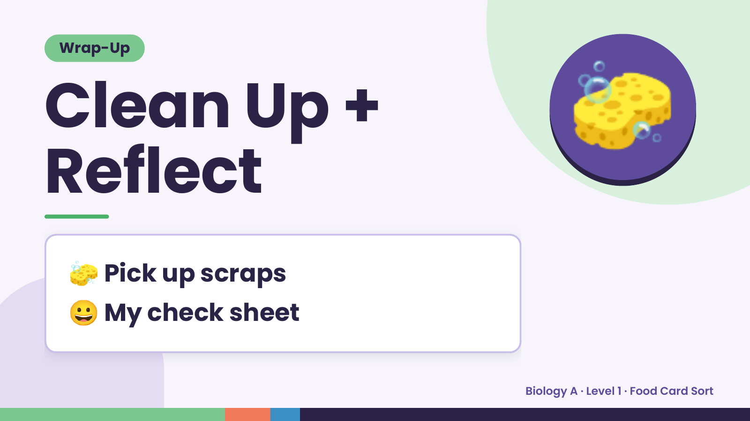
Notes:
Wrap-Up
Clean Up +
Reflect
🧽
🧽 Pick up scraps
😀 My check sheet
Biology A · Level 1 · Food Card Sort

