Slide 1
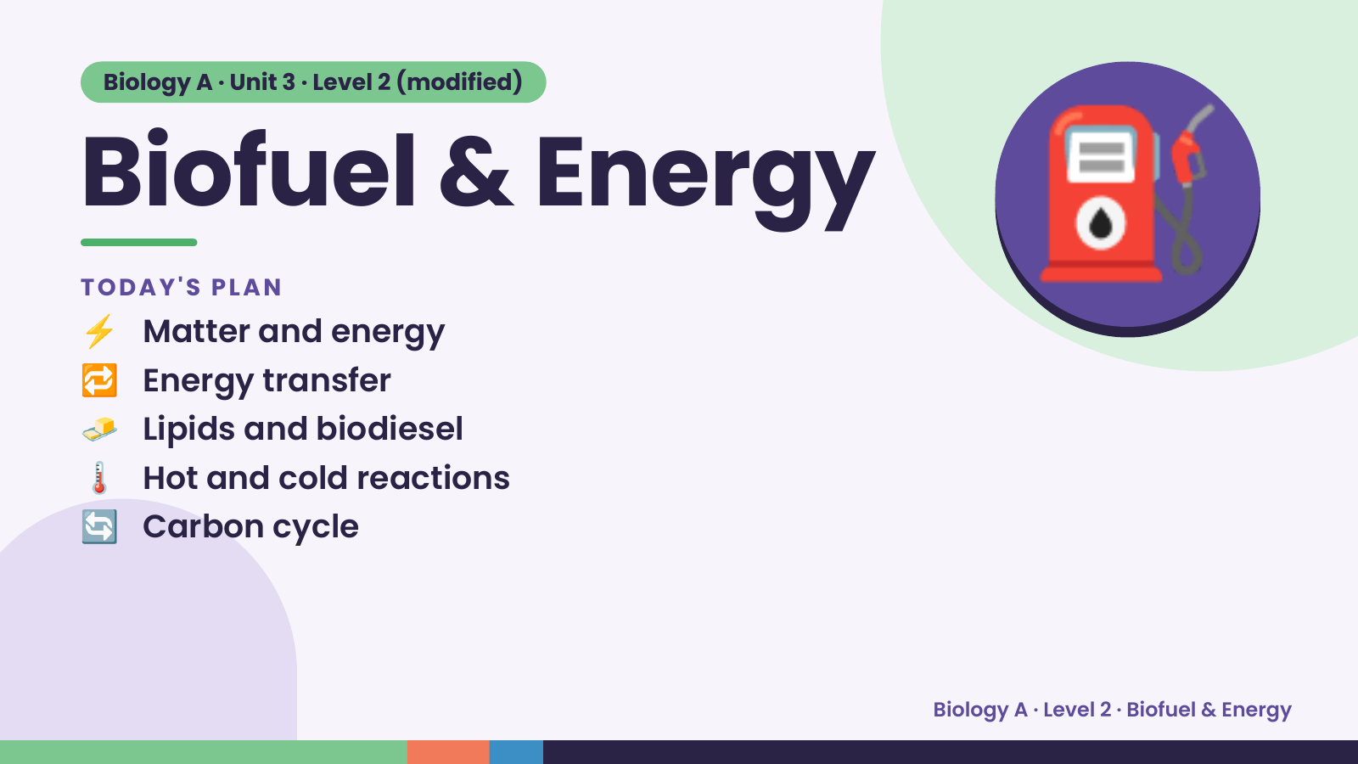
Notes:
Biology A · Unit 3 · Level 2 (modified)
Biofuel & Energy
⚡ Matter and energy
TODAY'S PLAN
🔁 Energy transfer
🧈 Lipids and biodiesel
⛽
🌡️ Hot and cold reactions
🔄 Carbon cycle
Biology A · Level 2 · Biofuel & Energy

Slide 2
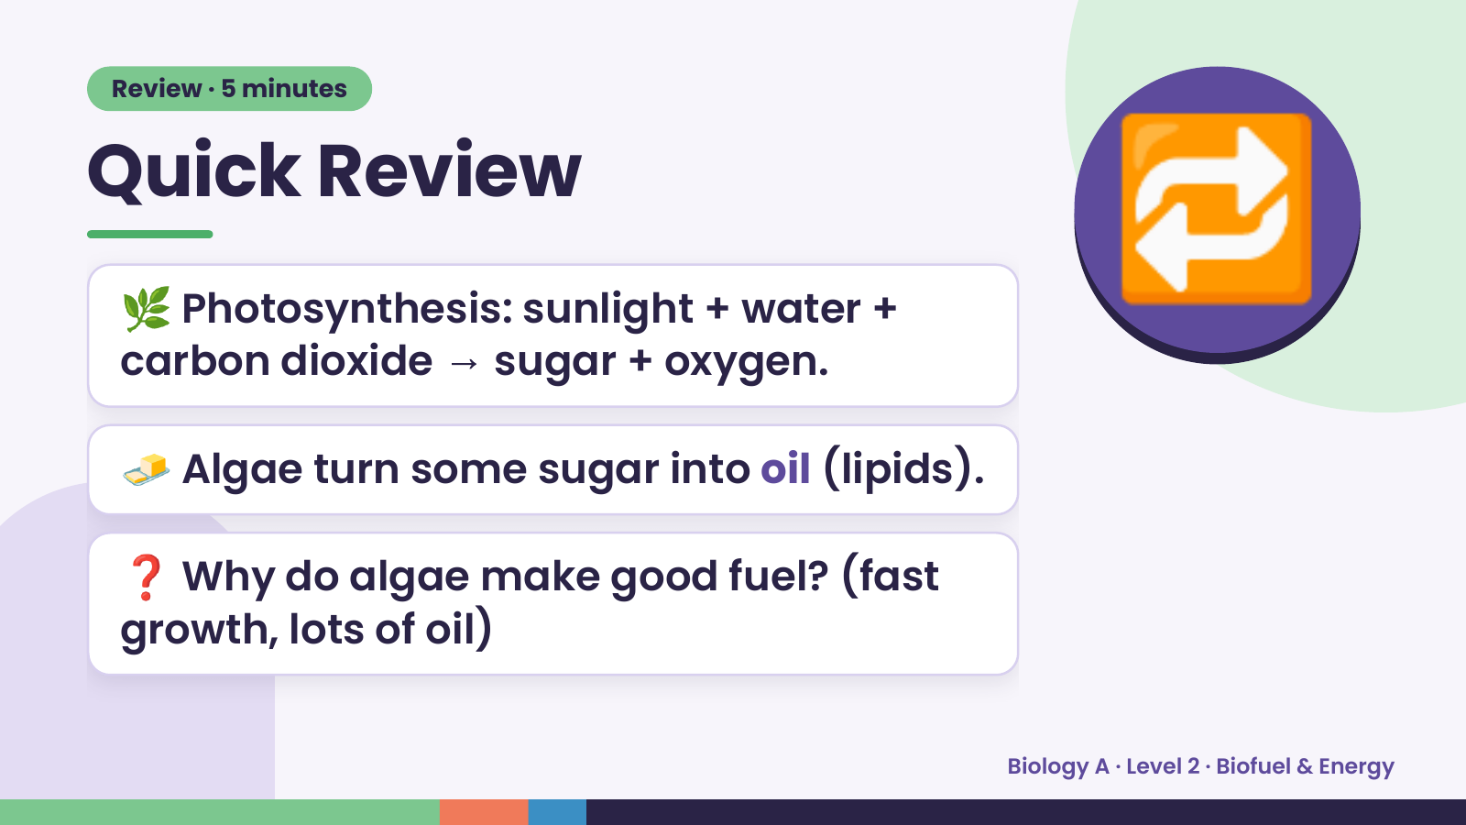
Notes:
Review · 5 minutes
Quick Review
🌿 Photosynthesis: sunlight + water +
carbon dioxide → sugar + oxygen.
🔁
🧈 Algae turn some sugar into oil (lipids).
❓ Why do algae make good fuel? (fast
growth, lots of oil)
Biology A · Level 2 · Biofuel & Energy

Slide 3
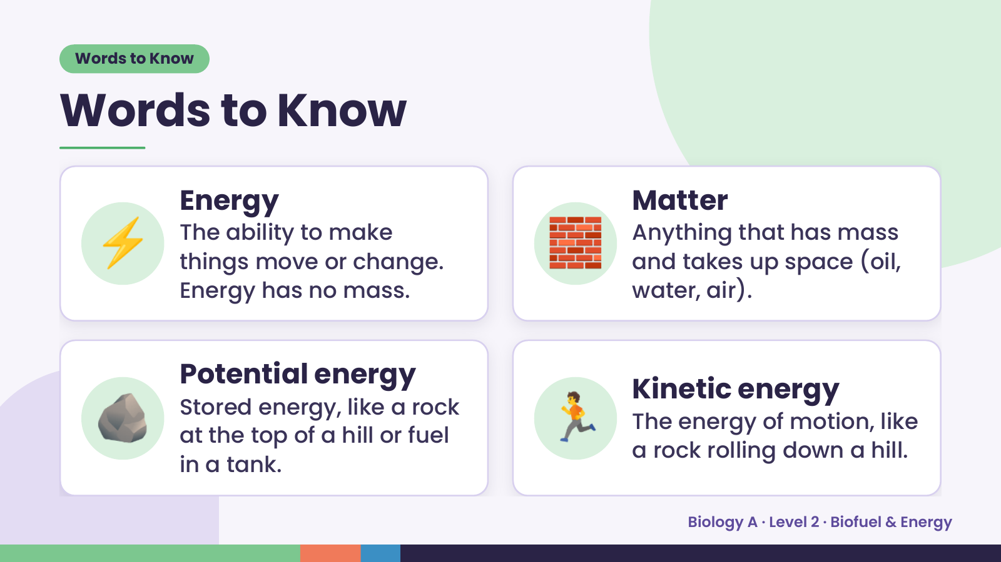
Notes:
Words to Know
Words to Know
⚡ Energy
The ability to make
things move or change.
Energy has no mass.
🧱 Matter
Anything that has mass
and takes up space (oil,
water, air).
🪨 Potential energy
Stored energy, like a rock
at the top of a hill or fuel
in a tank.
🏃 Kinetic energy
The energy of motion, like
a rock rolling down a hill.
Biology A · Level 2 · Biofuel & Energy

Slide 4
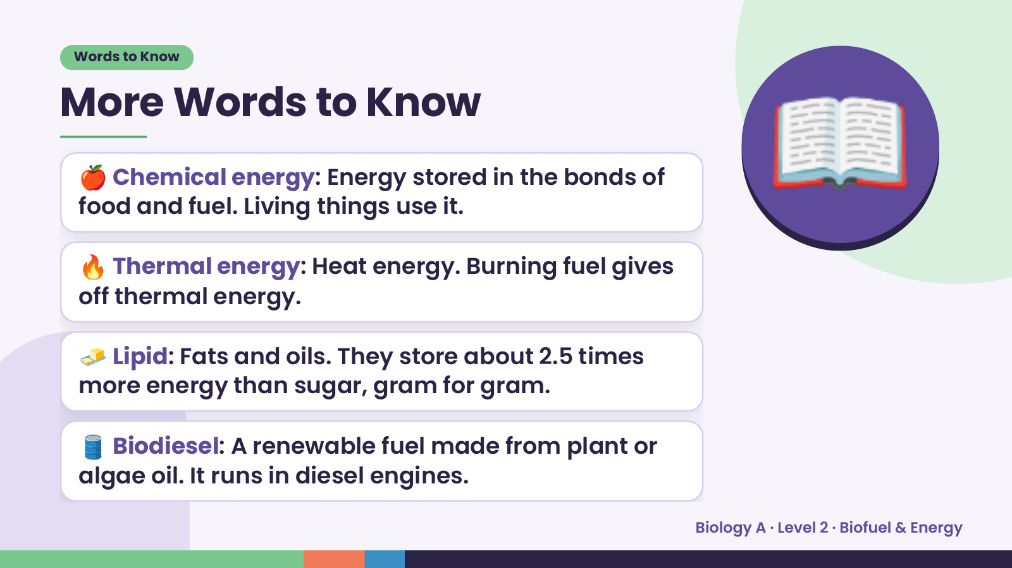
Notes:
Words to Know
More Words to Know
🍎 Chemical energy: Energy stored in the bonds of
food and fuel. Living things use it.
🔥 Thermal energy: Heat energy. Burning fuel gives
off thermal energy.
📖
🧈 Lipid: Fats and oils. They store about 2.5 times
more energy than sugar, gram for gram.
🛢️ Biodiesel: A renewable fuel made from plant or
algae oil. It runs in diesel engines.
Biology A · Level 2 · Biofuel & Energy

Slide 5
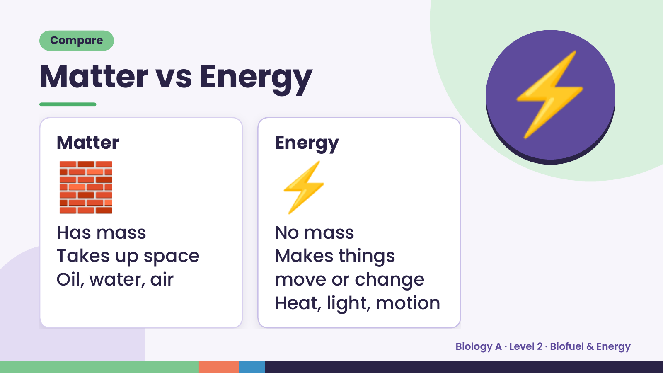
Notes:
Compare
Matter vs Energy
🧱
Matter
⚡
Energy
⚡
Has mass No mass
Takes up space Makes things
Oil, water, air move or change
Heat, light, motion
Biology A · Level 2 · Biofuel & Energy

Slide 6
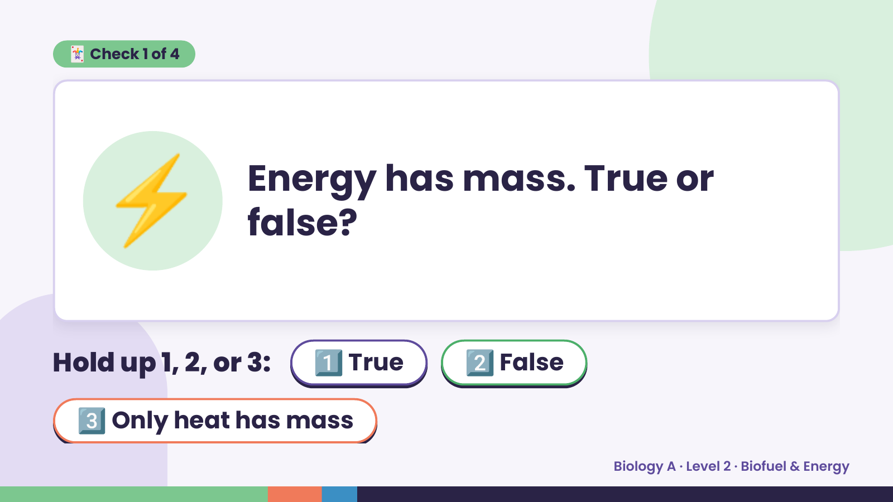
Notes:
🃏 Check 1 of 4
⚡ Energy has mass. True or
false?
Hold up 1, 2, or 3: 1️⃣ True 2️⃣ False
3️⃣ Only heat has mass
Biology A · Level 2 · Biofuel & Energy

Slide 7
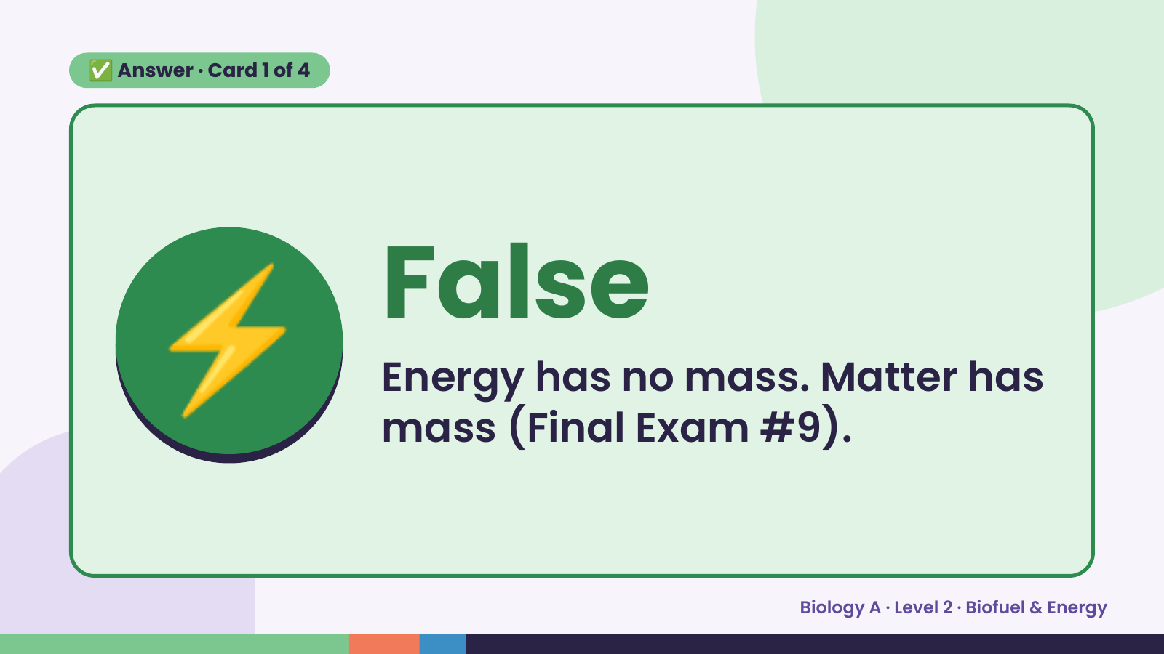
Notes:
✅ Answer · Card 1 of 4
⚡ False
Energy has no mass. Matter has
mass (Final Exam #9).
Biology A · Level 2 · Biofuel & Energy

Slide 8
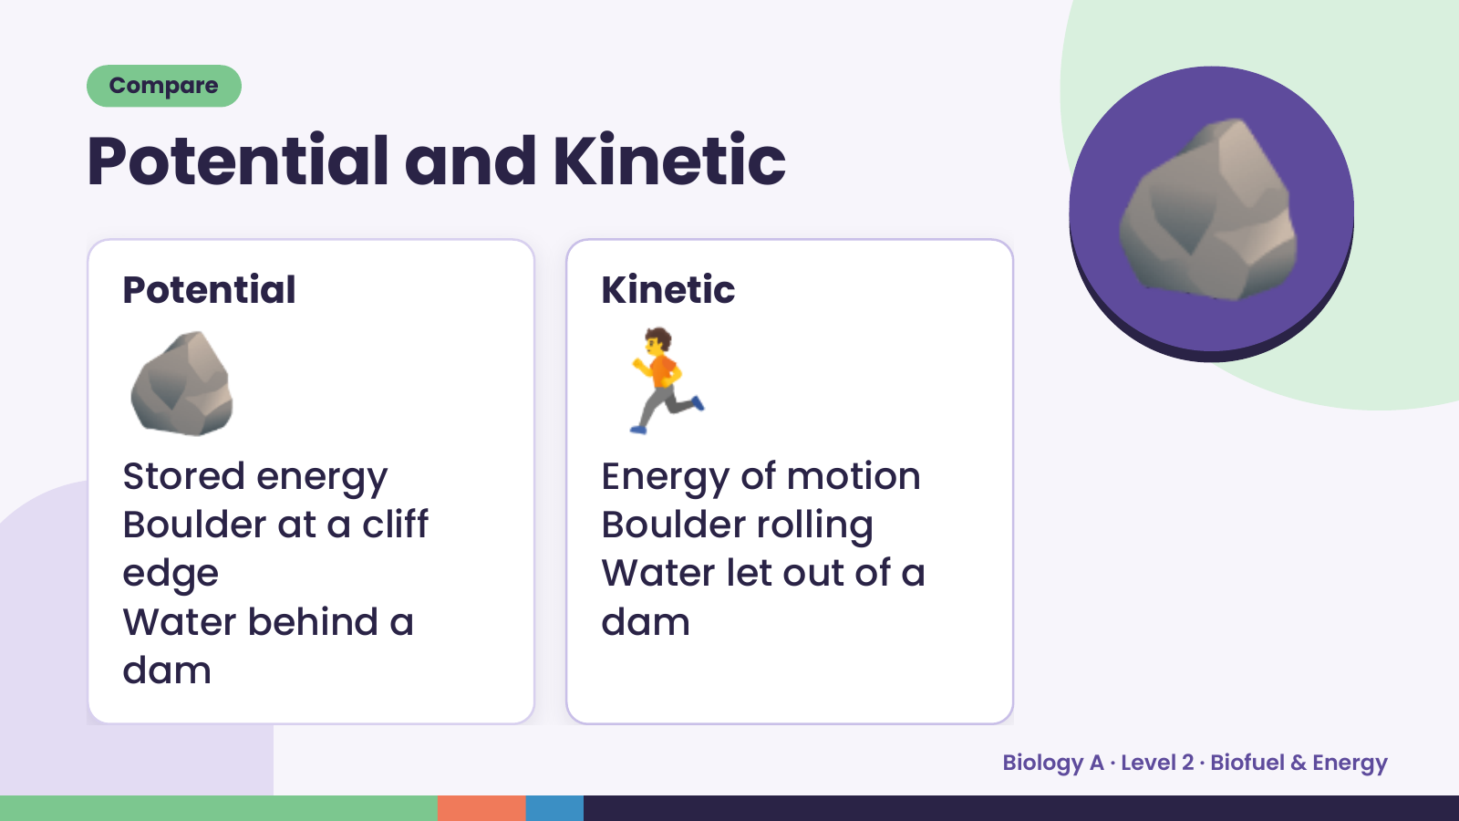
Notes:
Compare
Potential and Kinetic
🪨
Potential
🏃
Kinetic
🪨
Stored energy Energy of motion
Boulder at a cliff Boulder rolling
edge Water let out of a
Water behind a dam
dam
Biology A · Level 2 · Biofuel & Energy

Slide 9
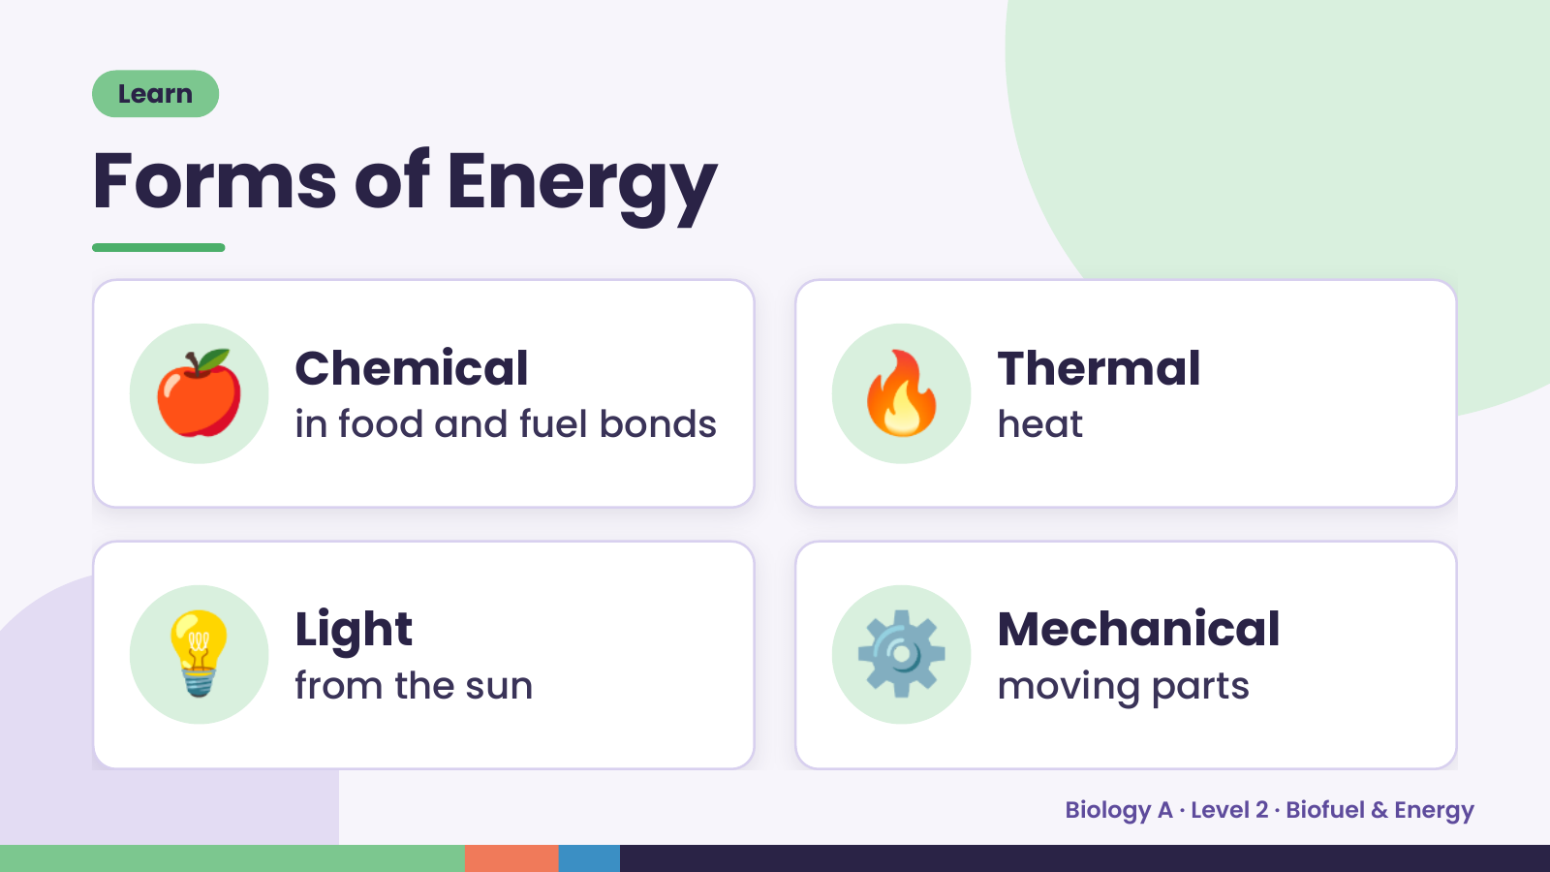
Notes:
Learn
Forms of Energy
🍎 Chemical
in food and fuel bonds 🔥 Thermal
heat
💡 Light
from the sun ⚙️ Mechanical
moving parts
Biology A · Level 2 · Biofuel & Energy

Slide 10
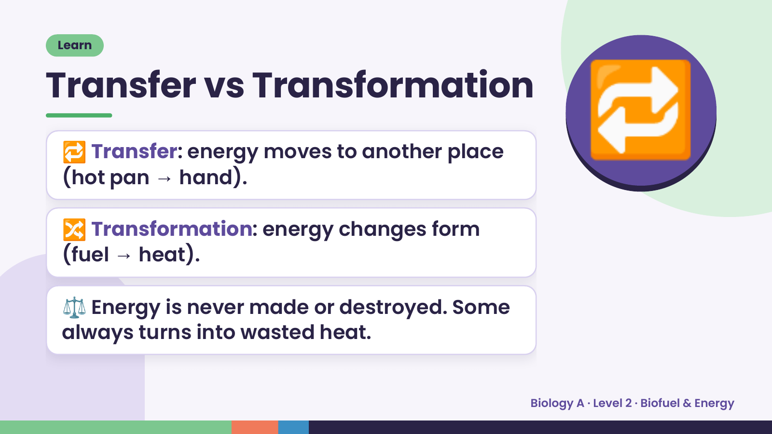
Notes:
Learn
Transfer vs Transformation
🔁 Transfer: energy moves to another place
(hot pan → hand).
🔀 Transformation: energy changes form
🔁
(fuel → heat).
⚖️ Energy is never made or destroyed. Some
always turns into wasted heat.
Biology A · Level 2 · Biofuel & Energy

Slide 11
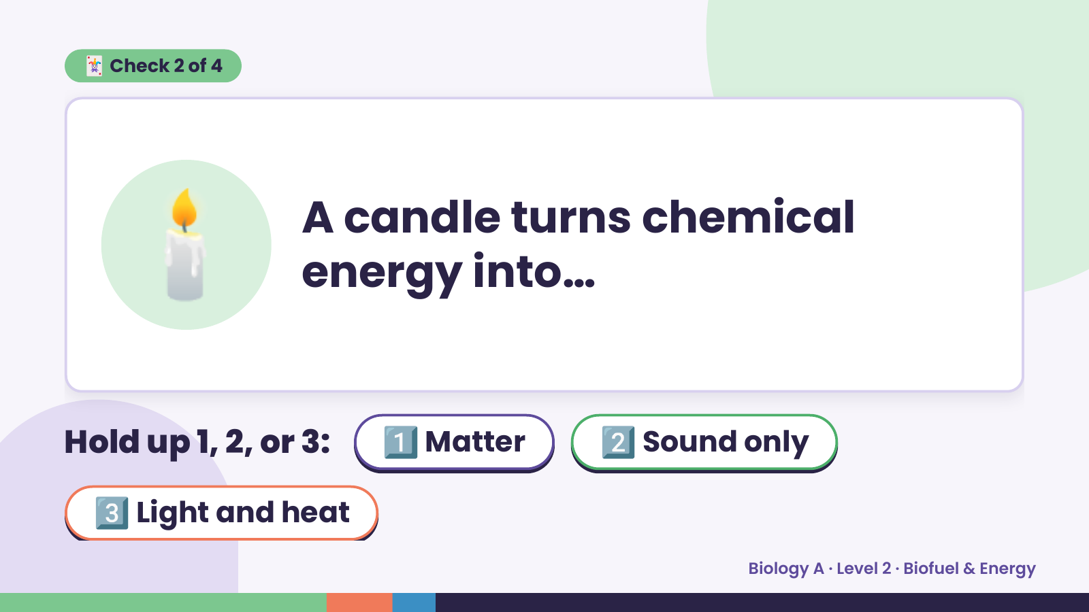
Notes:
🃏 Check 2 of 4
🕯️ A candle turns chemical
energy into…
Hold up 1, 2, or 3: 1️⃣ Matter 2️⃣ Sound only
3️⃣ Light and heat
Biology A · Level 2 · Biofuel & Energy

Slide 12
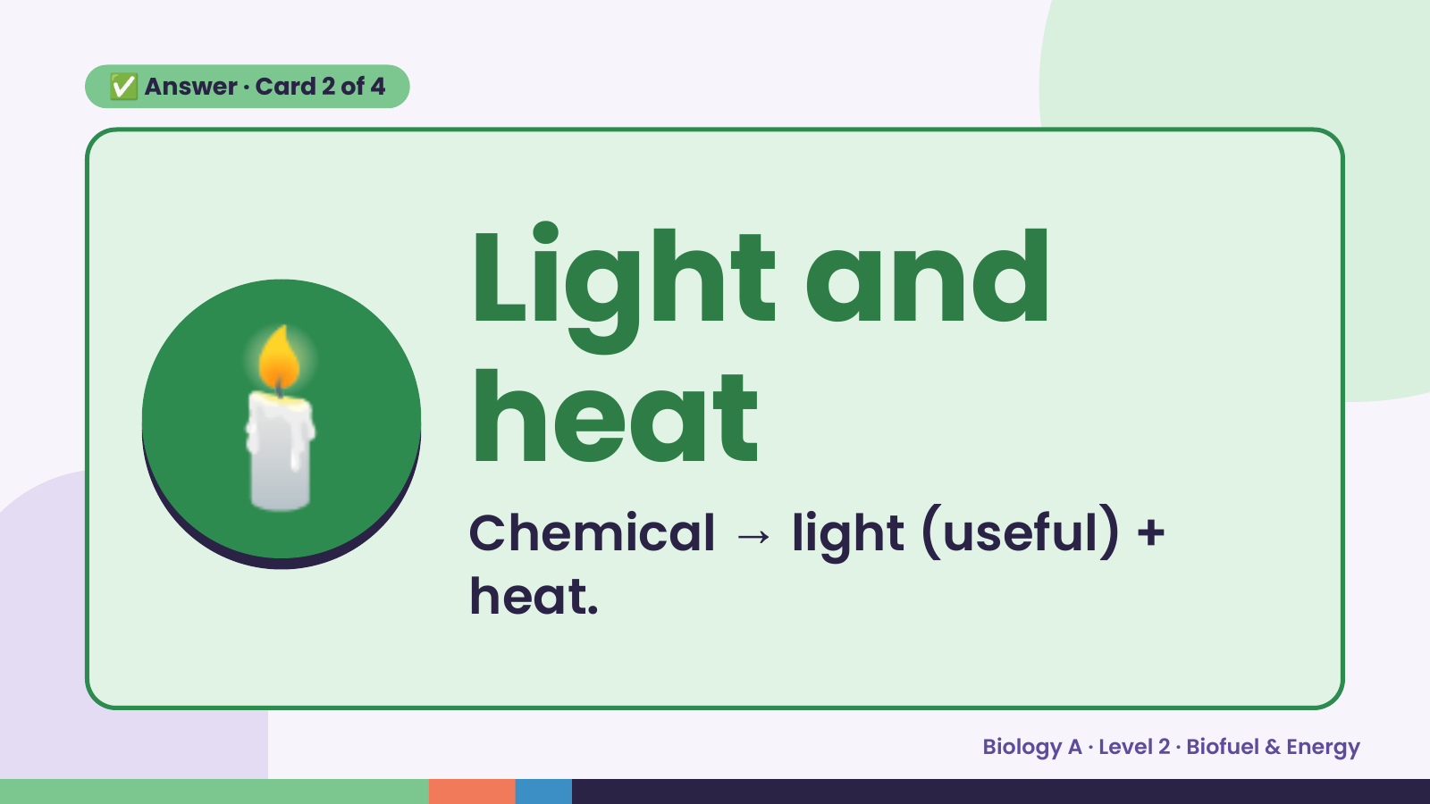
Notes:
✅ Answer · Card 2 of 4
🕯️ Light and
heat
Chemical → light (useful) +
heat.
Biology A · Level 2 · Biofuel & Energy

Slide 13
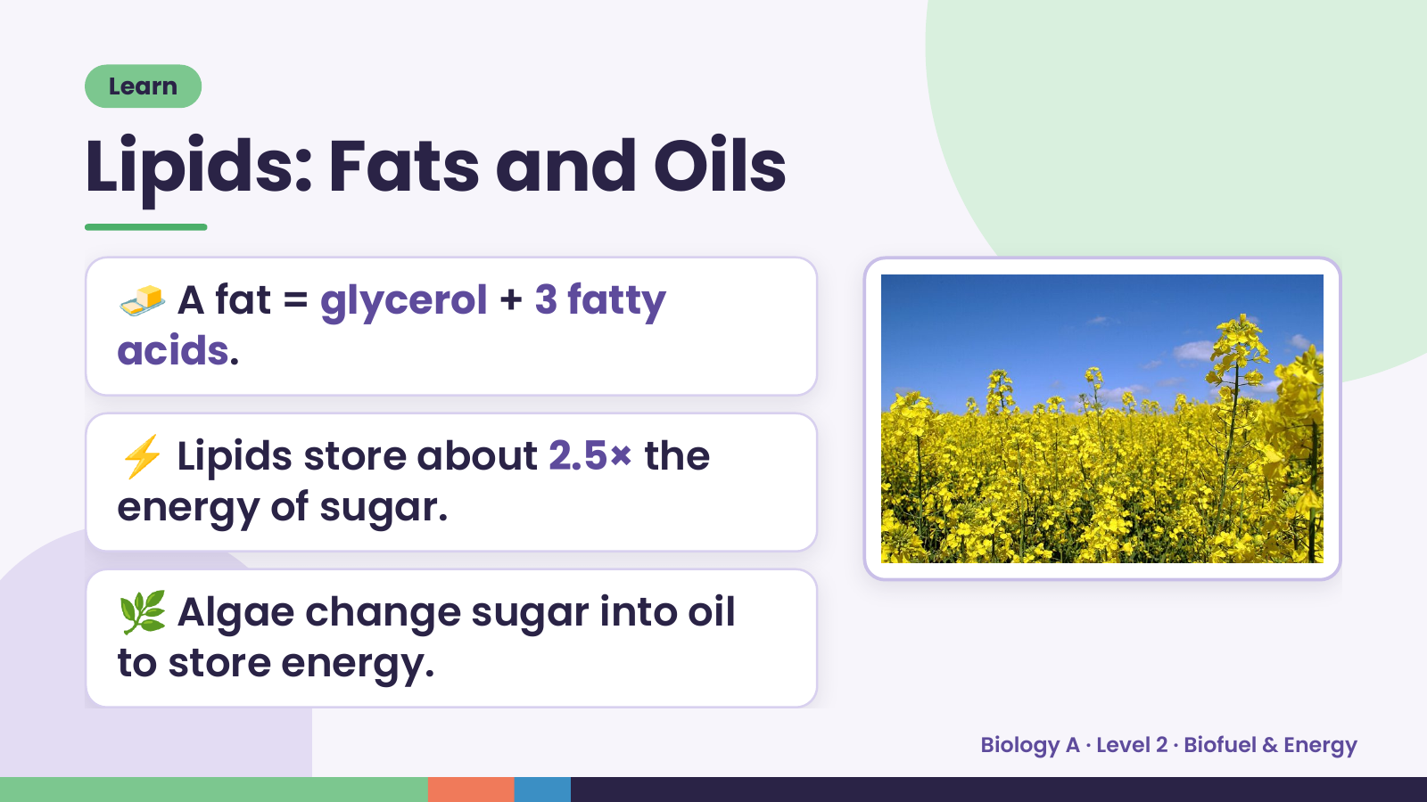
Notes:
Learn
Lipids: Fats and Oils
🧈 A fat = glycerol + 3 fatty
acids.
⚡ Lipids store about 2.5× the
energy of sugar.
🌿 Algae change sugar into oil
to store energy.
Biology A · Level 2 · Biofuel & Energy

Slide 14
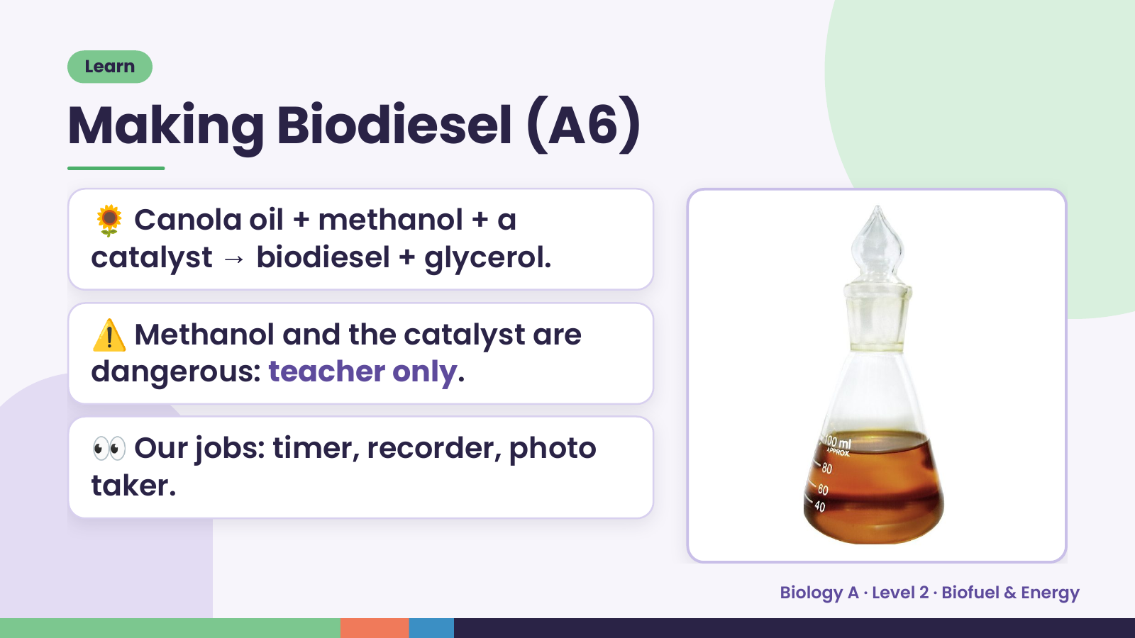
Notes:
Learn
Making Biodiesel (A6)
🌻 Canola oil + methanol + a
catalyst → biodiesel + glycerol.
⚠️ Methanol and the catalyst are
dangerous: teacher only.
👀 Our jobs: timer, recorder, photo
taker.
Biology A · Level 2 · Biofuel & Energy

Slide 15
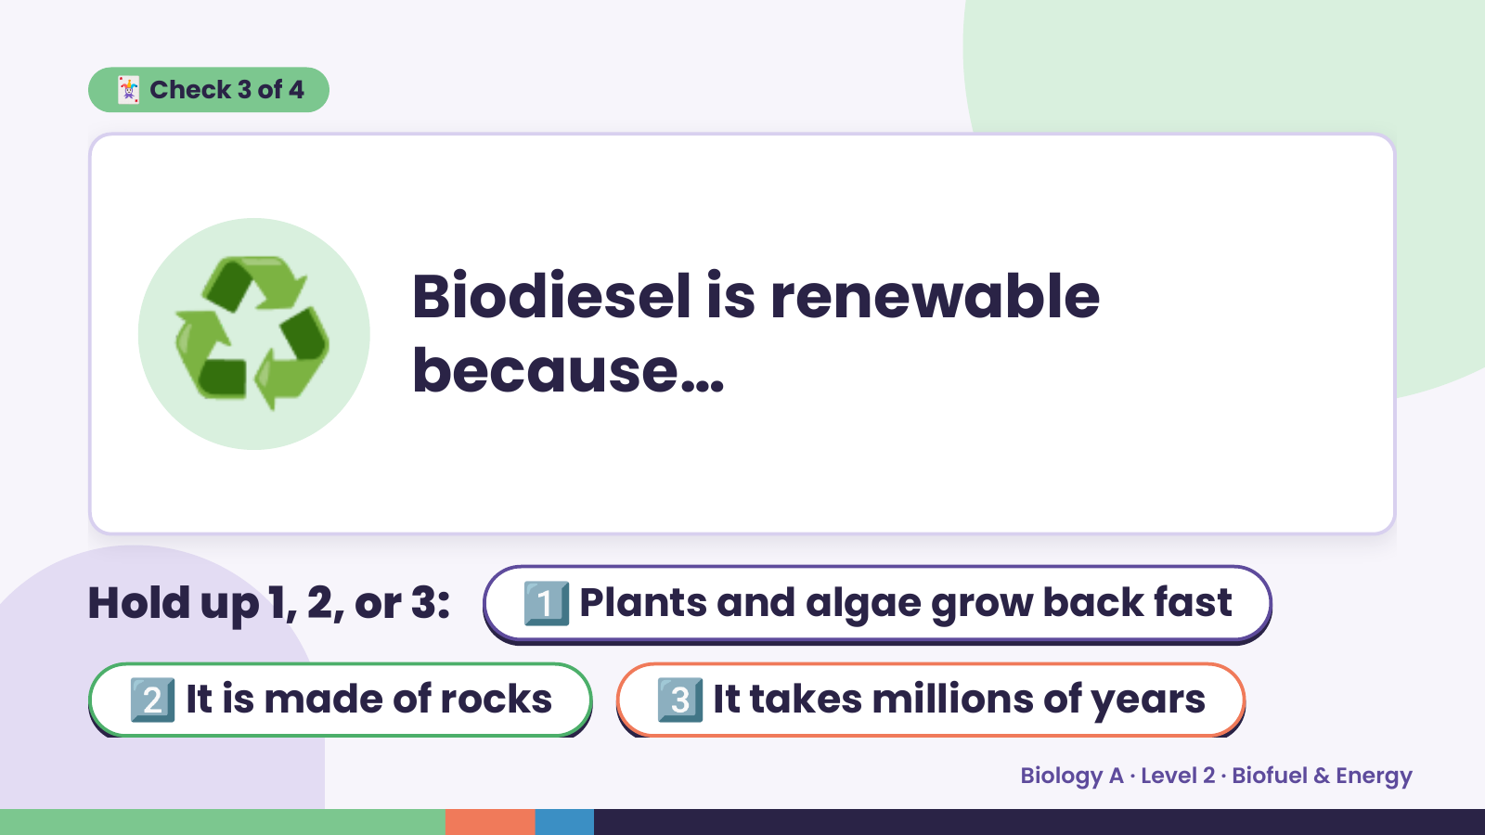
Notes:
🃏 Check 3 of 4
♻️ Biodiesel is renewable
because…
Hold up 1, 2, or 3: 1️⃣ Plants and algae grow back fast
2️⃣ It is made of rocks 3️⃣ It takes millions of years
Biology A · Level 2 · Biofuel & Energy

Slide 16
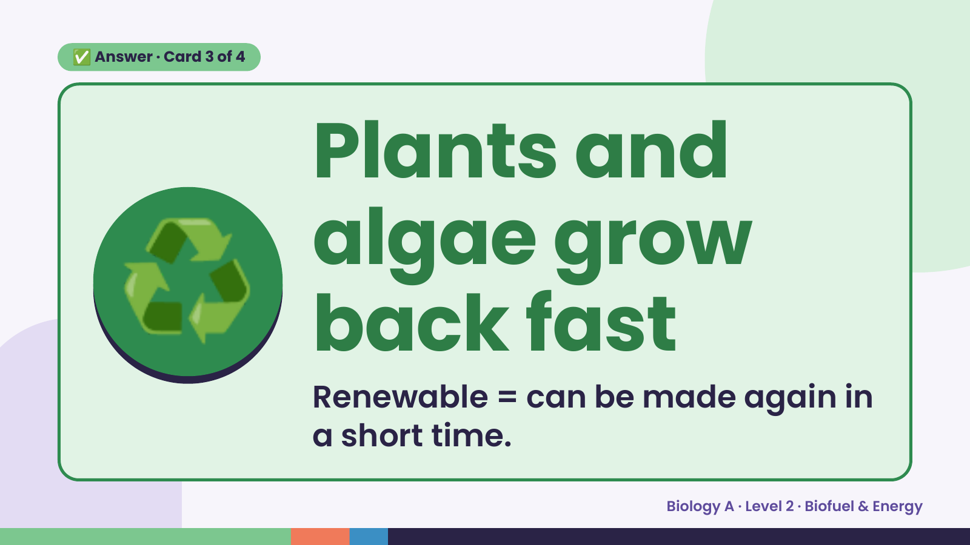
Notes:
✅ Answer · Card 3 of 4
♻️
Plants and
algae grow
back fast
Renewable = can be made again in
a short time.
Biology A · Level 2 · Biofuel & Energy

Slide 17
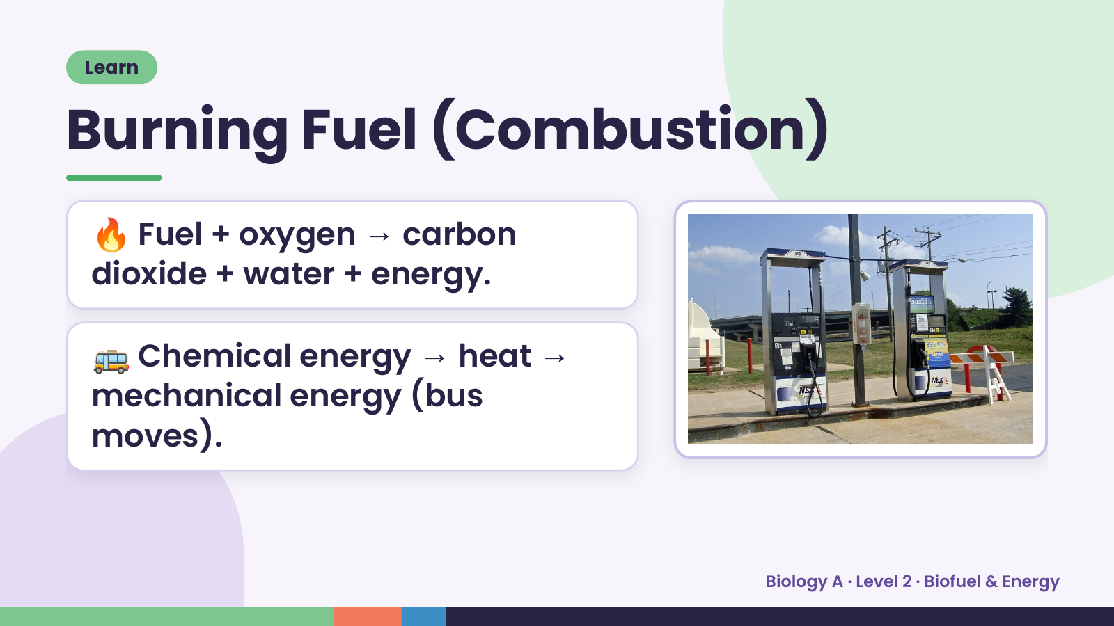
Notes:
Learn
Burning Fuel (Combustion)
🔥 Fuel + oxygen → carbon
dioxide + water + energy.
🚌 Chemical energy → heat →
mechanical energy (bus
moves).
Biology A · Level 2 · Biofuel & Energy

Slide 18
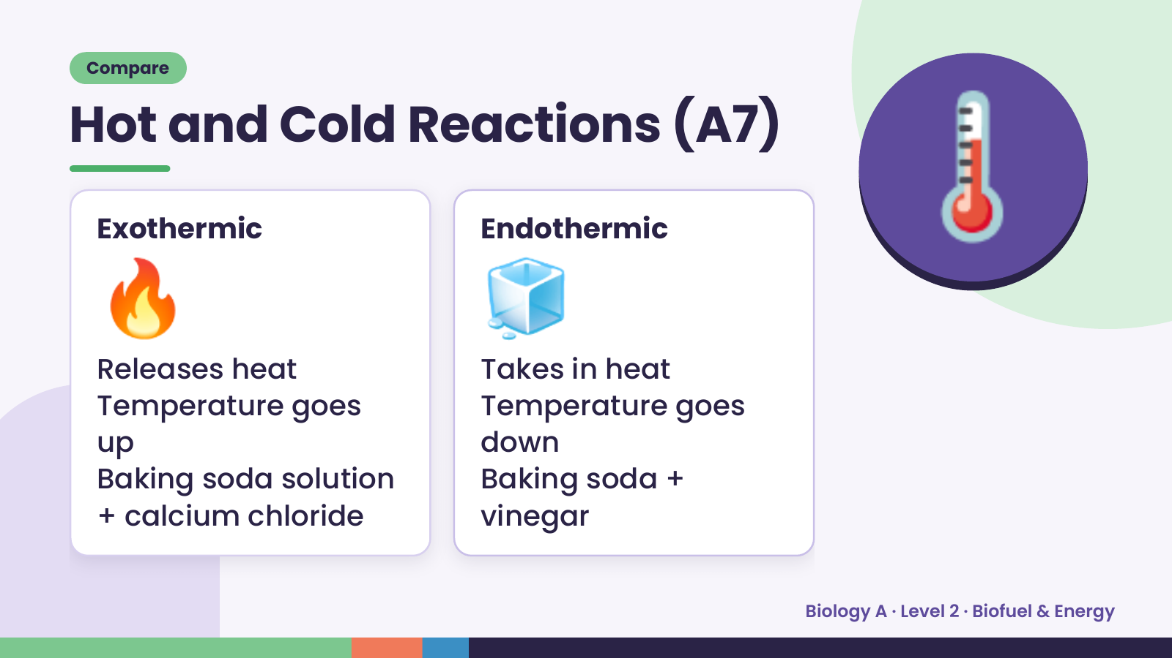
Notes:
Compare
Hot and Cold Reactions (A7)
🔥
Exothermic
Releases heat
🧊
Endothermic
Takes in heat
🌡️
Temperature goes Temperature goes
up down
Baking soda solution Baking soda +
+ calcium chloride vinegar
Biology A · Level 2 · Biofuel & Energy

Slide 19
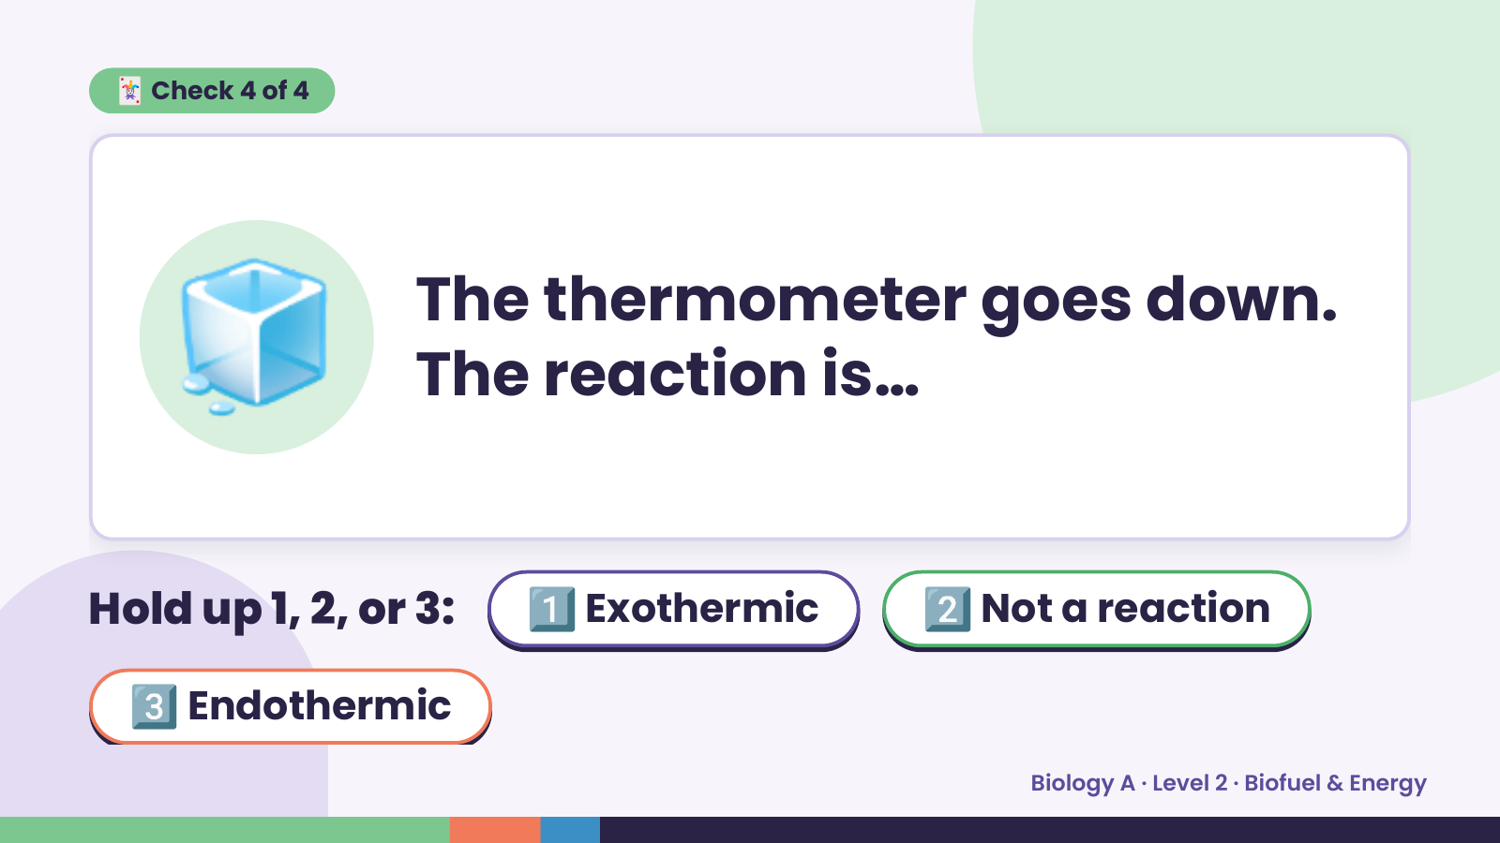
Notes:
🃏 Check 4 of 4
🧊 The thermometer goes down.
The reaction is…
Hold up 1, 2, or 3: 1️⃣ Exothermic 2️⃣ Not a reaction
3️⃣ Endothermic
Biology A · Level 2 · Biofuel & Energy

Slide 20
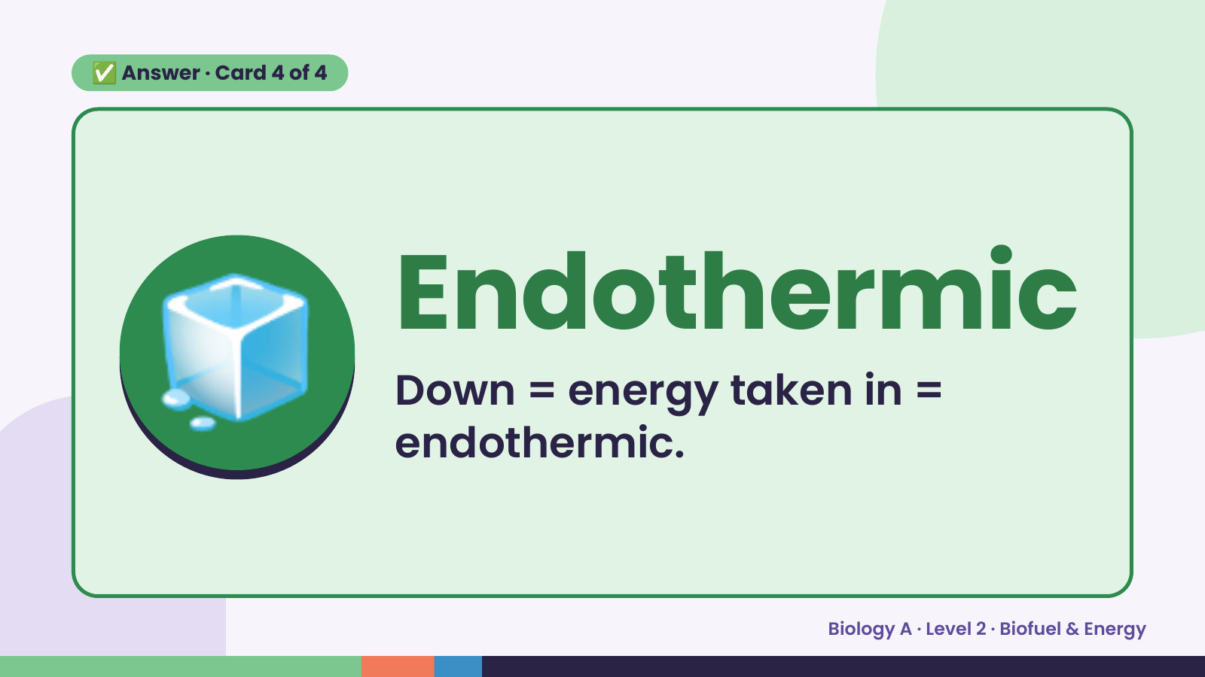
Notes:
✅ Answer · Card 4 of 4
🧊 Endothermic
Down = energy taken in =
endothermic.
Biology A · Level 2 · Biofuel & Energy

Slide 21
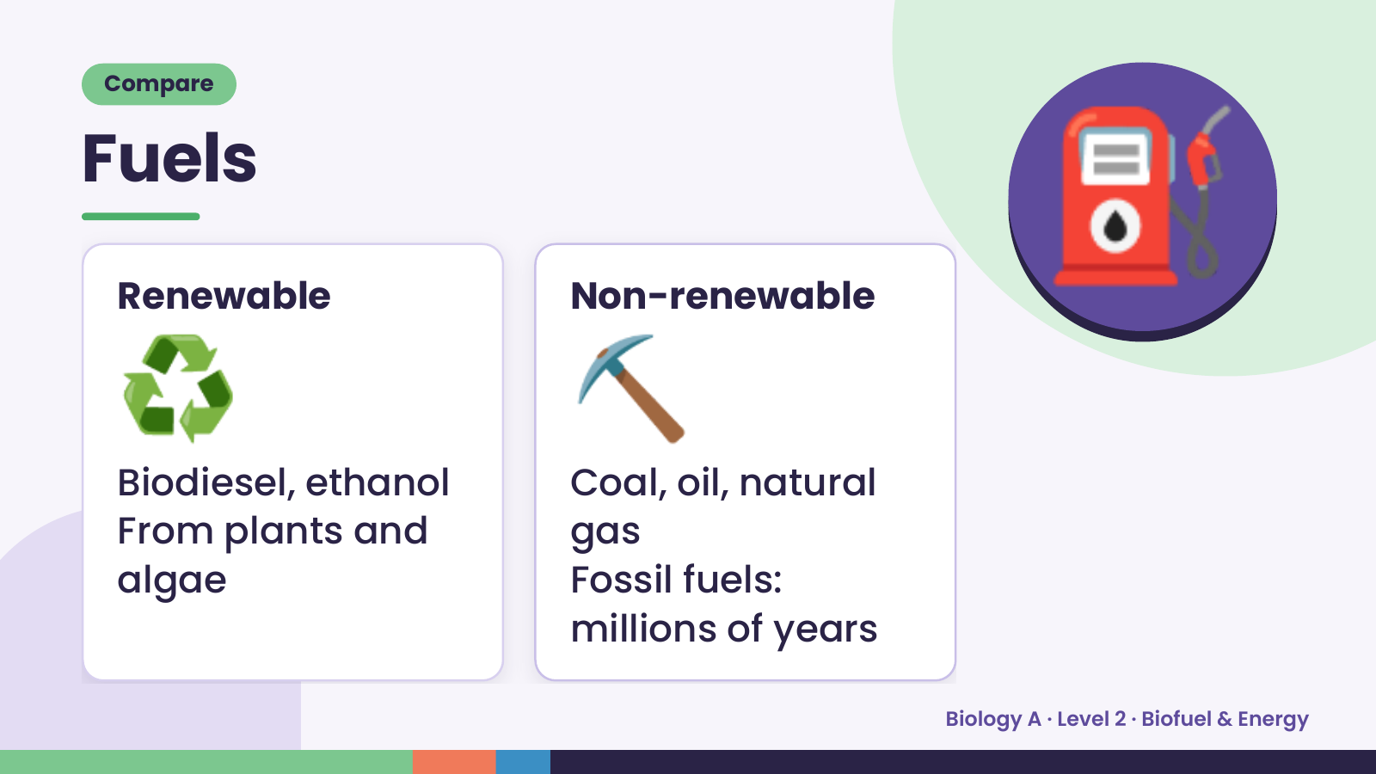
Notes:
Compare
Fuels
♻️
Renewable
⛏️
Non-renewable
⛽
Biodiesel, ethanol Coal, oil, natural
From plants and gas
algae Fossil fuels:
millions of years
Biology A · Level 2 · Biofuel & Energy

Slide 22
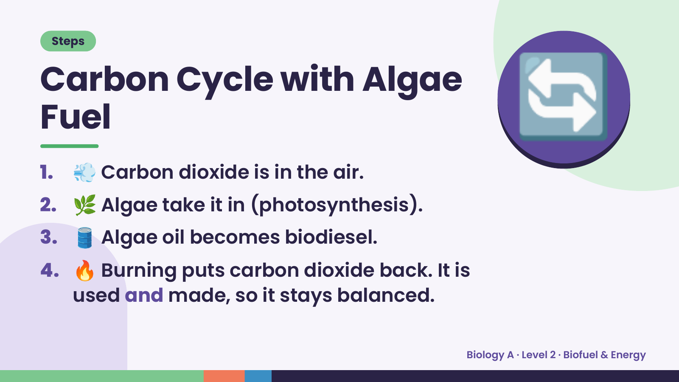
Notes:
Steps
Carbon Cycle with Algae
Fuel
1. 💨 Carbon dioxide is in the air.
2. 🌿 Algae take it in (photosynthesis).
🔄
3. 🛢️ Algae oil becomes biodiesel.
4. 🔥 Burning puts carbon dioxide back. It is
used and made, so it stays balanced.
Biology A · Level 2 · Biofuel & Energy

Slide 23
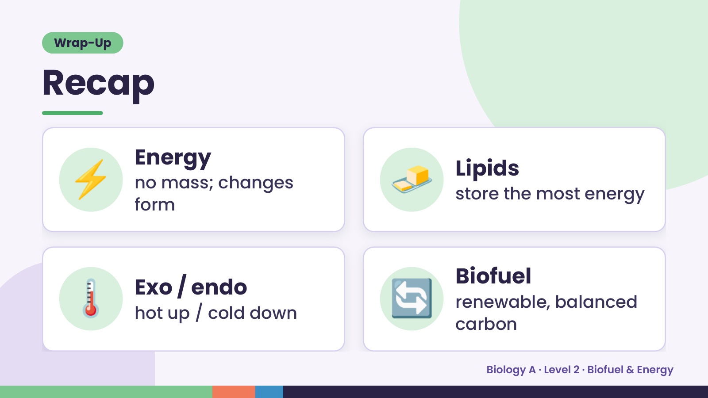
Notes:
Wrap-Up
Recap
⚡ Energy
no mass; changes
form
🧈 Lipids
store the most energy
🌡️ Exo / endo
hot up / cold down 🔄 Biofuel
renewable, balanced
carbon
Biology A · Level 2 · Biofuel & Energy

Slide 24
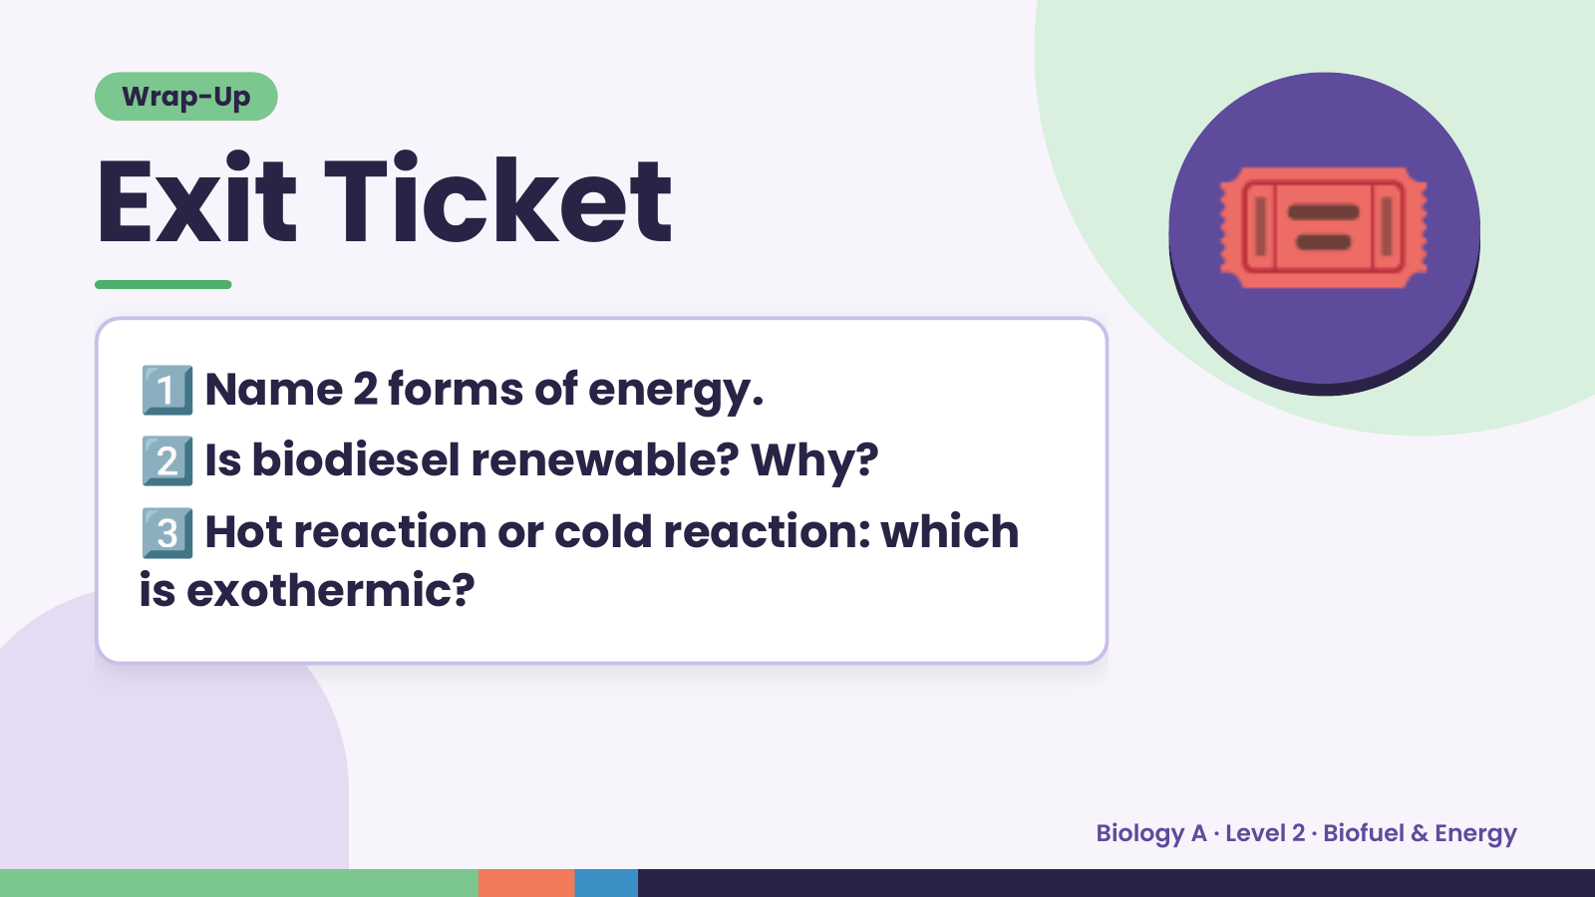
Notes:
Wrap-Up
Exit Ticket
1️⃣
2️⃣
Name 2 forms of energy.
Is biodiesel renewable? Why?
🎟️
3️⃣Hot reaction or cold reaction: which
is exothermic?
Biology A · Level 2 · Biofuel & Energy

