Slide 1
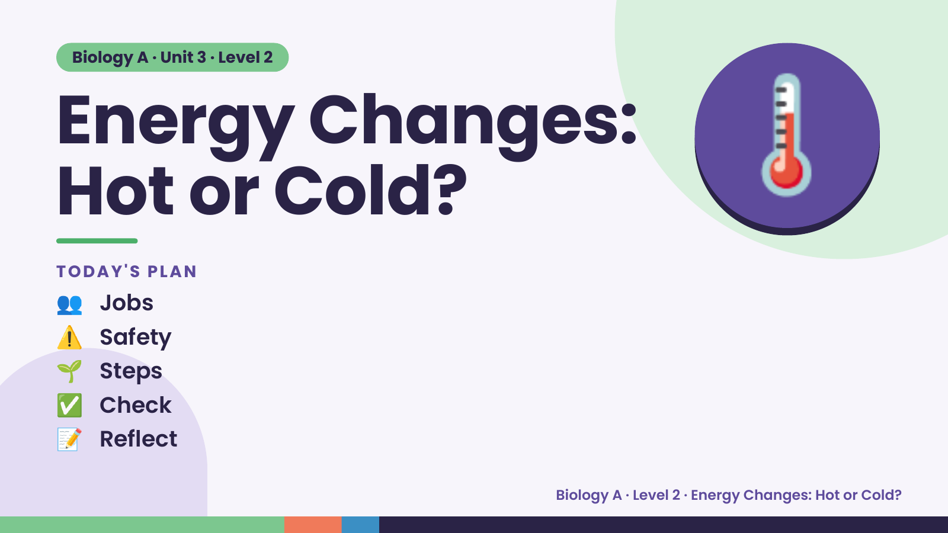
Notes:
Biology A · Unit 3 · Level 2
Energy Changes:
Hot or Cold?
👥 Jobs
TODAY'S PLAN
🌡️
⚠️ Safety
🌱 Steps
✅ Check
📝 Reflect
Biology A · Level 2 · Energy Changes: Hot or Cold?

Slide 2
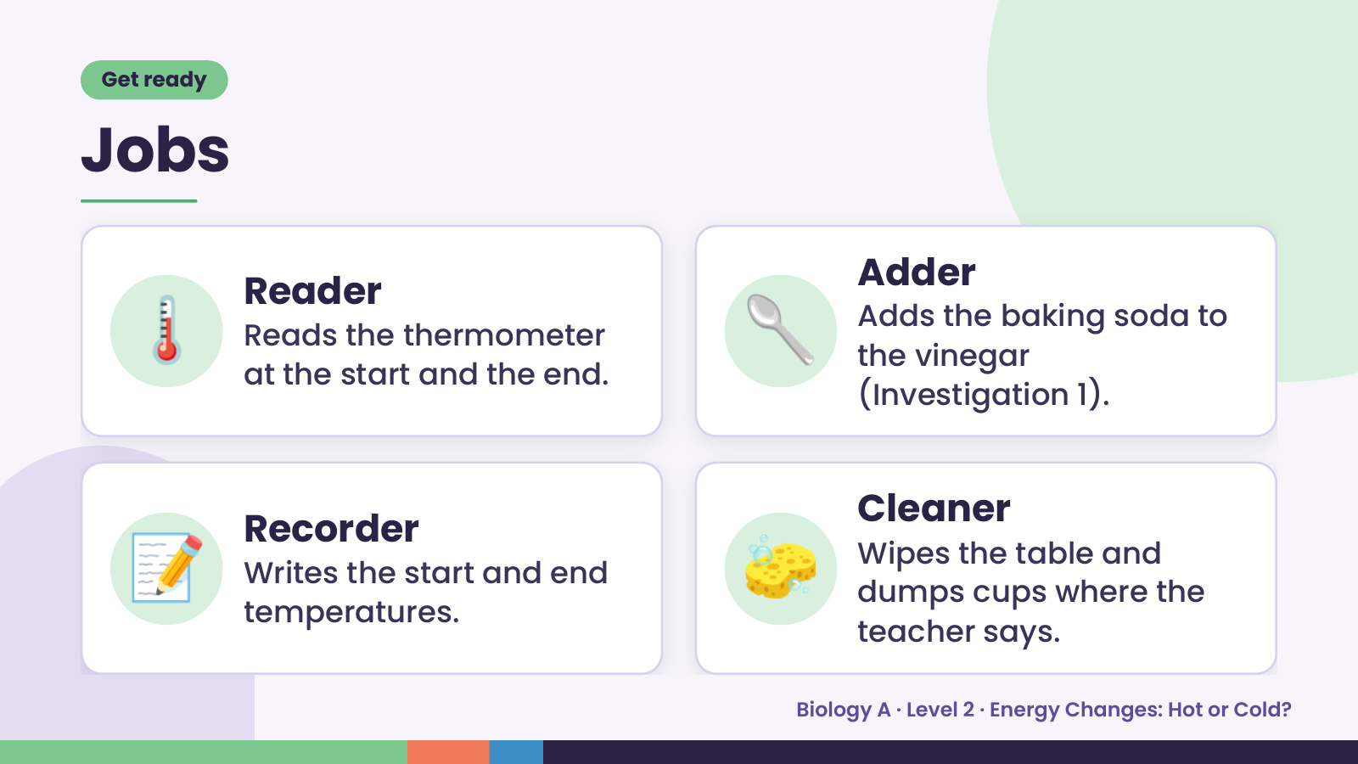
Notes:
Get ready
Jobs
🌡️ Reader
Reads the thermometer
at the start and the end.
🥄 Adder
Adds the baking soda to
the vinegar
(Investigation 1).
📝 Recorder
Writes the start and end
temperatures.
🧽 Cleaner
Wipes the table and
dumps cups where the
teacher says.
Biology A · Level 2 · Energy Changes: Hot or Cold?

Slide 3
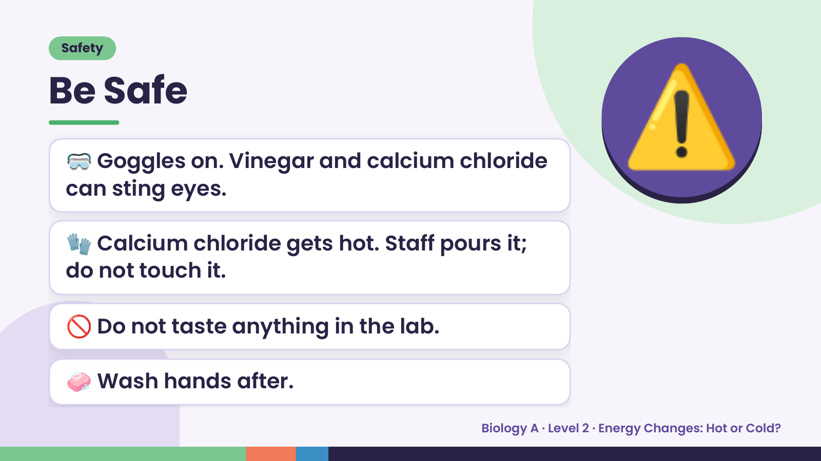
Notes:
Safety
Be Safe
🥽 Goggles on. Vinegar and calcium chloride
can sting eyes.
🧤 Calcium chloride gets hot. Staff pours it;
⚠️
do not touch it.
🚫 Do not taste anything in the lab.
🧼 Wash hands after.
Biology A · Level 2 · Energy Changes: Hot or Cold?

Slide 4
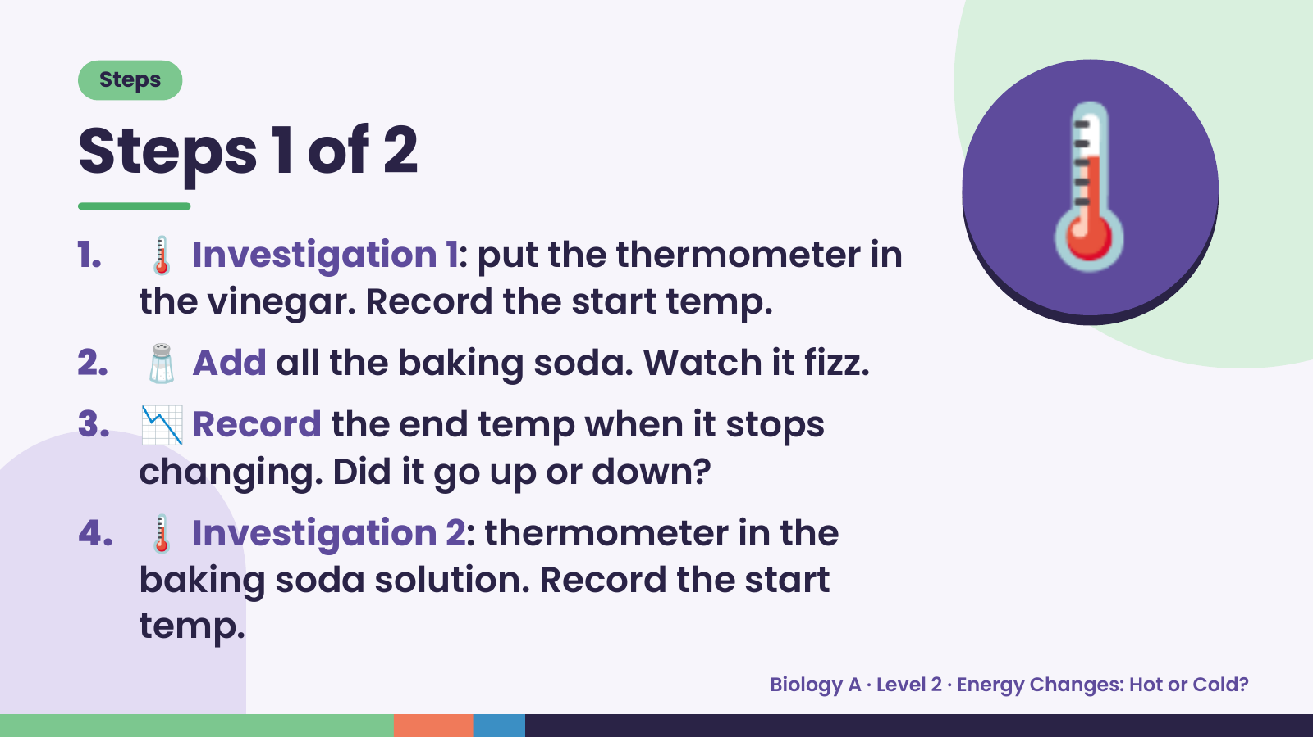
Notes:
Steps
Steps 1 of 2
1. 🌡️ Investigation 1: put the thermometer in
the vinegar. Record the start temp.
2. 🧂 Add all the baking soda. Watch it fizz.
🌡️
3. 📉 Record the end temp when it stops
changing. Did it go up or down?
4. 🌡️ Investigation 2: thermometer in the
baking soda solution. Record the start
temp.
Biology A · Level 2 · Energy Changes: Hot or Cold?

Slide 5
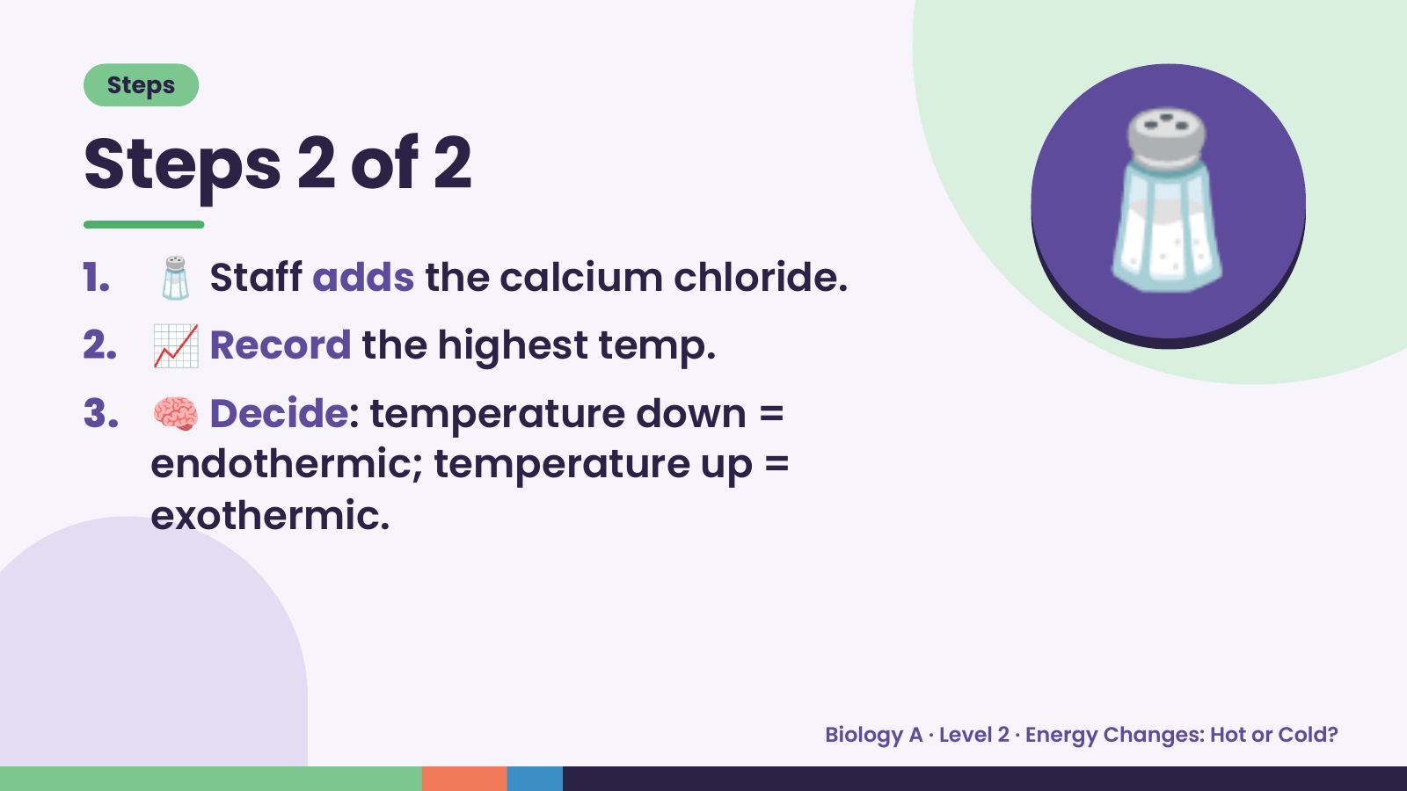
Notes:
Steps
Steps 2 of 2
1. 🧂 Staff adds the calcium chloride.
2. 📈 Record the highest temp.
3. 🧠 Decide: temperature down =
🧂
endothermic; temperature up =
exothermic.
Biology A · Level 2 · Energy Changes: Hot or Cold?

Slide 6
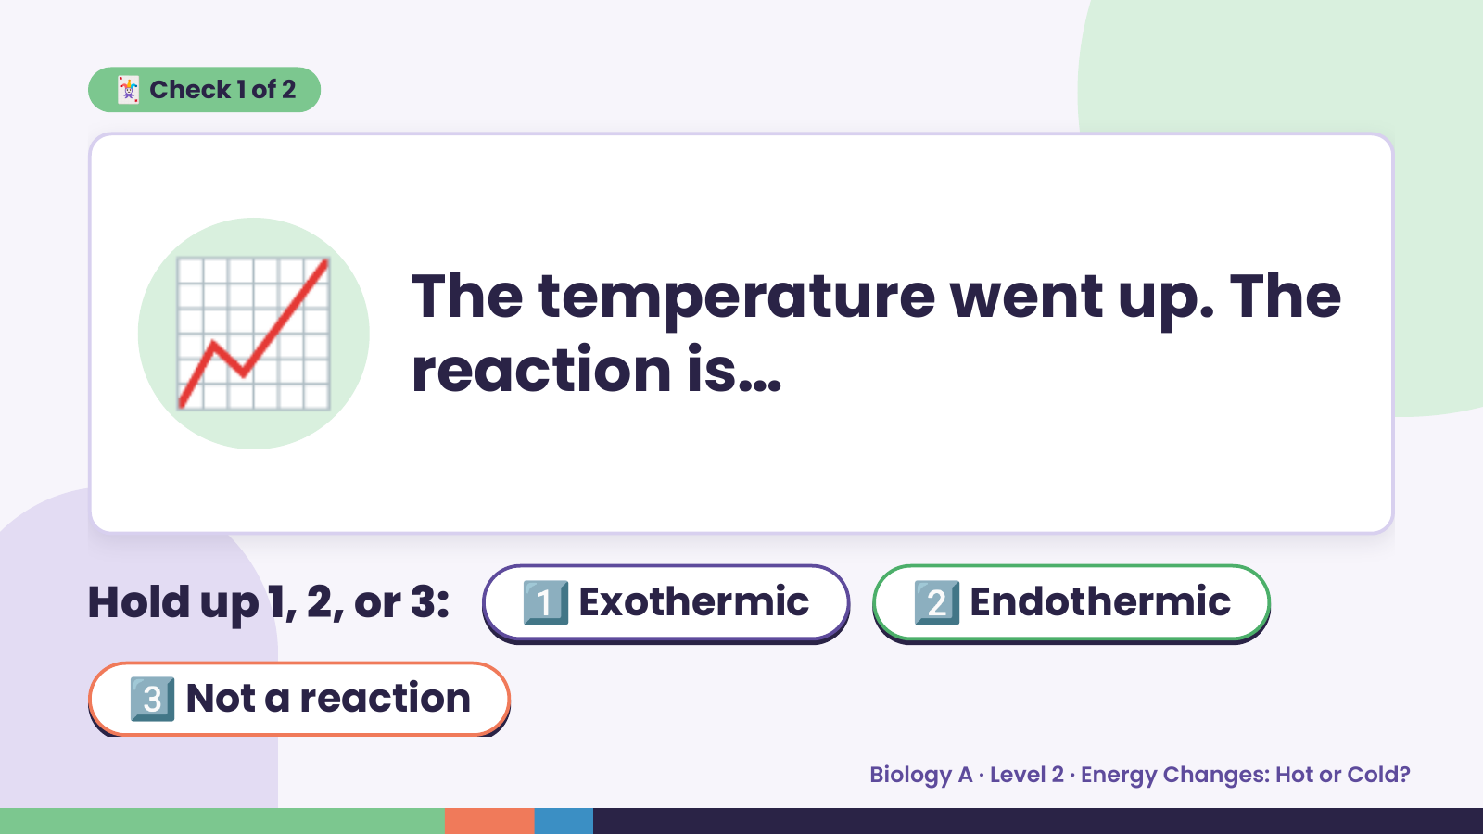
Notes:
🃏 Check 1 of 2
📈 The temperature went up. The
reaction is…
Hold up 1, 2, or 3: 1️⃣ Exothermic 2️⃣ Endothermic
3️⃣ Not a reaction
Biology A · Level 2 · Energy Changes: Hot or Cold?

Slide 7
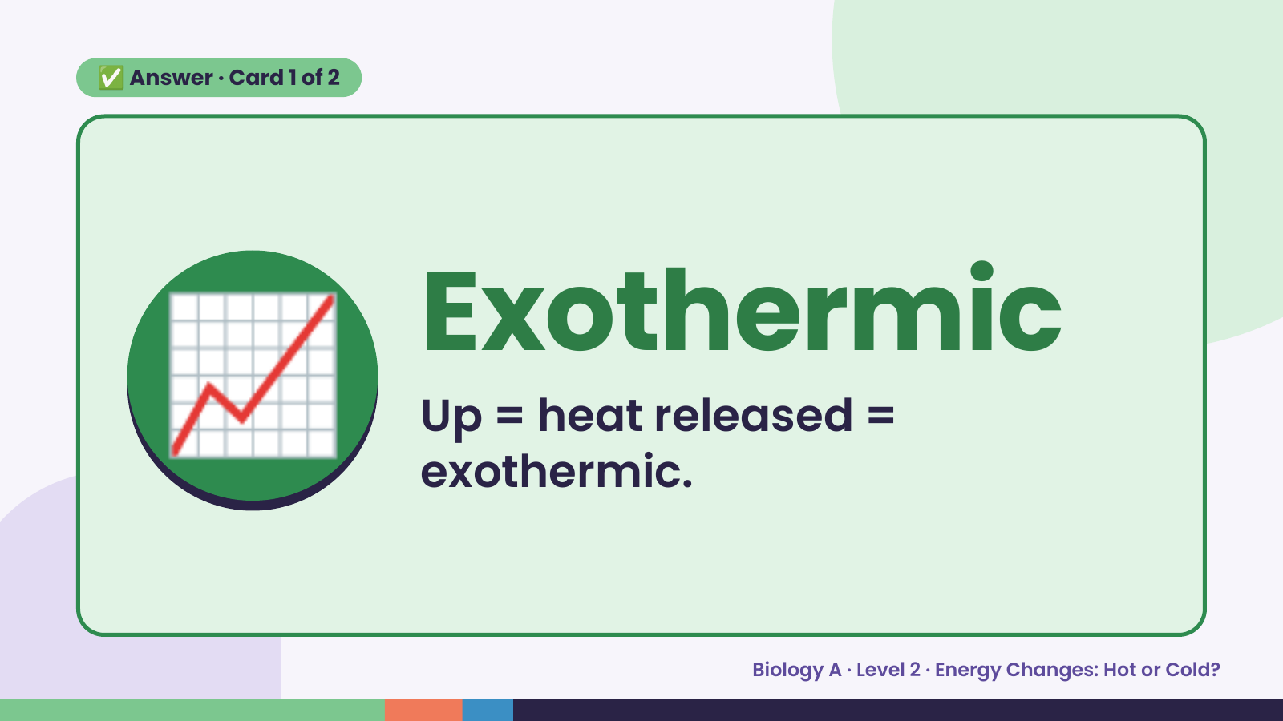
Notes:
✅ Answer · Card 1 of 2
📈 Exothermic
Up = heat released =
exothermic.
Biology A · Level 2 · Energy Changes: Hot or Cold?

Slide 8
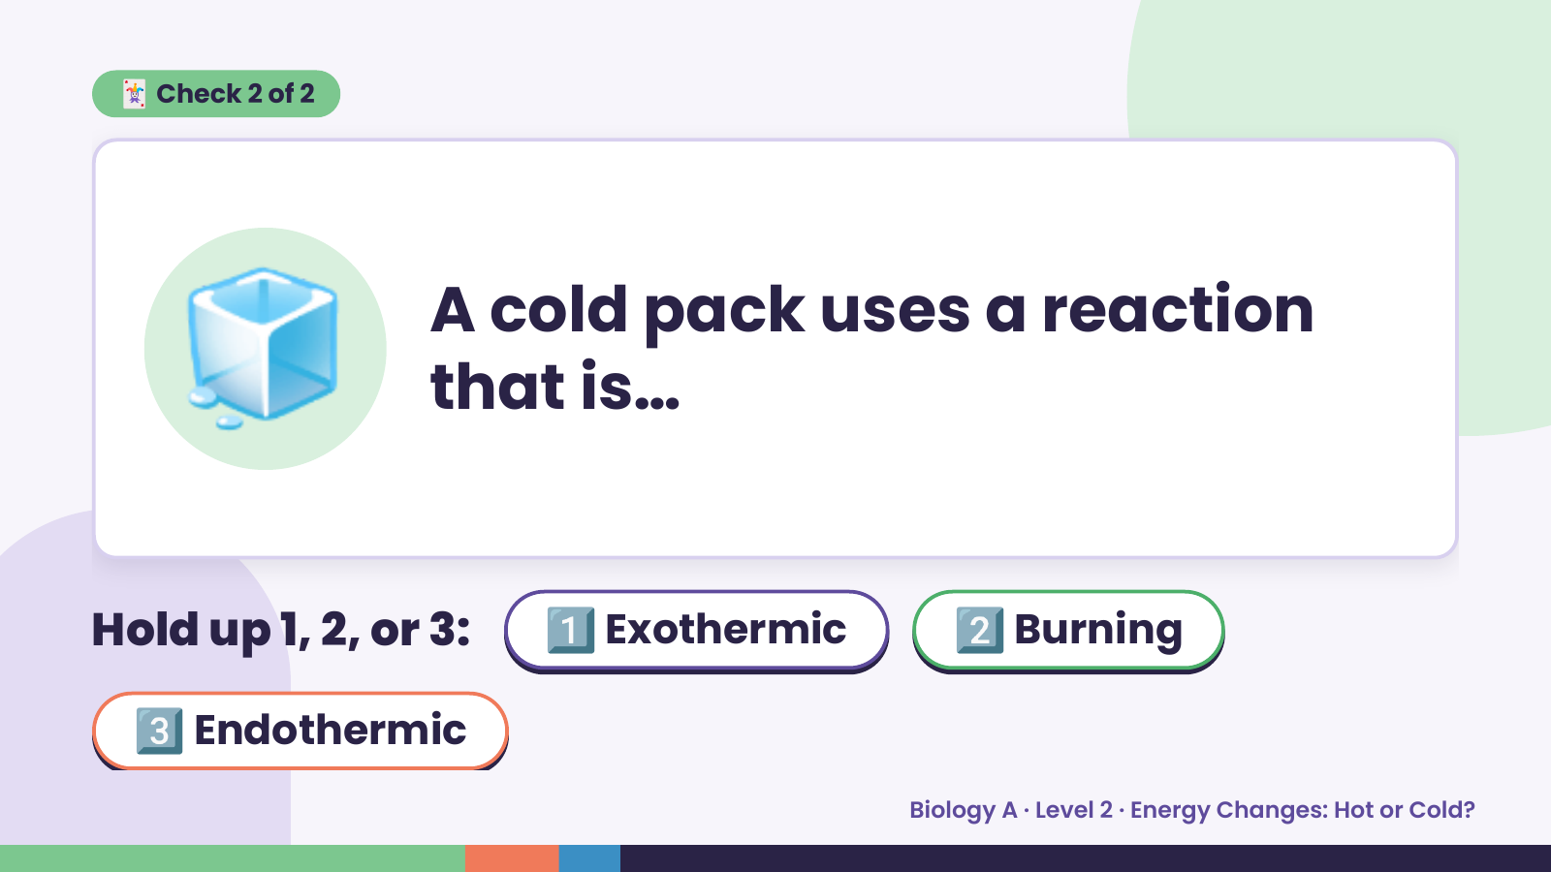
Notes:
🃏 Check 2 of 2
🧊 A cold pack uses a reaction
that is…
Hold up 1, 2, or 3: 1️⃣ Exothermic 2️⃣ Burning
3️⃣ Endothermic
Biology A · Level 2 · Energy Changes: Hot or Cold?

Slide 9
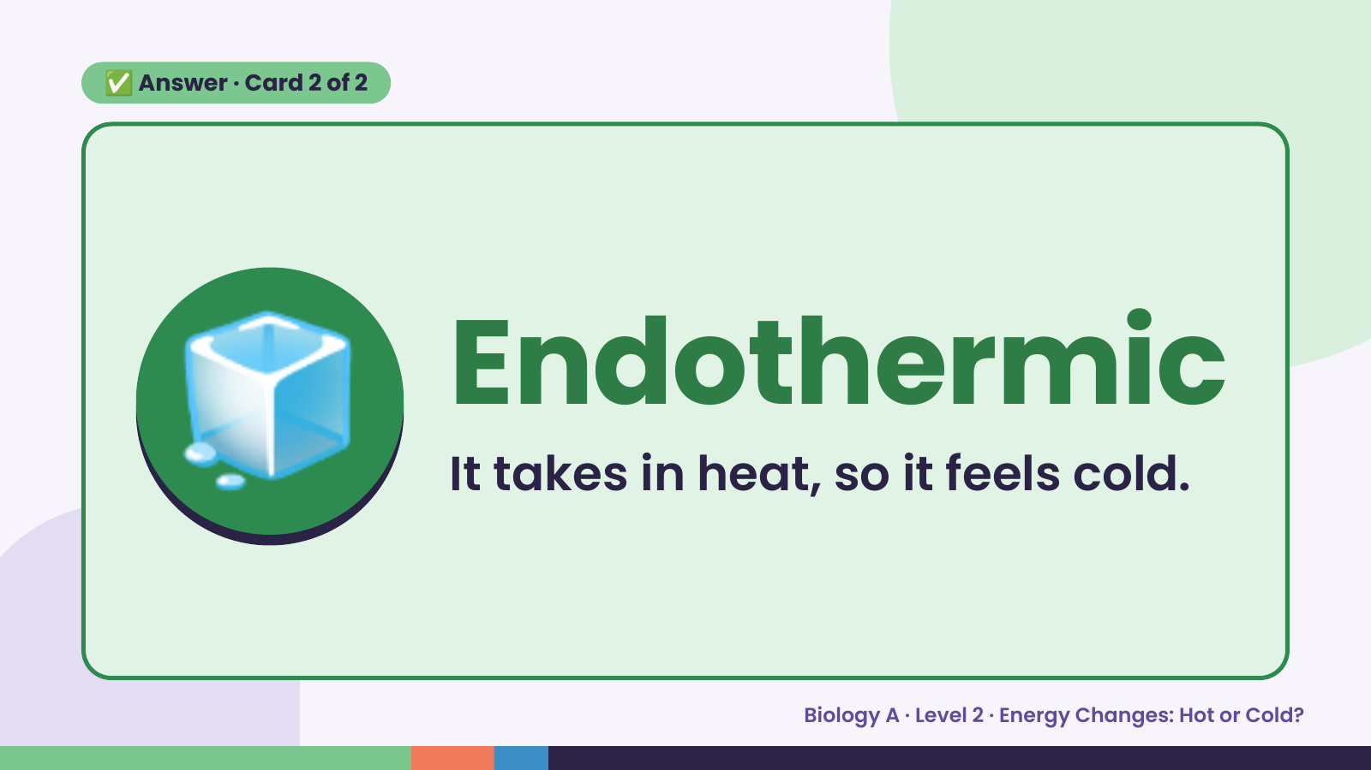
Notes:
✅ Answer · Card 2 of 2
🧊 Endothermic
It takes in heat, so it feels cold.
Biology A · Level 2 · Energy Changes: Hot or Cold?

Slide 10
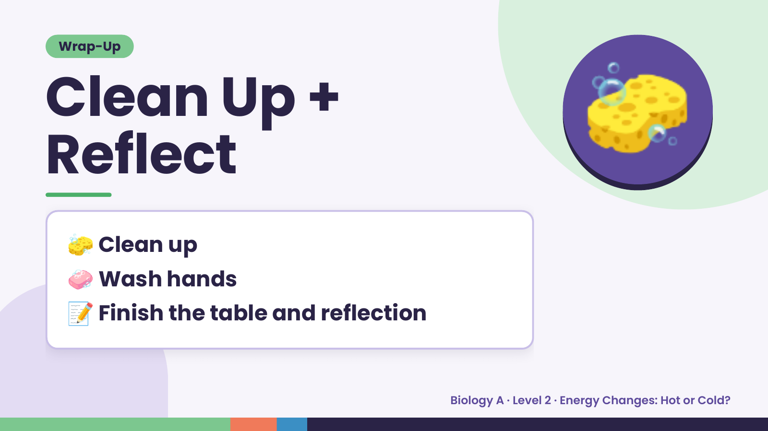
Notes:
Wrap-Up
Clean Up +
Reflect
🧽
🧽 Clean up
🧼 Wash hands
📝 Finish the table and reflection
Biology A · Level 2 · Energy Changes: Hot or Cold?

