Slide 1
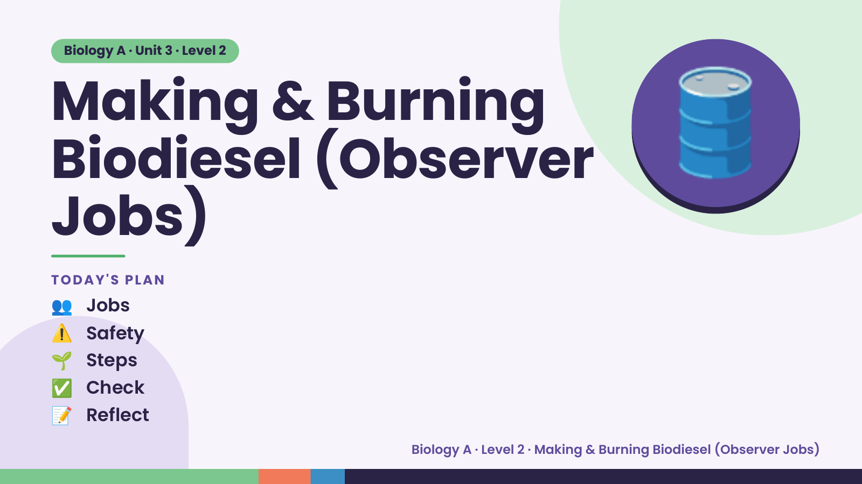
Notes:
Biology A · Unit 3 · Level 2
Making & Burning
Biodiesel (Observer
Jobs)
🛢️
TODAY'S PLAN
👥 Jobs
⚠️ Safety
🌱 Steps
✅ Check
📝 Reflect
Biology A · Level 2 · Making & Burning Biodiesel (Observer Jobs)

Slide 2
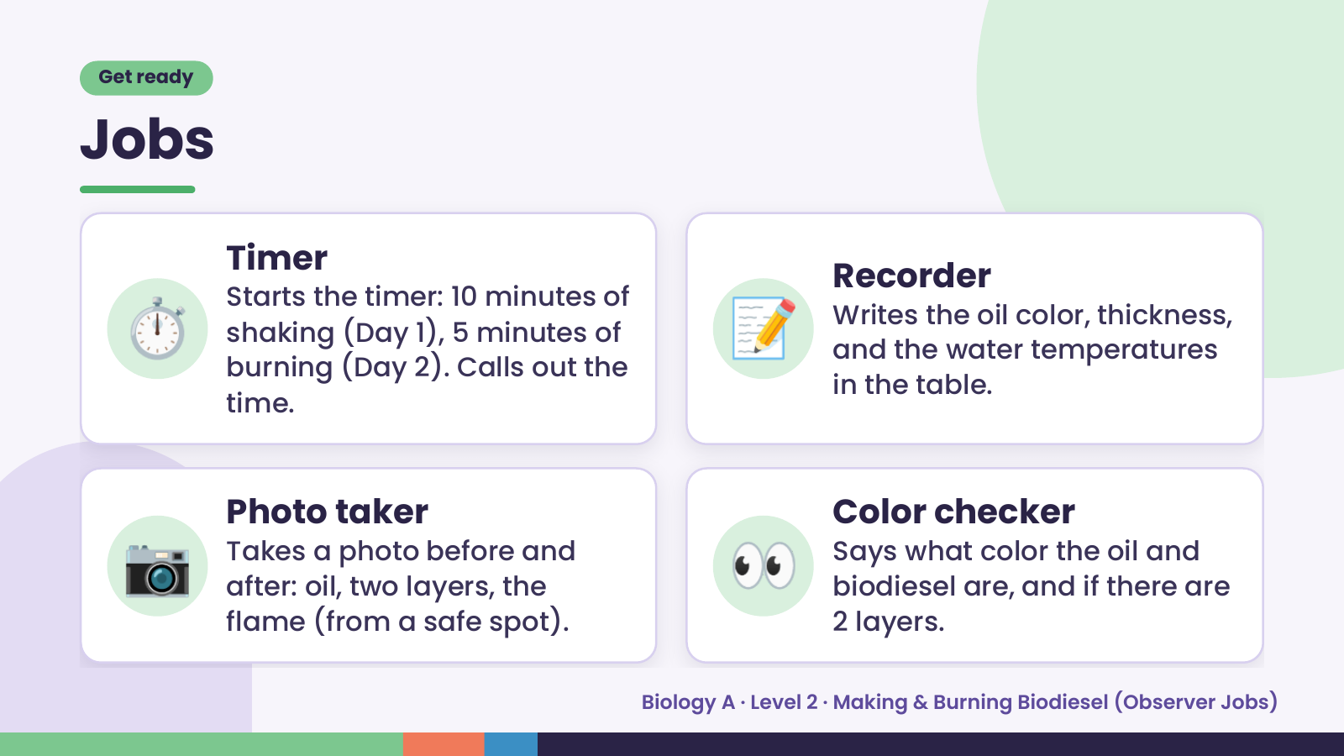
Notes:
Get ready
Jobs
⏱️ 📝
Timer
Recorder
Starts the timer: 10 minutes of
Writes the oil color, thickness,
shaking (Day 1), 5 minutes of
and the water temperatures
burning (Day 2). Calls out the
in the table.
time.
📷 Photo taker
Takes a photo before and
after: oil, two layers, the
flame (from a safe spot).
👀 Color checker
Says what color the oil and
biodiesel are, and if there are
2 layers.
Biology A · Level 2 · Making & Burning Biodiesel (Observer Jobs)

Slide 3
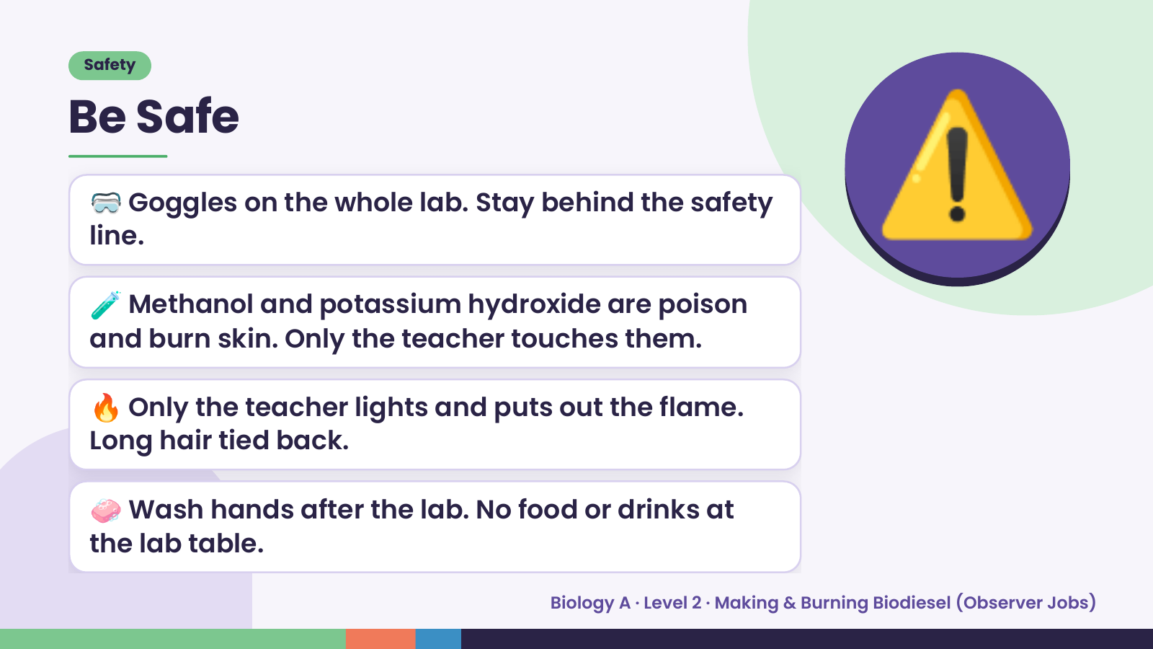
Notes:
Safety
Be Safe
🥽 Goggles on the whole lab. Stay behind the safety
line.
🧪 Methanol and potassium hydroxide are poison
and burn skin. Only the teacher touches them.
⚠️
🔥 Only the teacher lights and puts out the flame.
Long hair tied back.
🧼 Wash hands after the lab. No food or drinks at
the lab table.
Biology A · Level 2 · Making & Burning Biodiesel (Observer Jobs)

Slide 4
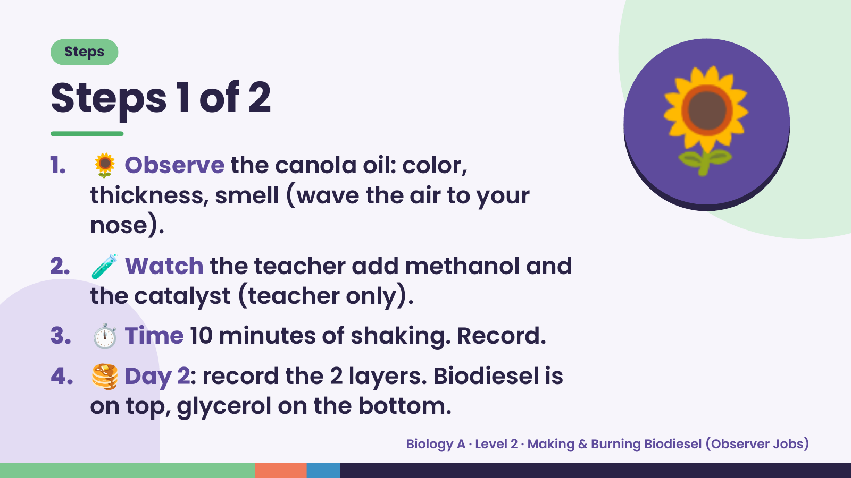
Notes:
Steps
Steps 1 of 2
1.
2.
🌻 Observe the canola oil: color,
thickness, smell (wave the air to your
nose).
🧪 Watch the teacher add methanol and
🌻
the catalyst (teacher only).
3. ⏱️ Time 10 minutes of shaking. Record.
4. 🥞 Day 2: record the 2 layers. Biodiesel is
on top, glycerol on the bottom.
Biology A · Level 2 · Making & Burning Biodiesel (Observer Jobs)

Slide 5
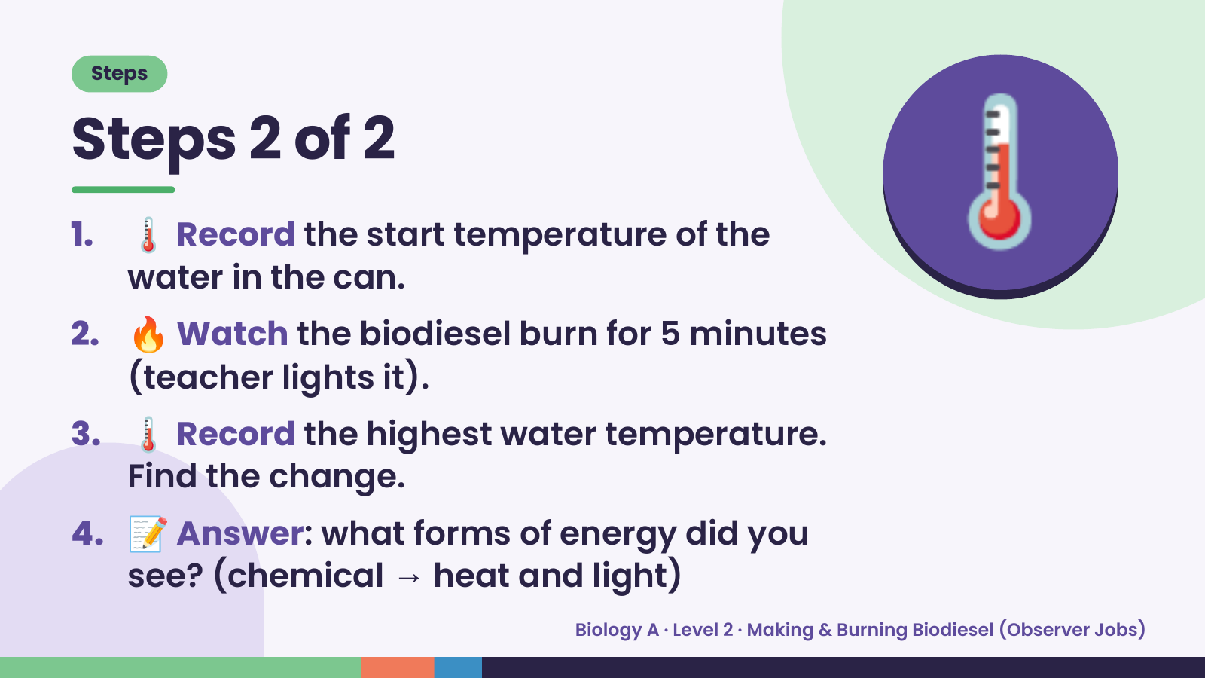
Notes:
Steps
Steps 2 of 2
1. 🌡️ Record the start temperature of the
water in the can.
2. 🔥 Watch the biodiesel burn for 5 minutes
(teacher lights it).
🌡️
3. 🌡️ Record the highest water temperature.
Find the change.
4. 📝 Answer: what forms of energy did you
see? (chemical → heat and light)
Biology A · Level 2 · Making & Burning Biodiesel (Observer Jobs)

Slide 6
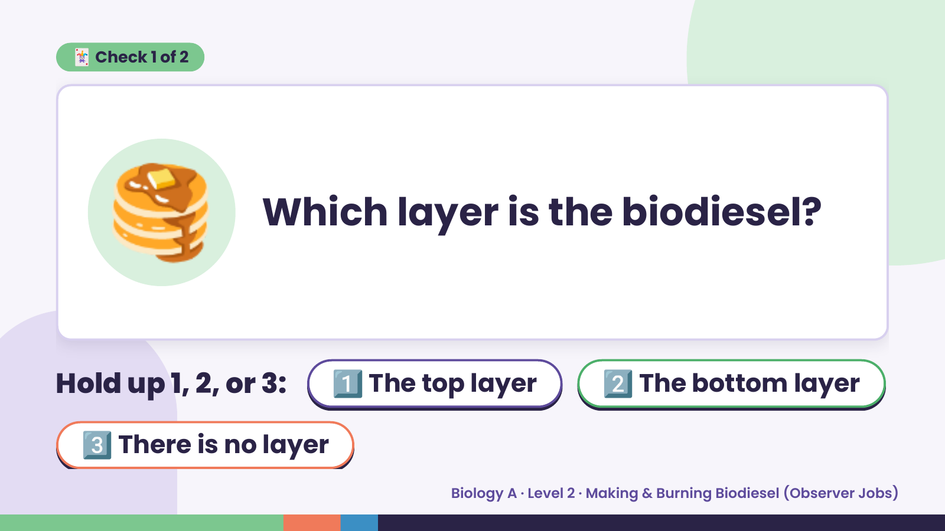
Notes:
🃏 Check 1 of 2
🥞 Which layer is the biodiesel?
Hold up 1, 2, or 3: 1️⃣ The top layer 2️⃣ The bottom layer
3️⃣ There is no layer
Biology A · Level 2 · Making & Burning Biodiesel (Observer Jobs)

Slide 7
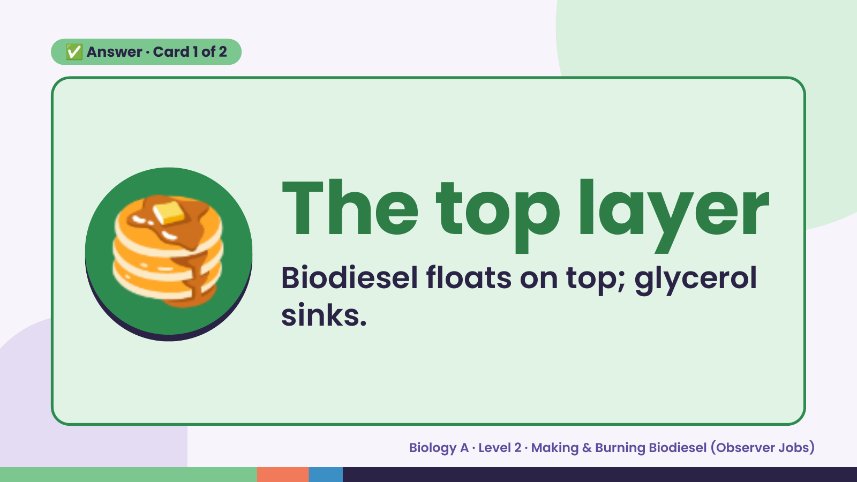
Notes:
✅ Answer · Card 1 of 2
🥞 The top layer
Biodiesel floats on top; glycerol
sinks.
Biology A · Level 2 · Making & Burning Biodiesel (Observer Jobs)

Slide 8
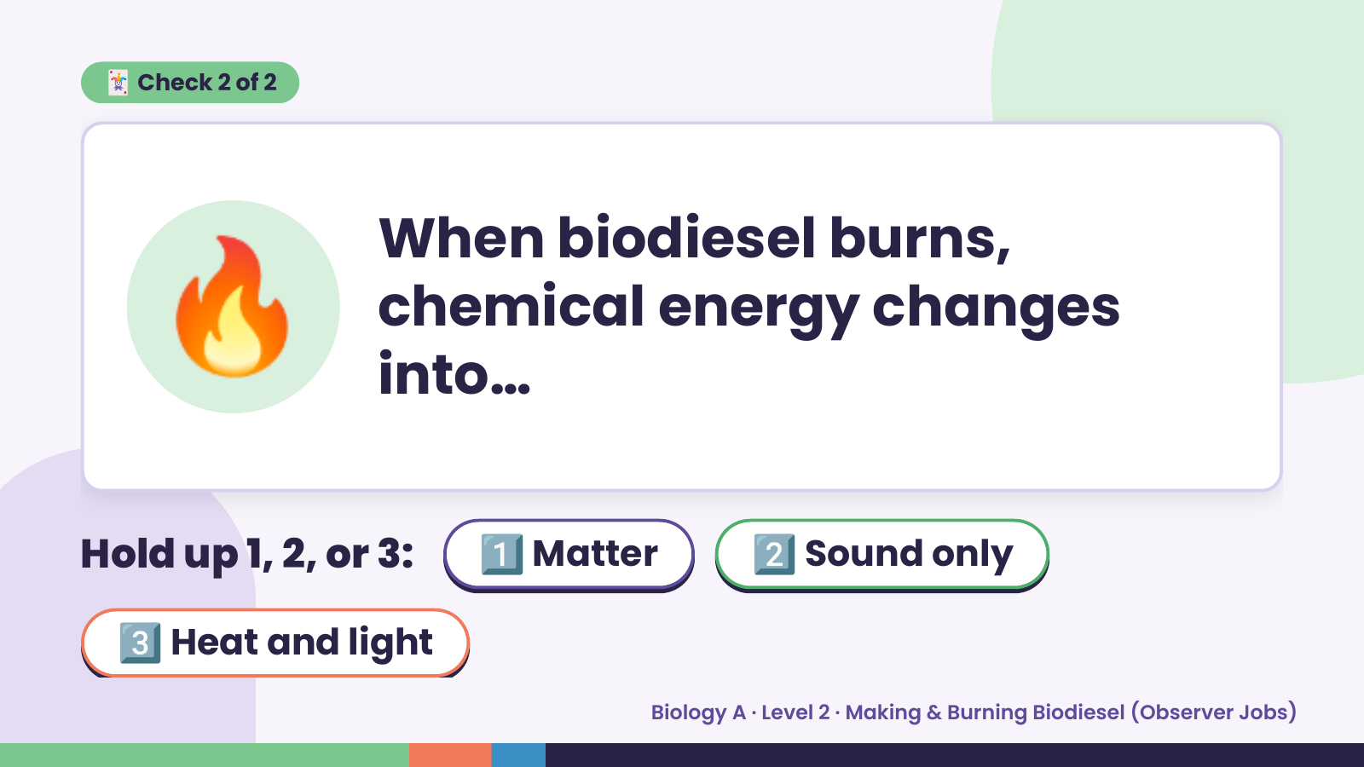
Notes:
🃏 Check 2 of 2
🔥 When biodiesel burns,
chemical energy changes
into…
Hold up 1, 2, or 3: 1️⃣ Matter 2️⃣ Sound only
3️⃣ Heat and light
Biology A · Level 2 · Making & Burning Biodiesel (Observer Jobs)

Slide 9
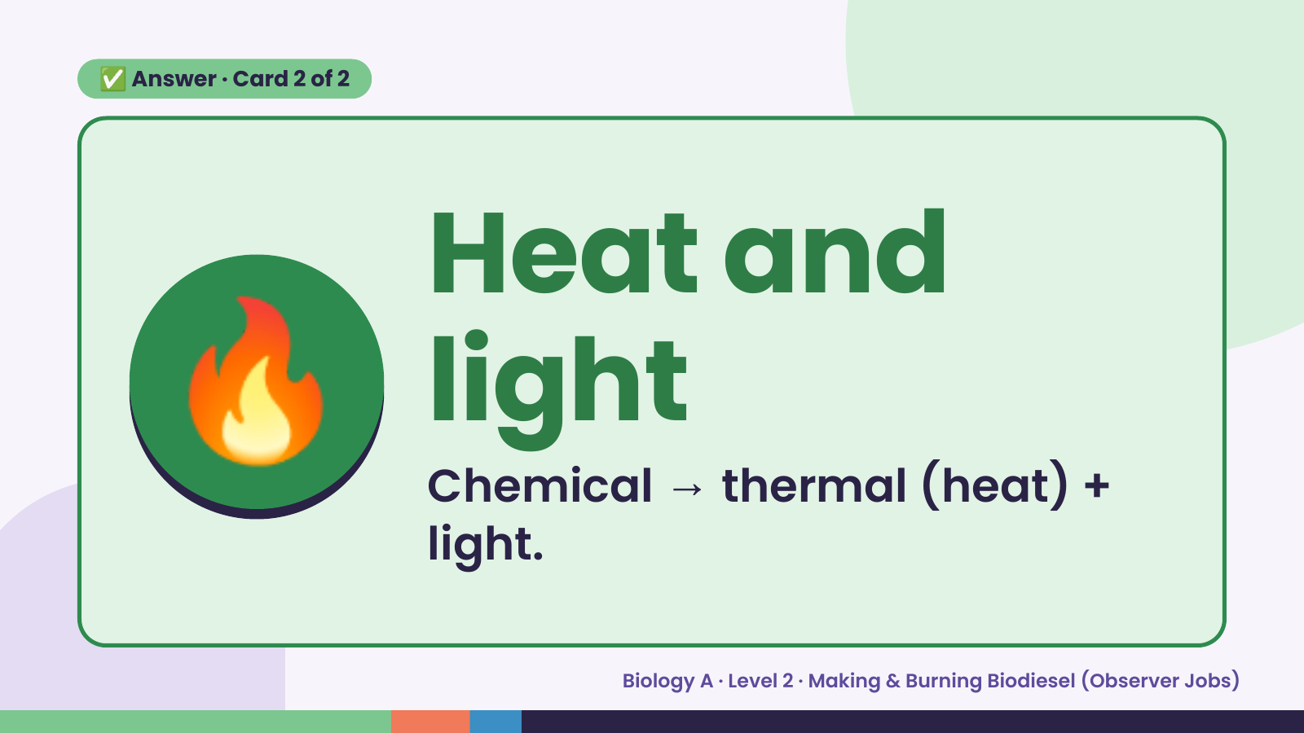
Notes:
✅ Answer · Card 2 of 2
🔥 Heat and
light
Chemical → thermal (heat) +
light.
Biology A · Level 2 · Making & Burning Biodiesel (Observer Jobs)

Slide 10
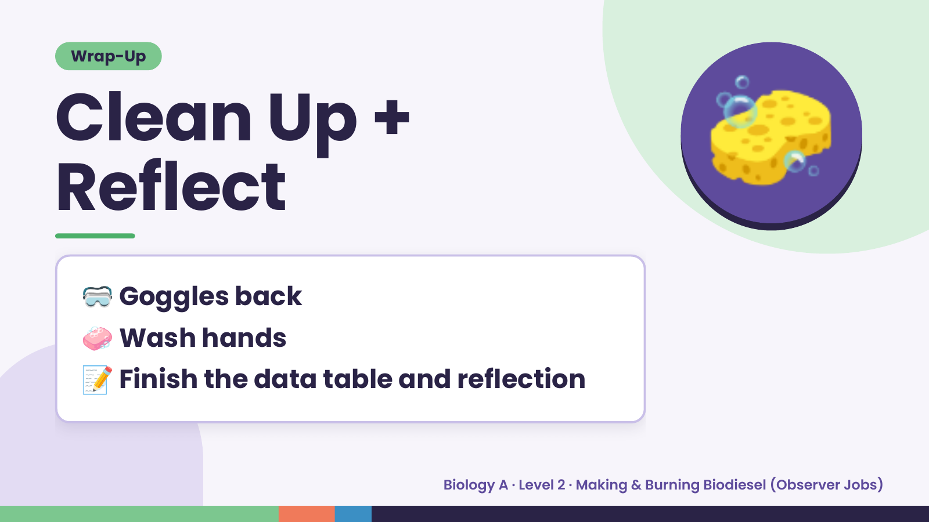
Notes:
Wrap-Up
Clean Up +
Reflect
🧽
🥽 Goggles back
🧼 Wash hands
📝 Finish the data table and reflection
Biology A · Level 2 · Making & Burning Biodiesel (Observer Jobs)

