Slide 1
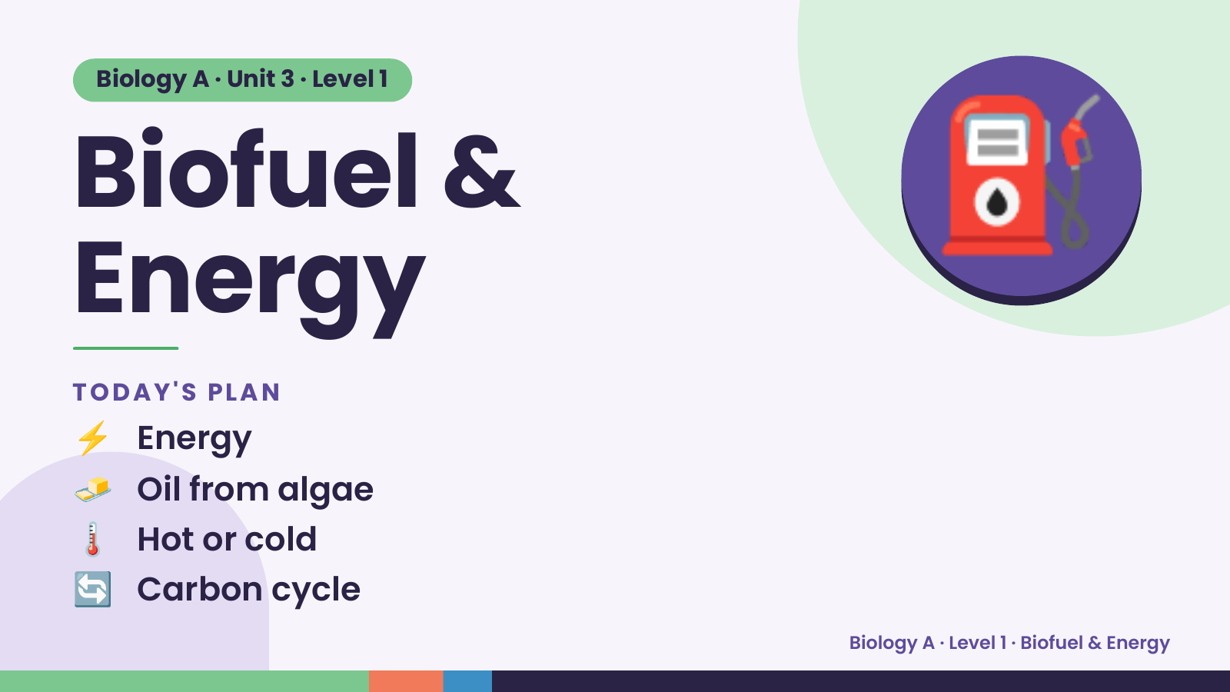
Notes:
Biology A · Unit 3 · Level 1
Biofuel &
Energy
⛽
⚡ Energy
TODAY'S PLAN
🧈 Oil from algae
🌡️ Hot or cold
🔄 Carbon cycle
Biology A · Level 1 · Biofuel & Energy

Slide 2
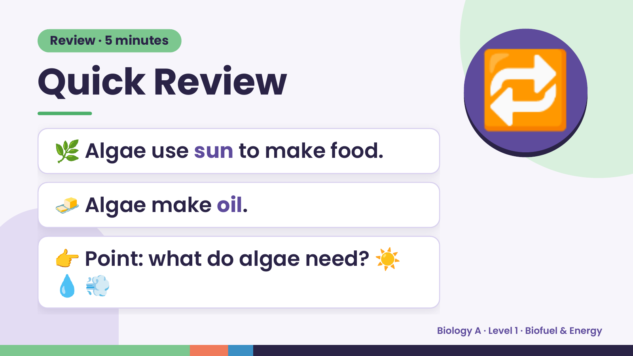
Notes:
Review · 5 minutes
Quick Review
🌿 Algae use sun to make food.
🔁
🧈 Algae make oil.
👉 Point: what do algae need? ☀️
💧💨
Biology A · Level 1 · Biofuel & Energy

Slide 3
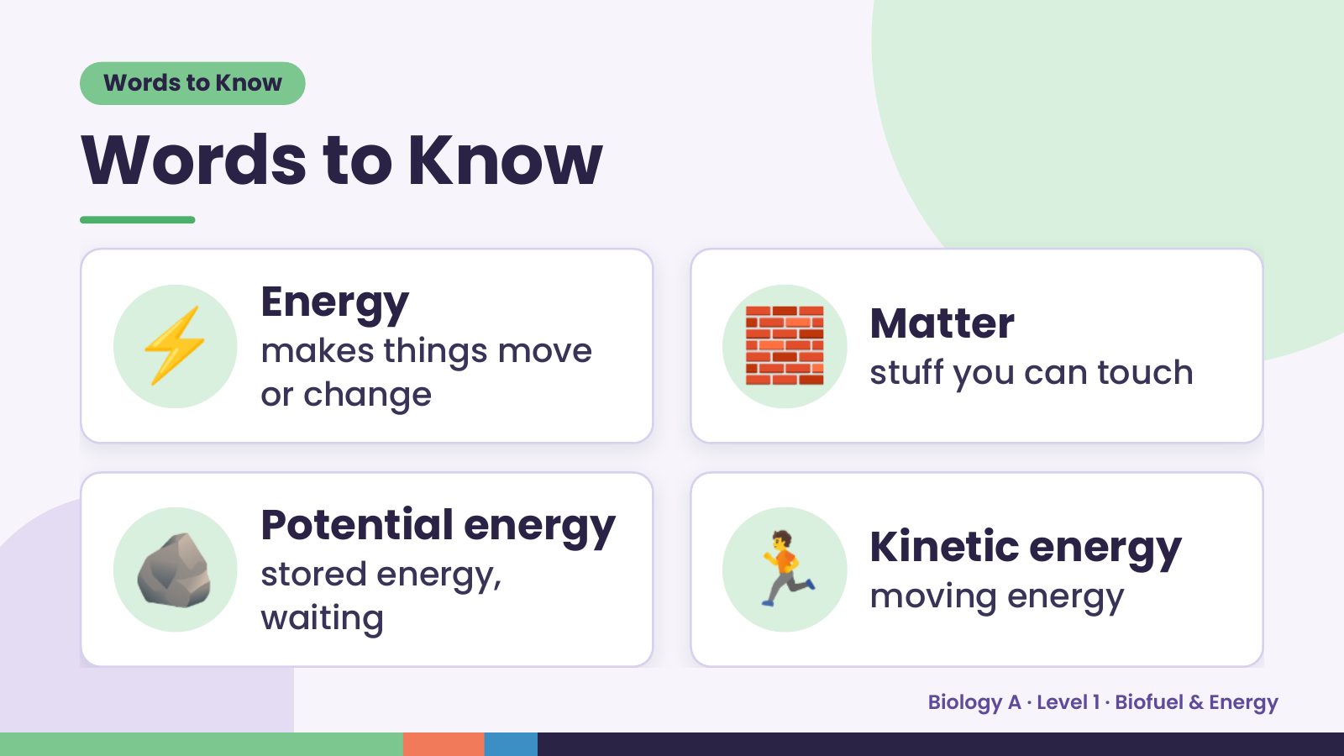
Notes:
Words to Know
Words to Know
⚡ Energy
makes things move
or change
🧱 Matter
stuff you can touch
🪨 Potential energy
stored energy,
waiting
🏃 Kinetic energy
moving energy
Biology A · Level 1 · Biofuel & Energy

Slide 4
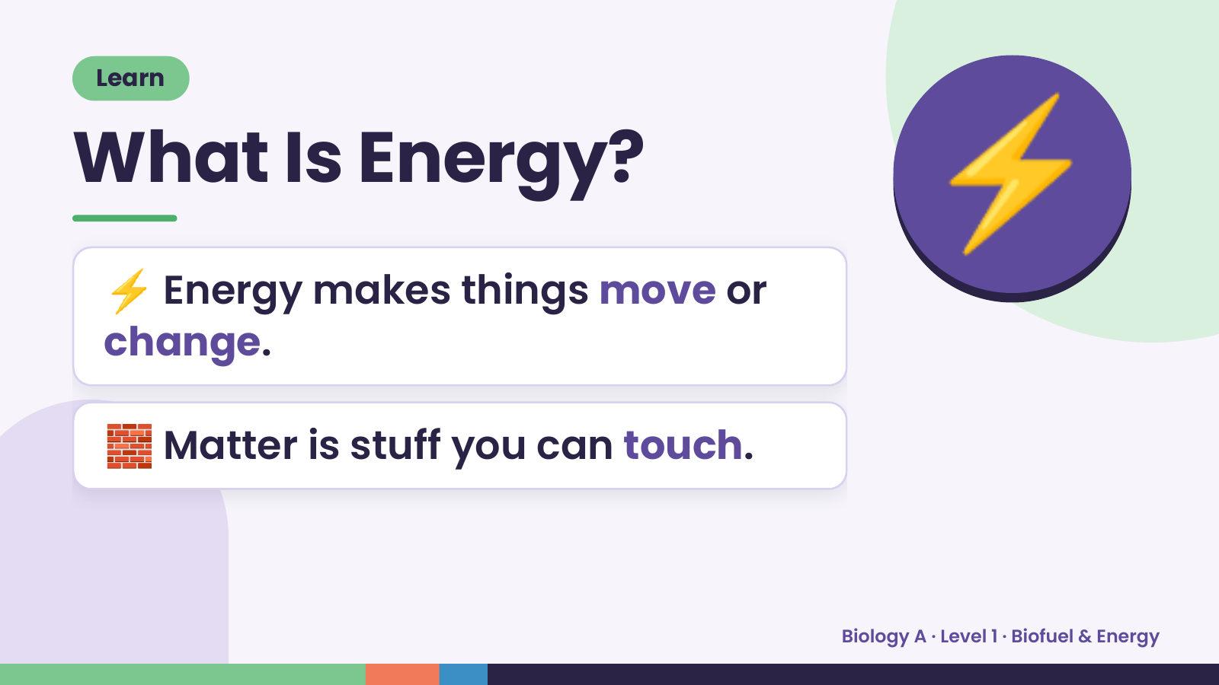
Notes:
Learn
What Is Energy?
⚡ Energy makes things move or
change.
⚡
🧱 Matter is stuff you can touch.
Biology A · Level 1 · Biofuel & Energy

Slide 5
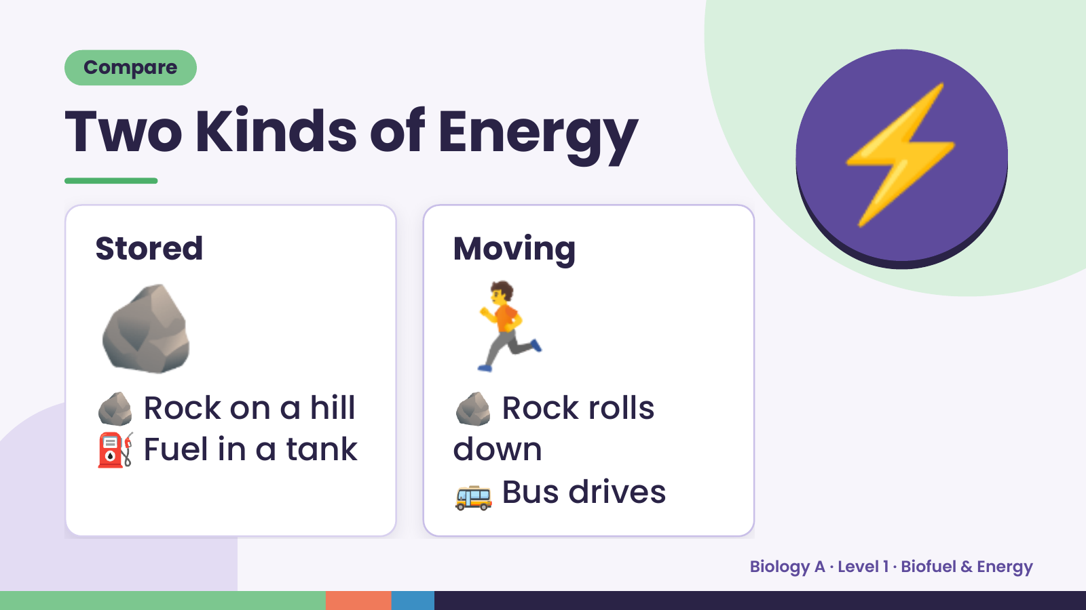
Notes:
Compare
Two Kinds of Energy
⚡
🪨
Stored
🪨 Rock on a hill
⛽ Fuel in a tank
🏃
Moving
🪨 Rock rolls
down
🚌 Bus drives
Biology A · Level 1 · Biofuel & Energy

Slide 6
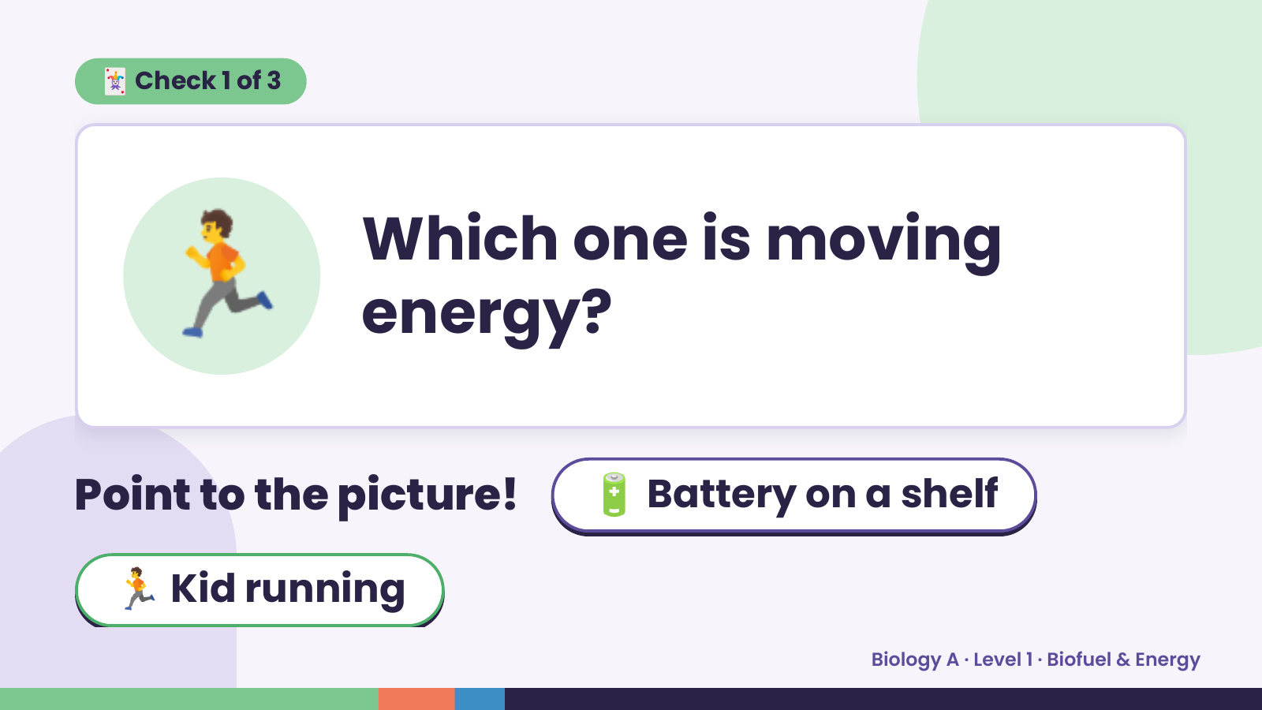
Notes:
🃏 Check 1 of 3
🏃 Which one is moving
energy?
Point to the picture! 🔋 Battery on a shelf
🏃 Kid running
Biology A · Level 1 · Biofuel & Energy

Slide 7
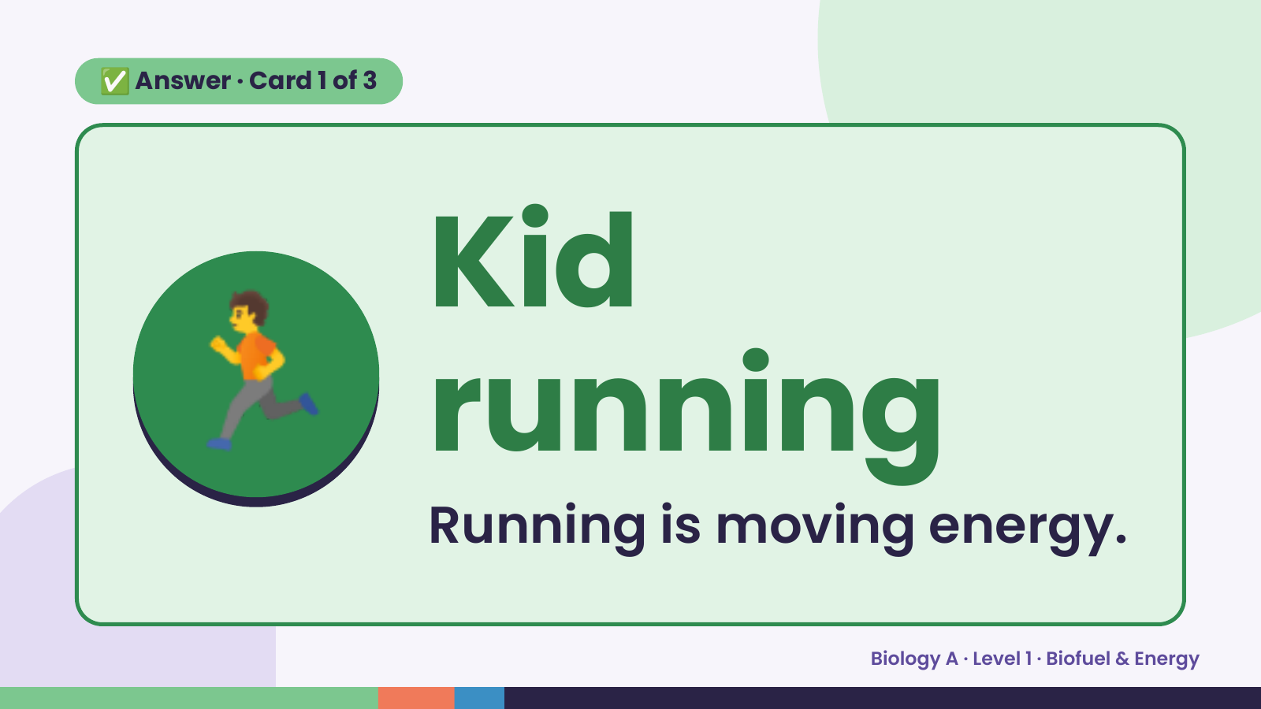
Notes:
✅ Answer · Card 1 of 3
🏃 Kid
running
Running is moving energy.
Biology A · Level 1 · Biofuel & Energy

Slide 8
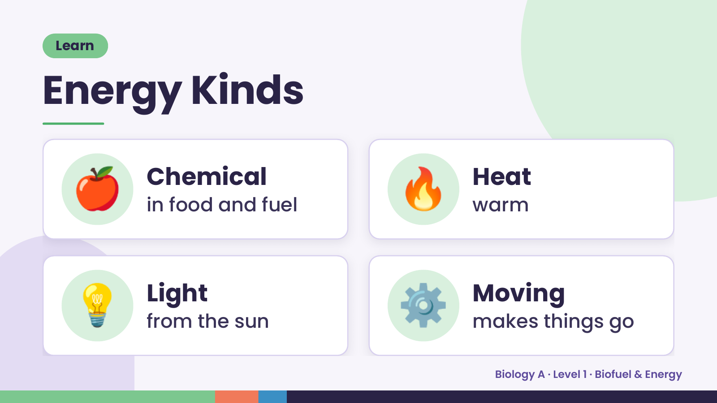
Notes:
Learn
Energy Kinds
🍎 Chemical
in food and fuel 🔥 Heat
warm
💡 Light
from the sun ⚙️ Moving
makes things go
Biology A · Level 1 · Biofuel & Energy

Slide 9
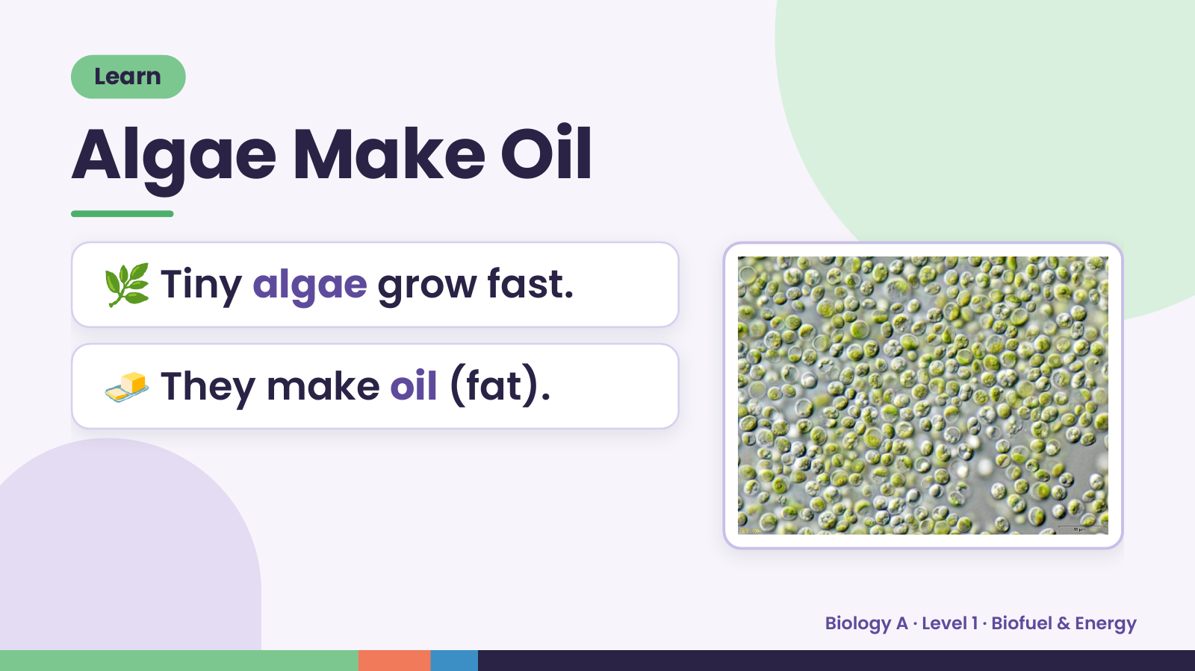
Notes:
Learn
Algae Make Oil
🌿 Tiny algae grow fast.
🧈 They make oil (fat).
Biology A · Level 1 · Biofuel & Energy

Slide 10
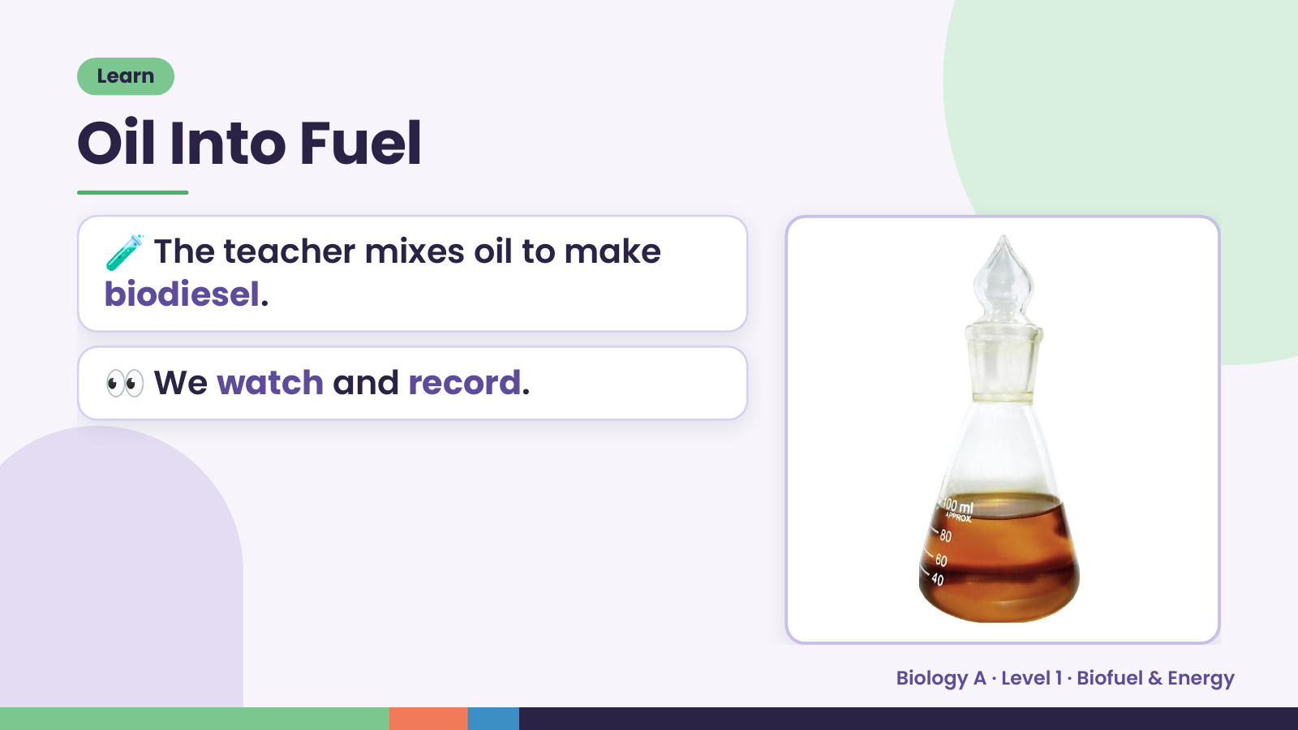
Notes:
Learn
Oil Into Fuel
🧪 The teacher mixes oil to make
biodiesel.
👀 We watch and record.
Biology A · Level 1 · Biofuel & Energy

Slide 11
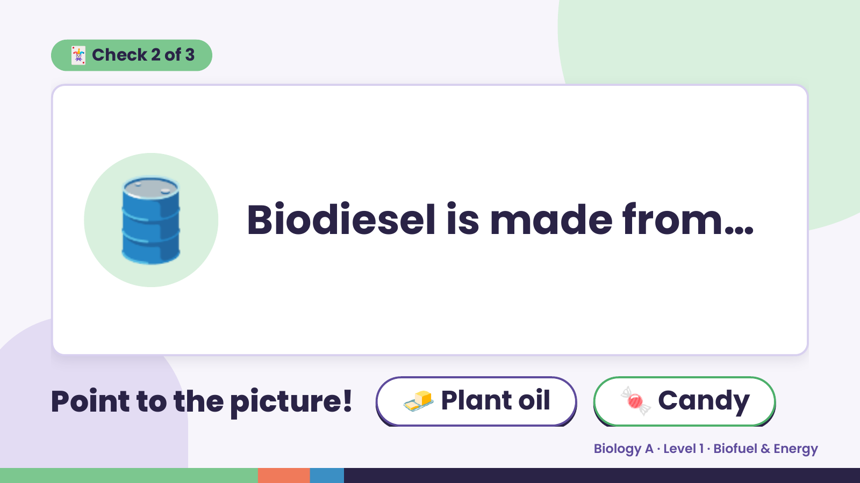
Notes:
🃏 Check 2 of 3
🛢️ Biodiesel is made from…
Point to the picture! 🧈 Plant oil 🍬 Candy
Biology A · Level 1 · Biofuel & Energy

Slide 12
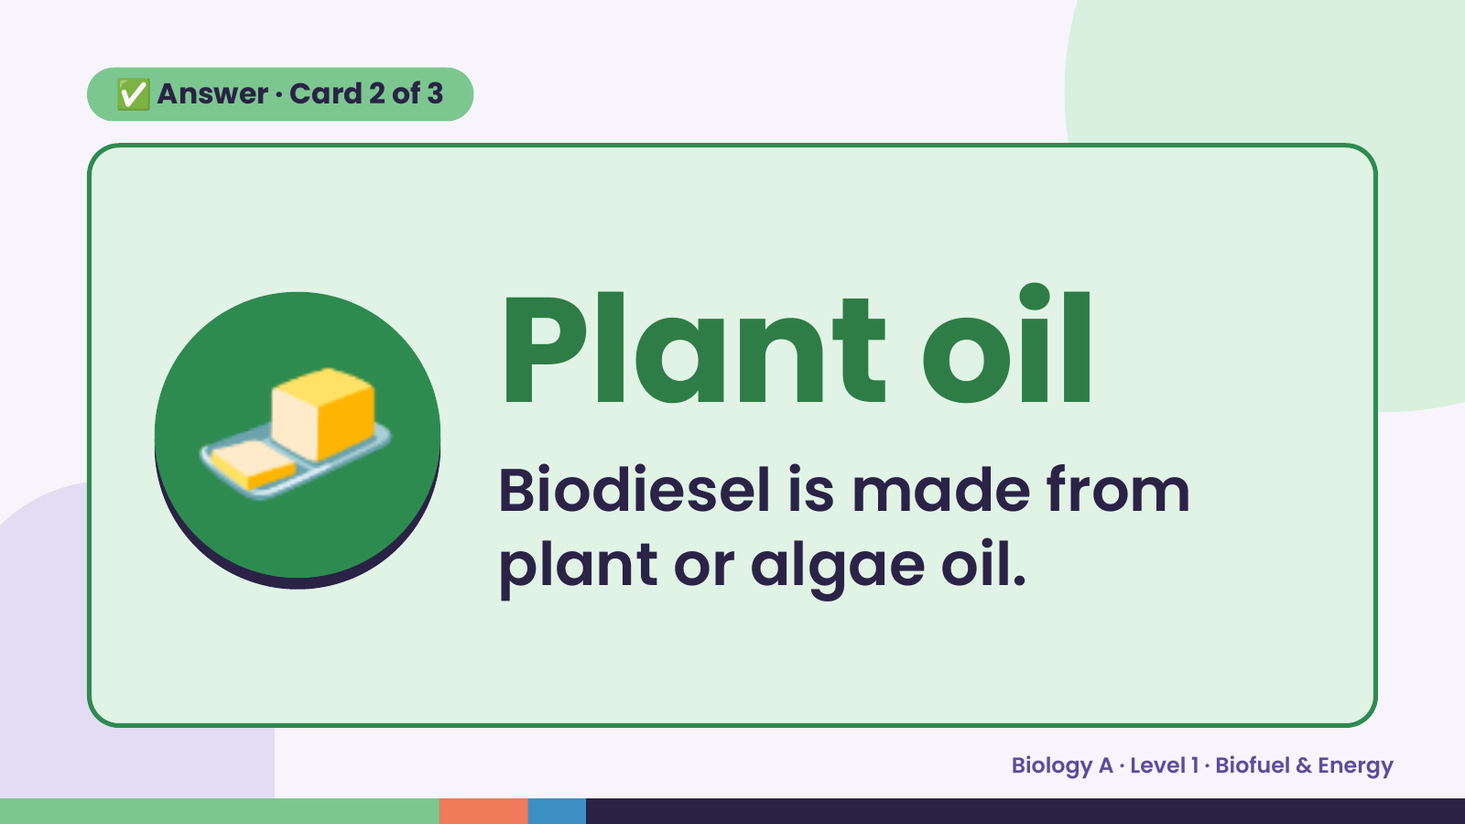
Notes:
✅ Answer · Card 2 of 3
🧈 Plant oil
Biodiesel is made from
plant or algae oil.
Biology A · Level 1 · Biofuel & Energy

Slide 13
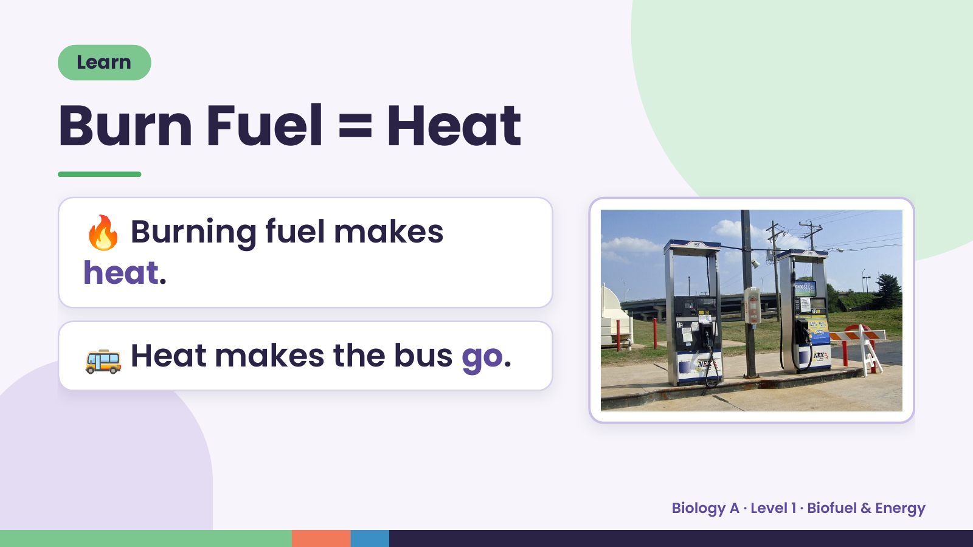
Notes:
Learn
Burn Fuel = Heat
🔥 Burning fuel makes
heat.
🚌 Heat makes the bus go.
Biology A · Level 1 · Biofuel & Energy

Slide 14
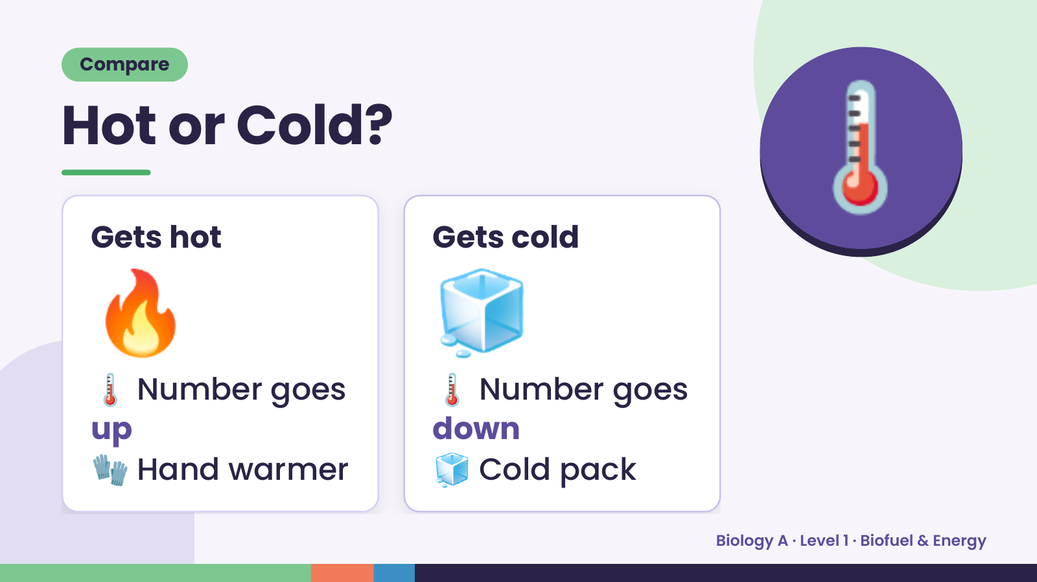
Notes:
Compare
Hot or Cold?
🌡️
🔥
Gets hot
🌡️ Number goes
up
🧊
Gets cold
🌡️ Number goes
🧤 Hand warmer
down
🧊 Cold pack
Biology A · Level 1 · Biofuel & Energy

Slide 15
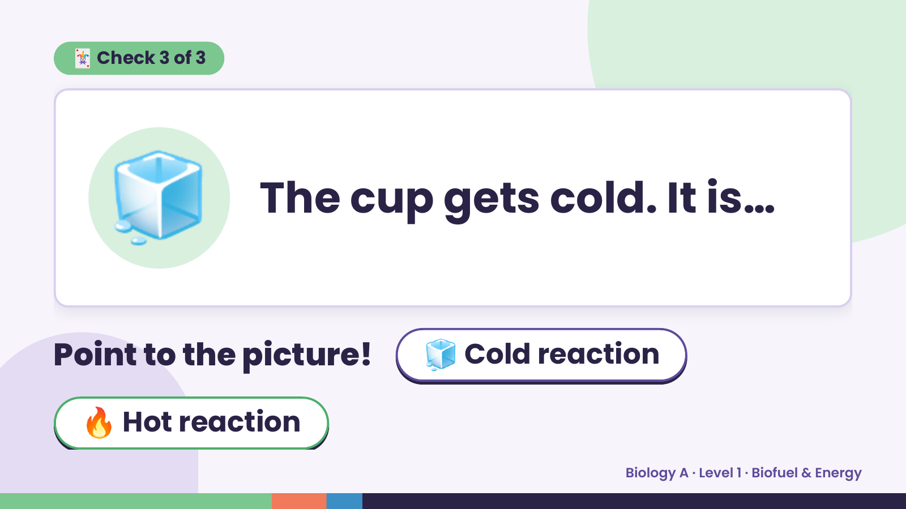
Notes:
🃏 Check 3 of 3
🧊 The cup gets cold. It is…
Point to the picture! 🧊 Cold reaction
🔥 Hot reaction
Biology A · Level 1 · Biofuel & Energy

Slide 16
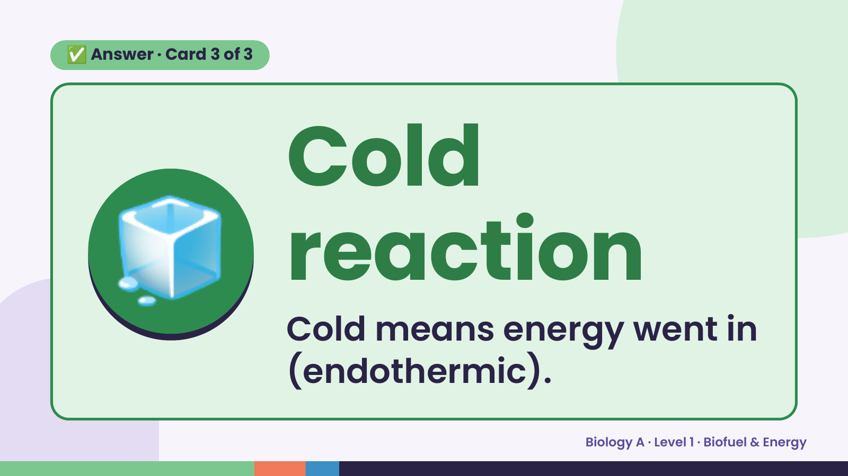
Notes:
✅ Answer · Card 3 of 3
🧊 Cold
reaction
Cold means energy went in
(endothermic).
Biology A · Level 1 · Biofuel & Energy

Slide 17
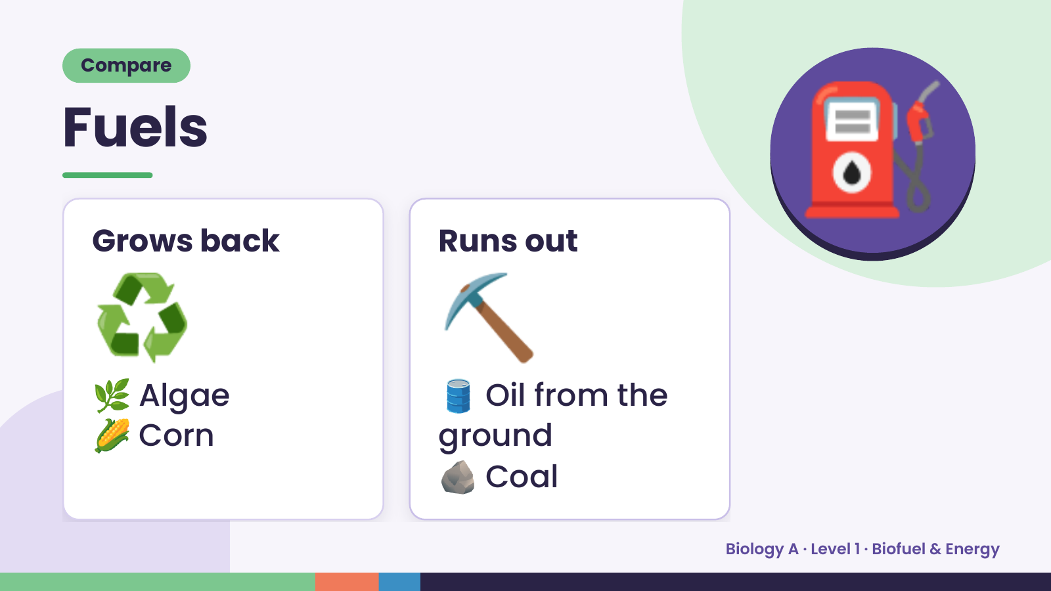
Notes:
Compare
Fuels
⛽
♻️
Grows back
🌿 Algae
🌽 Corn
⛏️
Runs out
🛢️ Oil from the
ground
🪨 Coal
Biology A · Level 1 · Biofuel & Energy

Slide 18
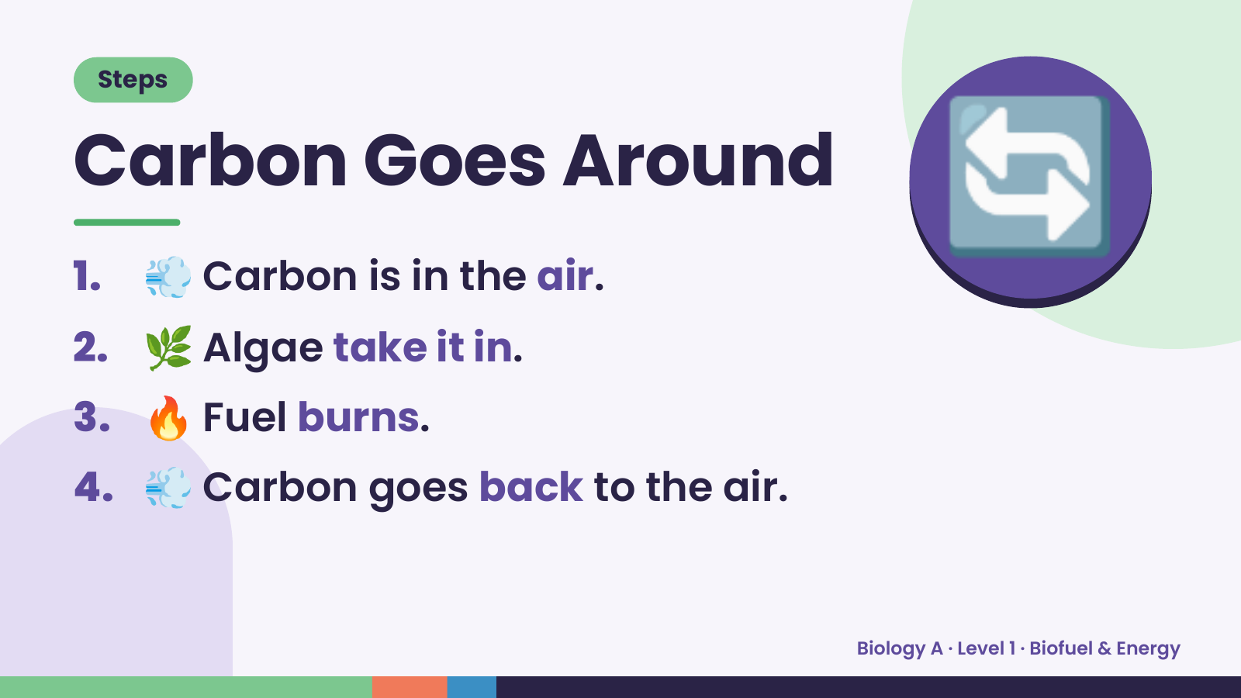
Notes:
Steps
Carbon Goes Around
1. 💨 Carbon is in the air.
2. 🌿 Algae take it in.
🔄
3. 🔥 Fuel burns.
4. 💨 Carbon goes back to the air.
Biology A · Level 1 · Biofuel & Energy

Slide 19
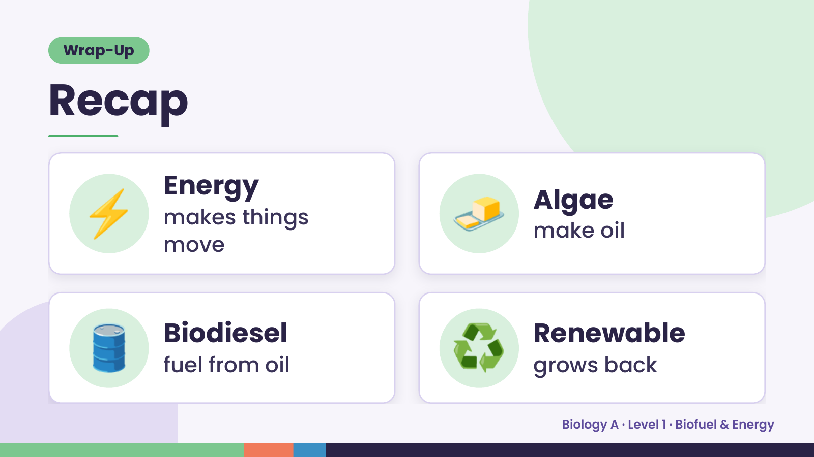
Notes:
Wrap-Up
Recap
⚡ Energy
makes things
move
🧈 Algae
make oil
🛢️ Biodiesel
fuel from oil ♻️ Renewable
grows back
Biology A · Level 1 · Biofuel & Energy

Slide 20
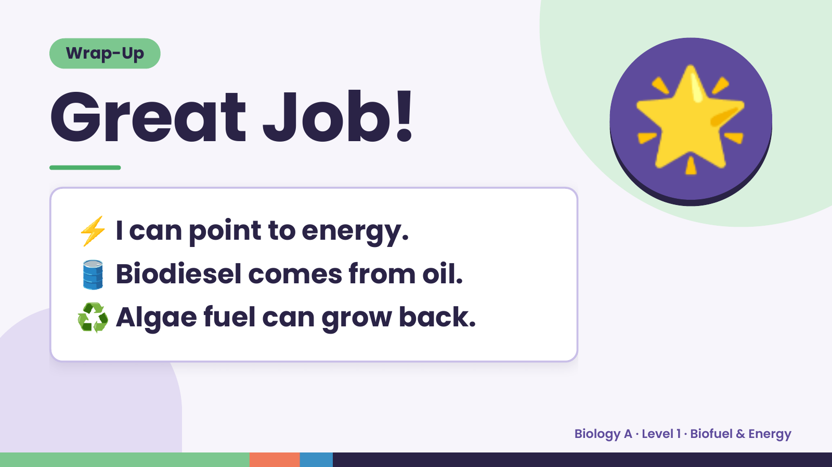
Notes:
Wrap-Up
Great Job!
⚡ I can point to energy.
🌟
🛢️ Biodiesel comes from oil.
♻️ Algae fuel can grow back.
Biology A · Level 1 · Biofuel & Energy

