Slide 1
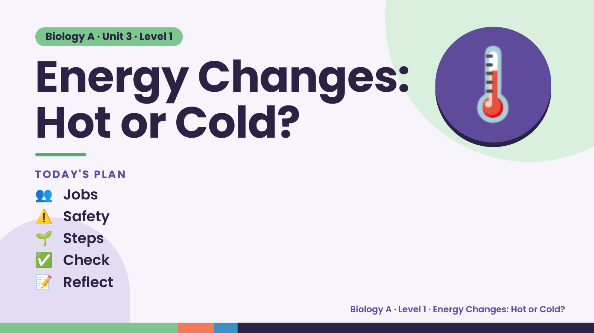
Notes:
Biology A · Unit 3 · Level 1
Energy Changes:
Hot or Cold?
TODAY'S PLAN
🌡️
👥 Jobs
⚠️ Safety
🌱 Steps
✅ Check
📝 Reflect
Biology A · Level 1 · Energy Changes: Hot or Cold?

Slide 2
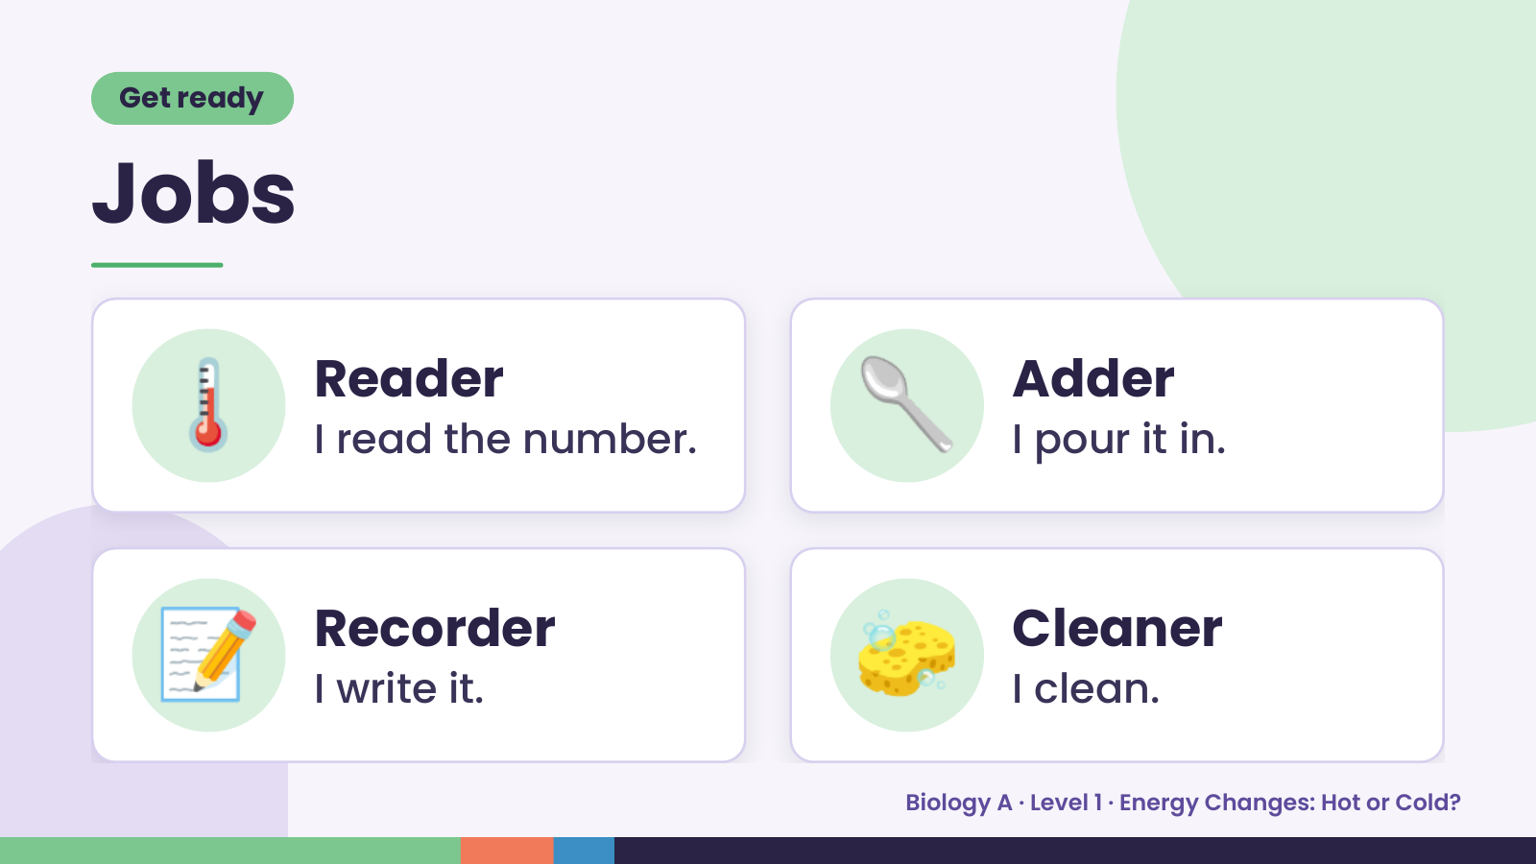
Notes:
Get ready
Jobs
🌡️ Reader
I read the number. 🥄 Adder
I pour it in.
📝 Recorder
I write it. 🧽 Cleaner
I clean.
Biology A · Level 1 · Energy Changes: Hot or Cold?

Slide 3
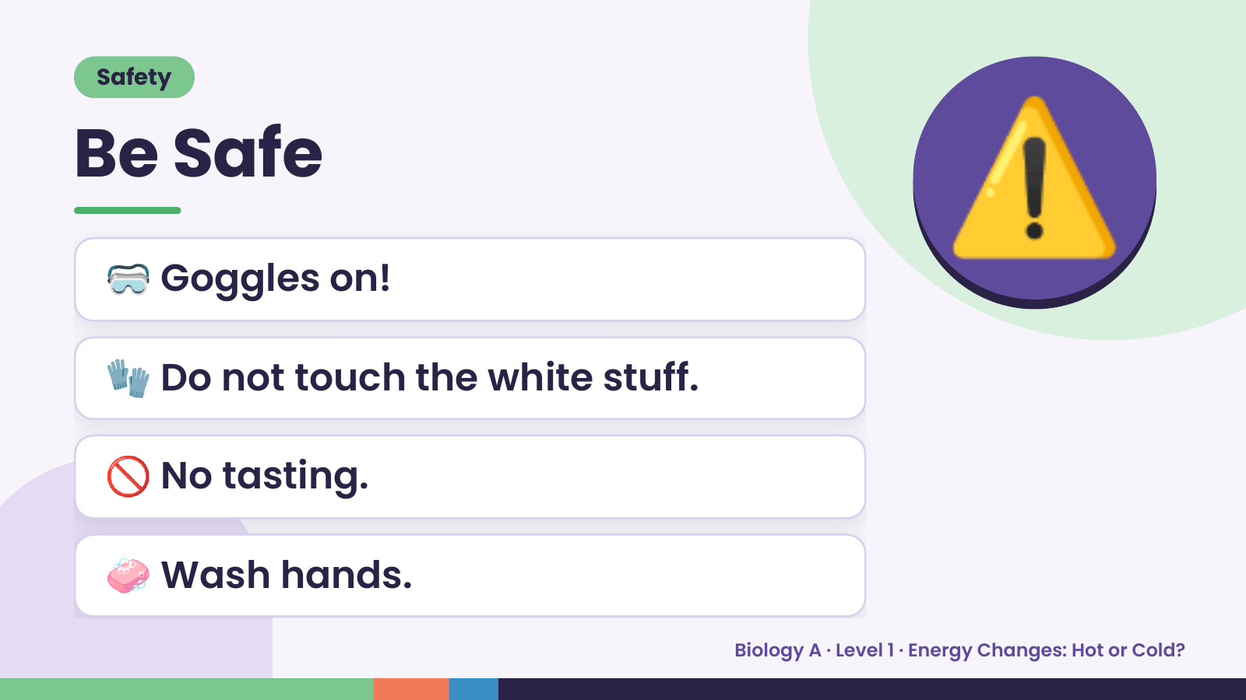
Notes:
Safety
Be Safe
🥽 Goggles on!
🧤 Do not touch the white stuff.
⚠️
🚫 No tasting.
🧼 Wash hands.
Biology A · Level 1 · Energy Changes: Hot or Cold?

Slide 4
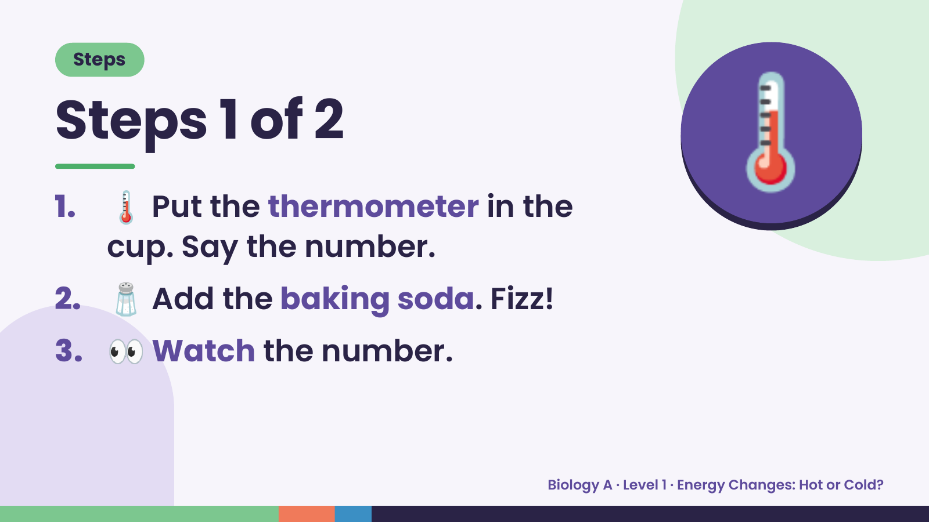
Notes:
Steps
Steps 1 of 2
1. 🌡️ Put the thermometer in the
cup. Say the number.
🌡️
2. 🧂 Add the baking soda. Fizz!
3. 👀 Watch the number.
Biology A · Level 1 · Energy Changes: Hot or Cold?

Slide 5
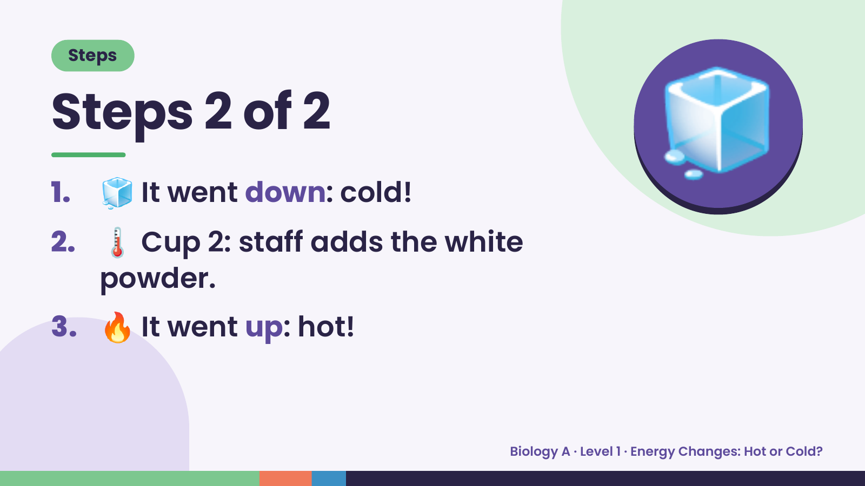
Notes:
Steps
Steps 2 of 2
1. 🧊 It went down: cold!
2. 🌡️ Cup 2: staff adds the white
🧊
powder.
3. 🔥 It went up: hot!
Biology A · Level 1 · Energy Changes: Hot or Cold?

Slide 6
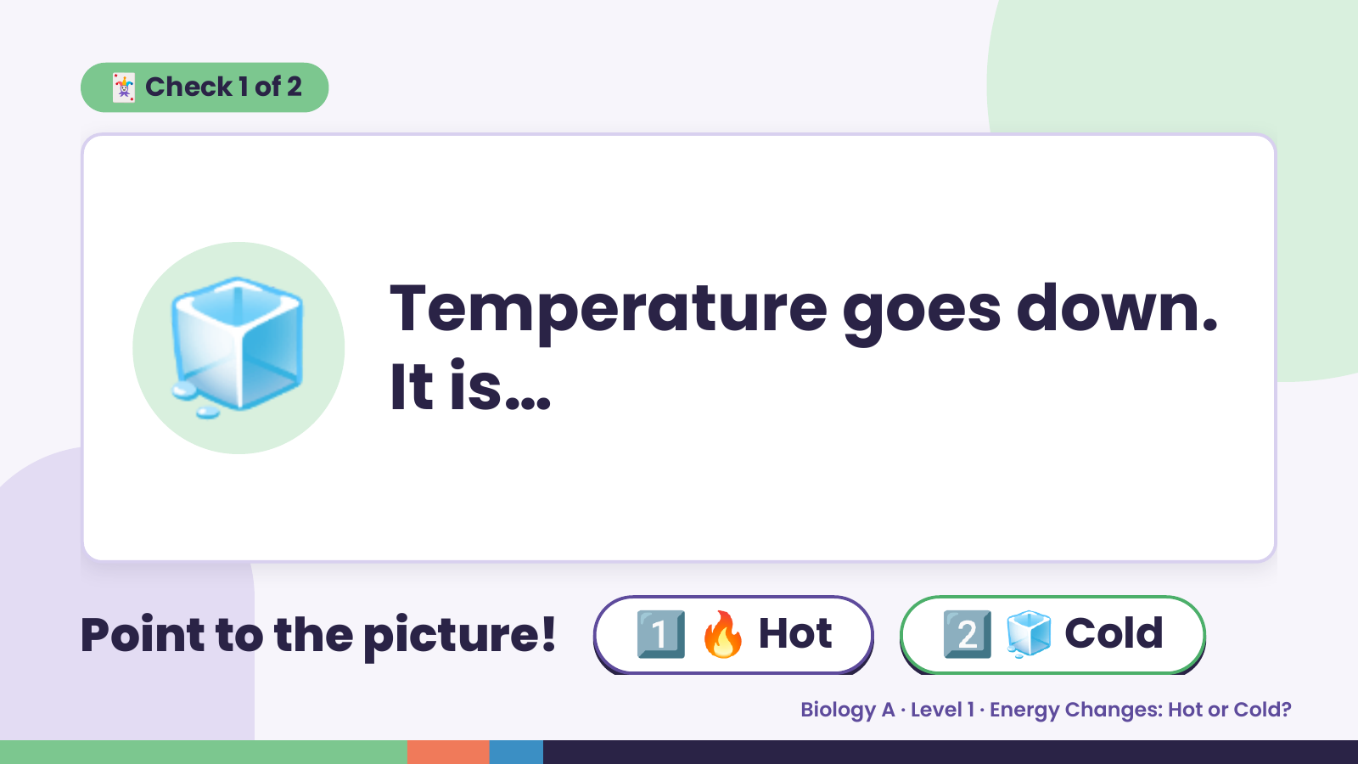
Notes:
🃏 Check 1 of 2
🧊 Temperature goes down.
It is…
Point to the picture! 1️⃣ 🔥 Hot 2️⃣ 🧊 Cold
Biology A · Level 1 · Energy Changes: Hot or Cold?

Slide 7
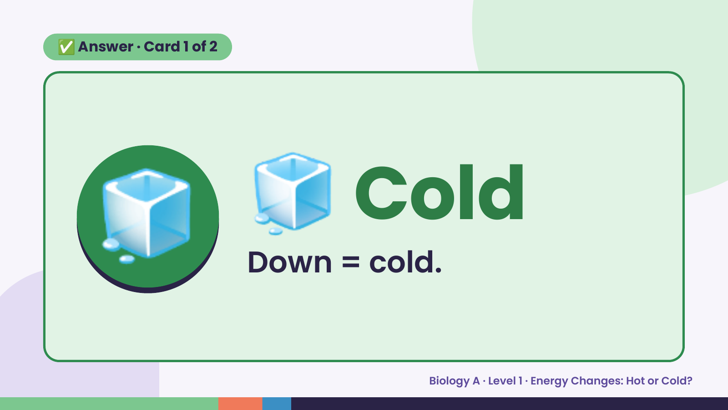
Notes:
✅ Answer · Card 1 of 2
🧊 🧊 Cold
Down = cold.
Biology A · Level 1 · Energy Changes: Hot or Cold?

Slide 8
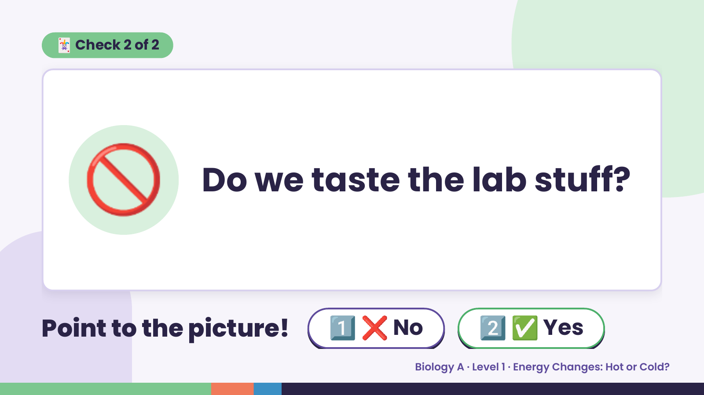
Notes:
🃏 Check 2 of 2
🚫 Do we taste the lab stuff?
Point to the picture! 1️⃣ ❌ No 2️⃣ ✅ Yes
Biology A · Level 1 · Energy Changes: Hot or Cold?

Slide 9
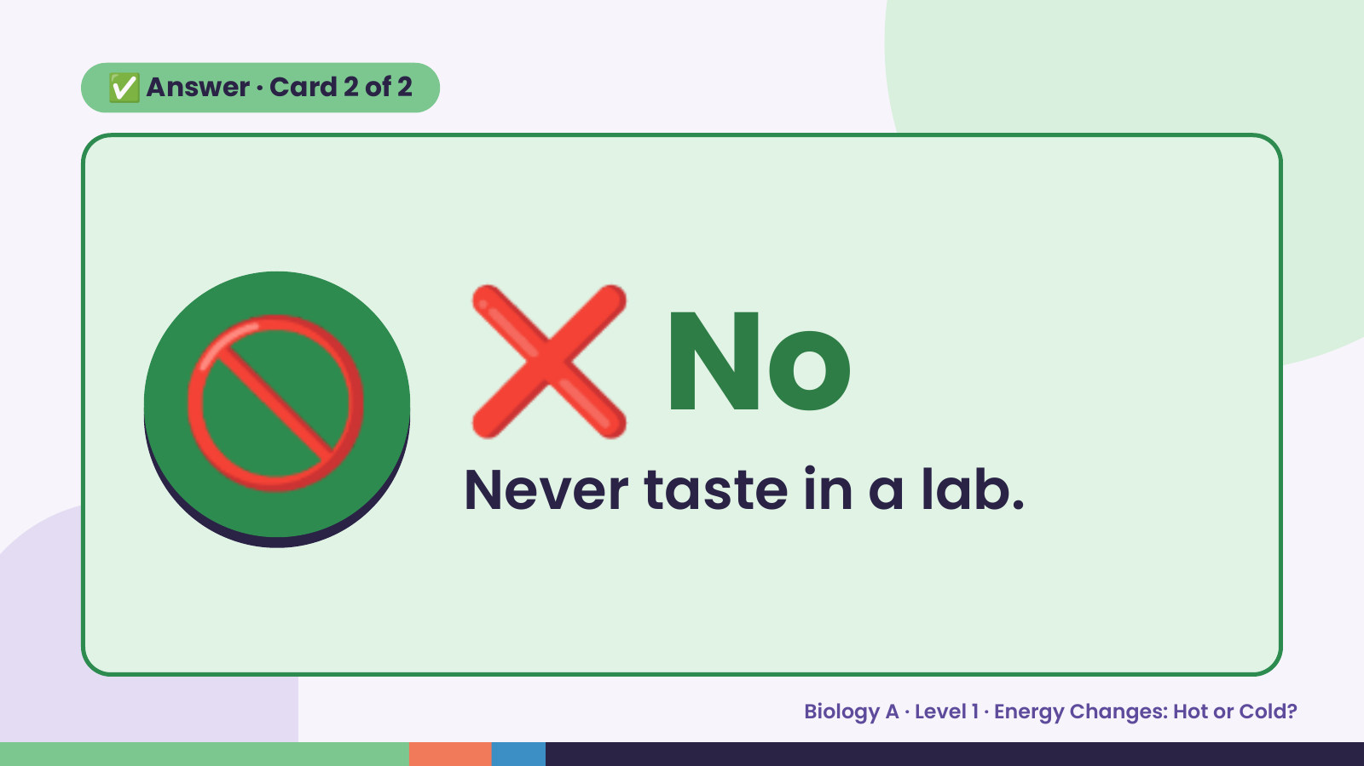
Notes:
✅ Answer · Card 2 of 2
🚫 ❌ No
Never taste in a lab.
Biology A · Level 1 · Energy Changes: Hot or Cold?

Slide 10
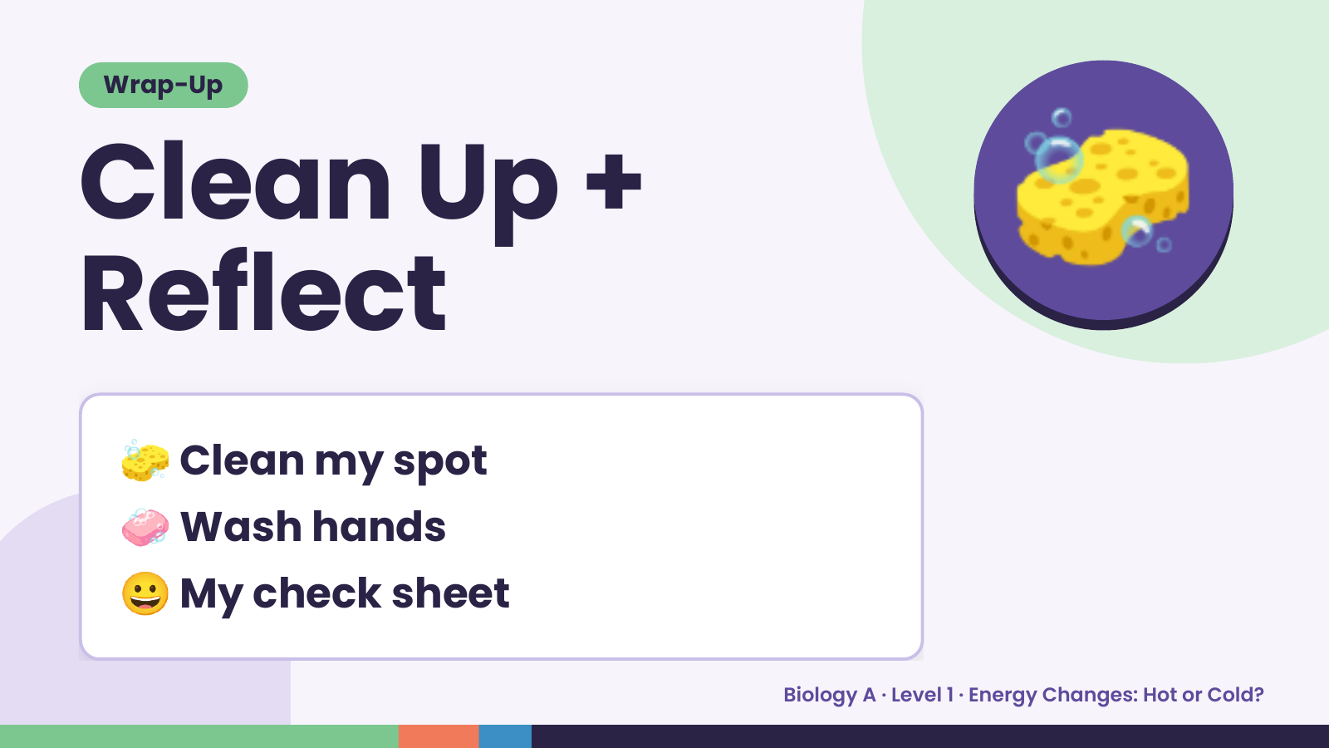
Notes:
Wrap-Up
Clean Up +
Reflect
🧽
🧽 Clean my spot
🧼 Wash hands
😀 My check sheet
Biology A · Level 1 · Energy Changes: Hot or Cold?

