Slide 1
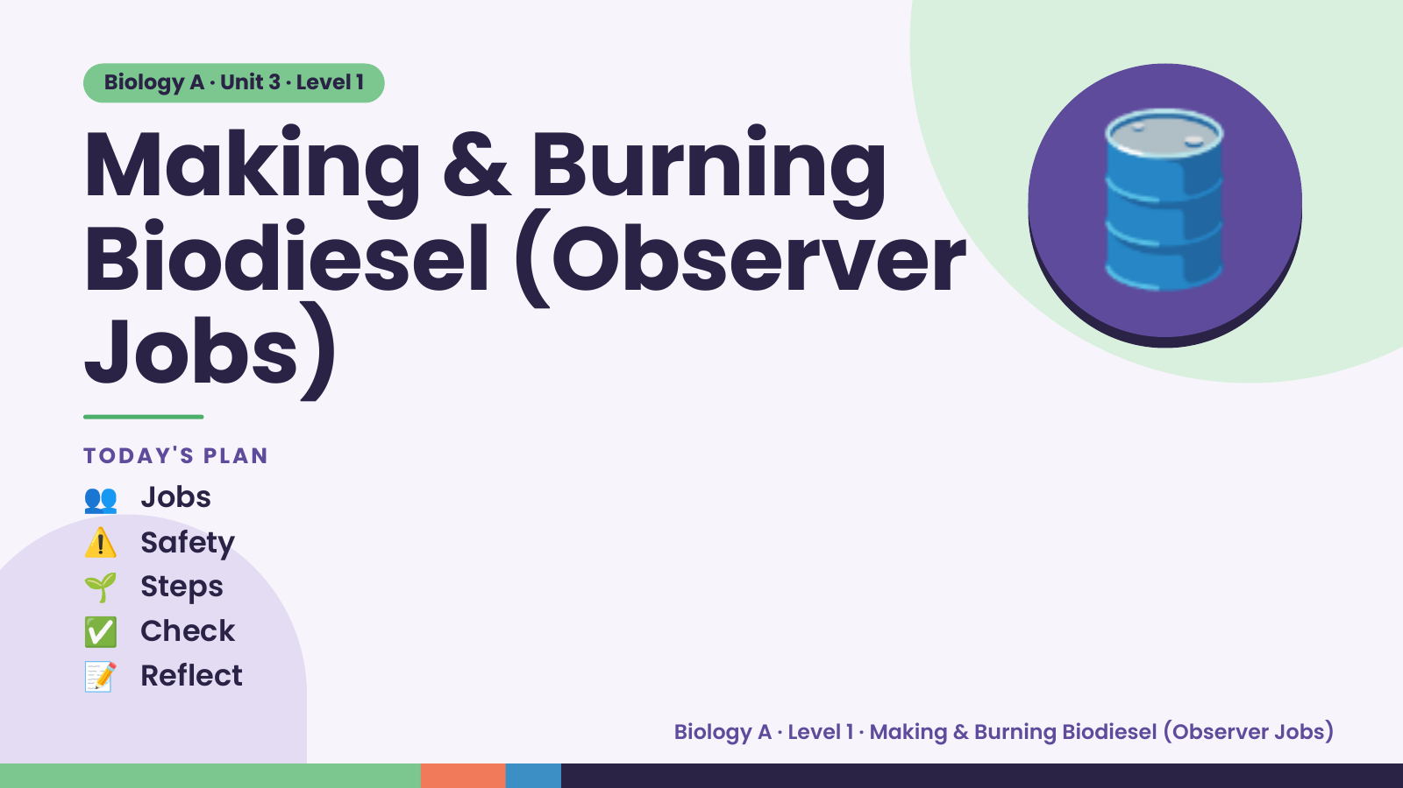
Notes:
Biology A · Unit 3 · Level 1
Making & Burning
Biodiesel (Observer
Jobs)
🛢️
TODAY'S PLAN
👥 Jobs
⚠️ Safety
🌱 Steps
✅ Check
📝 Reflect
Biology A · Level 1 · Making & Burning Biodiesel (Observer Jobs)

Slide 2
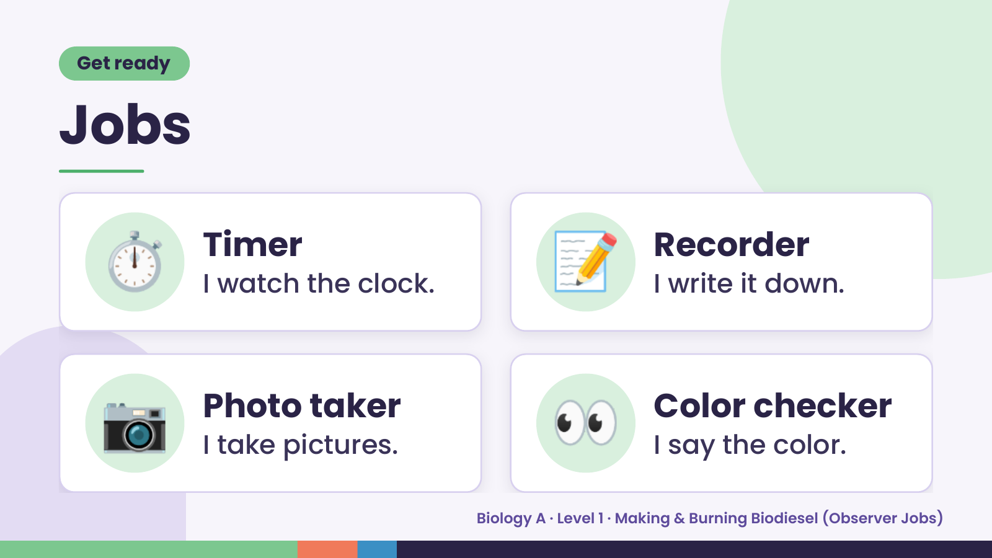
Notes:
Get ready
Jobs
⏱️ Timer
I watch the clock. 📝 Recorder
I write it down.
📷 Photo taker
I take pictures. 👀 Color checker
I say the color.
Biology A · Level 1 · Making & Burning Biodiesel (Observer Jobs)

Slide 3
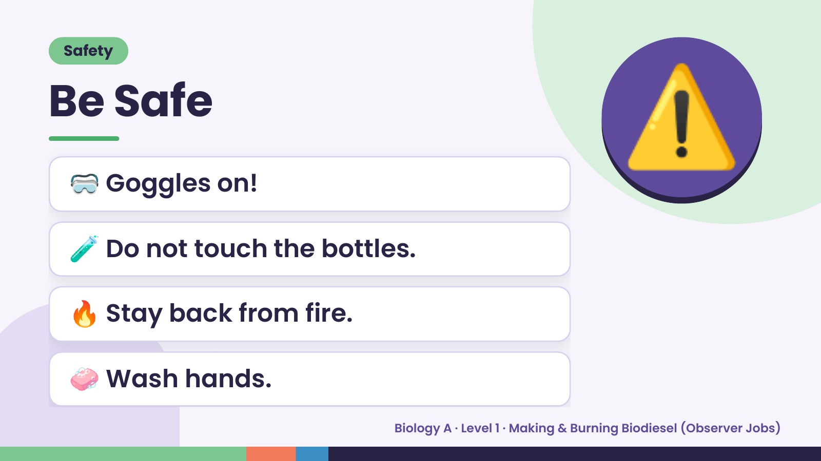
Notes:
Safety
Be Safe
🥽 Goggles on!
🧪 Do not touch the bottles.
⚠️
🔥 Stay back from fire.
🧼 Wash hands.
Biology A · Level 1 · Making & Burning Biodiesel (Observer Jobs)

Slide 4
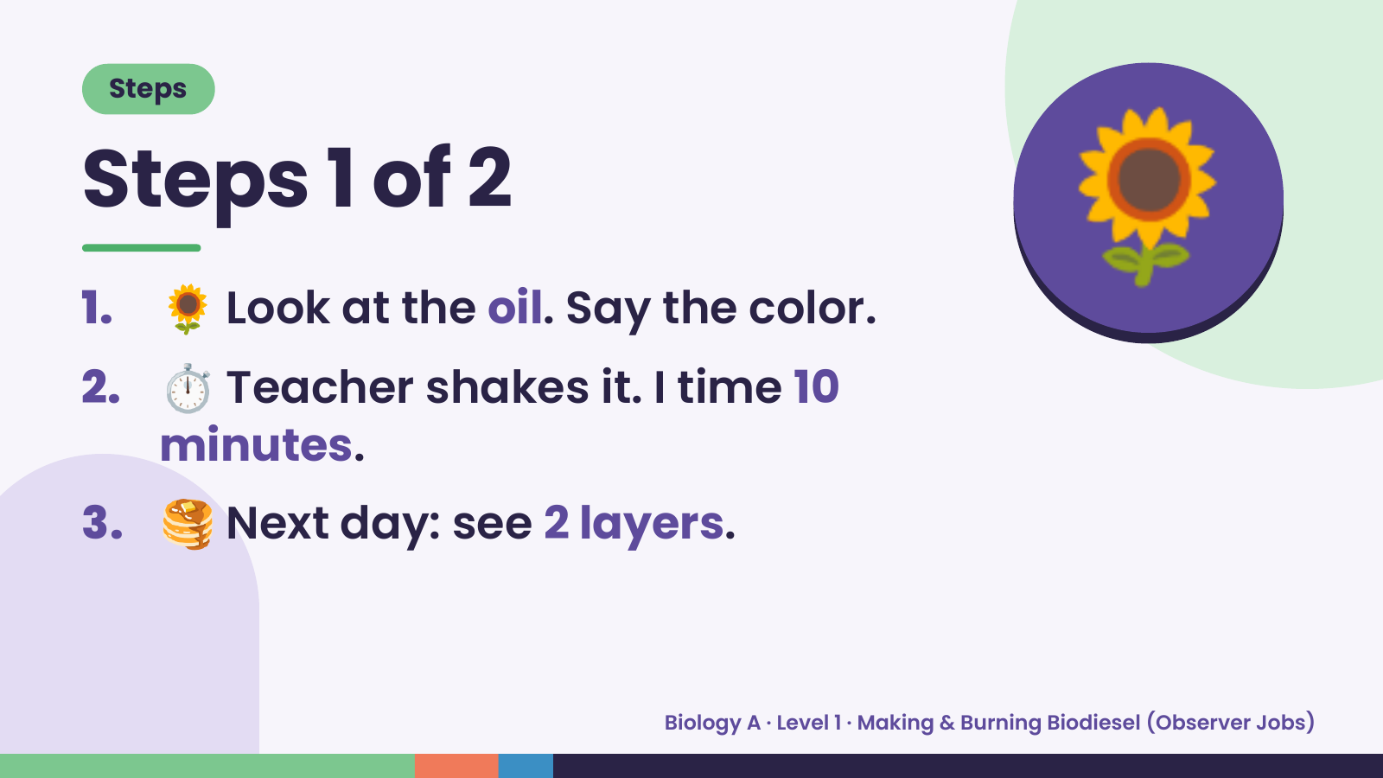
Notes:
Steps
Steps 1 of 2
1. 🌻 Look at the oil. Say the color.
2. ⏱️ Teacher shakes it. I time 10
🌻
minutes.
3. 🥞 Next day: see 2 layers.
Biology A · Level 1 · Making & Burning Biodiesel (Observer Jobs)

Slide 5
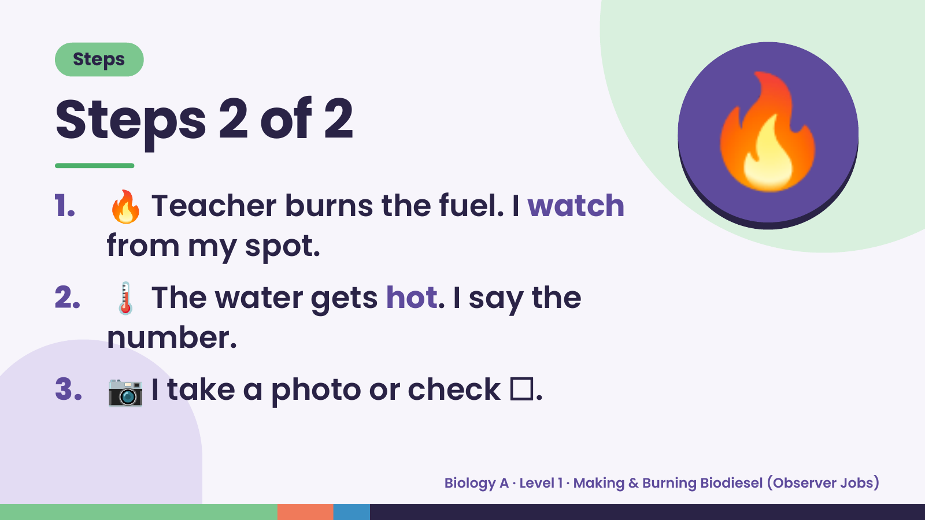
Notes:
Steps
Steps 2 of 2
1. 🔥 Teacher burns the fuel. I watch
from my spot.
🔥
2. 🌡️ The water gets hot. I say the
number.
3. 📷 I take a photo or check ☐.
Biology A · Level 1 · Making & Burning Biodiesel (Observer Jobs)

Slide 6
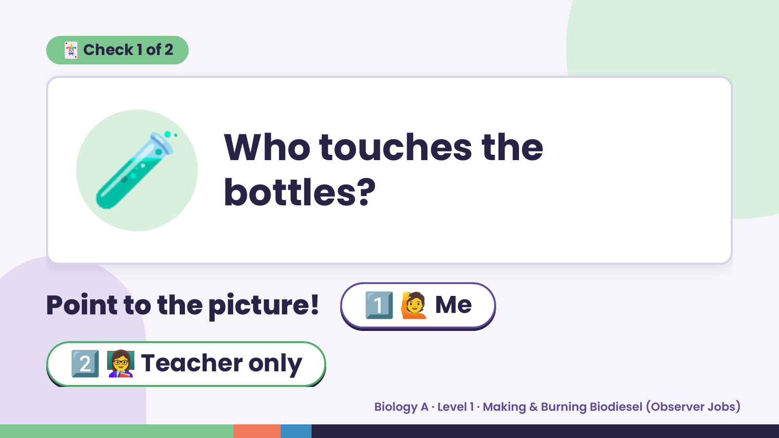
Notes:
🃏 Check 1 of 2
🧪 Who touches the
bottles?
Point to the picture! 1️⃣ 🙋 Me
2️⃣ 👩‍🏫 Teacher only
Biology A · Level 1 · Making & Burning Biodiesel (Observer Jobs)

Slide 7
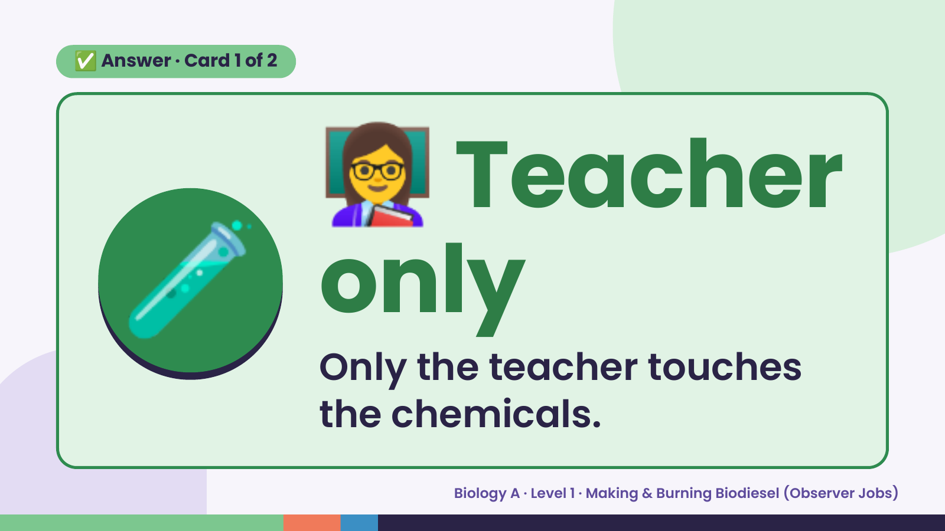
Notes:
👩‍🏫
✅ Answer · Card 1 of 2
🧪 onlyTeacher
Only the teacher touches
the chemicals.
Biology A · Level 1 · Making & Burning Biodiesel (Observer Jobs)

Slide 8
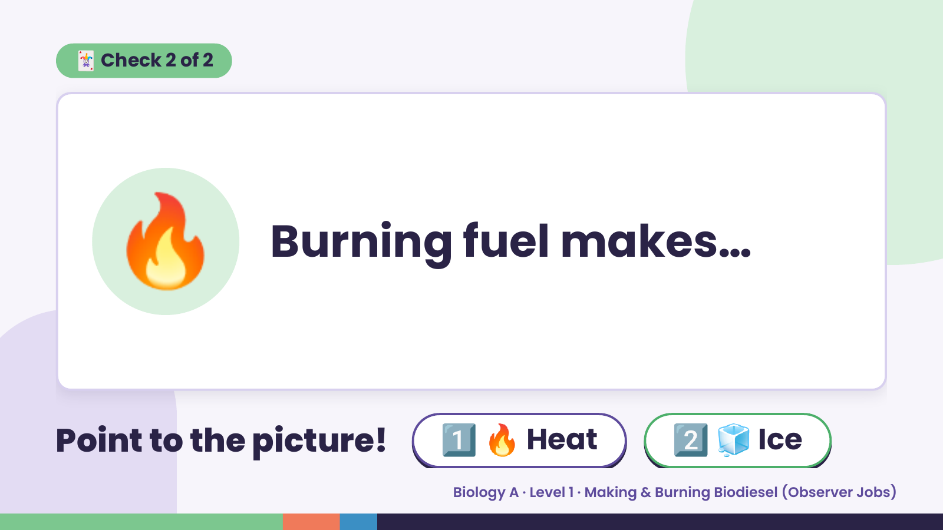
Notes:
🃏 Check 2 of 2
🔥 Burning fuel makes…
Point to the picture! 1️⃣ 🔥 Heat 2️⃣ 🧊 Ice
Biology A · Level 1 · Making & Burning Biodiesel (Observer Jobs)

Slide 9
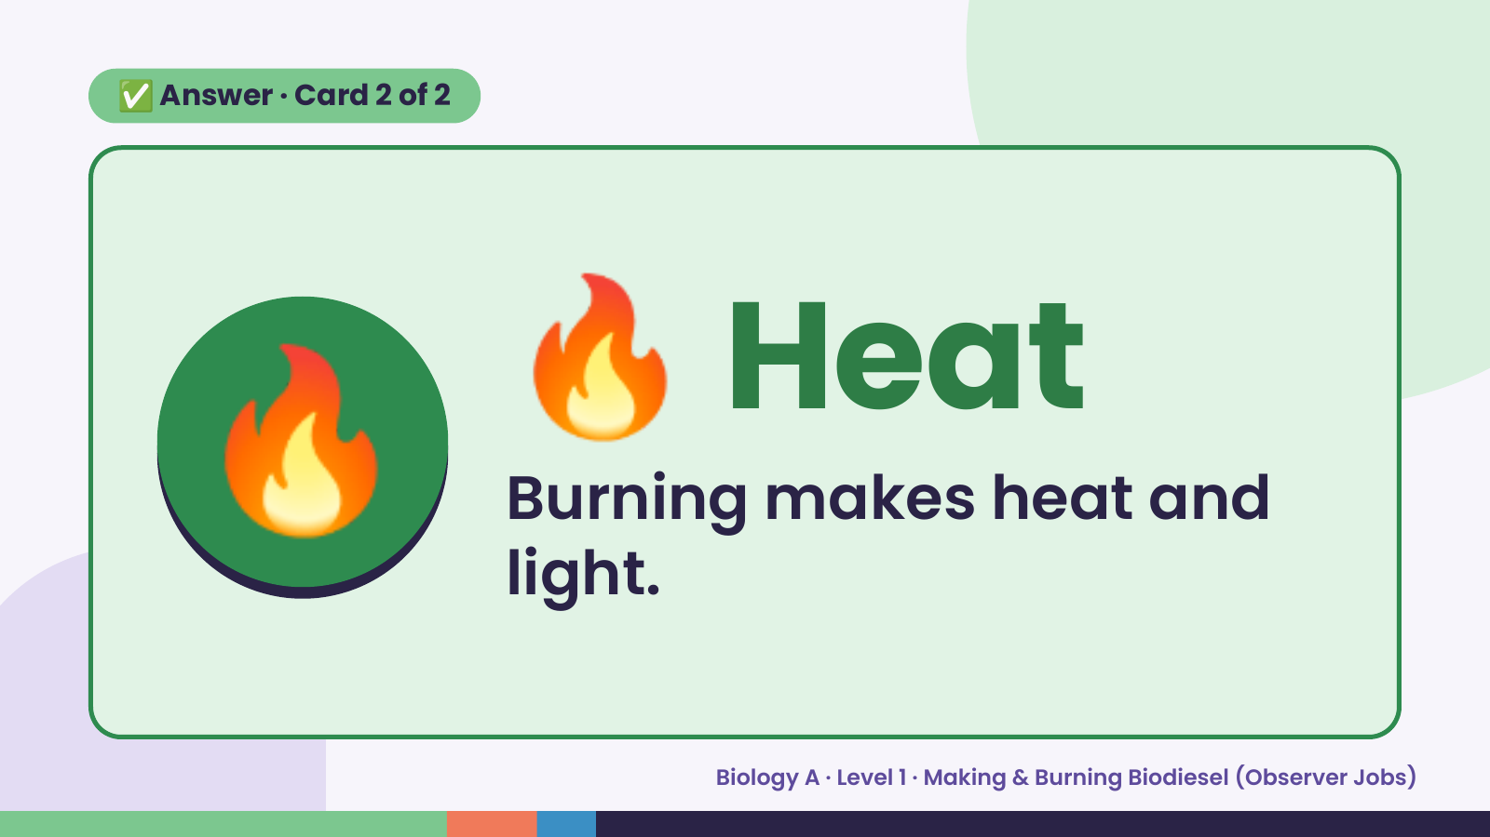
Notes:
✅ Answer · Card 2 of 2
🔥 🔥 Heat
Burning makes heat and
light.
Biology A · Level 1 · Making & Burning Biodiesel (Observer Jobs)

Slide 10
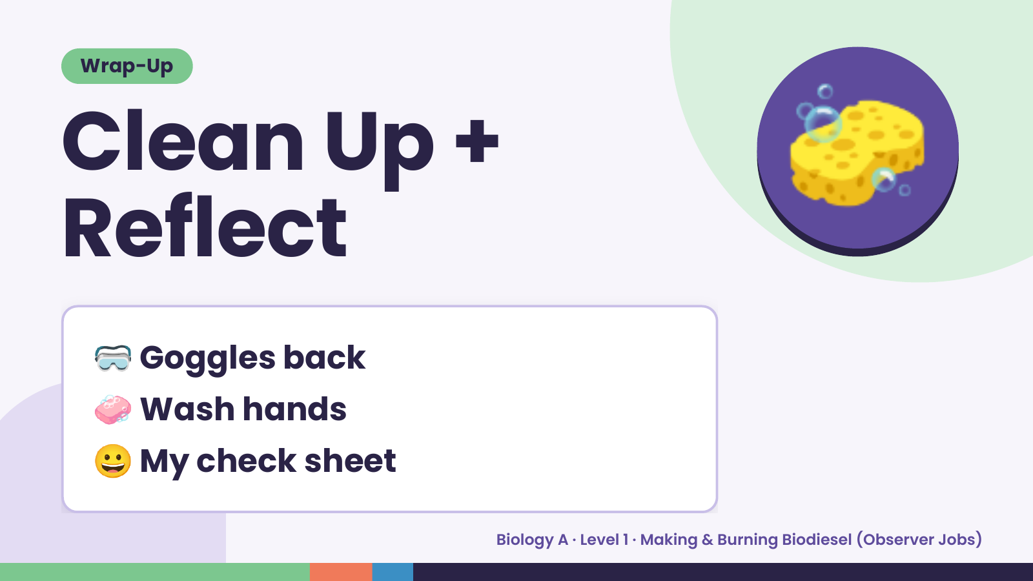
Notes:
Wrap-Up
Clean Up +
Reflect
🧽
🥽 Goggles back
🧼 Wash hands
😀 My check sheet
Biology A · Level 1 · Making & Burning Biodiesel (Observer Jobs)

