Slide 1
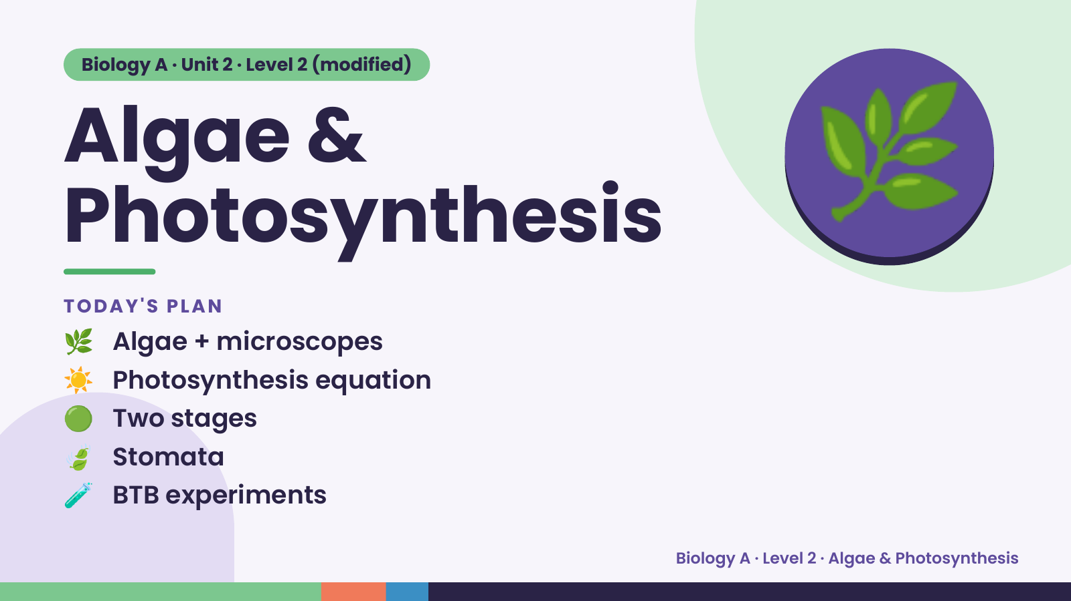
Notes:
Biology A · Unit 2 · Level 2 (modified)
Algae &
Photosynthesis
🌿 Algae + microscopes
TODAY'S PLAN
🌿
☀️ Photosynthesis equation
🟢 Two stages
🍃 Stomata
🧪 BTB experiments
Biology A · Level 2 · Algae & Photosynthesis

Slide 2
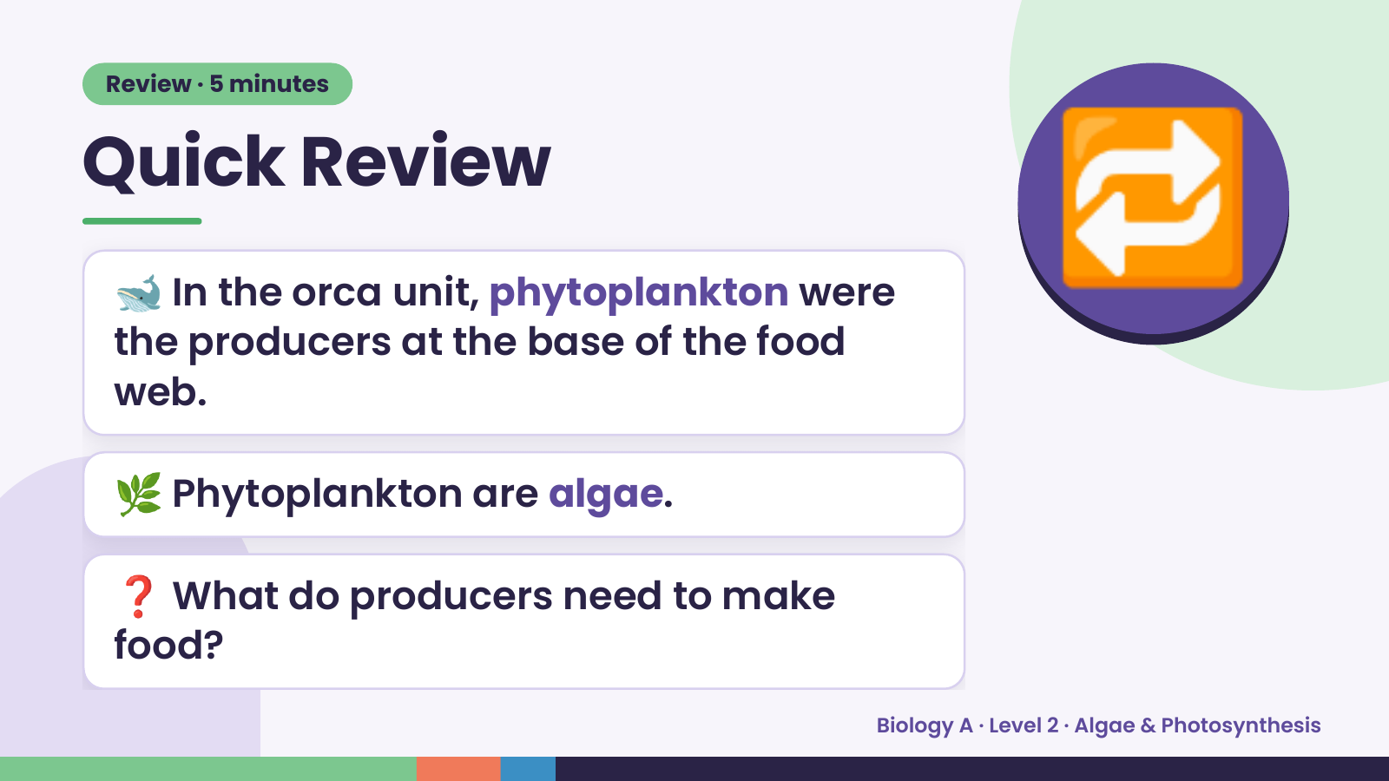
Notes:
Review · 5 minutes
Quick Review
🐋 In the orca unit, phytoplankton were
the producers at the base of the food
web.
🔁
🌿 Phytoplankton are algae.
❓ What do producers need to make
food?
Biology A · Level 2 · Algae & Photosynthesis

Slide 3
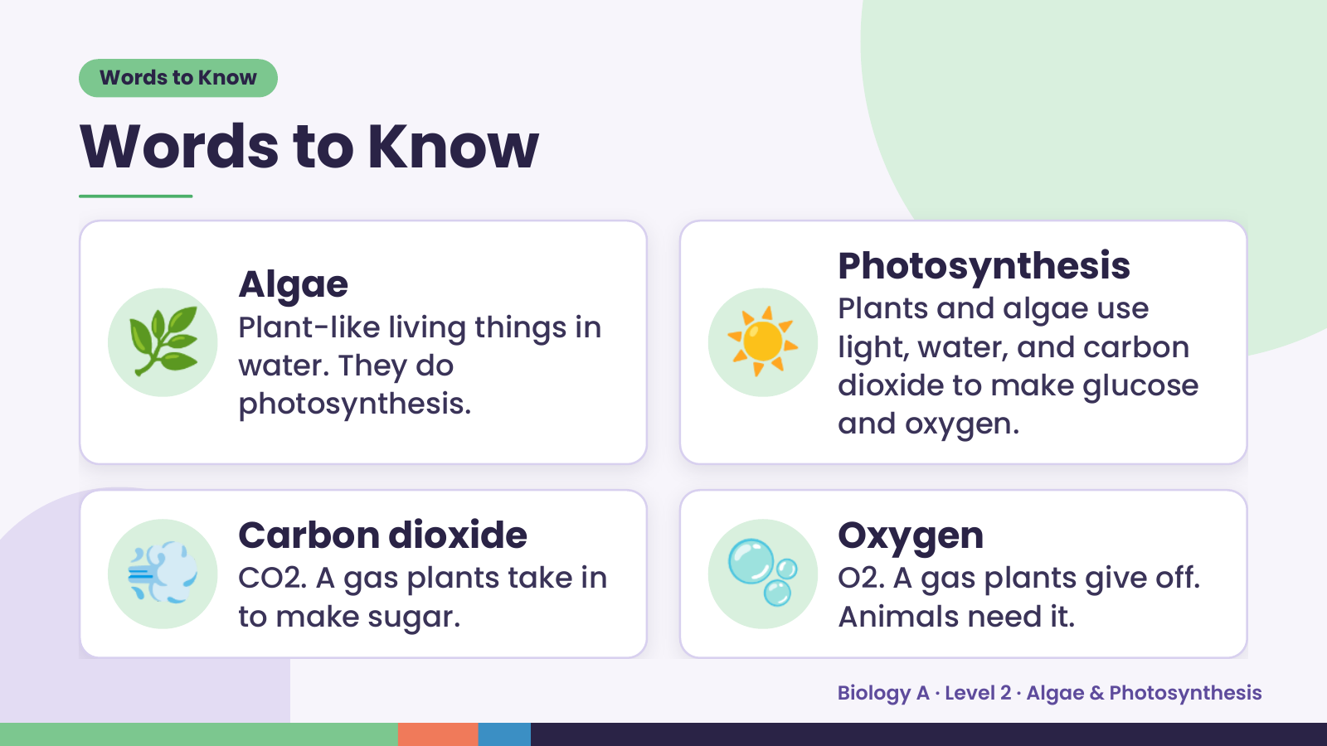
Notes:
Words to Know
Words to Know
🌿 ☀️
Photosynthesis
Algae
Plants and algae use
Plant-like living things in
light, water, and carbon
water. They do
dioxide to make glucose
photosynthesis.
and oxygen.
💨 Carbon dioxide
CO2. A gas plants take in
to make sugar.
🫧 Oxygen
O2. A gas plants give off.
Animals need it.
Biology A · Level 2 · Algae & Photosynthesis

Slide 4
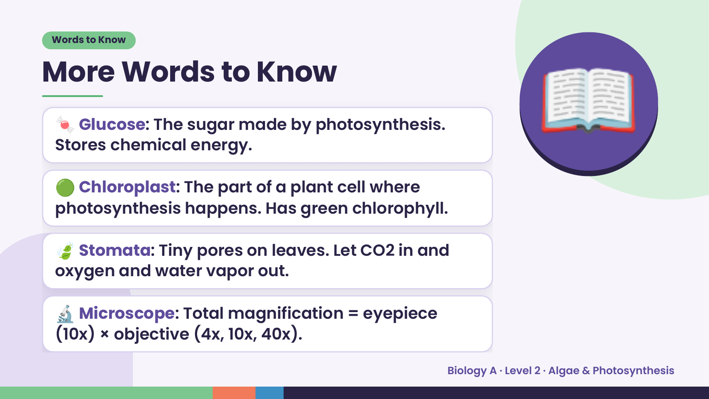
Notes:
Words to Know
More Words to Know
🍬 Glucose: The sugar made by photosynthesis.
Stores chemical energy.
🟢 Chloroplast: The part of a plant cell where
photosynthesis happens. Has green chlorophyll.
📖
🍃 Stomata: Tiny pores on leaves. Let CO2 in and
oxygen and water vapor out.
🔬 Microscope: Total magnification = eyepiece
(10x) × objective (4x, 10x, 40x).
Biology A · Level 2 · Algae & Photosynthesis

Slide 5
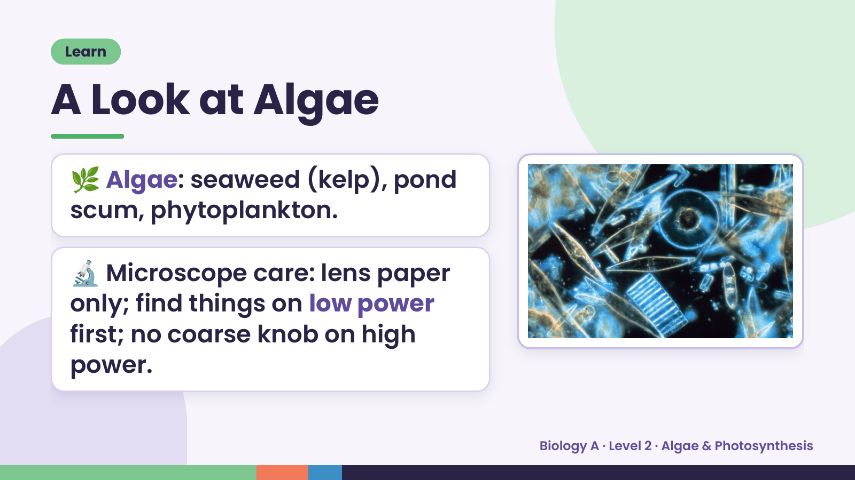
Notes:
Learn
A Look at Algae
🌿 Algae: seaweed (kelp), pond
scum, phytoplankton.
🔬 Microscope care: lens paper
only; find things on low power
first; no coarse knob on high
power.
Biology A · Level 2 · Algae & Photosynthesis

Slide 6
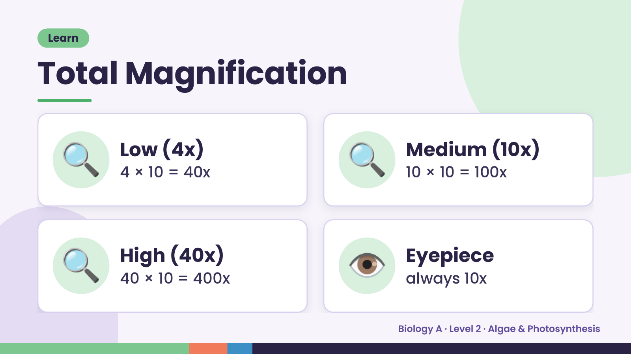
Notes:
Learn
Total Magnification
🔍 Low (4x)
4 × 10 = 40x 🔍 Medium (10x)
10 × 10 = 100x
🔍 High (40x)
40 × 10 = 400x 👁️ Eyepiece
always 10x
Biology A · Level 2 · Algae & Photosynthesis

Slide 7
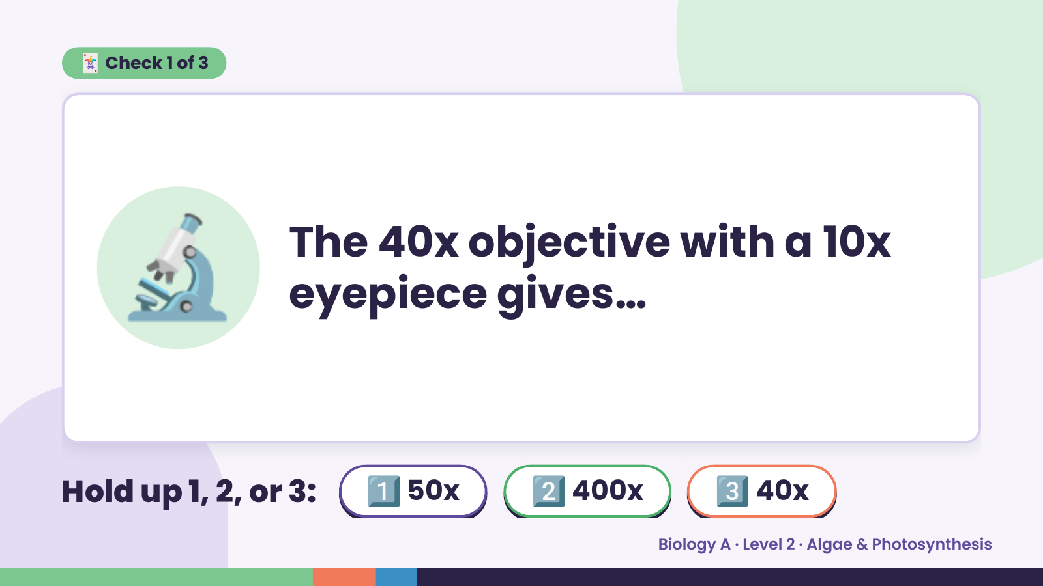
Notes:
🃏 Check 1 of 3
🔬 The 40x objective with a 10x
eyepiece gives…
Hold up 1, 2, or 3: 1️⃣ 50x 2️⃣ 400x 3️⃣ 40x
Biology A · Level 2 · Algae & Photosynthesis

Slide 8
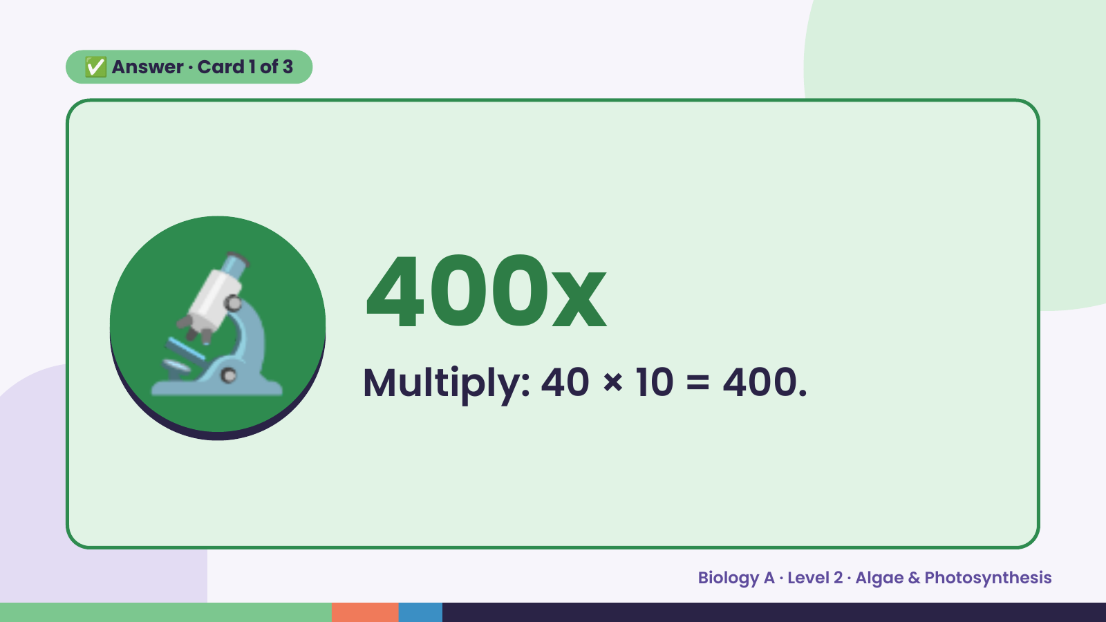
Notes:
✅ Answer · Card 1 of 3
🔬 400x
Multiply: 40 × 10 = 400.
Biology A · Level 2 · Algae & Photosynthesis

Slide 9
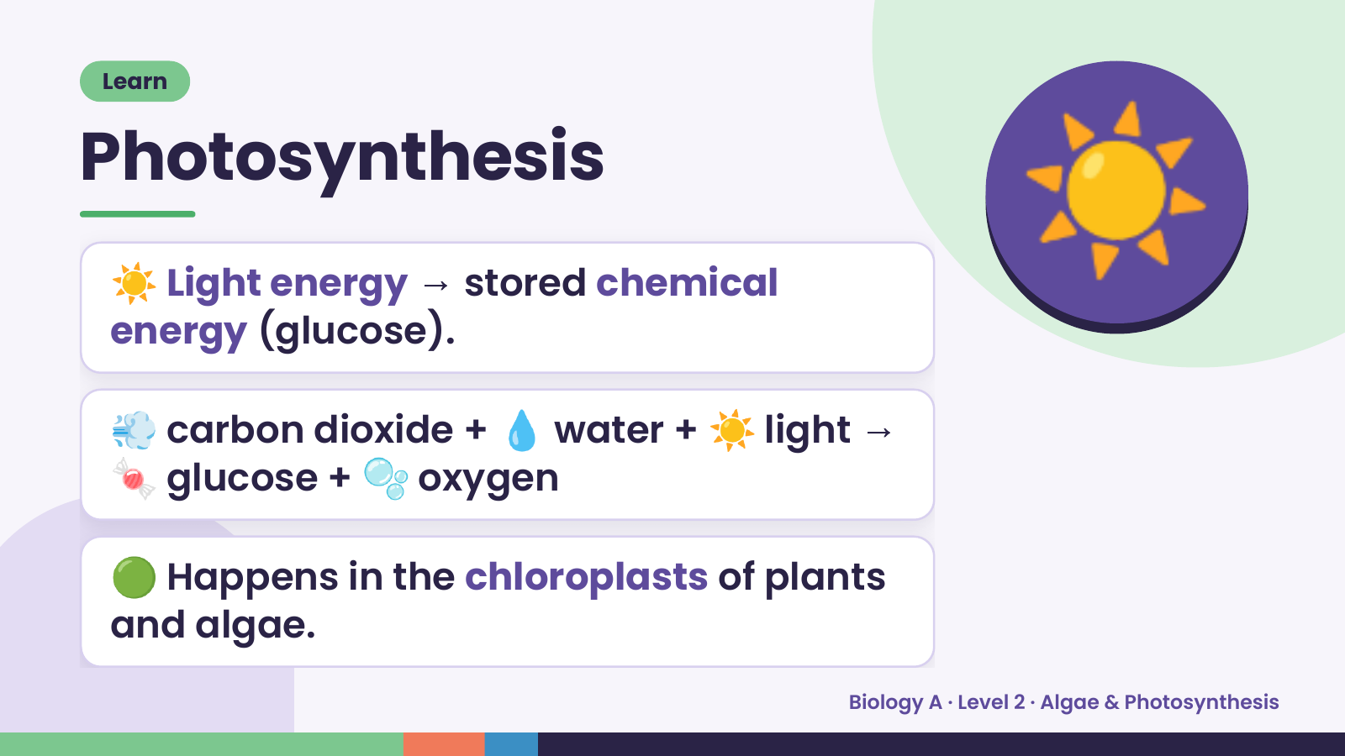
Notes:
Learn
Photosynthesis
☀️ Light energy → stored chemical
energy (glucose).
☀️
💨 carbon dioxide + 💧 water + ☀️ light →
🍬 glucose + 🫧 oxygen
🟢 Happens in the chloroplasts of plants
and algae.
Biology A · Level 2 · Algae & Photosynthesis

Slide 10
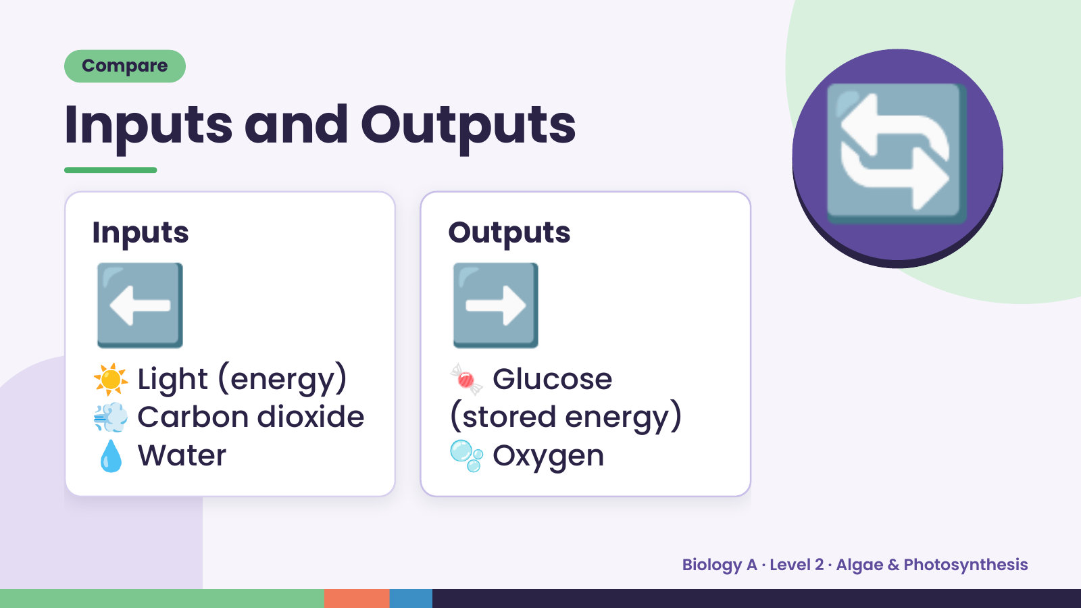
Notes:
Compare
Inputs and Outputs
⬅️
Inputs
➡️
Outputs
🔄
☀️ Light (energy) 🍬 Glucose
💨 Carbon dioxide
💧 Water 🫧 Oxygen
(stored energy)
Biology A · Level 2 · Algae & Photosynthesis

Slide 11
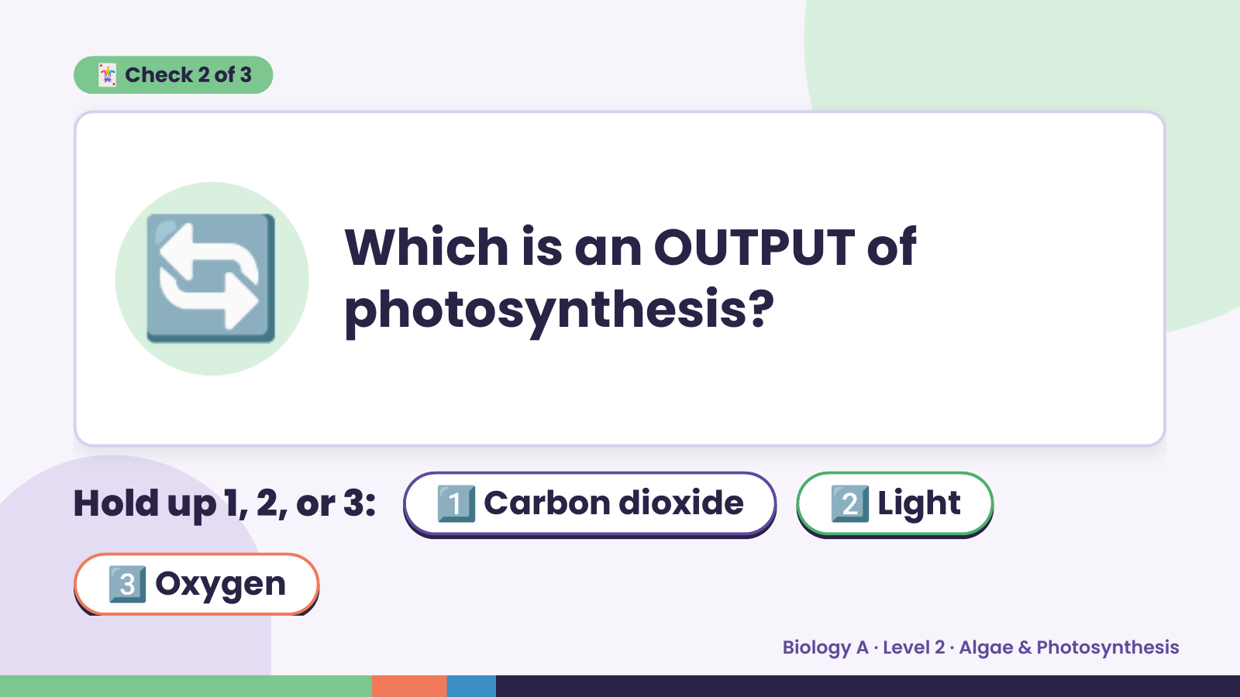
Notes:
🃏 Check 2 of 3
🔄 Which is an OUTPUT of
photosynthesis?
Hold up 1, 2, or 3: 1️⃣ Carbon dioxide 2️⃣ Light
3️⃣ Oxygen
Biology A · Level 2 · Algae & Photosynthesis

Slide 12
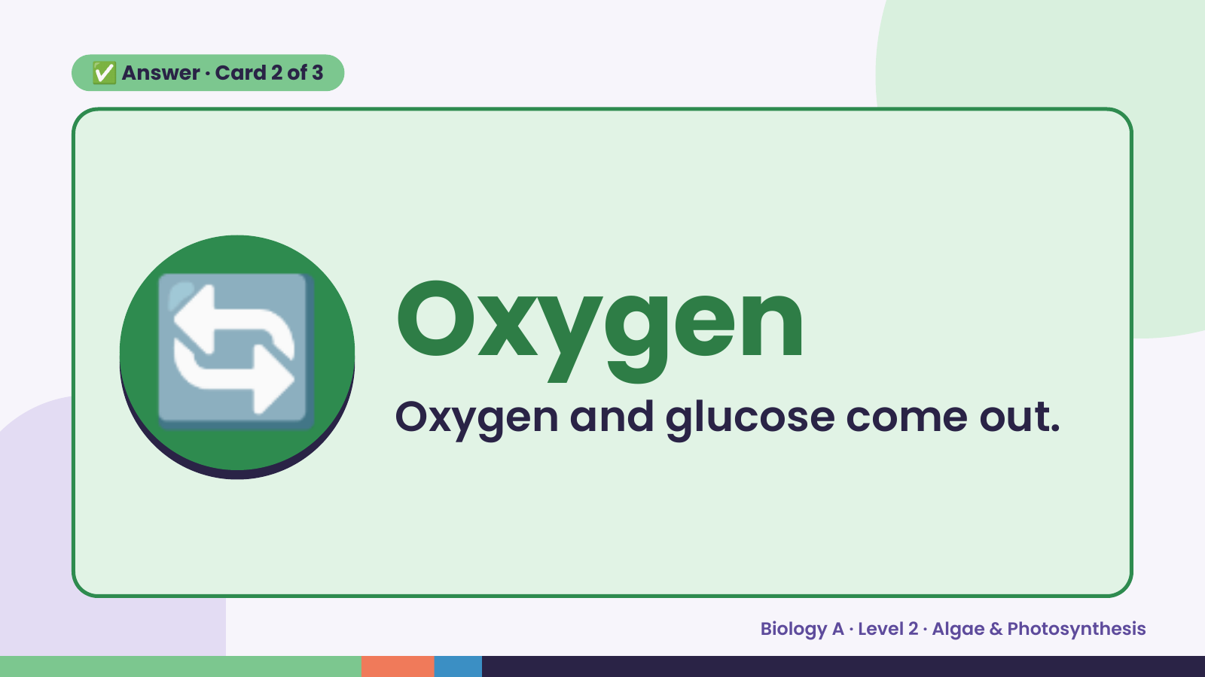
Notes:
✅ Answer · Card 2 of 3
🔄 Oxygen
Oxygen and glucose come out.
Biology A · Level 2 · Algae & Photosynthesis

Slide 13
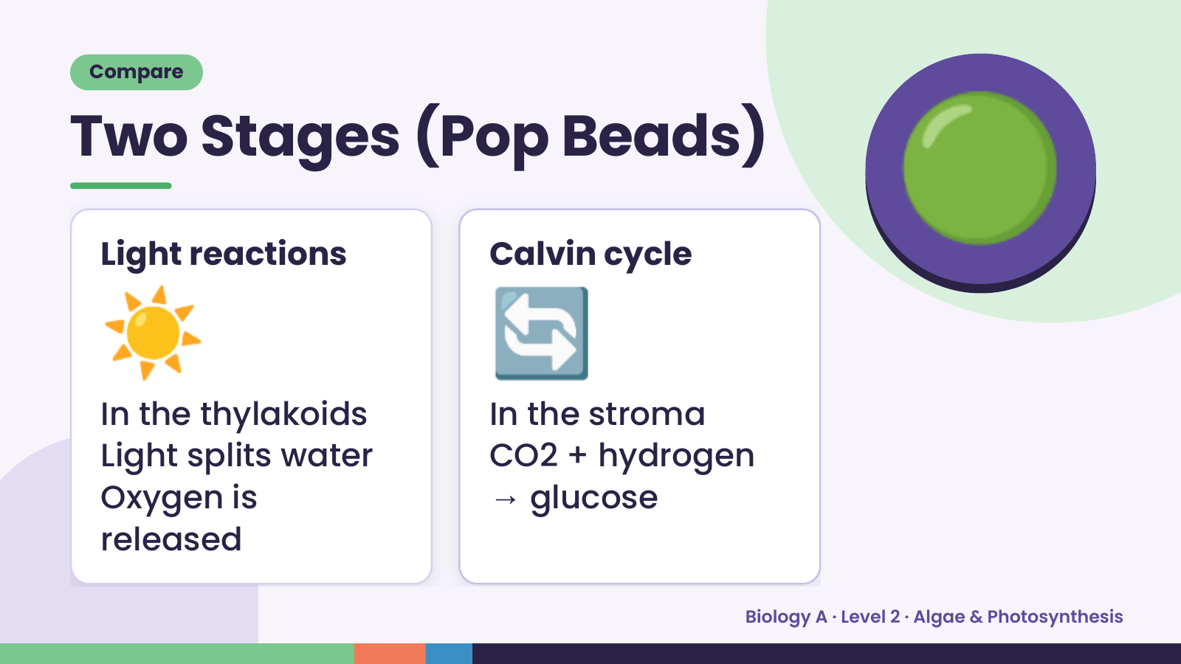
Notes:
Compare
Two Stages (Pop Beads)
☀️
Light reactions
🔄
Calvin cycle
🟢
In the thylakoids In the stroma
Light splits water CO2 + hydrogen
Oxygen is → glucose
released
Biology A · Level 2 · Algae & Photosynthesis

Slide 14
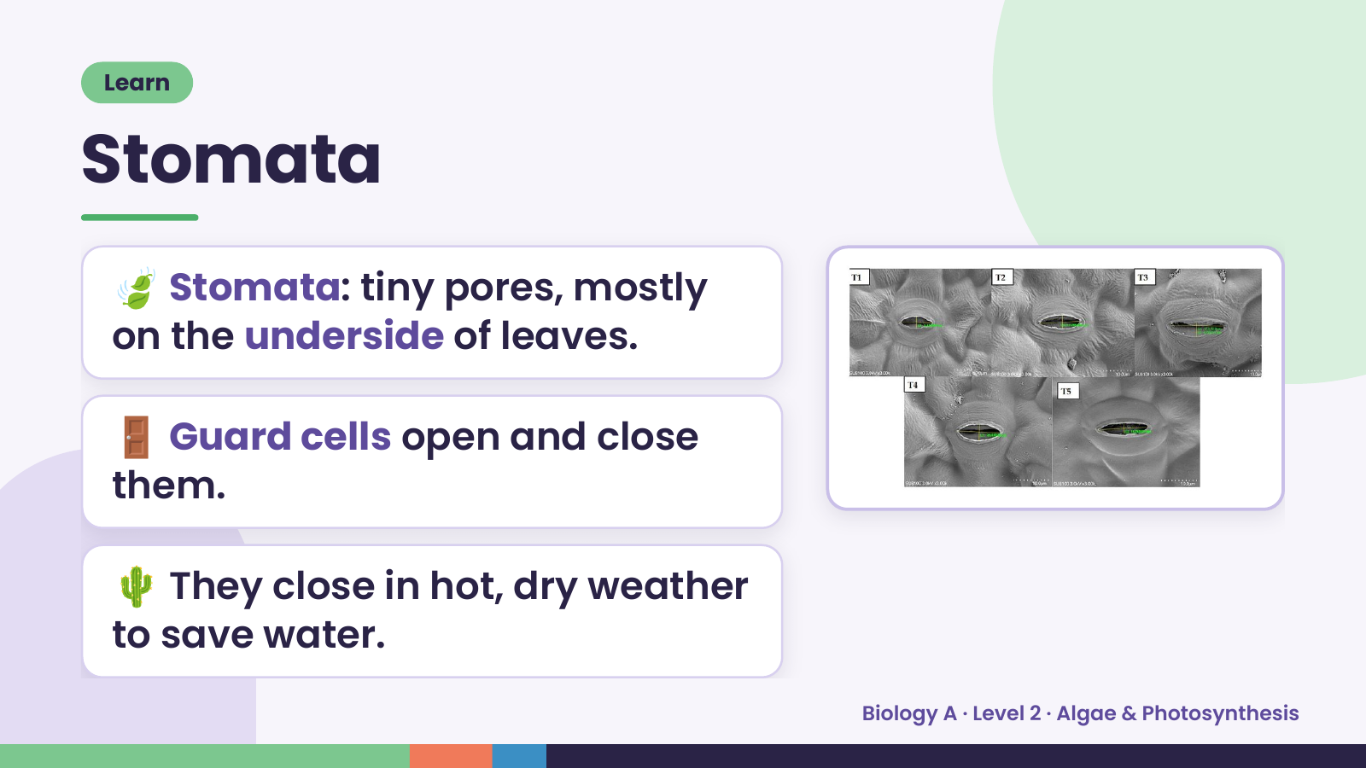
Notes:
Learn
Stomata
🍃 Stomata: tiny pores, mostly
on the underside of leaves.
🚪 Guard cells open and close
them.
🌵 They close in hot, dry weather
to save water.
Biology A · Level 2 · Algae & Photosynthesis

Slide 15
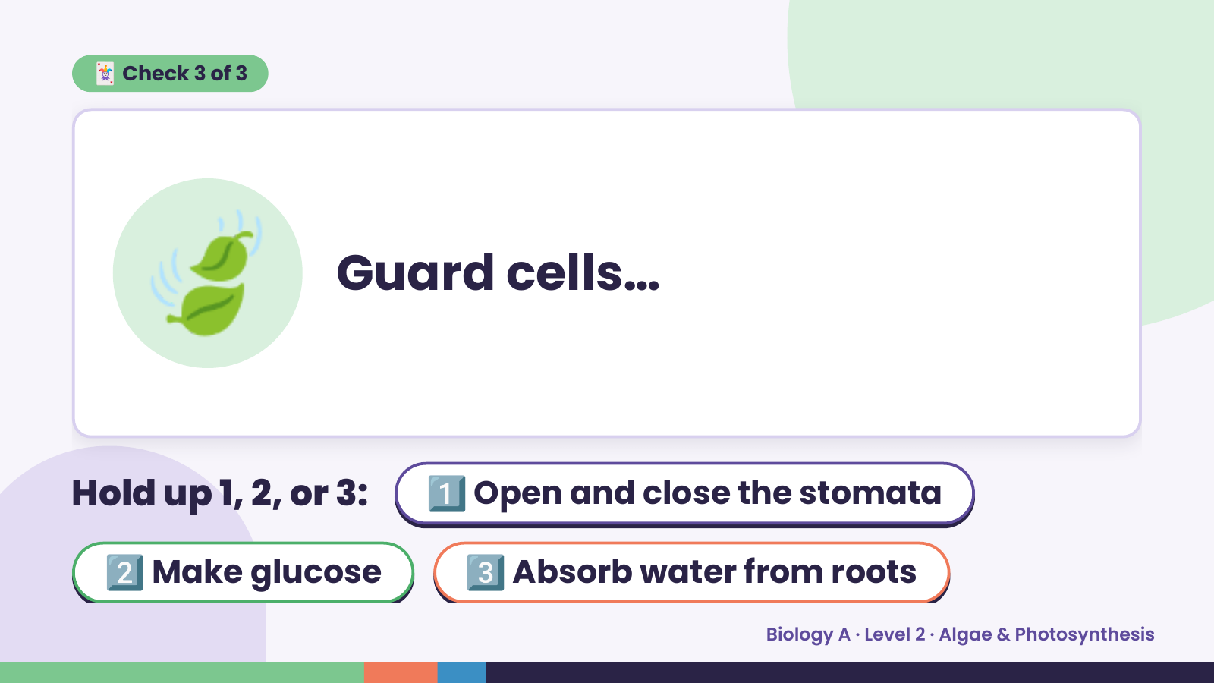
Notes:
🃏 Check 3 of 3
🍃 Guard cells…
Hold up 1, 2, or 3:1️⃣ Open and close the stomata
2️⃣ Make glucose 3️⃣ Absorb water from roots
Biology A · Level 2 · Algae & Photosynthesis

Slide 16
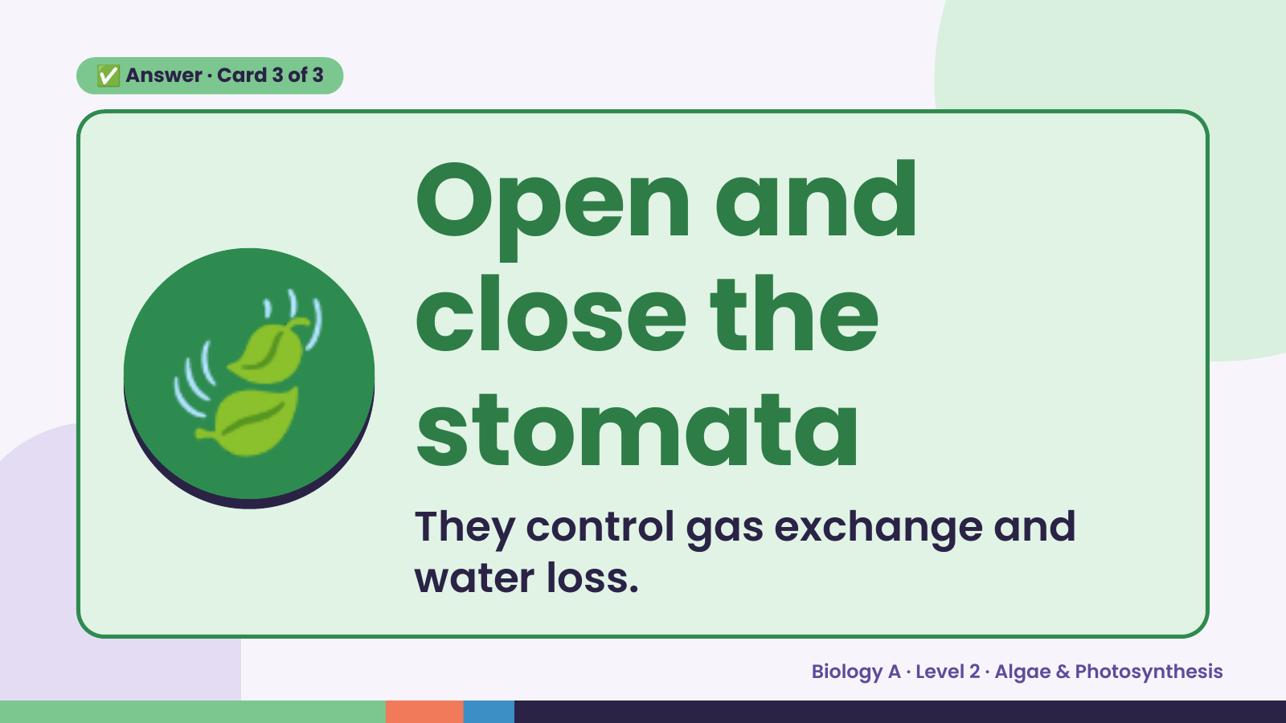
Notes:
✅ Answer · Card 3 of 3
🍃
Open and
close the
stomata
They control gas exchange and
water loss.
Biology A · Level 2 · Algae & Photosynthesis

Slide 17
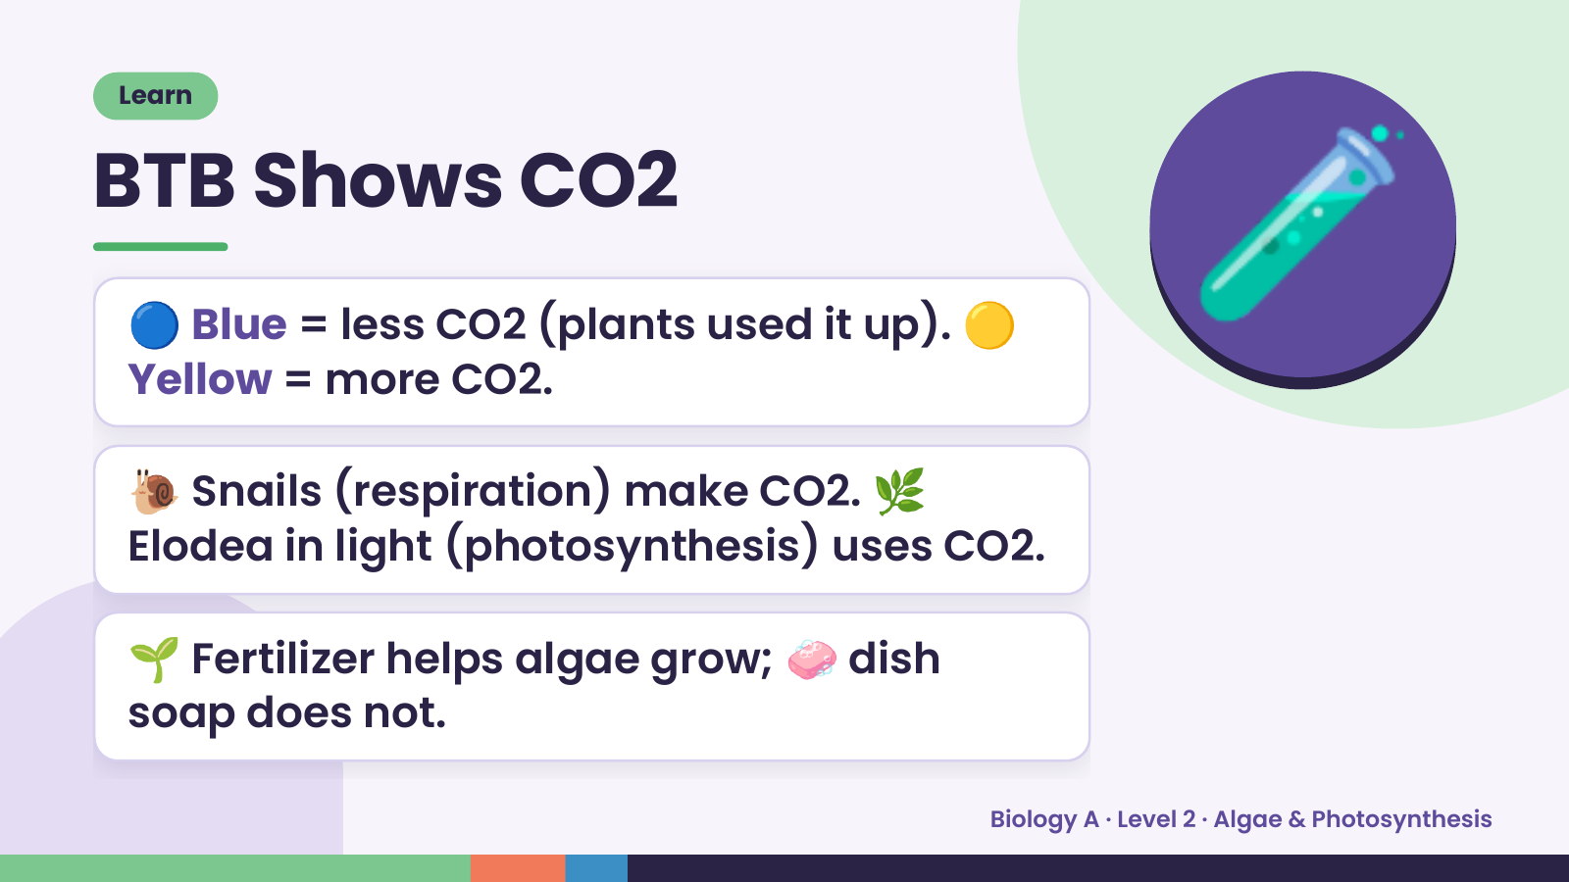
Notes:
Learn
BTB Shows CO2
🔵 Blue = less CO2 (plants used it up). 🟡
Yellow = more CO2.
🐌 Snails (respiration) make CO2. 🌿
🧪
Elodea in light (photosynthesis) uses CO2.
🌱 Fertilizer helps algae grow; 🧼 dish
soap does not.
Biology A · Level 2 · Algae & Photosynthesis

Slide 18
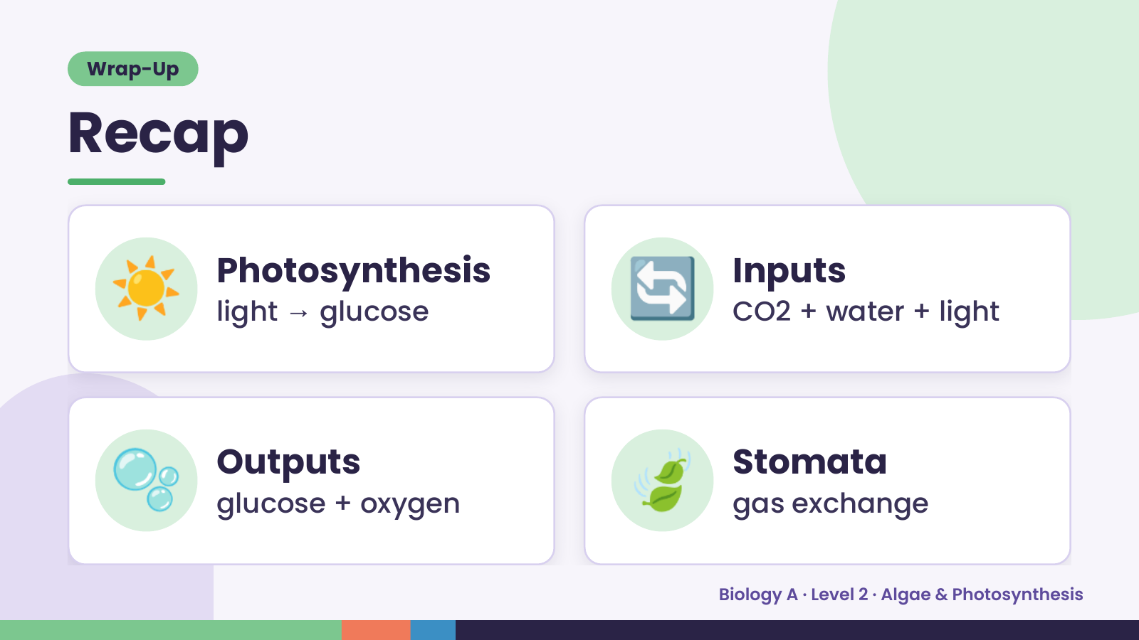
Notes:
Wrap-Up
Recap
☀️ Photosynthesis
light → glucose 🔄 Inputs
CO2 + water + light
🫧 Outputs
glucose + oxygen 🍃 Stomata
gas exchange
Biology A · Level 2 · Algae & Photosynthesis

Slide 19
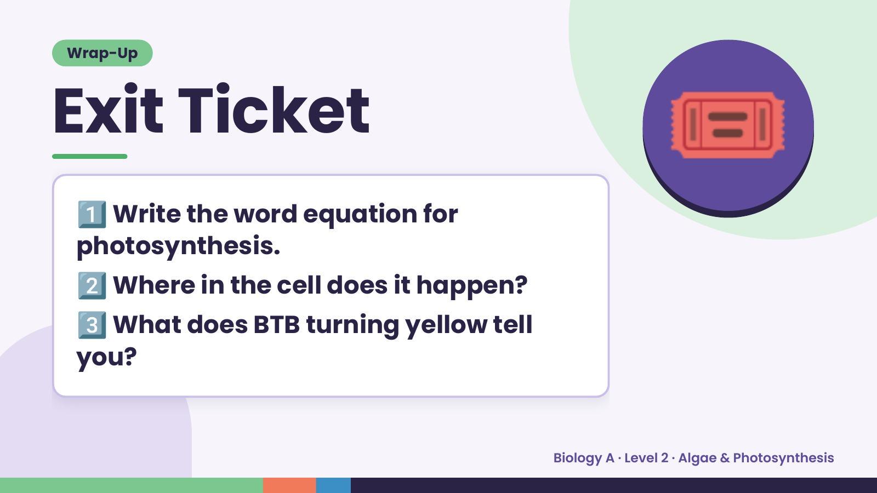
Notes:
Wrap-Up
Exit Ticket
1️⃣
Write the word equation for
photosynthesis.
🎟️
2️⃣Where in the cell does it happen?
3️⃣
What does BTB turning yellow tell
you?
Biology A · Level 2 · Algae & Photosynthesis

