Slide 1
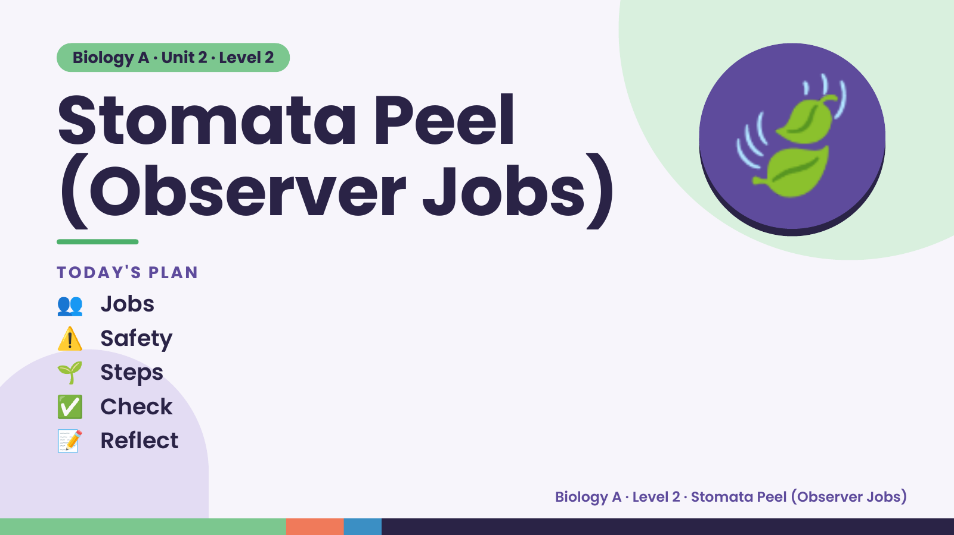
Notes:
Biology A · Unit 2 · Level 2
Stomata Peel
(Observer Jobs)
👥 Jobs
TODAY'S PLAN
🍃
⚠️ Safety
🌱 Steps
✅ Check
📝 Reflect
Biology A · Level 2 · Stomata Peel (Observer Jobs)

Slide 2
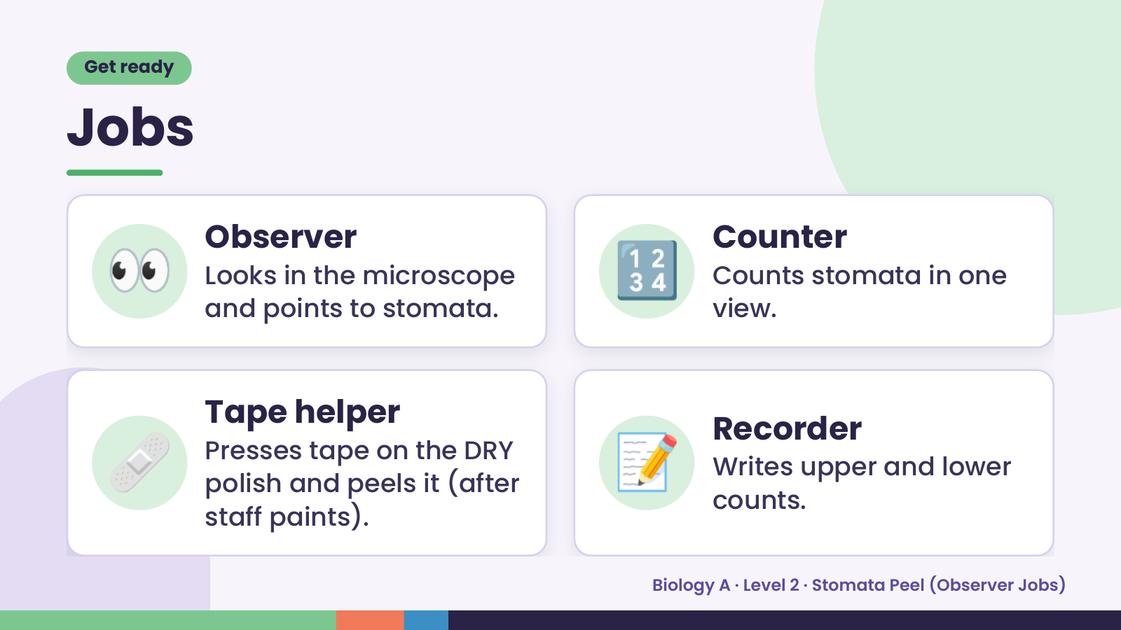
Notes:
Get ready
Jobs
👀 Observer
Looks in the microscope
and points to stomata.
🔢 Counter
Counts stomata in one
view.
🩹 Tape helper
Presses tape on the DRY
polish and peels it (after
staff paints).
📝 Recorder
Writes upper and lower
counts.
Biology A · Level 2 · Stomata Peel (Observer Jobs)

Slide 3
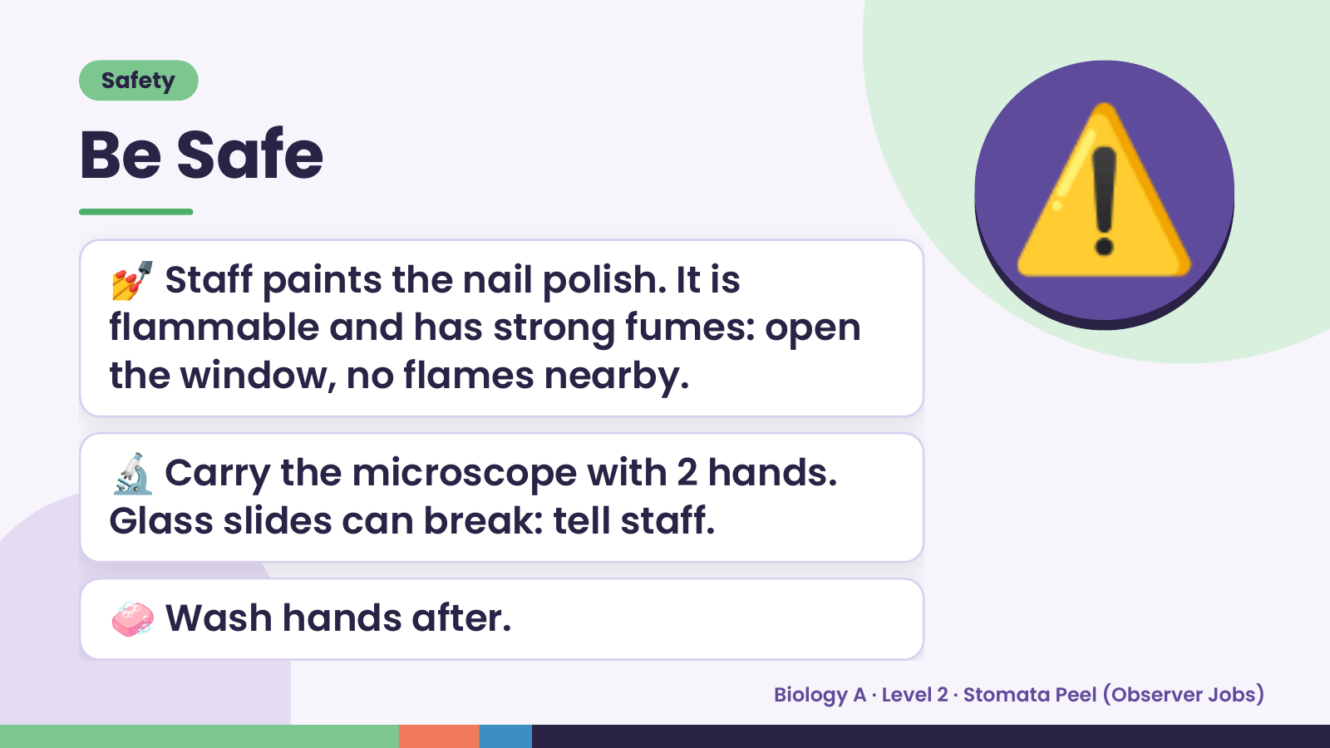
Notes:
Safety
Be Safe
💅 Staff paints the nail polish. It is
flammable and has strong fumes: open
the window, no flames nearby.
⚠️
🔬 Carry the microscope with 2 hands.
Glass slides can break: tell staff.
🧼 Wash hands after.
Biology A · Level 2 · Stomata Peel (Observer Jobs)

Slide 4
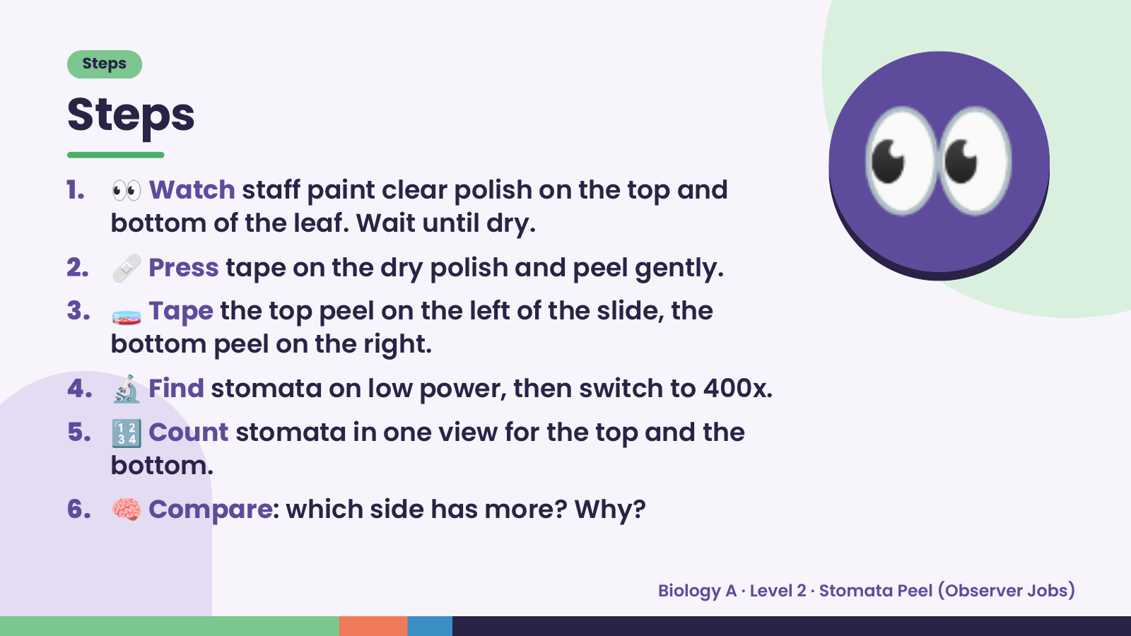
Notes:
Steps
Steps
1. 👀 Watch staff paint clear polish on the top and
bottom of the leaf. Wait until dry.
2. 🩹 Press tape on the dry polish and peel gently.
3. 🧫 Tape the top peel on the left of the slide, the
bottom peel on the right.
👀
4. 🔬 Find stomata on low power, then switch to 400x.
5. 🔢 Count stomata in one view for the top and the
bottom.
6. 🧠 Compare: which side has more? Why?
Biology A · Level 2 · Stomata Peel (Observer Jobs)

Slide 5
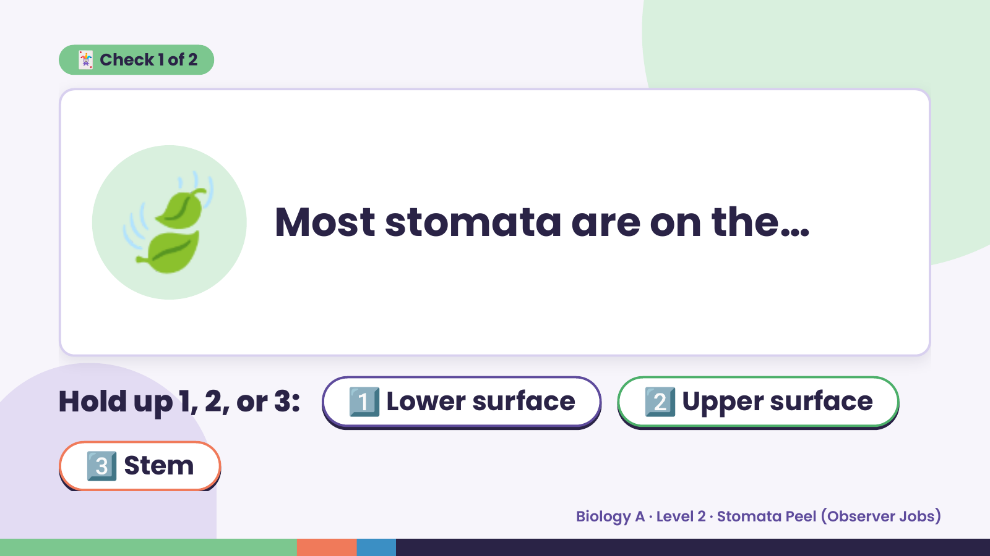
Notes:
🃏 Check 1 of 2
🍃 Most stomata are on the…
Hold up 1, 2, or 3: 1️⃣ Lower surface 2️⃣ Upper surface
3️⃣ Stem
Biology A · Level 2 · Stomata Peel (Observer Jobs)

Slide 6
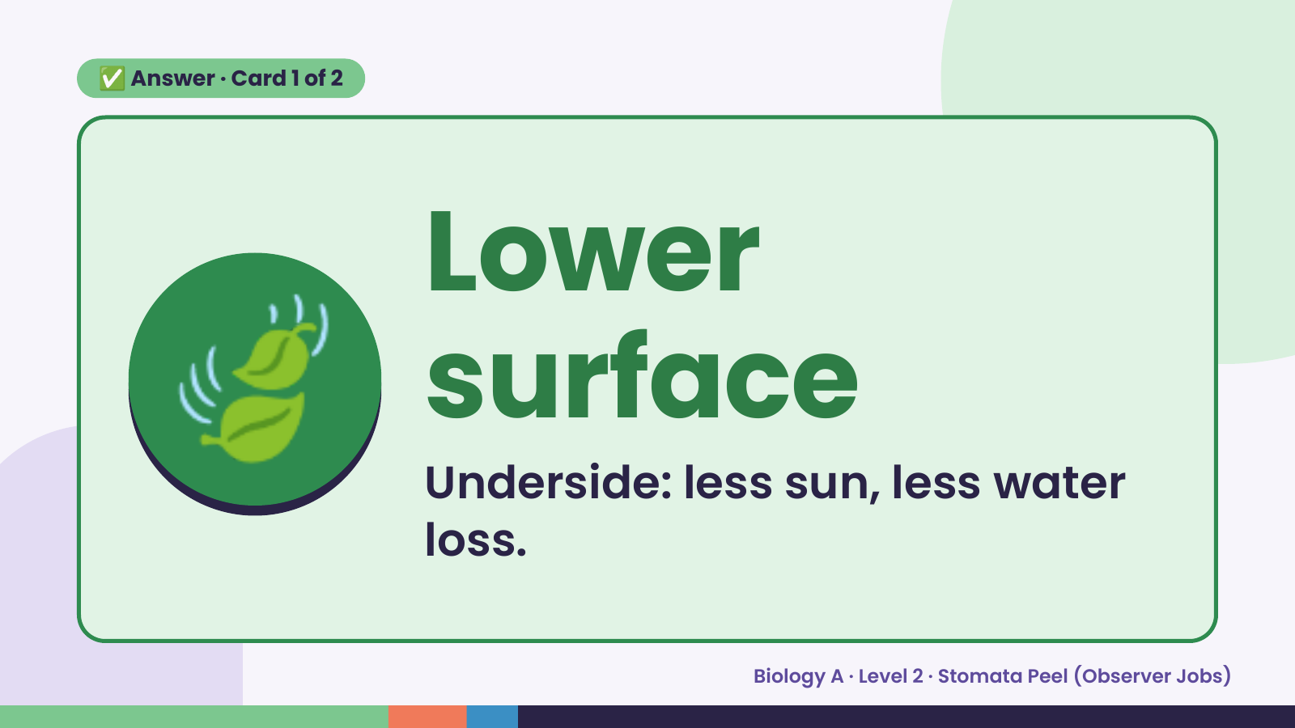
Notes:
✅ Answer · Card 1 of 2
🍃 Lower
surface
Underside: less sun, less water
loss.
Biology A · Level 2 · Stomata Peel (Observer Jobs)

Slide 7
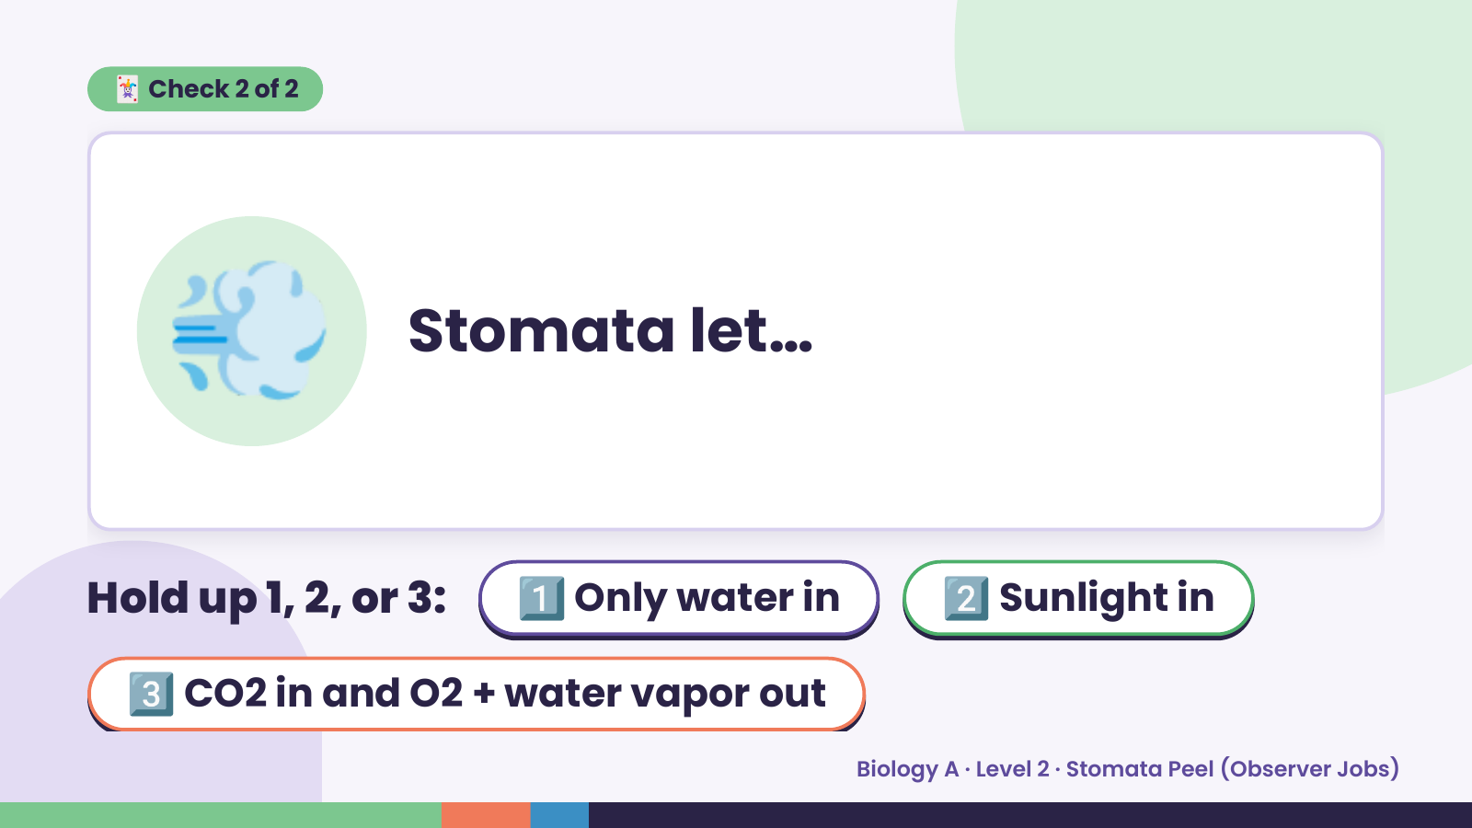
Notes:
🃏 Check 2 of 2
💨 Stomata let…
Hold up 1, 2, or 3: 1️⃣ Only water in 2️⃣ Sunlight in
3️⃣ CO2 in and O2 + water vapor out
Biology A · Level 2 · Stomata Peel (Observer Jobs)

Slide 8
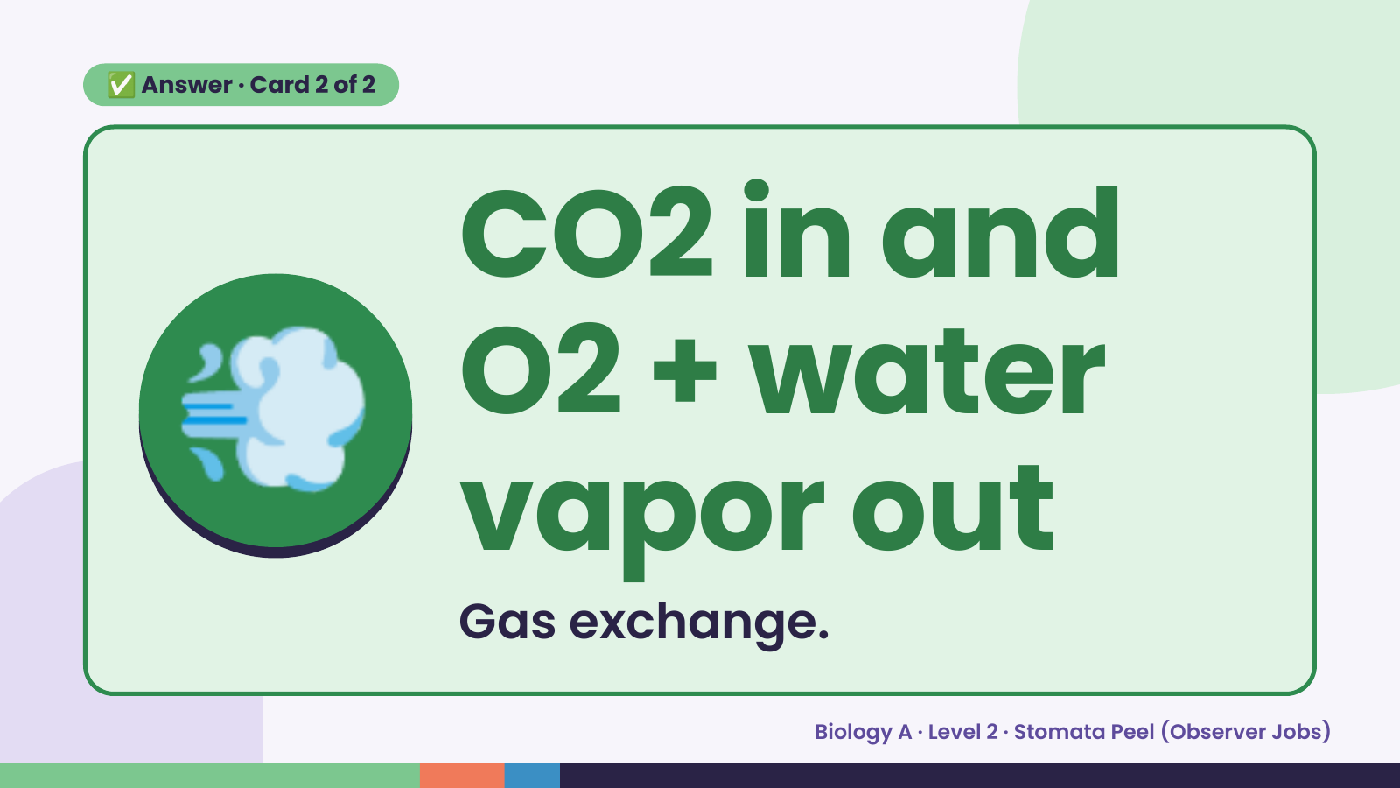
Notes:
✅ Answer · Card 2 of 2
💨 CO2 in and
O2 + water
vapor out
Gas exchange.
Biology A · Level 2 · Stomata Peel (Observer Jobs)

Slide 9
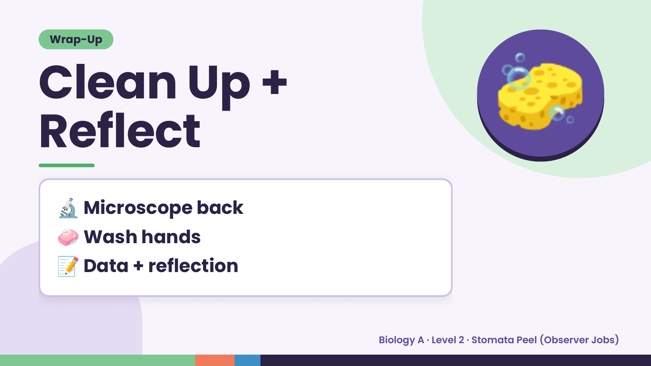
Notes:
Wrap-Up
Clean Up +
Reflect
🧽
🔬 Microscope back
🧼 Wash hands
📝 Data + reflection
Biology A · Level 2 · Stomata Peel (Observer Jobs)

