Slide 1
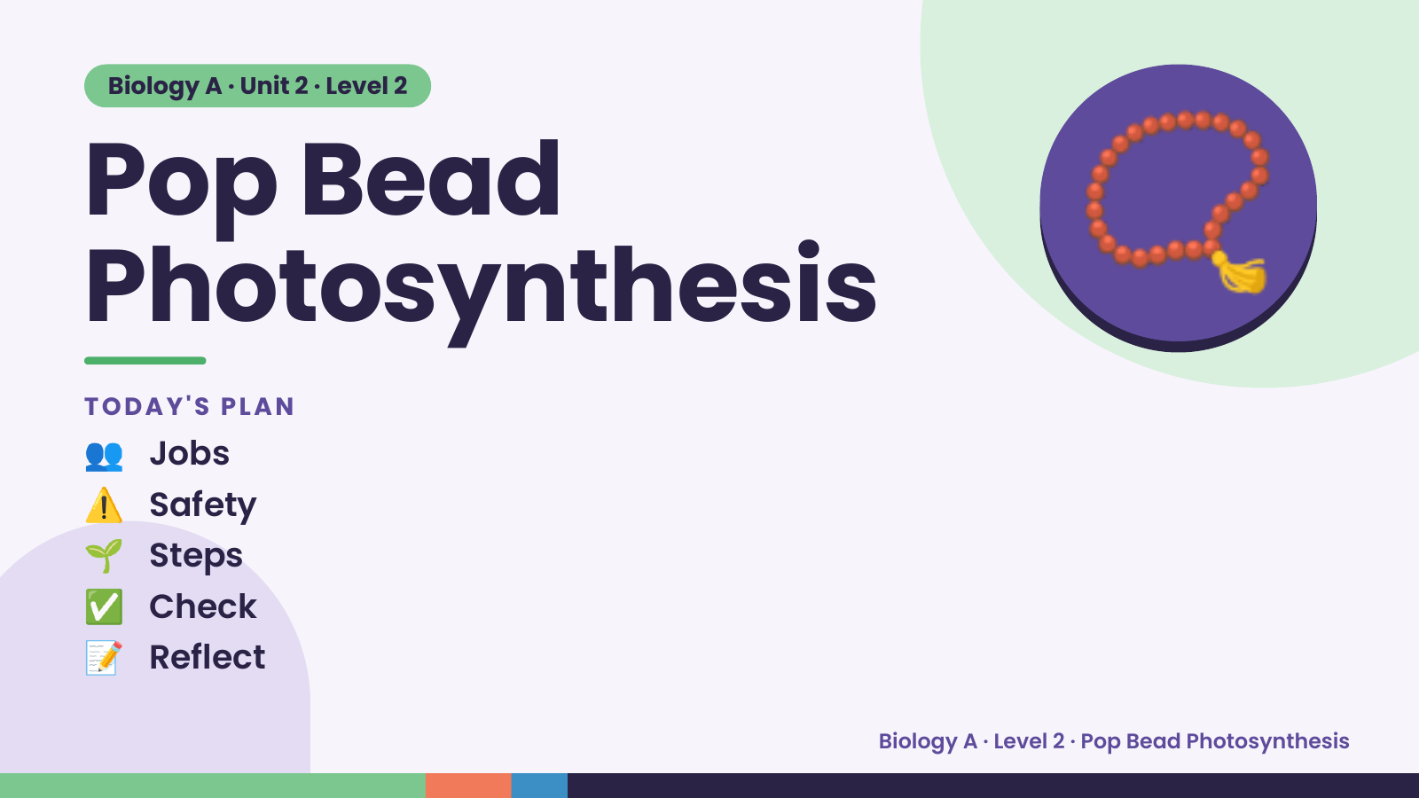
Notes:
Biology A · Unit 2 · Level 2
Pop Bead
Photosynthesis
👥 Jobs
TODAY'S PLAN
📿
⚠️ Safety
🌱 Steps
✅ Check
📝 Reflect
Biology A · Level 2 · Pop Bead Photosynthesis

Slide 2
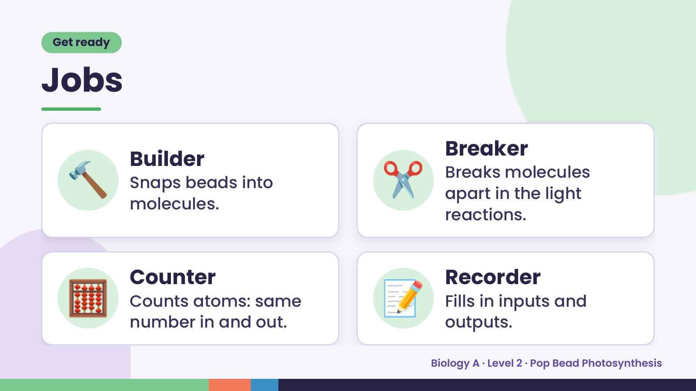
Notes:
Get ready
Jobs
🔨 Builder
Snaps beads into
molecules.
✂️ Breaker
Breaks molecules
apart in the light
reactions.
🧮 Counter
Counts atoms: same
number in and out.
📝 Recorder
Fills in inputs and
outputs.
Biology A · Level 2 · Pop Bead Photosynthesis

Slide 3
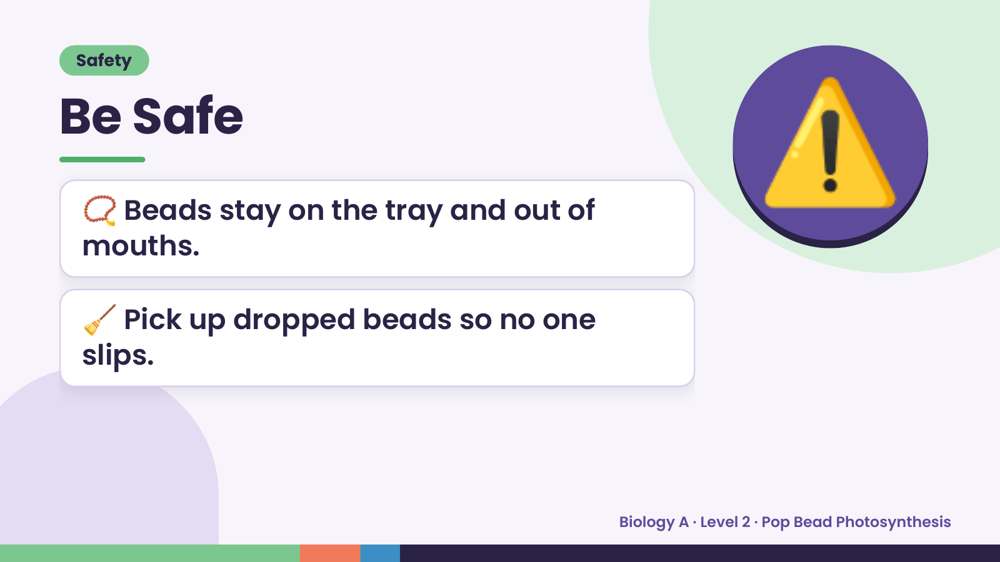
Notes:
Safety
Be Safe
📿 Beads stay on the tray and out of
mouths.
⚠️
🧹 Pick up dropped beads so no one
slips.
Biology A · Level 2 · Pop Bead Photosynthesis

Slide 4
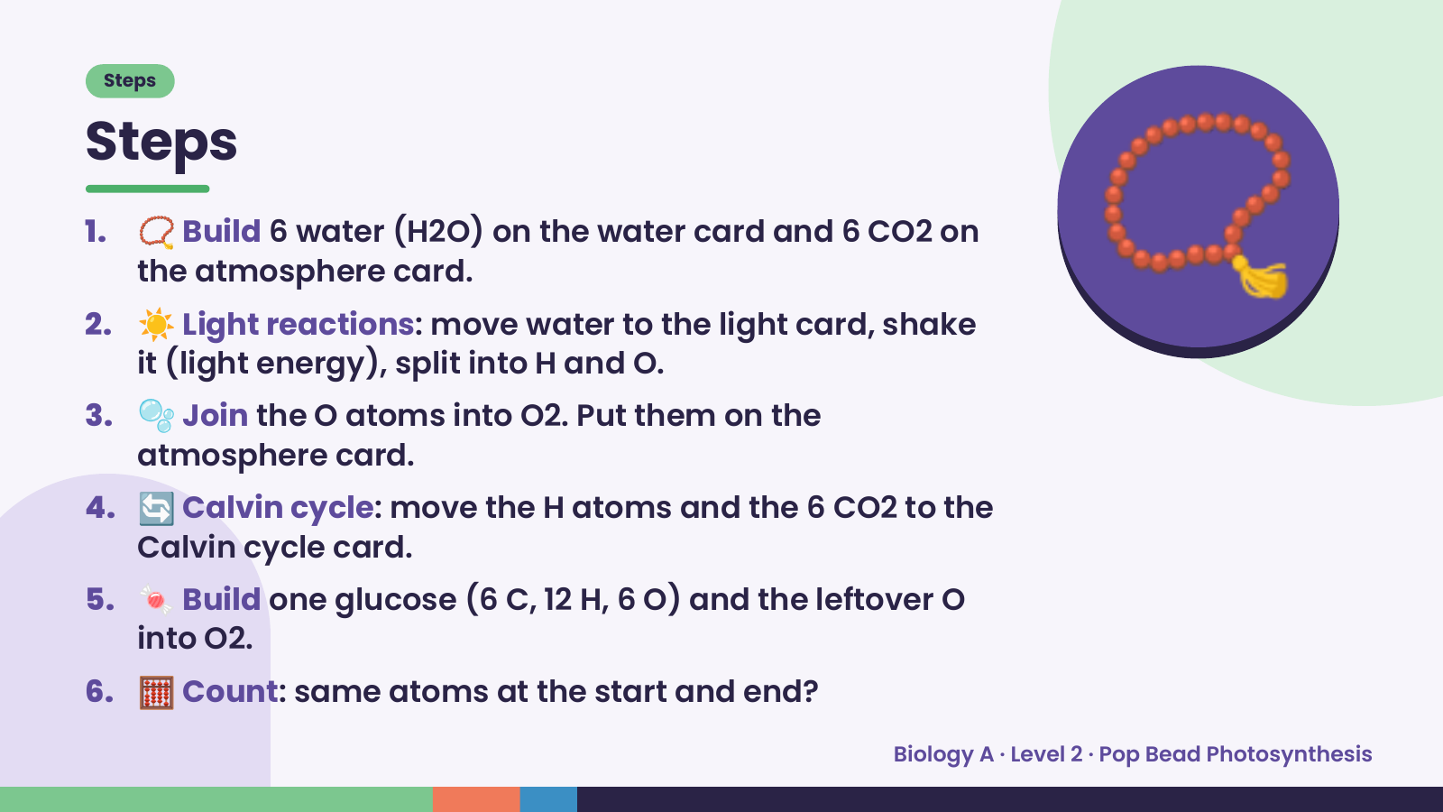
Notes:
Steps
Steps
1. 📿 Build 6 water (H2O) on the water card and 6 CO2 on
the atmosphere card.
2. ☀️ Light reactions: move water to the light card, shake
it (light energy), split into H and O.
3. 🫧 Join the O atoms into O2. Put them on the
atmosphere card.
📿
4. 🔄 Calvin cycle: move the H atoms and the 6 CO2 to the
Calvin cycle card.
5. 🍬 Build one glucose (6 C, 12 H, 6 O) and the leftover O
into O2.
6. 🧮 Count: same atoms at the start and end?
Biology A · Level 2 · Pop Bead Photosynthesis

Slide 5
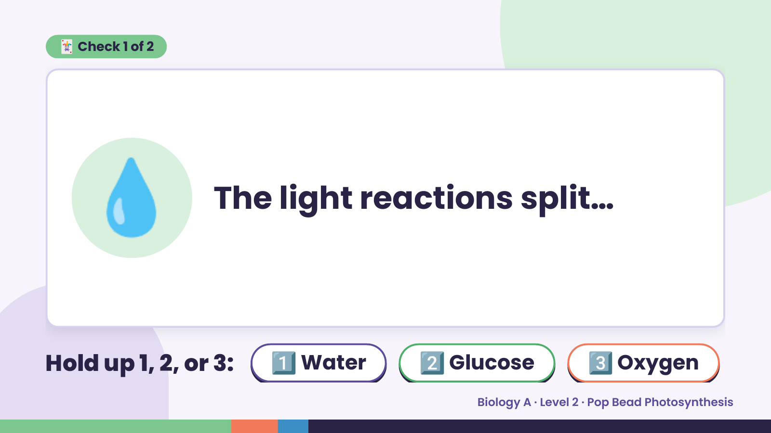
Notes:
🃏 Check 1 of 2
💧 The light reactions split…
Hold up 1, 2, or 3: 1️⃣ Water 2️⃣ Glucose 3️⃣ Oxygen
Biology A · Level 2 · Pop Bead Photosynthesis

Slide 6
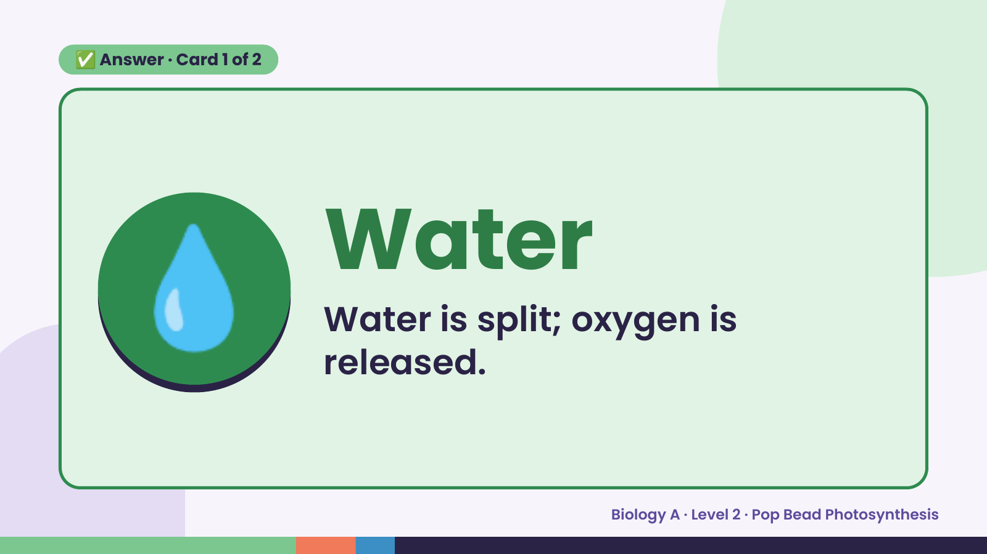
Notes:
✅ Answer · Card 1 of 2
💧 Water
Water is split; oxygen is
released.
Biology A · Level 2 · Pop Bead Photosynthesis

Slide 7
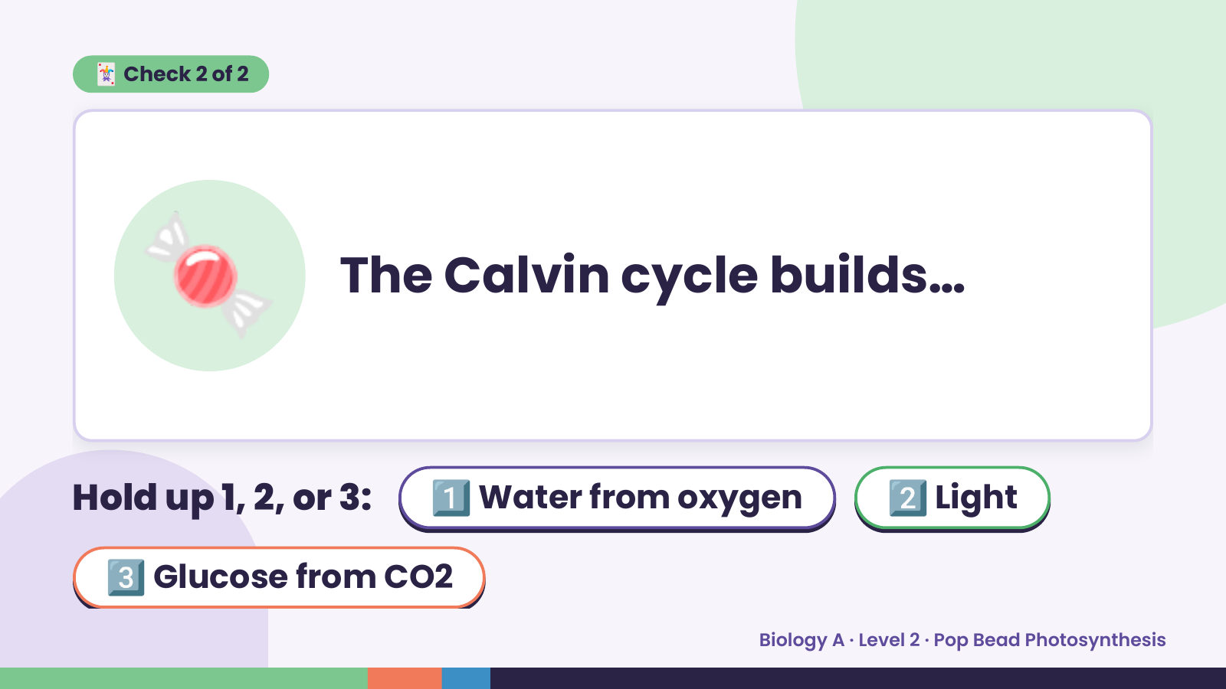
Notes:
🃏 Check 2 of 2
🍬 The Calvin cycle builds…
Hold up 1, 2, or 3: 1️⃣ Water from oxygen 2️⃣ Light
3️⃣ Glucose from CO2
Biology A · Level 2 · Pop Bead Photosynthesis

Slide 8
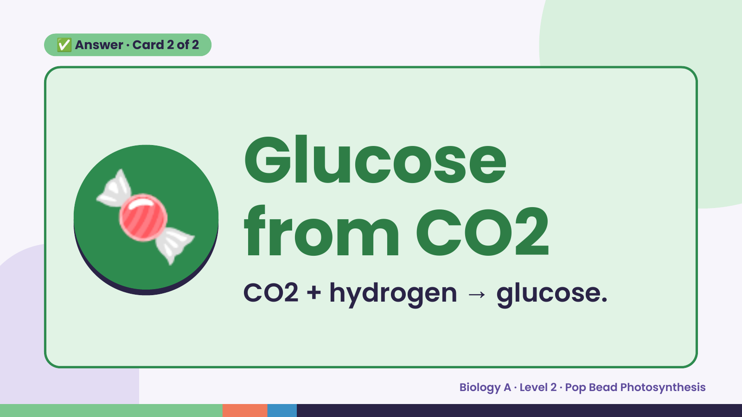
Notes:
✅ Answer · Card 2 of 2
🍬 Glucose
from CO2
CO2 + hydrogen → glucose.
Biology A · Level 2 · Pop Bead Photosynthesis

Slide 9
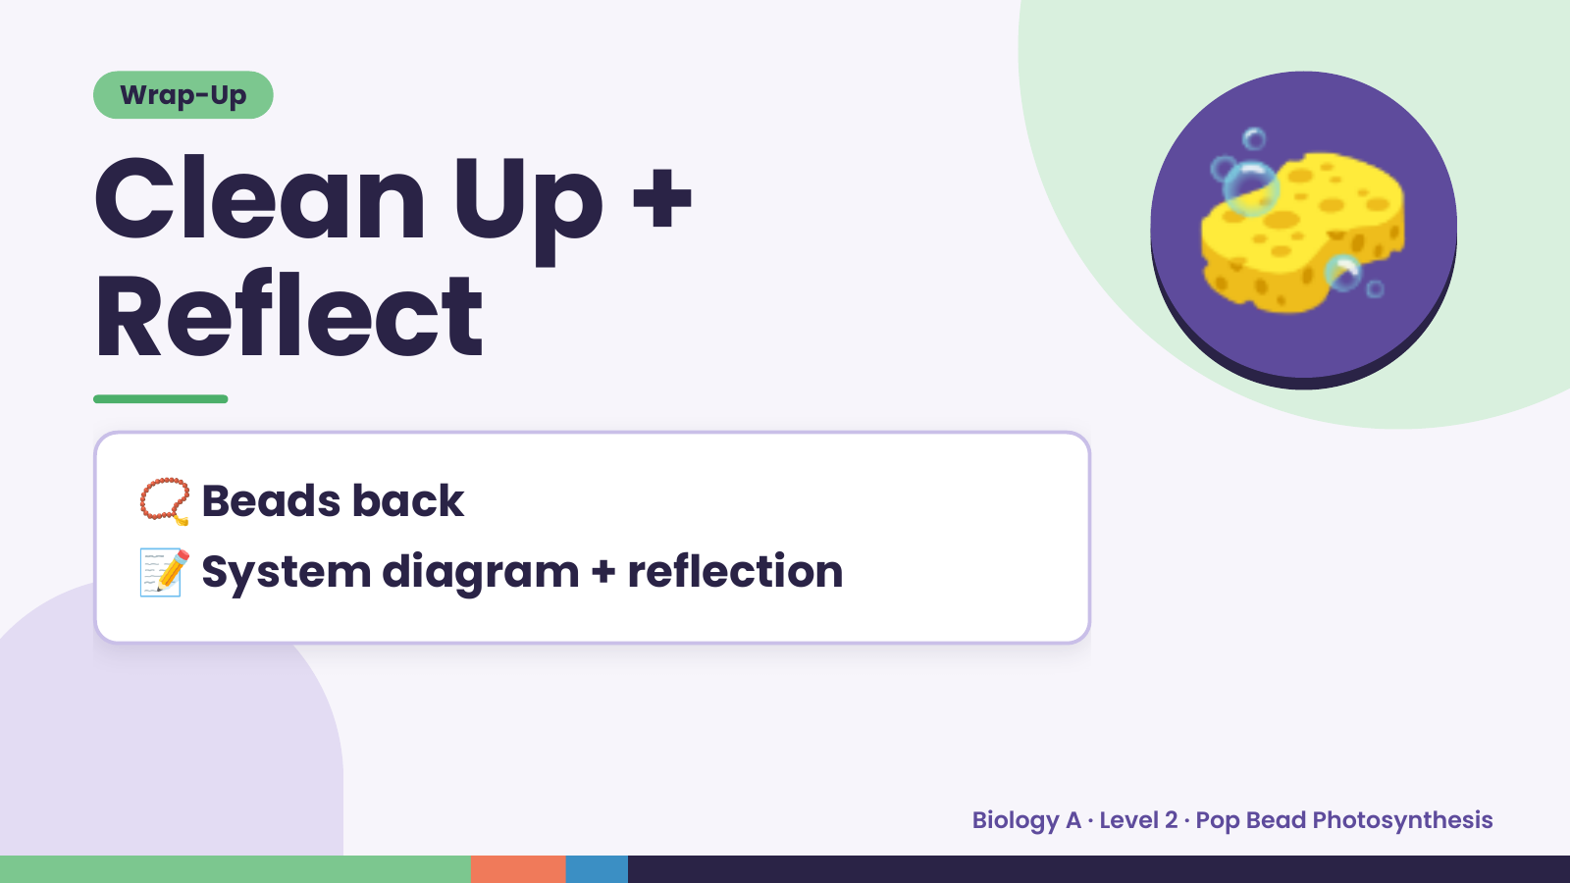
Notes:
Wrap-Up
Clean Up +
Reflect
🧽
📿 Beads back
📝 System diagram + reflection
Biology A · Level 2 · Pop Bead Photosynthesis

