Slide 1
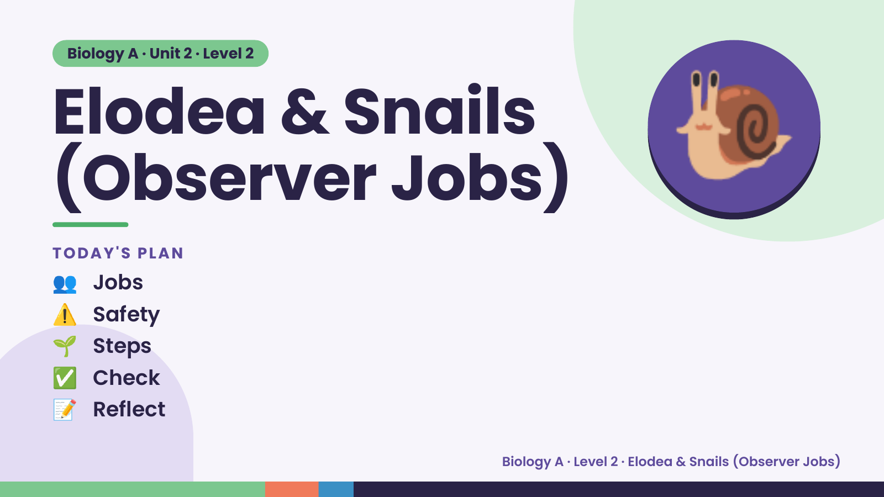
Notes:
Biology A · Unit 2 · Level 2
Elodea & Snails
(Observer Jobs)
👥 Jobs
TODAY'S PLAN
🐌
⚠️ Safety
🌱 Steps
✅ Check
📝 Reflect
Biology A · Level 2 · Elodea & Snails (Observer Jobs)

Slide 2
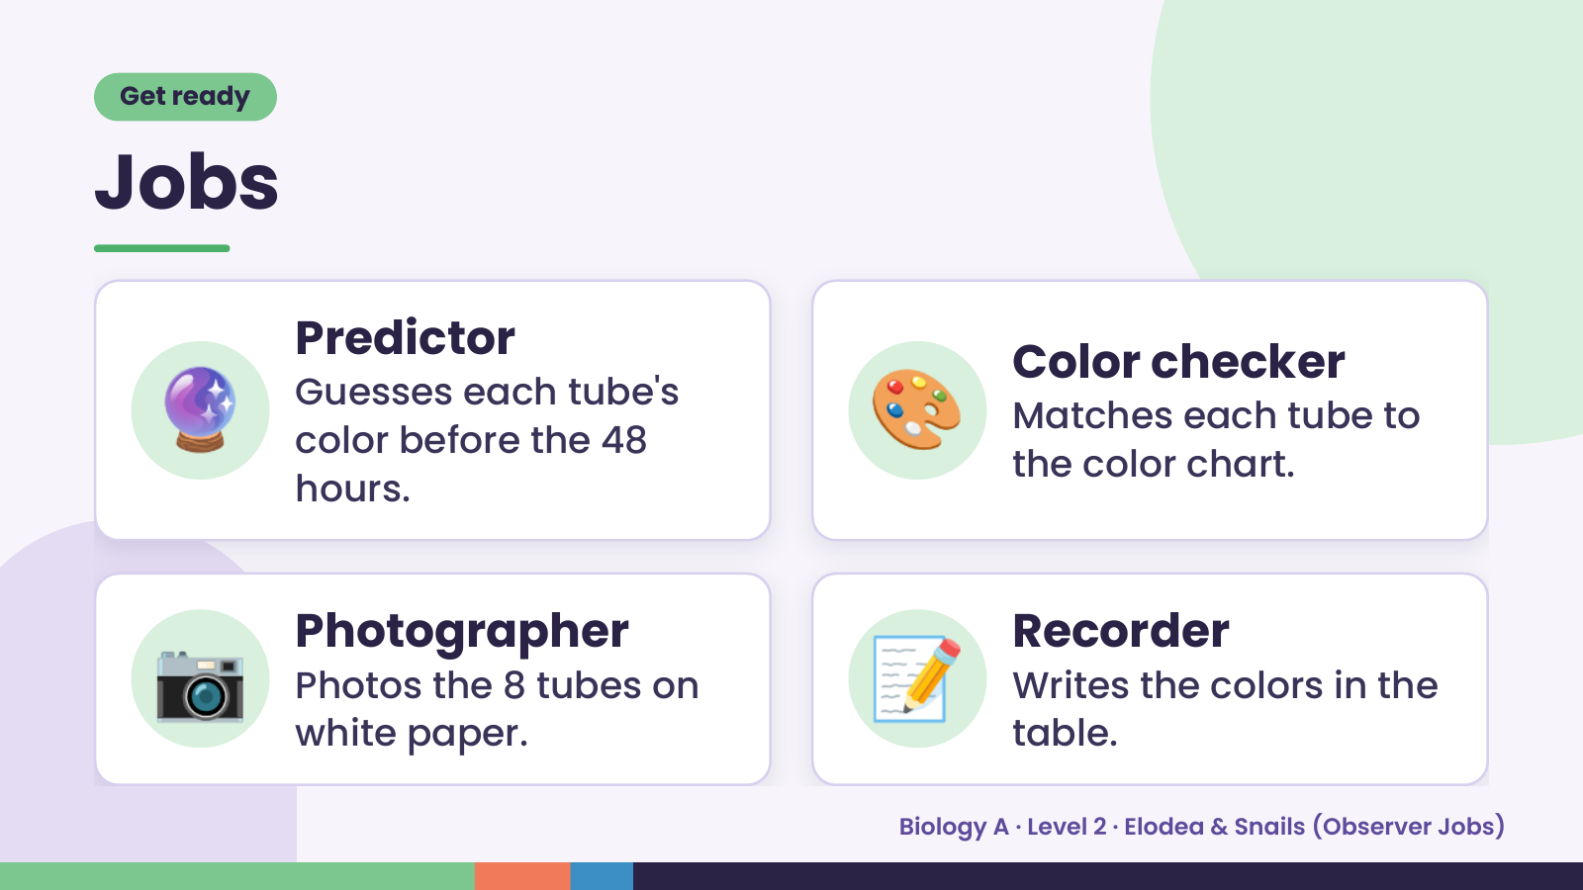
Notes:
Get ready
Jobs
🔮 Predictor
Guesses each tube's
color before the 48
hours.
🎨 Color checker
Matches each tube to
the color chart.
📷 Photographer
Photos the 8 tubes on
white paper.
📝 Recorder
Writes the colors in the
table.
Biology A · Level 2 · Elodea & Snails (Observer Jobs)

Slide 3
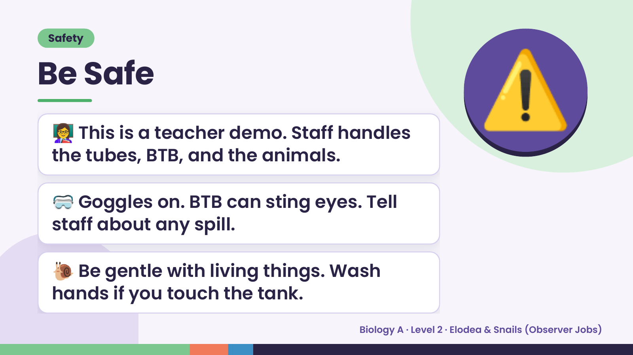
Notes:
Safety
Be Safe
👩‍🏫 This is a teacher demo. Staff handles
the tubes, BTB, and the animals.
⚠️
🥽 Goggles on. BTB can sting eyes. Tell
staff about any spill.
🐌 Be gentle with living things. Wash
hands if you touch the tank.
Biology A · Level 2 · Elodea & Snails (Observer Jobs)

Slide 4
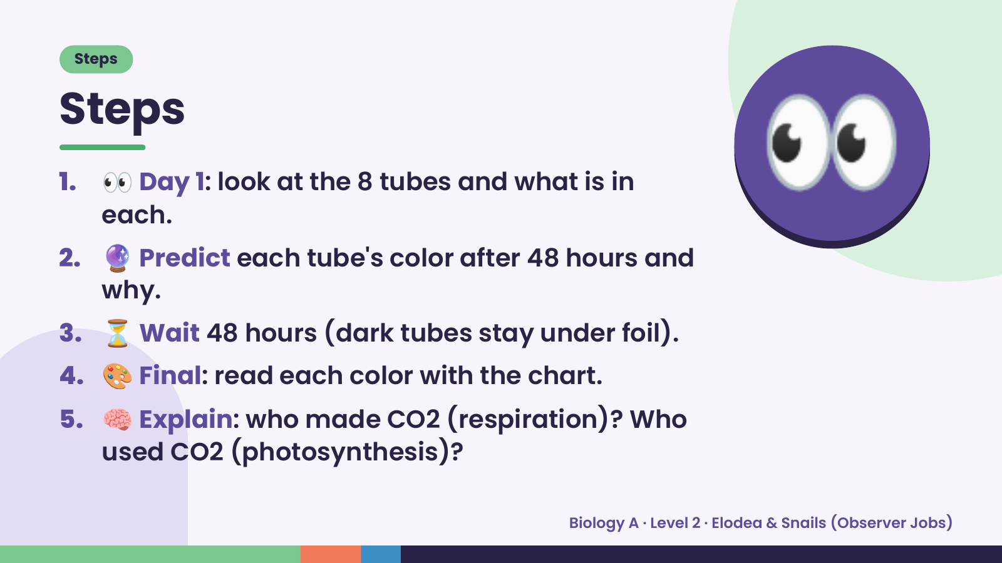
Notes:
Steps
Steps
1. 👀 Day 1: look at the 8 tubes and what is in
each.
2. 🔮 Predict each tube's color after 48 hours and
why.
👀
3. ⏳ Wait 48 hours (dark tubes stay under foil).
4. 🎨 Final: read each color with the chart.
5. 🧠 Explain: who made CO2 (respiration)? Who
used CO2 (photosynthesis)?
Biology A · Level 2 · Elodea & Snails (Observer Jobs)

Slide 5
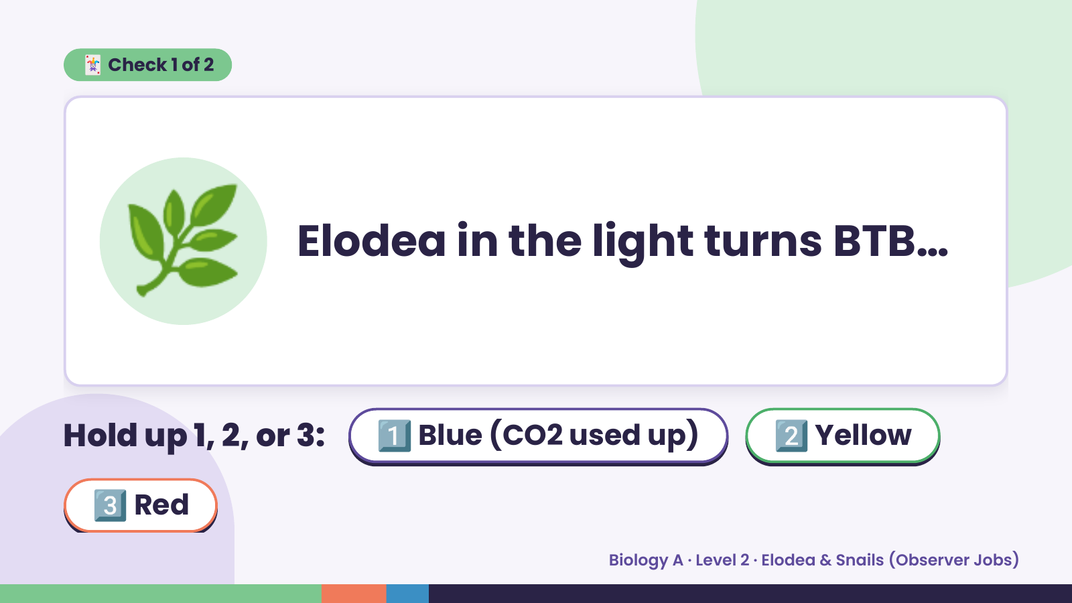
Notes:
🃏 Check 1 of 2
🌿 Elodea in the light turns BTB…
Hold up 1, 2, or 3: 1️⃣ Blue (CO2 used up) 2️⃣ Yellow
3️⃣ Red
Biology A · Level 2 · Elodea & Snails (Observer Jobs)

Slide 6
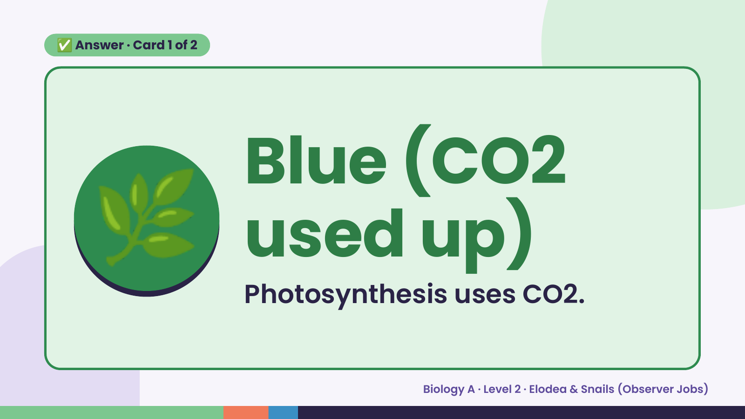
Notes:
✅ Answer · Card 1 of 2
🌿 Blue (CO2
used up)
Photosynthesis uses CO2.
Biology A · Level 2 · Elodea & Snails (Observer Jobs)

Slide 7
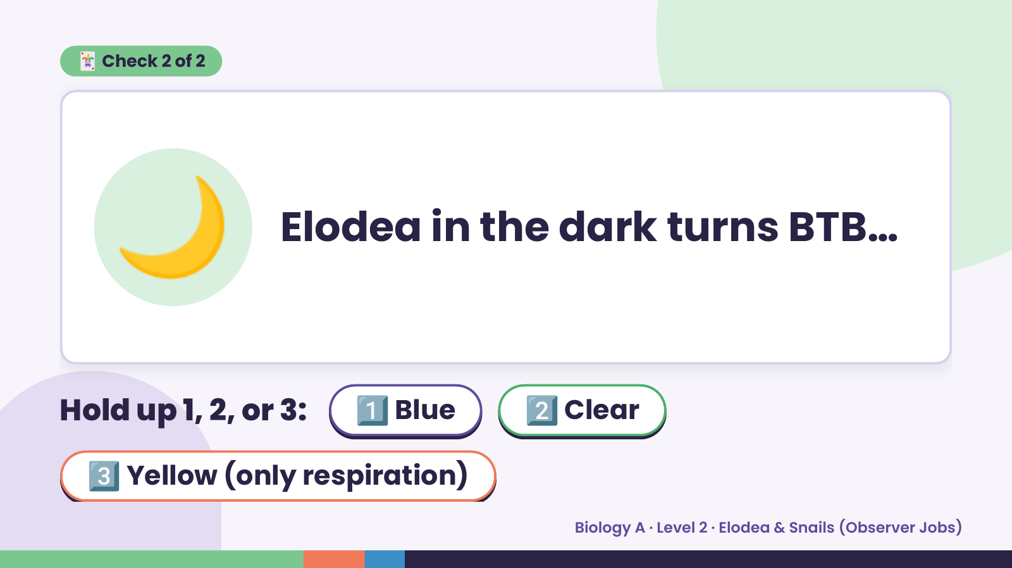
Notes:
🃏 Check 2 of 2
🌙 Elodea in the dark turns BTB…
Hold up 1, 2, or 3: 1️⃣ Blue 2️⃣ Clear
3️⃣ Yellow (only respiration)
Biology A · Level 2 · Elodea & Snails (Observer Jobs)

Slide 8
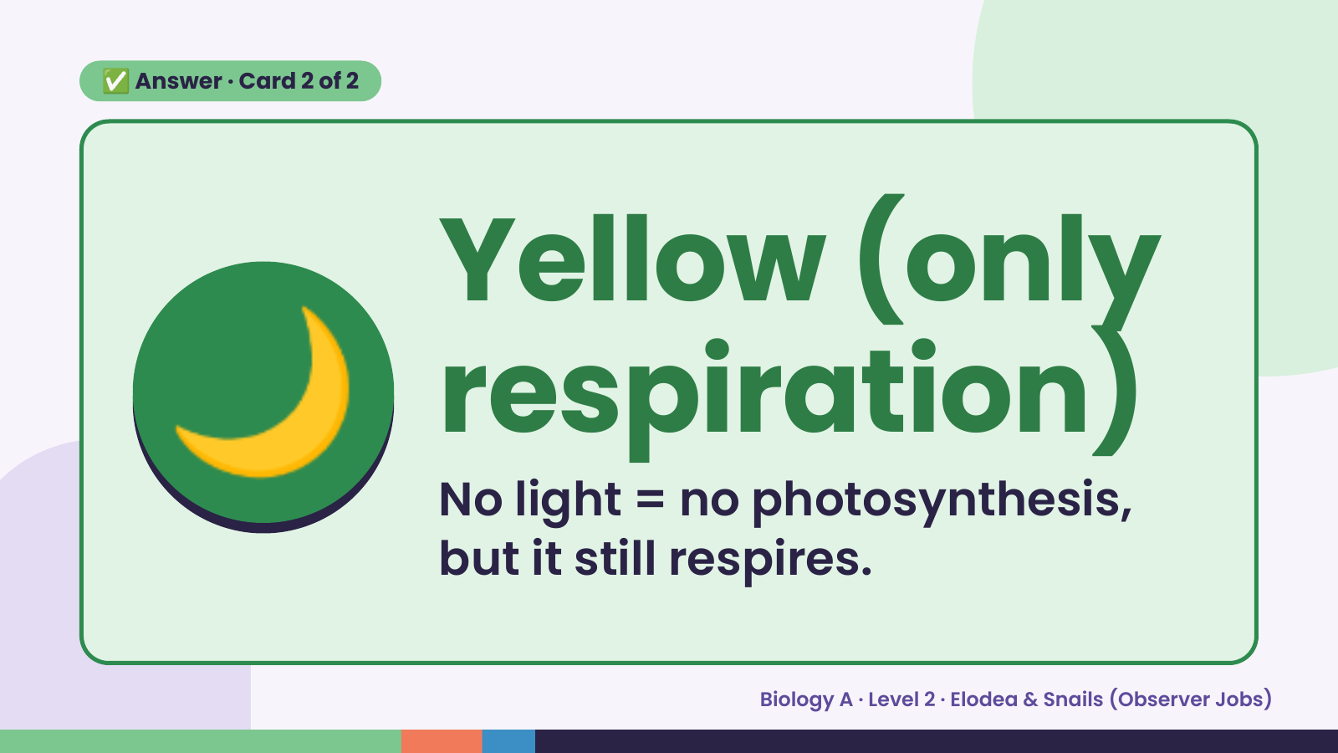
Notes:
✅ Answer · Card 2 of 2
🌙 Yellow (only
respiration)
No light = no photosynthesis,
but it still respires.
Biology A · Level 2 · Elodea & Snails (Observer Jobs)

Slide 9
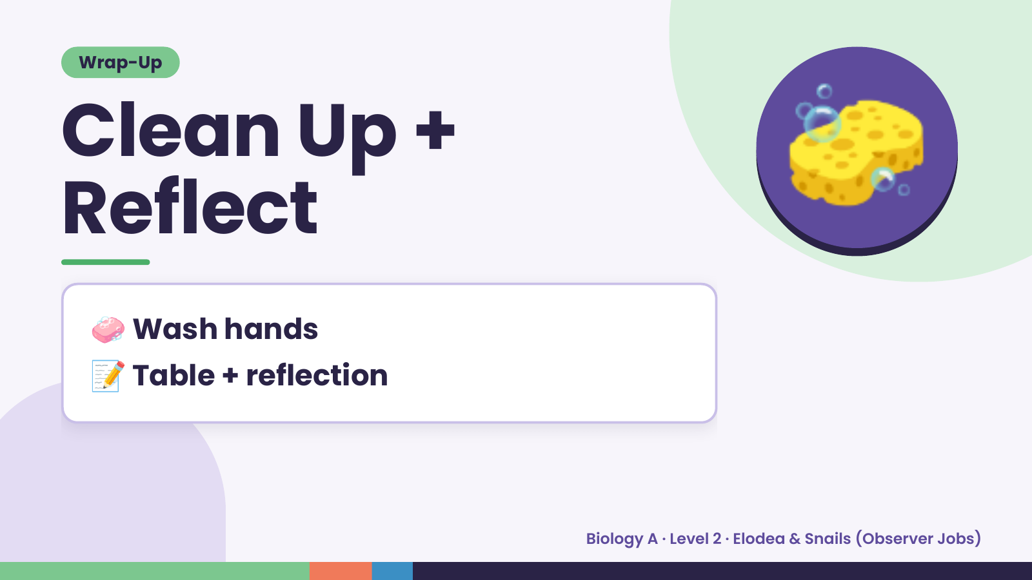
Notes:
Wrap-Up
Clean Up +
Reflect
🧽
🧼 Wash hands
📝 Table + reflection
Biology A · Level 2 · Elodea & Snails (Observer Jobs)

