Slide 1
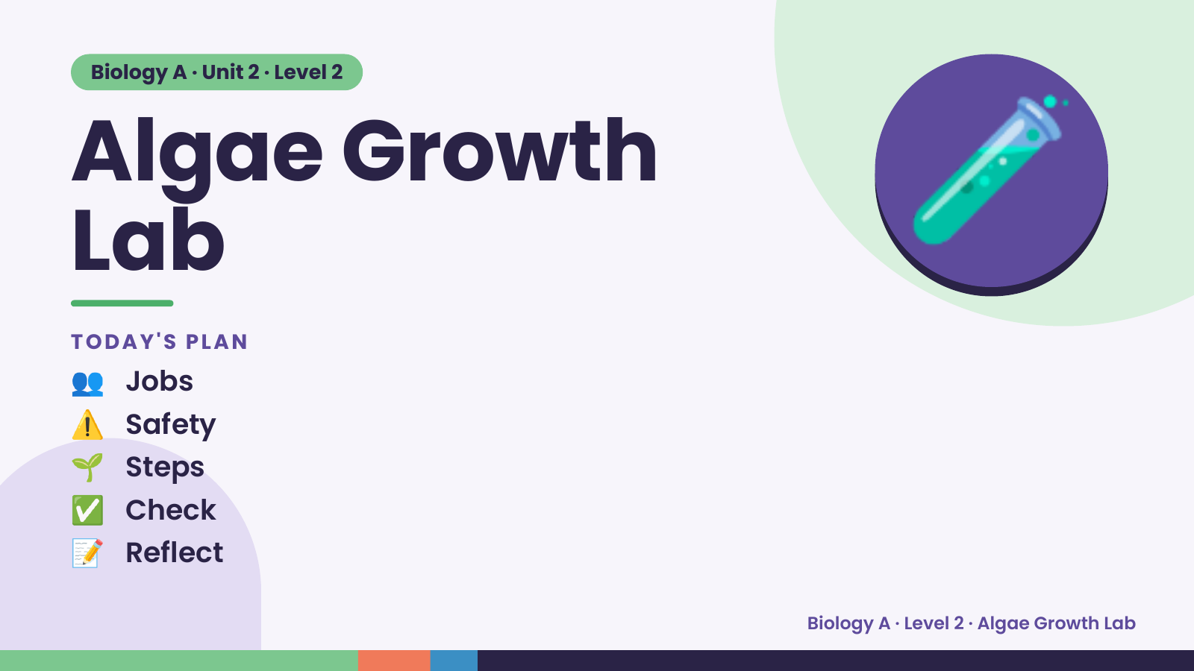
Notes:
Biology A · Unit 2 · Level 2
Algae Growth
Lab
👥 Jobs
TODAY'S PLAN
🧪
⚠️ Safety
🌱 Steps
✅ Check
📝 Reflect
Biology A · Level 2 · Algae Growth Lab

Slide 2
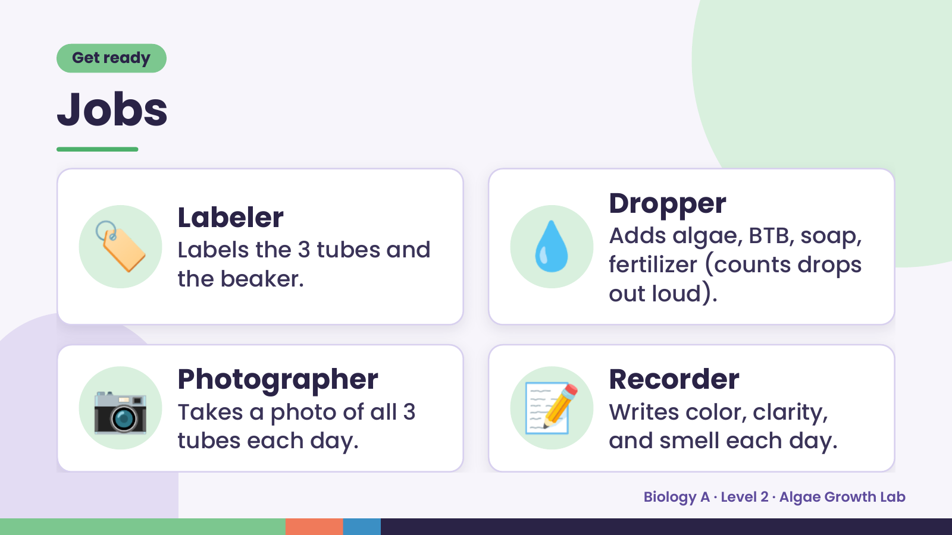
Notes:
Get ready
Jobs
🏷️ Labeler
Labels the 3 tubes and
the beaker.
💧 Dropper
Adds algae, BTB, soap,
fertilizer (counts drops
out loud).
📷 Photographer
Takes a photo of all 3
tubes each day.
📝 Recorder
Writes color, clarity,
and smell each day.
Biology A · Level 2 · Algae Growth Lab

Slide 3
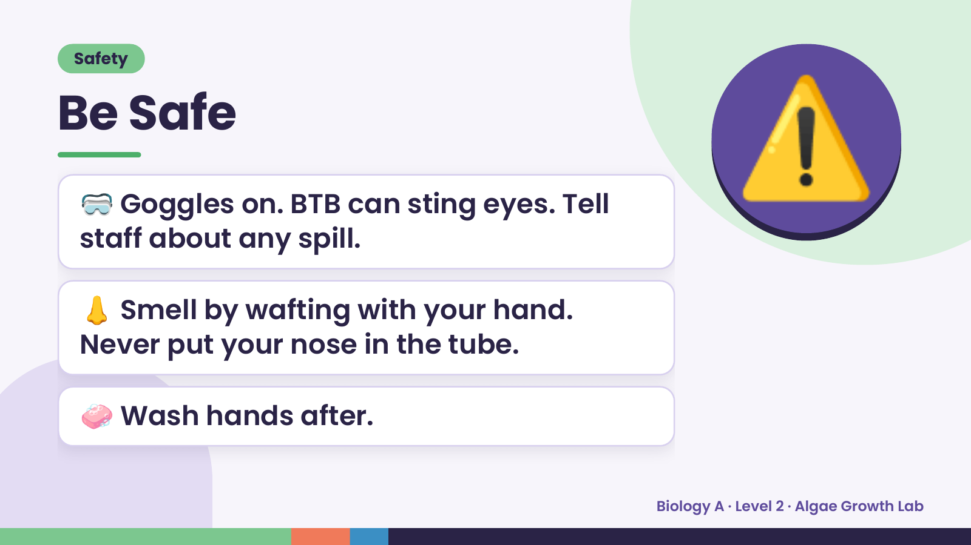
Notes:
Safety
Be Safe
🥽 Goggles on. BTB can sting eyes. Tell
staff about any spill.
⚠️
👃 Smell by wafting with your hand.
Never put your nose in the tube.
🧼 Wash hands after.
Biology A · Level 2 · Algae Growth Lab

Slide 4
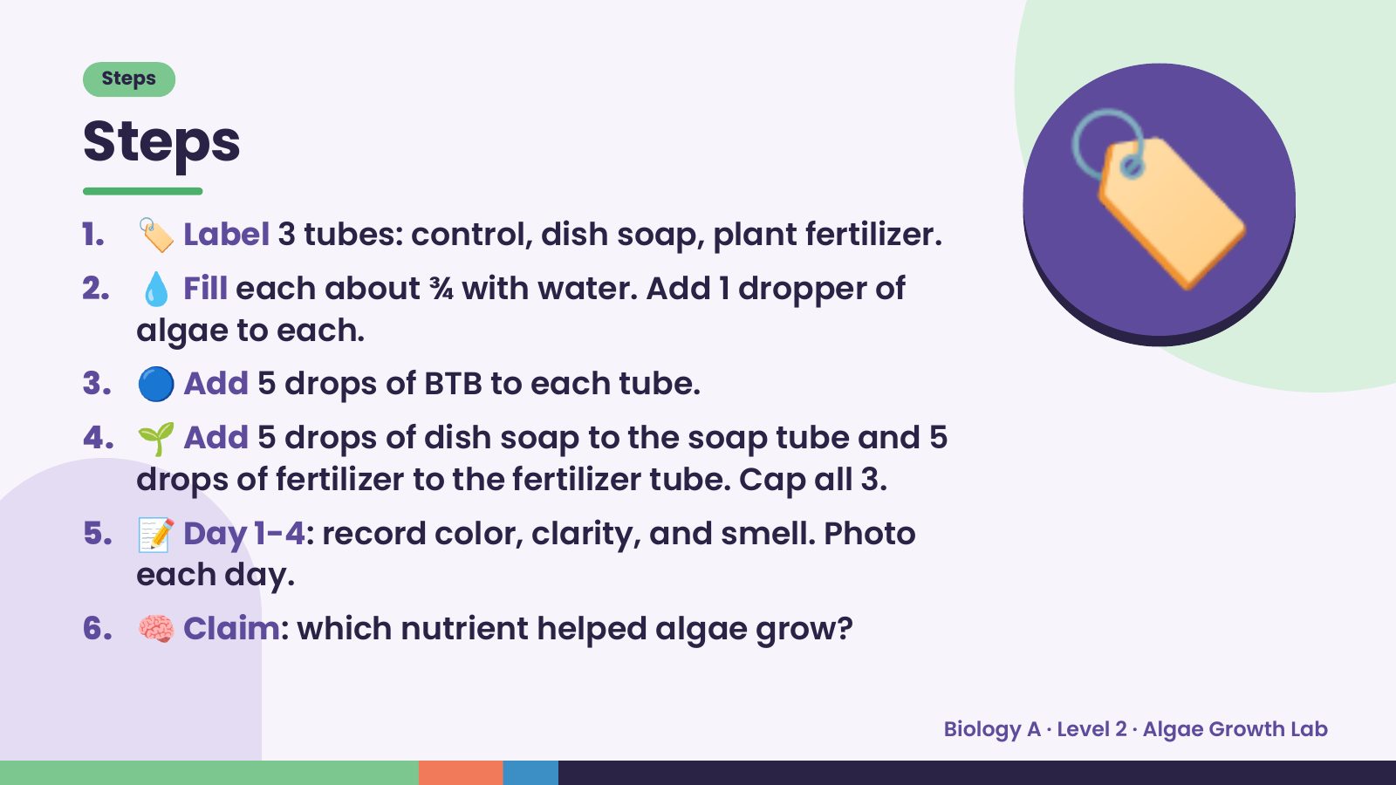
Notes:
Steps
Steps
1. 🏷️ Label 3 tubes: control, dish soap, plant fertilizer.
2. 💧 Fill each about ¾ with water. Add 1 dropper of
algae to each.
3. 🔵 Add 5 drops of BTB to each tube.
4. 🌱 Add 5 drops of dish soap to the soap tube and 5
🏷️
drops of fertilizer to the fertilizer tube. Cap all 3.
5. 📝 Day 1-4: record color, clarity, and smell. Photo
each day.
6. 🧠 Claim: which nutrient helped algae grow?
Biology A · Level 2 · Algae Growth Lab

Slide 5
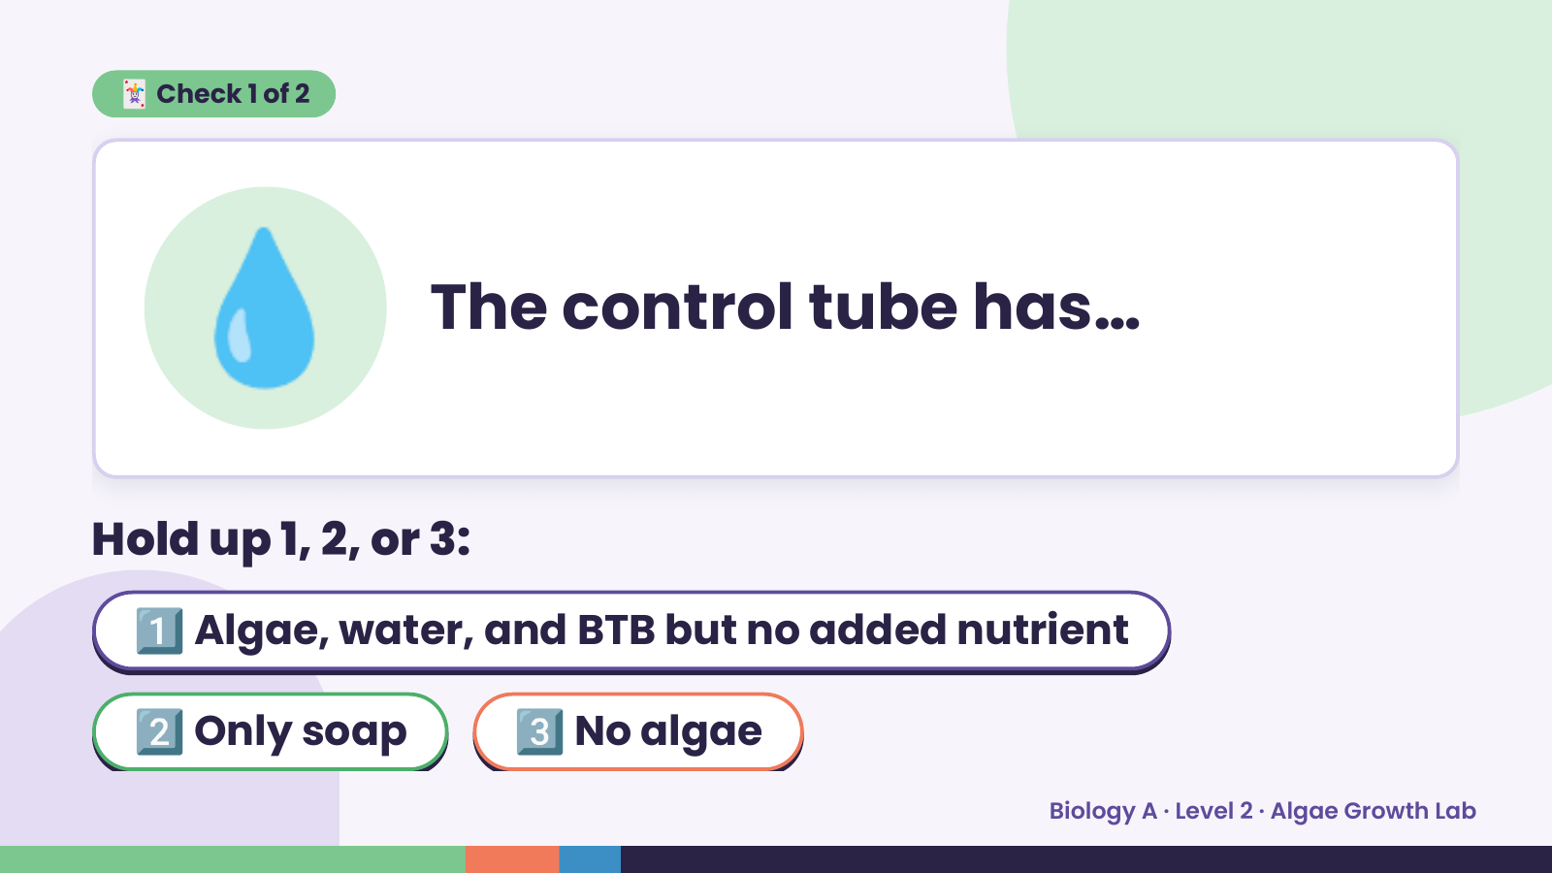
Notes:
💧
🃏 Check 1 of 2
The control tube has…
Hold up 1, 2, or 3:
1️⃣ Algae, water, and BTB but no added nutrient
2️⃣ Only soap 3️⃣ No algae
Biology A · Level 2 · Algae Growth Lab

Slide 6
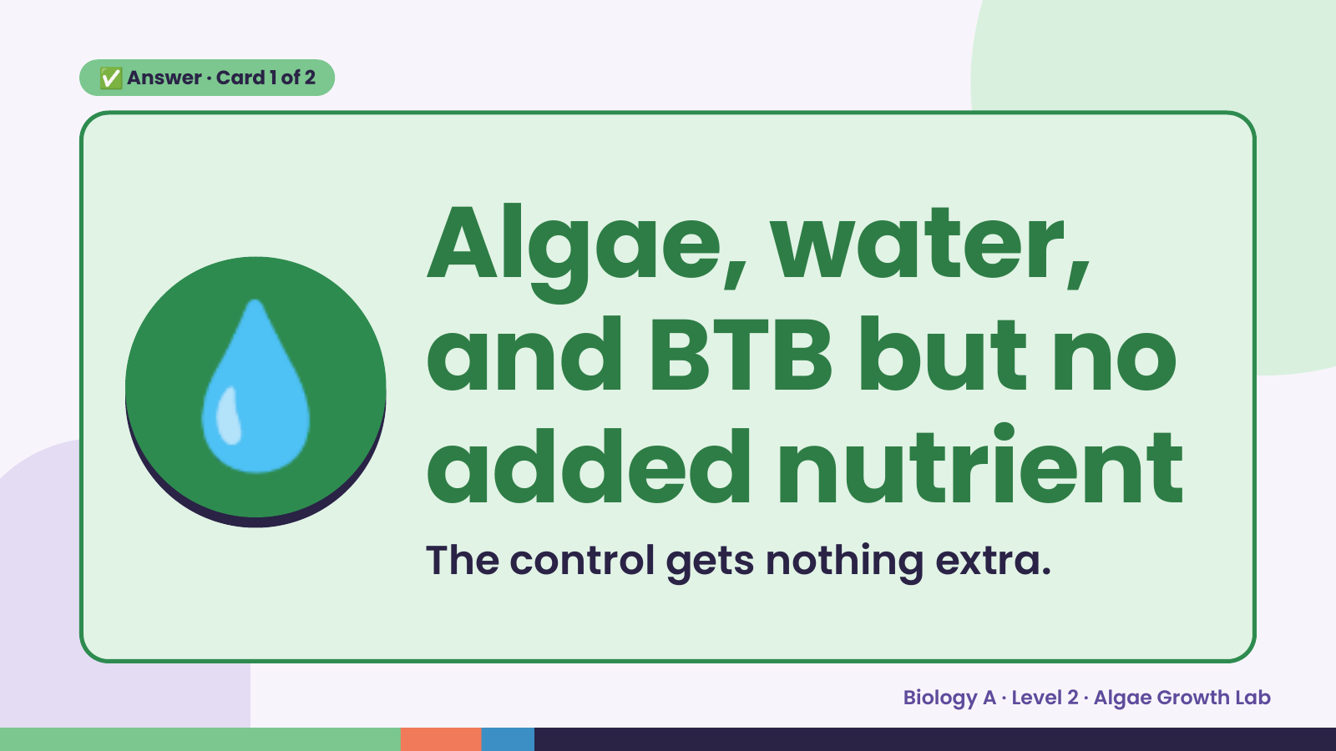
Notes:
✅ Answer · Card 1 of 2
💧 Algae, water,
and BTB but no
added nutrient
The control gets nothing extra.
Biology A · Level 2 · Algae Growth Lab

Slide 7
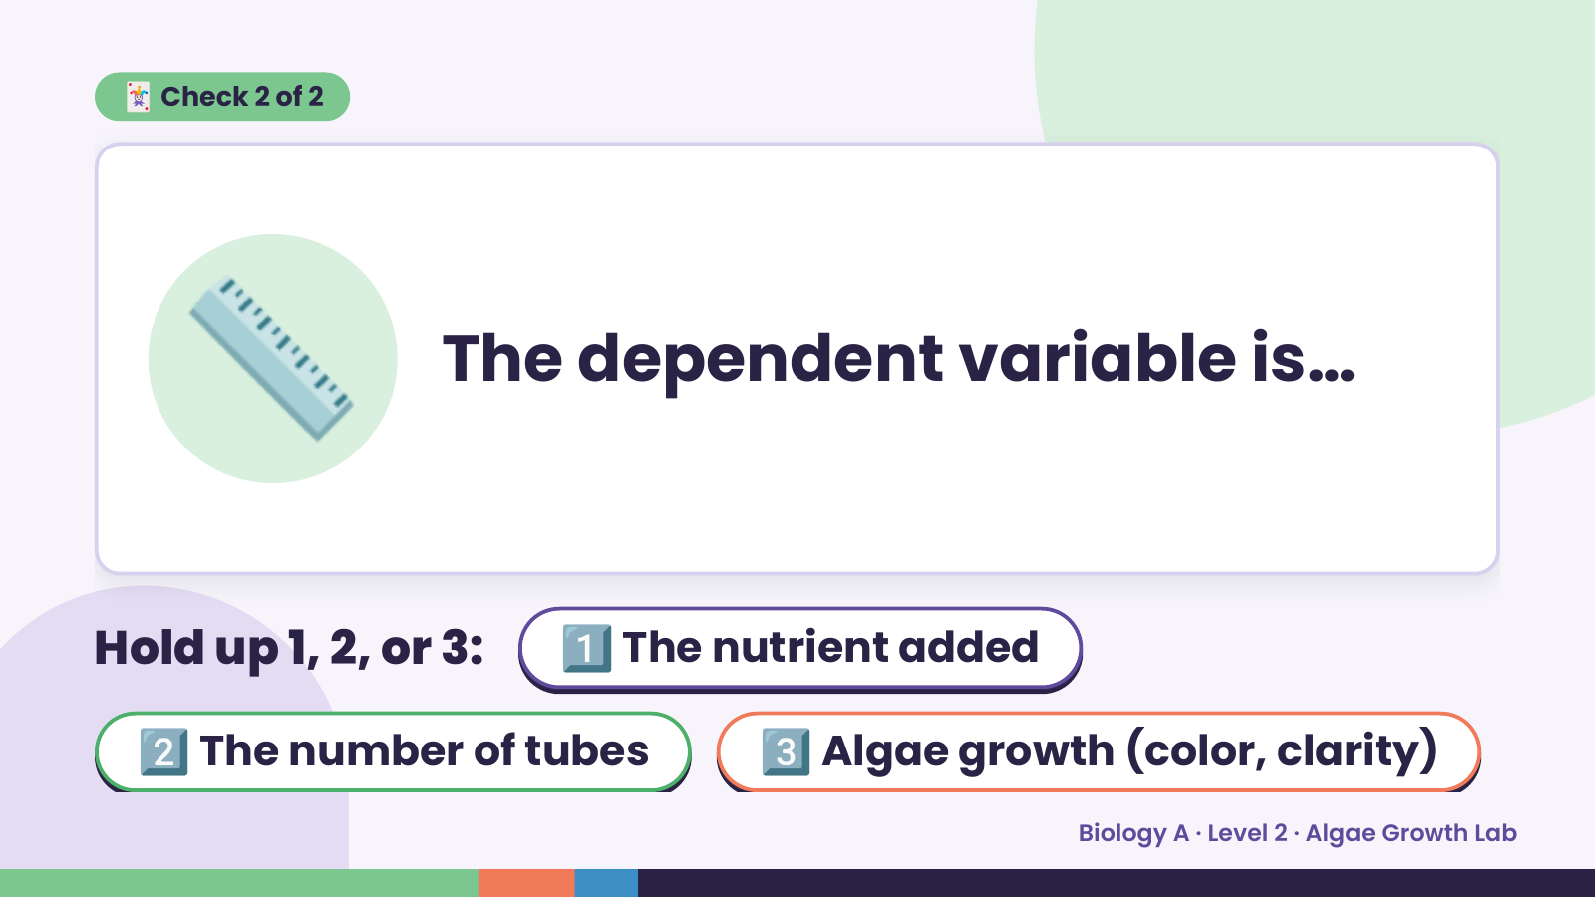
Notes:
🃏 Check 2 of 2
📏 The dependent variable is…
Hold up 1, 2, or 3: 1️⃣ The nutrient added
2️⃣ The number of tubes 3️⃣ Algae growth (color, clarity)
Biology A · Level 2 · Algae Growth Lab

Slide 8
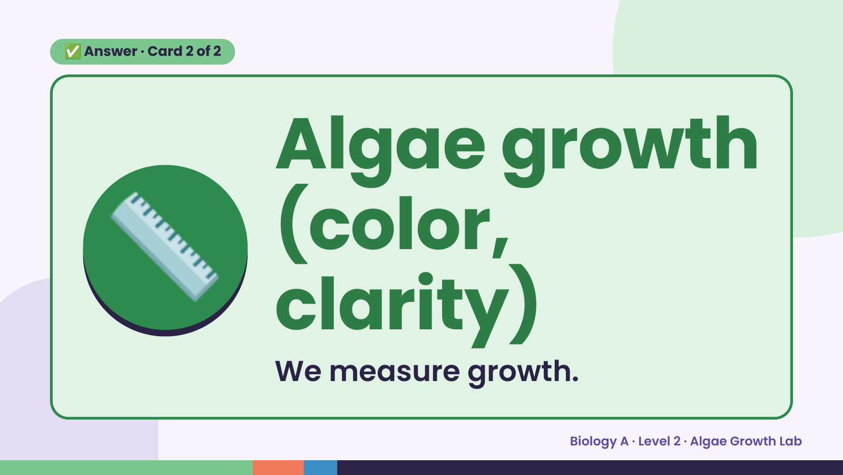
Notes:
✅ Answer · Card 2 of 2
📏 Algae growth
(color,
clarity)
We measure growth.
Biology A · Level 2 · Algae Growth Lab

Slide 9
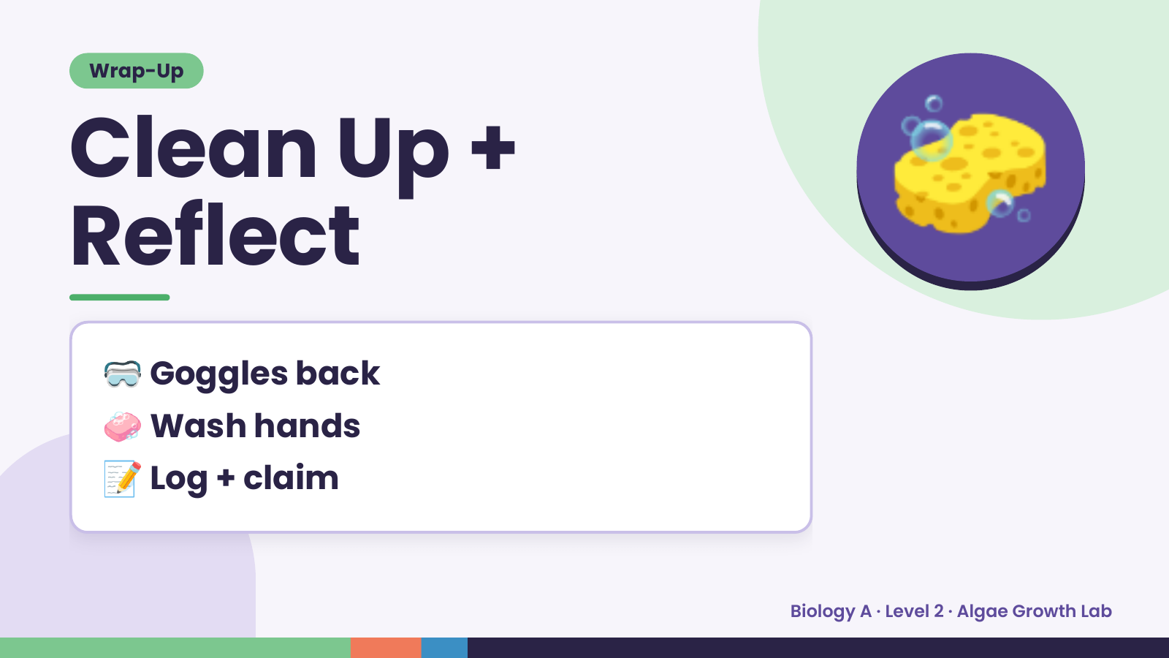
Notes:
Wrap-Up
Clean Up +
Reflect
🧽
🥽 Goggles back
🧼 Wash hands
📝 Log + claim
Biology A · Level 2 · Algae Growth Lab

