Slide 1
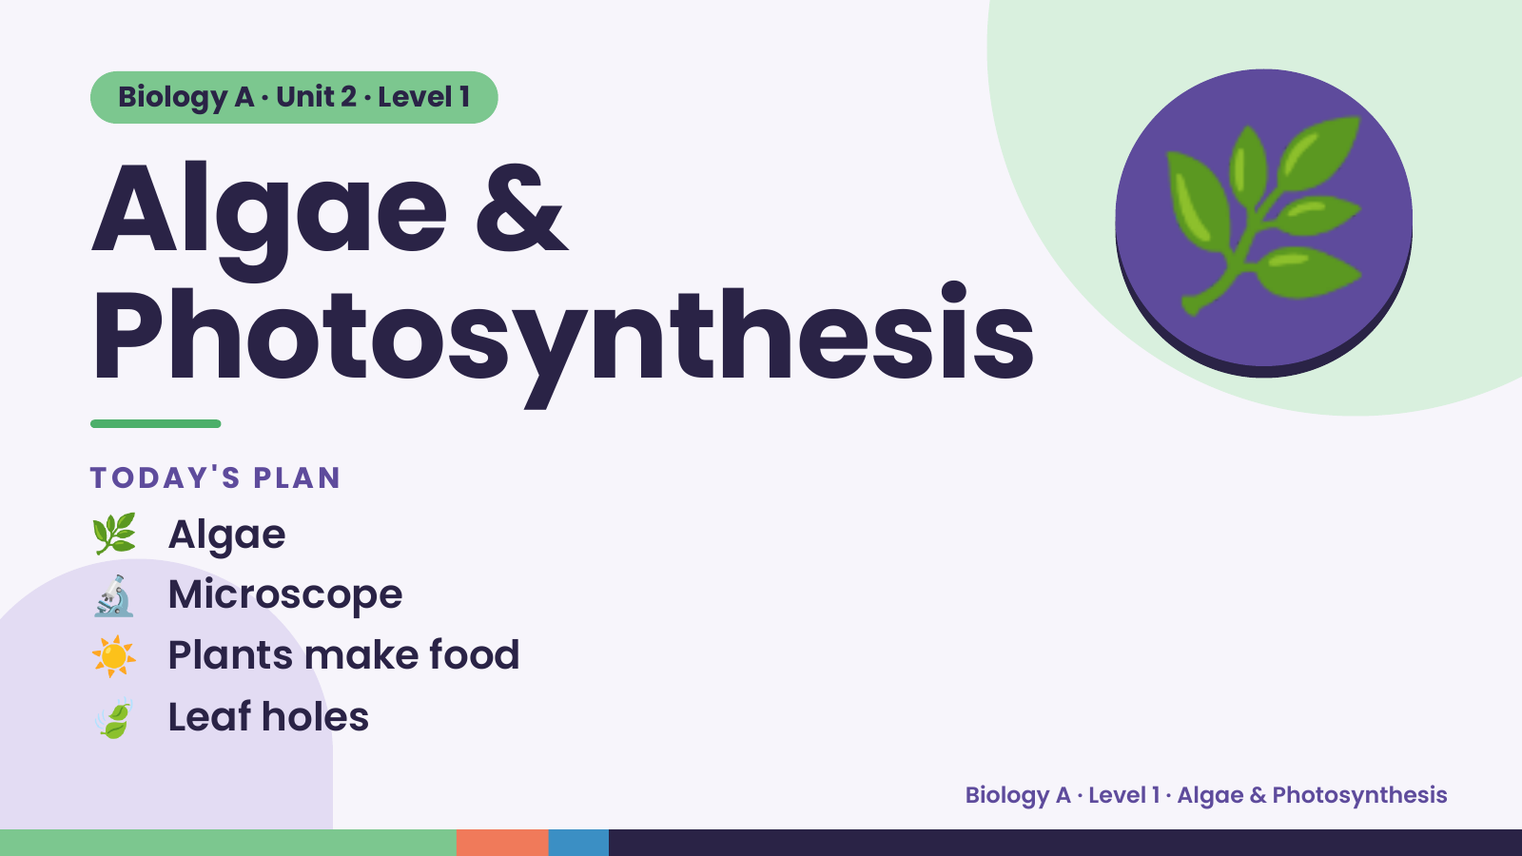
Notes:
Biology A · Unit 2 · Level 1
Algae &
Photosynthesis
🌿
🌿 Algae
TODAY'S PLAN
🔬 Microscope
☀️ Plants make food
🍃 Leaf holes
Biology A · Level 1 · Algae & Photosynthesis

Slide 2
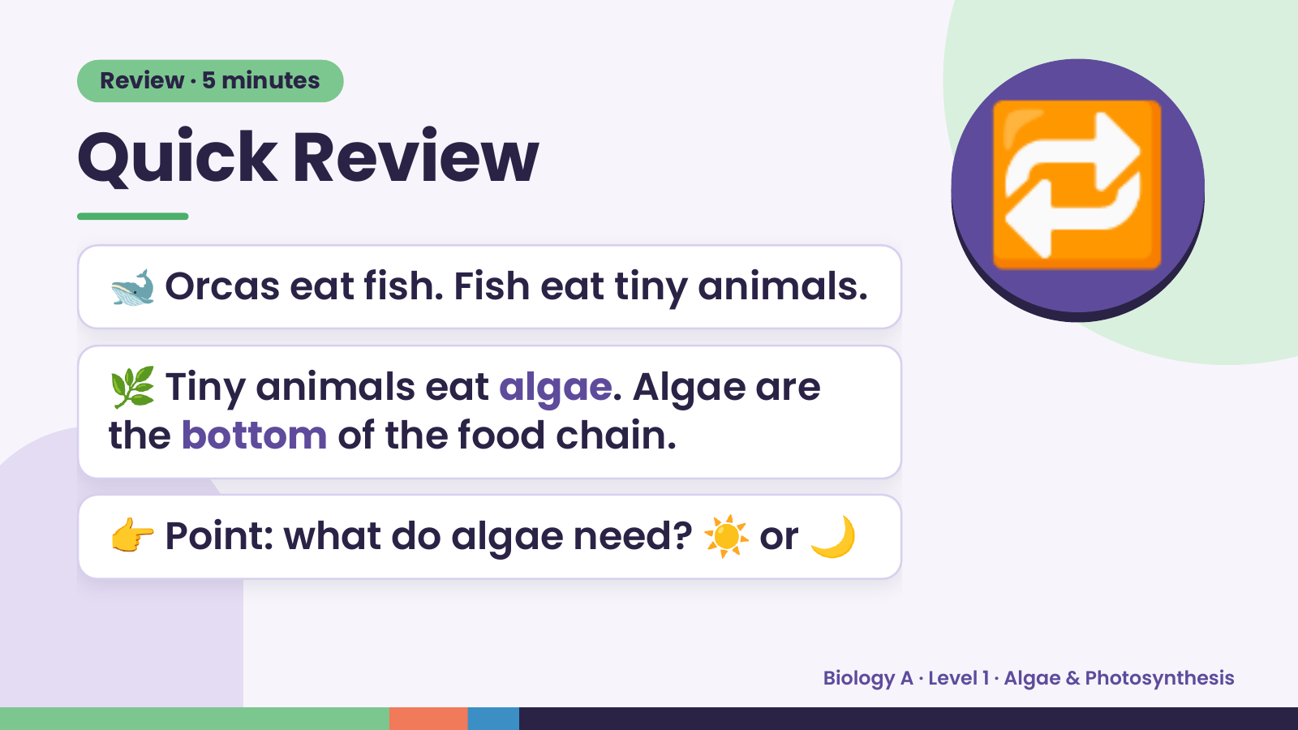
Notes:
Review · 5 minutes
Quick Review
🐋 Orcas eat fish. Fish eat tiny animals.
🌿 Tiny animals eat algae. Algae are
🔁
the bottom of the food chain.
👉 Point: what do algae need? ☀️ or 🌙
Biology A · Level 1 · Algae & Photosynthesis

Slide 3
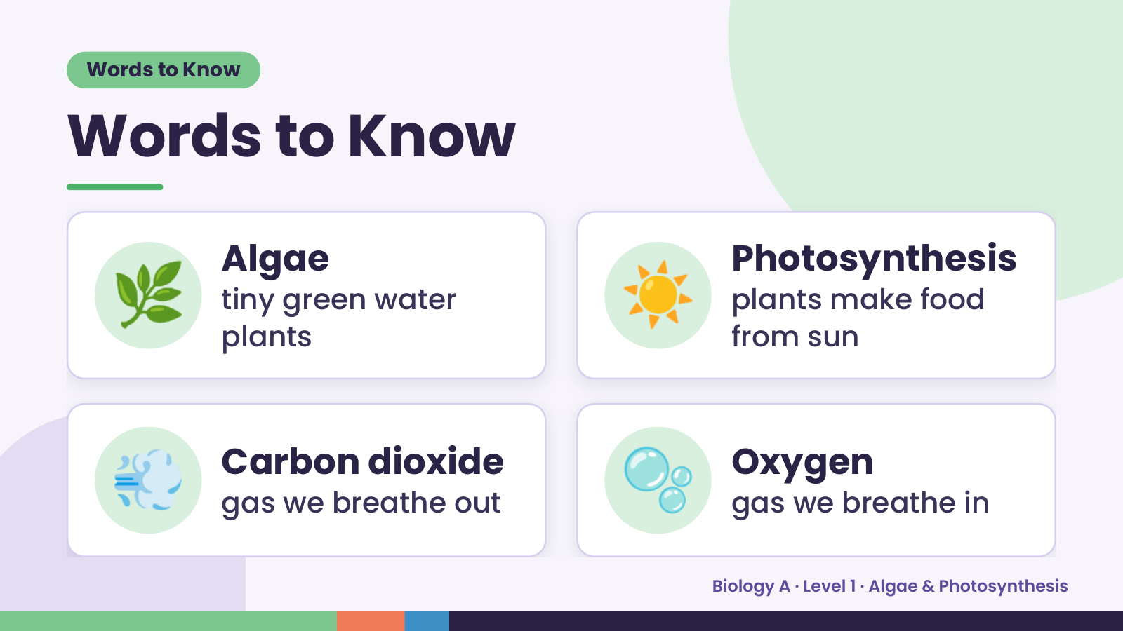
Notes:
Words to Know
Words to Know
🌿 Algae
tiny green water
plants
☀️ Photosynthesis
plants make food
from sun
💨 Carbon dioxide
gas we breathe out 🫧 Oxygen
gas we breathe in
Biology A · Level 1 · Algae & Photosynthesis

Slide 4
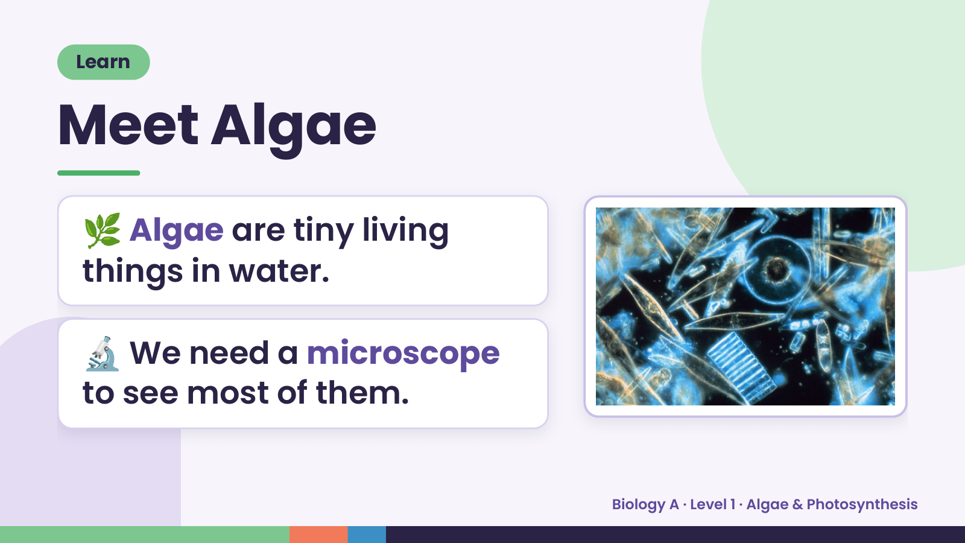
Notes:
Learn
Meet Algae
🌿 Algae are tiny living
things in water.
🔬 We need a microscope
to see most of them.
Biology A · Level 1 · Algae & Photosynthesis

Slide 5
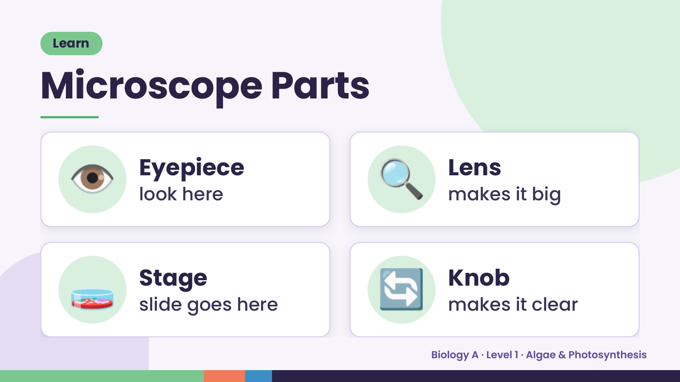
Notes:
Learn
Microscope Parts
👁️ Eyepiece
look here 🔍 Lens
makes it big
🧫 Stage
slide goes here 🔄 Knob
makes it clear
Biology A · Level 1 · Algae & Photosynthesis

Slide 6
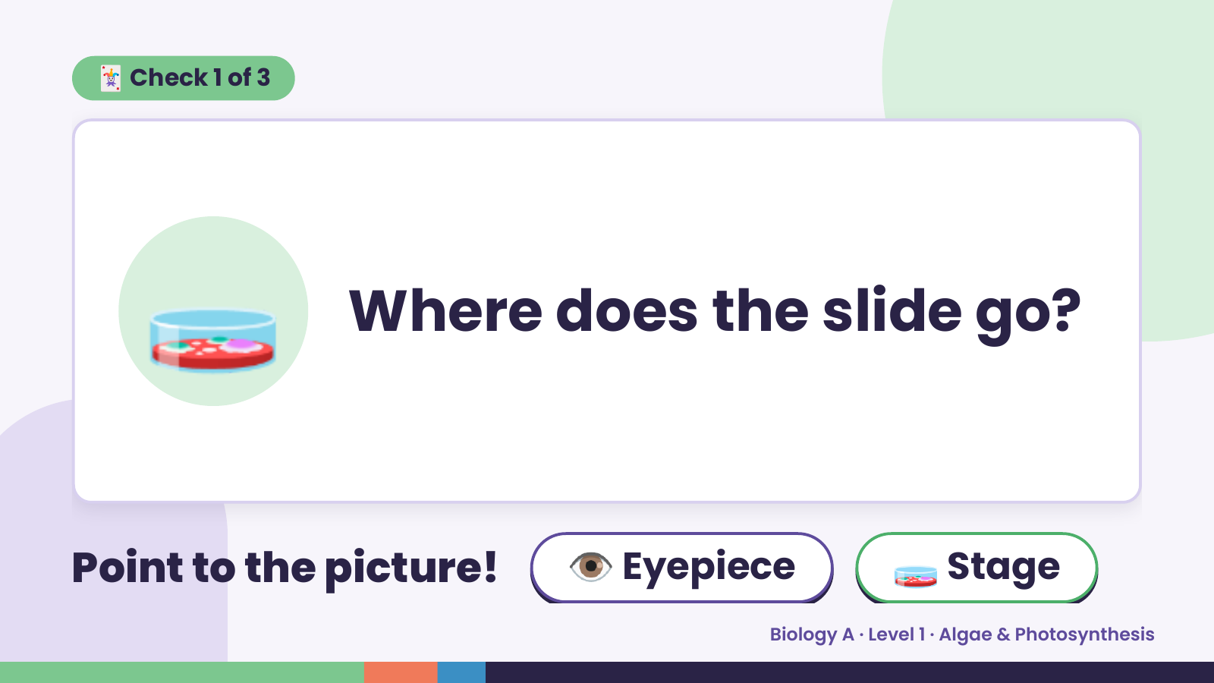
Notes:
🃏 Check 1 of 3
🧫 Where does the slide go?
Point to the picture! 👁️ Eyepiece 🧫 Stage
Biology A · Level 1 · Algae & Photosynthesis

Slide 7
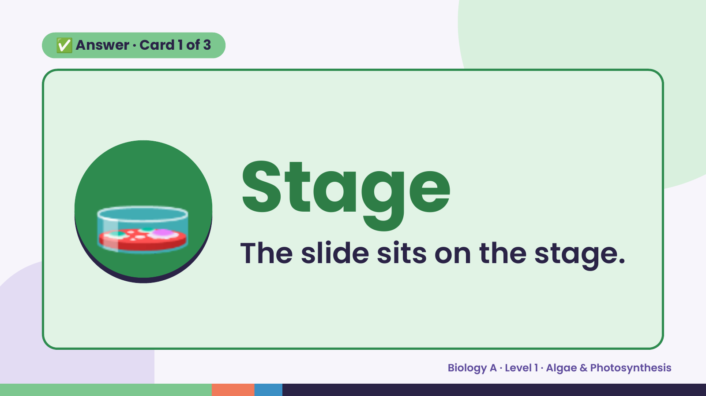
Notes:
✅ Answer · Card 1 of 3
🧫 Stage
The slide sits on the stage.
Biology A · Level 1 · Algae & Photosynthesis

Slide 8
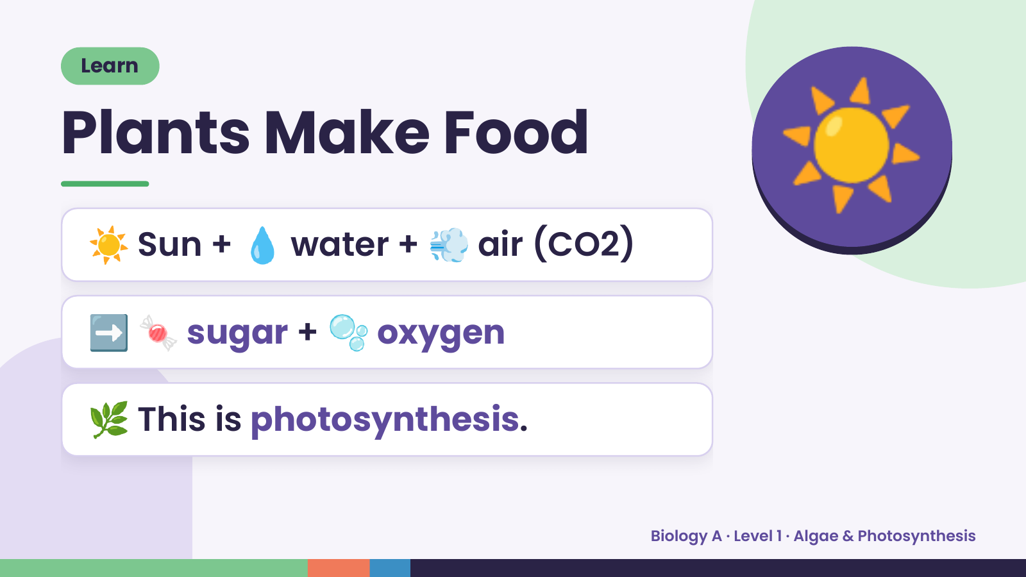
Notes:
Learn
Plants Make Food
☀️ Sun + 💧 water + 💨 air (CO2)
☀️
➡️ 🍬 sugar + 🫧 oxygen
🌿 This is photosynthesis.
Biology A · Level 1 · Algae & Photosynthesis

Slide 9
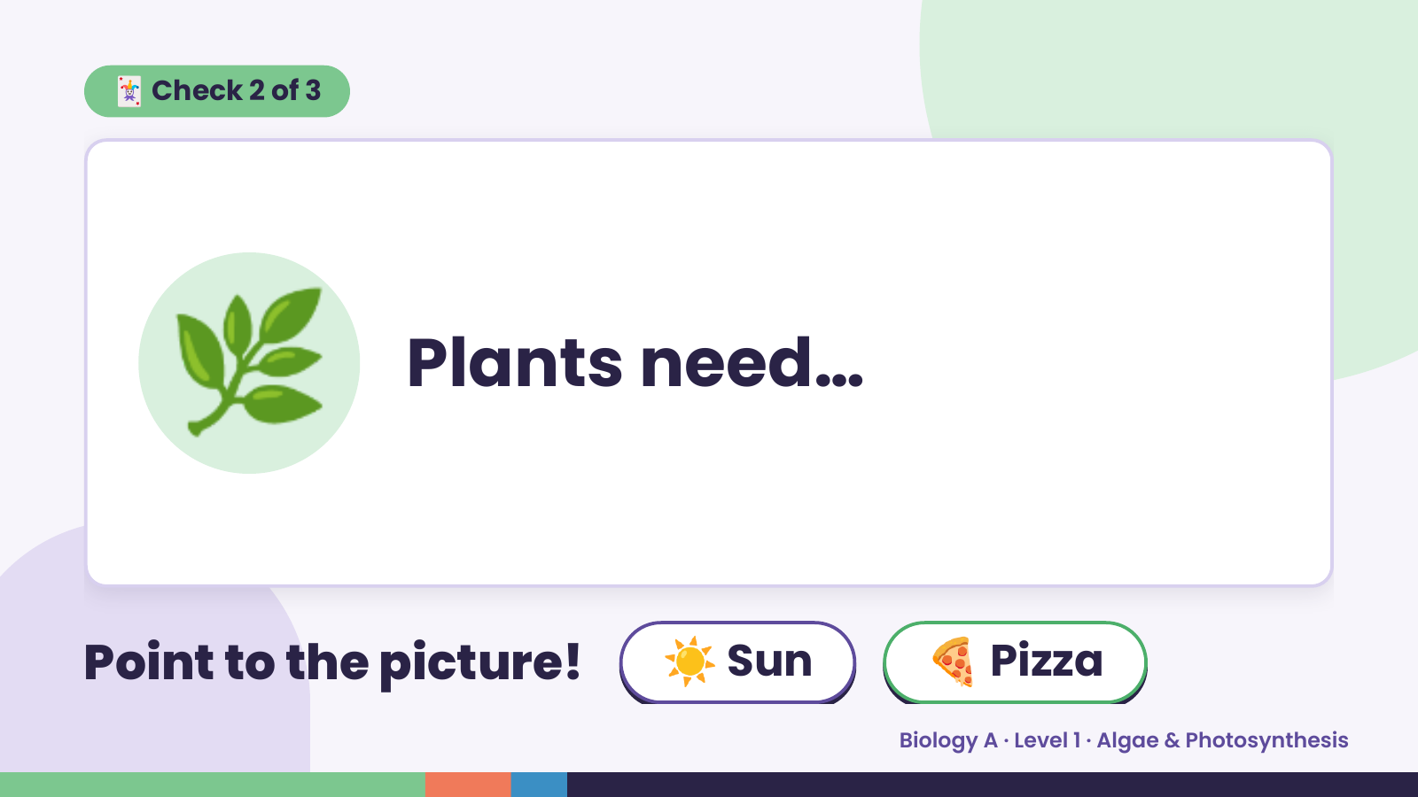
Notes:
🃏 Check 2 of 3
🌿 Plants need…
Point to the picture! ☀️ Sun 🍕 Pizza
Biology A · Level 1 · Algae & Photosynthesis

Slide 10
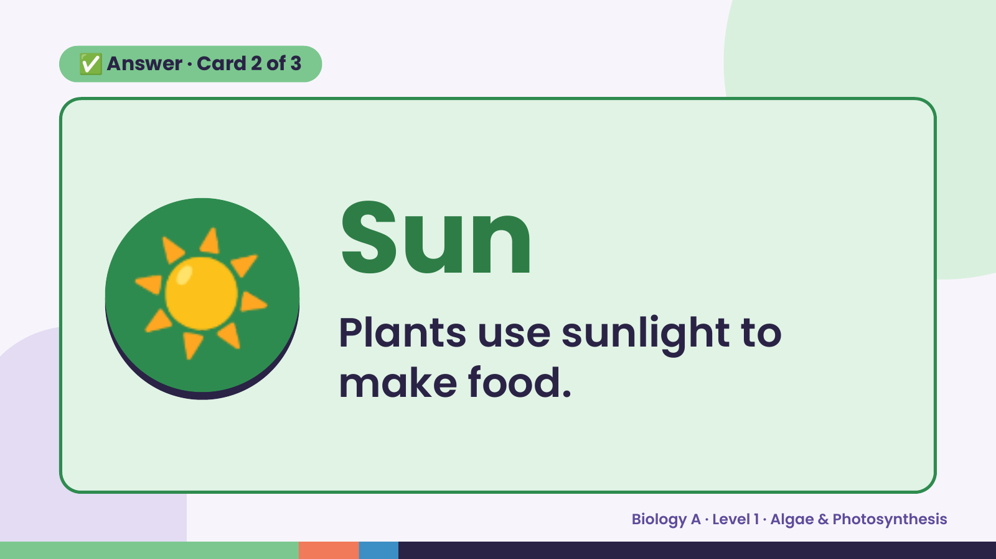
Notes:
✅ Answer · Card 2 of 3
☀️ Sun
Plants use sunlight to
make food.
Biology A · Level 1 · Algae & Photosynthesis

Slide 11
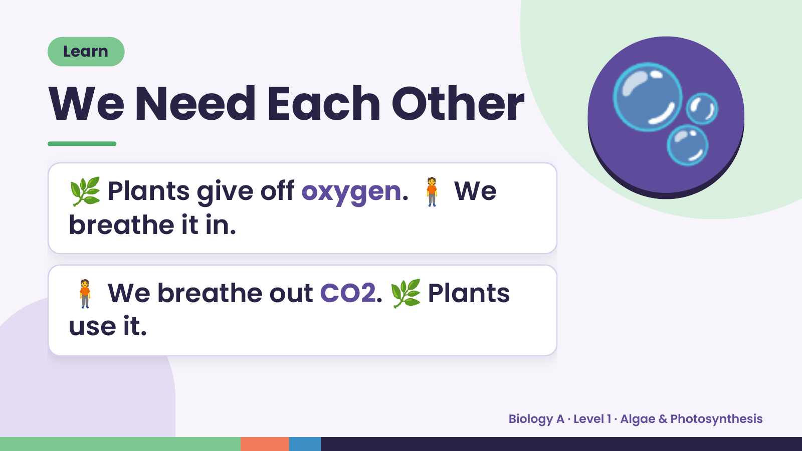
Notes:
Learn
We Need Each Other
🌿 Plants give off oxygen. 🧍 We
breathe it in.
🫧
🧍 We breathe out CO2. 🌿 Plants
use it.
Biology A · Level 1 · Algae & Photosynthesis

Slide 12
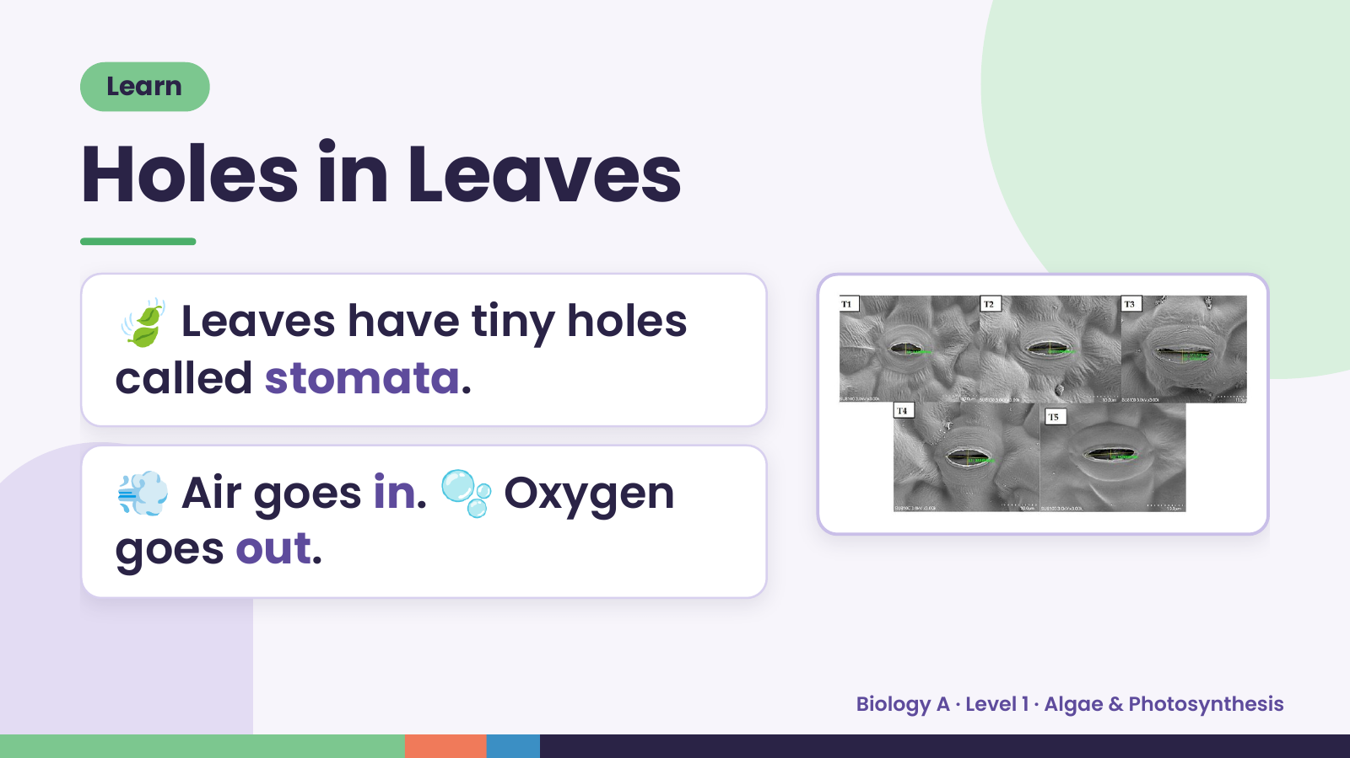
Notes:
Learn
Holes in Leaves
🍃 Leaves have tiny holes
called stomata.
💨 Air goes in. 🫧 Oxygen
goes out.
Biology A · Level 1 · Algae & Photosynthesis

Slide 13
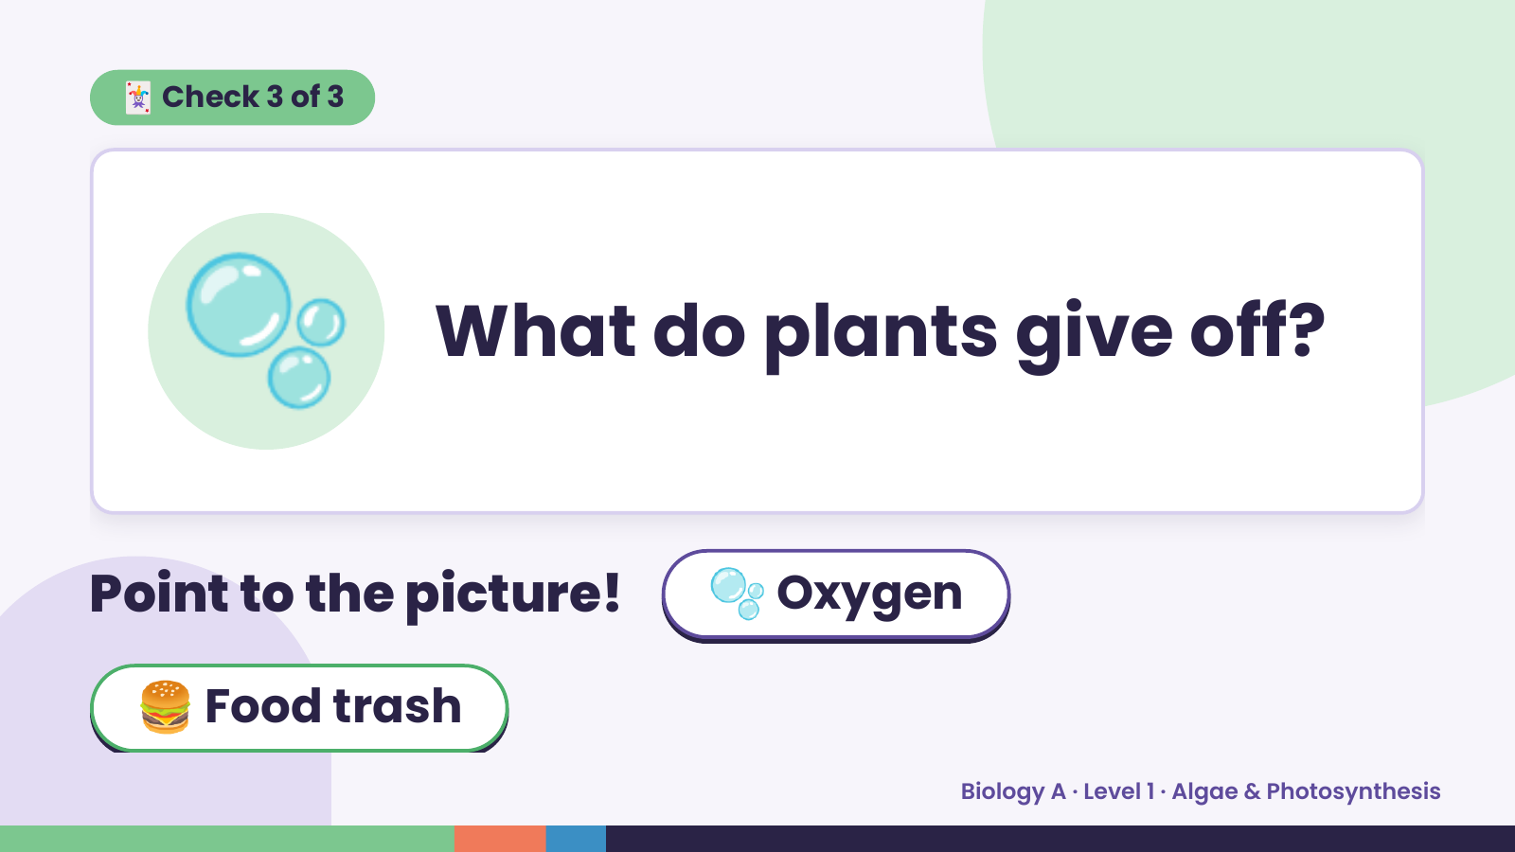
Notes:
🃏 Check 3 of 3
🫧 What do plants give off?
Point to the picture! 🫧 Oxygen
🍔 Food trash
Biology A · Level 1 · Algae & Photosynthesis

Slide 14
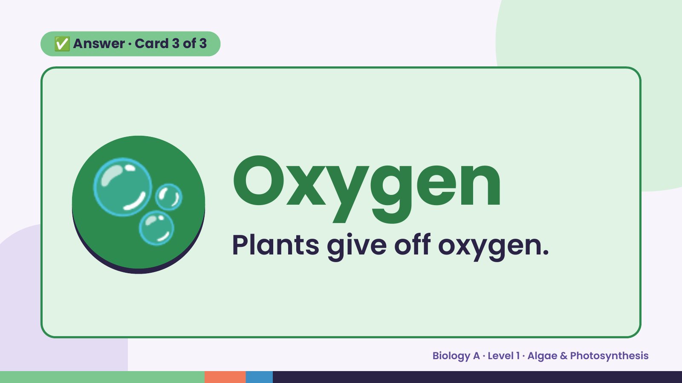
Notes:
✅ Answer · Card 3 of 3
🫧 Oxygen
Plants give off oxygen.
Biology A · Level 1 · Algae & Photosynthesis

Slide 15
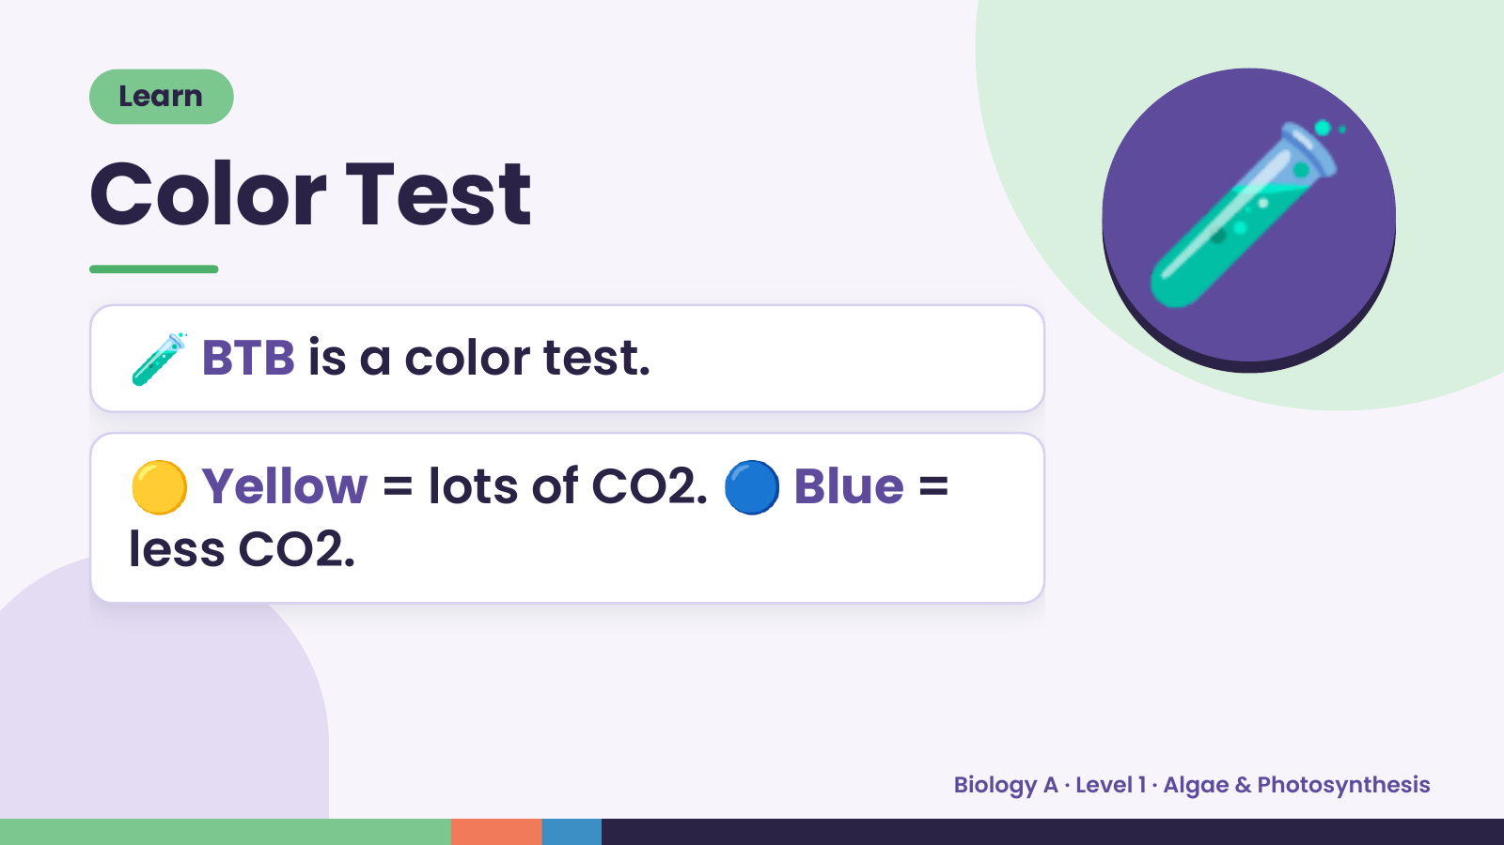
Notes:
Learn
Color Test
🧪 BTB is a color test.
🧪
🟡 Yellow = lots of CO2. 🔵 Blue =
less CO2.
Biology A · Level 1 · Algae & Photosynthesis

Slide 16
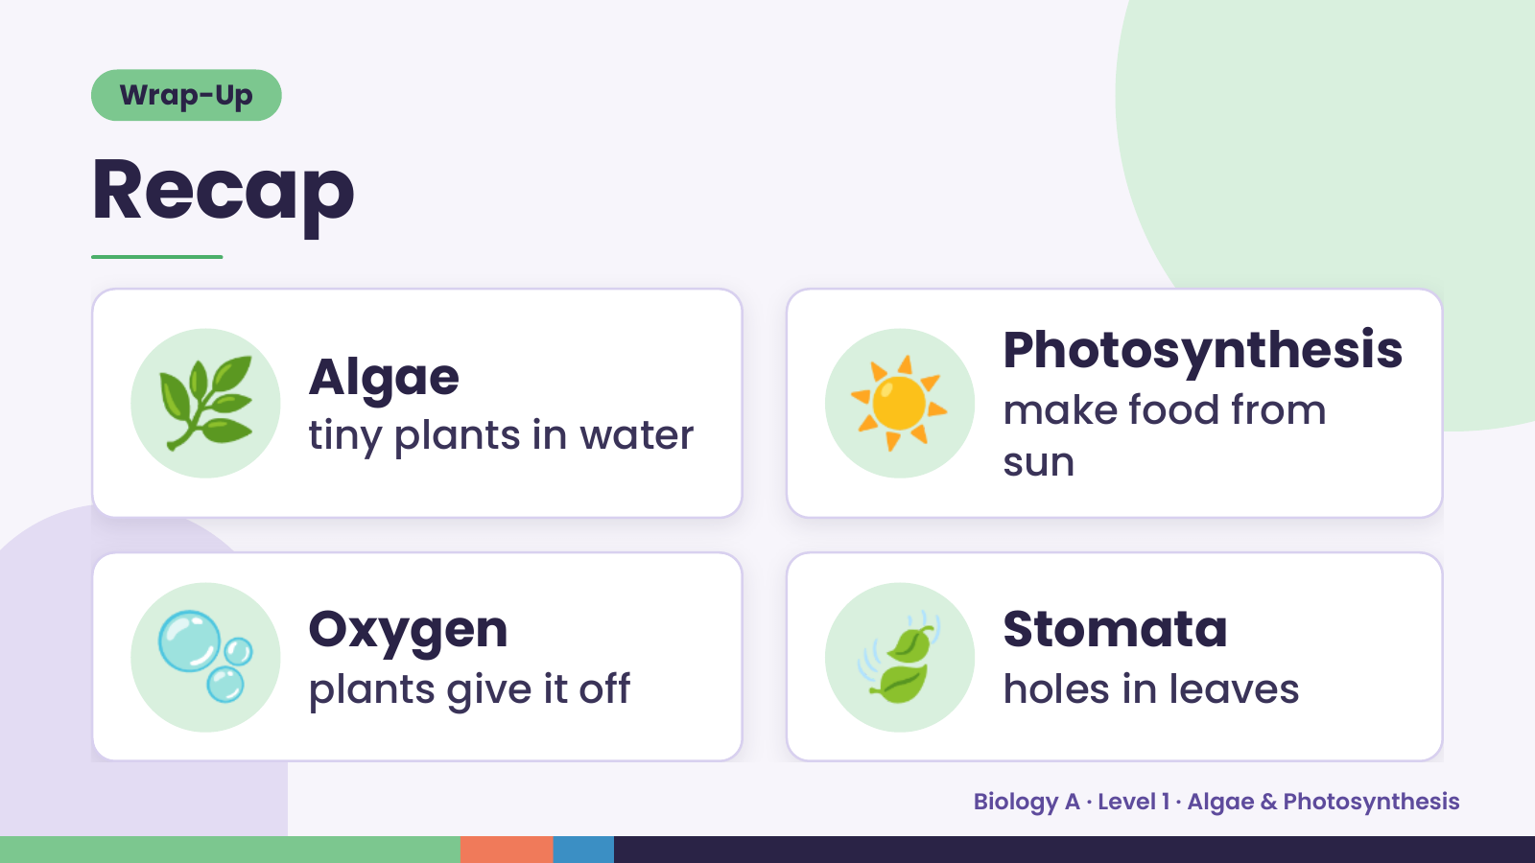
Notes:
Wrap-Up
Recap
🌿 Algae
tiny plants in water ☀️ Photosynthesis
make food from
sun
🫧 Oxygen
plants give it off 🍃 Stomata
holes in leaves
Biology A · Level 1 · Algae & Photosynthesis

Slide 17
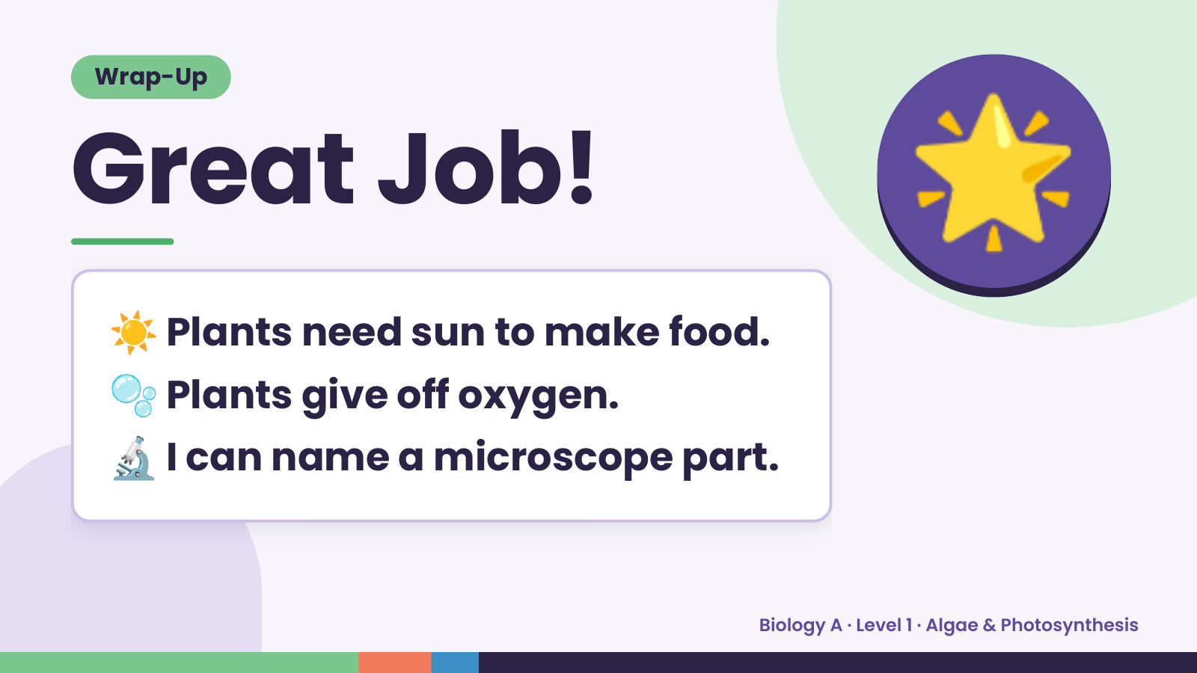
Notes:
Wrap-Up
Great Job!
☀️ Plants need sun to make food.
🌟
🫧 Plants give off oxygen.
🔬 I can name a microscope part.
Biology A · Level 1 · Algae & Photosynthesis

