Slide 1
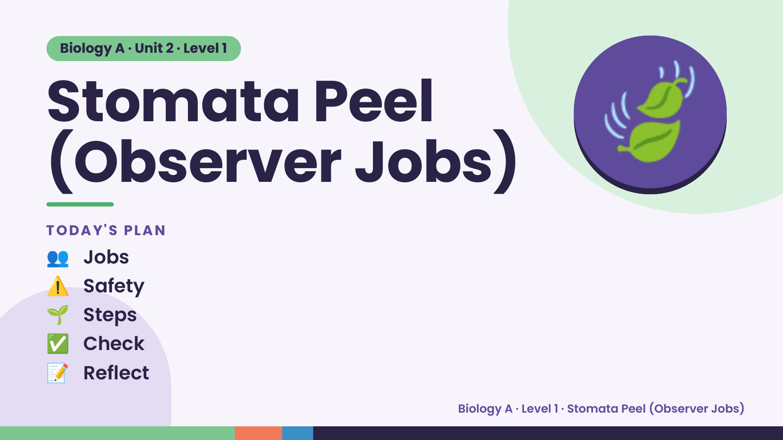
Notes:
Biology A · Unit 2 · Level 1
Stomata Peel
(Observer Jobs)
TODAY'S PLAN
🍃
👥 Jobs
⚠️ Safety
🌱 Steps
✅ Check
📝 Reflect
Biology A · Level 1 · Stomata Peel (Observer Jobs)

Slide 2
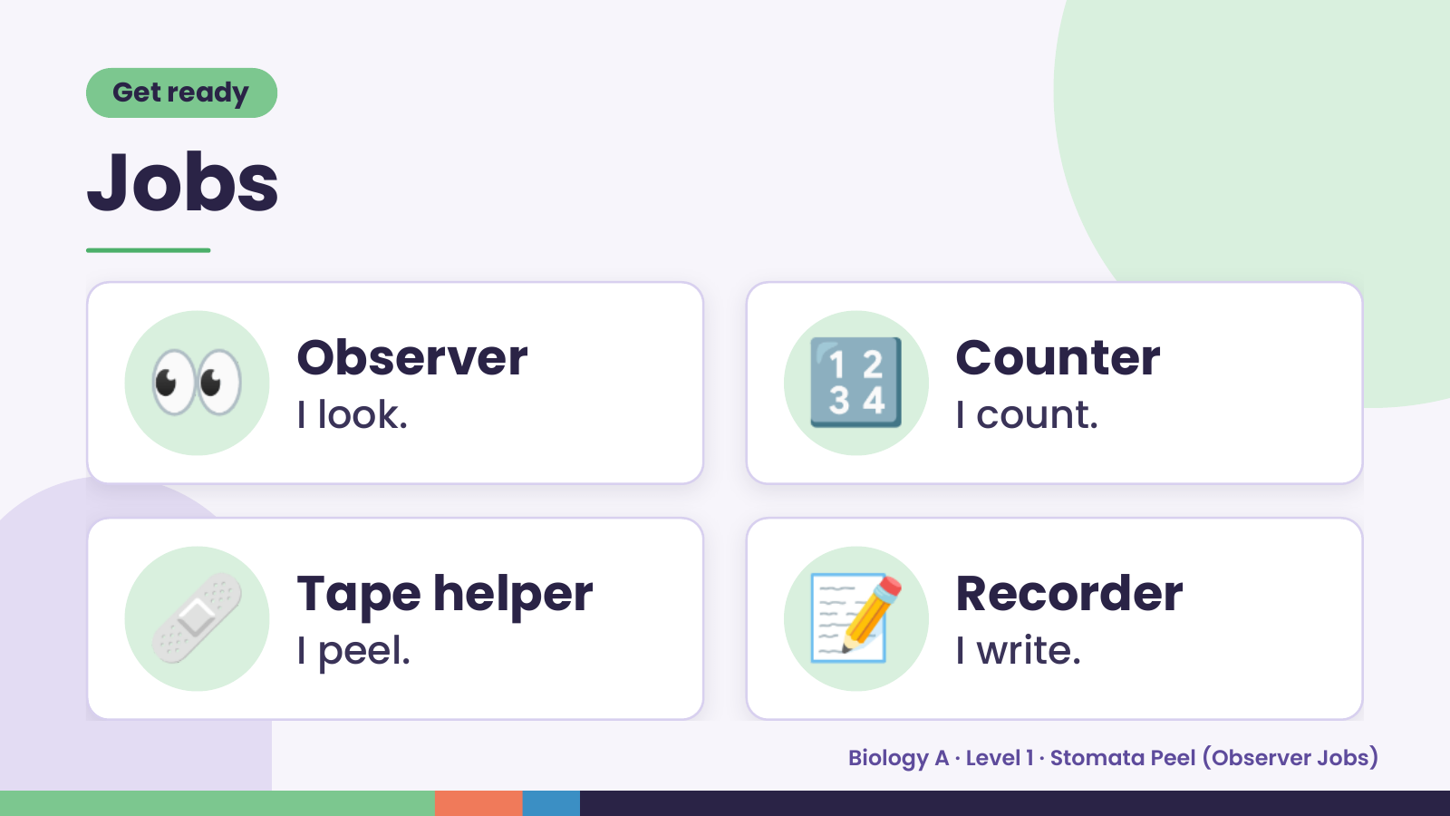
Notes:
Get ready
Jobs
👀 Observer
I look. 🔢 Counter
I count.
🩹 Tape helper
I peel. 📝 Recorder
I write.
Biology A · Level 1 · Stomata Peel (Observer Jobs)

Slide 3
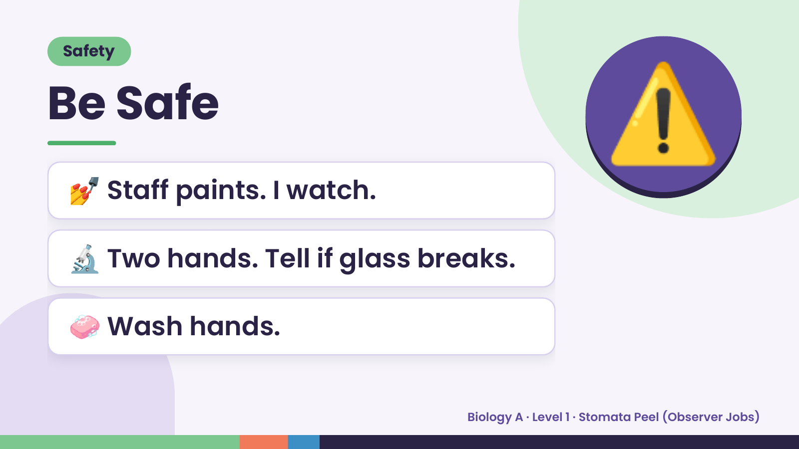
Notes:
Safety
Be Safe
💅 Staff paints. I watch.
⚠️
🔬 Two hands. Tell if glass breaks.
🧼 Wash hands.
Biology A · Level 1 · Stomata Peel (Observer Jobs)

Slide 4
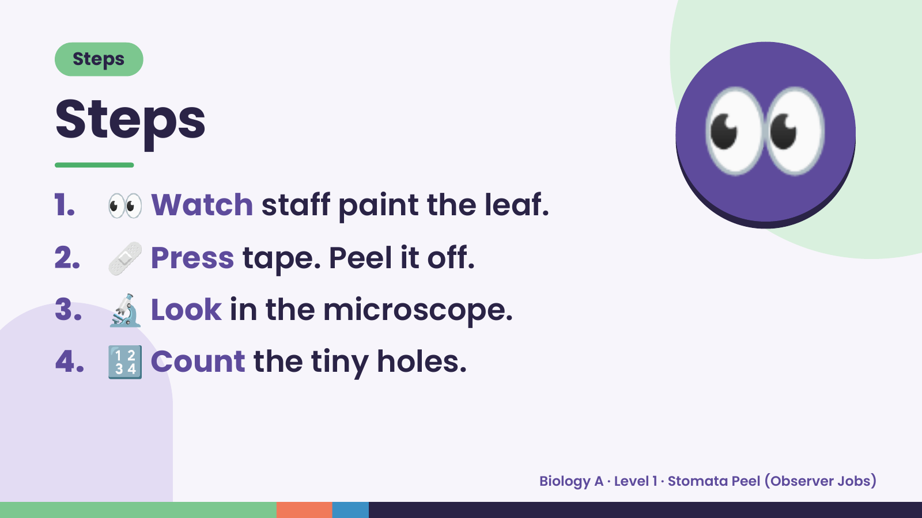
Notes:
Steps
Steps
1. 👀 Watch staff paint the leaf.
2. 🩹 Press tape. Peel it off.
👀
3. 🔬 Look in the microscope.
4. 🔢 Count the tiny holes.
Biology A · Level 1 · Stomata Peel (Observer Jobs)

Slide 5
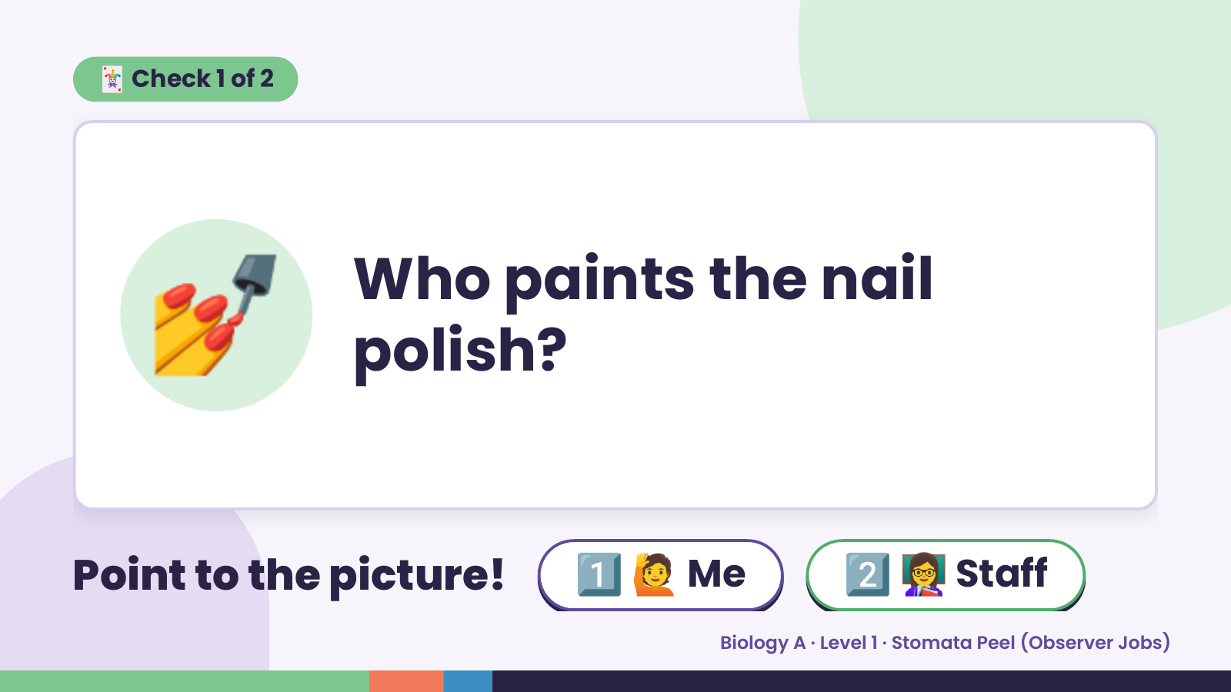
Notes:
🃏 Check 1 of 2
💅 Who paints the nail
polish?
Point to the picture! 1️⃣ 🙋 Me 2️⃣ 👩‍🏫 Staff
Biology A · Level 1 · Stomata Peel (Observer Jobs)

Slide 6
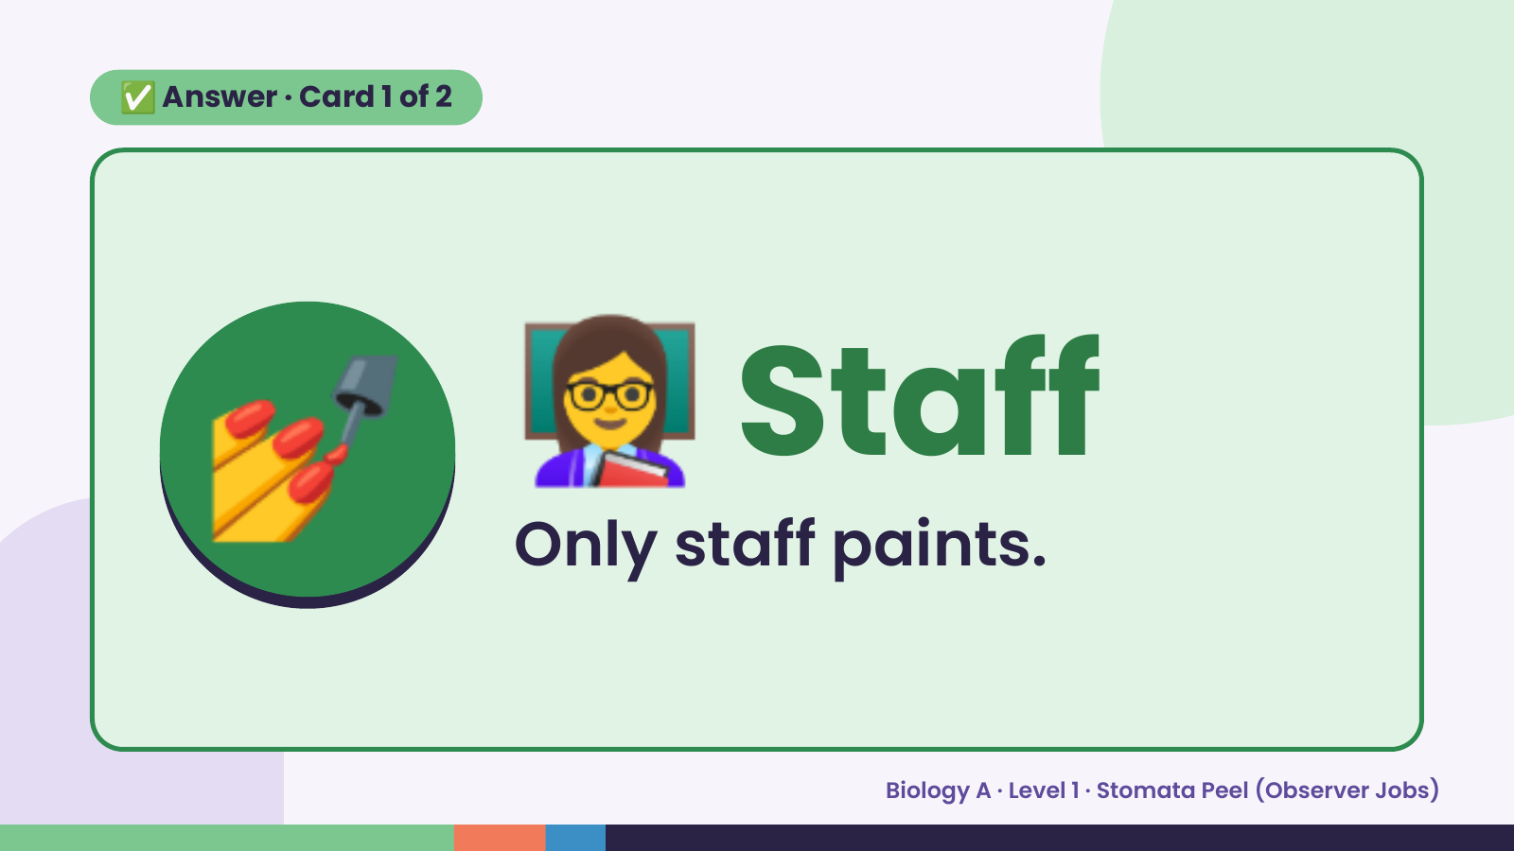
Notes:
✅ Answer · Card 1 of 2
💅 👩‍🏫 Staff
Only staff paints.
Biology A · Level 1 · Stomata Peel (Observer Jobs)

Slide 7
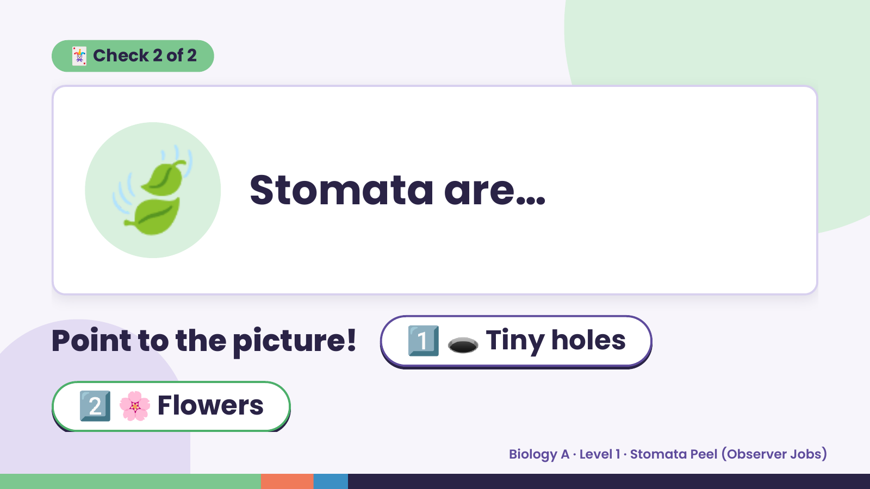
Notes:
🃏 Check 2 of 2
🍃 Stomata are…
Point to the picture! 1️⃣ 🕳️ Tiny holes
2️⃣ 🌸 Flowers
Biology A · Level 1 · Stomata Peel (Observer Jobs)

Slide 8
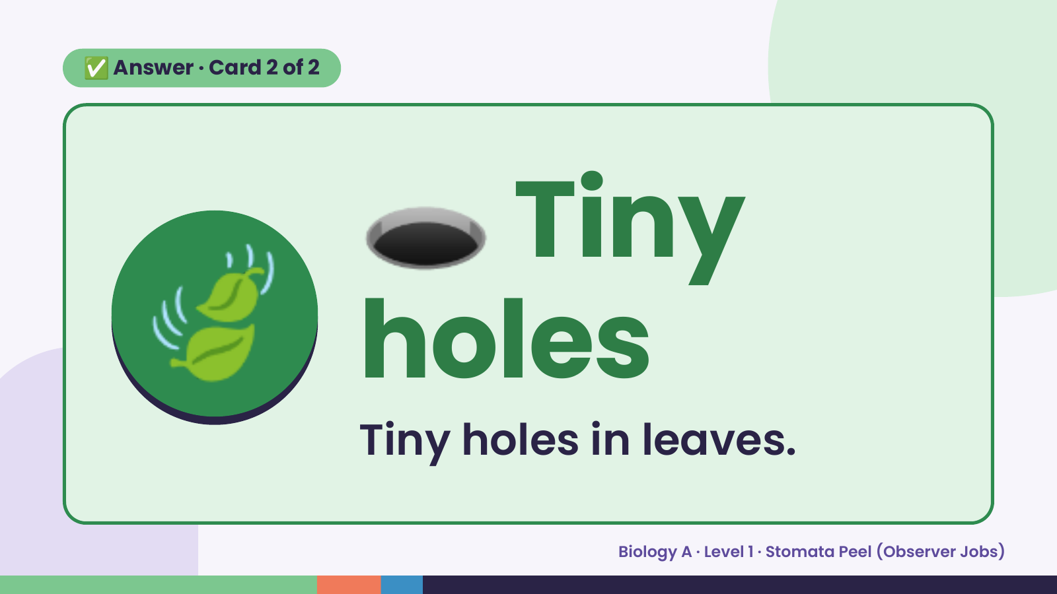
Notes:
🕳️
✅ Answer · Card 2 of 2
🍃 holes
Tiny
Tiny holes in leaves.
Biology A · Level 1 · Stomata Peel (Observer Jobs)

Slide 9
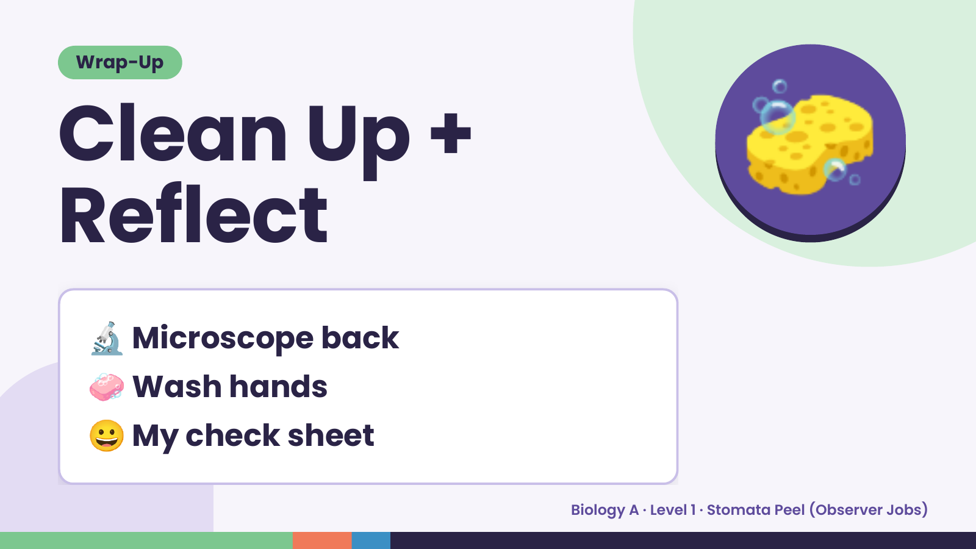
Notes:
Wrap-Up
Clean Up +
Reflect
🧽
🔬 Microscope back
🧼 Wash hands
😀 My check sheet
Biology A · Level 1 · Stomata Peel (Observer Jobs)

