Slide 1
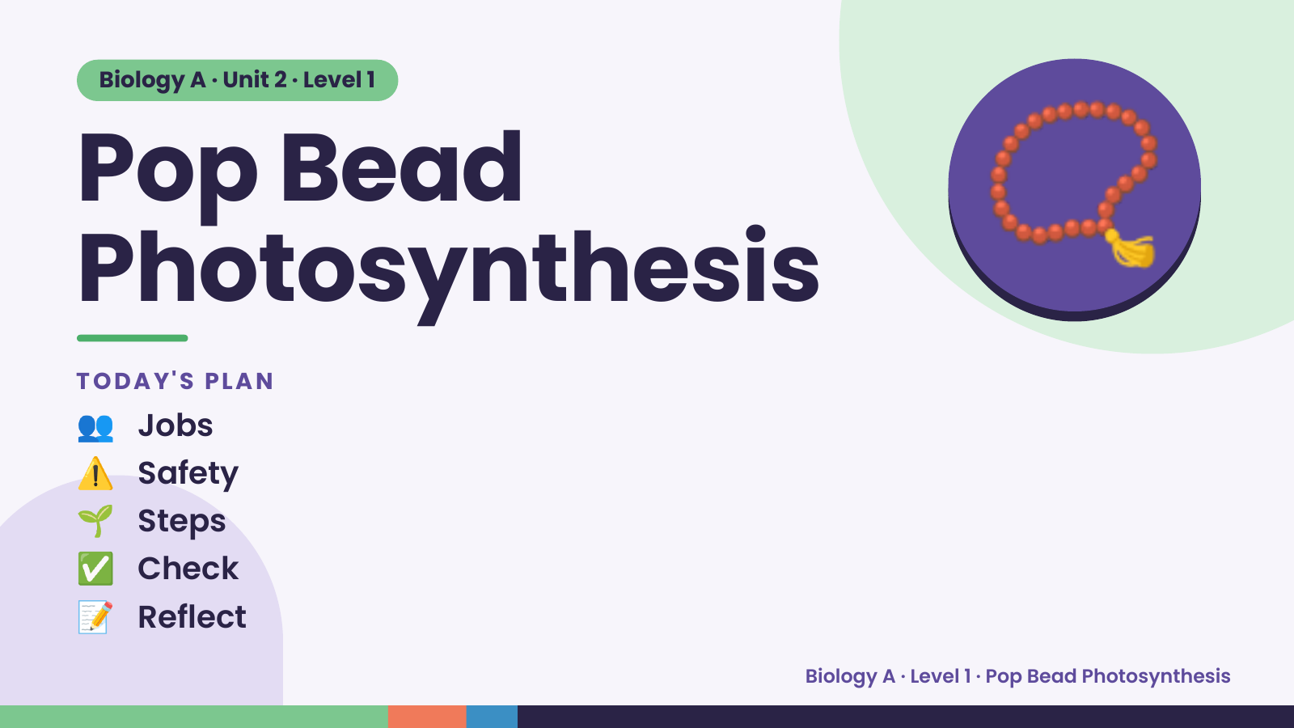
Notes:
Biology A · Unit 2 · Level 1
Pop Bead
Photosynthesis
TODAY'S PLAN
📿
👥 Jobs
⚠️ Safety
🌱 Steps
✅ Check
📝 Reflect
Biology A · Level 1 · Pop Bead Photosynthesis

Slide 2
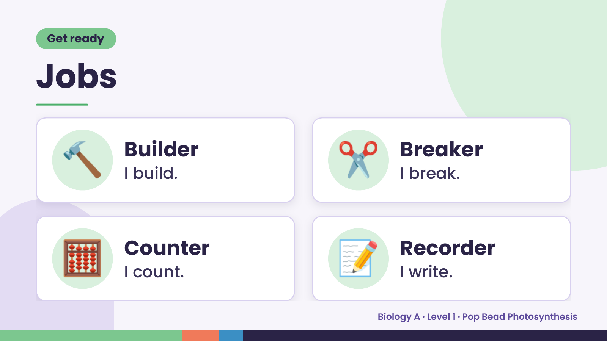
Notes:
Get ready
Jobs
🔨 Builder
I build. ✂️ Breaker
I break.
🧮 Counter
I count. 📝 Recorder
I write.
Biology A · Level 1 · Pop Bead Photosynthesis

Slide 3
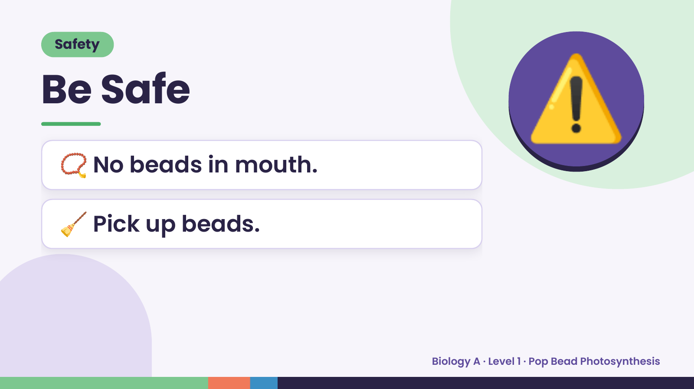
Notes:
Safety
Be Safe
📿 No beads in mouth.
⚠️
🧹 Pick up beads.
Biology A · Level 1 · Pop Bead Photosynthesis

Slide 4
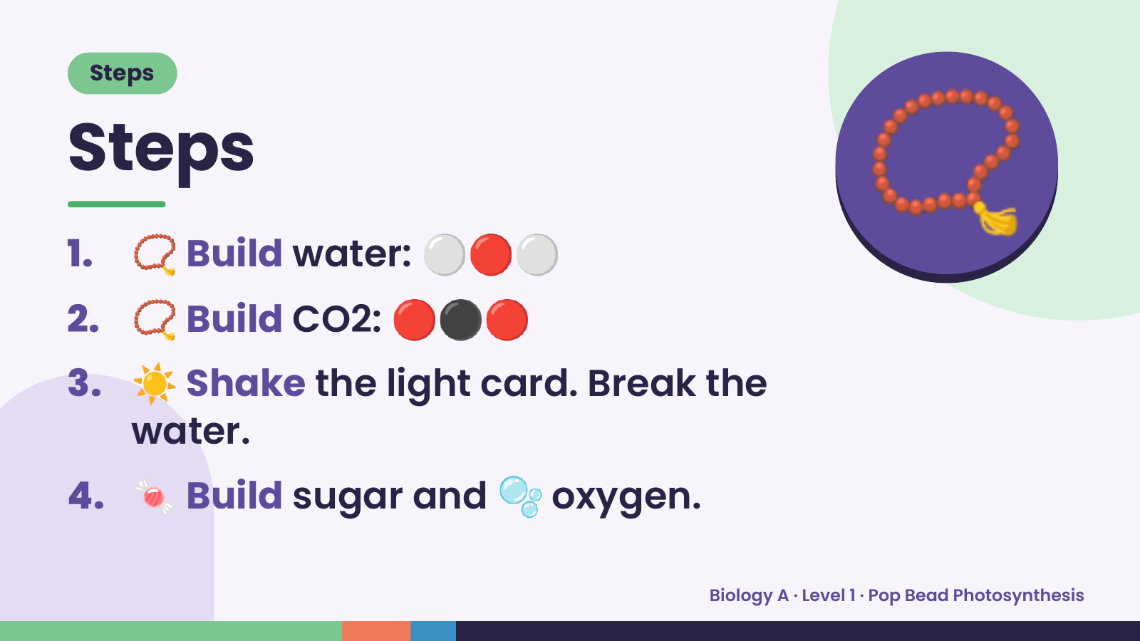
Notes:
Steps
Steps
1. 📿 Build water: ⚪🔴⚪
2. 📿 Build CO2: 🔴⚫🔴
📿
3. ☀️ Shake the light card. Break the
water.
4. 🍬 Build sugar and 🫧 oxygen.
Biology A · Level 1 · Pop Bead Photosynthesis

Slide 5
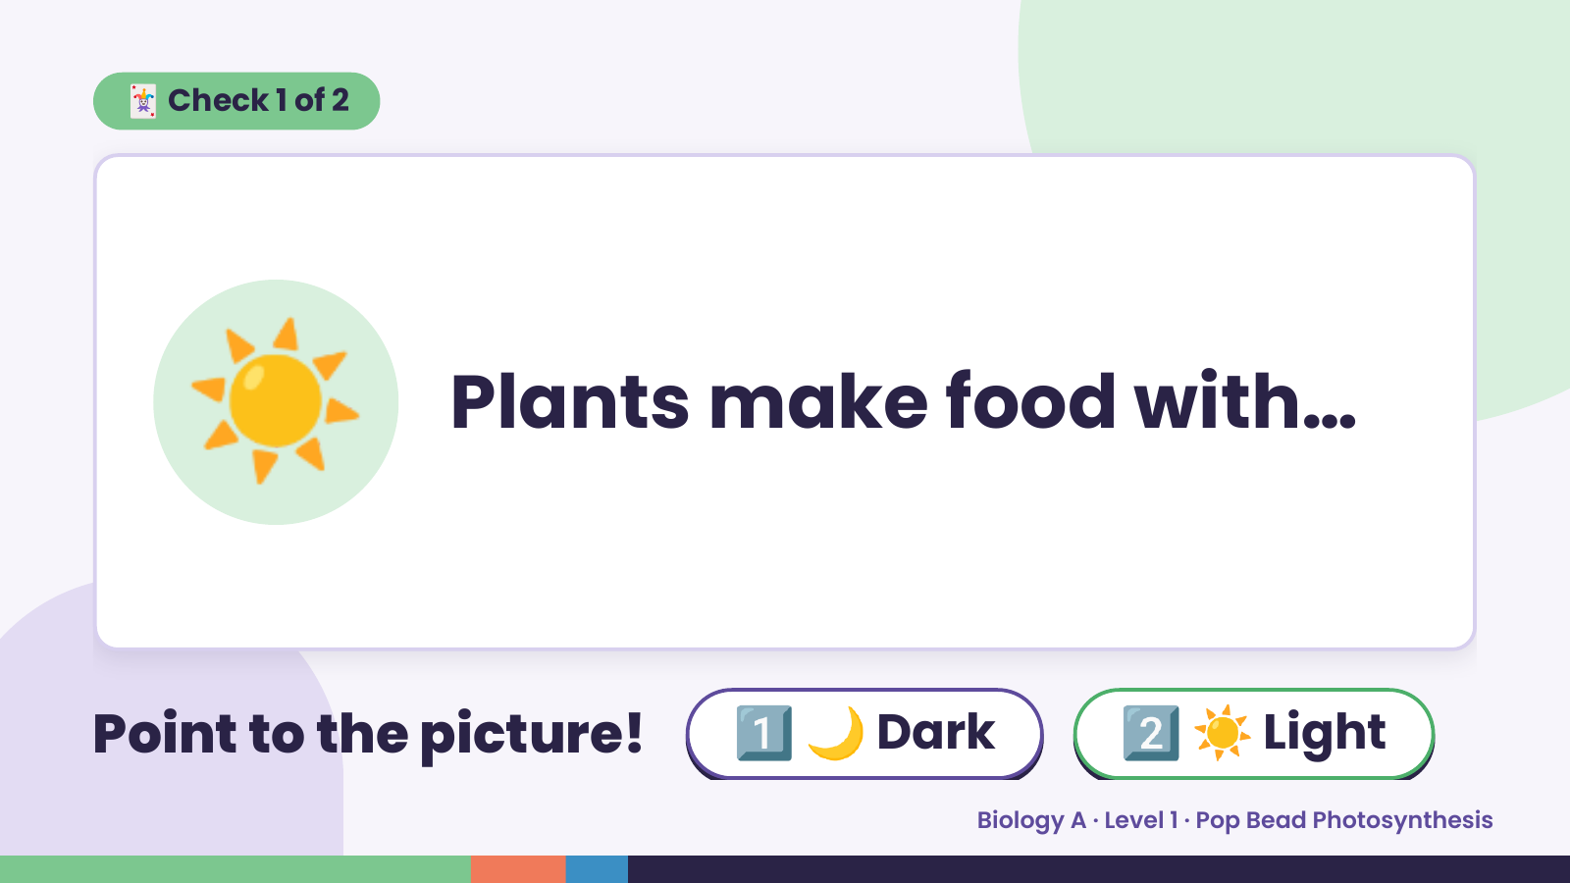
Notes:
🃏 Check 1 of 2
☀️ Plants make food with…
Point to the picture! 1️⃣ 🌙 Dark 2️⃣ ☀️ Light
Biology A · Level 1 · Pop Bead Photosynthesis

Slide 6
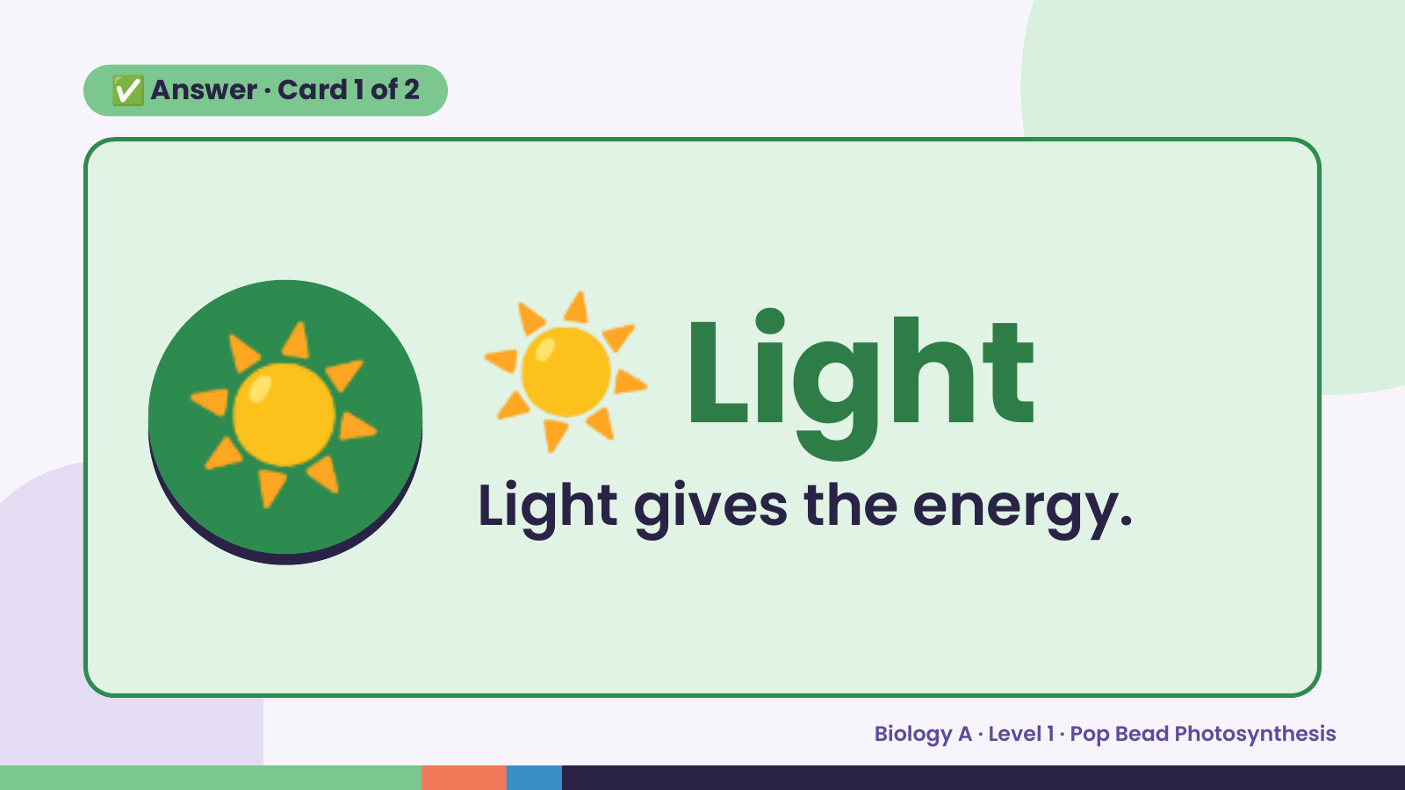
Notes:
✅ Answer · Card 1 of 2
☀️ ☀️ Light
Light gives the energy.
Biology A · Level 1 · Pop Bead Photosynthesis

Slide 7
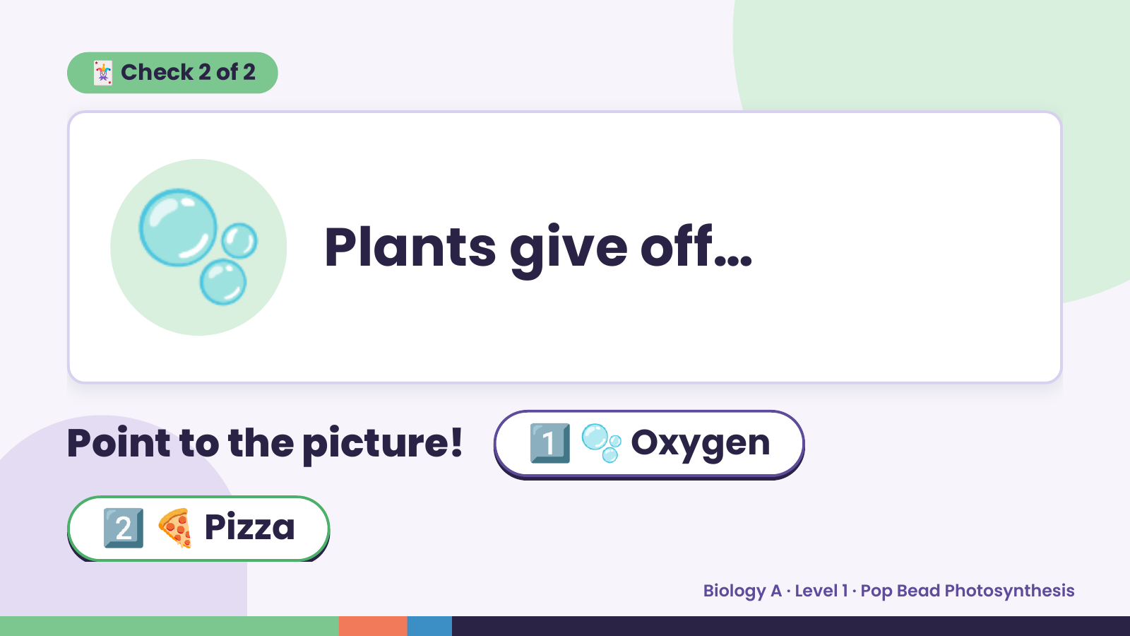
Notes:
🃏 Check 2 of 2
🫧 Plants give off…
Point to the picture! 1️⃣ 🫧 Oxygen
2️⃣ 🍕 Pizza
Biology A · Level 1 · Pop Bead Photosynthesis

Slide 8
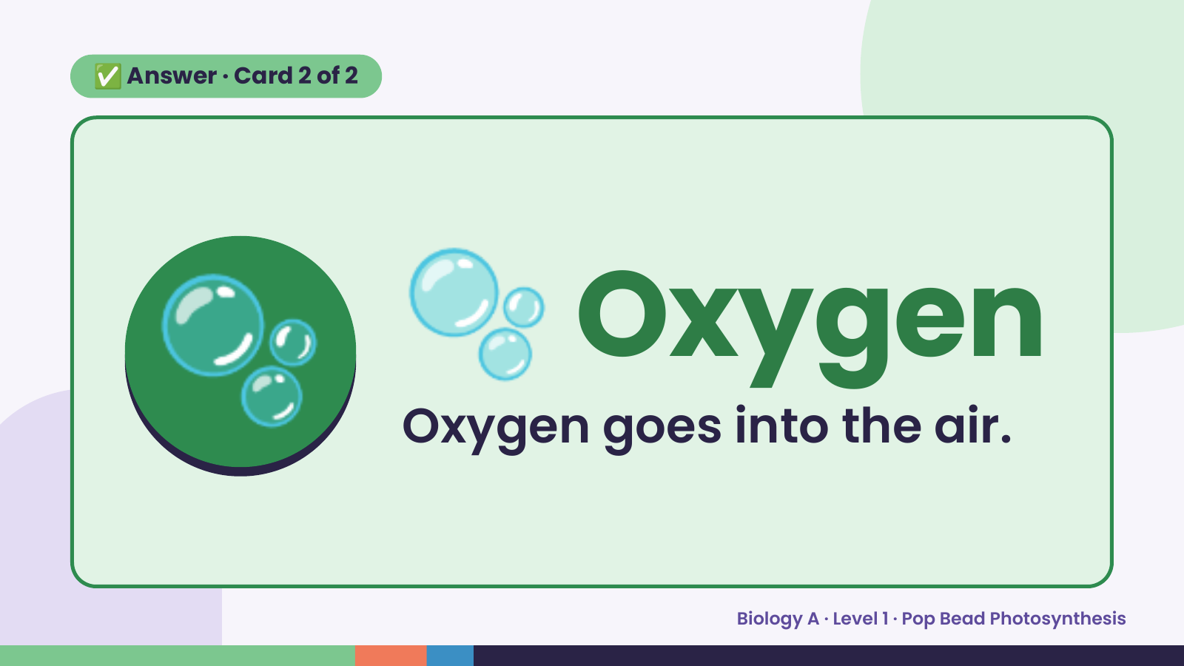
Notes:
✅ Answer · Card 2 of 2
🫧 🫧 Oxygen
Oxygen goes into the air.
Biology A · Level 1 · Pop Bead Photosynthesis

Slide 9
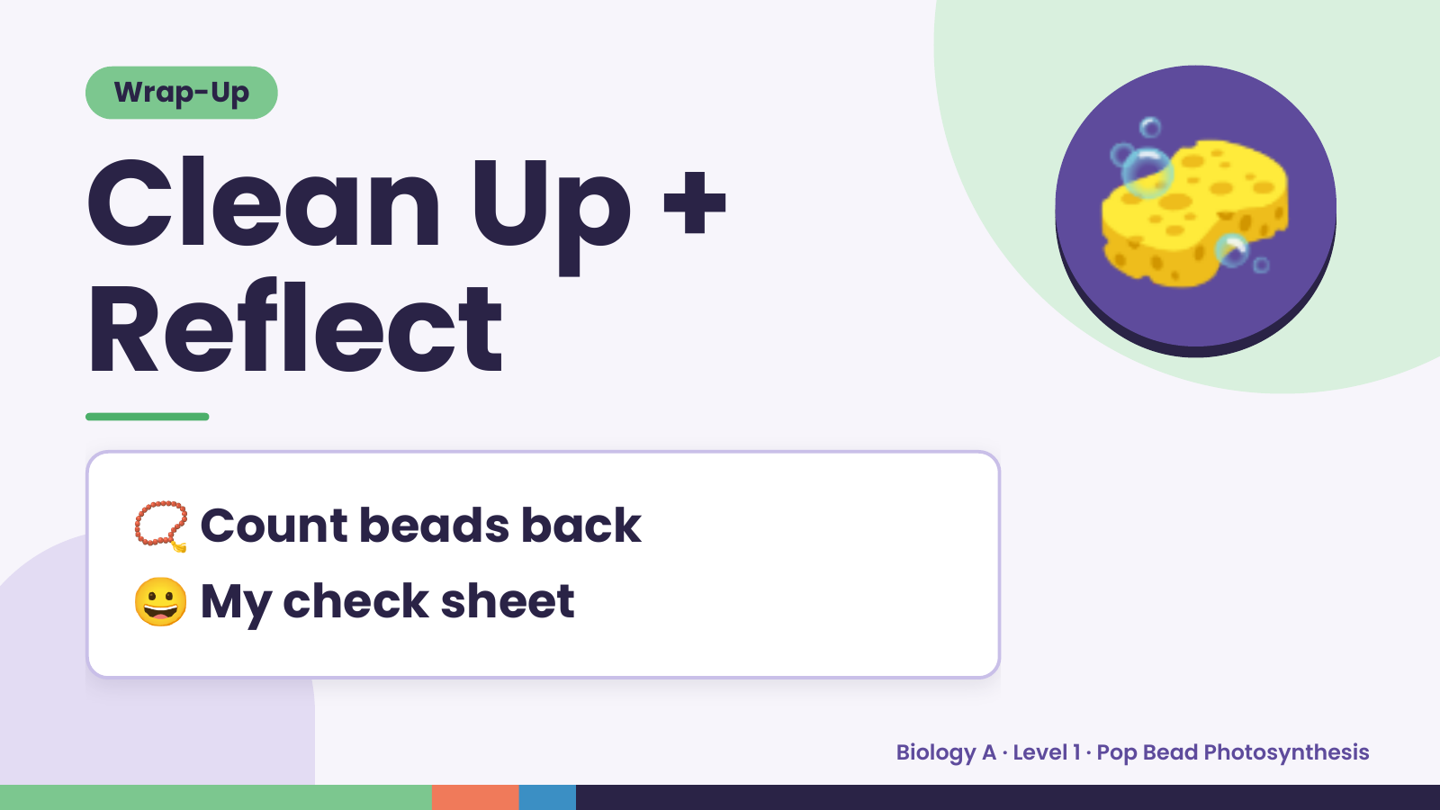
Notes:
Wrap-Up
Clean Up +
Reflect
🧽
📿 Count beads back
😀 My check sheet
Biology A · Level 1 · Pop Bead Photosynthesis

