Slide 1
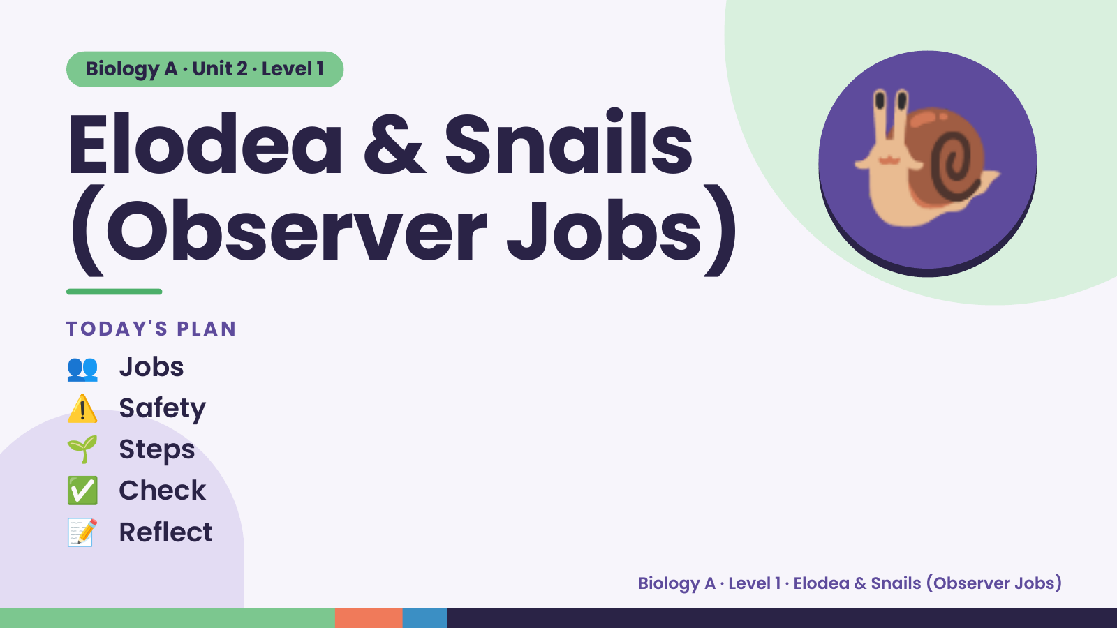
Notes:
Biology A · Unit 2 · Level 1
Elodea & Snails
(Observer Jobs)
TODAY'S PLAN
🐌
👥 Jobs
⚠️ Safety
🌱 Steps
✅ Check
📝 Reflect
Biology A · Level 1 · Elodea & Snails (Observer Jobs)

Slide 2
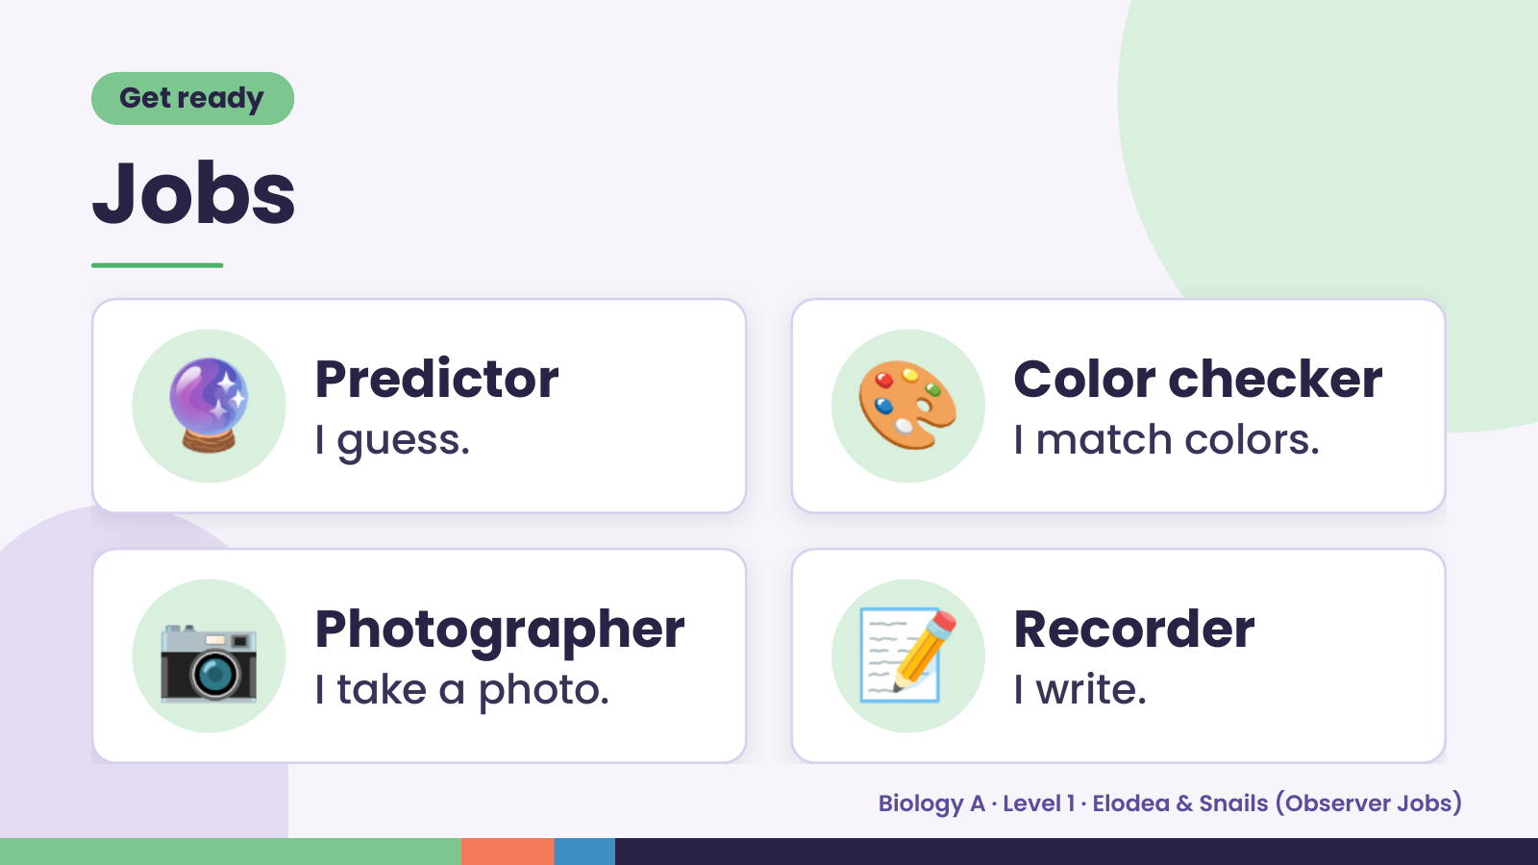
Notes:
Get ready
Jobs
🔮 Predictor
I guess. 🎨 Color checker
I match colors.
📷 Photographer
I take a photo. 📝 Recorder
I write.
Biology A · Level 1 · Elodea & Snails (Observer Jobs)

Slide 3
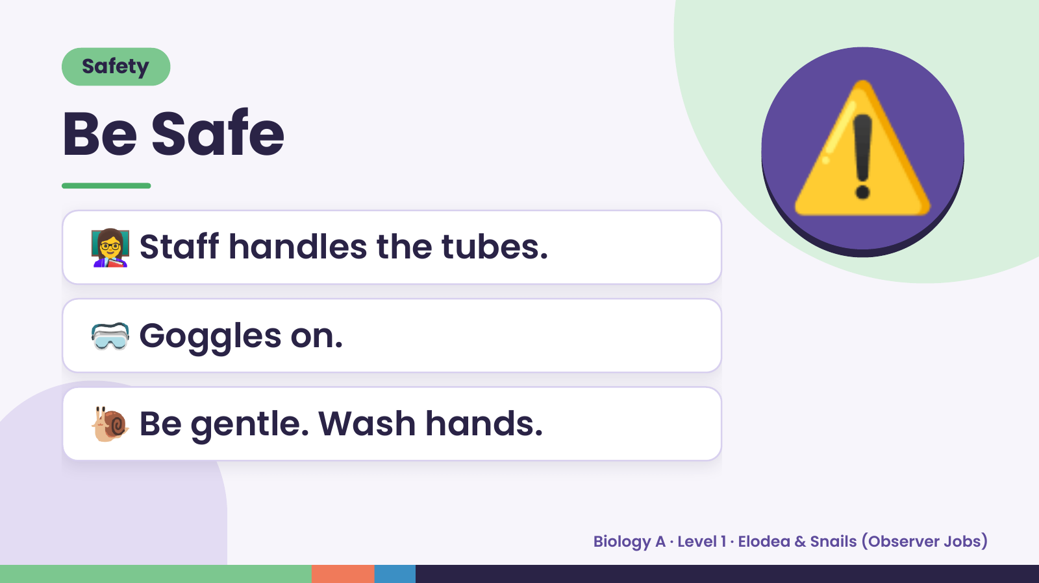
Notes:
Safety
Be Safe
👩‍🏫 Staff handles the tubes.
⚠️
🥽 Goggles on.
🐌 Be gentle. Wash hands.
Biology A · Level 1 · Elodea & Snails (Observer Jobs)

Slide 4
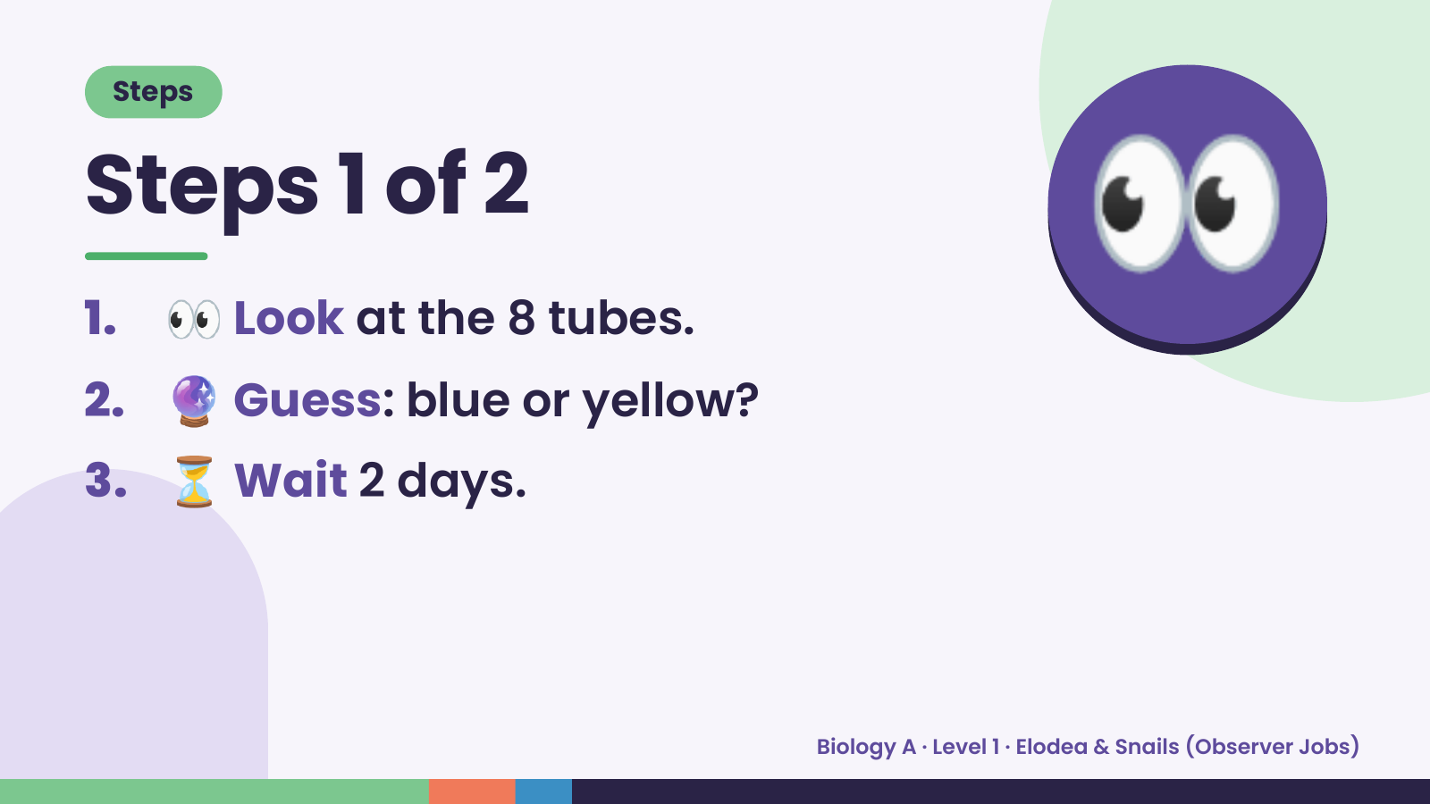
Notes:
Steps
Steps 1 of 2
1. 👀 Look at the 8 tubes.
2. 🔮 Guess: blue or yellow?
👀
3. ⏳ Wait 2 days.
Biology A · Level 1 · Elodea & Snails (Observer Jobs)

Slide 5
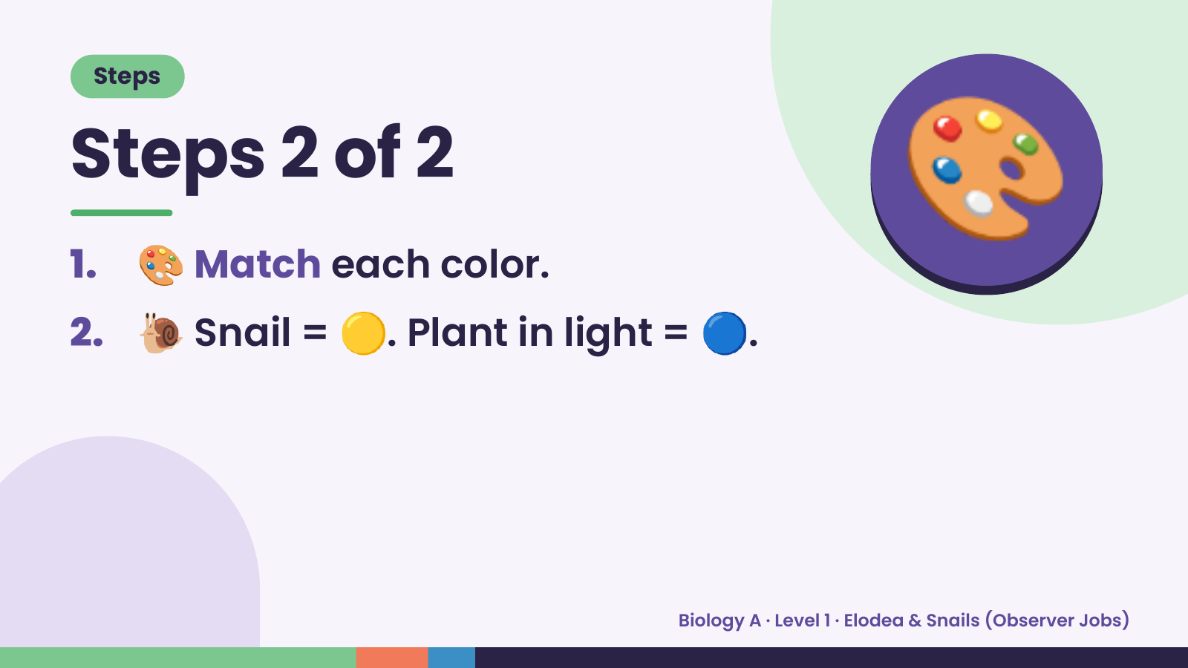
Notes:
Steps
Steps 2 of 2
1. 🎨 Match each color.
2. 🐌 Snail = 🟡. Plant in light = 🔵.
🎨
Biology A · Level 1 · Elodea & Snails (Observer Jobs)

Slide 6
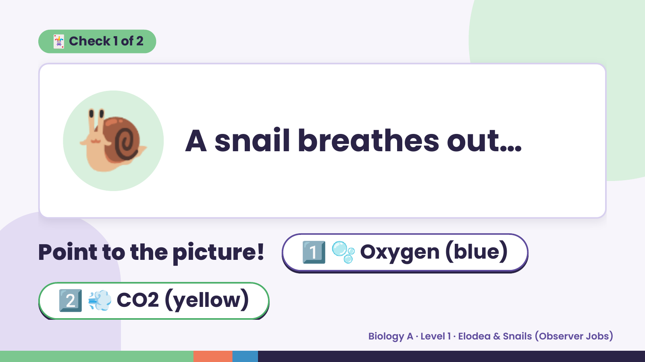
Notes:
🃏 Check 1 of 2
🐌 A snail breathes out…
Point to the picture! 1️⃣ 🫧 Oxygen (blue)
2️⃣ 💨 CO2 (yellow)
Biology A · Level 1 · Elodea & Snails (Observer Jobs)

Slide 7
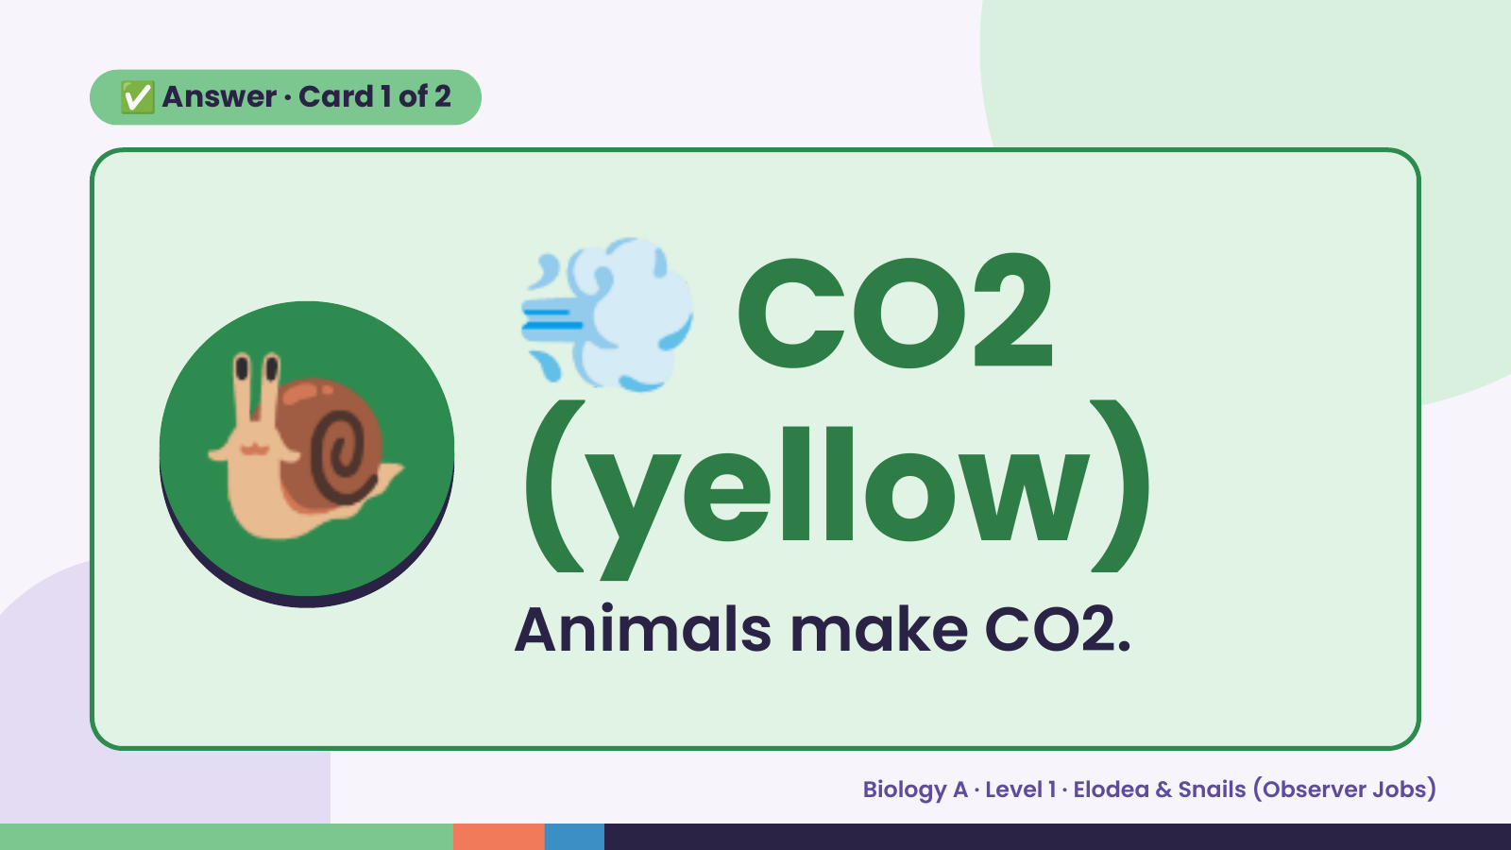
Notes:
💨
✅ Answer · Card 1 of 2
🐌 (yellow)
CO2
Animals make CO2.
Biology A · Level 1 · Elodea & Snails (Observer Jobs)

Slide 8
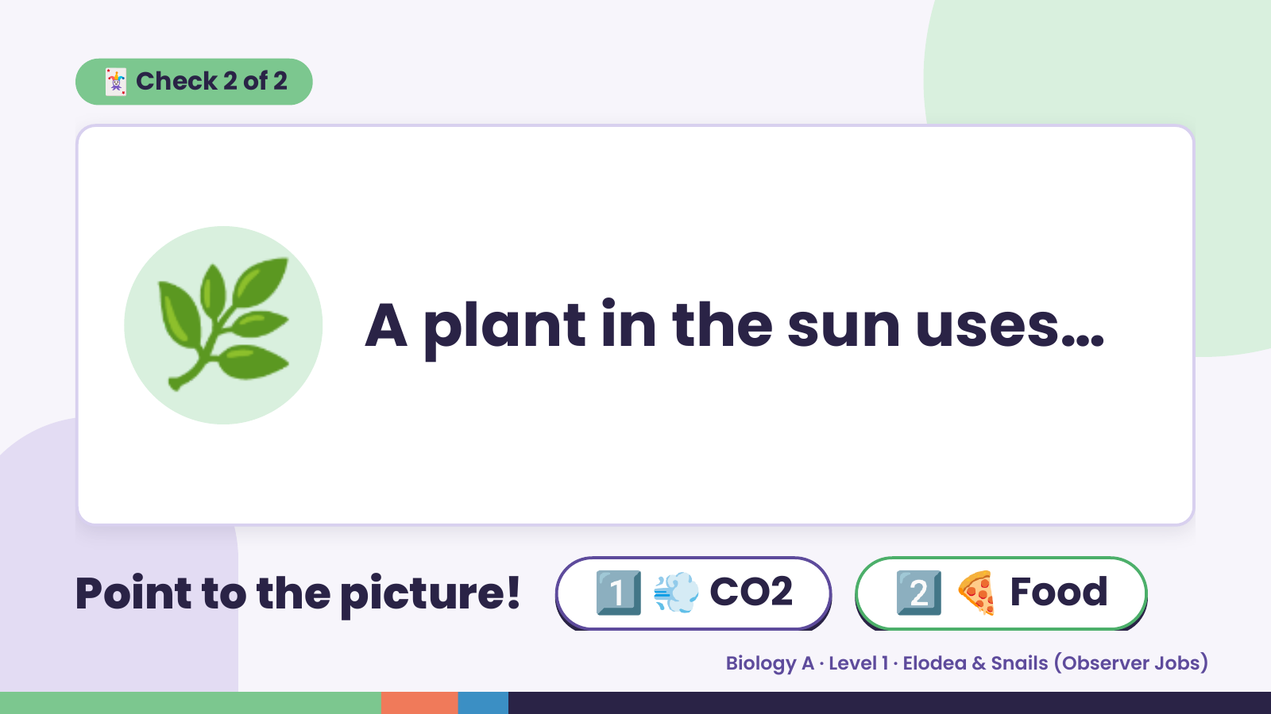
Notes:
🃏 Check 2 of 2
🌿 A plant in the sun uses…
Point to the picture! 1️⃣ 💨 CO2 2️⃣ 🍕 Food
Biology A · Level 1 · Elodea & Snails (Observer Jobs)

Slide 9
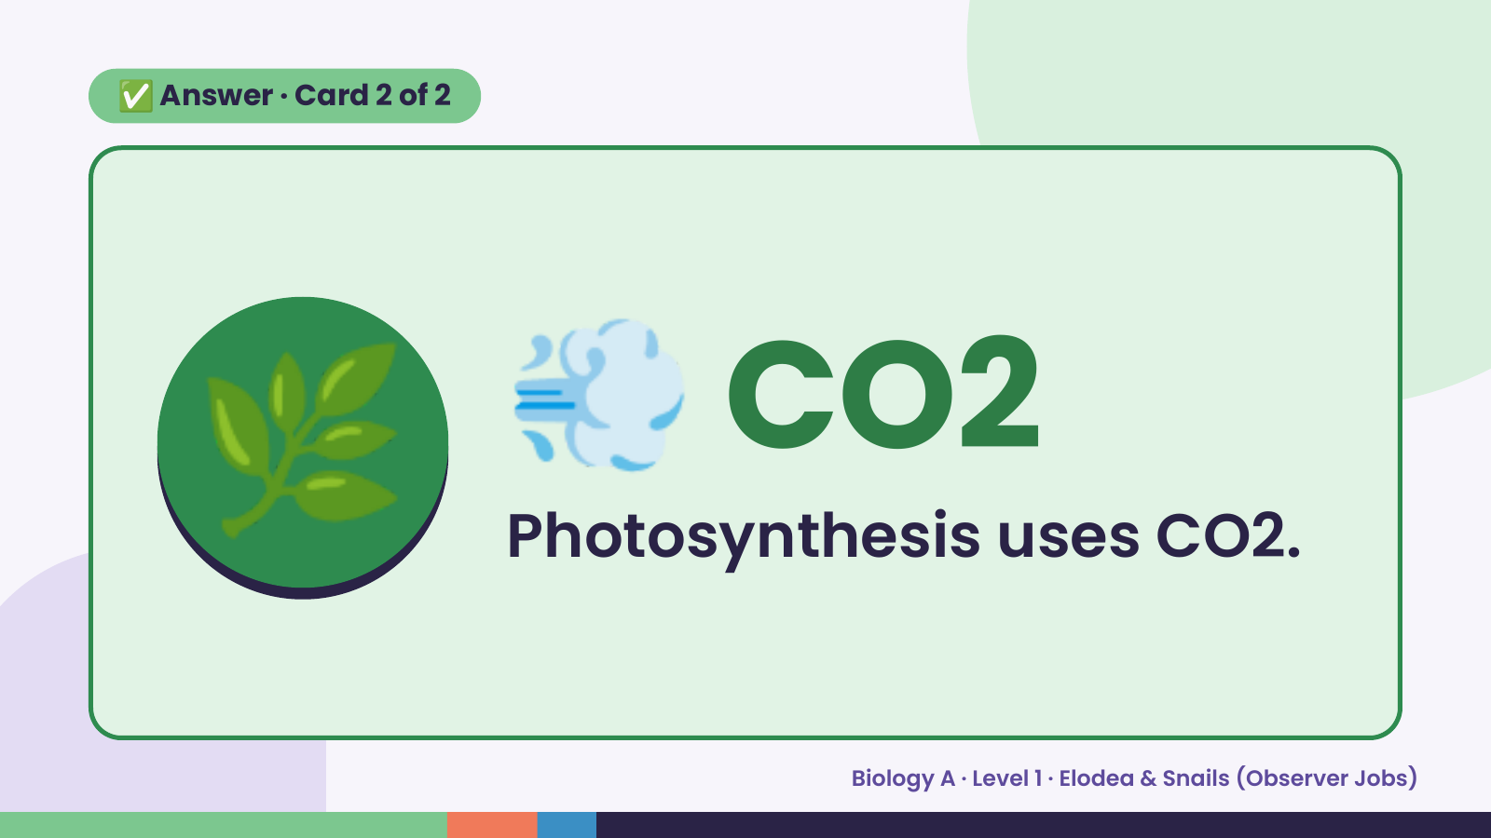
Notes:
✅ Answer · Card 2 of 2
🌿 💨 CO2
Photosynthesis uses CO2.
Biology A · Level 1 · Elodea & Snails (Observer Jobs)

Slide 10
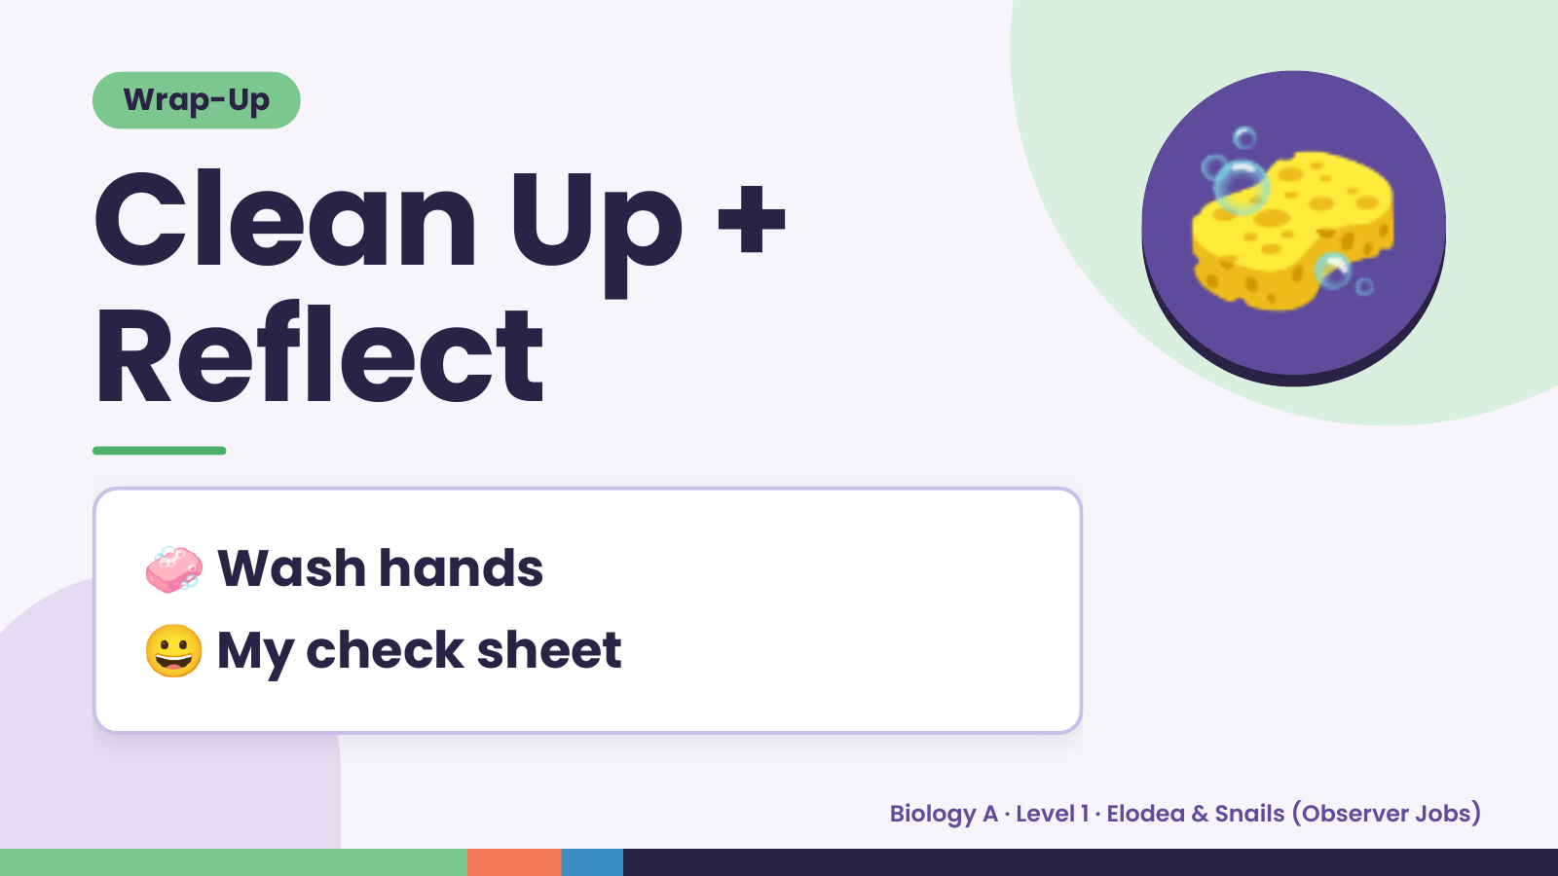
Notes:
Wrap-Up
Clean Up +
Reflect
🧽
🧼 Wash hands
😀 My check sheet
Biology A · Level 1 · Elodea & Snails (Observer Jobs)

