Slide 1
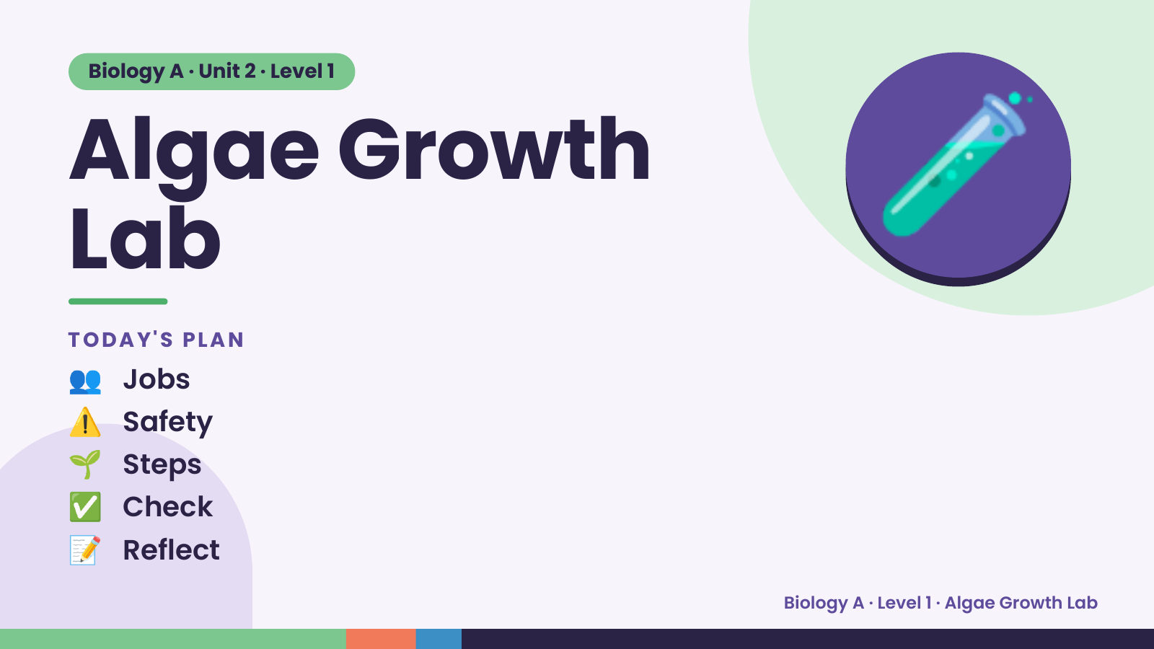
Notes:
Biology A · Unit 2 · Level 1
Algae Growth
Lab
TODAY'S PLAN
🧪
👥 Jobs
⚠️ Safety
🌱 Steps
✅ Check
📝 Reflect
Biology A · Level 1 · Algae Growth Lab

Slide 2
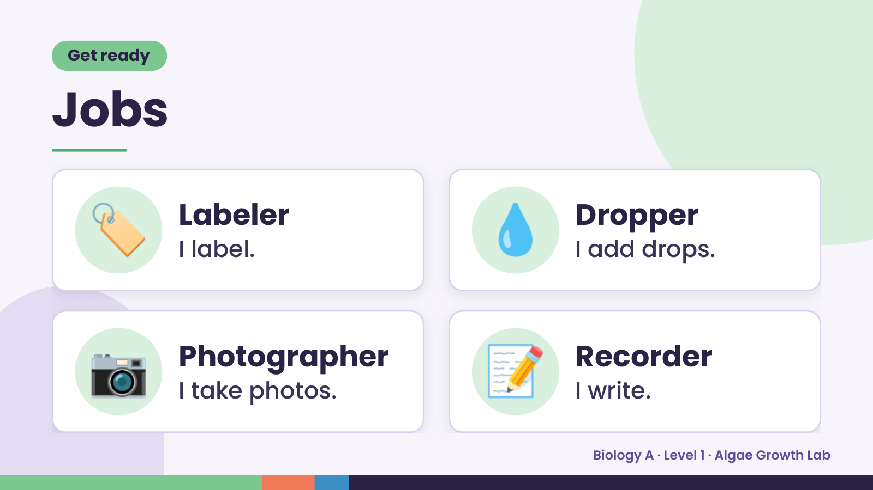
Notes:
Get ready
Jobs
🏷️ Labeler
I label. 💧 Dropper
I add drops.
📷 Photographer
I take photos. 📝 Recorder
I write.
Biology A · Level 1 · Algae Growth Lab

Slide 3
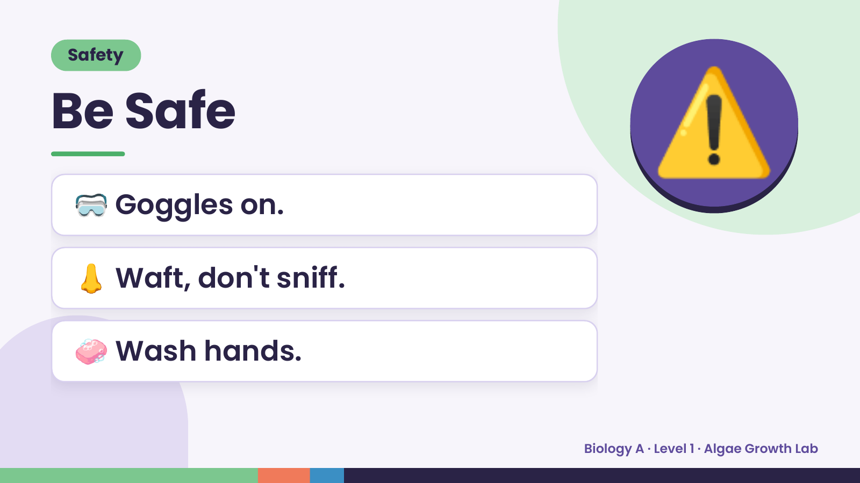
Notes:
Safety
Be Safe
🥽 Goggles on.
⚠️
👃 Waft, don't sniff.
🧼 Wash hands.
Biology A · Level 1 · Algae Growth Lab

Slide 4
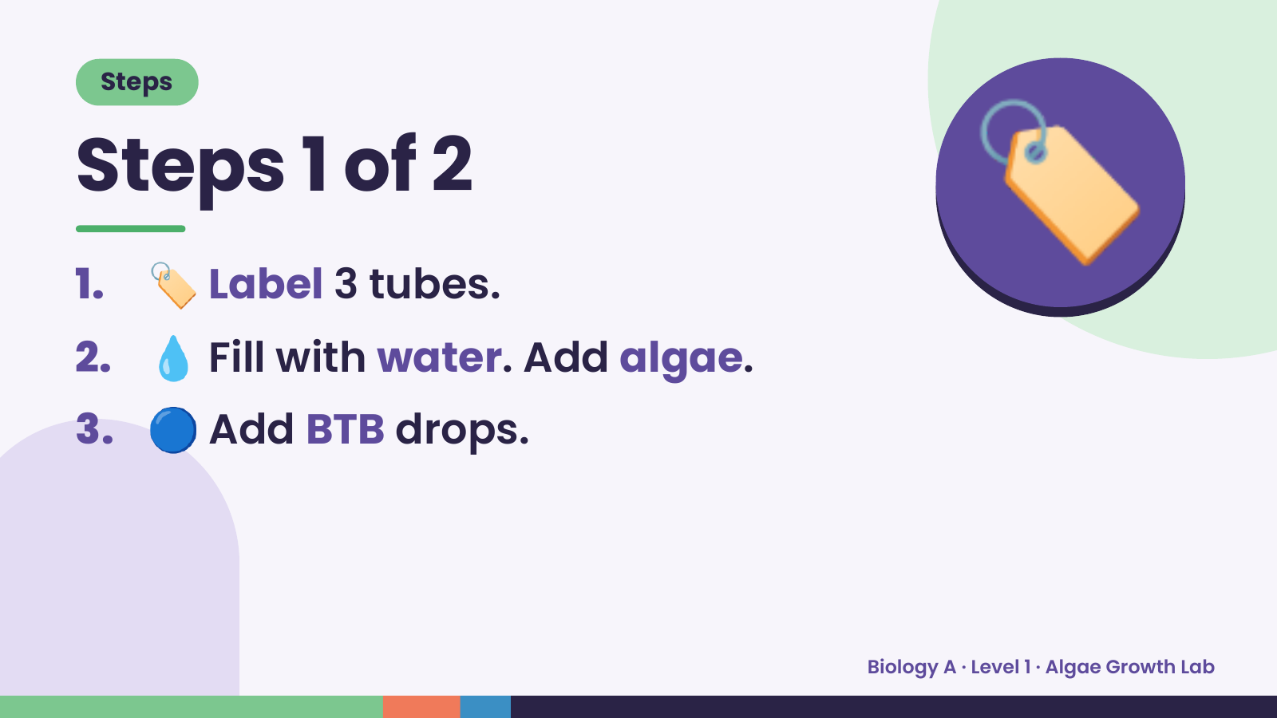
Notes:
Steps
Steps 1 of 2
1. 🏷️ Label 3 tubes.
2. 💧 Fill with water. Add algae.
🏷️
3. 🔵 Add BTB drops.
Biology A · Level 1 · Algae Growth Lab

Slide 5
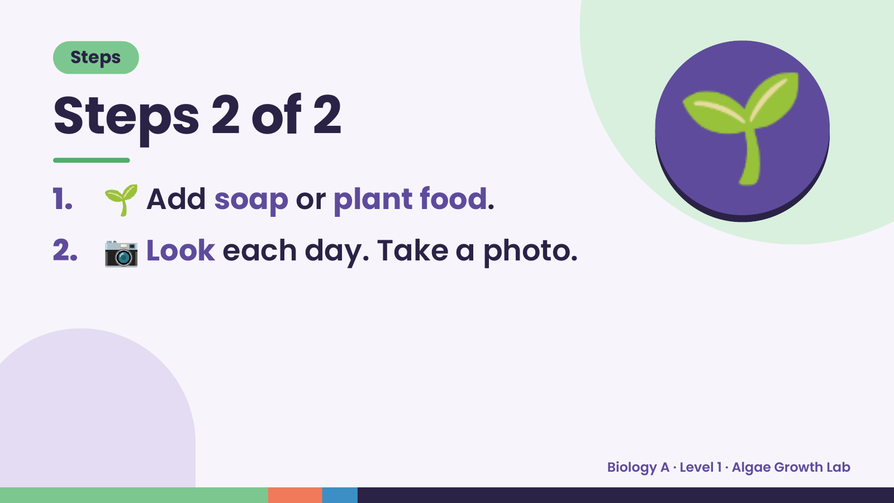
Notes:
Steps
Steps 2 of 2
1. 🌱 Add soap or plant food.
2. 📷 Look each day. Take a photo.
🌱
Biology A · Level 1 · Algae Growth Lab

Slide 6
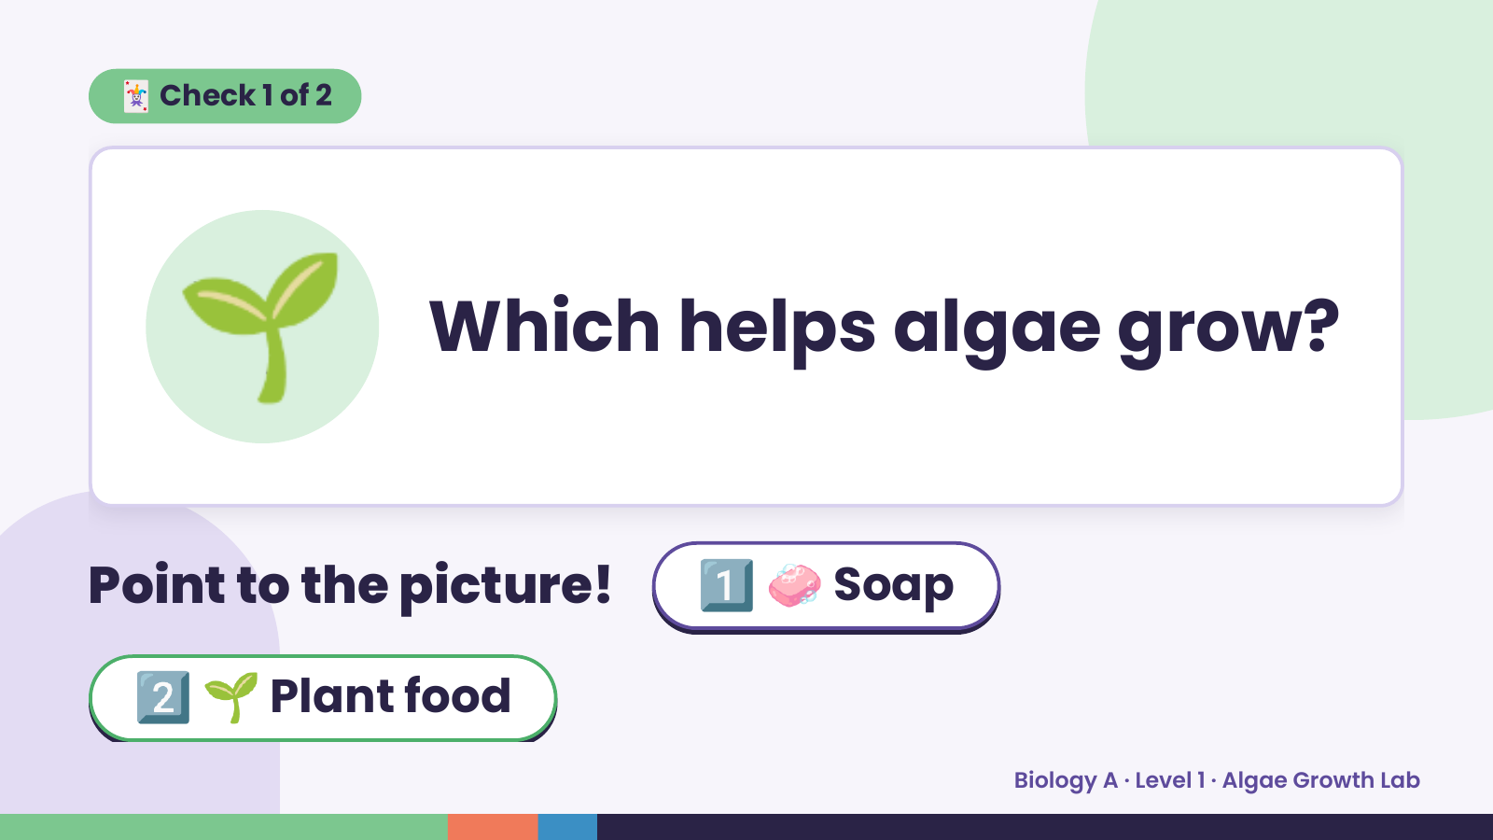
Notes:
🃏 Check 1 of 2
🌱 Which helps algae grow?
Point to the picture! 1️⃣ 🧼 Soap
2️⃣ 🌱 Plant food
Biology A · Level 1 · Algae Growth Lab

Slide 7
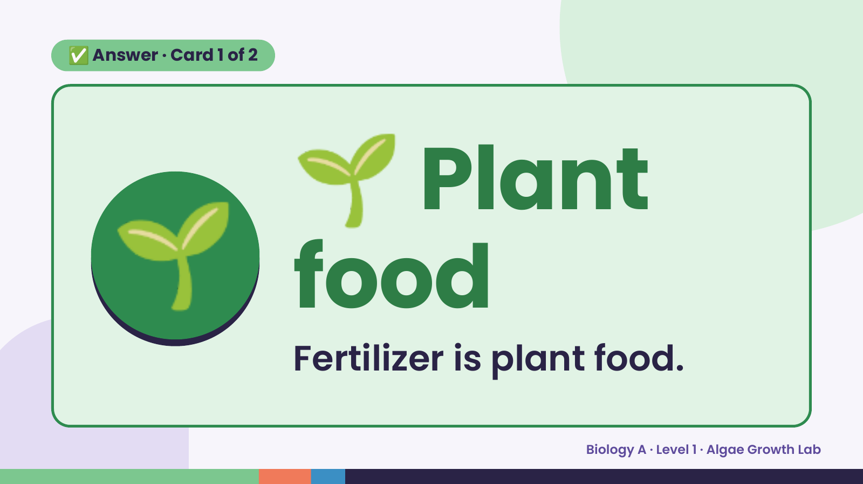
Notes:
🌱
✅ Answer · Card 1 of 2
🌱 food
Plant
Fertilizer is plant food.
Biology A · Level 1 · Algae Growth Lab

Slide 8
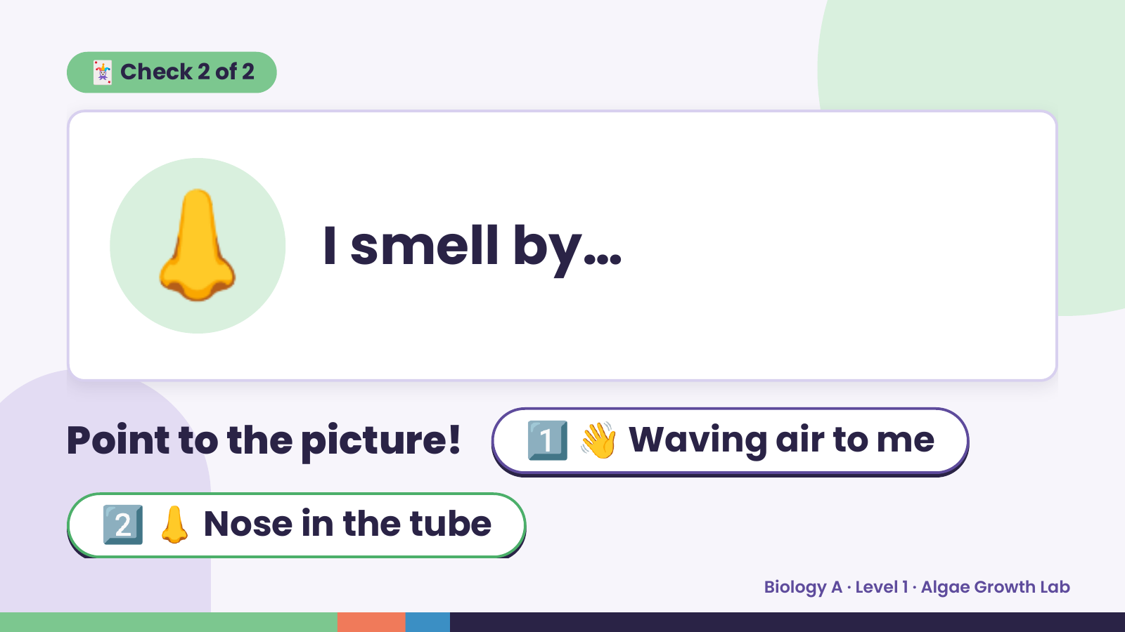
Notes:
🃏 Check 2 of 2
👃 I smell by…
Point to the picture! 1️⃣ 👋 Waving air to me
2️⃣ 👃 Nose in the tube
Biology A · Level 1 · Algae Growth Lab

Slide 9
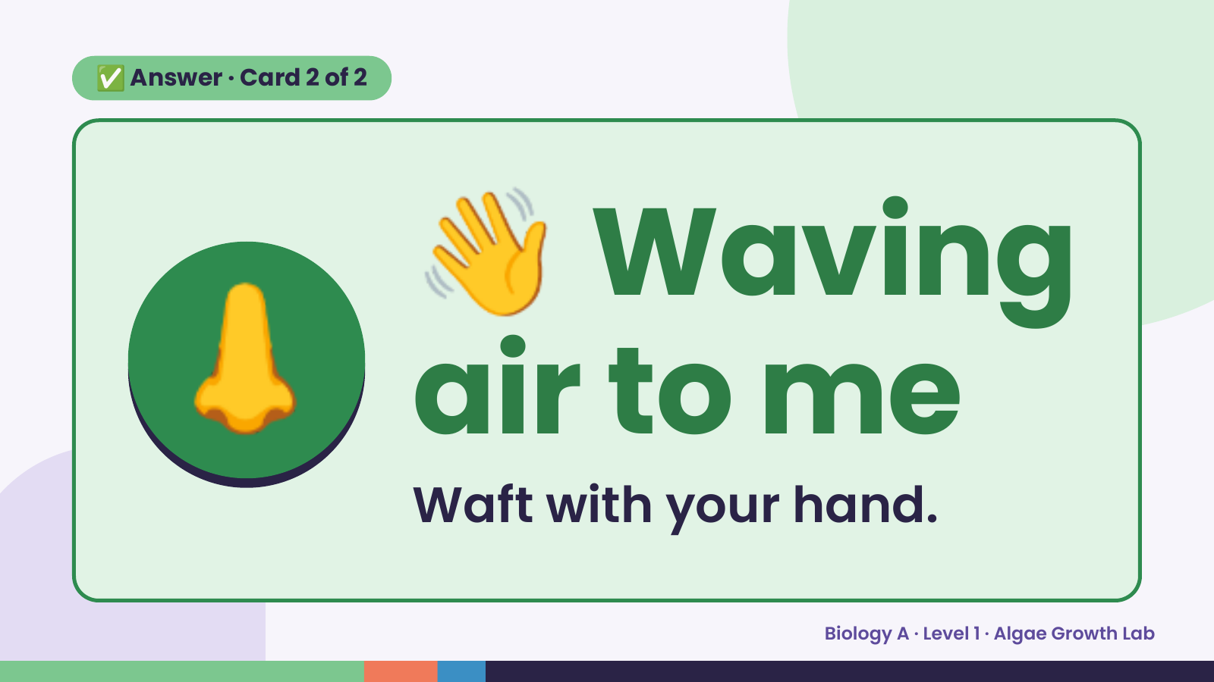
Notes:
👋
✅ Answer · Card 2 of 2
👃 air to me
Waving
Waft with your hand.
Biology A · Level 1 · Algae Growth Lab

Slide 10
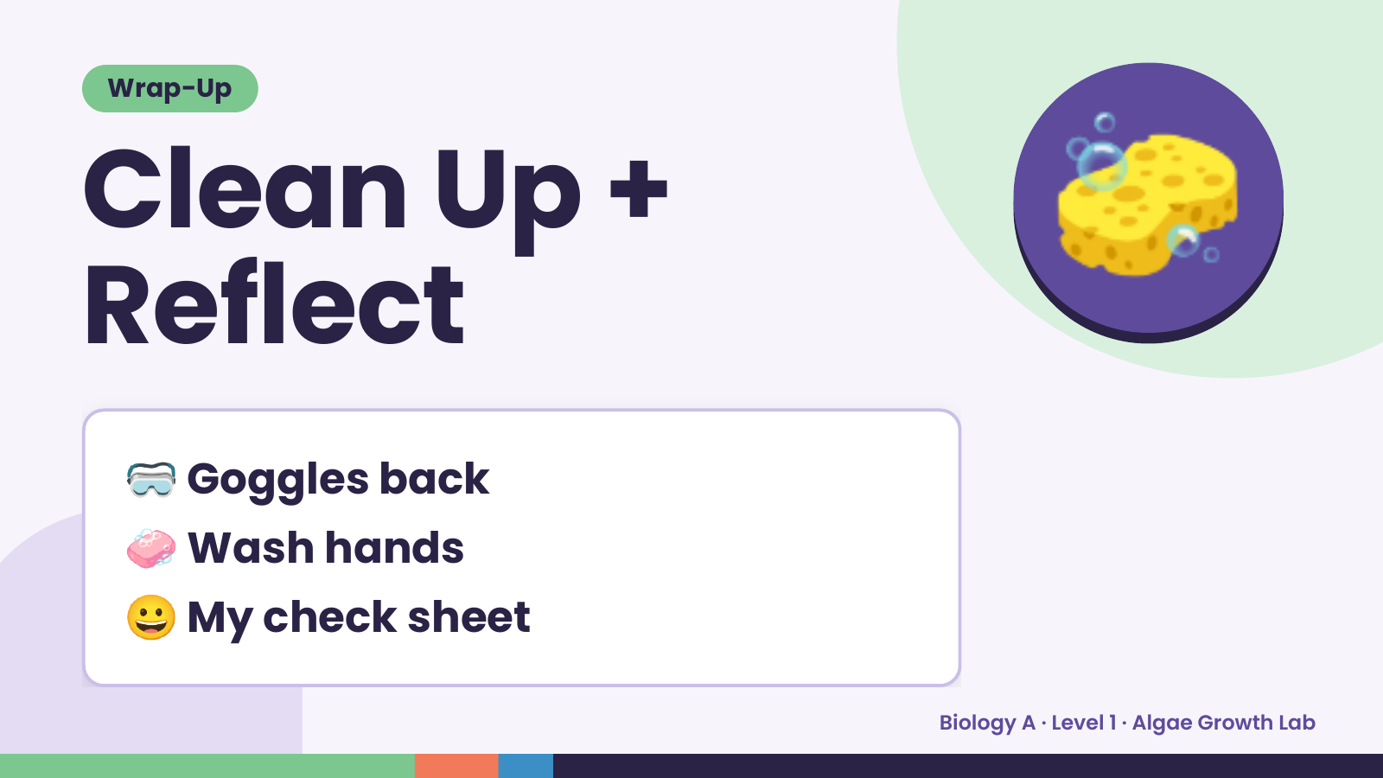
Notes:
Wrap-Up
Clean Up +
Reflect
🧽
🥽 Goggles back
🧼 Wash hands
😀 My check sheet
Biology A · Level 1 · Algae Growth Lab

