Slide 1
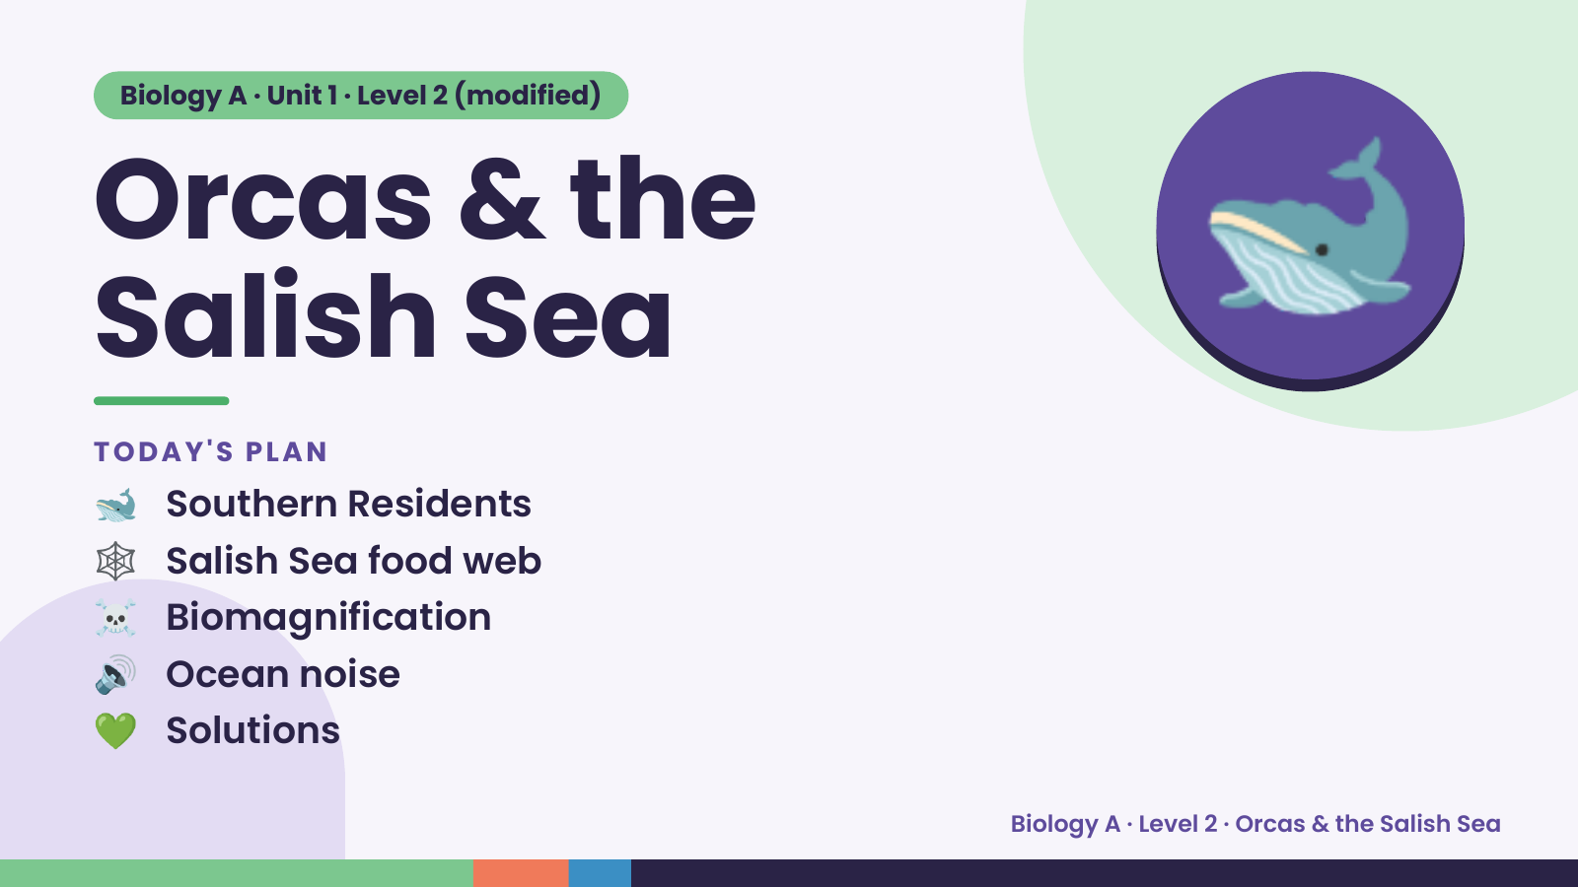
Notes:
Biology A · Unit 1 · Level 2 (modified)
Orcas & the
Salish Sea
🐋 Southern Residents
TODAY'S PLAN
🐋
🕸️ Salish Sea food web
☠️ Biomagnification
🔊 Ocean noise
💚 Solutions
Biology A · Level 2 · Orcas & the Salish Sea

Slide 2
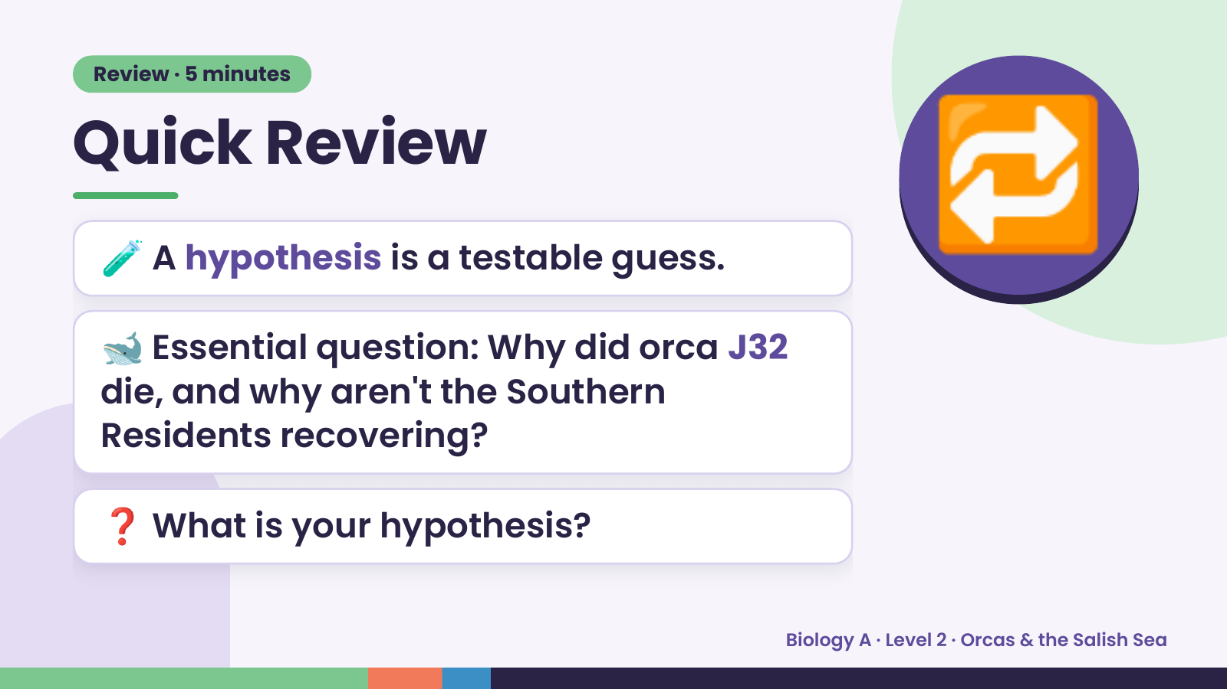
Notes:
Review · 5 minutes
Quick Review
🧪 A hypothesis is a testable guess.
🐋 Essential question: Why did orca J32
🔁
die, and why aren't the Southern
Residents recovering?
❓ What is your hypothesis?
Biology A · Level 2 · Orcas & the Salish Sea

Slide 3
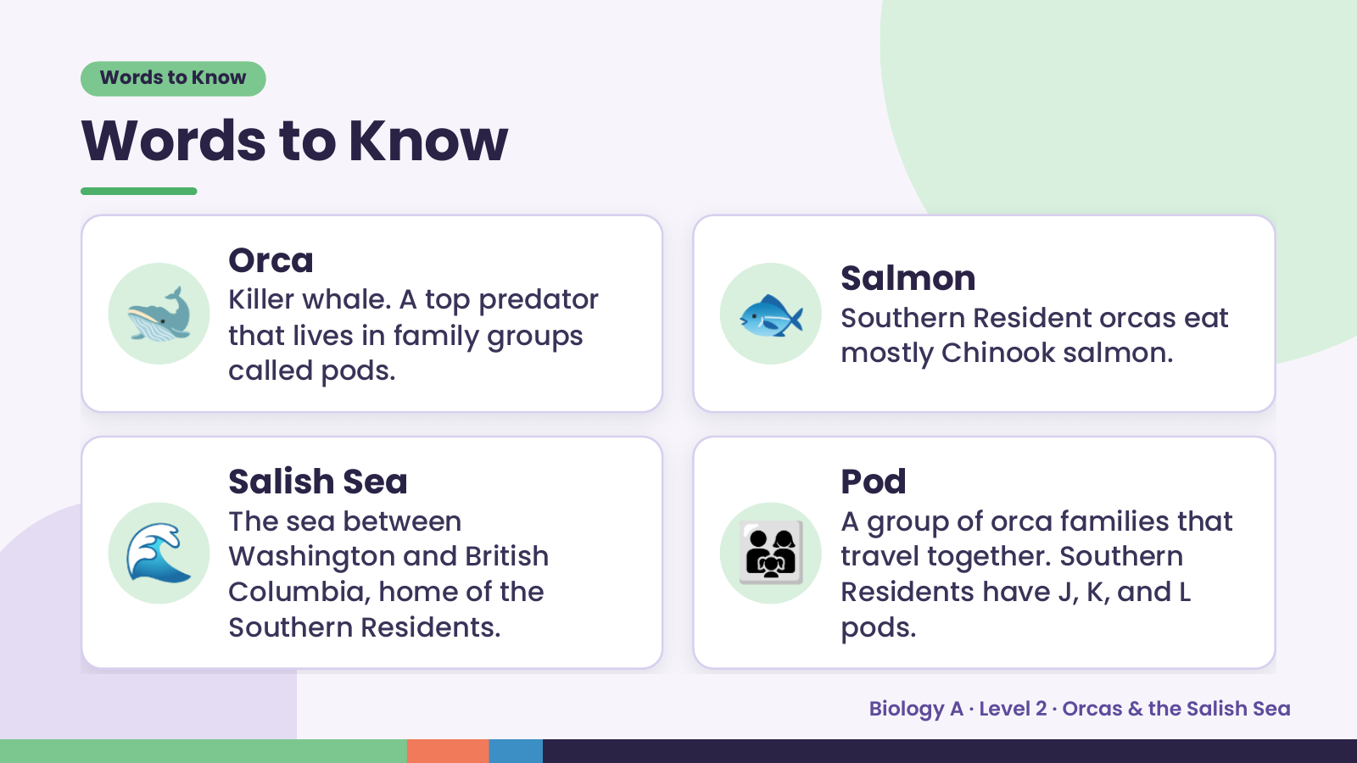
Notes:
Words to Know
Words to Know
🐋 Orca
Killer whale. A top predator
that lives in family groups
called pods.
🐟 Salmon
Southern Resident orcas eat
mostly Chinook salmon.
🌊 👨‍👩‍👧
Salish Sea Pod
The sea between A group of orca families that
Washington and British travel together. Southern
Columbia, home of the Residents have J, K, and L
Southern Residents. pods.
Biology A · Level 2 · Orcas & the Salish Sea

Slide 4
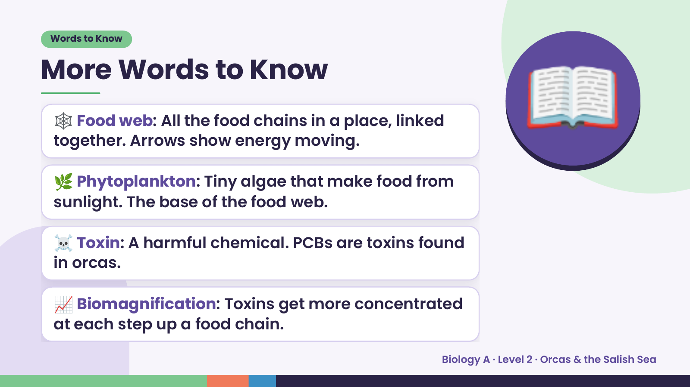
Notes:
Words to Know
More Words to Know
🕸️ Food web: All the food chains in a place, linked
together. Arrows show energy moving.
🌿 Phytoplankton: Tiny algae that make food from
sunlight. The base of the food web.
📖
☠️ Toxin: A harmful chemical. PCBs are toxins found
in orcas.
📈 Biomagnification: Toxins get more concentrated
at each step up a food chain.
Biology A · Level 2 · Orcas & the Salish Sea

Slide 5
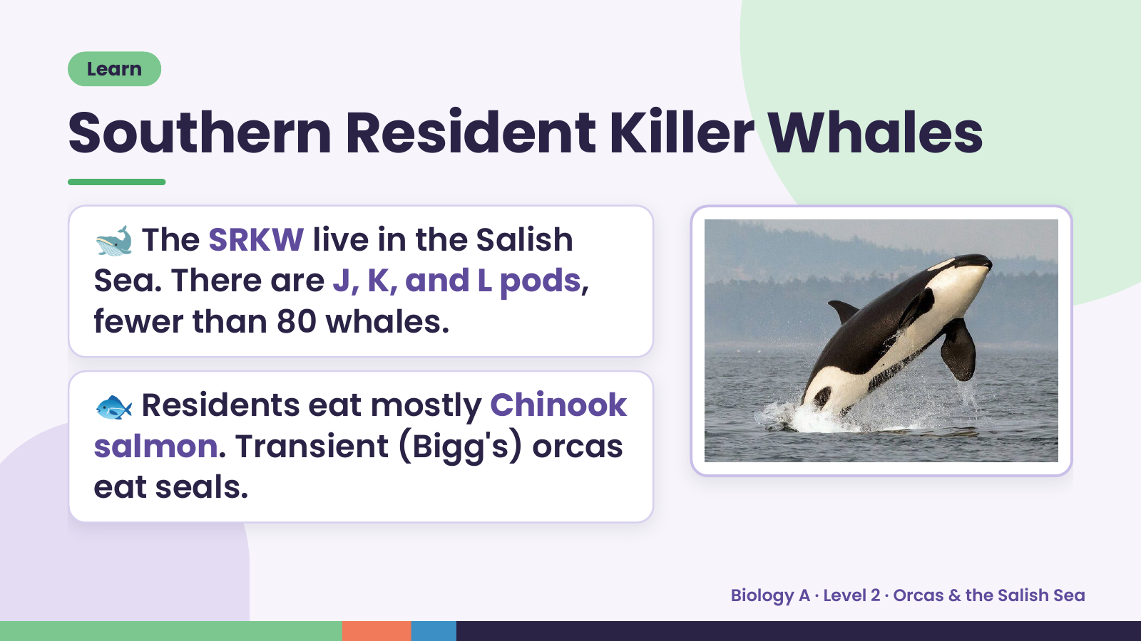
Notes:
Learn
Southern Resident Killer Whales
🐋 The SRKW live in the Salish
Sea. There are J, K, and L pods,
fewer than 80 whales.
🐟 Residents eat mostly Chinook
salmon. Transient (Bigg's) orcas
eat seals.
Biology A · Level 2 · Orcas & the Salish Sea

Slide 6
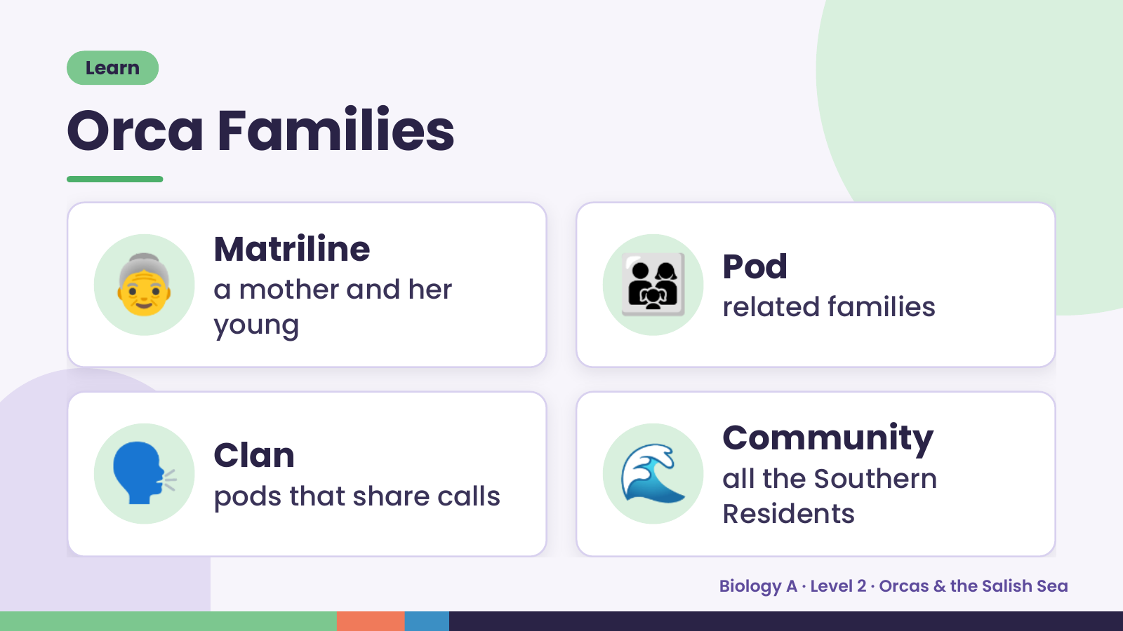
Notes:
Learn
Orca Families
👵 Matriline
a mother and her
young
👨‍👩‍👧 Pod
related families
🗣️ Clan
pods that share calls 🌊 Community
all the Southern
Residents
Biology A · Level 2 · Orcas & the Salish Sea

Slide 7
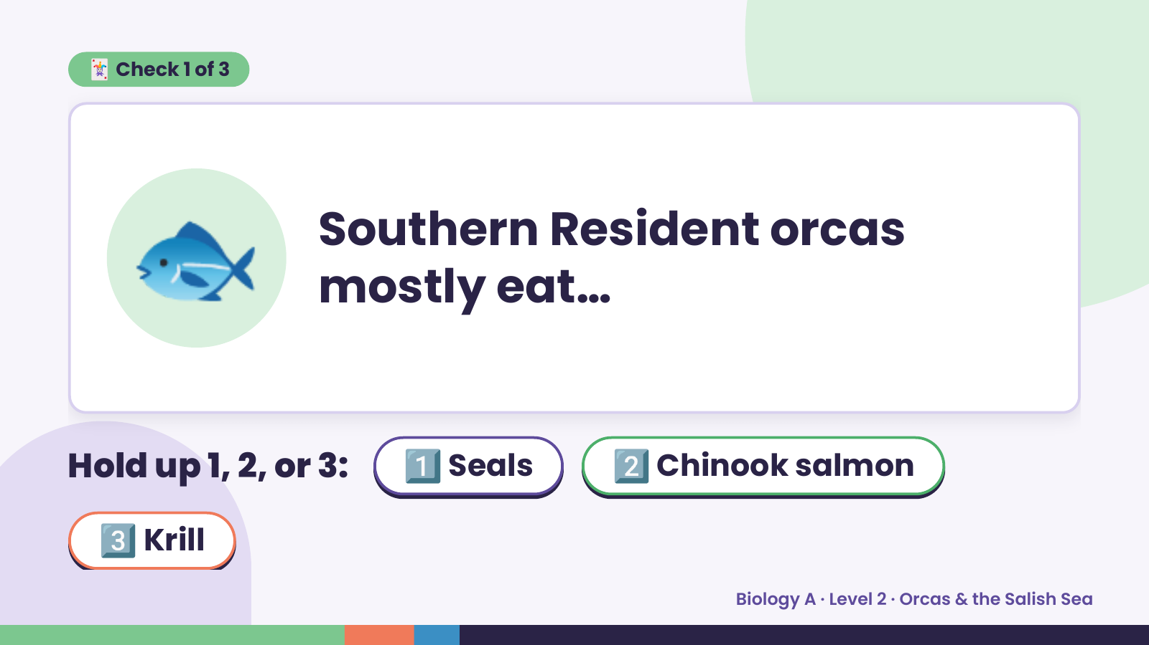
Notes:
🃏 Check 1 of 3
🐟 Southern Resident orcas
mostly eat…
Hold up 1, 2, or 3: 1️⃣ Seals 2️⃣ Chinook salmon
3️⃣ Krill
Biology A · Level 2 · Orcas & the Salish Sea

Slide 8
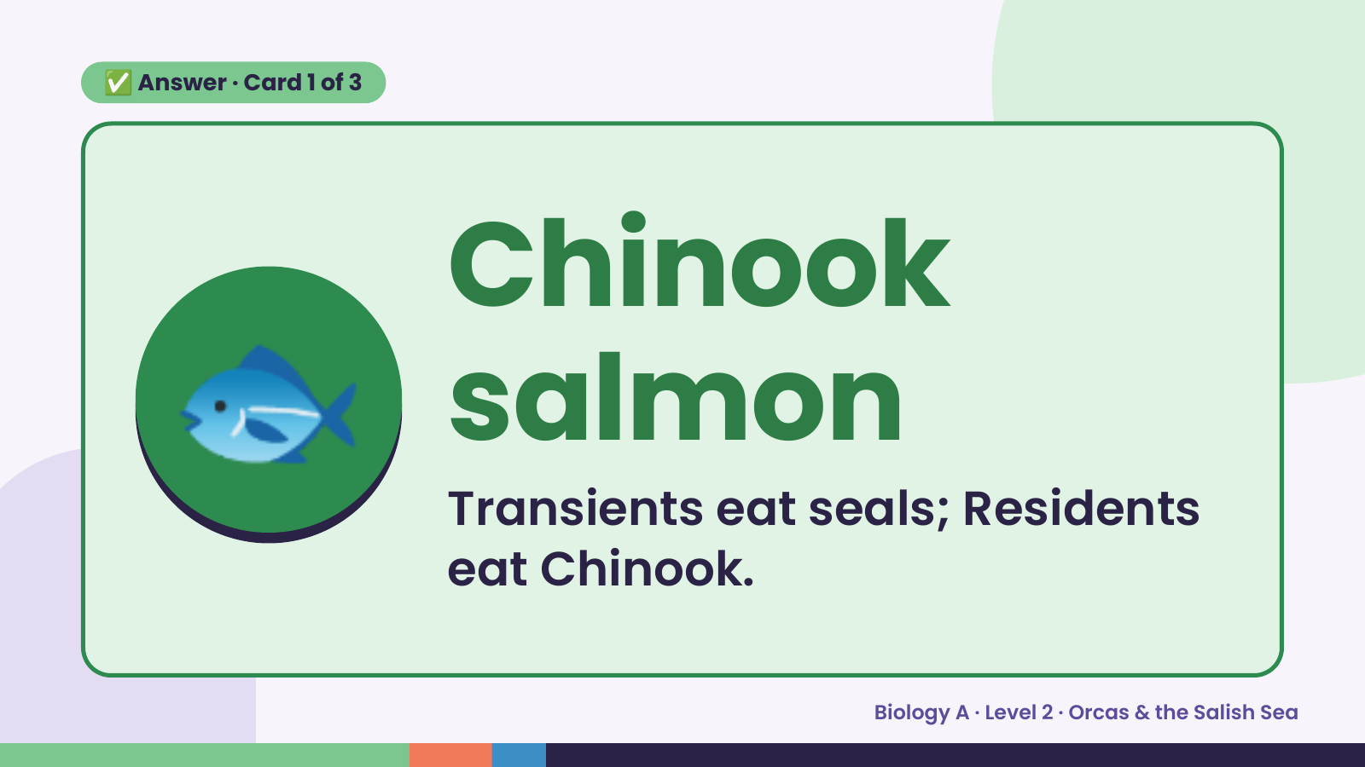
Notes:
✅ Answer · Card 1 of 3
🐟 Chinook
salmon
Transients eat seals; Residents
eat Chinook.
Biology A · Level 2 · Orcas & the Salish Sea

Slide 9
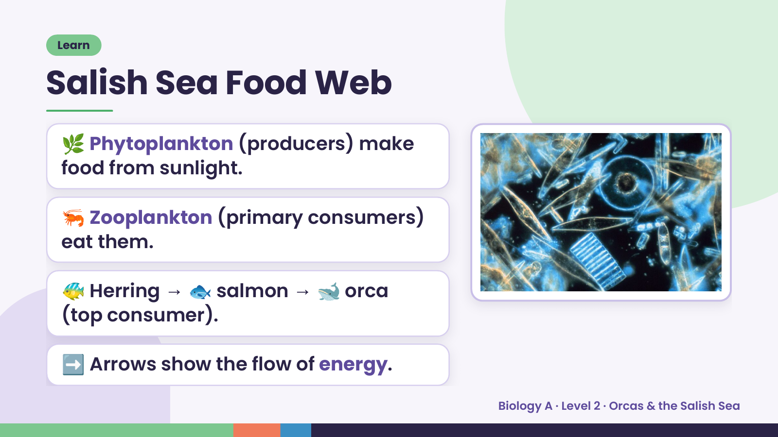
Notes:
Learn
Salish Sea Food Web
🌿 Phytoplankton (producers) make
food from sunlight.
🦐 Zooplankton (primary consumers)
eat them.
🐠 Herring → 🐟 salmon → 🐋 orca
(top consumer).
➡️ Arrows show the flow of energy.
Biology A · Level 2 · Orcas & the Salish Sea

Slide 10
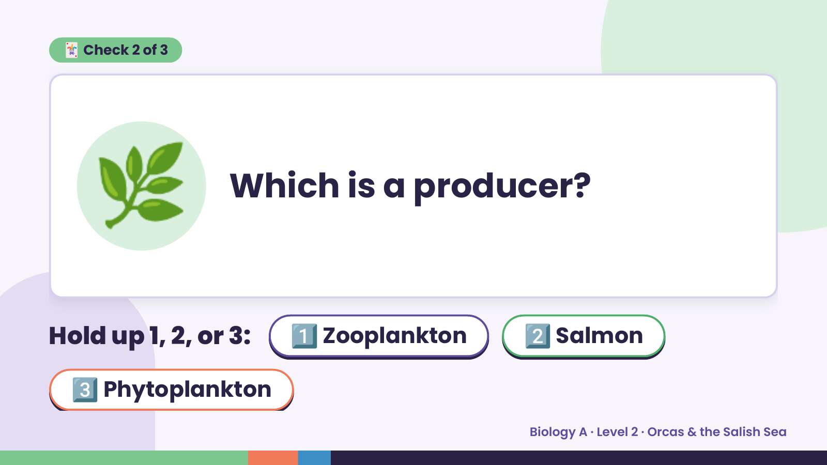
Notes:
🃏 Check 2 of 3
🌿 Which is a producer?
Hold up 1, 2, or 3: 1️⃣ Zooplankton 2️⃣ Salmon
3️⃣ Phytoplankton
Biology A · Level 2 · Orcas & the Salish Sea

Slide 11
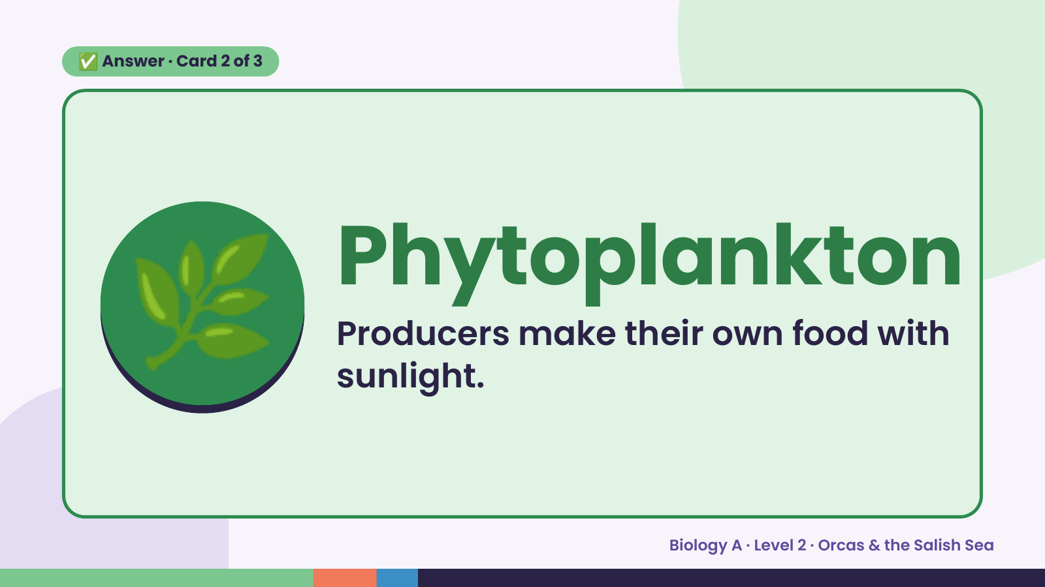
Notes:
✅ Answer · Card 2 of 3
🌿 Phytoplankton
Producers make their own food with
sunlight.
Biology A · Level 2 · Orcas & the Salish Sea

Slide 12
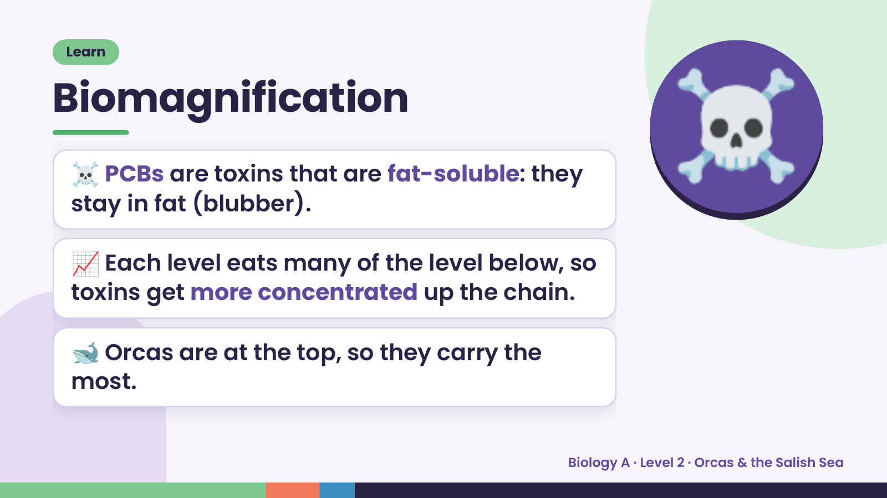
Notes:
Learn
Biomagnification
☠️ PCBs are toxins that are fat-soluble: they
stay in fat (blubber).
📈 Each level eats many of the level below, so
☠️
toxins get more concentrated up the chain.
🐋 Orcas are at the top, so they carry the
most.
Biology A · Level 2 · Orcas & the Salish Sea

Slide 13
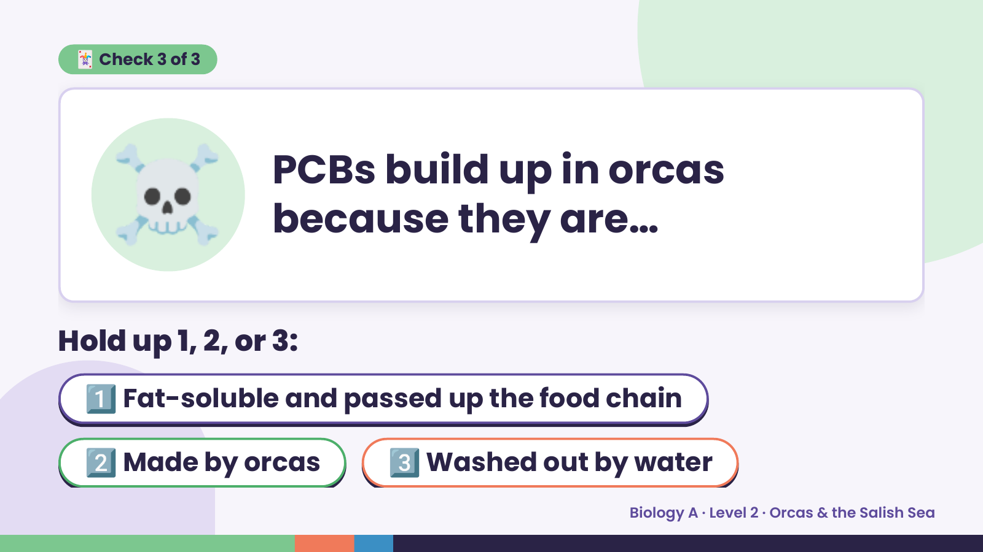
Notes:
☠️
🃏 Check 3 of 3
PCBs build up in orcas
because they are…
Hold up 1, 2, or 3:
1️⃣ Fat-soluble and passed up the food chain
2️⃣ Made by orcas 3️⃣ Washed out by water
Biology A · Level 2 · Orcas & the Salish Sea

Slide 14
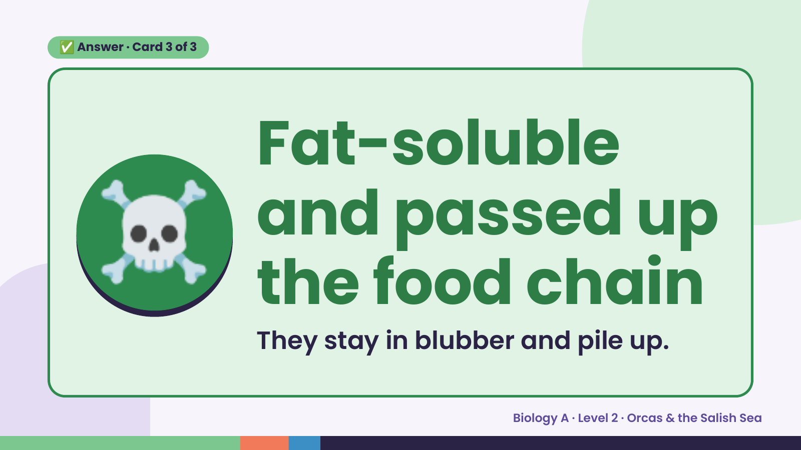
Notes:
✅ Answer · Card 3 of 3
☠️ Fat-soluble
and passed up
the food chain
They stay in blubber and pile up.
Biology A · Level 2 · Orcas & the Salish Sea

Slide 15
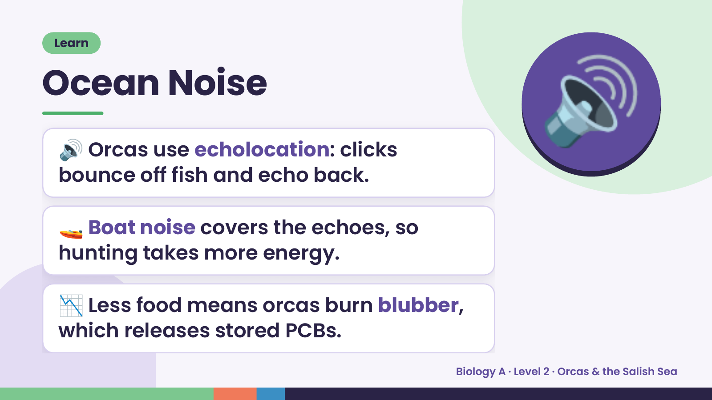
Notes:
Learn
Ocean Noise
🔊 Orcas use echolocation: clicks
bounce off fish and echo back.
🔊
🚤 Boat noise covers the echoes, so
hunting takes more energy.
📉 Less food means orcas burn blubber,
which releases stored PCBs.
Biology A · Level 2 · Orcas & the Salish Sea

Slide 16
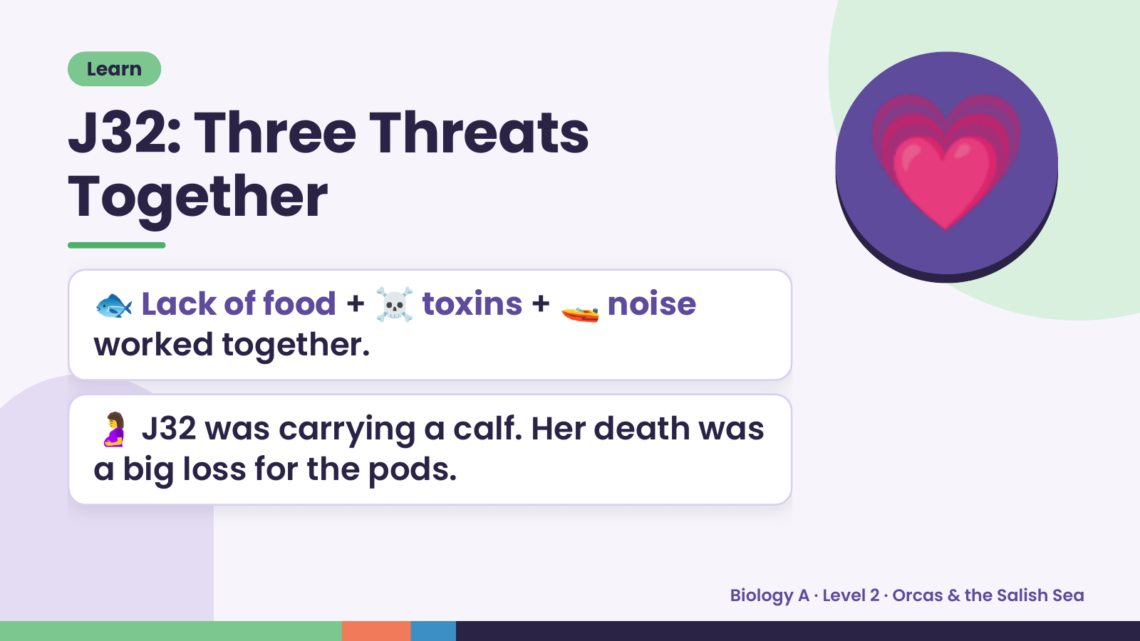
Notes:
Learn
J32: Three Threats
Together
🐟 Lack of food + ☠️ toxins + 🚤 noise
worked together.
💗
🤰 J32 was carrying a calf. Her death was
a big loss for the pods.
Biology A · Level 2 · Orcas & the Salish Sea

Slide 17
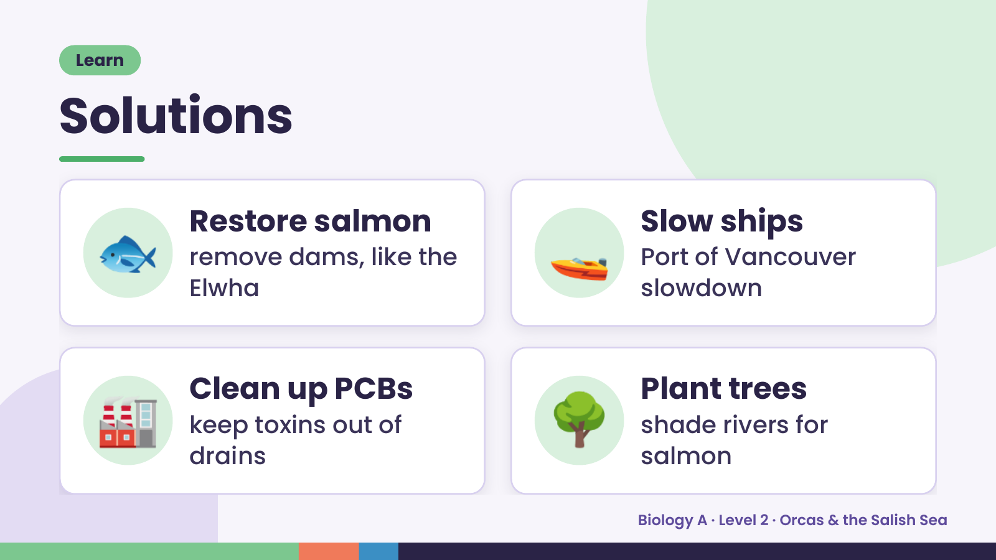
Notes:
Learn
Solutions
🐟 Restore salmon
remove dams, like the
Elwha
🚤 Slow ships
Port of Vancouver
slowdown
🏭 Clean up PCBs
keep toxins out of
drains
🌳 Plant trees
shade rivers for
salmon
Biology A · Level 2 · Orcas & the Salish Sea

Slide 18
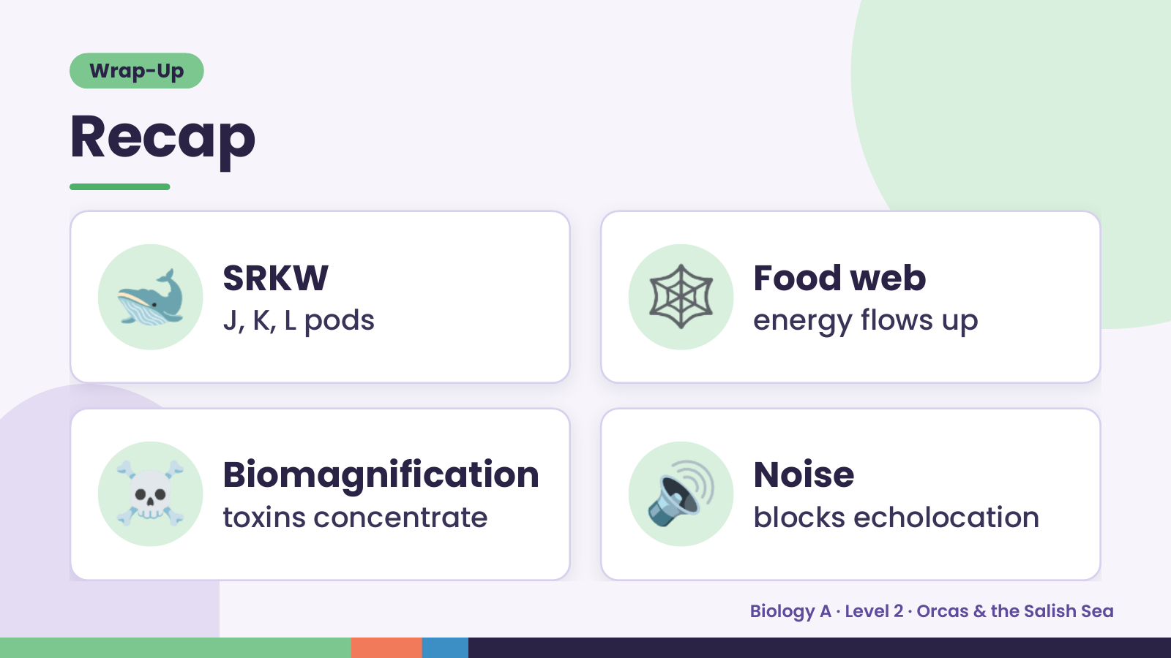
Notes:
Wrap-Up
Recap
🐋 SRKW
J, K, L pods 🕸️ Food web
energy flows up
☠️ Biomagnification
toxins concentrate 🔊 Noise
blocks echolocation
Biology A · Level 2 · Orcas & the Salish Sea

Slide 19
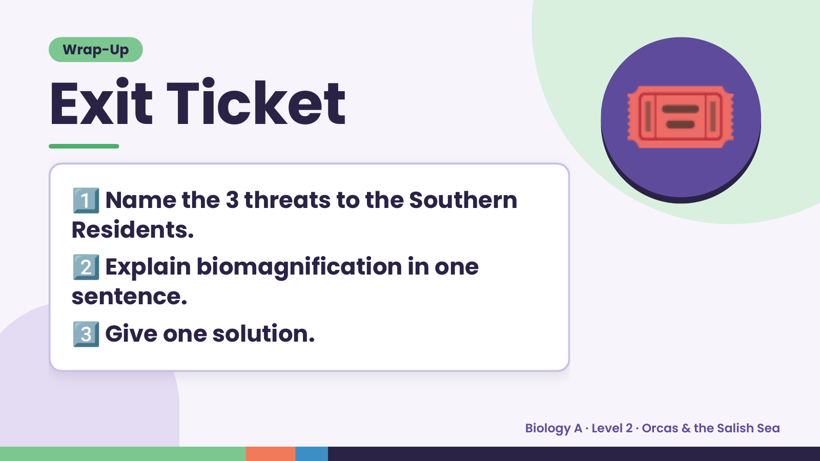
Notes:
Wrap-Up
Exit Ticket
1️⃣
Name the 3 threats to the Southern
Residents.
🎟️
2️⃣
Explain biomagnification in one
sentence.
3️⃣Give one solution.
Biology A · Level 2 · Orcas & the Salish Sea

