Slide 1
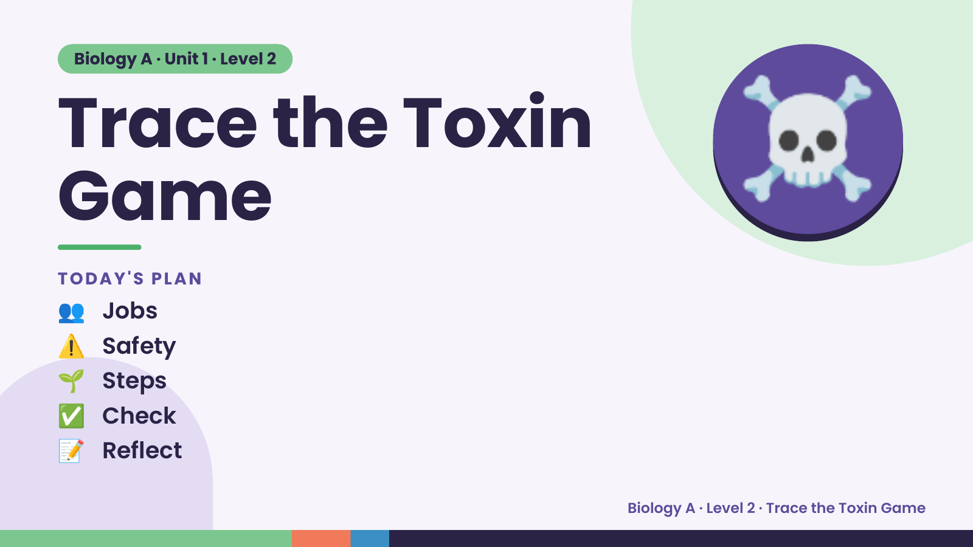
Notes:
Biology A · Unit 1 · Level 2
Trace the Toxin
Game
👥 Jobs
TODAY'S PLAN
☠️
⚠️ Safety
🌱 Steps
✅ Check
📝 Reflect
Biology A · Level 2 · Trace the Toxin Game

Slide 2
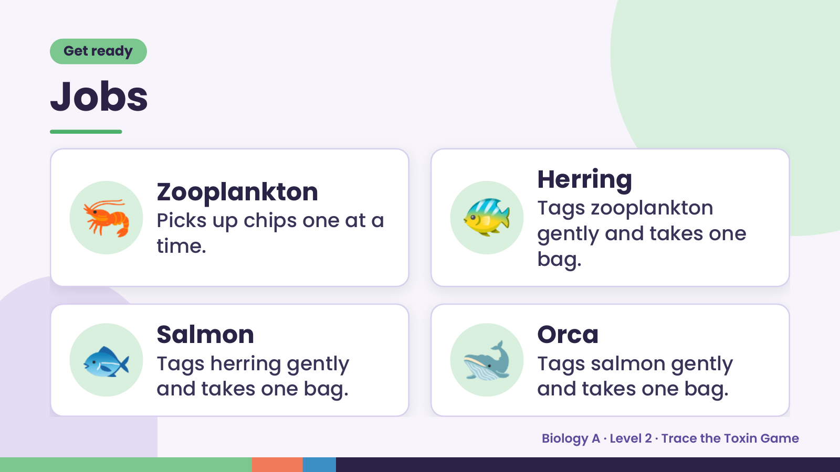
Notes:
Get ready
Jobs
🦐 Zooplankton
Picks up chips one at a
time.
🐠 Herring
Tags zooplankton
gently and takes one
bag.
🐟 Salmon
Tags herring gently
and takes one bag.
🐋 Orca
Tags salmon gently
and takes one bag.
Biology A · Level 2 · Trace the Toxin Game

Slide 3
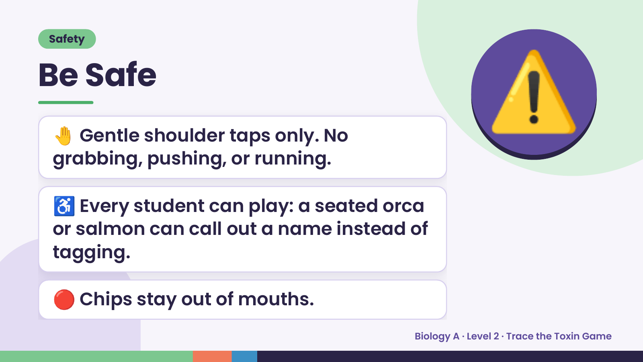
Notes:
Safety
Be Safe
🤚 Gentle shoulder taps only. No
grabbing, pushing, or running.
⚠️
♿ Every student can play: a seated orca
or salmon can call out a name instead of
tagging.
🔴 Chips stay out of mouths.
Biology A · Level 2 · Trace the Toxin Game

Slide 4
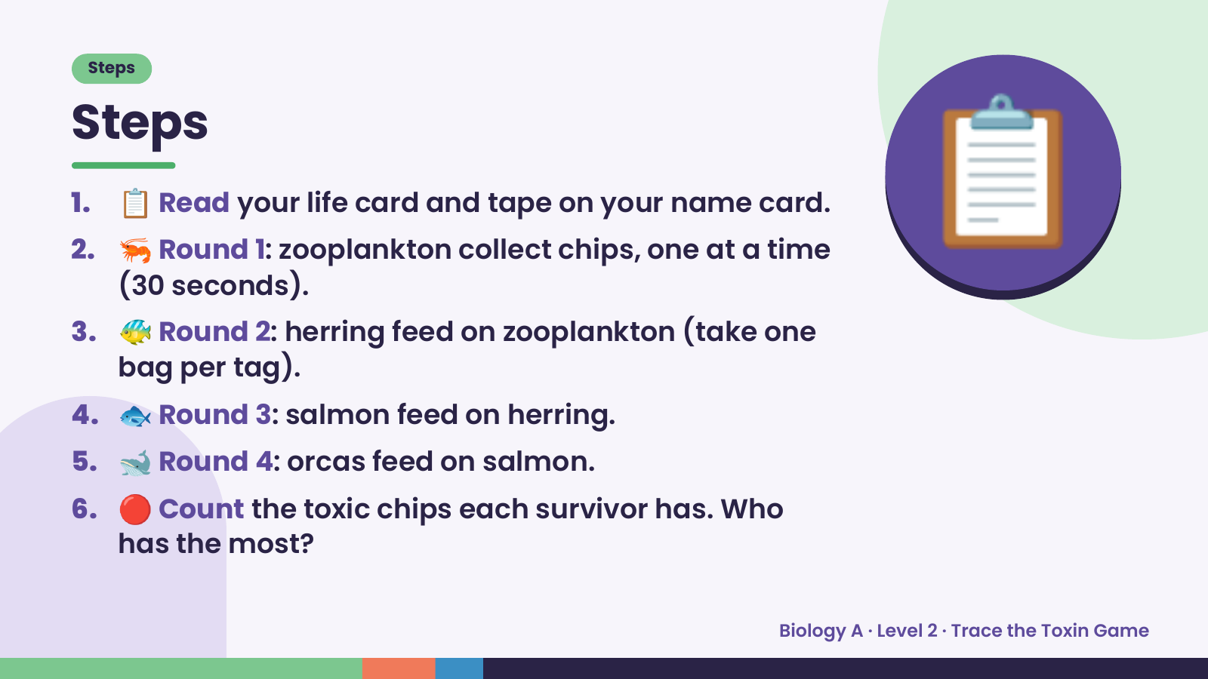
Notes:
Steps
Steps
1. 📋 Read your life card and tape on your name card.
2. 🦐 Round 1: zooplankton collect chips, one at a time
(30 seconds).
3. 🐠 Round 2: herring feed on zooplankton (take one
bag per tag).
📋
4. 🐟 Round 3: salmon feed on herring.
5. 🐋 Round 4: orcas feed on salmon.
6. 🔴 Count the toxic chips each survivor has. Who
has the most?
Biology A · Level 2 · Trace the Toxin Game

Slide 5
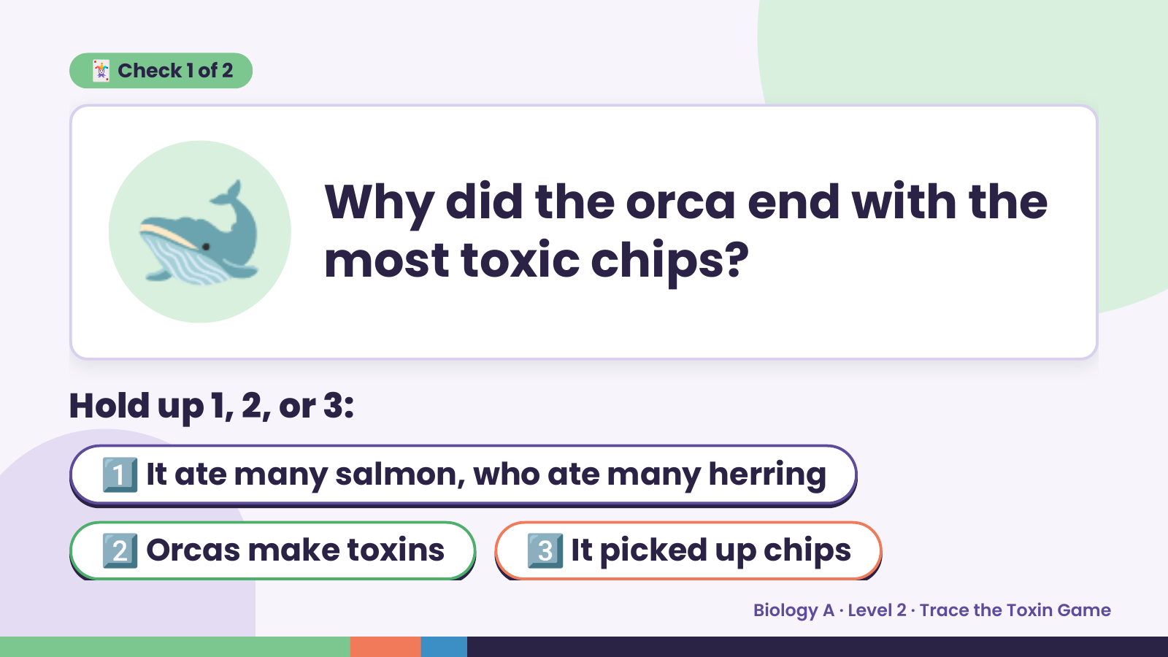
Notes:
🐋
🃏 Check 1 of 2
Why did the orca end with the
most toxic chips?
Hold up 1, 2, or 3:
1️⃣ It ate many salmon, who ate many herring
2️⃣ Orcas make toxins 3️⃣ It picked up chips
Biology A · Level 2 · Trace the Toxin Game

Slide 6
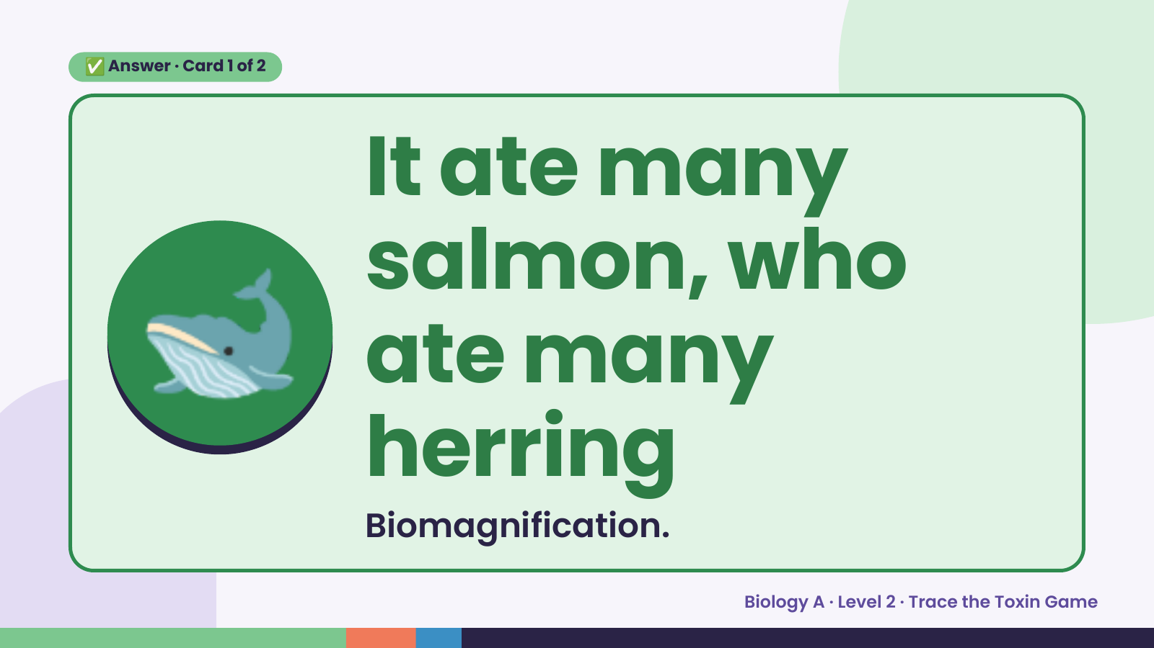
Notes:
✅ Answer · Card 1 of 2
🐋
It ate many
salmon, who
ate many
herring
Biomagnification.
Biology A · Level 2 · Trace the Toxin Game

Slide 7
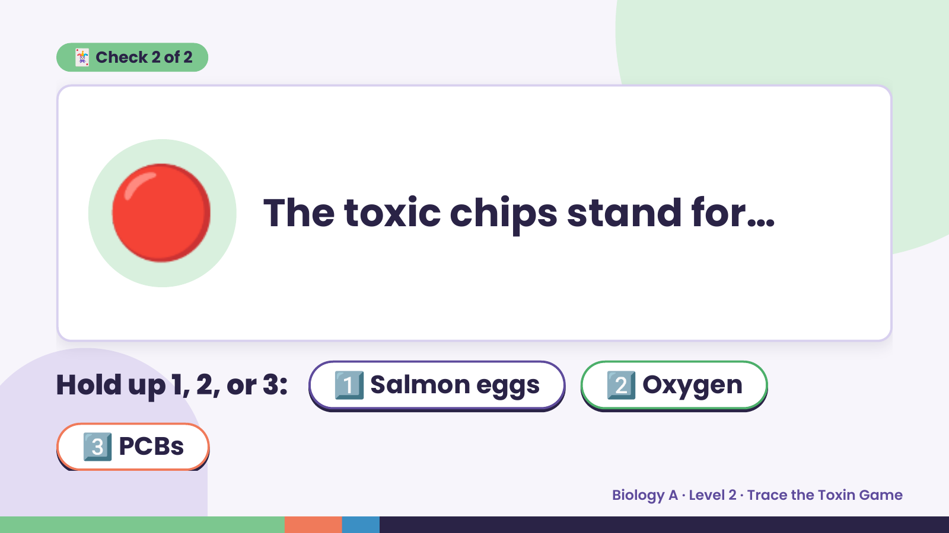
Notes:
🃏 Check 2 of 2
🔴 The toxic chips stand for…
Hold up 1, 2, or 3: 1️⃣ Salmon eggs 2️⃣ Oxygen
3️⃣ PCBs
Biology A · Level 2 · Trace the Toxin Game

Slide 8
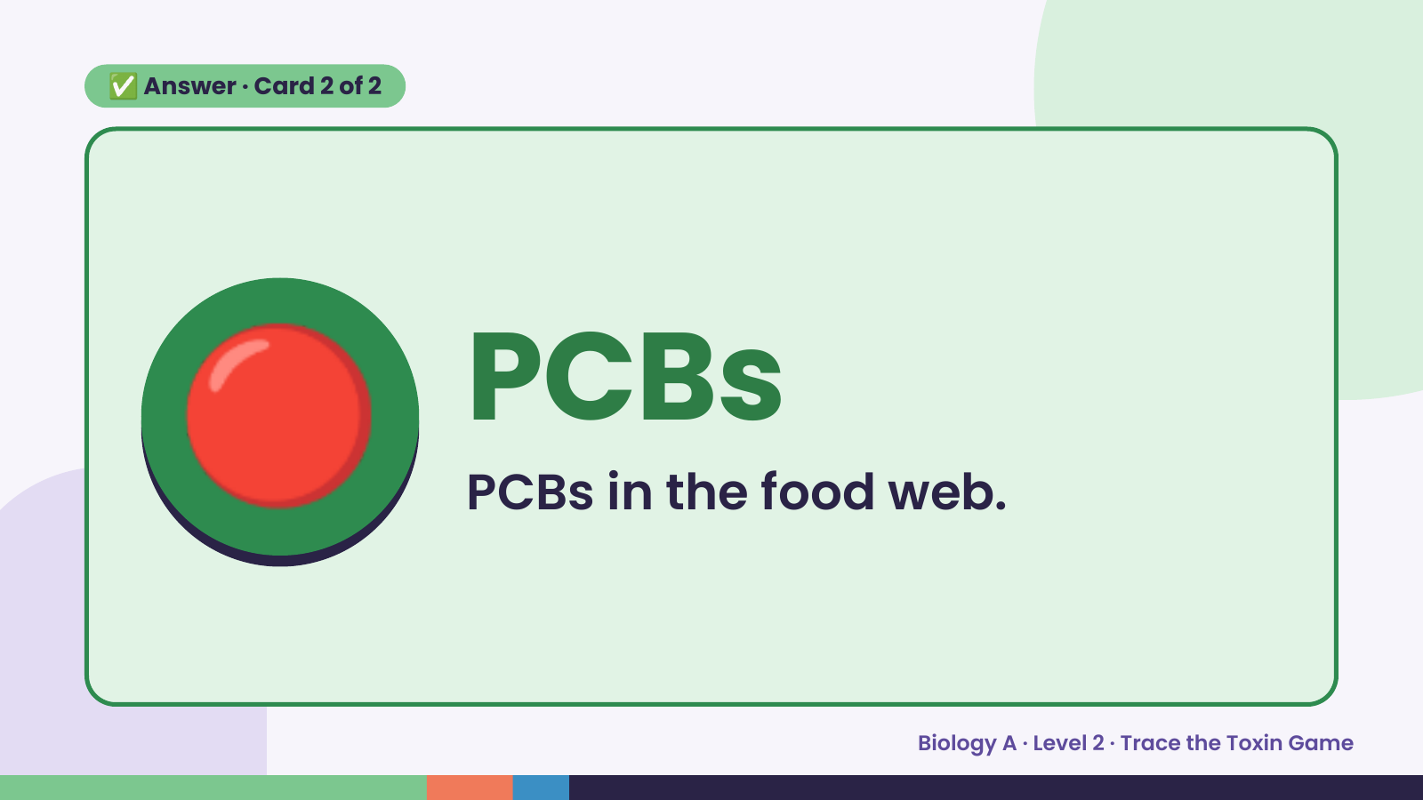
Notes:
✅ Answer · Card 2 of 2
🔴 PCBs
PCBs in the food web.
Biology A · Level 2 · Trace the Toxin Game

Slide 9
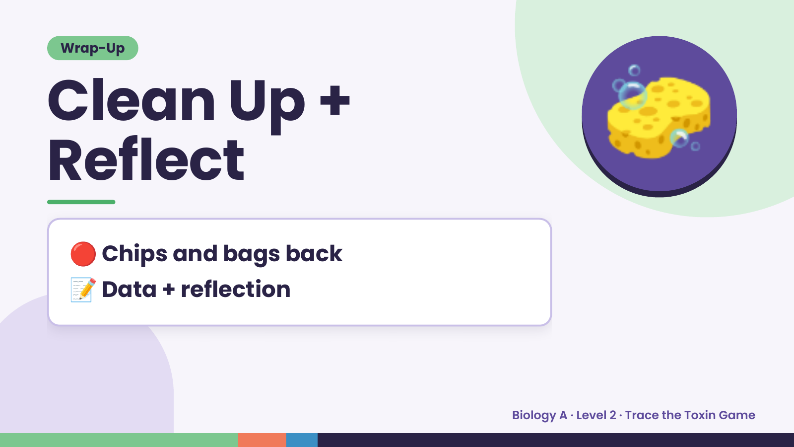
Notes:
Wrap-Up
Clean Up +
Reflect
🧽
🔴 Chips and bags back
📝 Data + reflection
Biology A · Level 2 · Trace the Toxin Game

