Slide 1
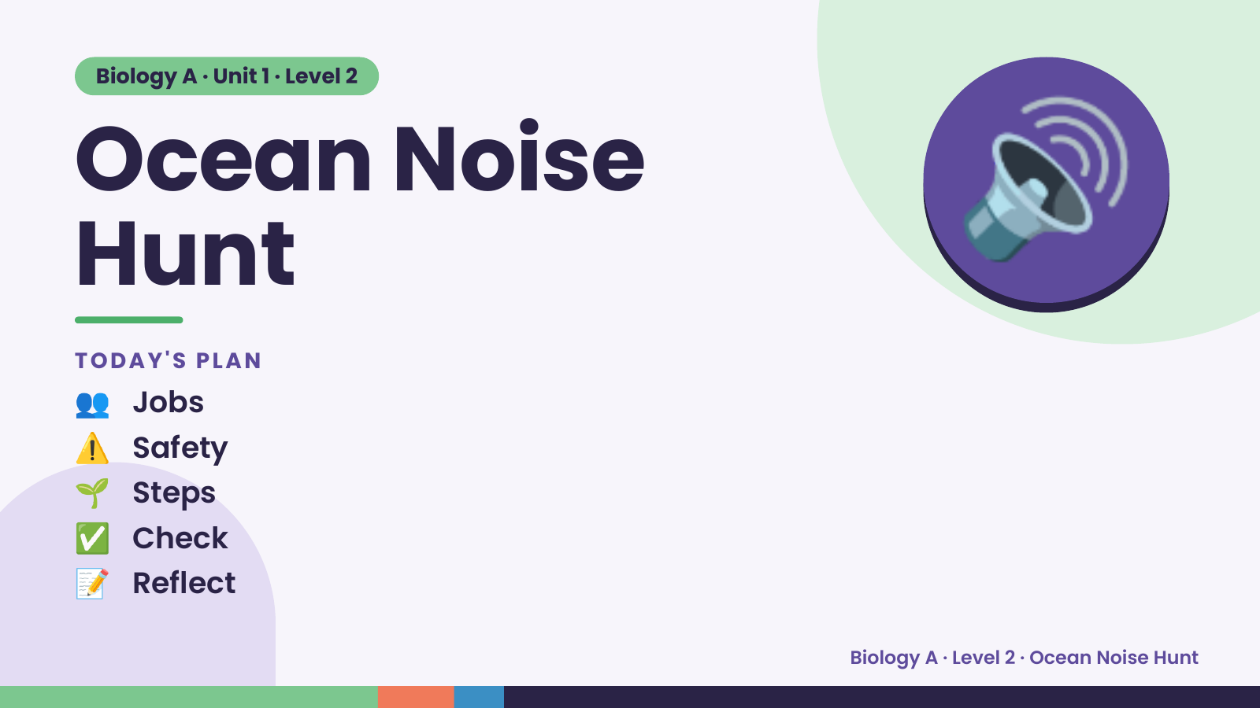
Notes:
Biology A · Unit 1 · Level 2
Ocean Noise
Hunt
👥 Jobs
TODAY'S PLAN
🔊
⚠️ Safety
🌱 Steps
✅ Check
📝 Reflect
Biology A · Level 2 · Ocean Noise Hunt

Slide 2
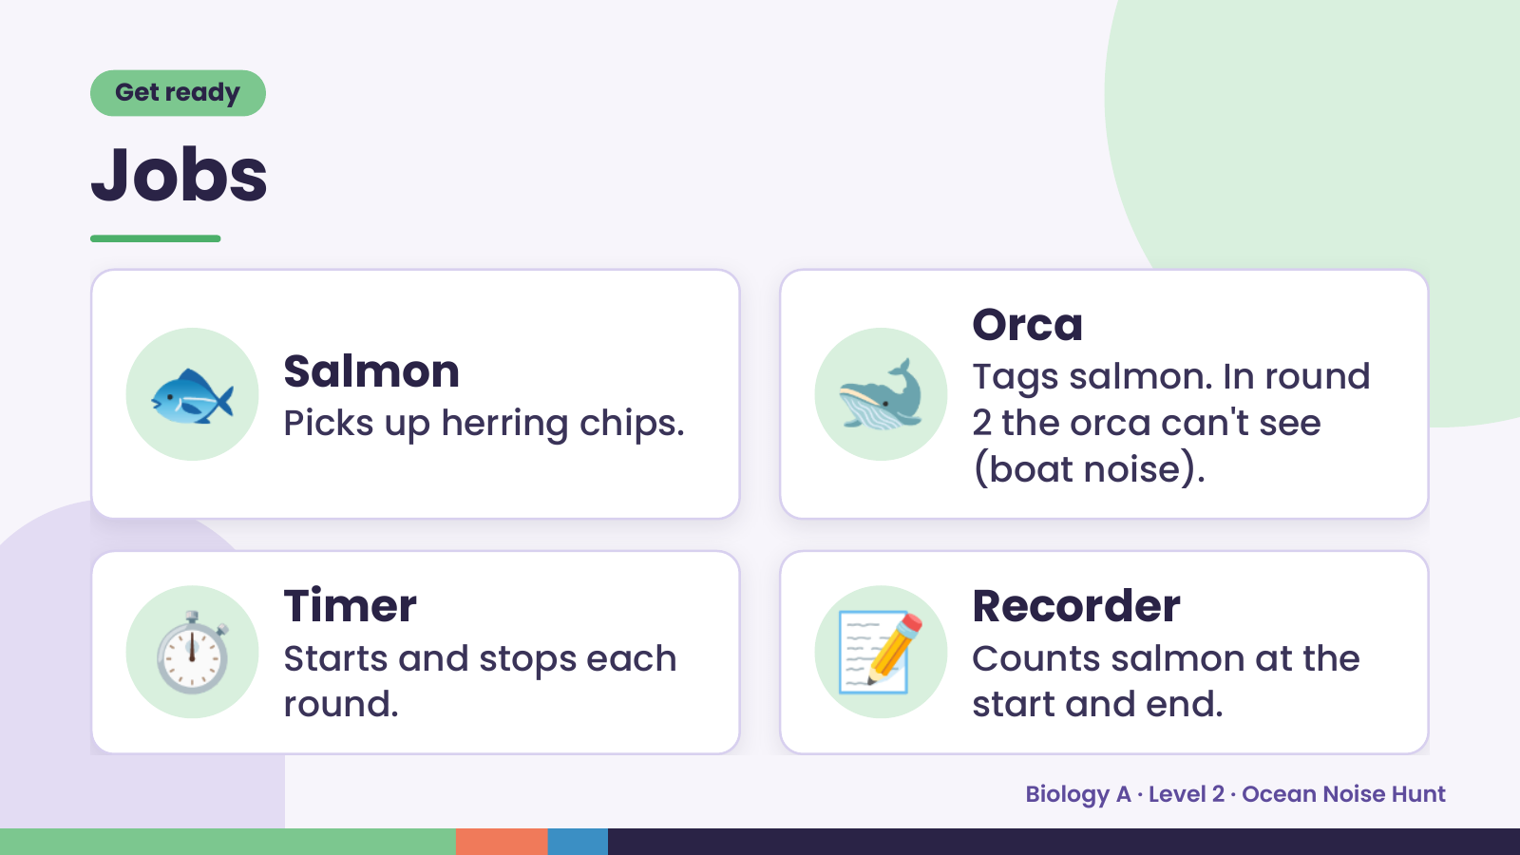
Notes:
Get ready
Jobs
🐟 Salmon
Picks up herring chips. 🐋 Orca
Tags salmon. In round
2 the orca can't see
(boat noise).
⏱️ Timer
Starts and stops each
round.
📝 Recorder
Counts salmon at the
start and end.
Biology A · Level 2 · Ocean Noise Hunt

Slide 3
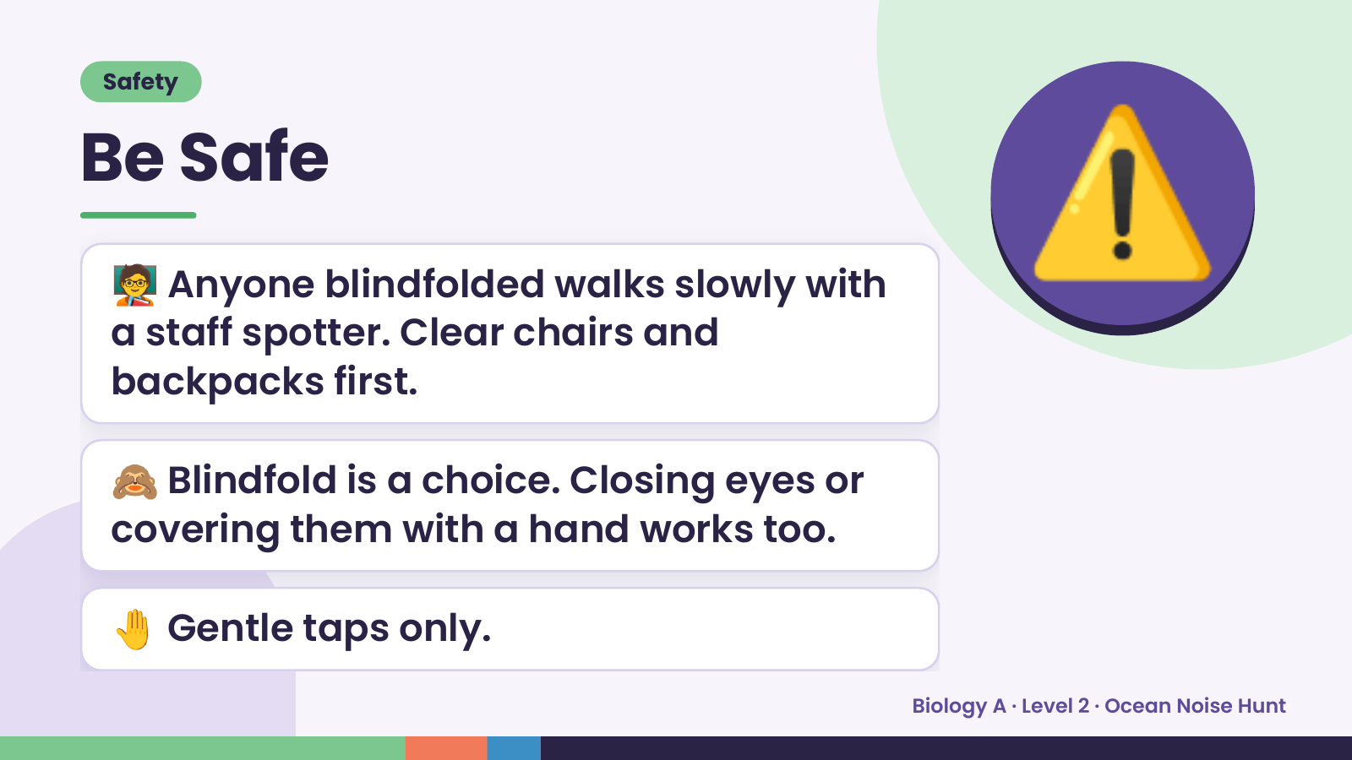
Notes:
Safety
Be Safe
🧑‍🏫 Anyone blindfolded walks slowly with
a staff spotter. Clear chairs and
backpacks first.
⚠️
🙈 Blindfold is a choice. Closing eyes or
covering them with a hand works too.
🤚 Gentle taps only.
Biology A · Level 2 · Ocean Noise Hunt

Slide 4
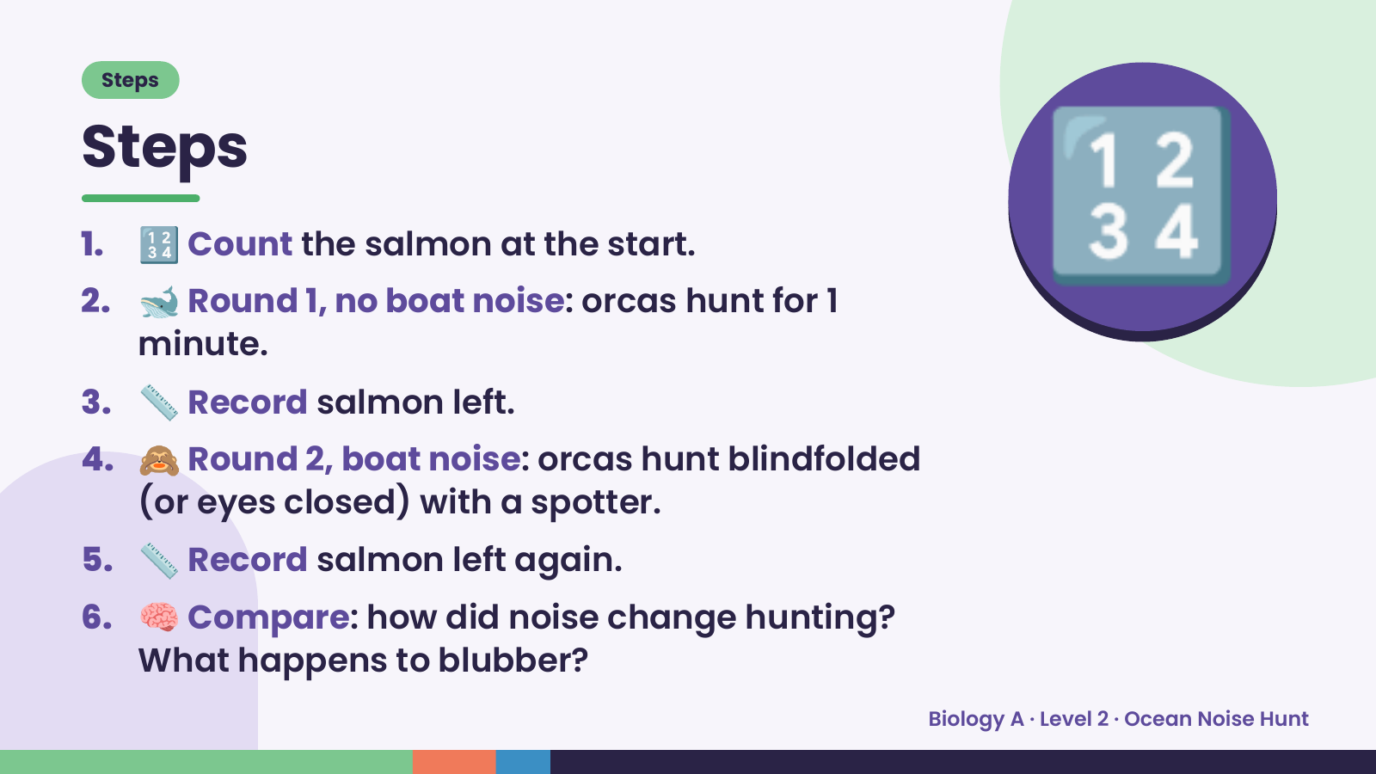
Notes:
Steps
Steps
1. 🔢 Count the salmon at the start.
2. 🐋 Round 1, no boat noise: orcas hunt for 1
minute.
3. 📏 Record salmon left.
🔢
4. 🙈 Round 2, boat noise: orcas hunt blindfolded
(or eyes closed) with a spotter.
5. 📏 Record salmon left again.
6. 🧠 Compare: how did noise change hunting?
What happens to blubber?
Biology A · Level 2 · Ocean Noise Hunt

Slide 5
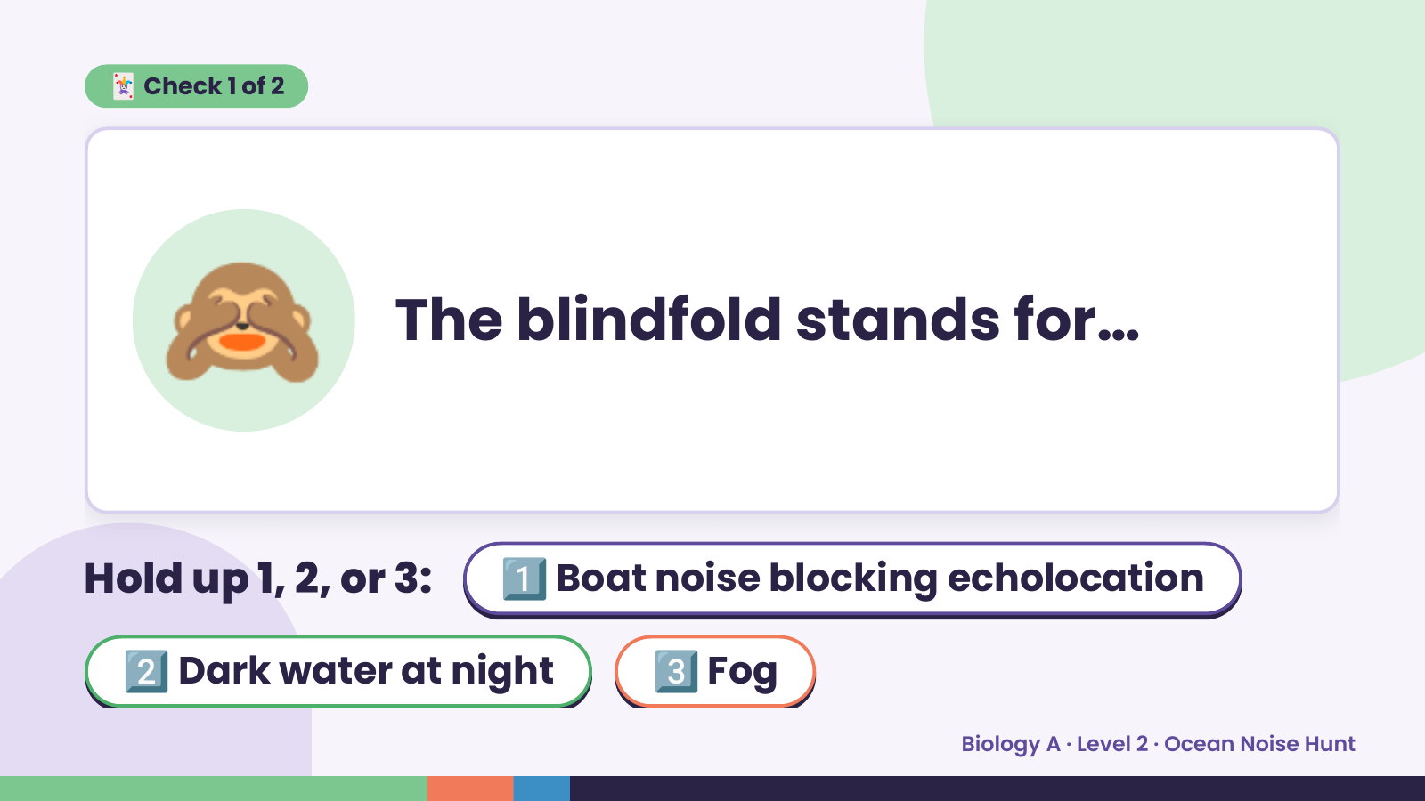
Notes:
🃏 Check 1 of 2
🙈 The blindfold stands for…
Hold up 1, 2, or 3: 1️⃣ Boat noise blocking echolocation
2️⃣ Dark water at night 3️⃣ Fog
Biology A · Level 2 · Ocean Noise Hunt

Slide 6
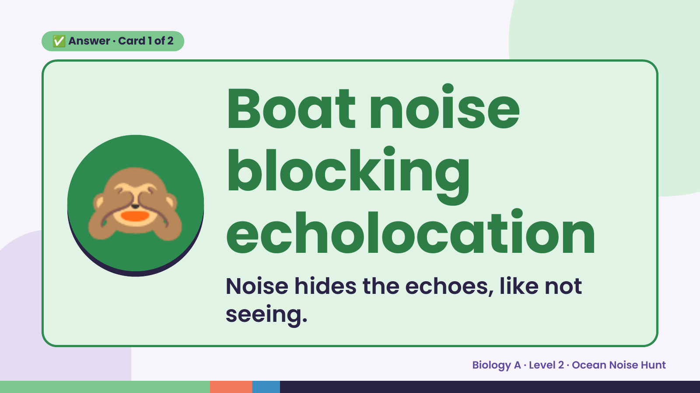
Notes:
✅ Answer · Card 1 of 2
🙈
Boat noise
blocking
echolocation
Noise hides the echoes, like not
seeing.
Biology A · Level 2 · Ocean Noise Hunt

Slide 7
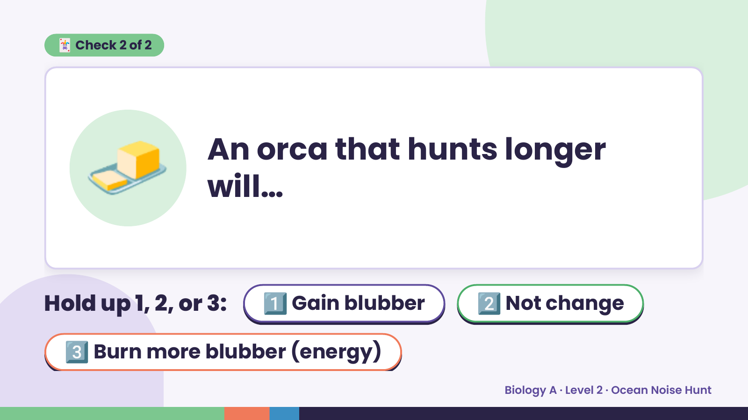
Notes:
🃏 Check 2 of 2
🧈 An orca that hunts longer
will…
Hold up 1, 2, or 3: 1️⃣ Gain blubber 2️⃣ Not change
3️⃣ Burn more blubber (energy)
Biology A · Level 2 · Ocean Noise Hunt

Slide 8
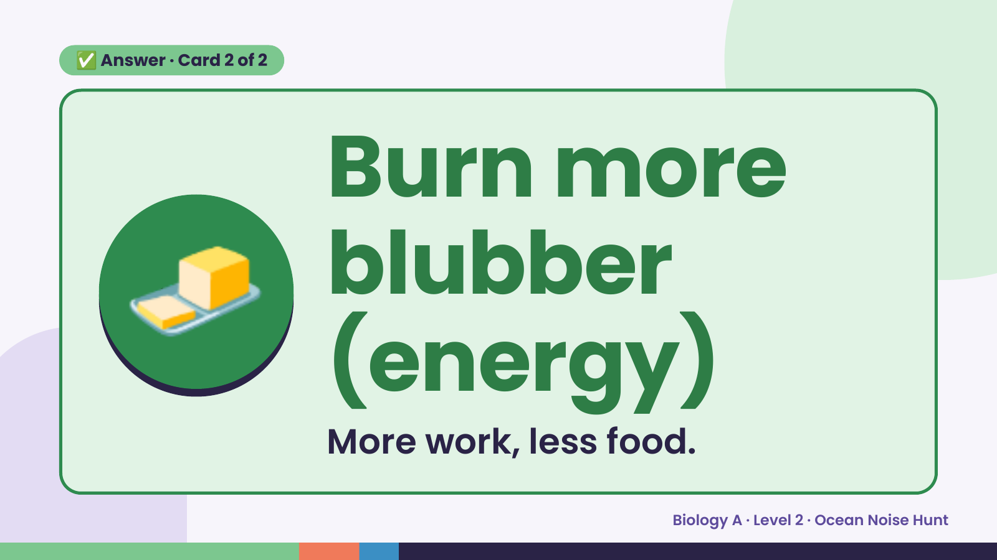
Notes:
✅ Answer · Card 2 of 2
🧈 Burn more
blubber
(energy)
More work, less food.
Biology A · Level 2 · Ocean Noise Hunt

Slide 9
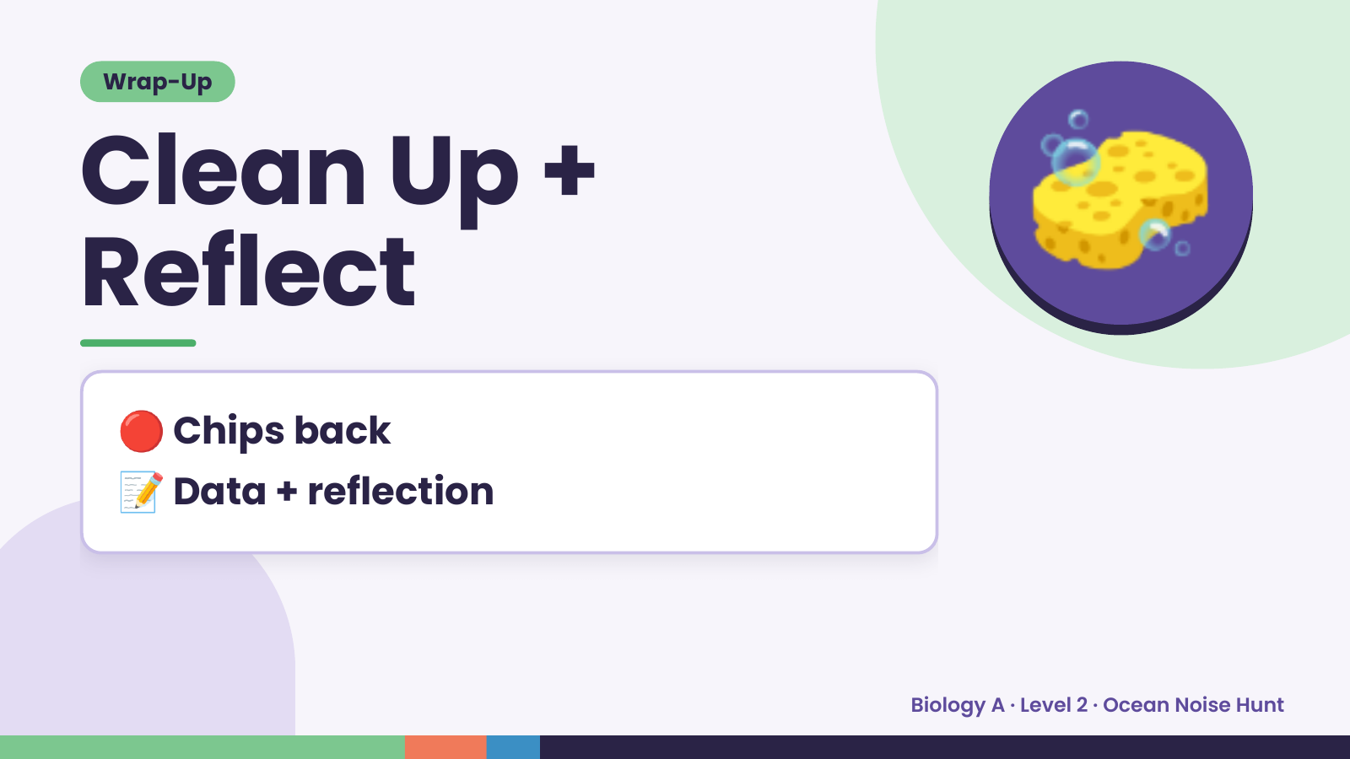
Notes:
Wrap-Up
Clean Up +
Reflect
🧽
🔴 Chips back
📝 Data + reflection
Biology A · Level 2 · Ocean Noise Hunt

