Slide 1
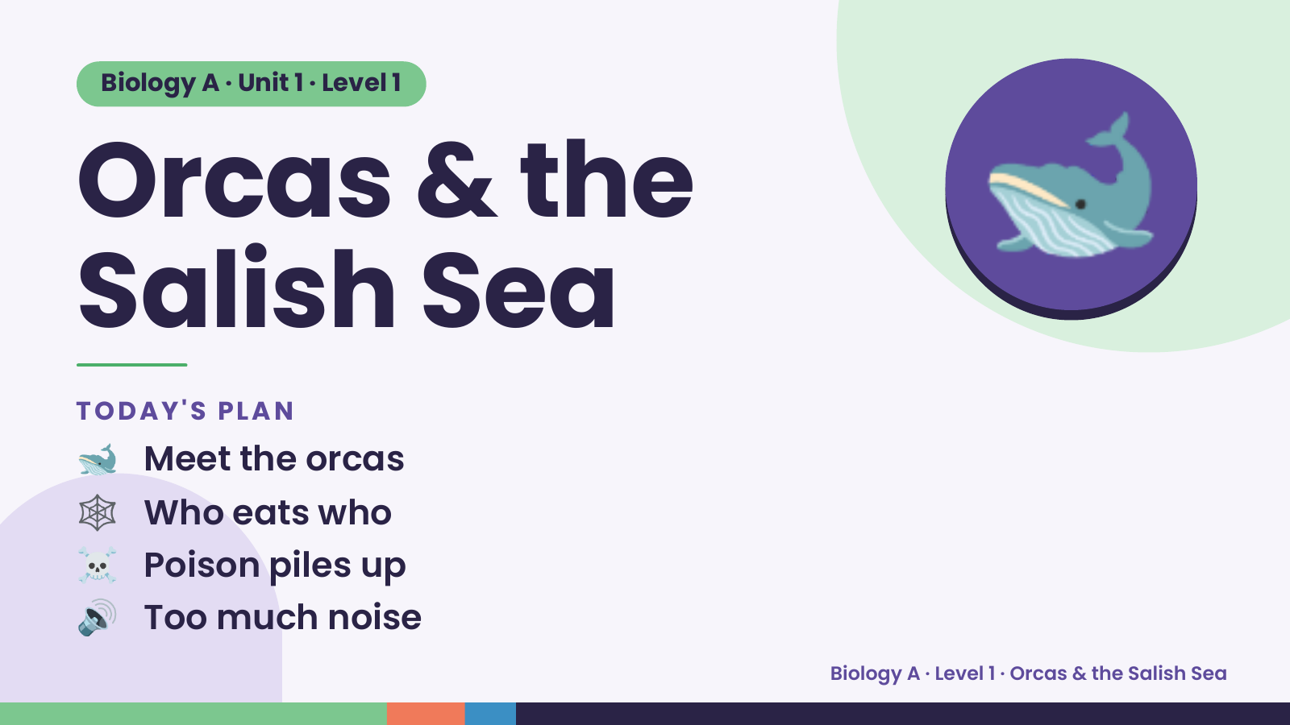
Notes:
Biology A · Unit 1 · Level 1
Orcas & the
Salish Sea
🐋
🐋 Meet the orcas
TODAY'S PLAN
🕸️ Who eats who
☠️ Poison piles up
🔊 Too much noise
Biology A · Level 1 · Orcas & the Salish Sea

Slide 2
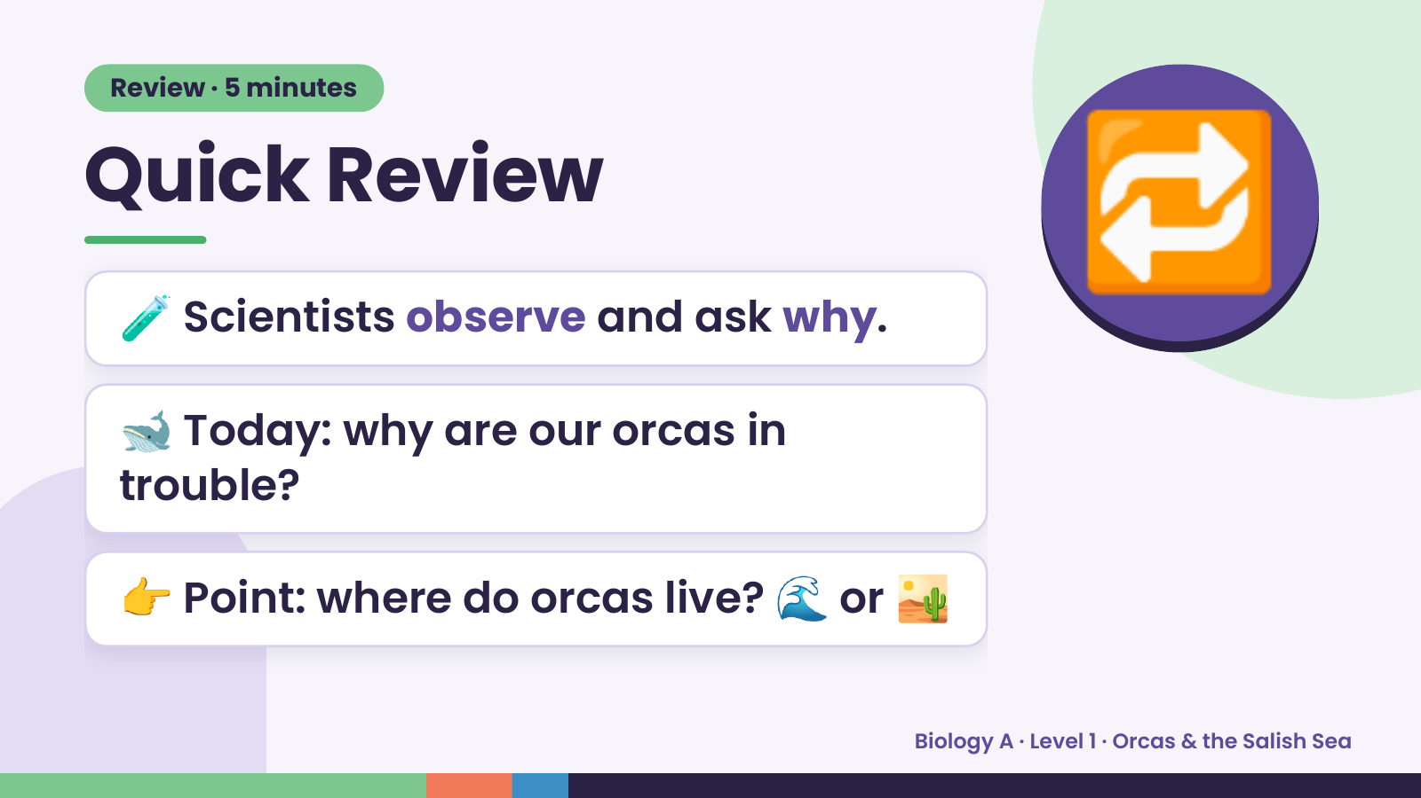
Notes:
Review · 5 minutes
Quick Review
🧪 Scientists observe and ask why.
🐋 Today: why are our orcas in
🔁
trouble?
👉 Point: where do orcas live? 🌊 or 🏜️
Biology A · Level 1 · Orcas & the Salish Sea

Slide 3
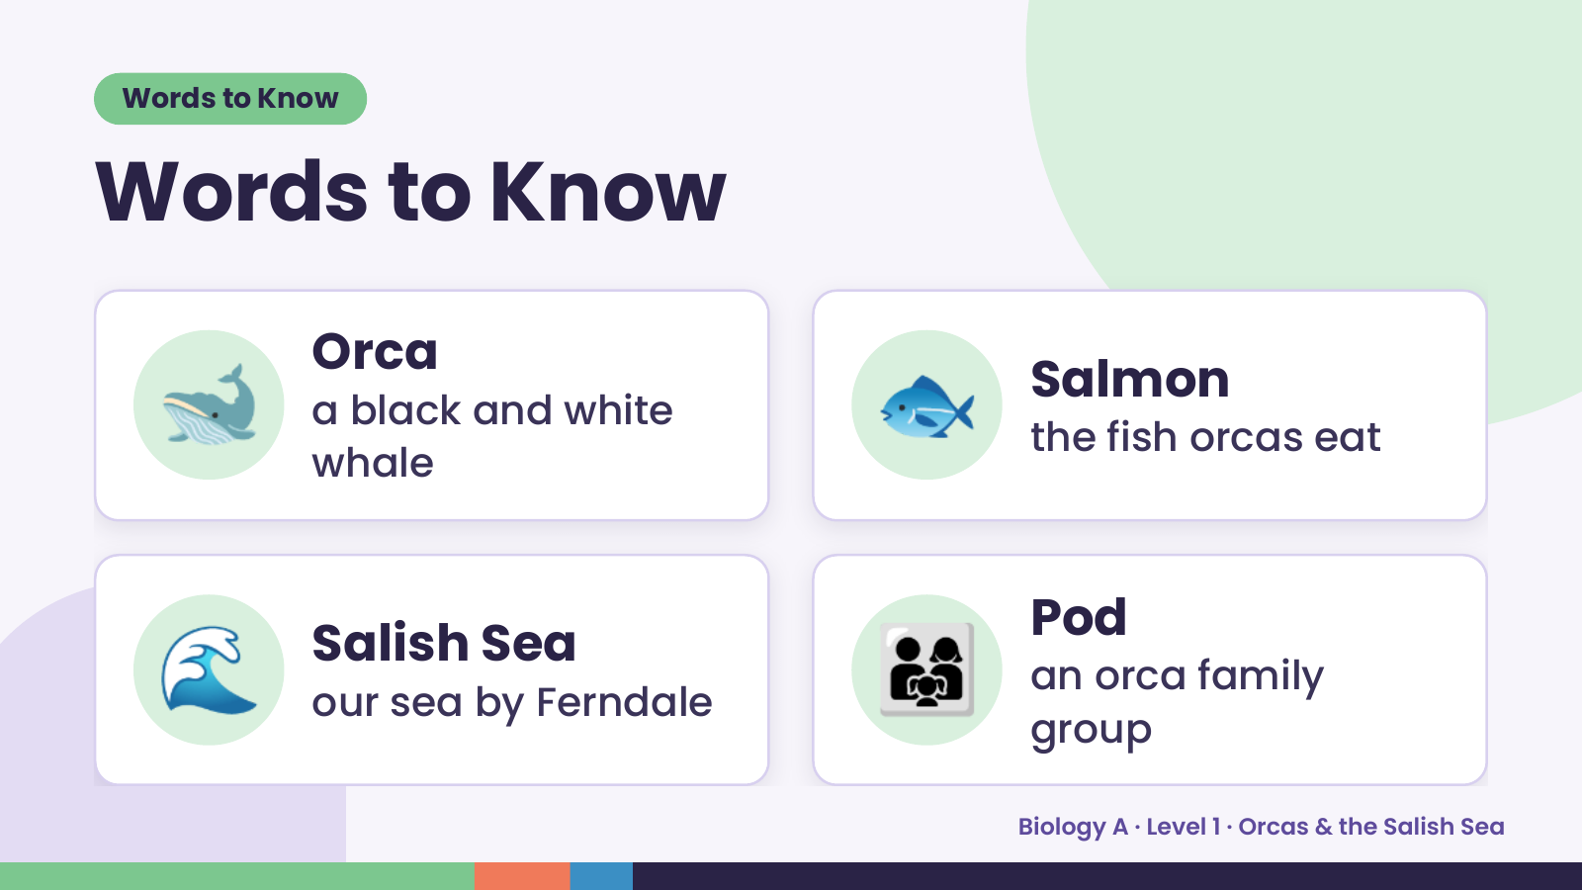
Notes:
Words to Know
Words to Know
🐋 Orca
a black and white
whale
🐟 Salmon
the fish orcas eat
🌊 Salish Sea
our sea by Ferndale 👨‍👩‍👧 Pod
an orca family
group
Biology A · Level 1 · Orcas & the Salish Sea

Slide 4
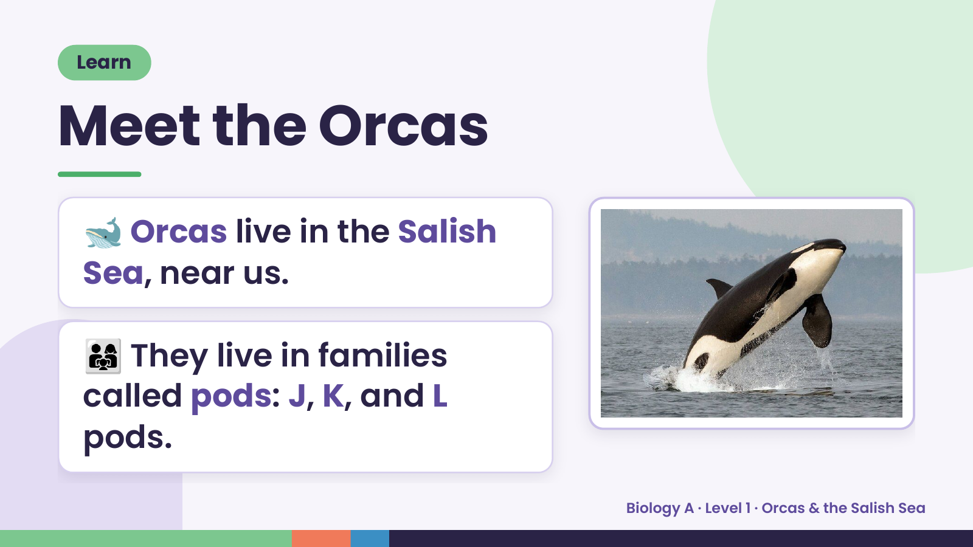
Notes:
Learn
Meet the Orcas
🐋 Orcas live in the Salish
Sea, near us.
👨‍👩‍👧 They live in families
called pods: J, K, and L
pods.
Biology A · Level 1 · Orcas & the Salish Sea

Slide 5
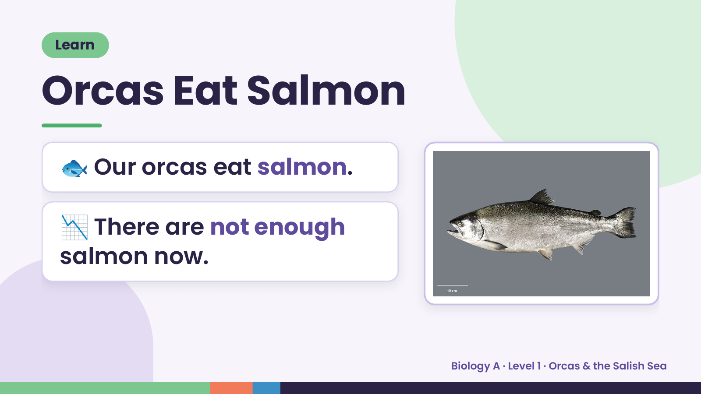
Notes:
Learn
Orcas Eat Salmon
🐟 Our orcas eat salmon.
📉 There are not enough
salmon now.
Biology A · Level 1 · Orcas & the Salish Sea

Slide 6
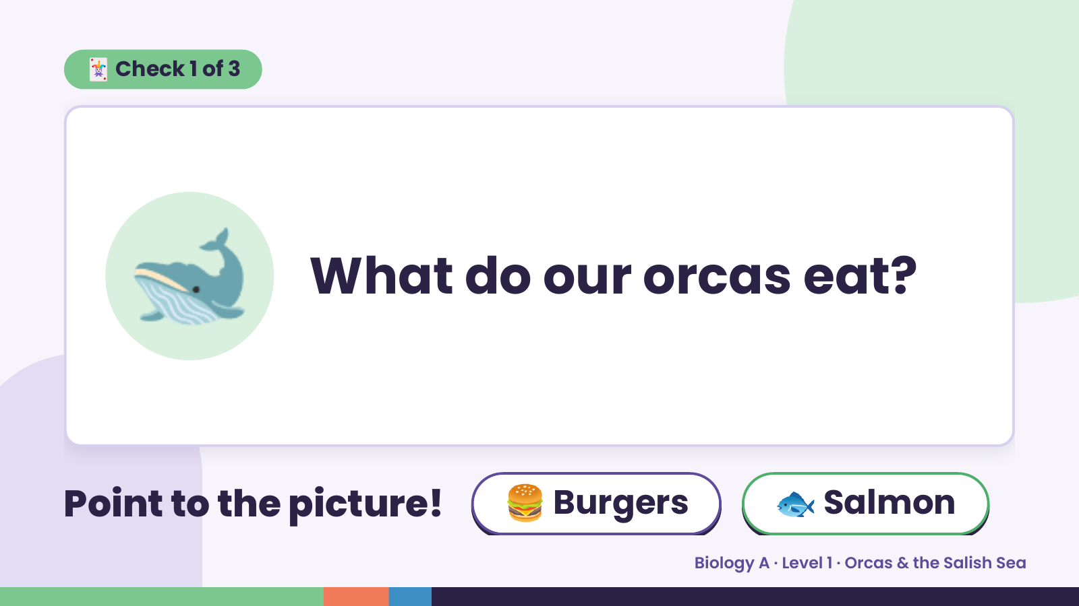
Notes:
🃏 Check 1 of 3
🐋 What do our orcas eat?
Point to the picture! 🍔 Burgers 🐟 Salmon
Biology A · Level 1 · Orcas & the Salish Sea

Slide 7
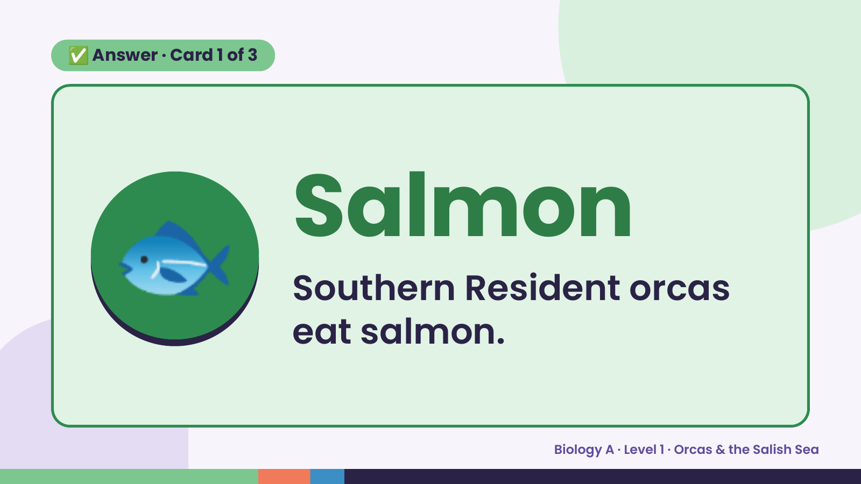
Notes:
✅ Answer · Card 1 of 3
🐟 Salmon
Southern Resident orcas
eat salmon.
Biology A · Level 1 · Orcas & the Salish Sea

Slide 8
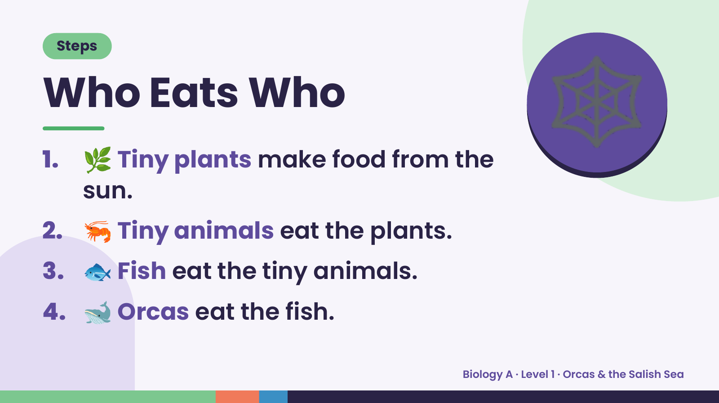
Notes:
Steps
Who Eats Who
1. 🌿 Tiny plants make food from the
sun.
🕸️
2. 🦐 Tiny animals eat the plants.
3. 🐟 Fish eat the tiny animals.
4. 🐋 Orcas eat the fish.
Biology A · Level 1 · Orcas & the Salish Sea

Slide 9
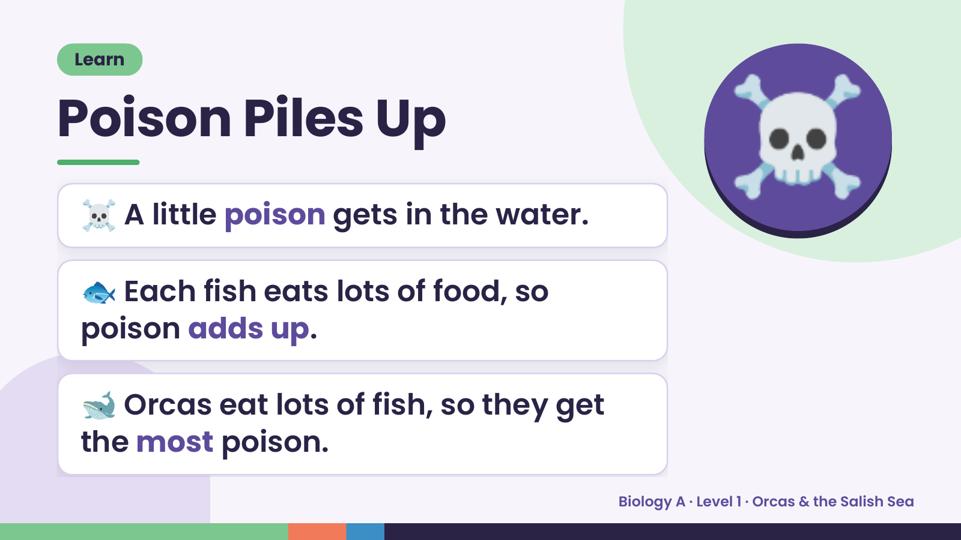
Notes:
Learn
Poison Piles Up
☠️ A little poison gets in the water.
🐟 Each fish eats lots of food, so
☠️
poison adds up.
🐋 Orcas eat lots of fish, so they get
the most poison.
Biology A · Level 1 · Orcas & the Salish Sea

Slide 10
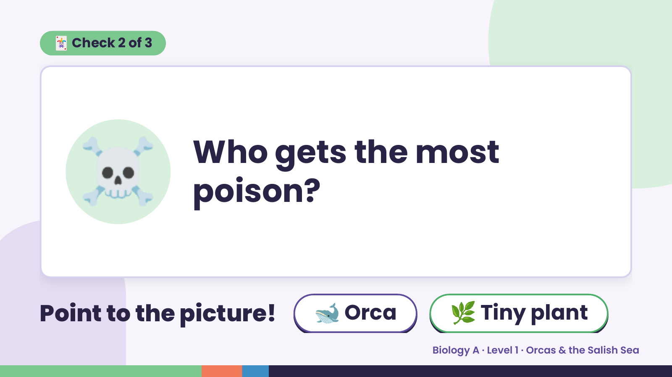
Notes:
🃏 Check 2 of 3
☠️ Who gets the most
poison?
Point to the picture! 🐋 Orca 🌿 Tiny plant
Biology A · Level 1 · Orcas & the Salish Sea

Slide 11
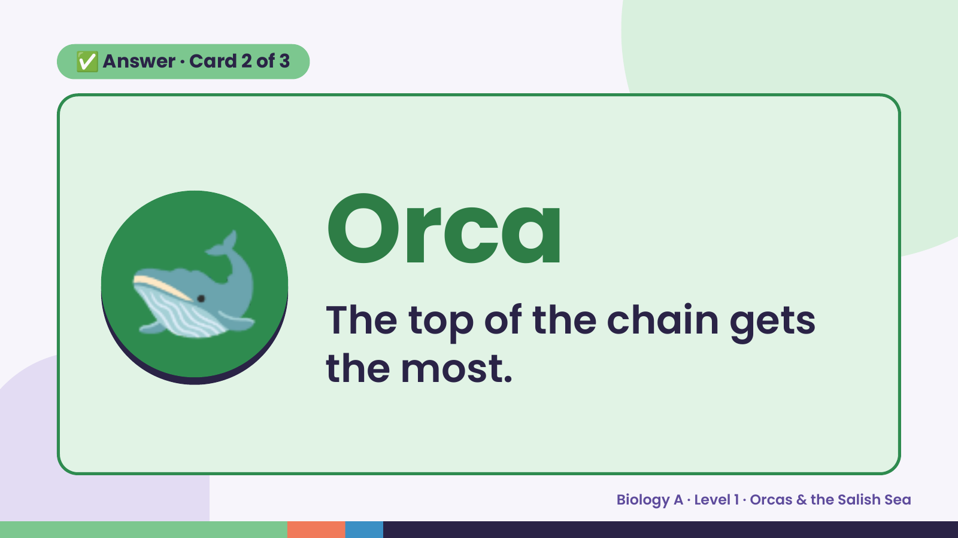
Notes:
✅ Answer · Card 2 of 3
🐋 Orca
The top of the chain gets
the most.
Biology A · Level 1 · Orcas & the Salish Sea

Slide 12
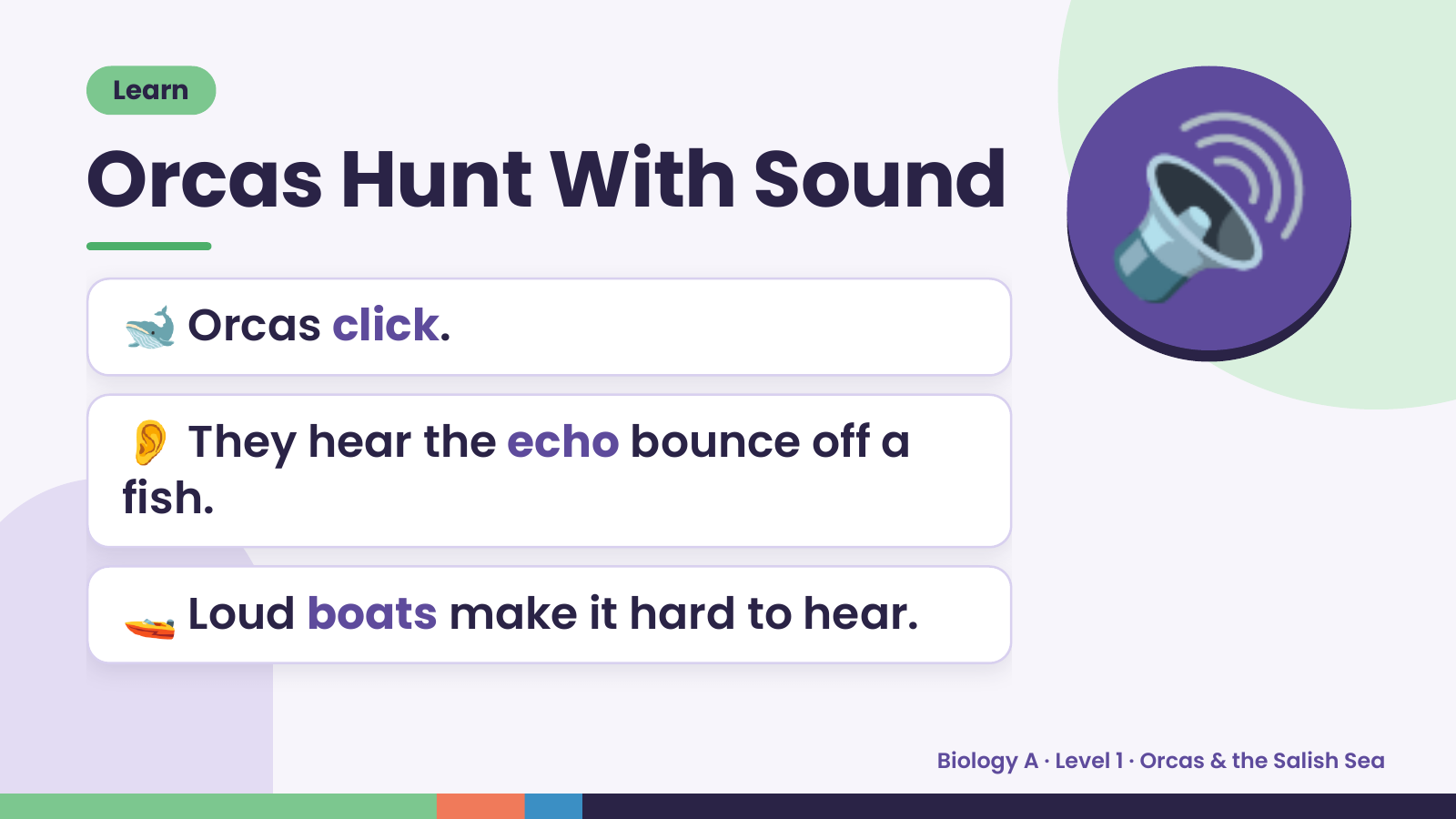
Notes:
Learn
Orcas Hunt With Sound
🐋 Orcas click.
👂 They hear the echo bounce off a
🔊
fish.
🚤 Loud boats make it hard to hear.
Biology A · Level 1 · Orcas & the Salish Sea

Slide 13
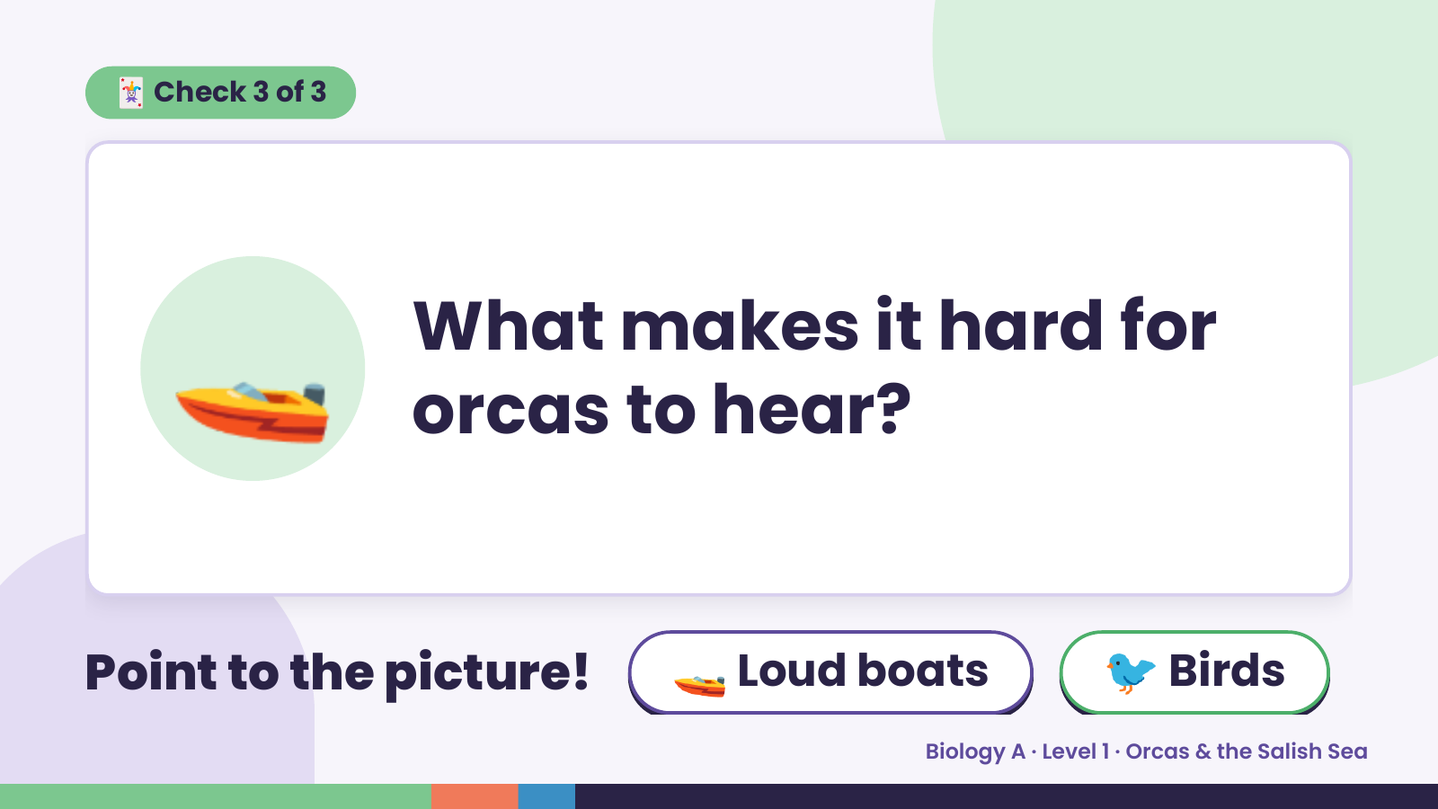
Notes:
🃏 Check 3 of 3
🚤 What makes it hard for
orcas to hear?
Point to the picture! 🚤 Loud boats 🐦 Birds
Biology A · Level 1 · Orcas & the Salish Sea

Slide 14
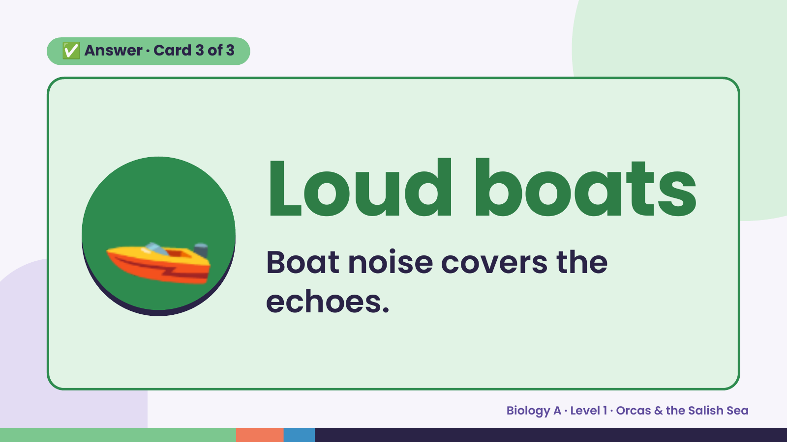
Notes:
✅ Answer · Card 3 of 3
🚤 Loud boats
Boat noise covers the
echoes.
Biology A · Level 1 · Orcas & the Salish Sea

Slide 15
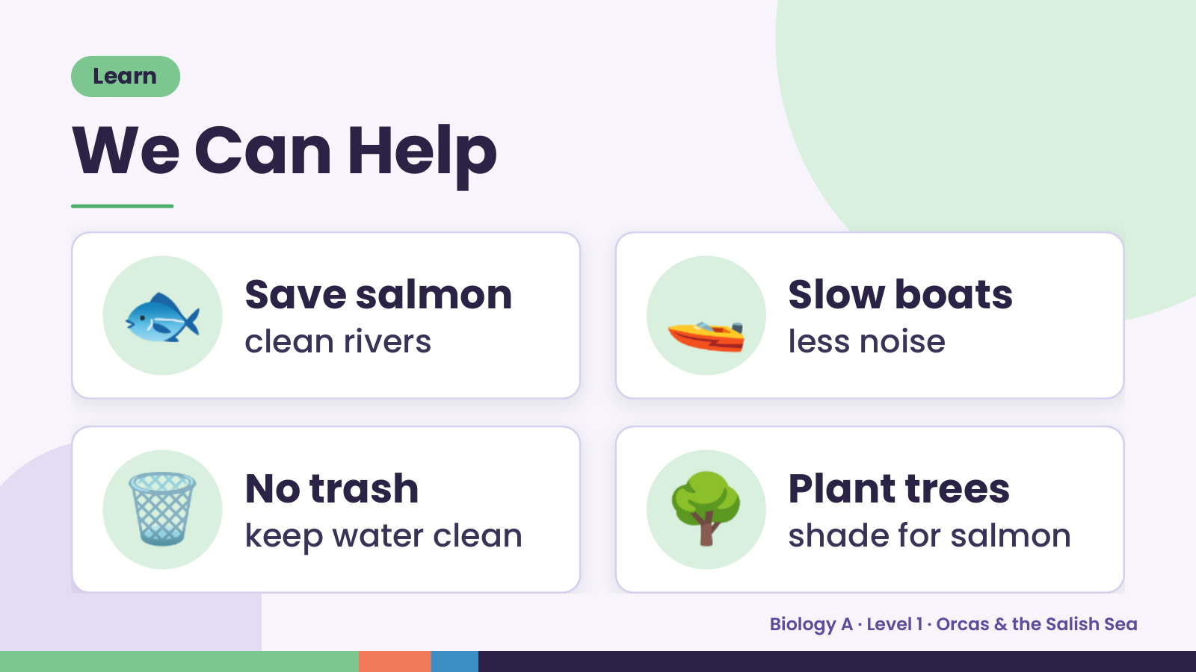
Notes:
Learn
We Can Help
🐟 Save salmon
clean rivers 🚤 Slow boats
less noise
🗑️ No trash
keep water clean 🌳 Plant trees
shade for salmon
Biology A · Level 1 · Orcas & the Salish Sea

Slide 16
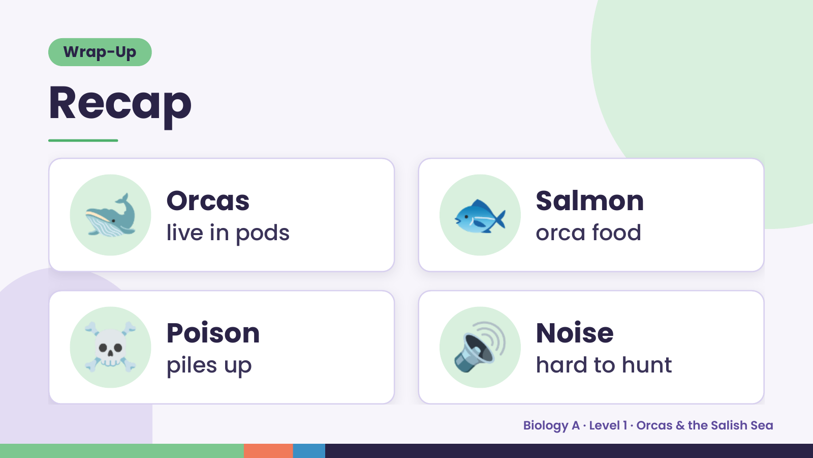
Notes:
Wrap-Up
Recap
🐋 Orcas
live in pods 🐟 Salmon
orca food
☠️ Poison
piles up 🔊 Noise
hard to hunt
Biology A · Level 1 · Orcas & the Salish Sea

Slide 17
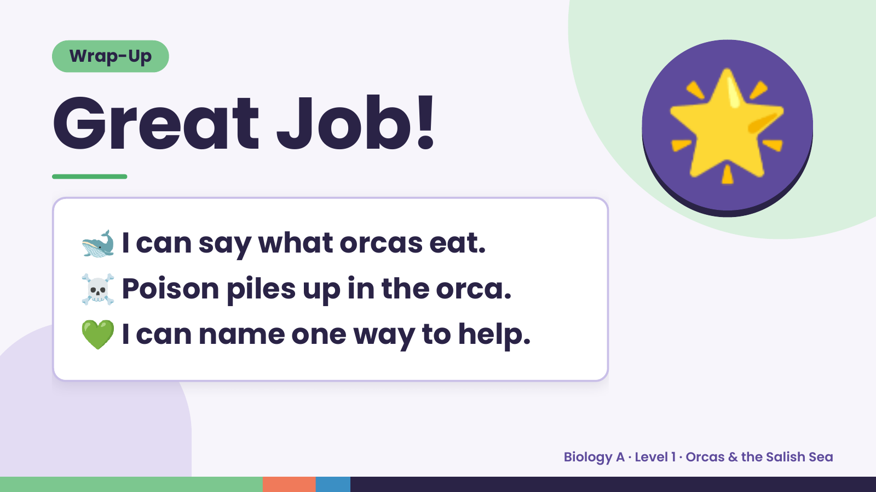
Notes:
Wrap-Up
Great Job!
🐋 I can say what orcas eat.
🌟
☠️ Poison piles up in the orca.
💚 I can name one way to help.
Biology A · Level 1 · Orcas & the Salish Sea

