Slide 1
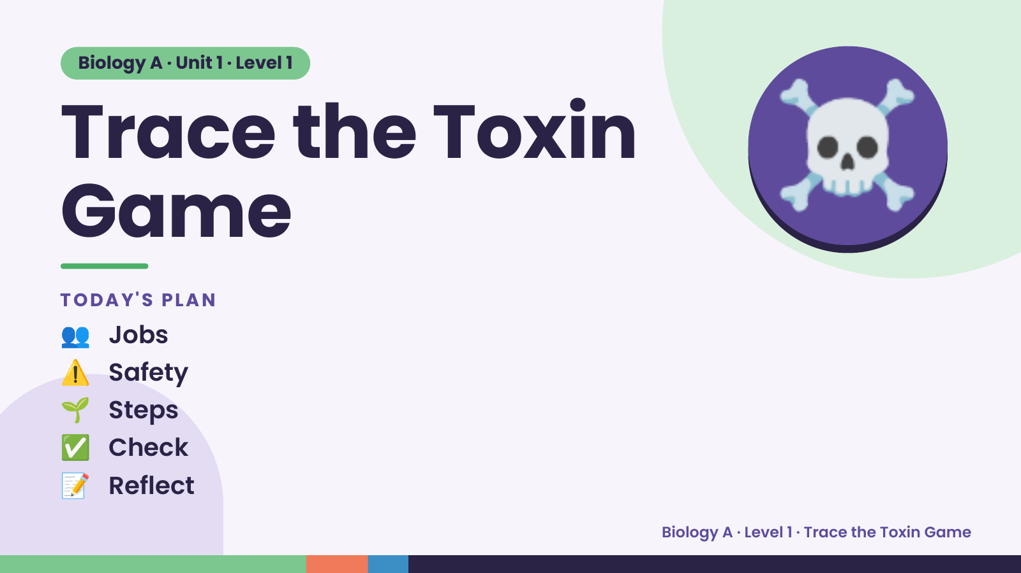
Notes:
Biology A · Unit 1 · Level 1
Trace the Toxin
Game
TODAY'S PLAN
☠️
👥 Jobs
⚠️ Safety
🌱 Steps
✅ Check
📝 Reflect
Biology A · Level 1 · Trace the Toxin Game

Slide 2
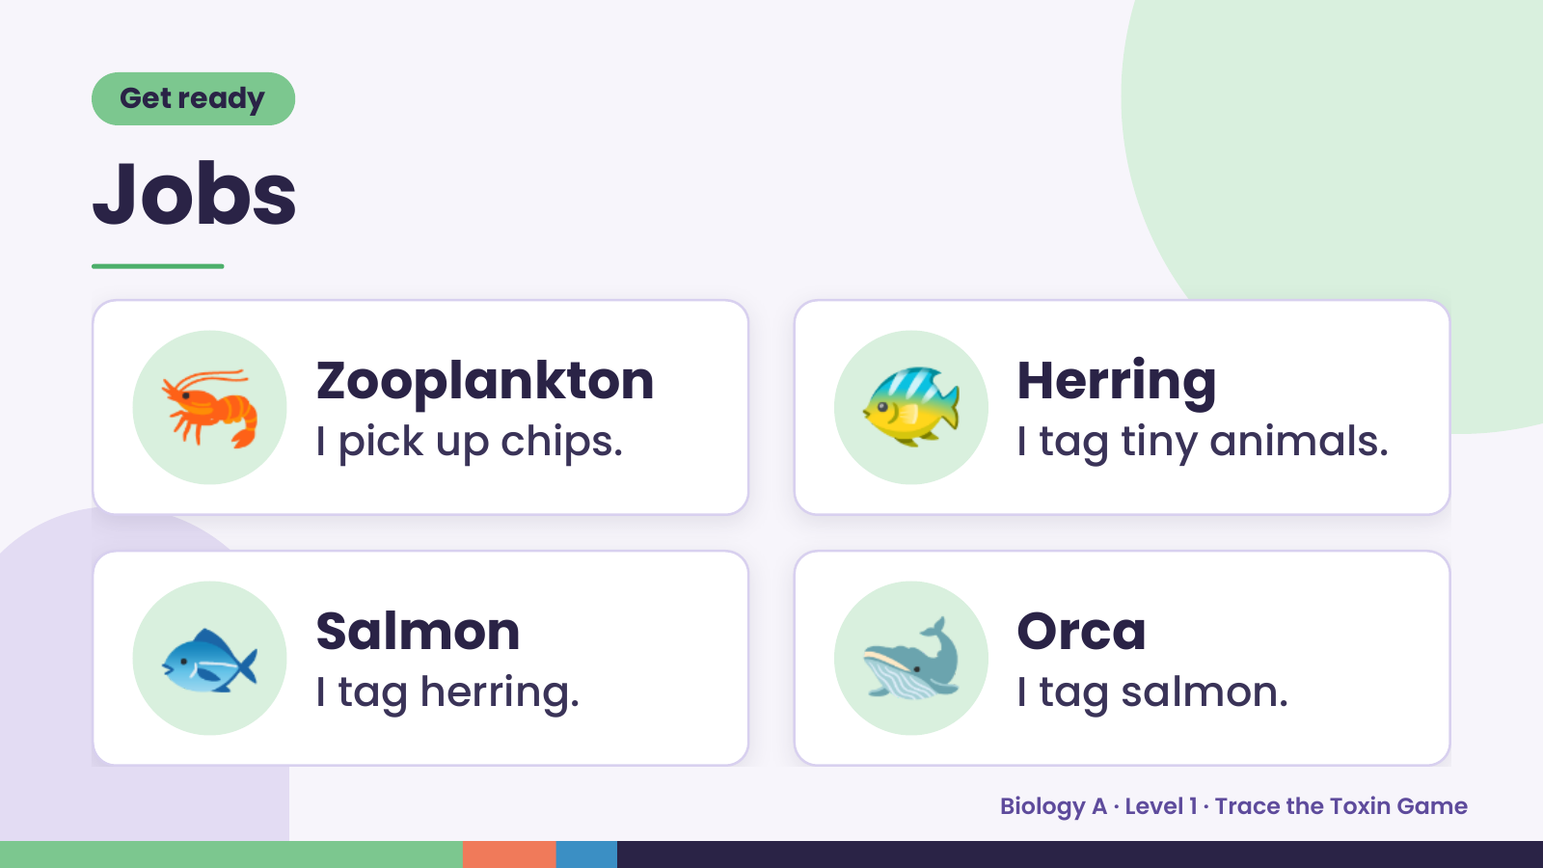
Notes:
Get ready
Jobs
🦐 Zooplankton
I pick up chips. 🐠 Herring
I tag tiny animals.
🐟 Salmon
I tag herring. 🐋 Orca
I tag salmon.
Biology A · Level 1 · Trace the Toxin Game

Slide 3
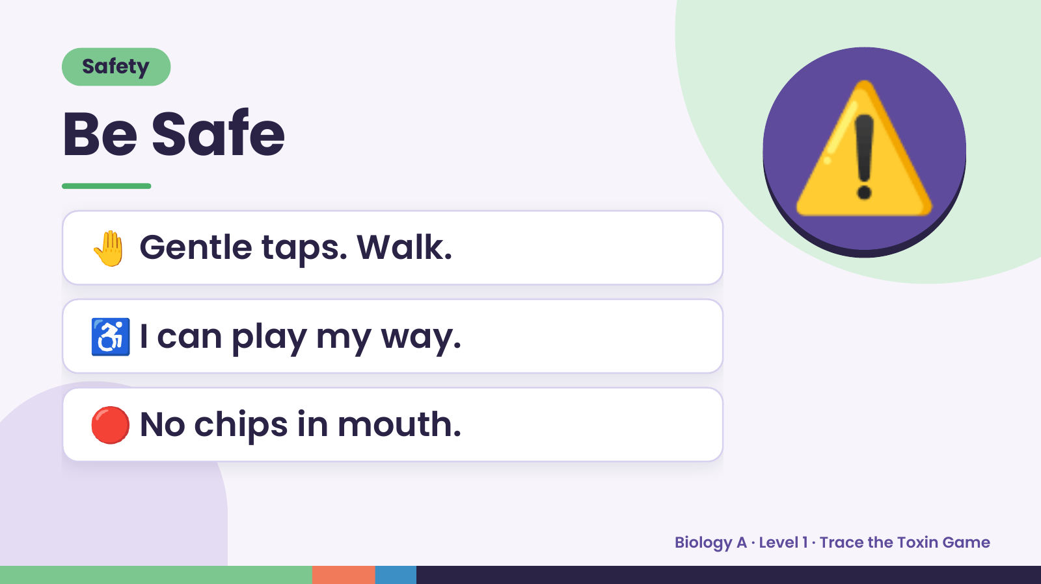
Notes:
Safety
Be Safe
🤚 Gentle taps. Walk.
⚠️
♿ I can play my way.
🔴 No chips in mouth.
Biology A · Level 1 · Trace the Toxin Game

Slide 4
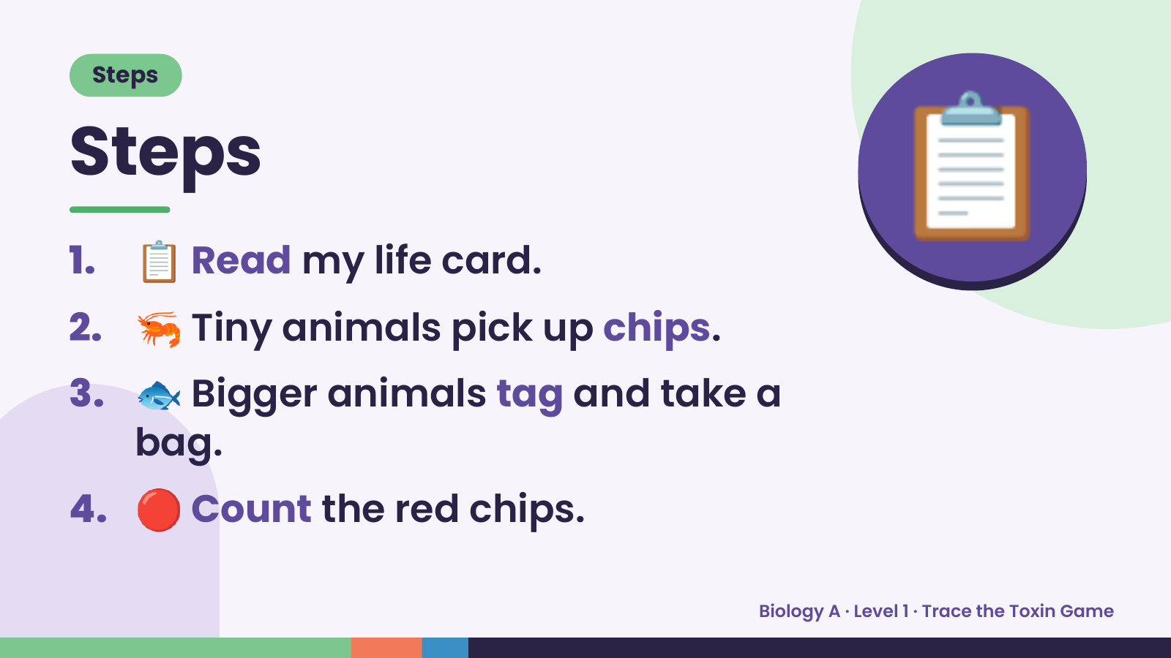
Notes:
Steps
Steps
1. 📋 Read my life card.
2. 🦐 Tiny animals pick up chips.
📋
3. 🐟 Bigger animals tag and take a
bag.
4. 🔴 Count the red chips.
Biology A · Level 1 · Trace the Toxin Game

Slide 5
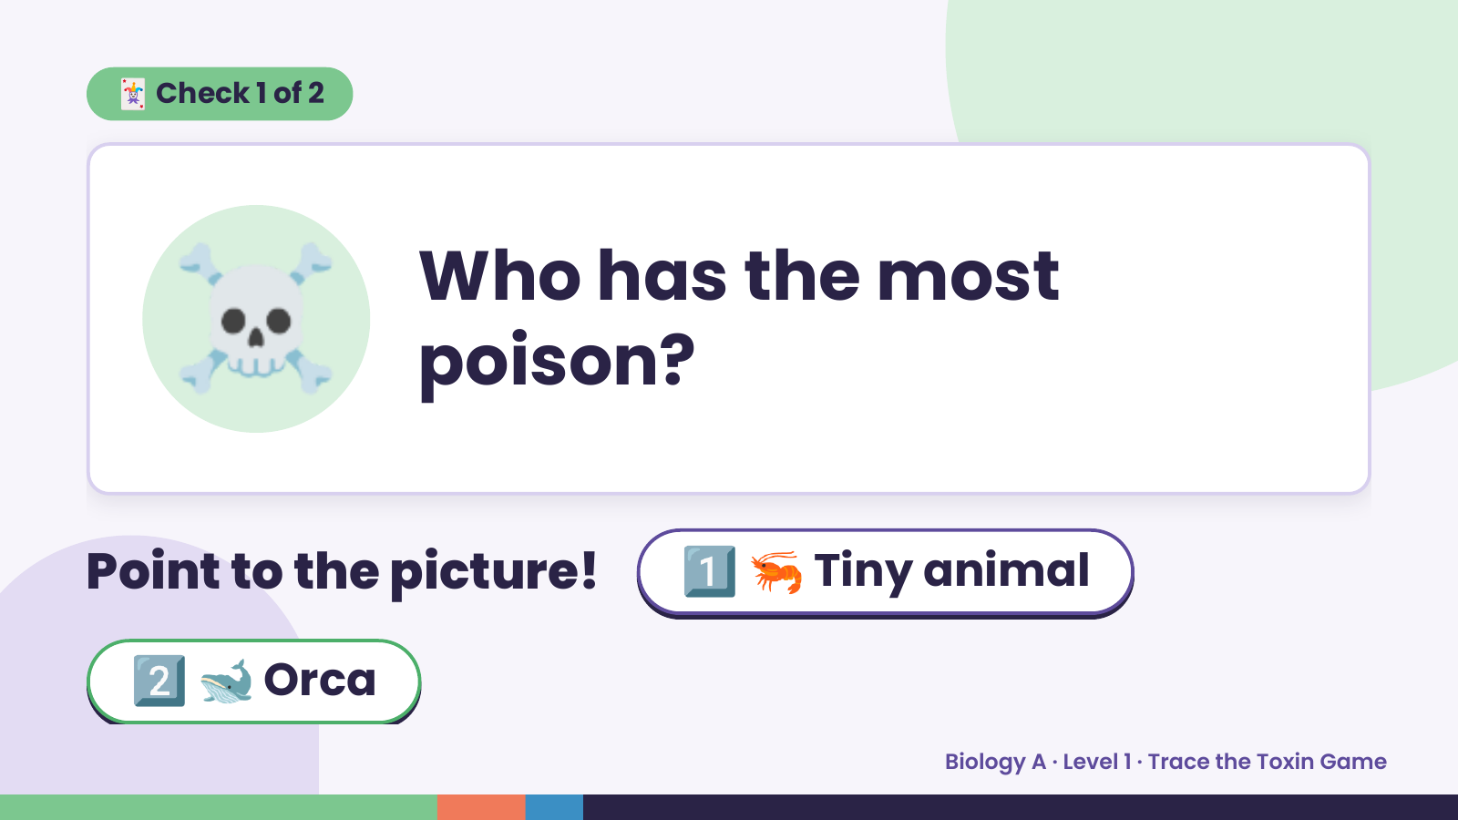
Notes:
🃏 Check 1 of 2
☠️ Who has the most
poison?
Point to the picture! 1️⃣ 🦐 Tiny animal
2️⃣ 🐋 Orca
Biology A · Level 1 · Trace the Toxin Game

Slide 6
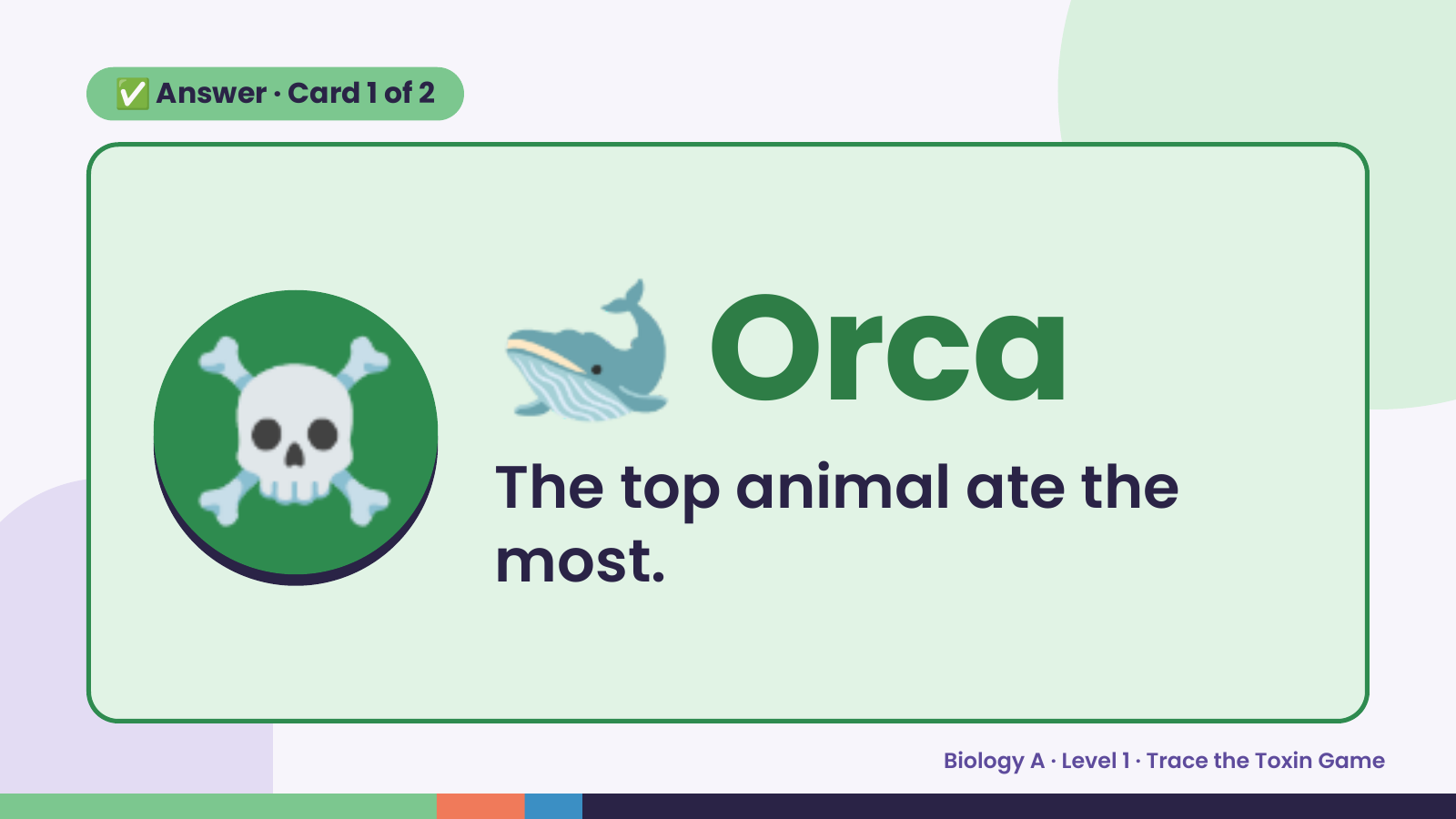
Notes:
✅ Answer · Card 1 of 2
☠️ 🐋 Orca
The top animal ate the
most.
Biology A · Level 1 · Trace the Toxin Game

Slide 7
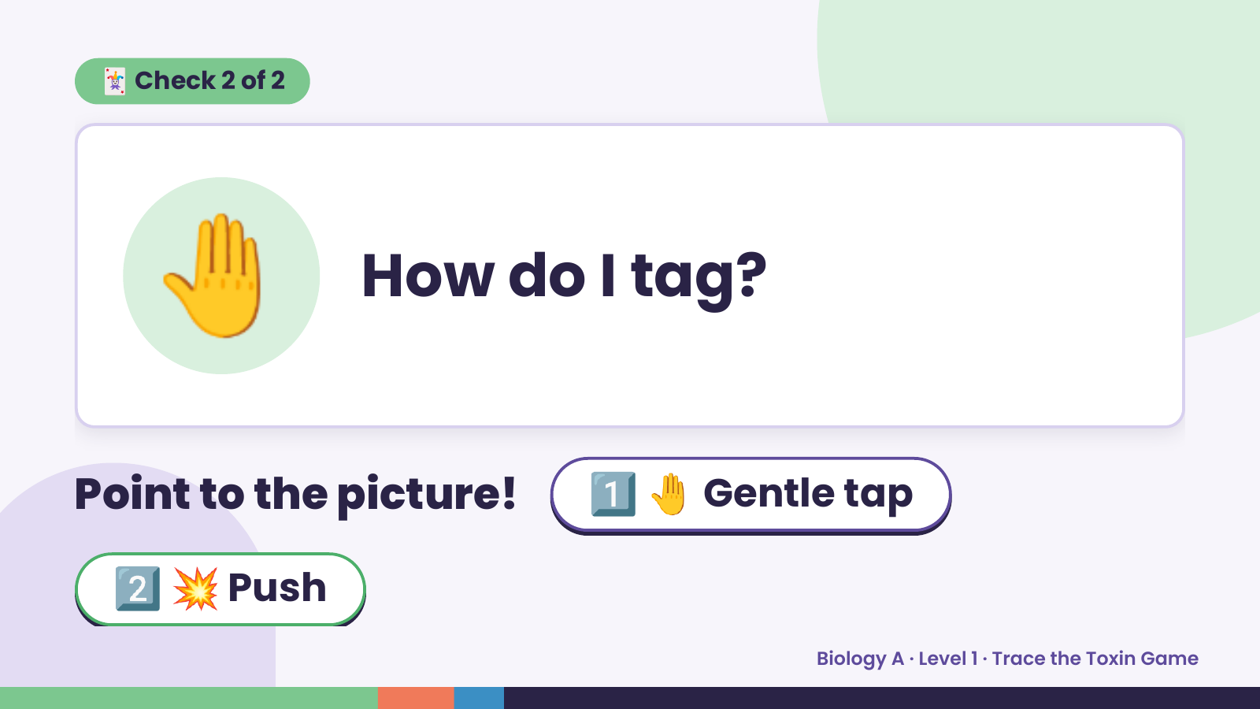
Notes:
🃏 Check 2 of 2
🤚 How do I tag?
Point to the picture! 1️⃣ 🤚 Gentle tap
2️⃣ 💥 Push
Biology A · Level 1 · Trace the Toxin Game

Slide 8
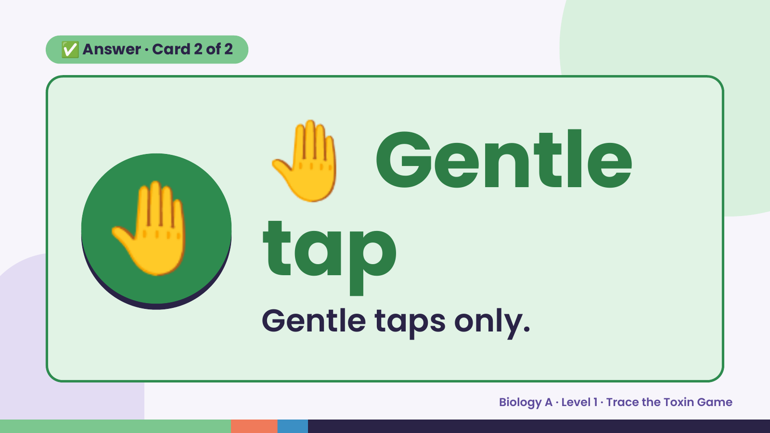
Notes:
🤚
✅ Answer · Card 2 of 2
🤚 tapGentle
Gentle taps only.
Biology A · Level 1 · Trace the Toxin Game

Slide 9
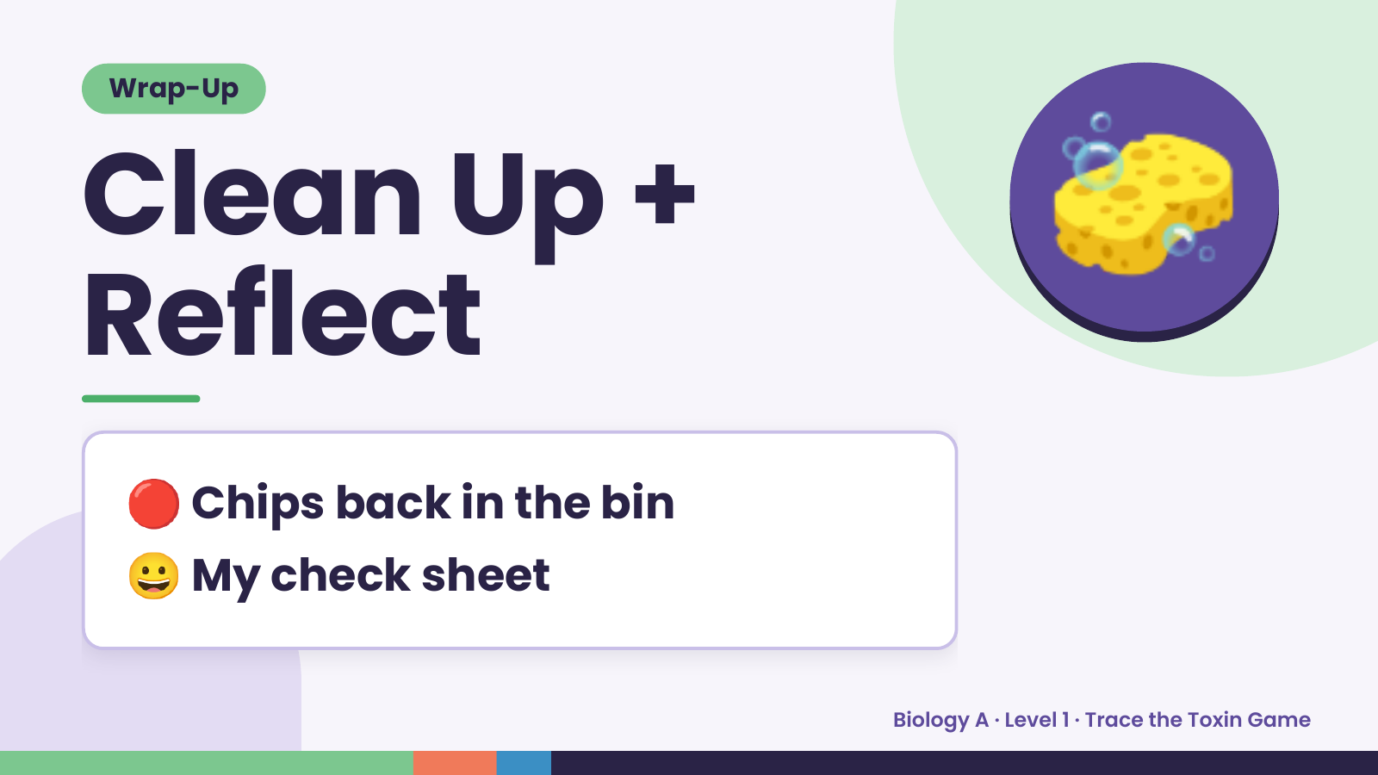
Notes:
Wrap-Up
Clean Up +
Reflect
🧽
🔴 Chips back in the bin
😀 My check sheet
Biology A · Level 1 · Trace the Toxin Game

