Slide 1
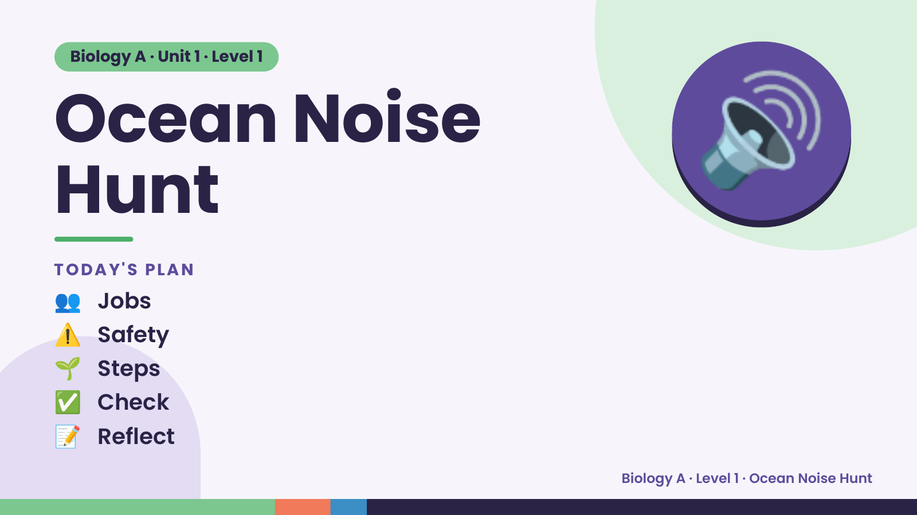
Notes:
Biology A · Unit 1 · Level 1
Ocean Noise
Hunt
TODAY'S PLAN
🔊
👥 Jobs
⚠️ Safety
🌱 Steps
✅ Check
📝 Reflect
Biology A · Level 1 · Ocean Noise Hunt

Slide 2
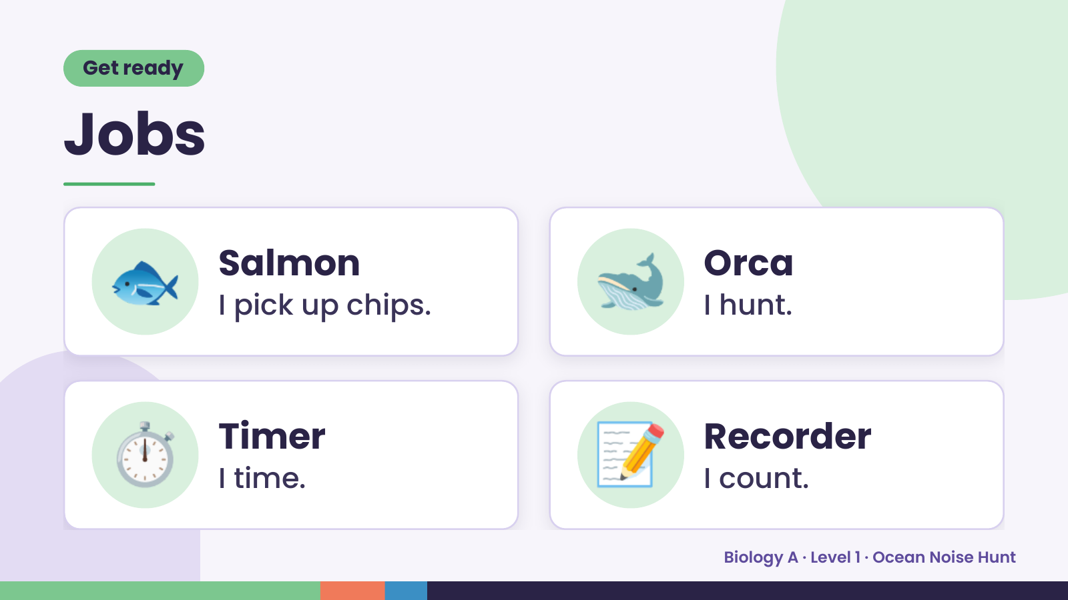
Notes:
Get ready
Jobs
🐟 Salmon
I pick up chips. 🐋 Orca
I hunt.
⏱️ Timer
I time. 📝 Recorder
I count.
Biology A · Level 1 · Ocean Noise Hunt

Slide 3
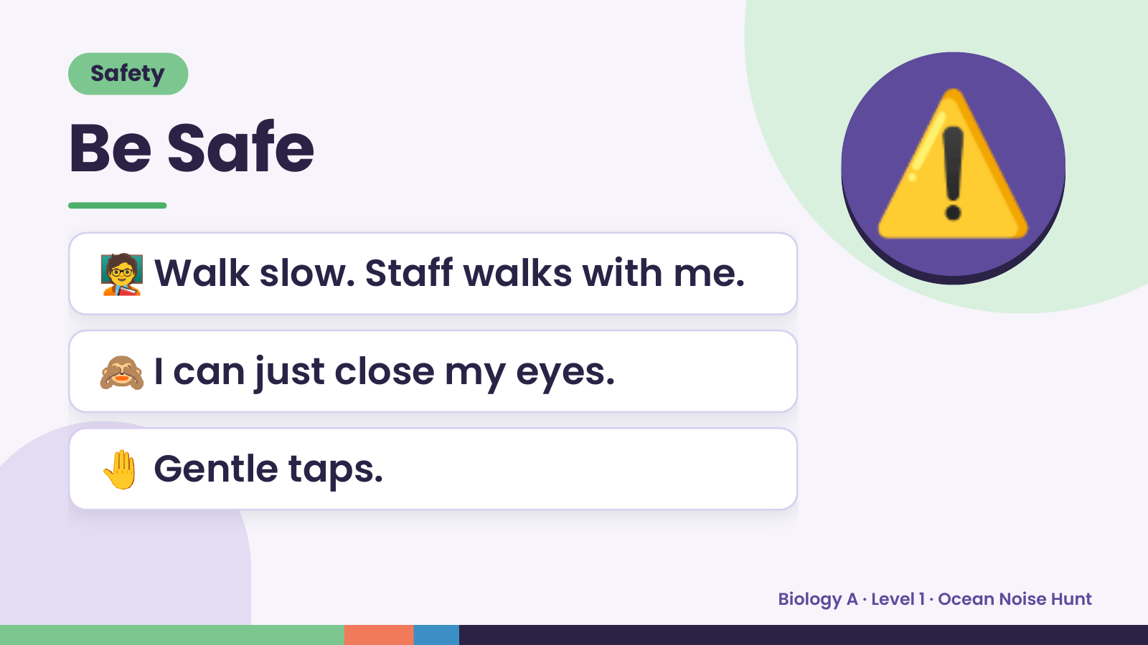
Notes:
Safety
Be Safe
🧑‍🏫 Walk slow. Staff walks with me.
⚠️
🙈 I can just close my eyes.
🤚 Gentle taps.
Biology A · Level 1 · Ocean Noise Hunt

Slide 4
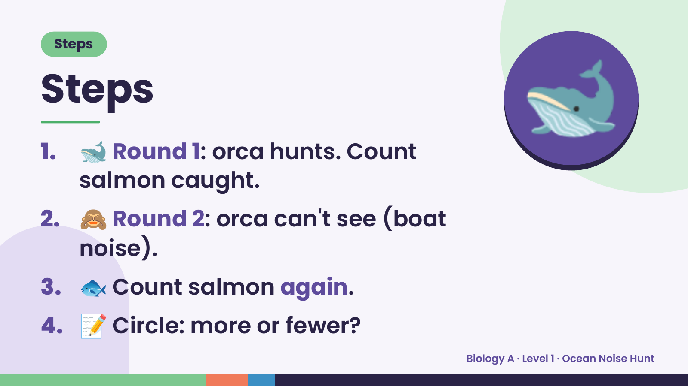
Notes:
Steps
Steps
1. 🐋 Round 1: orca hunts. Count
salmon caught.
🐋
2. 🙈 Round 2: orca can't see (boat
noise).
3. 🐟 Count salmon again.
4. 📝 Circle: more or fewer?
Biology A · Level 1 · Ocean Noise Hunt

Slide 5
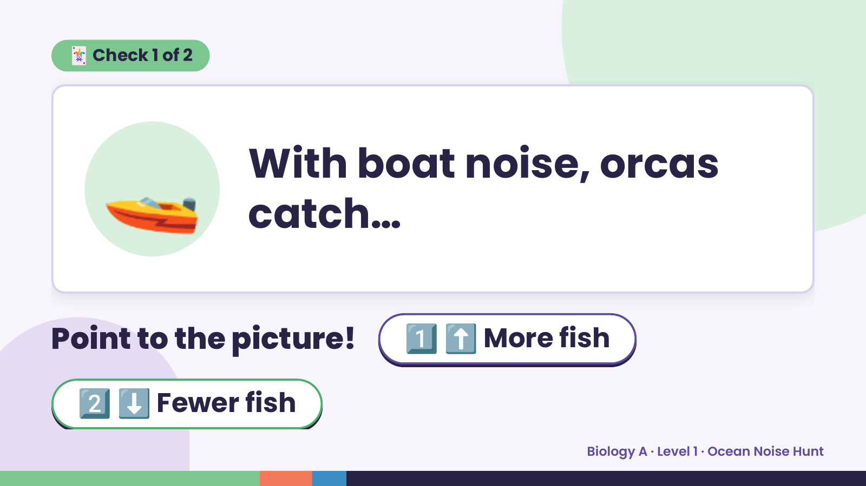
Notes:
🃏 Check 1 of 2
🚤 With boat noise, orcas
catch…
Point to the picture! 1️⃣ ⬆️ More fish
2️⃣ ⬇️ Fewer fish
Biology A · Level 1 · Ocean Noise Hunt

Slide 6
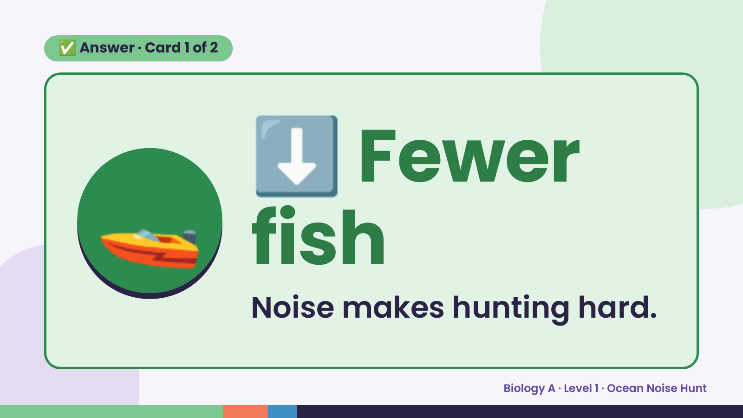
Notes:
⬇️
✅ Answer · Card 1 of 2
🚤 fish
Fewer
Noise makes hunting hard.
Biology A · Level 1 · Ocean Noise Hunt

Slide 7
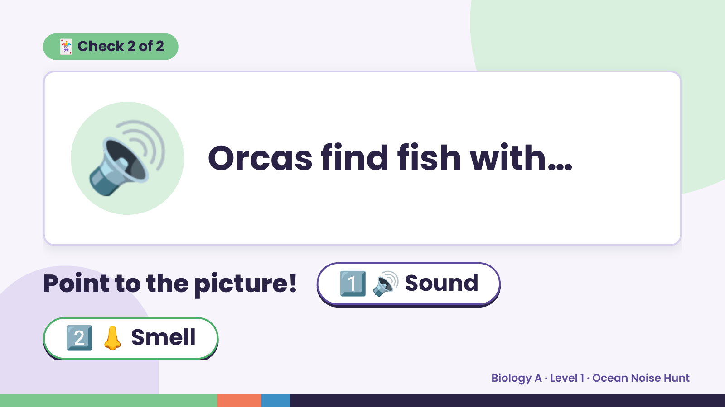
Notes:
🃏 Check 2 of 2
🔊 Orcas find fish with…
Point to the picture! 1️⃣ 🔊 Sound
2️⃣ 👃 Smell
Biology A · Level 1 · Ocean Noise Hunt

Slide 8
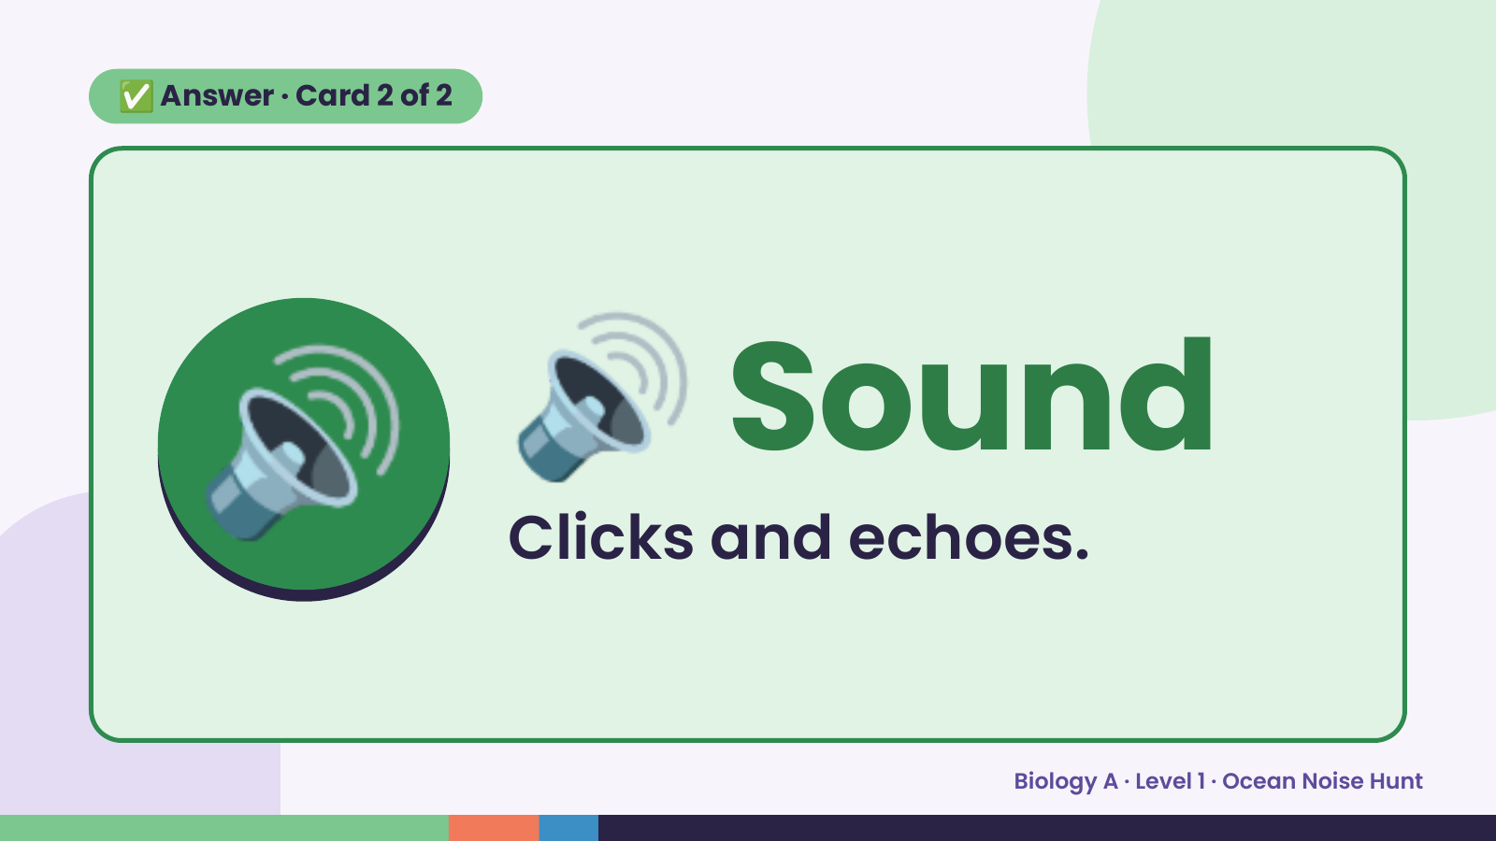
Notes:
✅ Answer · Card 2 of 2
🔊 🔊 Sound
Clicks and echoes.
Biology A · Level 1 · Ocean Noise Hunt

Slide 9
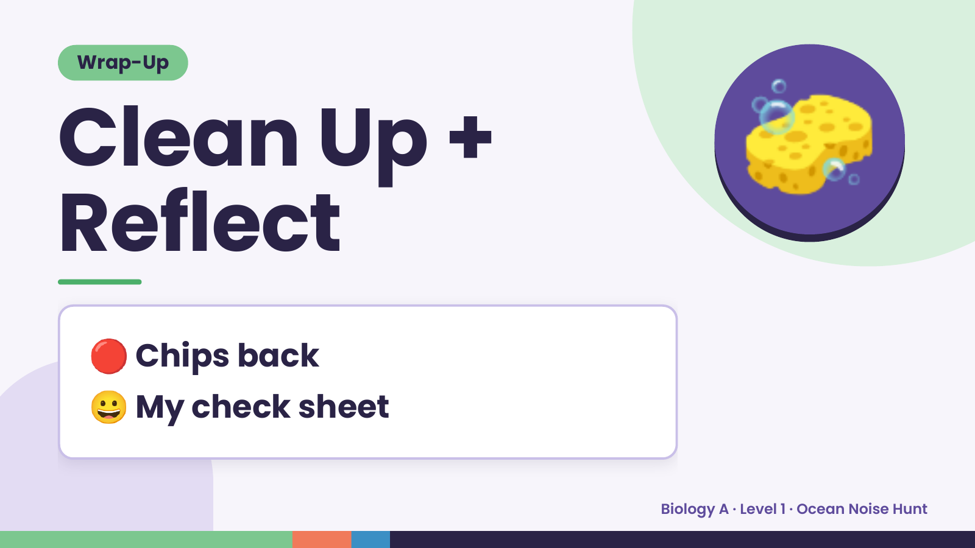
Notes:
Wrap-Up
Clean Up +
Reflect
🧽
🔴 Chips back
😀 My check sheet
Biology A · Level 1 · Ocean Noise Hunt

