Slide 1
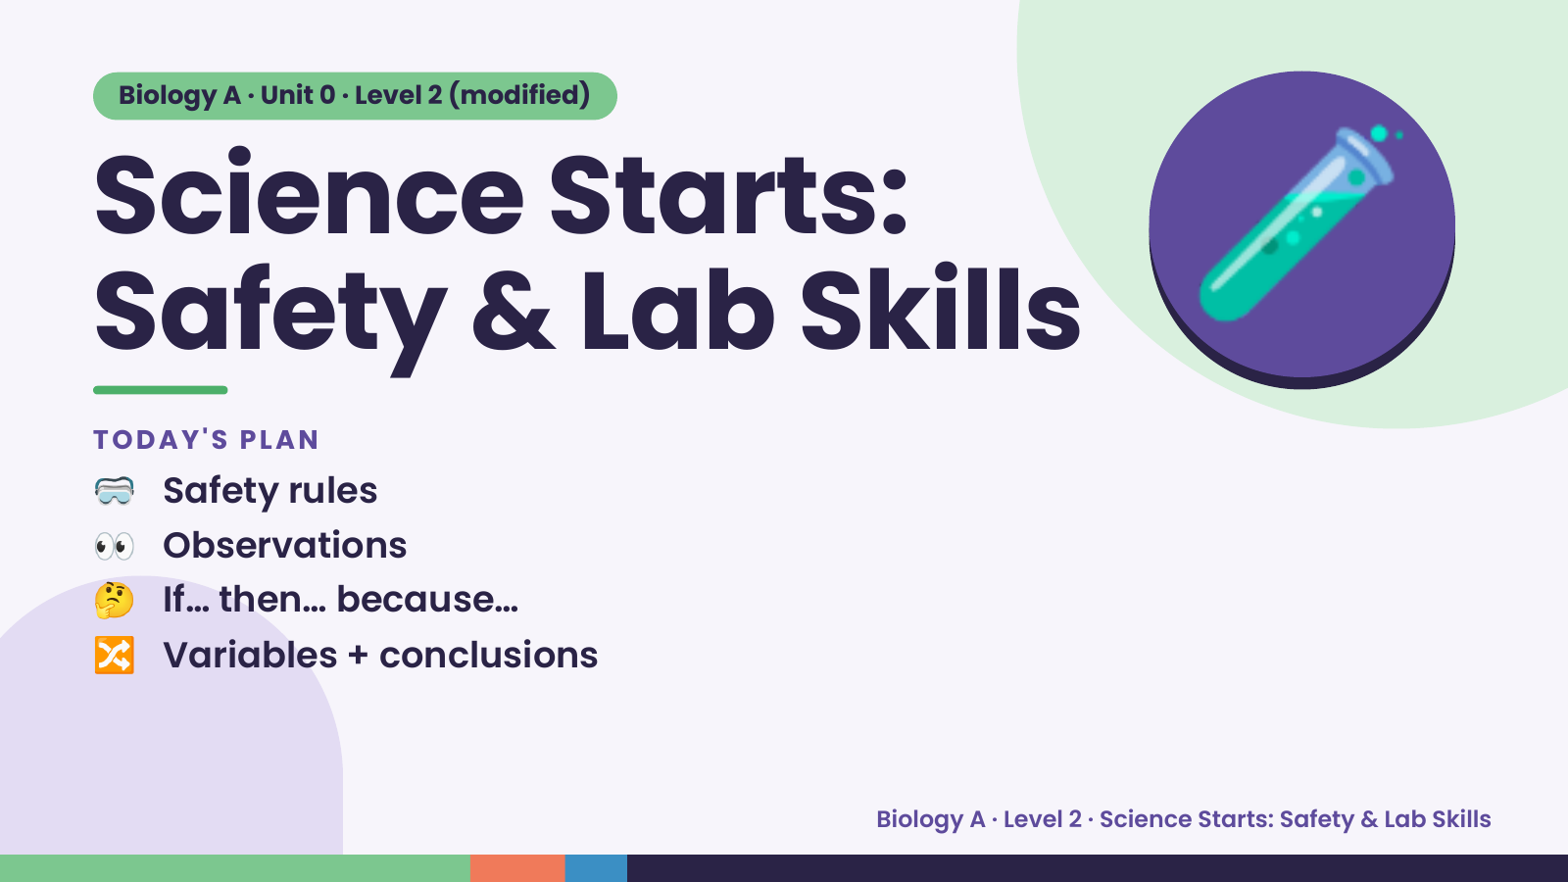
Notes:
Biology A · Unit 0 · Level 2 (modified)
Science Starts:
Safety & Lab Skills
🥽 Safety rules
TODAY'S PLAN
🧪
👀 Observations
🤔 If… then… because…
🔀 Variables + conclusions
Biology A · Level 2 · Science Starts: Safety & Lab Skills

Slide 2
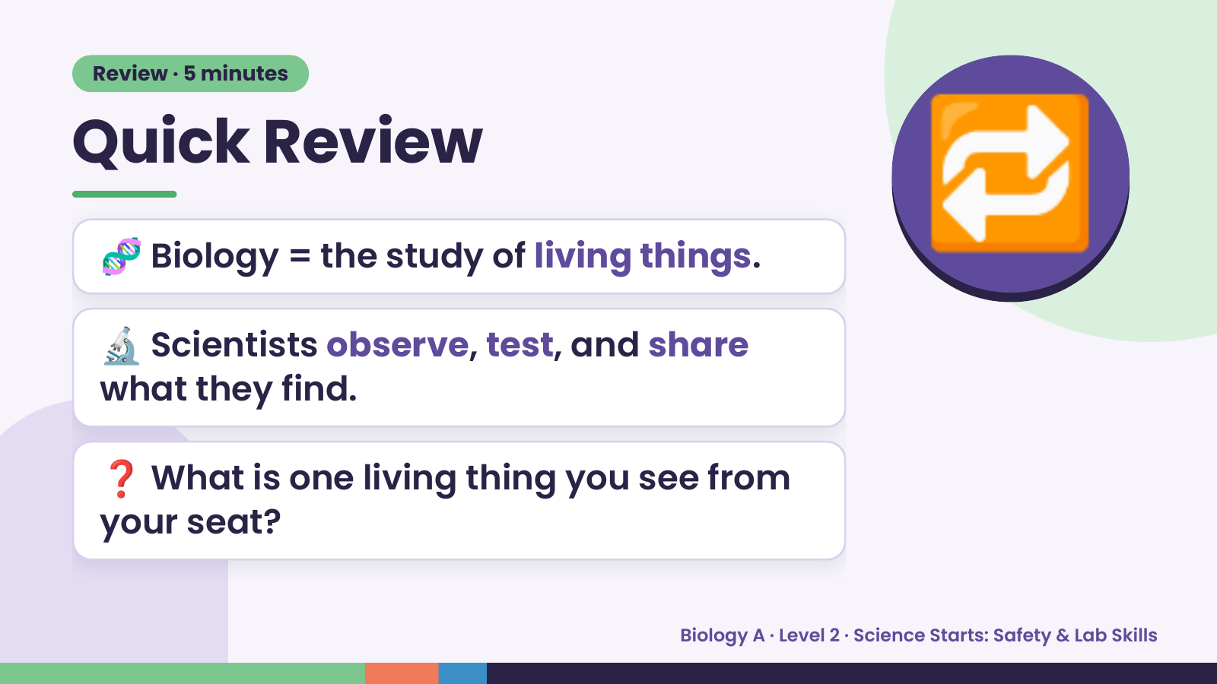
Notes:
Review · 5 minutes
Quick Review
🧬 Biology = the study of living things.
🔬 Scientists observe, test, and share
🔁
what they find.
❓ What is one living thing you see from
your seat?
Biology A · Level 2 · Science Starts: Safety & Lab Skills

Slide 3
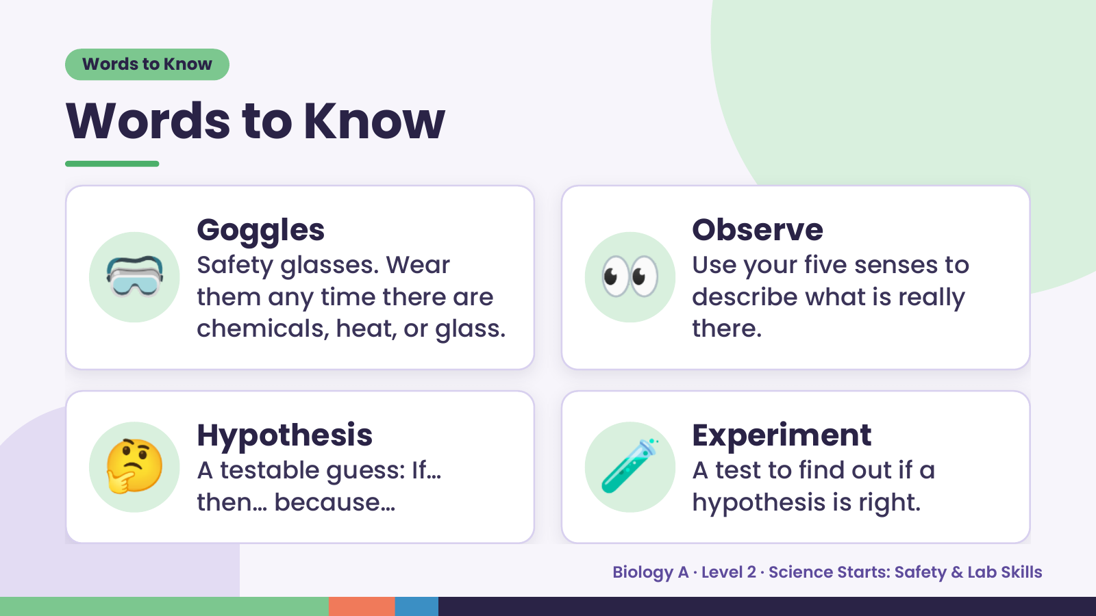
Notes:
Words to Know
Words to Know
🥽 Goggles
Safety glasses. Wear
them any time there are
chemicals, heat, or glass.
👀 Observe
Use your five senses to
describe what is really
there.
🤔 Hypothesis
A testable guess: If…
then… because…
🧪 Experiment
A test to find out if a
hypothesis is right.
Biology A · Level 2 · Science Starts: Safety & Lab Skills

Slide 4
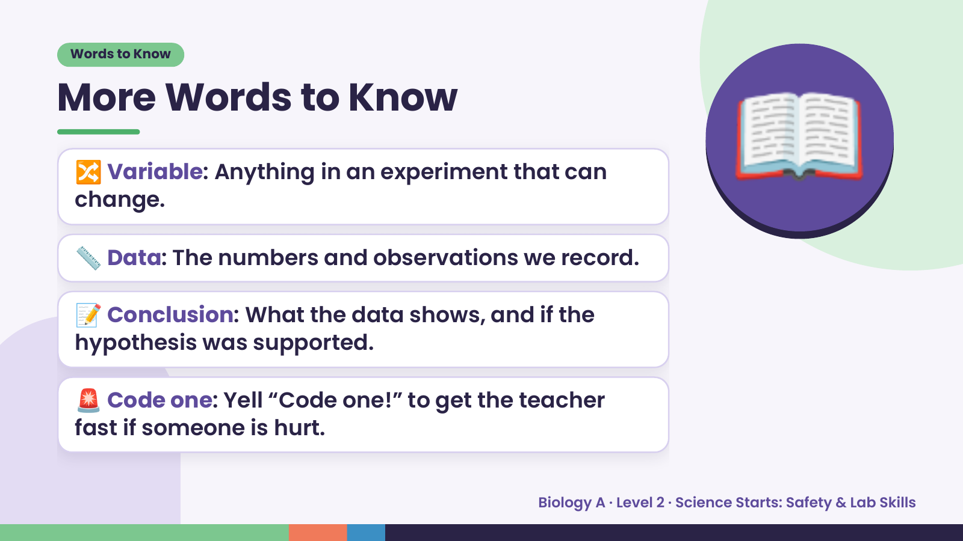
Notes:
Words to Know
More Words to Know
🔀 Variable: Anything in an experiment that can
change.
📏 Data: The numbers and observations we record.
📖
📝 Conclusion: What the data shows, and if the
hypothesis was supported.
🚨 Code one: Yell “Code one!” to get the teacher
fast if someone is hurt.
Biology A · Level 2 · Science Starts: Safety & Lab Skills

Slide 5
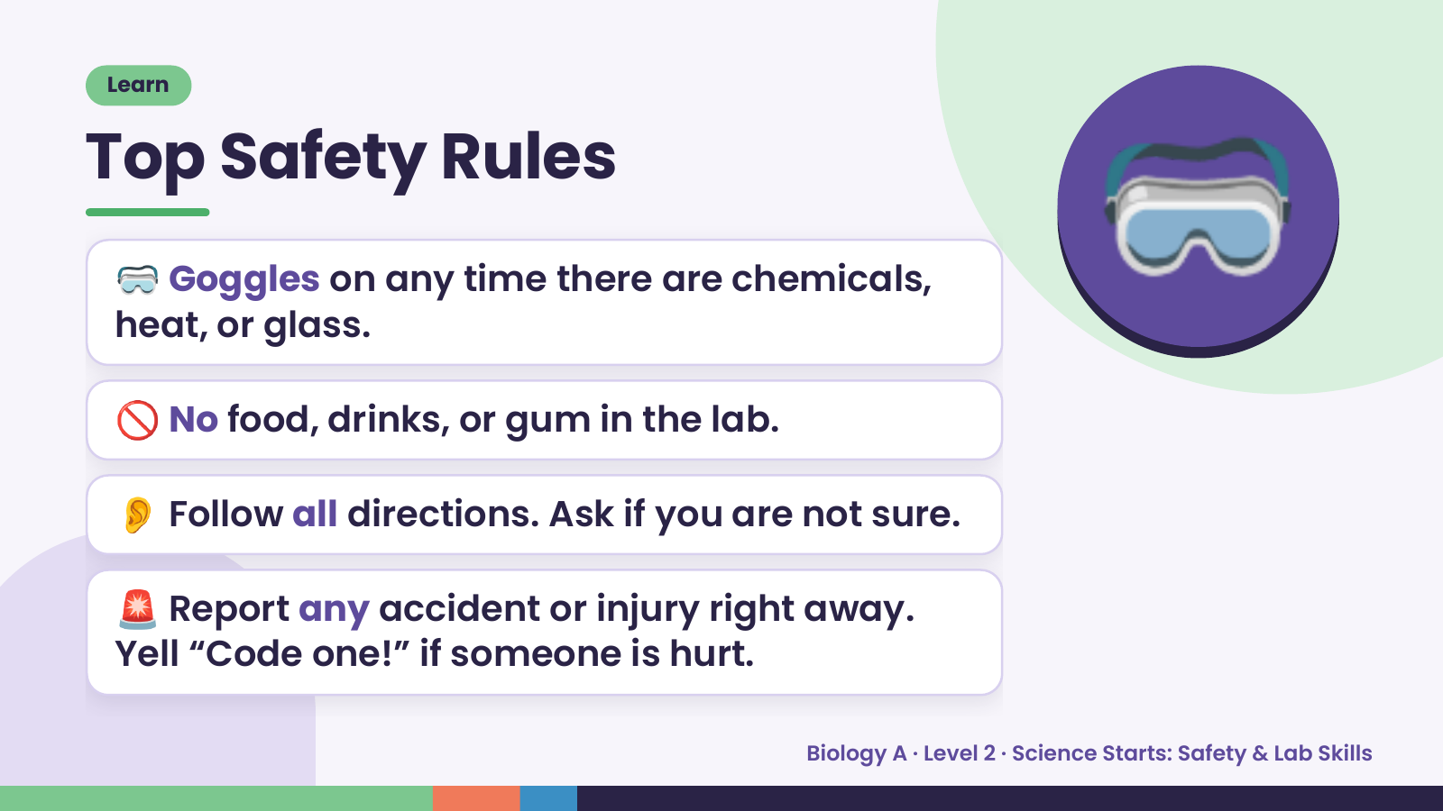
Notes:
Learn
Top Safety Rules
🥽 Goggles on any time there are chemicals,
heat, or glass.
🚫 No food, drinks, or gum in the lab.
🥽
👂 Follow all directions. Ask if you are not sure.
🚨 Report any accident or injury right away.
Yell “Code one!” if someone is hurt.
Biology A · Level 2 · Science Starts: Safety & Lab Skills

Slide 6
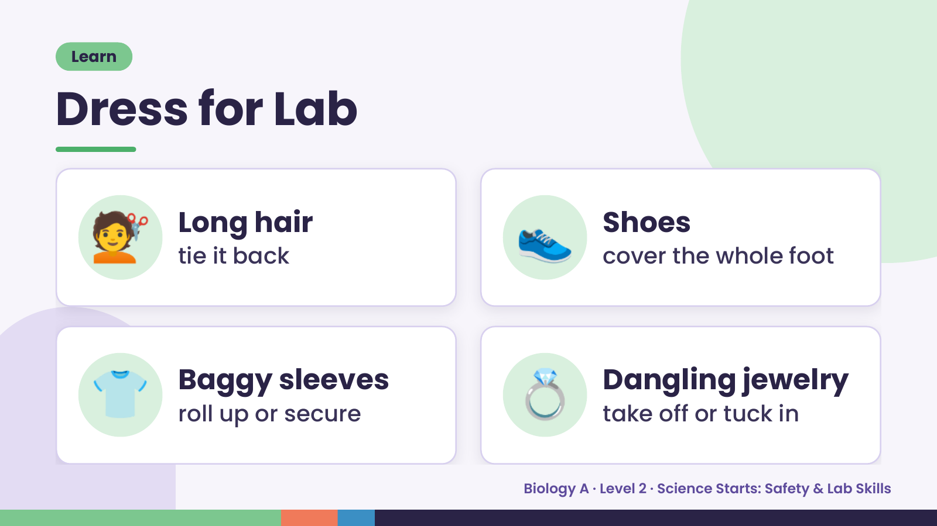
Notes:
Learn
Dress for Lab
💇 Long hair
tie it back 👟 Shoes
cover the whole foot
👕 Baggy sleeves
roll up or secure 💍 Dangling jewelry
take off or tuck in
Biology A · Level 2 · Science Starts: Safety & Lab Skills

Slide 7
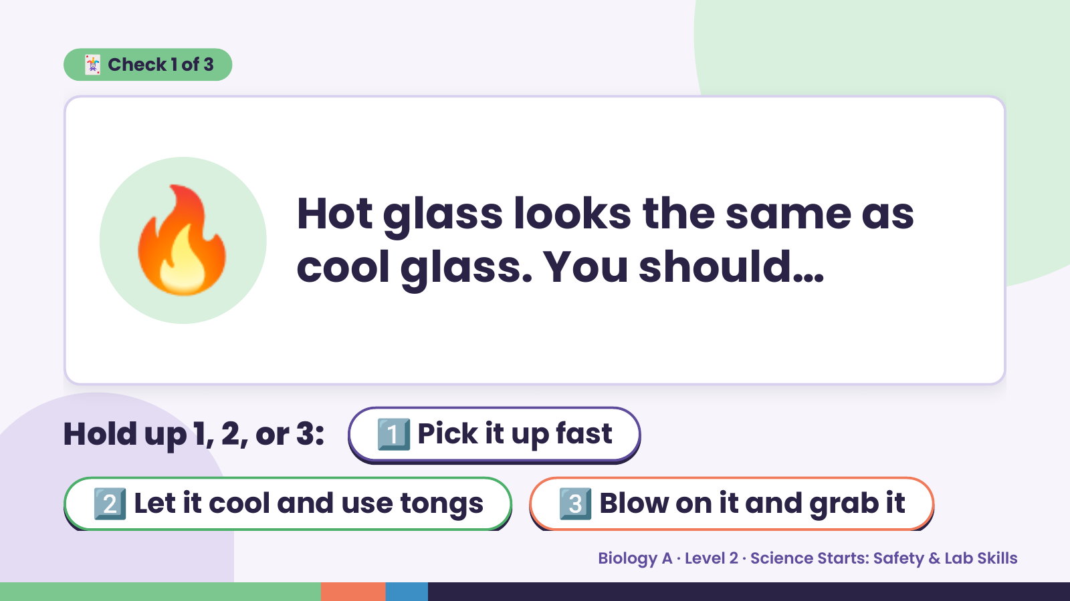
Notes:
🃏 Check 1 of 3
🔥 Hot glass looks the same as
cool glass. You should…
Hold up 1, 2, or 3: 1️⃣ Pick it up fast
2️⃣ Let it cool and use tongs 3️⃣ Blow on it and grab it
Biology A · Level 2 · Science Starts: Safety & Lab Skills

Slide 8
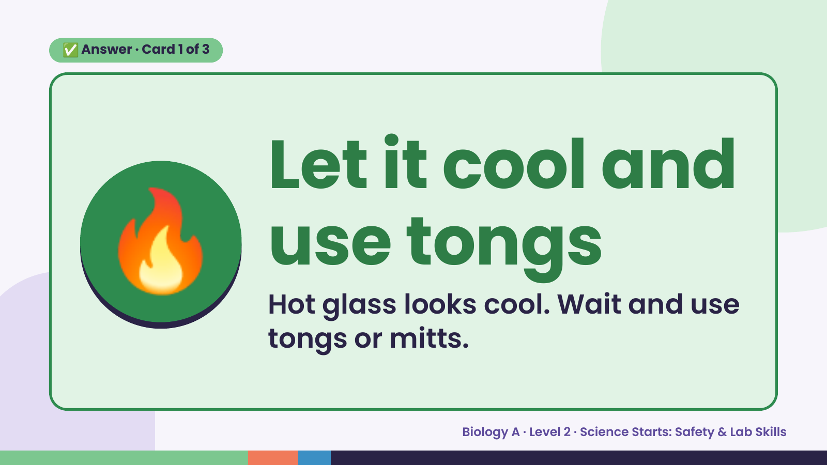
Notes:
✅ Answer · Card 1 of 3
🔥 Let it cool and
use tongs
Hot glass looks cool. Wait and use
tongs or mitts.
Biology A · Level 2 · Science Starts: Safety & Lab Skills

Slide 9
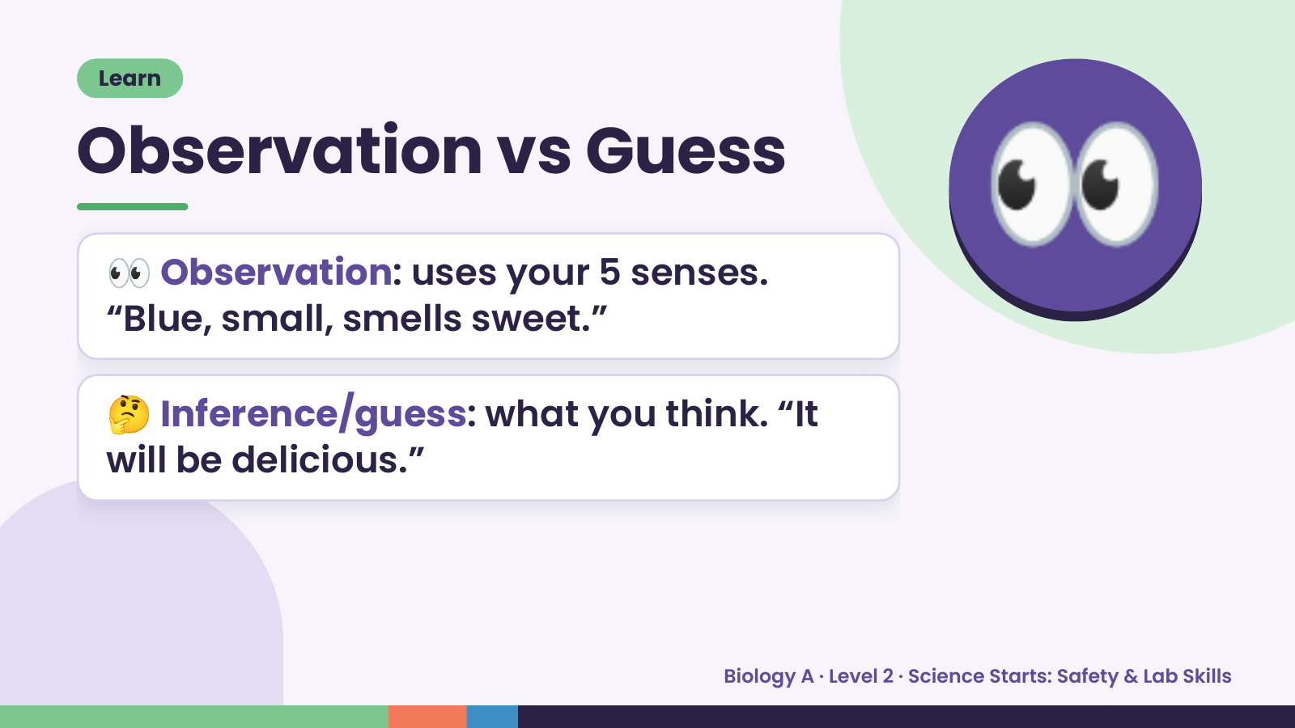
Notes:
Learn
Observation vs Guess
👀 Observation: uses your 5 senses.
“Blue, small, smells sweet.”
👀
🤔 Inference/guess: what you think. “It
will be delicious.”
Biology A · Level 2 · Science Starts: Safety & Lab Skills

Slide 10
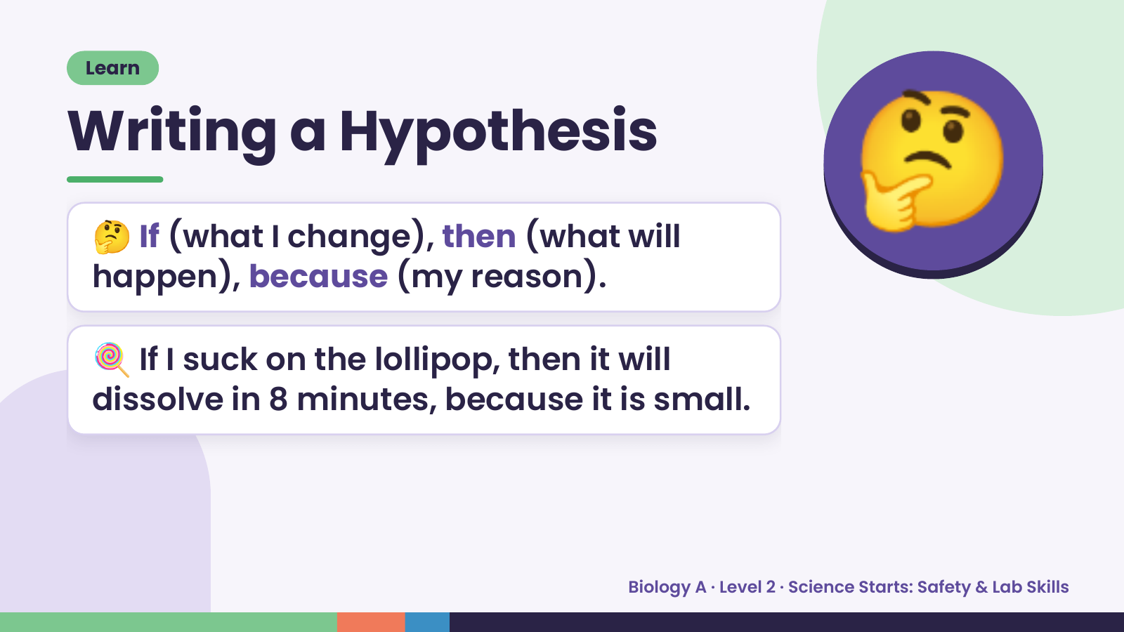
Notes:
Learn
Writing a Hypothesis
🤔 If (what I change), then (what will
happen), because (my reason).
🤔
🍭 If I suck on the lollipop, then it will
dissolve in 8 minutes, because it is small.
Biology A · Level 2 · Science Starts: Safety & Lab Skills

Slide 11
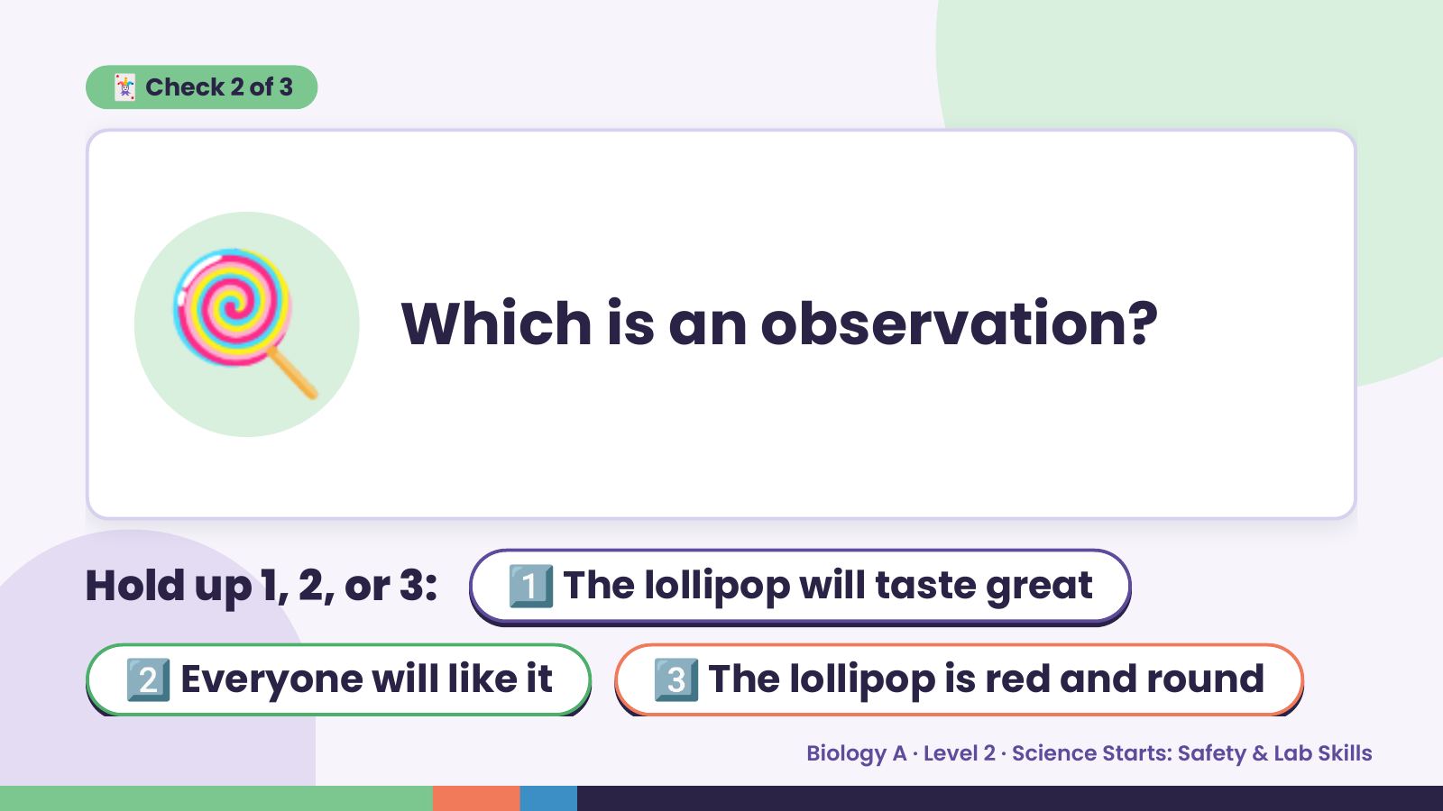
Notes:
🃏 Check 2 of 3
🍭 Which is an observation?
Hold up 1, 2, or 3: 1️⃣ The lollipop will taste great
2️⃣ Everyone will like it 3️⃣ The lollipop is red and round
Biology A · Level 2 · Science Starts: Safety & Lab Skills

Slide 12
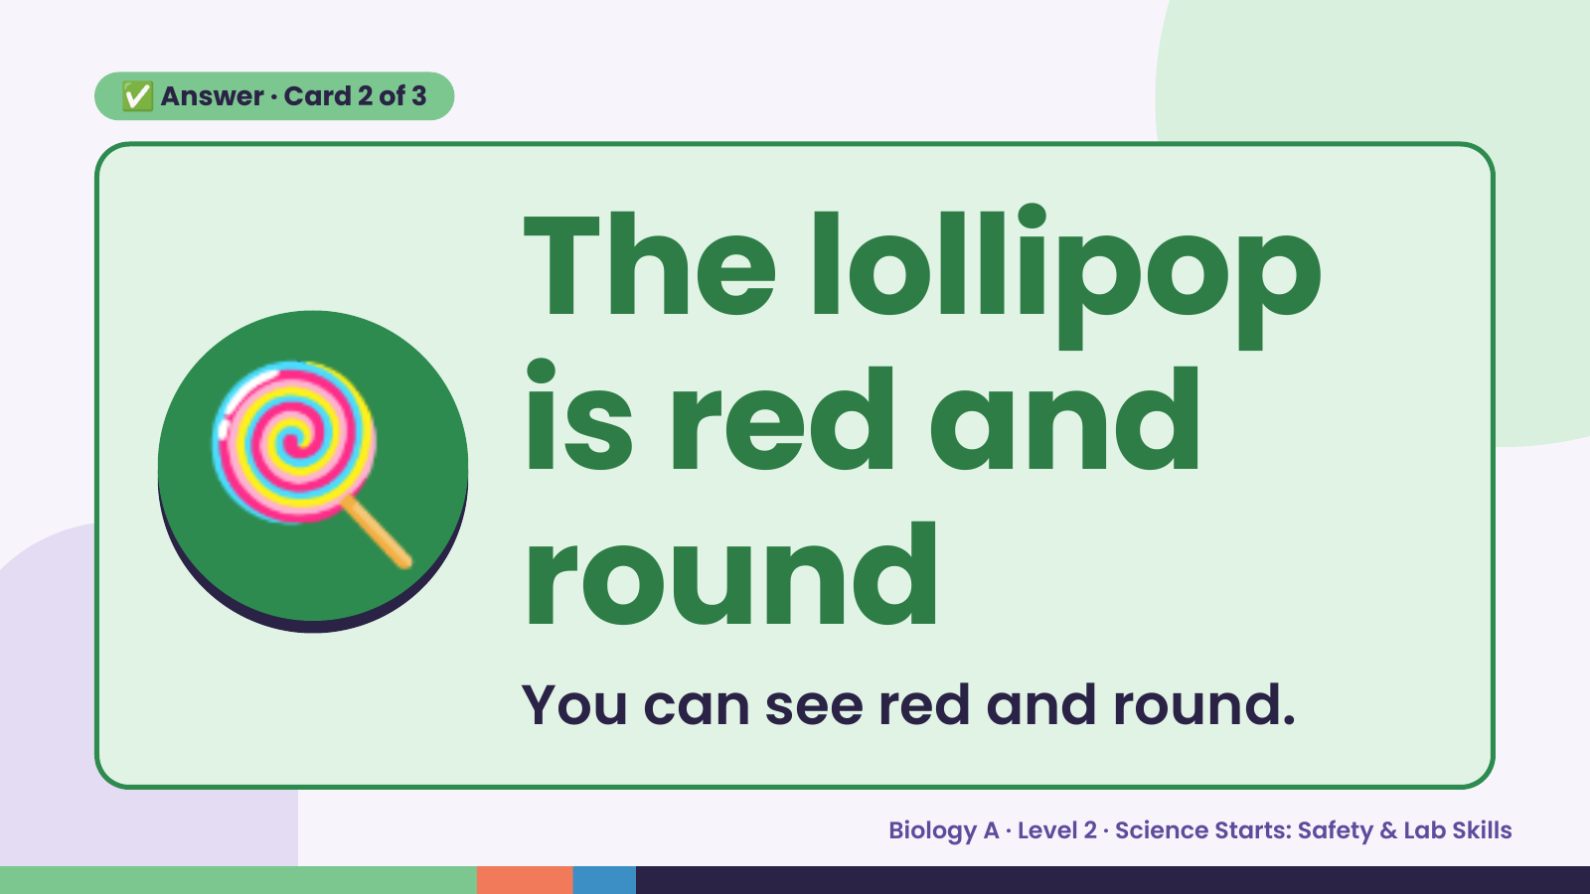
Notes:
✅ Answer · Card 2 of 3
🍭 The lollipop
is red and
round
You can see red and round.
Biology A · Level 2 · Science Starts: Safety & Lab Skills

Slide 13
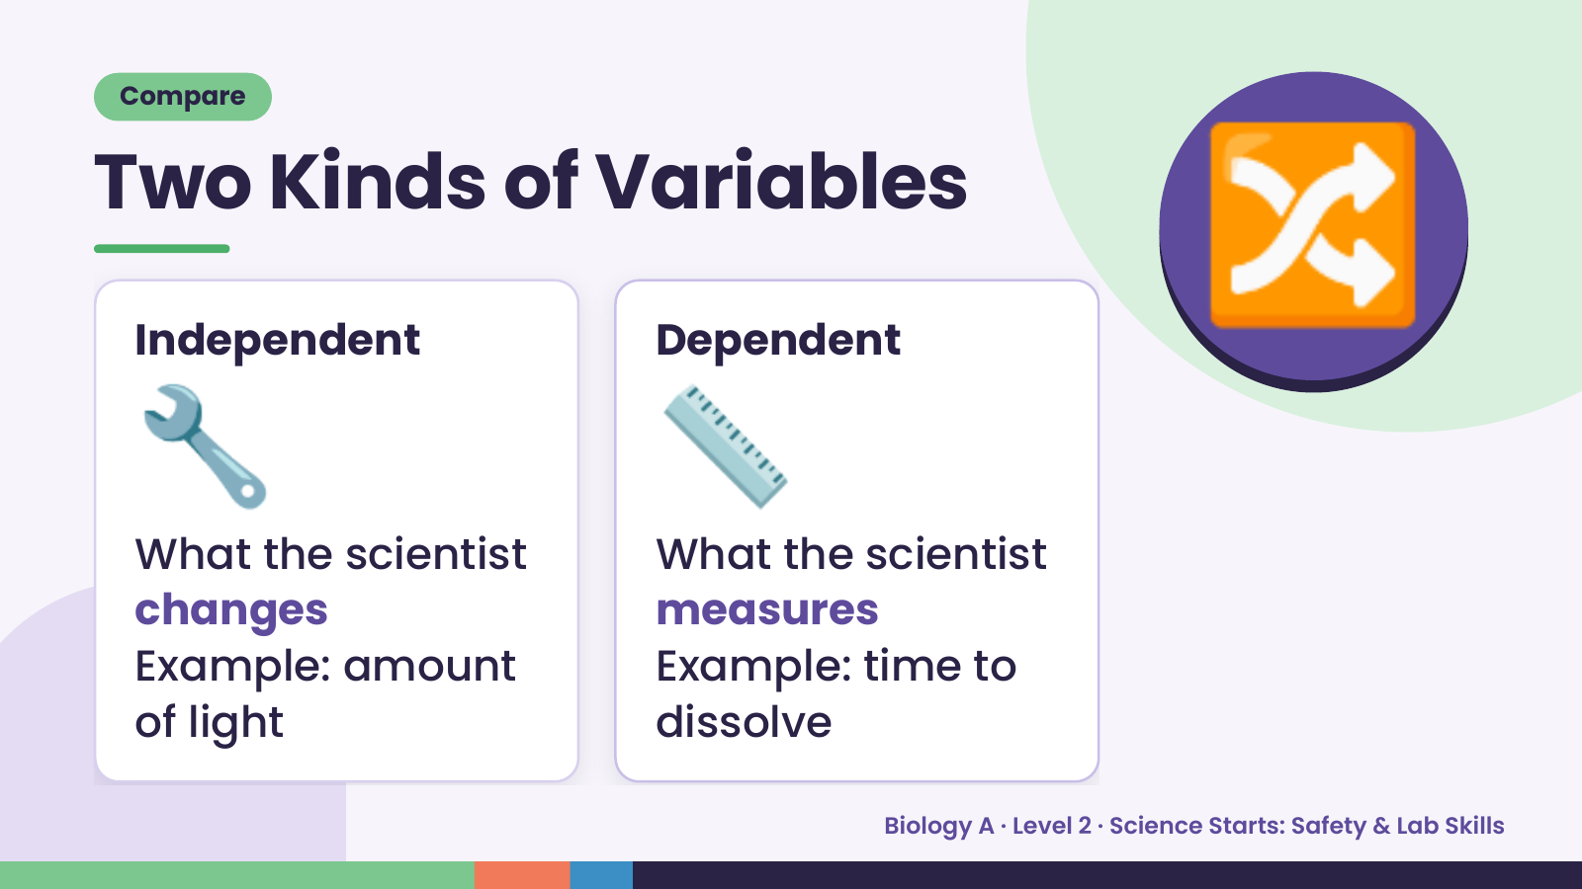
Notes:
Compare
Two Kinds of Variables
🔧
Independent
📏
Dependent
🔀
What the scientist What the scientist
changes measures
Example: amount Example: time to
of light dissolve
Biology A · Level 2 · Science Starts: Safety & Lab Skills

Slide 14
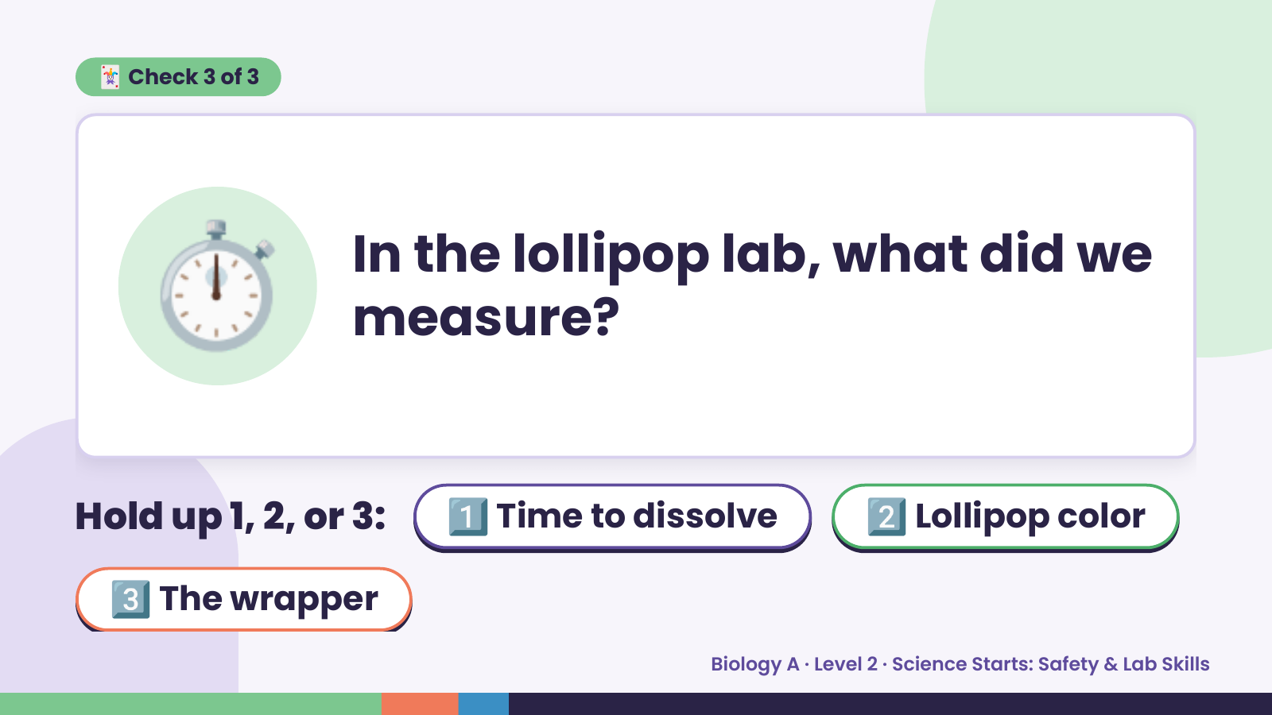
Notes:
🃏 Check 3 of 3
⏱️ In the lollipop lab, what did we
measure?
Hold up 1, 2, or 3: 1️⃣ Time to dissolve 2️⃣ Lollipop color
3️⃣ The wrapper
Biology A · Level 2 · Science Starts: Safety & Lab Skills

Slide 15
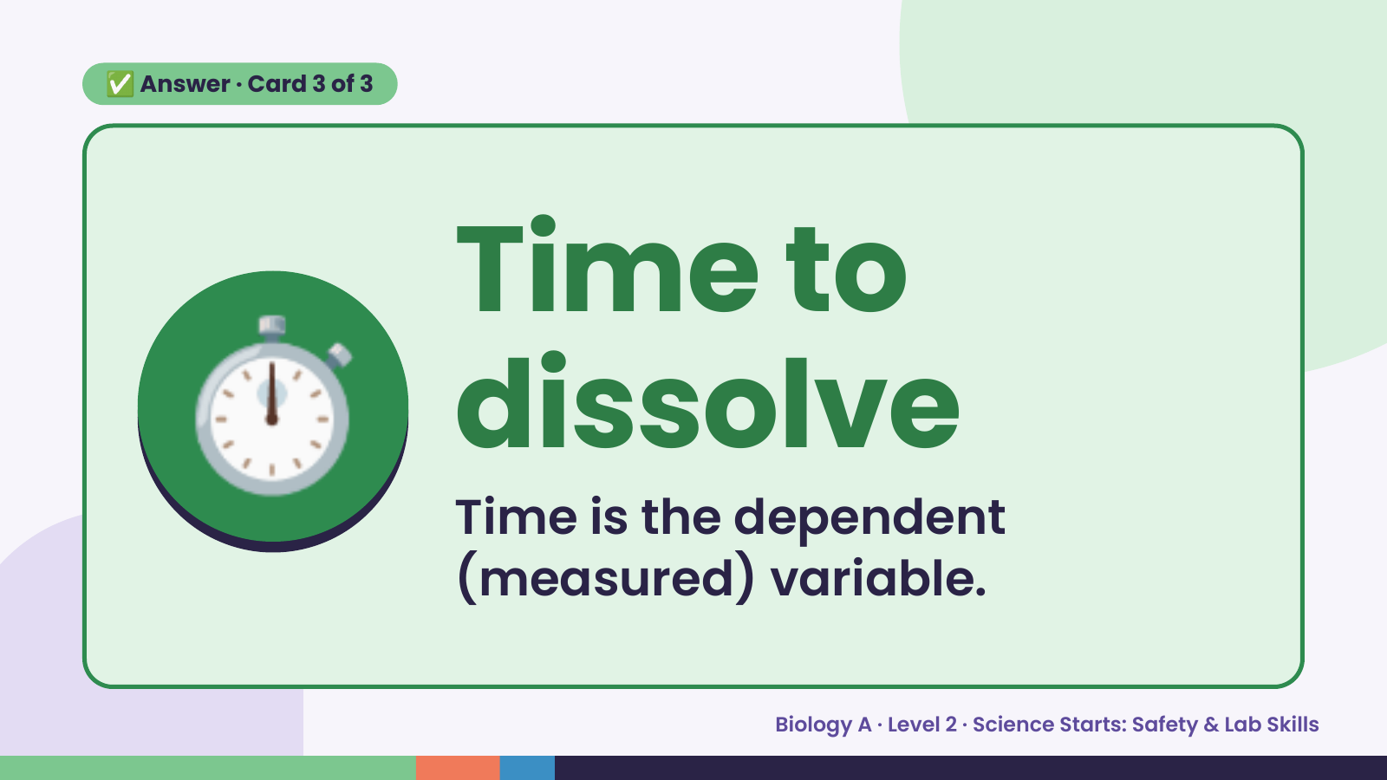
Notes:
✅ Answer · Card 3 of 3
⏱️ Time to
dissolve
Time is the dependent
(measured) variable.
Biology A · Level 2 · Science Starts: Safety & Lab Skills

Slide 16
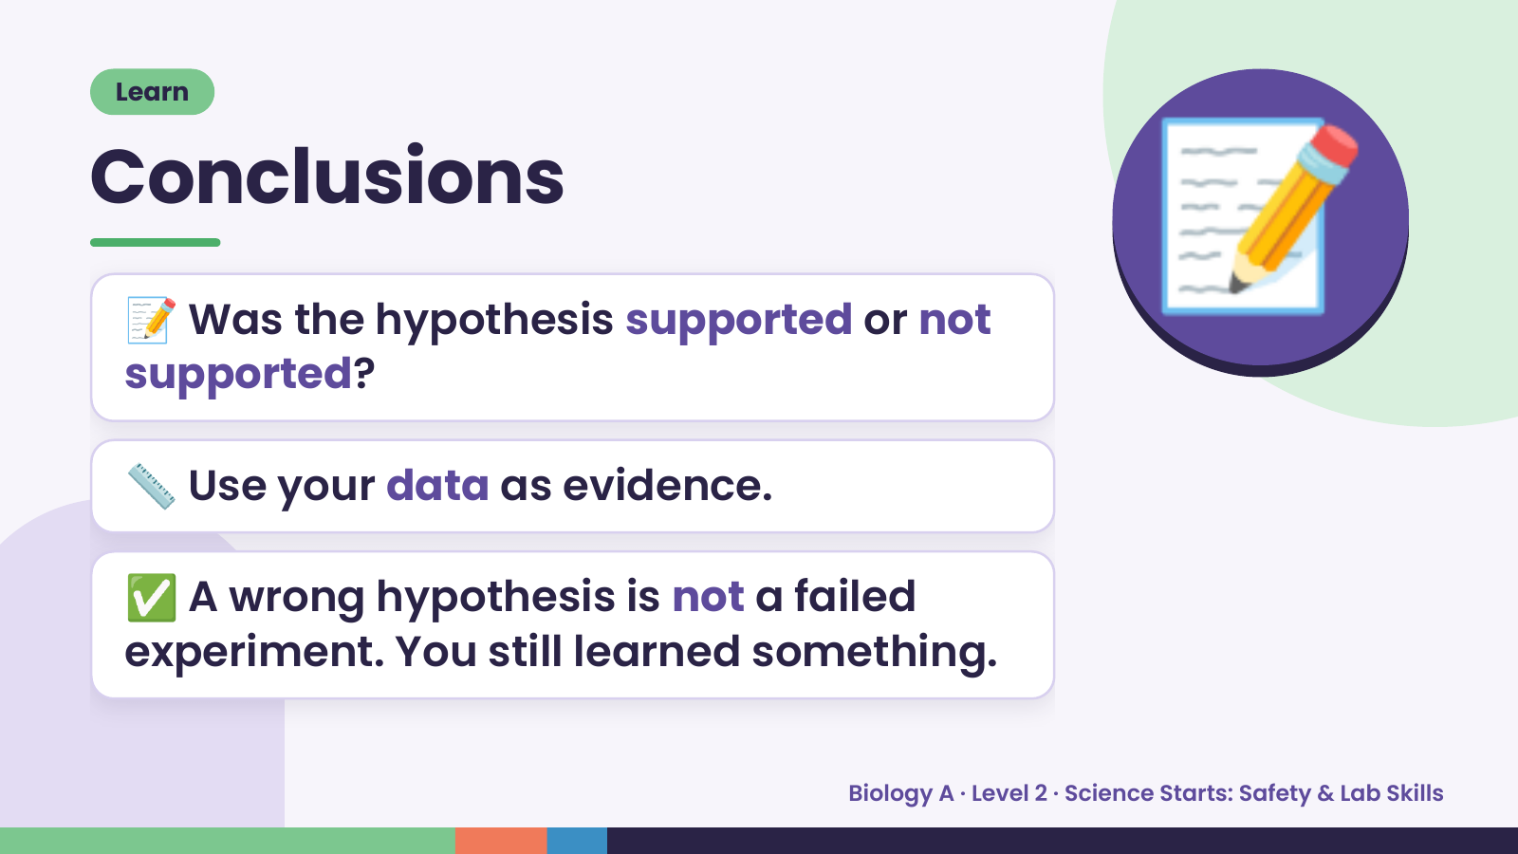
Notes:
Learn
Conclusions
📝 Was the hypothesis supported or not
supported?
📝
📏 Use your data as evidence.
✅ A wrong hypothesis is not a failed
experiment. You still learned something.
Biology A · Level 2 · Science Starts: Safety & Lab Skills

Slide 17
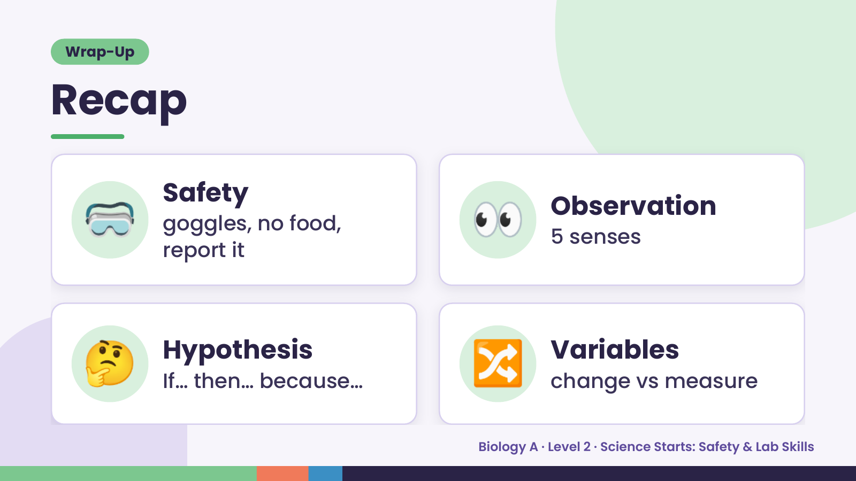
Notes:
Wrap-Up
Recap
🥽 Safety
goggles, no food,
report it
👀 Observation
5 senses
🤔 Hypothesis
If… then… because… 🔀 Variables
change vs measure
Biology A · Level 2 · Science Starts: Safety & Lab Skills

Slide 18
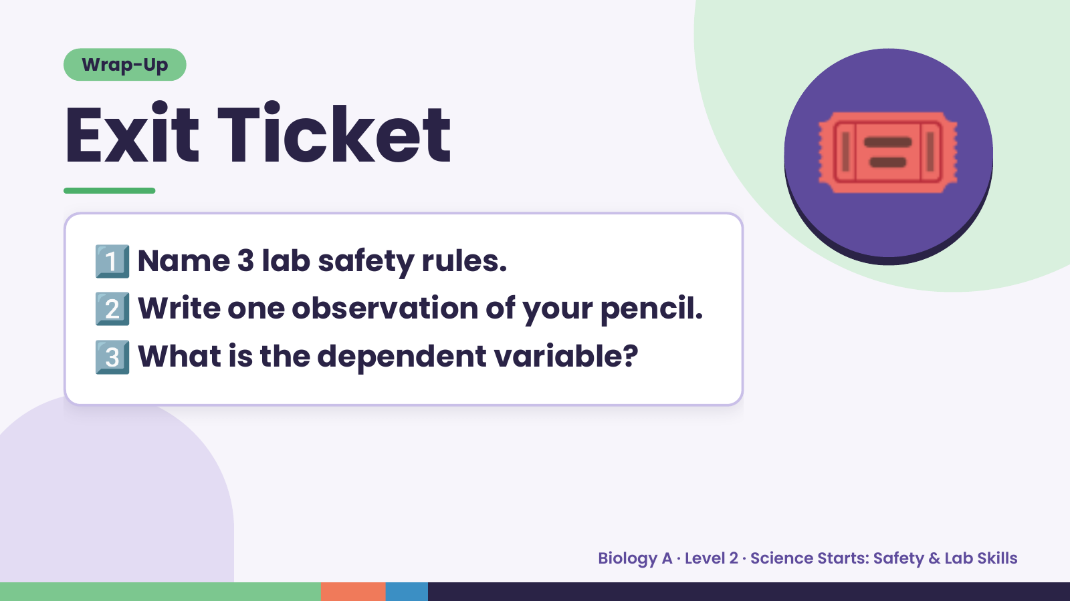
Notes:
Wrap-Up
Exit Ticket
1️⃣
2️⃣
Name 3 lab safety rules.
Write one observation of your pencil.
🎟️
3️⃣What is the dependent variable?
Biology A · Level 2 · Science Starts: Safety & Lab Skills

