Slide 1
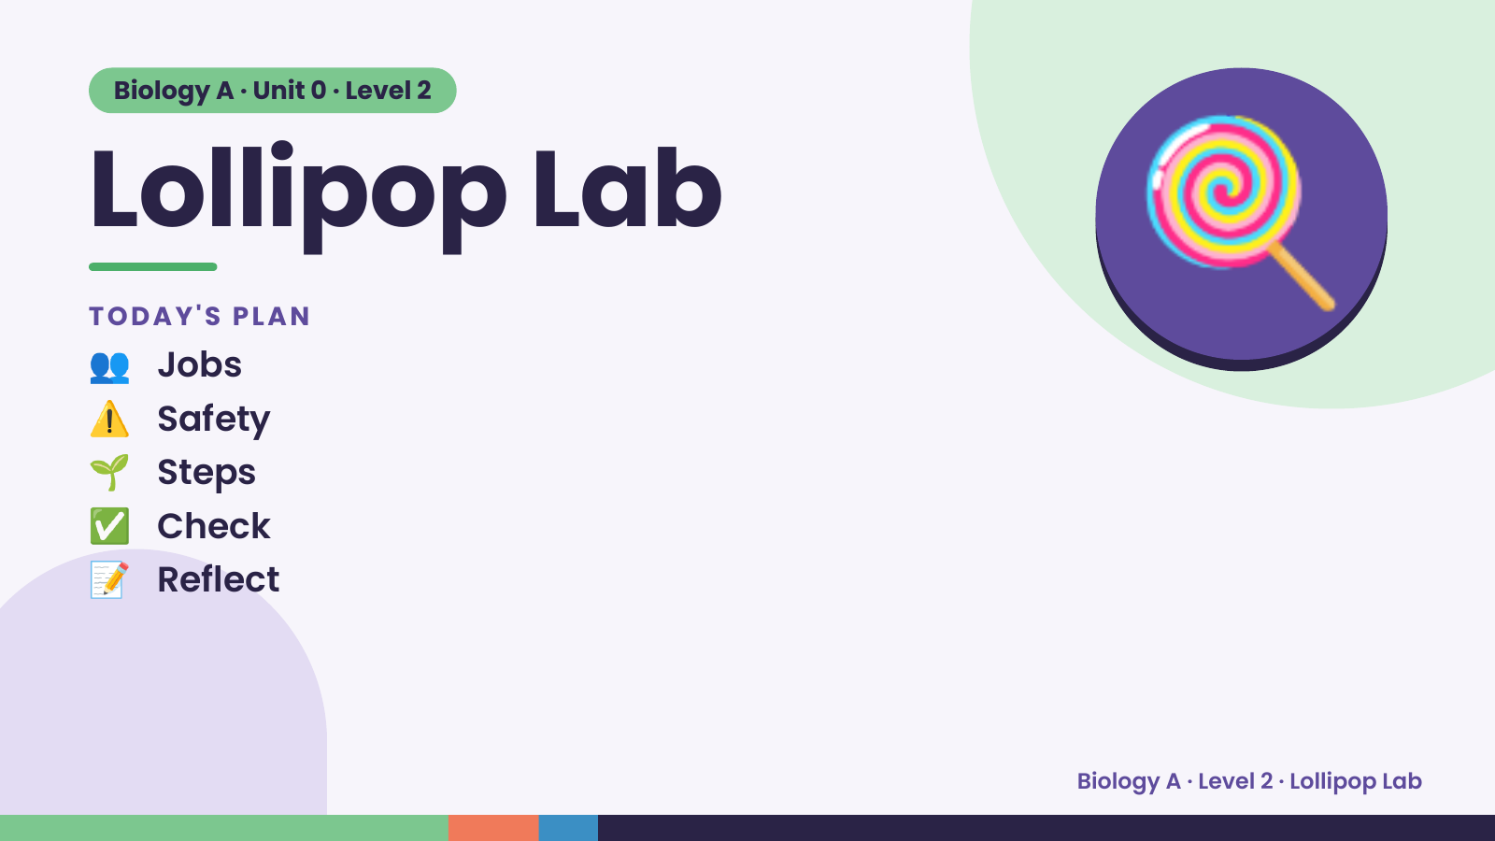
Notes:
Biology A · Unit 0 · Level 2
Lollipop Lab
👥 Jobs
TODAY'S PLAN
⚠️ Safety
🌱 Steps
🍭
✅ Check
📝 Reflect
Biology A · Level 2 · Lollipop Lab

Slide 2
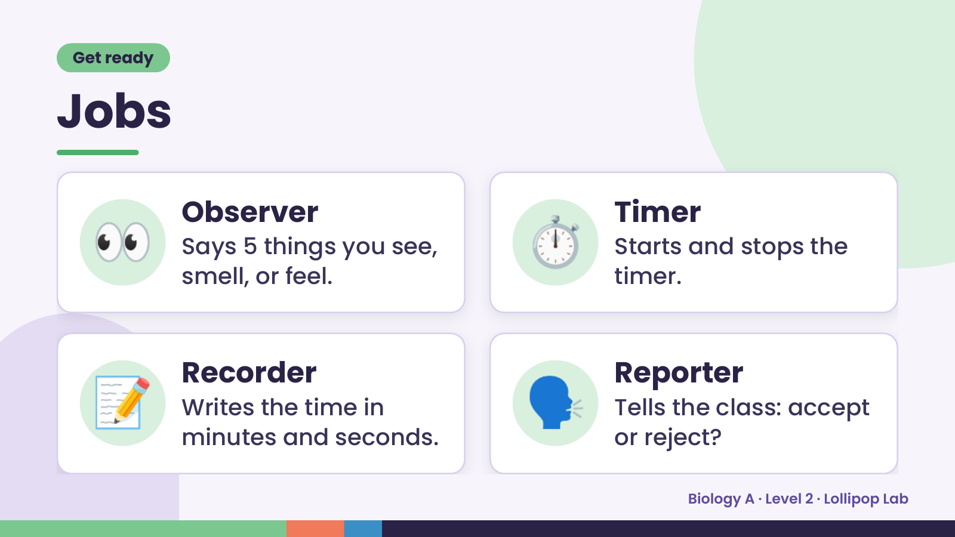
Notes:
Get ready
Jobs
👀 Observer
Says 5 things you see,
smell, or feel.
⏱️ Timer
Starts and stops the
timer.
📝 Recorder
Writes the time in
minutes and seconds.
🗣️ Reporter
Tells the class: accept
or reject?
Biology A · Level 2 · Lollipop Lab

Slide 3
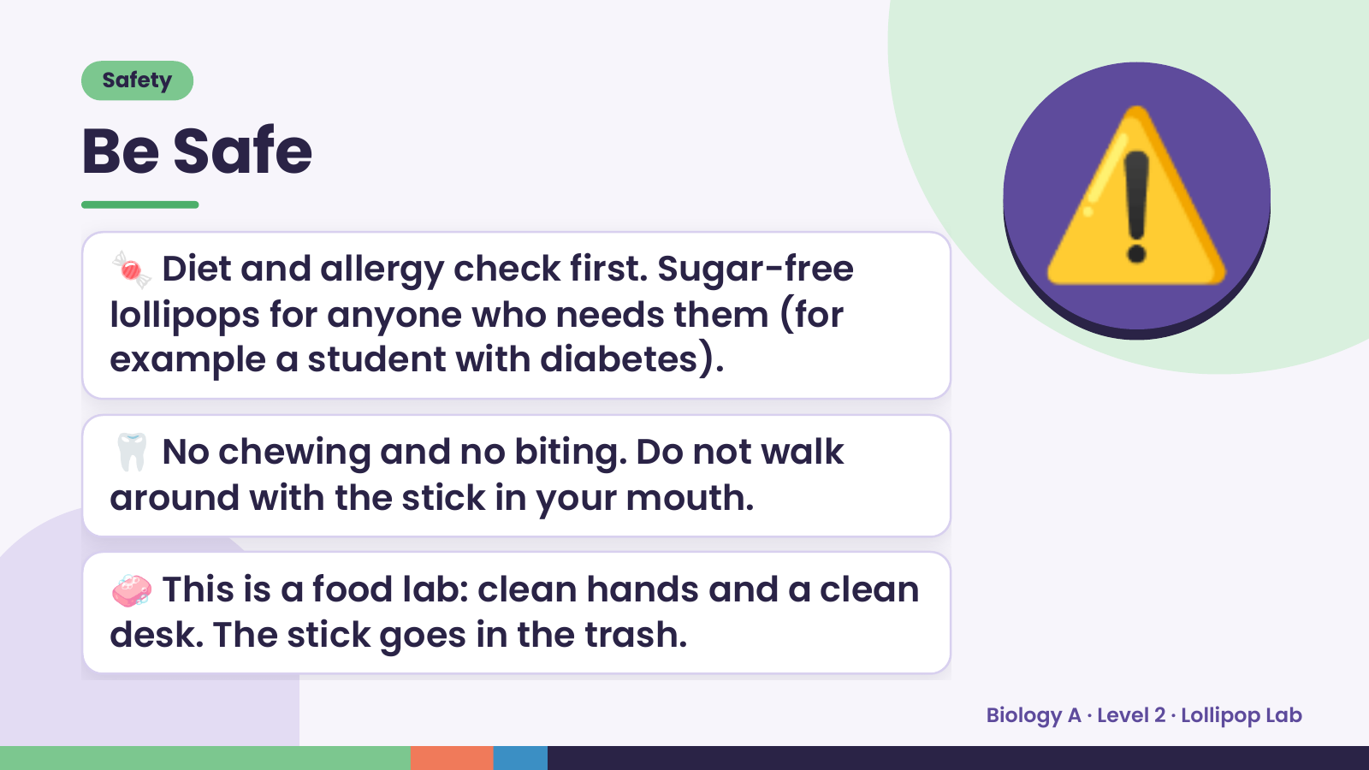
Notes:
Safety
Be Safe
🍬 Diet and allergy check first. Sugar-free
lollipops for anyone who needs them (for
example a student with diabetes).
⚠️
🦷 No chewing and no biting. Do not walk
around with the stick in your mouth.
🧼 This is a food lab: clean hands and a clean
desk. The stick goes in the trash.
Biology A · Level 2 · Lollipop Lab

Slide 4
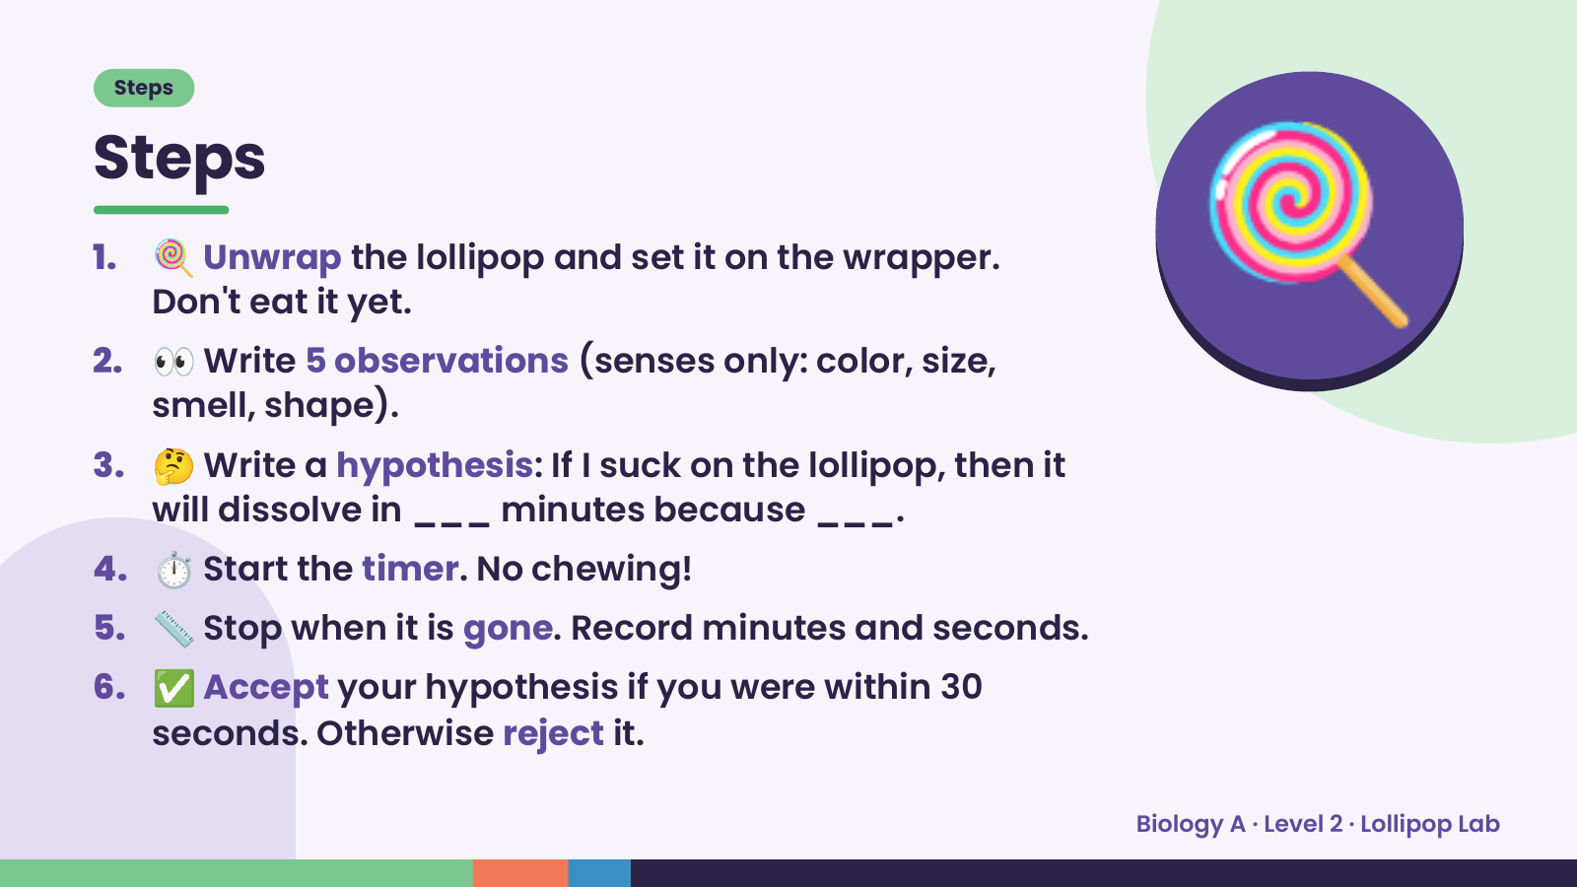
Notes:
Steps
Steps
1. 🍭 Unwrap the lollipop and set it on the wrapper.
Don't eat it yet.
2. 👀 Write 5 observations (senses only: color, size,
smell, shape).
3. 🤔 Write a hypothesis: If I suck on the lollipop, then it
🍭
will dissolve in ___ minutes because ___.
4. ⏱️ Start the timer. No chewing!
5. 📏 Stop when it is gone. Record minutes and seconds.
6. ✅ Accept your hypothesis if you were within 30
seconds. Otherwise reject it.
Biology A · Level 2 · Lollipop Lab

Slide 5
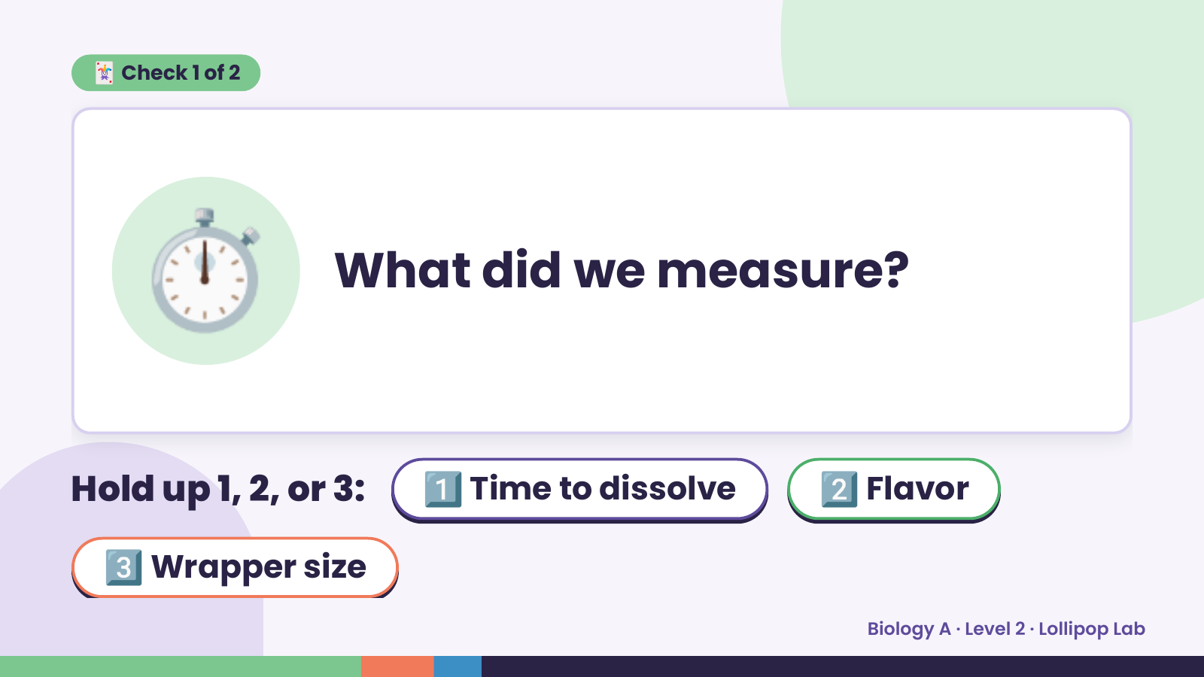
Notes:
🃏 Check 1 of 2
⏱️ What did we measure?
Hold up 1, 2, or 3: 1️⃣ Time to dissolve 2️⃣ Flavor
3️⃣ Wrapper size
Biology A · Level 2 · Lollipop Lab

Slide 6
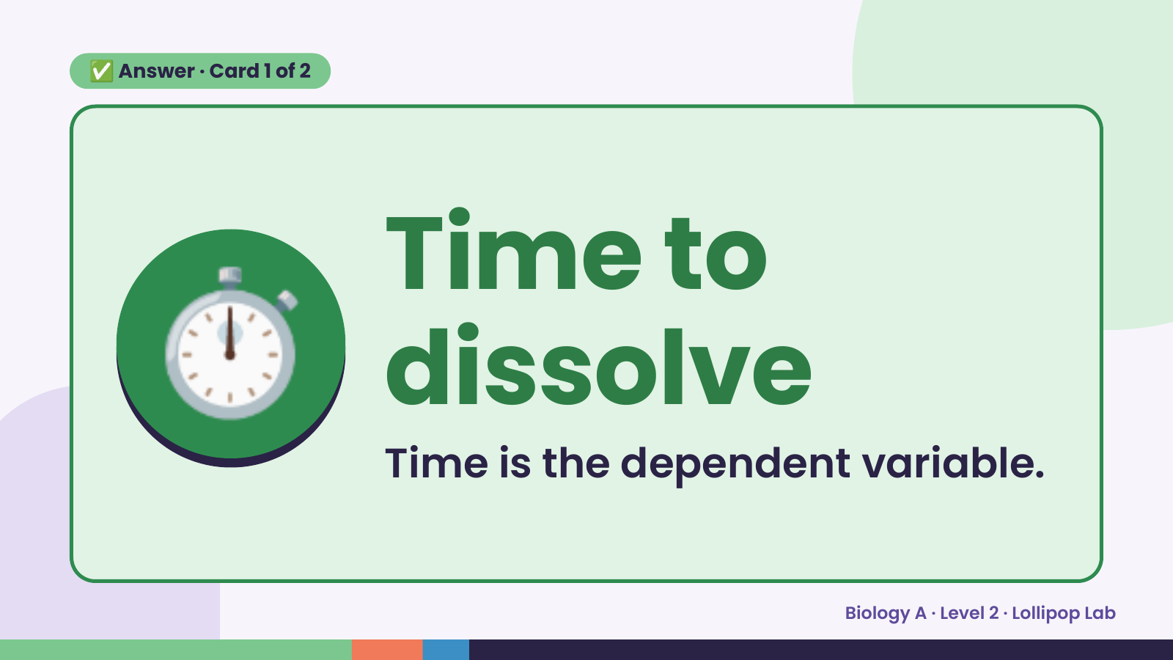
Notes:
✅ Answer · Card 1 of 2
⏱️ Time to
dissolve
Time is the dependent variable.
Biology A · Level 2 · Lollipop Lab

Slide 7
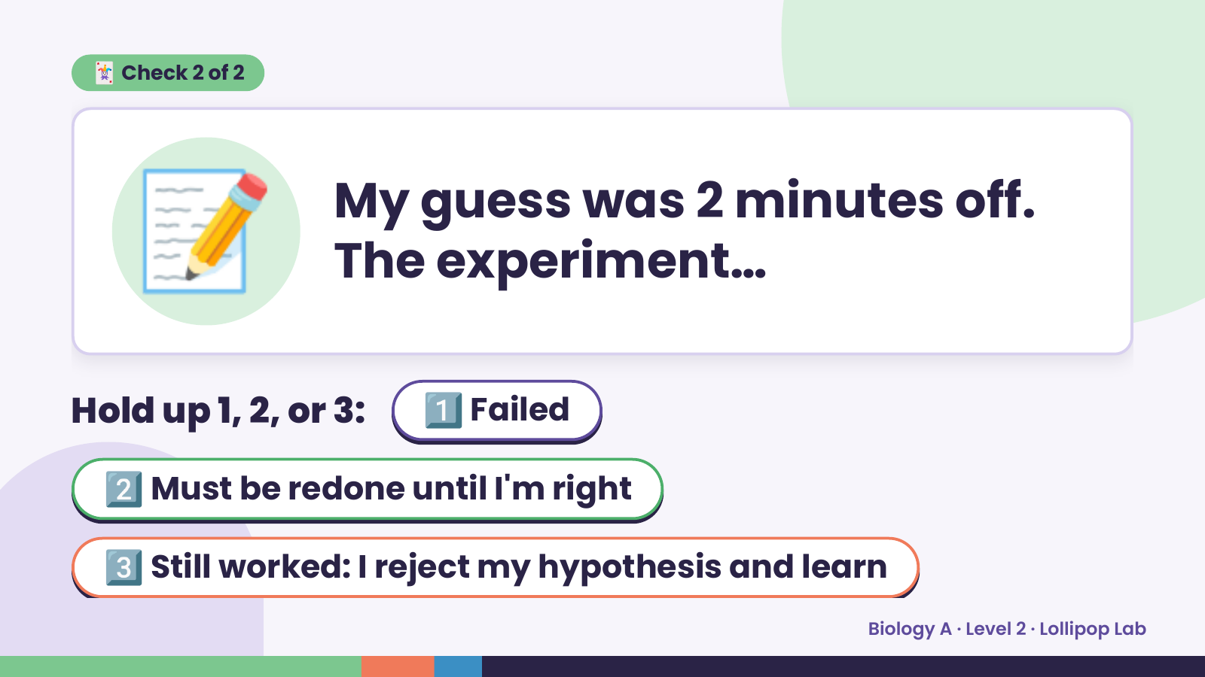
Notes:
📝
🃏 Check 2 of 2
My guess was 2 minutes off.
The experiment…
Hold up 1, 2, or 3: 1️⃣ Failed
2️⃣ Must be redone until I'm right
3️⃣ Still worked: I reject my hypothesis and learn
Biology A · Level 2 · Lollipop Lab

Slide 8
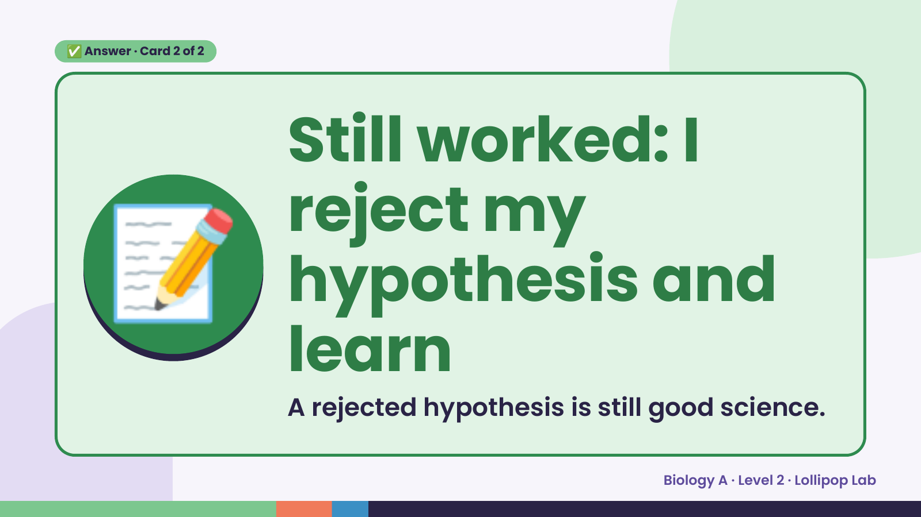
Notes:
✅ Answer · Card 2 of 2
📝
Still worked: I
reject my
hypothesis and
learn
A rejected hypothesis is still good science.
Biology A · Level 2 · Lollipop Lab

Slide 9
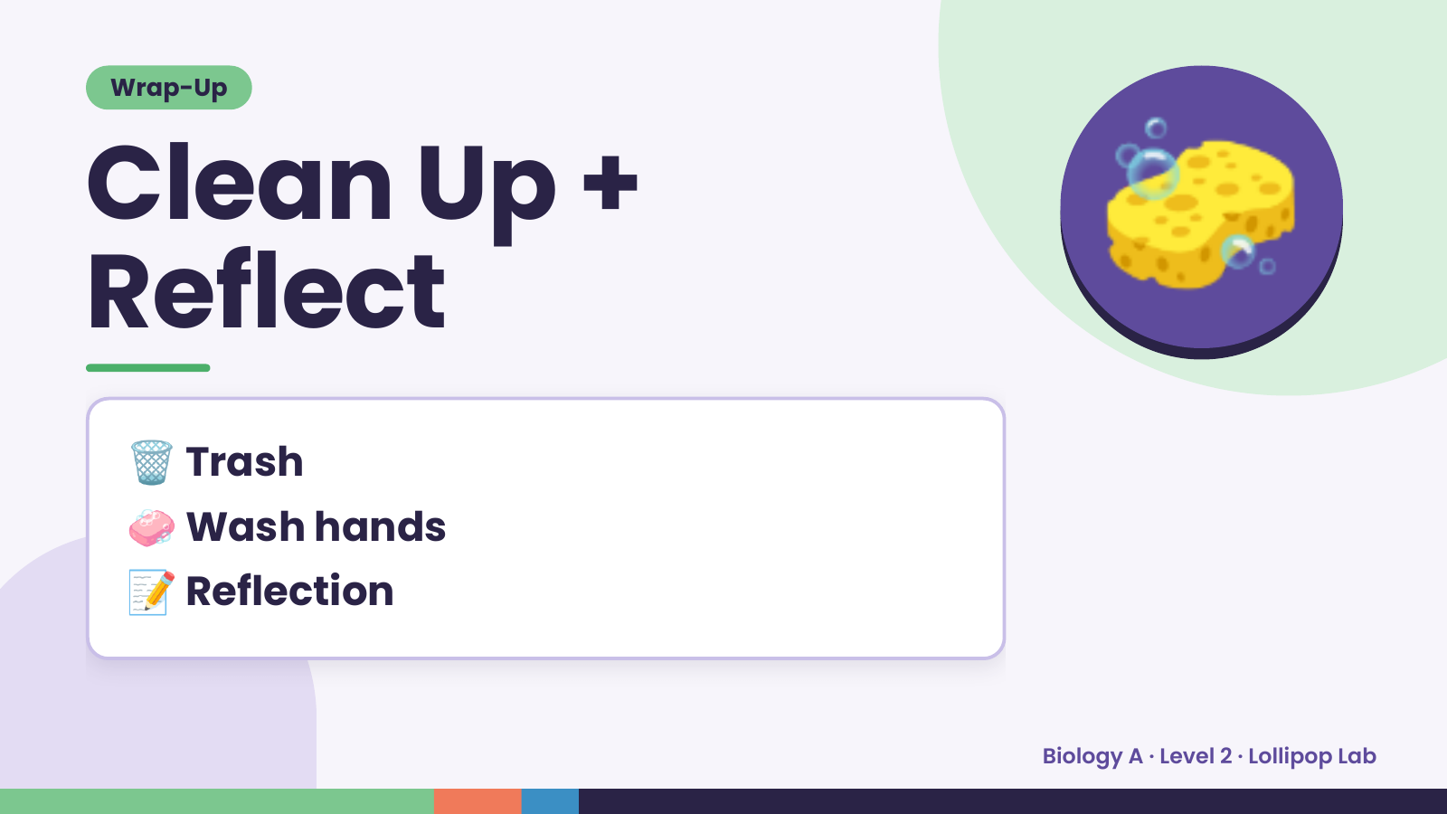
Notes:
Wrap-Up
Clean Up +
Reflect
🧽
🗑️ Trash
🧼 Wash hands
📝 Reflection
Biology A · Level 2 · Lollipop Lab

